Slide 1
Introduction of Panda Software
Sun Shengsen
Institute of High Energy Physics
NanKai University 2018.04.26

Slide 2
Outline
PANDA Detector
FairRoot
PandaRoot
FairMQ
What could we do?

Slide 3
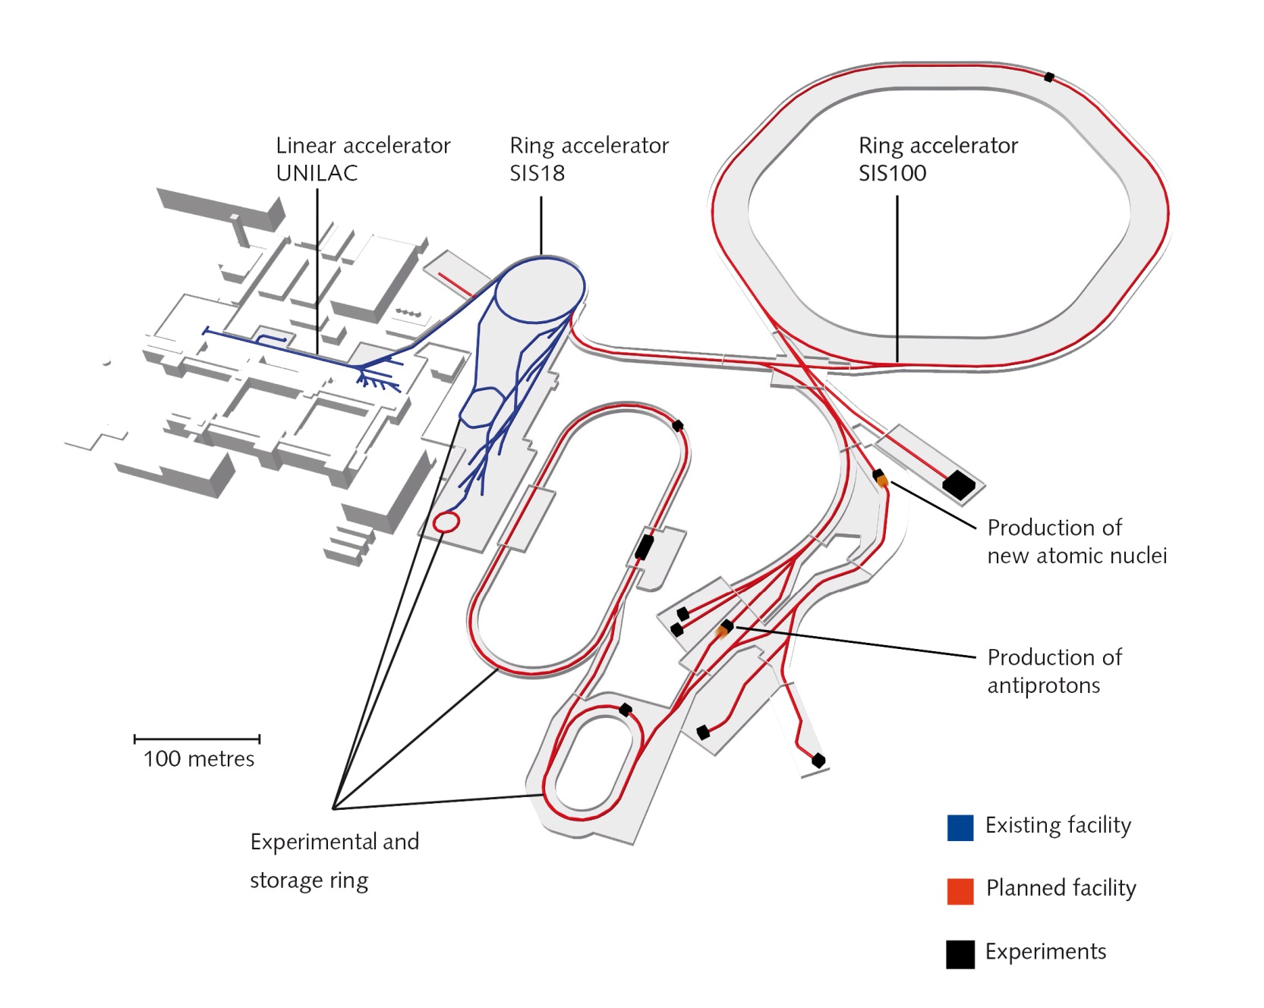
FAIR

Slide 4
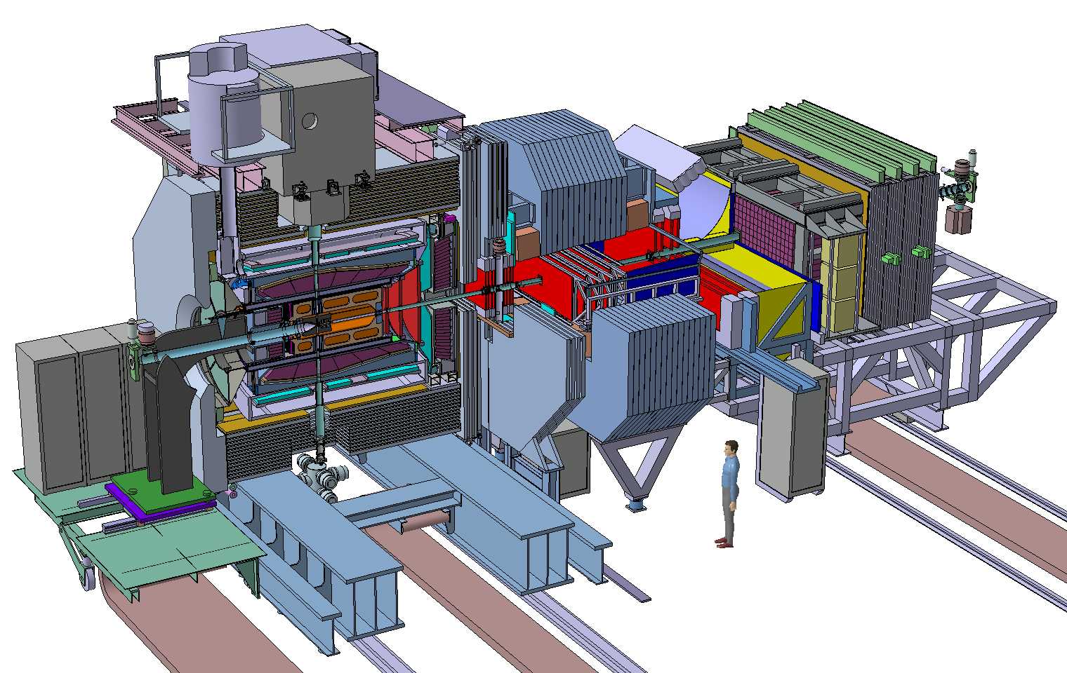
The PANDA Experiment Anti-Proton ANnihilation at DArmstadt
Multi purpose detector at FAIR
Physics program
$p\overline{p}$, $\overline{p}A$ collisions
1.5→15 GeV/c ($\overline{p}$ momentum)
Charmonium ($c\overline{c}$) spectroscopy
Open charm spectroscopy
Search for gluonic excitations (hybrids-glueballs)
Charmed hadrons in nuclei
Single and double Hypernuclei
Other options (Parton Distrib, EM Form Factor, ……)

Slide 5
Technical Progress TDRs and Construction

Slide 6
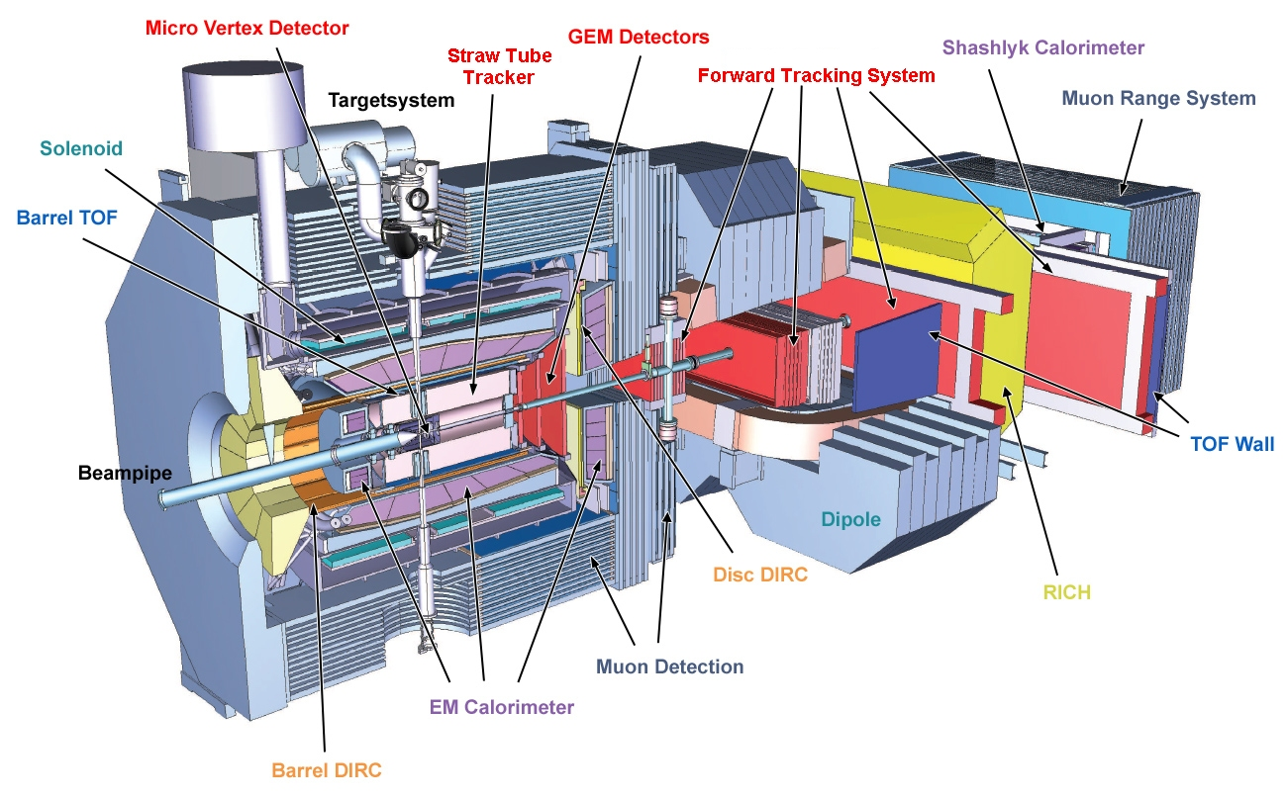
PANDA Detector

Slide 7
PANDA Detector
A target spectrometer (TS) consisting of a 2T solenoid around the interaction region
A forward spectrometer (FS) based on a 1T dipole to momentum-analyze the forward-going particles
Tracking system
Particle identification system
Electromagnetic calorimeter
Target system
Magnet

Slide 8
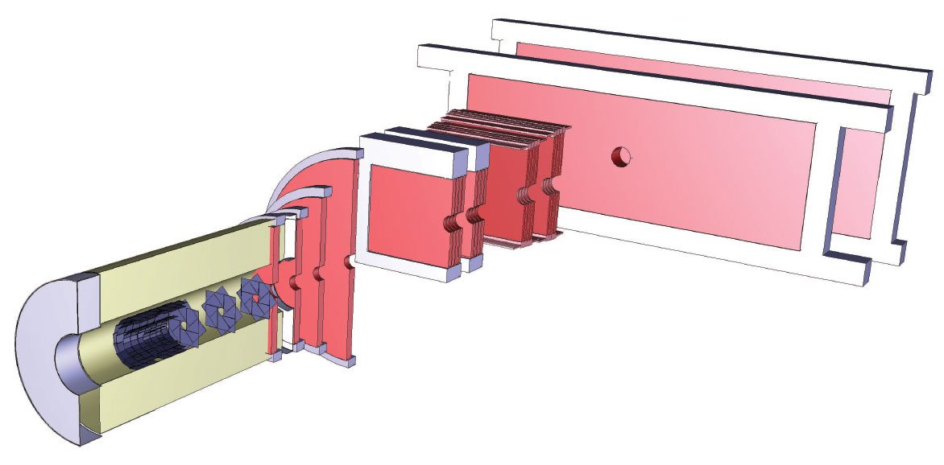
Tracking System
MVD: Micro Vertex Detector
STT: Straw Tube Tracker $150μm$
GEM: Gas Electron Multiplier Stations $<100μm$
Forward Tracker $100μm$

Slide 9
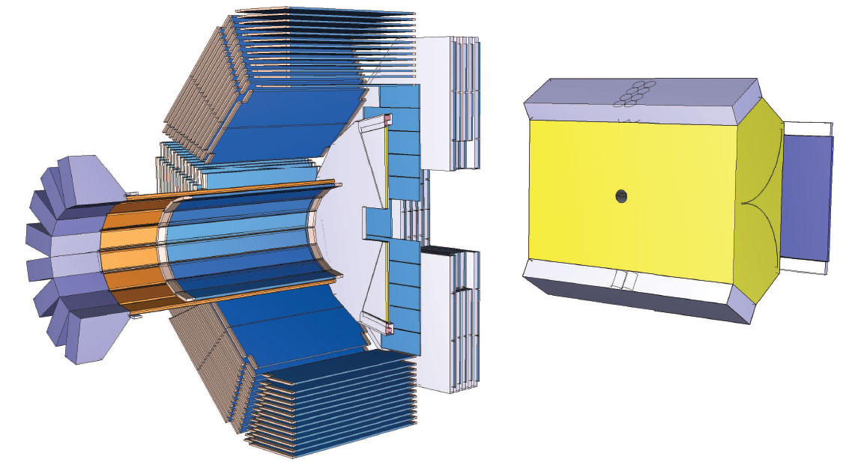
Particle Identification System
DIRC: Detection of Internally Reflected Cherenkov Light 4GeV π/K
TOF: Time of Flight system 100ps
MDT: Muon Detection System
RICH: Aerogel Ring Imaging Cherenkov Counter

Slide 10
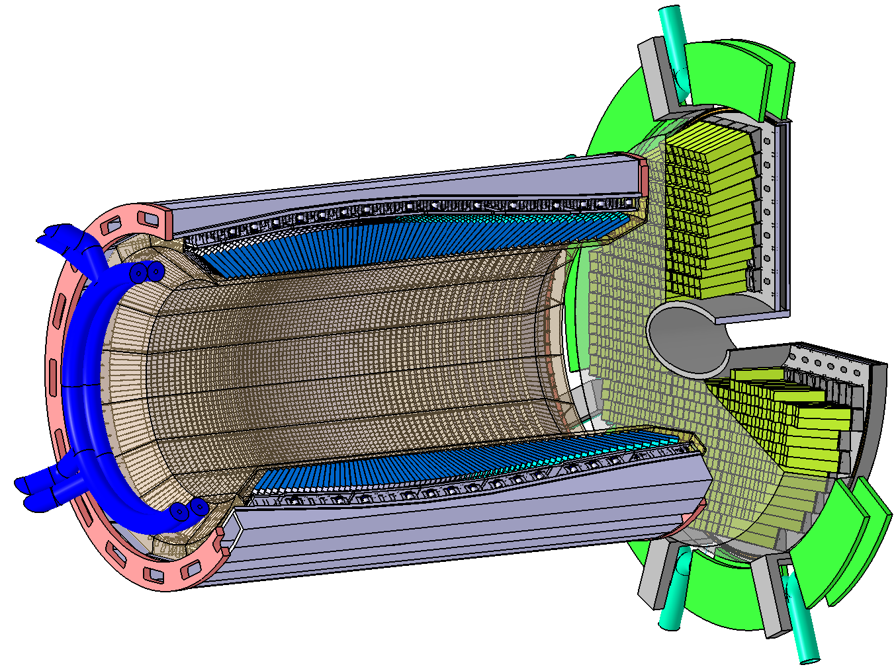
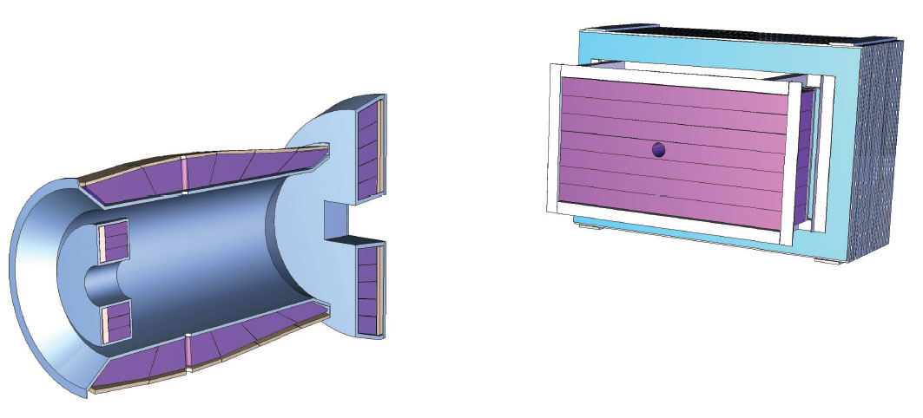
Electromagnetic Calorimeter
Barrel: Giessen
Forward endcap: Bochum
Backward endcap: Mainz
Shashlik:
$\frac{1.54\%}{\sqrt{E}}⊕0.3\%$

Slide 11
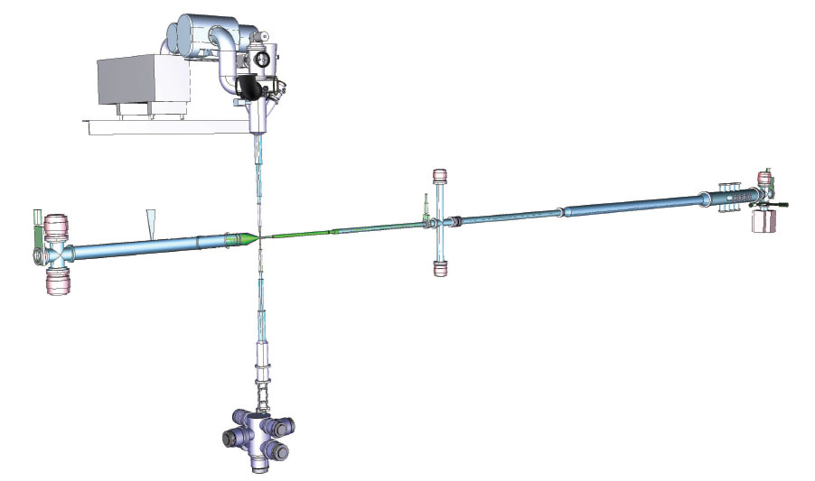
Target System
Cluster beam target
Pellet beam target
Fiber target

Slide 12
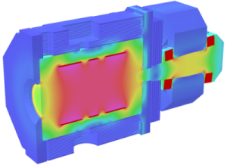
Magnetic
A solenoidal magnetic field of 2T around the interaction region and a dipole field of up to 1T for particles emitted at forward angles below 5(10)°.

Slide 13
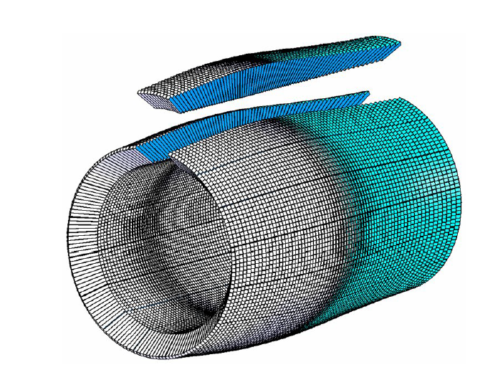
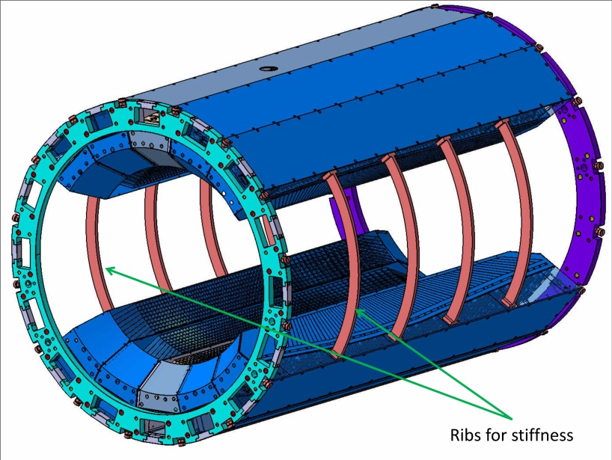
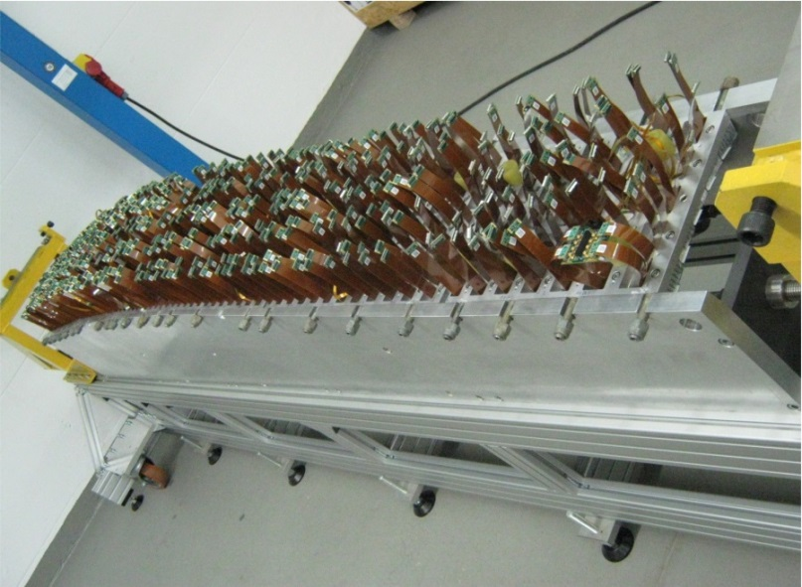
Barrel EMC Hardware
Assembly of 1st full Barrel EMC slice
710 crystals and 1420 APDs
Mechanics not approved
Beam test plan

Slide 14
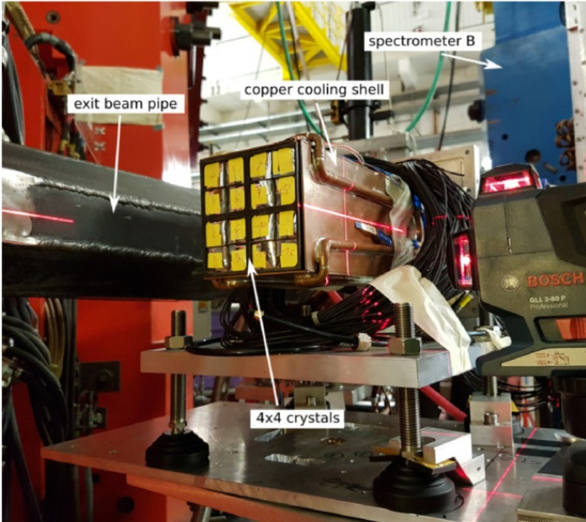
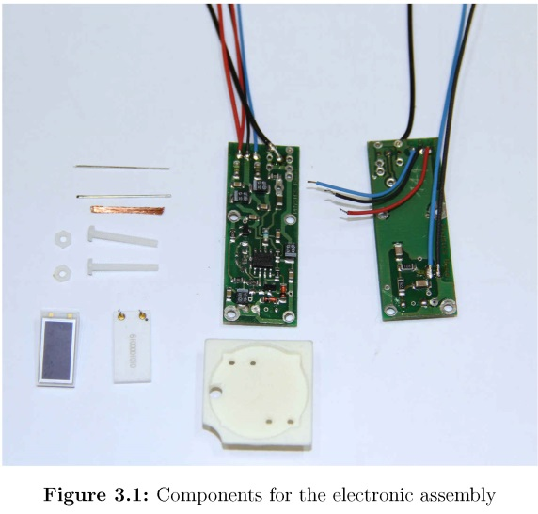
End cap EMC
Backward EMC (BWEC)
Prototype with all final parts PROTO16-2
BWEC geometry in PandaRoot repository
Test beam at MAMI in A1 spectrometer hall
Forward EMC (FWEC)
APD submodule production
Preassembly pedestal delivered
Heater units for temperature regulation

Slide 15
Some history of FairRoot
FairRoot(CbmRoot) started in 2003/4 as a software framework
In 2005/6, splitted into the base part FairRoot and the experiment specific parts like CbmRoot and PandaRoot
FairRoot framework : an object oriented simulation, reconstruction and data analysis framework based on ROOT.
ROOT+VMC-based, modular and virtual design, low-threshold usage, platform independent, dynamic data structure, ……

Slide 16
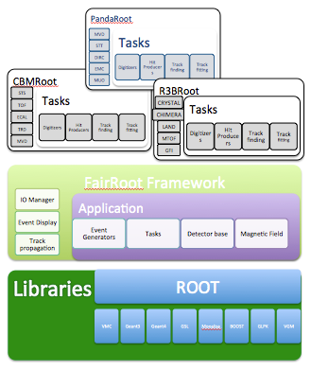
FairRoot
Manage classes
Execution of simulation or reconstruction
File IO
Parameter IO / Geometry
Deliver base classes
Magnetic field
Event generators

Slide 17
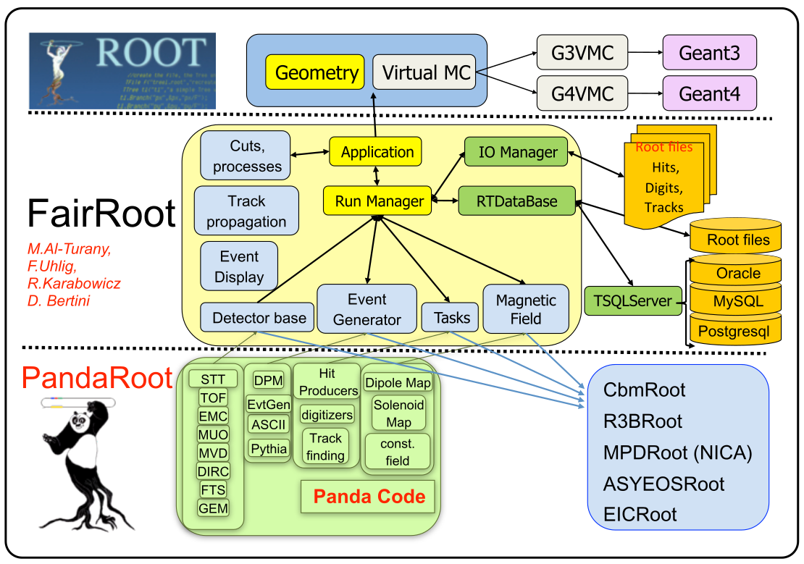
Structure of Code

Slide 18
The Mission
Event Generator
Determine properties of particles in primary interaction
Transport
Transport particles through the detector material
Full Simulation
SIM
Digitizer
Determine detector response
DIGI
Fast Simulation
Reconstruction local / global
local: sub-detector response global: track finding + fitting
RECO
Analysis
PID
Combine all detector data Calculate PID prob.
PID
storage levels
Physics Analysis
Extract signal from background

Slide 19
PANDA Data Flow
* Dual parton Model
** Ultra Relativistic Quantum
Molecular Dynamics
Event Generator
EvtGen
DPM*
Pythia6/8
UrQMD **
FTF
Transport
GEANT3/GEANT4
Digitizer
MVD
STT
FTS
GEM
TOF
DIRC
MUON
EMC
Tracking
Charged Track
Charged Candidate
Neutral Candidate
Particle
Identification
PID Probability
Analysis
Analysis

Slide 20
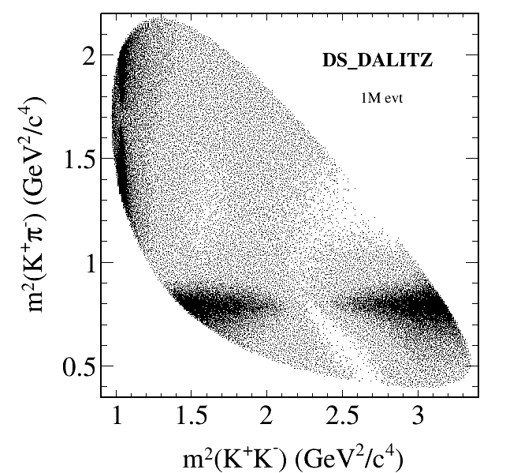
Event Generation
Many different event generators available
EvtGen:
Simulation of dedicated physics channels
Can be extended by individual decay models
Dual-Parton-Model (DPM):
Background generator for anti-proton – proton interactions
UrQMD:
Background generator for anti-proton – nucleus interactions
FTF generator:
New development of a combined background generator by Vladimir Uzhinsky and Aida Galoyan
Box generator:
Particle gun

Slide 21
Particle Propagator
Usage of Virtual Monte Carlo allows seamless change of propagation engine
Available:
Geant3
Geant4
(Fluka)
Same geometry description in propagation and reconstruction of events by using the same geometry engine from root

Slide 22
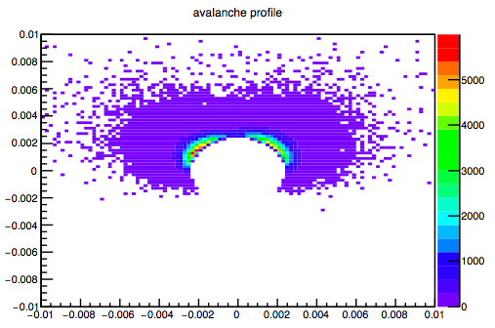
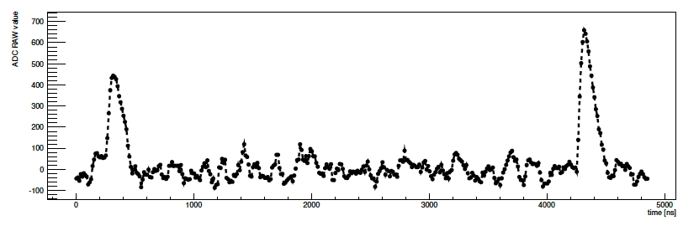
Digitization
Translates ideal detector data into realistic data stream
3D space points into channel number
Deposited energy into ADC values
Adding noise and inefficiencies
Charge sharing between neighboring detector elements
Dead times and electronics properties
Data should look like as coming from the final experiment
Avalanche Simulation in MDT
Simulated EMC waveform

Slide 23
Reconstruction 1
Local reconstruction for each sub-detector
Translation from detector data into physical parameters (from channel number to space point, ADC to energy)
Calibration
Cluster formation
Reconstruction algorithms
Various different algorithms implemented for each sub-detectors
Compared with test beam data
PandaRoot used to reconstruct test beam data

Slide 24
Reconstruction 2
Global reconstruction
Combining different sub-detectors
Tracking
PID
Event building

Slide 25
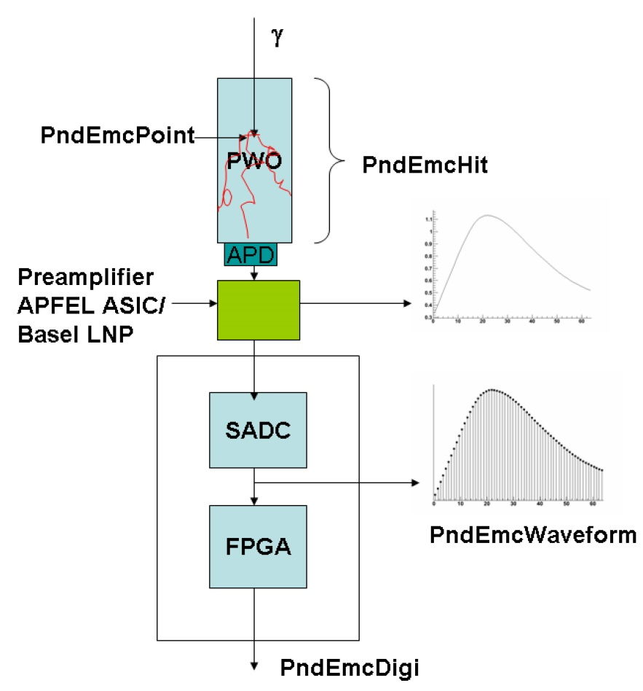
Data Flow in EMC simulation and Reconstruction
EMC Geometry update
Error Matrices
Energy crystal calibration
……

Slide 26
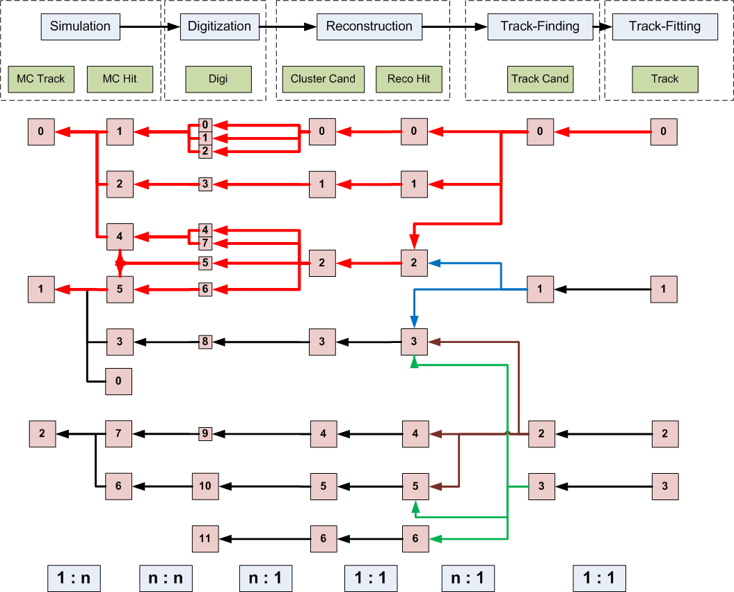
MC Truth Propagation

Slide 27
Event Structure / Time Based Simulation
ev 1
ev 2
ev 3
time
SciTil
EMC
MVD
STT
= detector hits from different events

Slide 28
FairRoot → ALFA
AliRoot6 (O²)
CbmRoot
R3BRoot
SofiaRoot
MPDRoot
ShipRoot
PandaRoot
AsyEosRoot
FopiRoot
EICRoot
ALFA
FairRoot
????
DDS
Building configuration
Testing
Fair MQ
MC Application
Module
Detector
Magnetic Field
Event
Generator
Runtime DB
Libraries and Tools
Protocol Buffers
BOOST
ROOT
ZeroMQ
CMake
Geant4
Genat4_VMC
Geant3
VGM
…

Slide 29
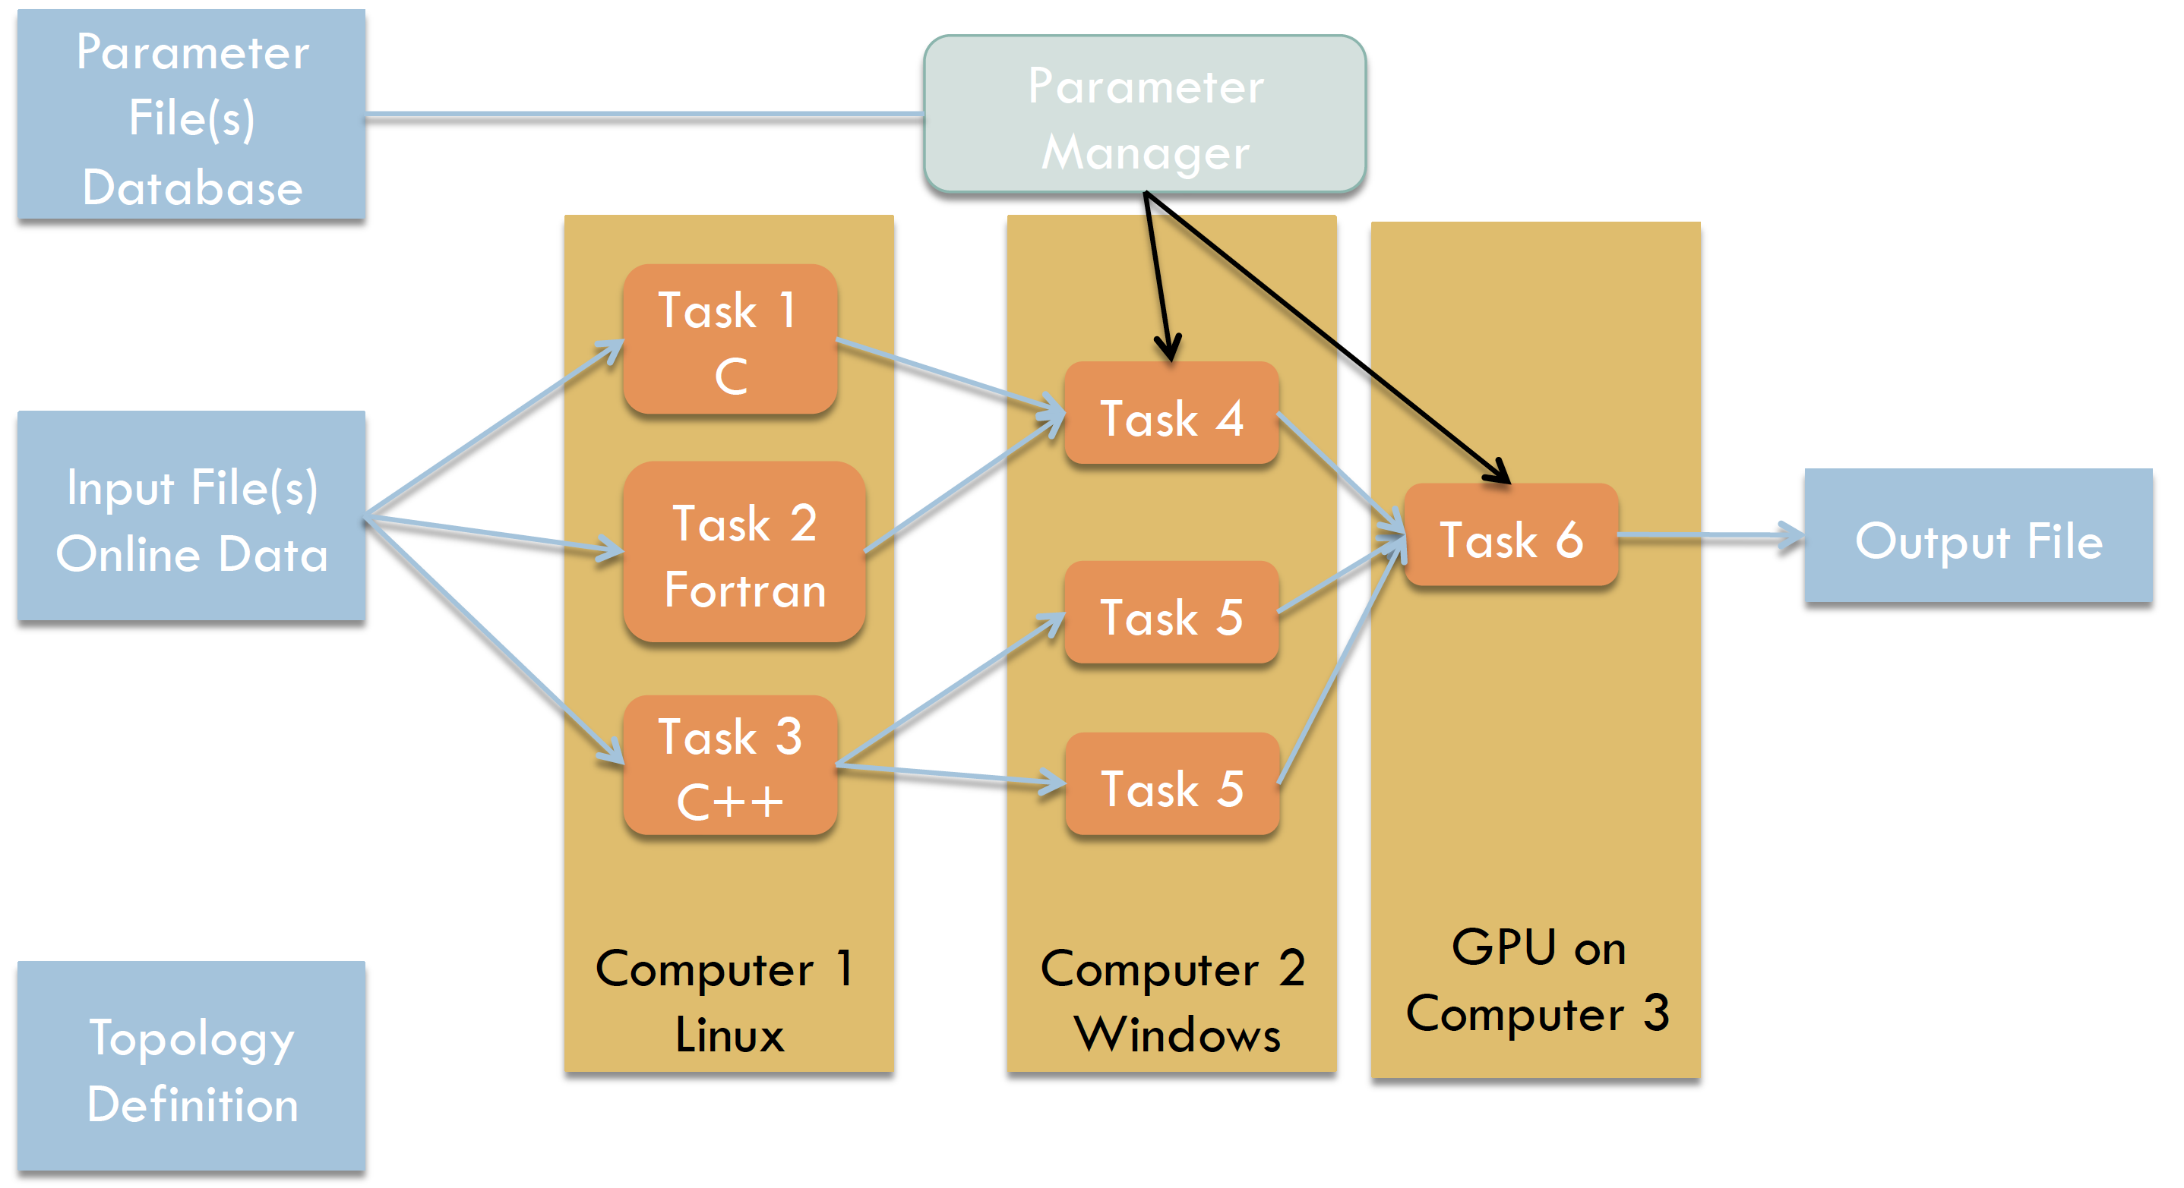
FairMQ
Message Queue

Slide 30
FairMQ
Huge amounts of data
Traditional trigger are extended by heterogenous (CPU, GPU, FPGA,……) online computing farms to reduce data flow
Stored data are repeatedly analyzed in the offline computing facilities (farms, grid, cloud)
Online processing
Extend traditional single-process FairRoot to allow simulation and reconstruction of streaming data
Separate running of tasks multiple processes (multi-threaded / GPU) to increase stability (process crashes do not immediately affect other components and allow easier recovery)
Communicate via platform-independent message (simplify integration of different hardware and programming language)

Slide 31
FairMQ
Message Queue: transport message between processes using queues
FairMQ: data transport framework to organize processing tasks in topologies, consisting of independent processes (devices), communicating via asynchronous message queues over network or inter-process channels.

Slide 32
Detector Implementation 02/2018
Tobias Stockmanns “Computing Status”
Det. | Geo | Digi | Local Reco | PID | TimeBased Sim | Manpower
MVD | Fine-tuning | PASTA missing | Implemented | Implemented | Implemented
STT | No passive | No Digis | Missing | Implemented | No pile-up | Master Stu.
GEM | Implemented | Implemented | Implemented | no PID | Implemented
DIRC | global missing | Implemented | Implemented | Prop. distrib. missing | Implemented
DISC | Implemented | Implemented | Implemented | Implemented | Implemented
SciTil | Implemented | Implemented | Implemented | Implemented | Implemented
EMC | Barrel EMC alm. finished | Implemented | Needs tuning | Implemented | Implemented
MDT | Very basic | Basic | Implemented | Hard cuts | -
MDT2 | Not all passive | Implemented | Implemented | - | Implemented
FTS | No passive | No Digis | Missing | no PID | No pile-up
FTOF | No passive | Implemented | Implemented | Implemented | Implemented
FRICH | Not all passive | Fast/Full | Implemented | Implemented | Implemented
FSC | Implemented | EMC | EMC | EMC | -
LMD | Implemented | Implemented | Implemented | no PID | Implemented

Slide 33
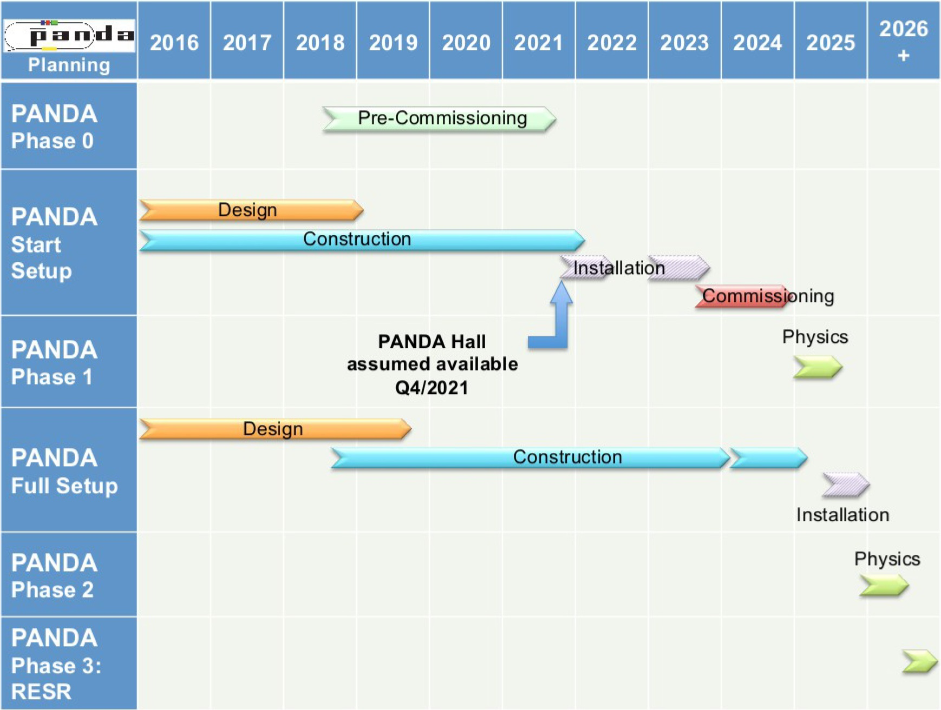
PANDA Schedule
Lars Schmitt “Status Update of PANDA”
Install periods:
2021/10-2022/6
solenoid, dipole,
supports, etc.
2023/01-2023/10
all other systems
Commissioning with protons 2024
Start of Physics with antiprotons in 2025

Slide 34
What could we do?
EMC software of PandaRoot
Geometry
Simulation — more discussions with detector and electronics experts
Reconstruction and calibration
Absolute energy calibration/correction?
PID?
Beam Test of prototype
EMC related in FairMQ
DAQ?
Other subdetectors?

