Slide 1
CEPC Higgs Combination
Rehearsal
Zhang Kaili¹, Cui Zhenwei², Wang Jin³, Liu Zhen⁴
Institute of High Energy Physics
Peking University
The University of Sydney
University of Pittsburgh
Workshop on the Circular Electron Positron Collider
2018.05.25 Rome

Slide 2

OUTLINE
Why and How we do combination
Results of $σ\left(ZH\right)∗Br$
𝜅 Framework
$H→μμ$ study
Summary

Slide 3
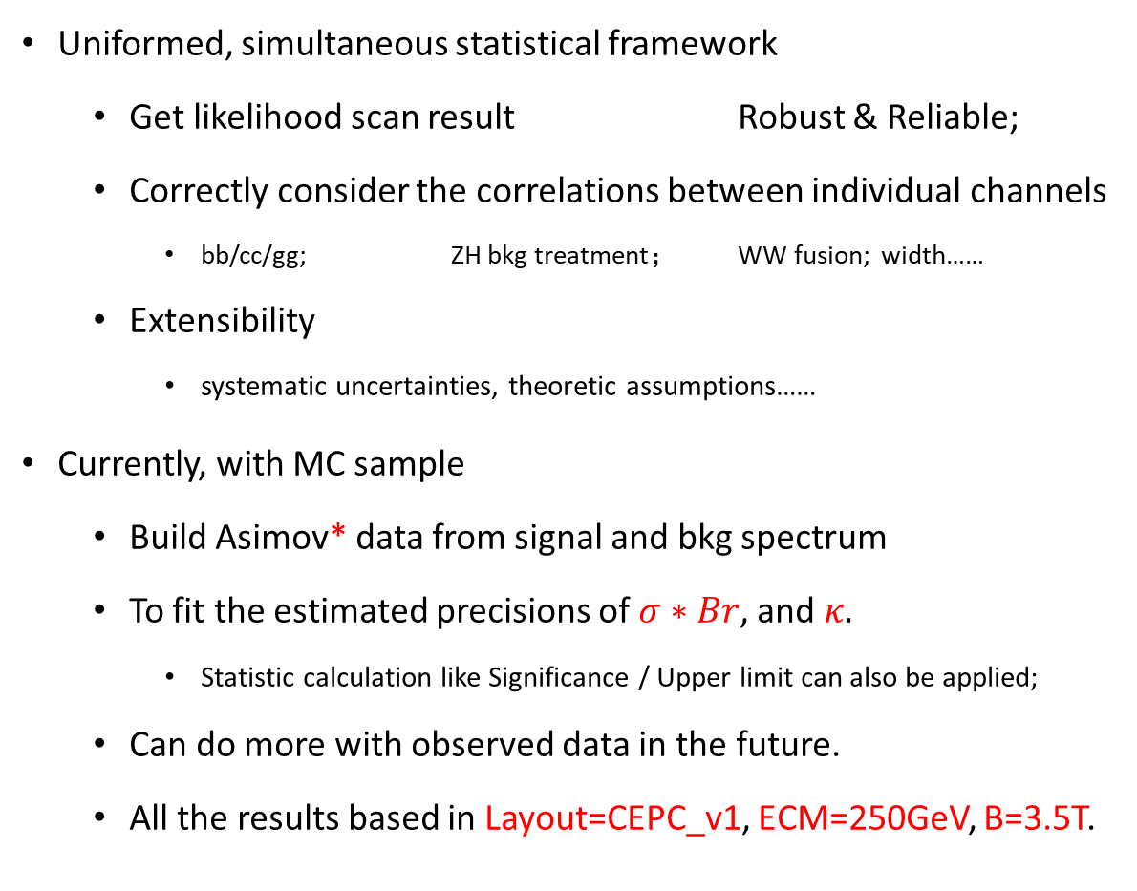
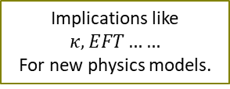
Why Combination?
Uniformed, simultaneous statistical framework
  Get likelihood scan result Robust & Reliable;
  Correctly consider the correlations between individual channels
    bb/cc/gg; ZH bkg treatment； WW fusion; width……
  Extensibility
    systematic uncertainties, theoretic assumptions……
Currently, with MC sample
  Build Asimov* data from signal and bkg spectrum
  To fit the estimated precisions of $σ∗Br$, and $κ.$
    Statistic calculation like Significance / Upper limit can also be applied;
  Can do more with observed data in the future.
  All the results based in Layout=CEPC_v1, ECM=250GeV, B=3.5T.
Individual Study
(No correlation)
Combination
(With correlation)
Implications like $κ, EFT……$
For new physics models.
*:see more in arXiv:1007.1727

Slide 4
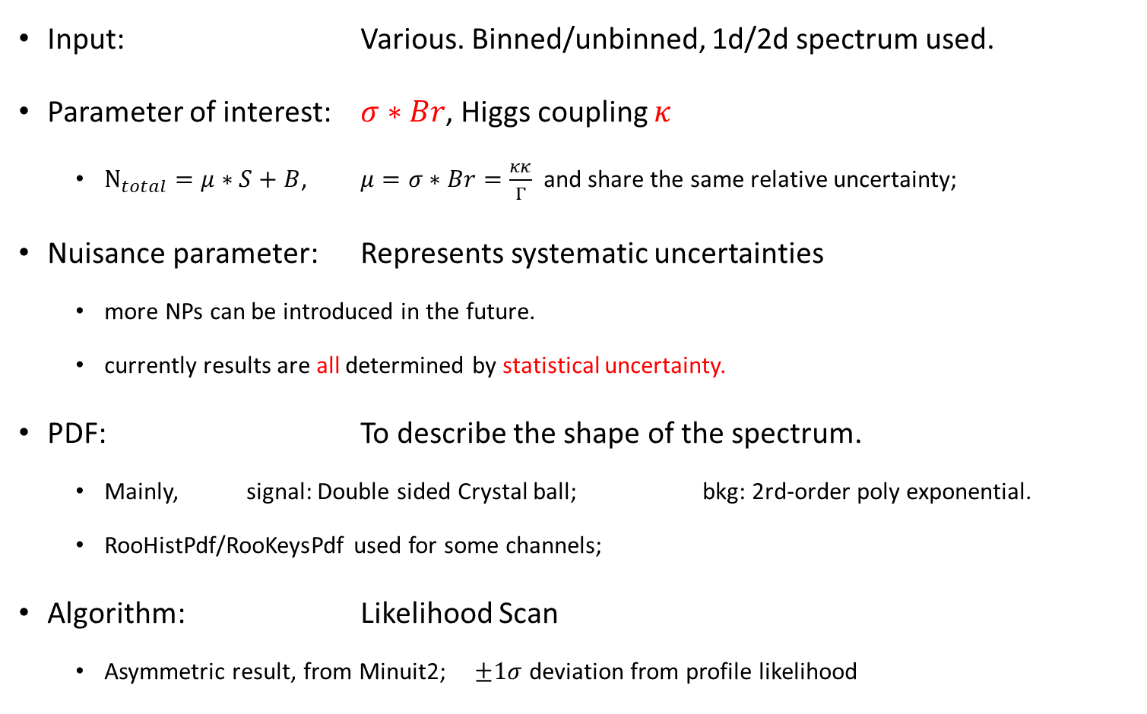
Fit techniques
Input: Various. Binned/unbinned, 1d/2d spectrum used.
Parameter of interest: $σ∗Br$, Higgs coupling $κ$
  $N_{total}=μ∗S+B$, $μ=σ∗Br=\frac{κκ}{Γ}$ and share the same relative uncertainty;
Nuisance parameter: Represents systematic uncertainties
  more NPs can be introduced in the future.
  currently results are all determined by statistical uncertainty.
PDF: To describe the shape of the spectrum.
  Mainly, signal: Double sided Crystal ball; bkg: 2rd-order poly exponential.
  RooHistPdf/RooKeysPdf used for some channels;
Algorithm: Likelihood Scan
  Asymmetric result, from Minuit2; $±1σ$ deviation from profile likelihood

Slide 5
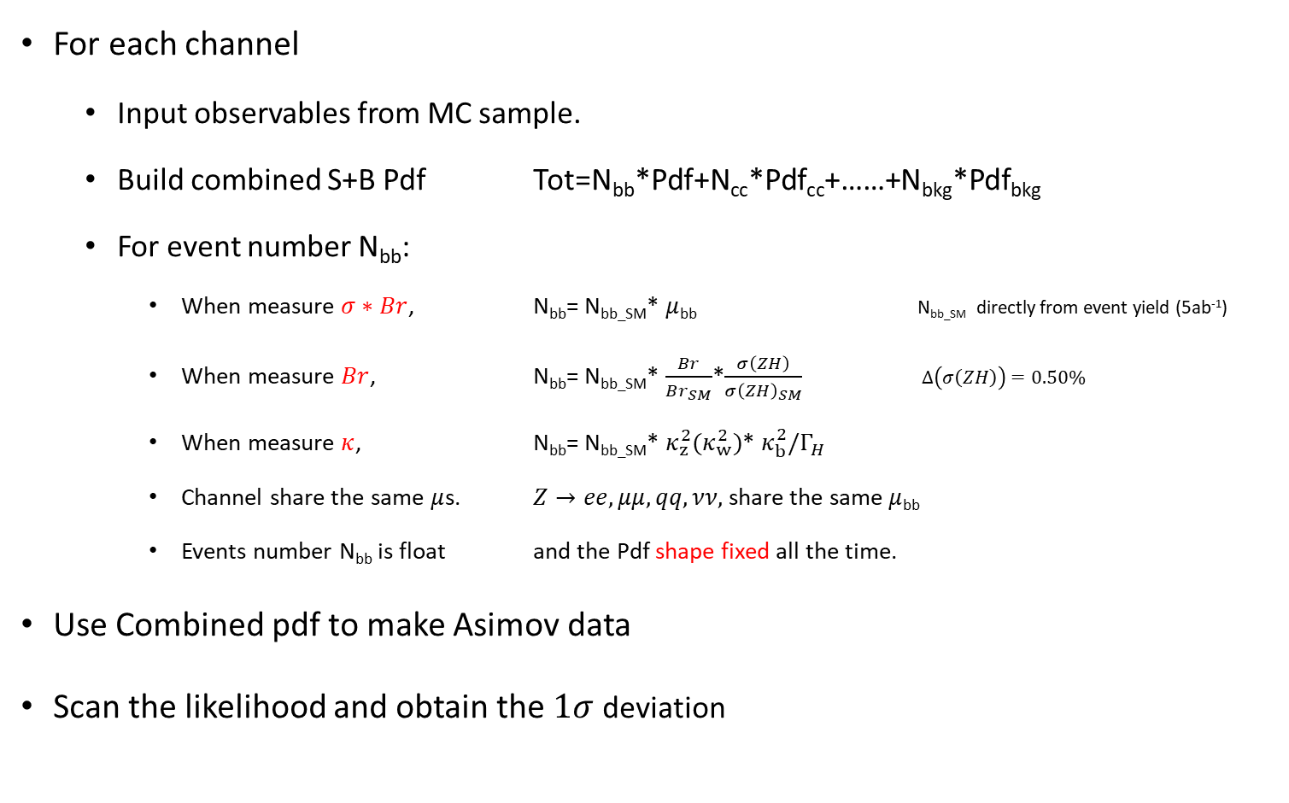
Fit techniques
For each channel
  Input observables from MC sample.
  Build combined S+B Pdf Tot=N_{bb}*Pdf+N_{cc}*Pdf_{cc}+……+N_{bkg}*Pdf_{bkg}
  For event number N_{bb}:
    When measure $σ∗Br$, N_{bb}= N_{bb_SM}* $μ$_{bb} N_{bb_SM} directly from event yield (5ab⁻¹)
    When measure $Br$, N_{bb}= N_{bb_SM}* $\frac{Br}{Br_{SM}}$*$\frac{σ\left(ZH\right)}{σ{\left(ZH\right)}_{SM}}$ $Δ\left(σ\left(ZH\right)\right)=0.50\%$
    When measure $κ$, N_{bb}= N_{bb_SM}* $κ_{z}^{2}(κ_{w}^{2})$* $κ_{b}^{2}/Γ_{H}$
    Channel share the same $μ$s. $Z→ee,μμ,qq,νν,$ share the same $μ$_{bb}
    Events number N_{bb} is float and the Pdf shape fixed all the time.
Use Combined pdf to make Asimov data
Scan the likelihood and obtain the $1σ$ deviation

Slide 6
Channels Table
All channels scaled to 5ab⁻¹
Signal |  | Precision | Signal |  | Precision | Signal |  | Precision
Z | H |  | Z | H |  | Z | H
H->qq |  |  | H->WW |  |  | H->ZZ
ee | bb | 1.6% | ee | lvlv | 9.2% | vv | μμqq | 8.2%
 | cc | 23.6% |  | evqq | 4.6% | vv | eeqq | 35.2%
 | gg | 13.3% |  | μvqq | 3.9% | μμ | vvqq | 7.3%
μμ | bb | 1.1% | μμ | lvlv | 7.3% | ee | eeqq | 35.1%
 | cc | 14.8% |  | evqq | 4.0% | ee | μμqq | 23.0%
 | gg | 8.0% |  | μvqq | 4.0% | ZH bkg contribution |  | 19.4%
qq | bb | 0.5% | vv | qqqq | 2.0% | vvH(WW fusion)
 | cc | 11.9% |  | evqq | 4.7% | vv | bb | 3.1%
 | gg | 3.9% |  | μvqq | 4.2% | H→μμ
vv | bb | 0.4% |  | lvlv | 11.3% | qq | μμ | 15.9%
 | cc | 3.9% | qq | lvqq | 2.2%(ILC) | ee
 | gg | 1.5% | ZH bkg contribution |  | 3.0% | μμ
H→ττ |  |  | H→γγ, Zγ |  |  | vv
ee | ττ | 2.8% | μμ+ττ | γγ | 41.0% | H->Invisible |  | Br, Upper
μμ |  | 2.8% | vv |  | 13.7% | qq | ZZ(vvvv) | 0.8%
qq |  | 1.0% | qq |  | 10.3% | ee |  | 0.6%
vv |  | 3.1% | vv | Zγ(qqγ) | 21.2% | μμ |  | 0.6%

Slide 7
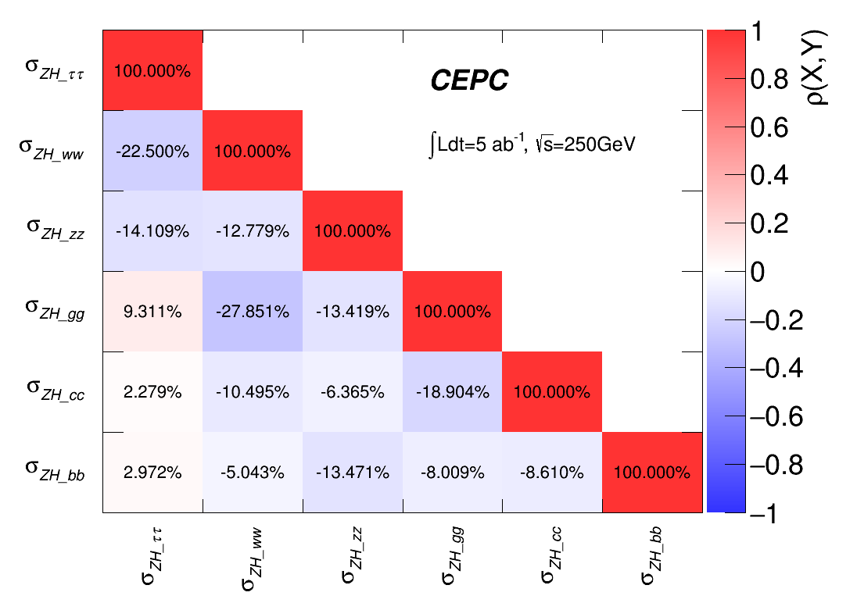

Treatment for ZH bkg
In individual analysis, other ZH processes are tagged as bkg;
  Signal in one channel can be bkg for another channel.
  Should taken into account in combination.
    $Z→μμ,H→ττ$, the main bkg is $H→WW$.
      These WW events should be considered in $μ_{WW}.$
      Standalone WW channel 1.2% improved to 1.0% this way;
    Combined fit for H->bb/cc/gg/ww/zz hadronic decay, Fully correlated.

Slide 8
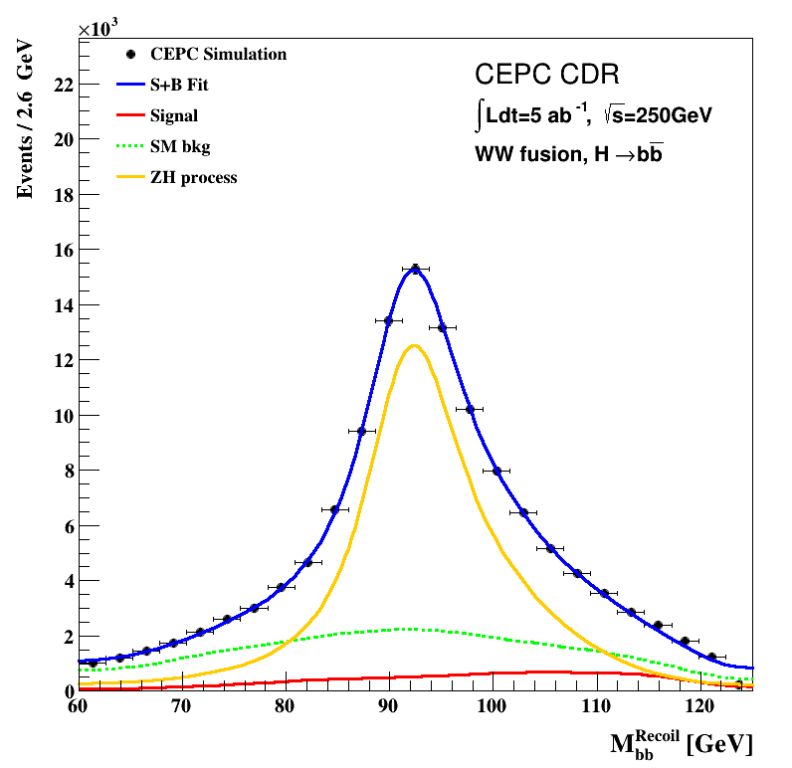
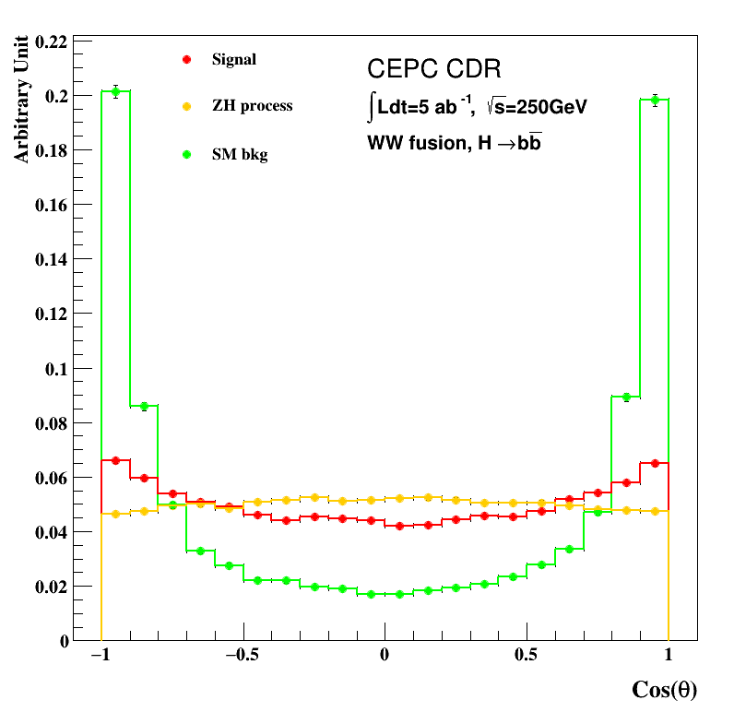
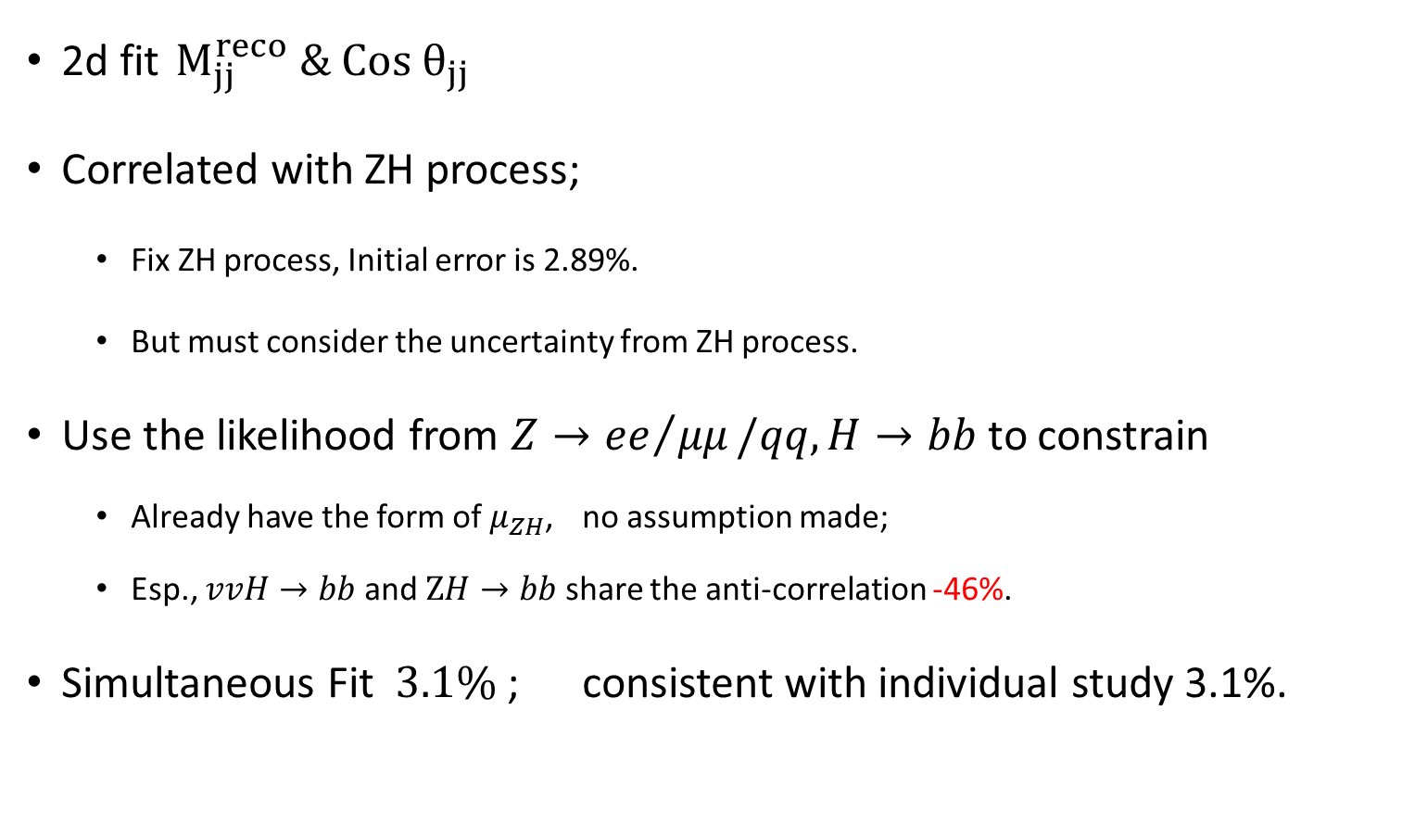
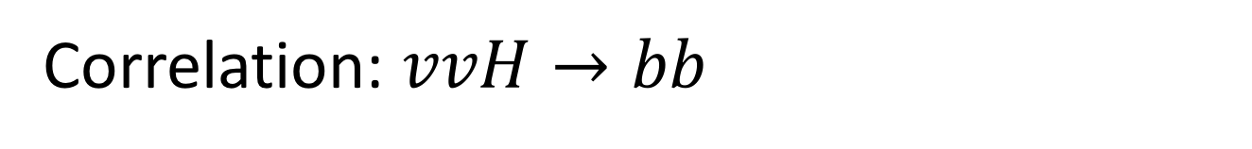
Correlation: $vvH→bb$
  2d fit $M_{jj}^{reco} \& Co{s θ}_{jj}$
  Correlated with ZH process;
    Fix ZH process, Initial error is 2.89%.
    But must consider the uncertainty from ZH process.
Use the likelihood from $Z→{ee}/{μμ}/qq, H→bb$ to constrain
  Already have the form of $μ_{ZH}$, no assumption made;
  Esp., $vvH→bb$ and $ZH→bb$ share the anti-correlation -46%.
Simultaneous Fit $3.1\%$ ; consistent with individual study 3.1%.

Slide 9
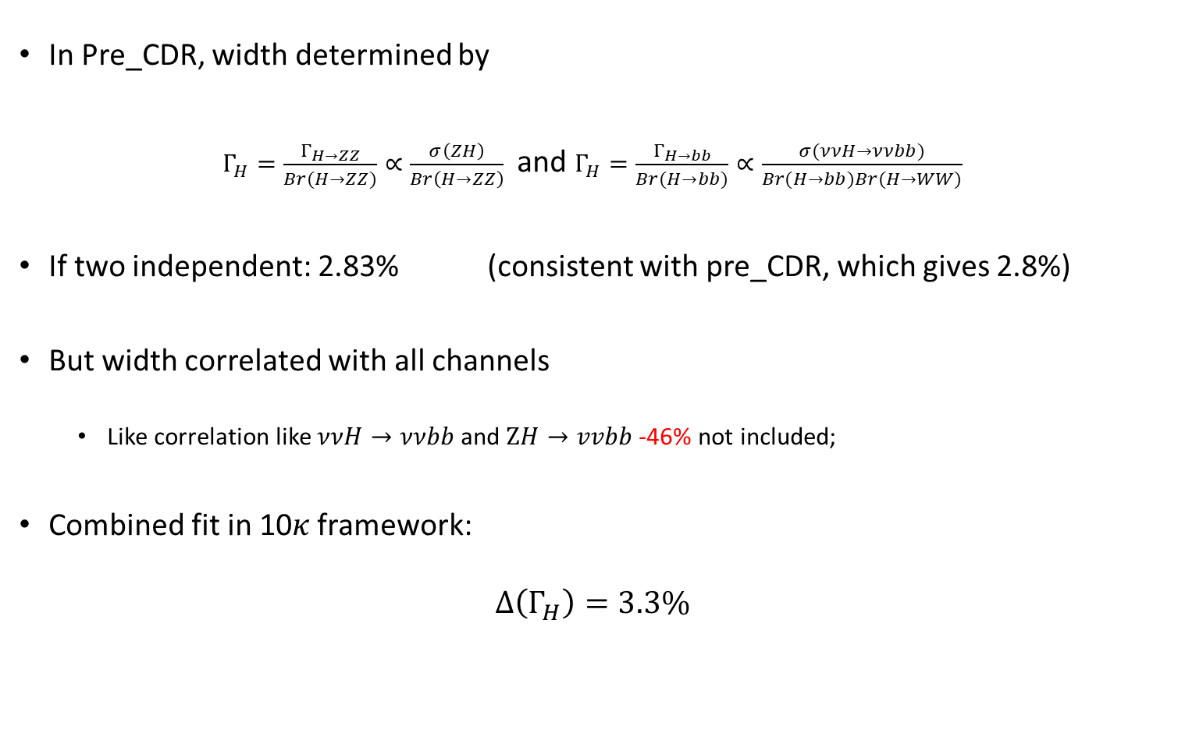
Correlation: Higgs width
In Pre_CDR, width determined by
$Γ_{H}=\frac{Γ_{H→ZZ}}{Br(H→ZZ)}∝\frac{σ\left(ZH\right)}{Br\left(H→ZZ\right)}$ and $Γ_{H}=\frac{Γ_{H→bb}}{Br(H→bb)}∝\frac{σ(ννH→ννbb)}{Br(H→bb)Br(H→WW)}$
If two independent: 2.83% (consistent with pre_CDR, which gives 2.8%)
But width correlated with all channels
  Like correlation like $ννH→ννbb$ and $ZH→vvbb$ -46% not included;
Combined fit in 10𝜅 framework:
$$Δ\left(Γ_{H}\right)=3.3\%$$

Slide 10
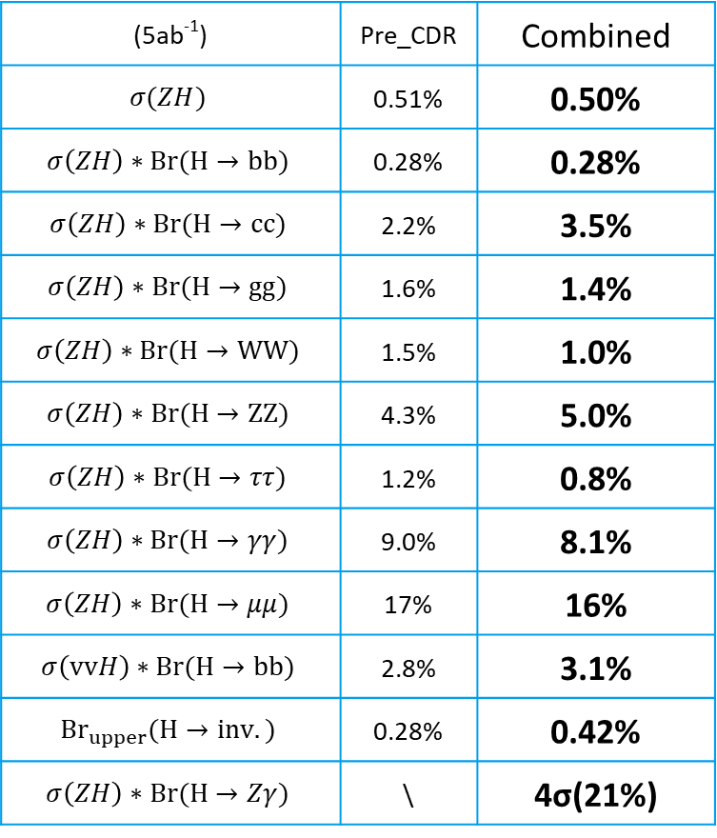

Fit result of $σ\left(ZH\right)∗Br$
(5ab⁻¹) | Pre_CDR | Combined
$$σ(ZH)$$ | 0.51% | 0.50%
$$σ\left(ZH\right)∗Br(H→bb)$$ | 0.28% | 0.28%
$$σ\left(ZH\right)∗Br(H→cc)$$ | 2.2% | 3.5%
$$σ\left(ZH\right)∗Br(H→gg)$$ | 1.6% | 1.4%
$$σ\left(ZH\right)∗Br(H→WW)$$ | 1.5% | 1.0%
$$σ\left(ZH\right)∗Br(H→ZZ)$$ | 4.3% | 5.0%
$$σ\left(ZH\right)∗Br(H→ττ)$$ | 1.2% | 0.8%
$$σ\left(ZH\right)∗Br(H→γγ)$$ | 9.0% | 8.1%
$$σ\left(ZH\right)∗Br(H→μμ)$$ | 17% | 16%
$$σ\left(vvH\right)∗Br(H→bb)$$ | 2.8% | 3.1%
$${Br}_{upper}(H→inv.)$$ | 0.28% | 0.42%
$$σ\left(ZH\right)∗Br(H→Zγ)$$ | \ | 4σ(21%)
bb: most precise, highly correlated with cc/gg due to flavor tagging algorithm (improving);
With MC sample, signal strength for each channel are all exactly to 1. (Guaranteed by Asimov Data)

Slide 11

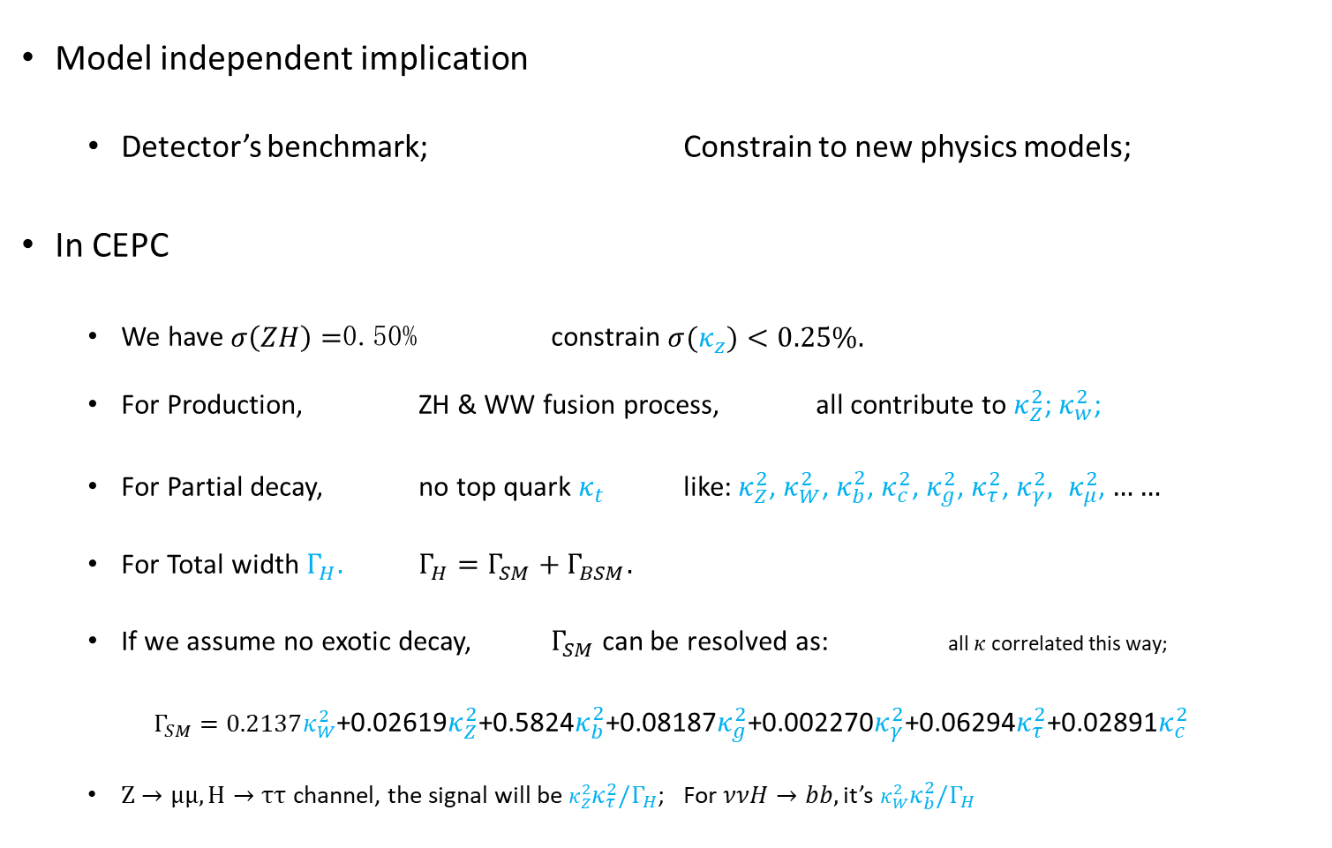
  $κ$ Framework
$κ$ defined as the ratio of the Higgs coupling to SM expects.
Model independent implication
  Detector’s benchmark; Constrain to new physics models;
In CEPC
  We have $σ\left(ZH\right)=$0.50% constrain $σ(κ_{z})<0.25\%.$
  For Production, ZH & WW fusion process, all contribute to $κ_{Z}^{2}$; $κ_{w}^{2}$;
  For Partial decay, no top quark $κ_{t}$ like: $κ_{Z}^{2}$, $κ_{W}^{2}$, $κ_{b}^{2}$, $κ_{c}^{2}$, $κ_{g}^{2}$, $κ_{τ}^{2}$, $κ_{γ}^{2}, κ_{μ}^{2}$, $……$
  For Total width $Γ_{H}.$ $Γ_{H}=Γ_{SM}+Γ_{BSM}.$
  If we assume no exotic decay, $Γ_{SM}$ can be resolved as: all $κ$ correlated this way;
  $Γ_{SM}=0.2137κ_{W}^{2}$+0.02619$κ_{Z}^{2}$+0.5824$κ_{b}^{2}$+0.08187$κ_{g}^{2}$+0.002270$κ_{γ}^{2}$+0.06294$κ_{τ}^{2}$+0.02891$κ_{c}^{2}$
  $Z→μμ,H→ττ$ channel, the signal will be $κ_{Z}^{2}κ_{τ}^{2}/Γ_{H}$; For $ννH→bb,$ it’s $κ_{W}^{2}κ_{b}^{2}/Γ_{H}$

Slide 12
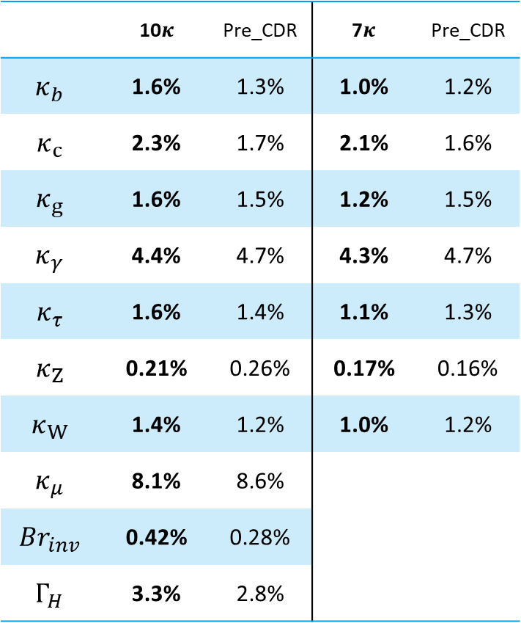

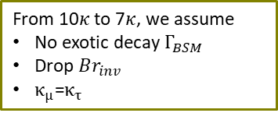
Fit result of $κ$
In different interpretation,
Higgs width can be independent or resolved by branch ratio.
 | 10$κ$ | Pre_CDR | 7$κ$ | Pre_CDR
$$κ_{b}$$ | 1.6% | 1.3% | 1.0% | 1.2%
$$κ_{c}$$ | 2.3% | 1.7% | 2.1% | 1.6%
$$κ_{g}$$ | 1.6% | 1.5% | 1.2% | 1.5%
$$κ_{γ}$$ | 4.4% | 4.7% | 4.3% | 4.7%
$$κ_{τ}$$ | 1.6% | 1.4% | 1.1% | 1.3%
$$κ_{Z}$$ | 0.21% | 0.26% | 0.17% | 0.16%
$$κ_{W}$$ | 1.4% | 1.2% | 1.0% | 1.2%
$$κ_{μ}$$ | 8.1% | 8.6%
$$Br_{inv}$$ | 0.42% | 0.28%
$$Γ_{H}$$ | 3.3% | 2.8%
From 10$κ$ to 7$κ$, we assume
No exotic decay $Γ_{BSM}$
Drop $Br_{inv}$
$κ_{μ}$=$κ_{τ}$

Slide 13
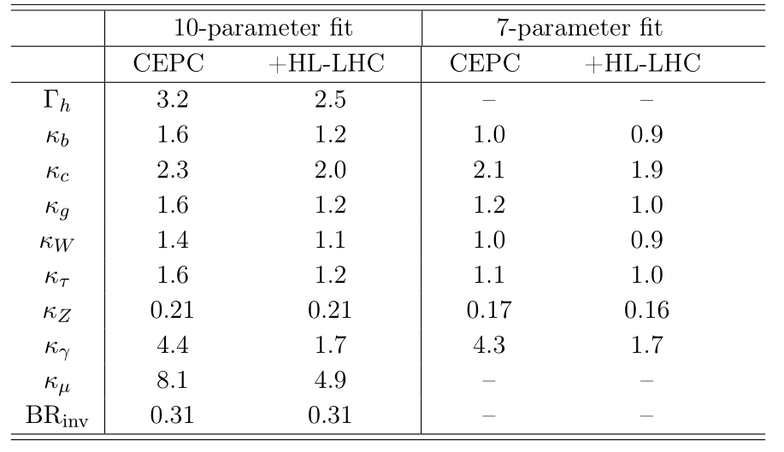
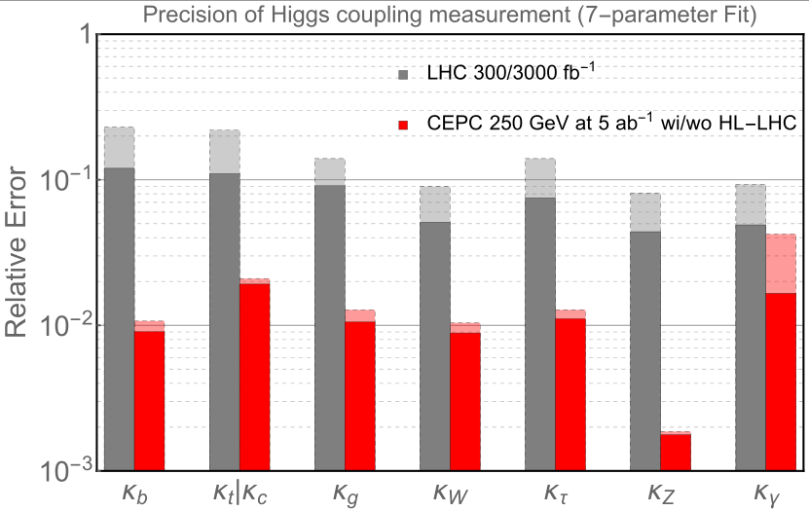

Integration to HL-LHC
*: here $Br_{inv}$ for BSM.

Slide 14
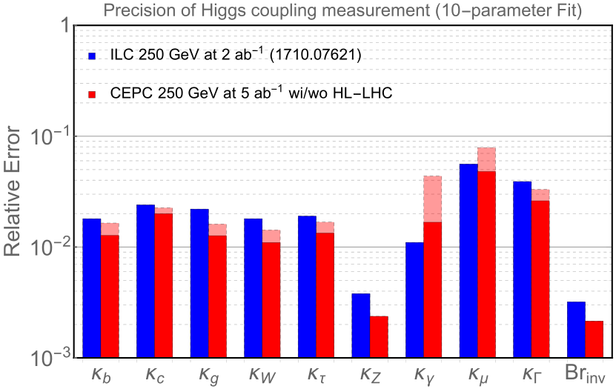
Compared to ILC(1710.07621)

Slide 15
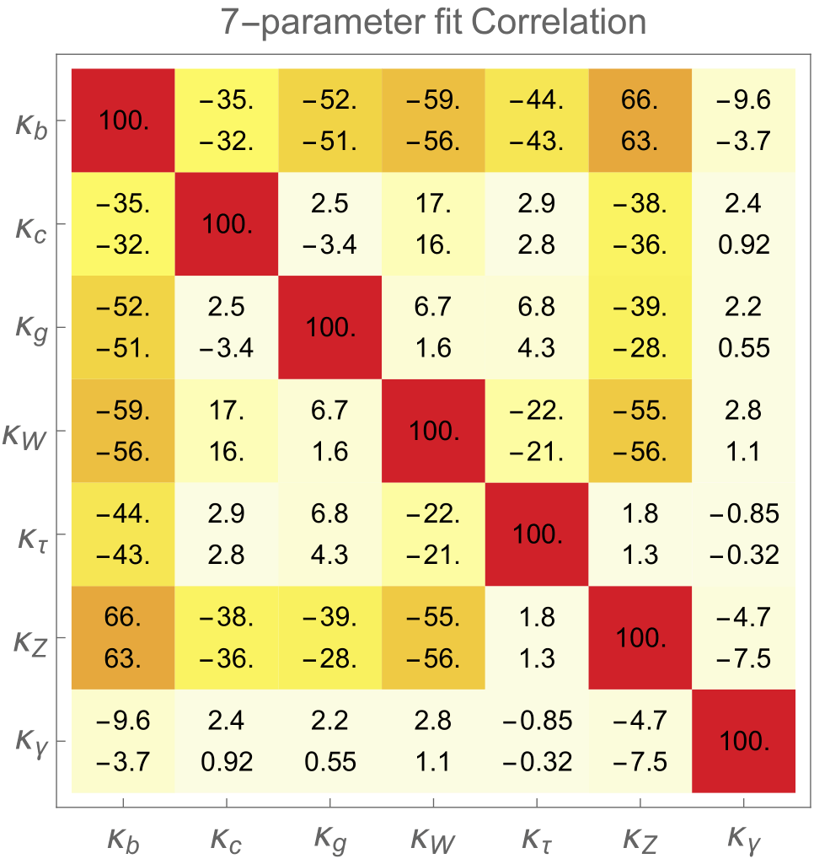
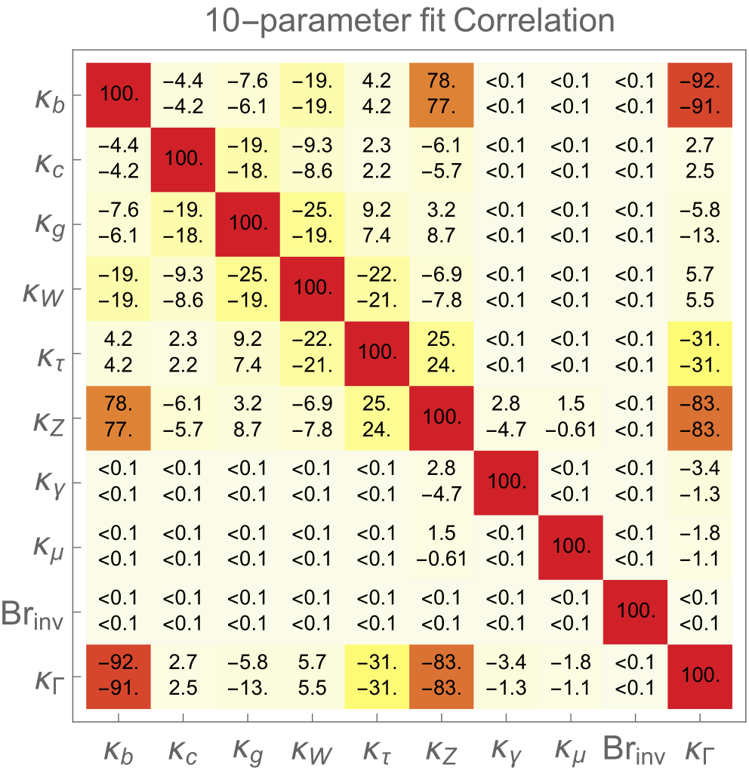
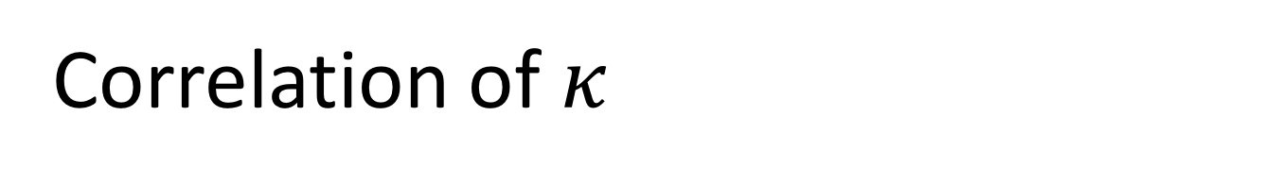
Correlation of $κ$
For each entry,
upper one is CEPC result
lower one is CEPC+HL-LHC result.

Slide 16
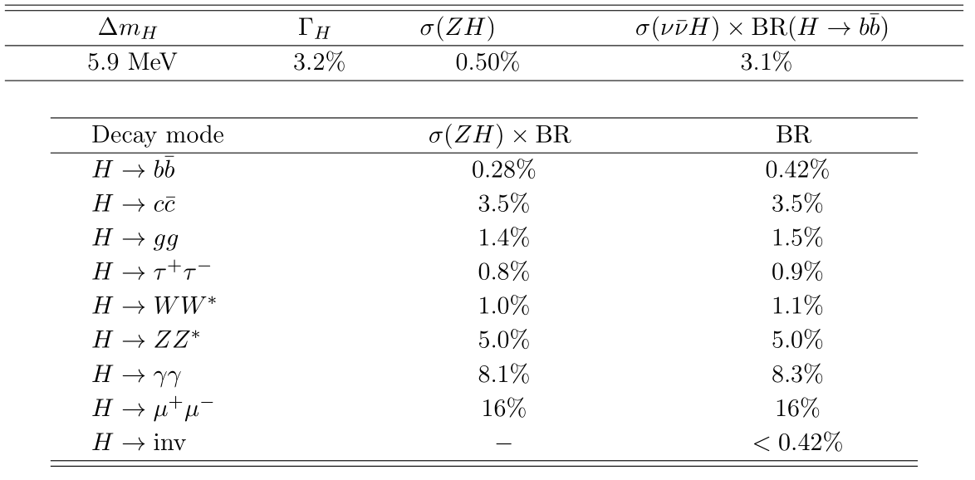
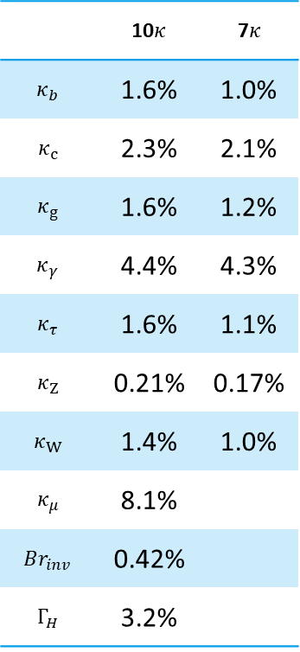
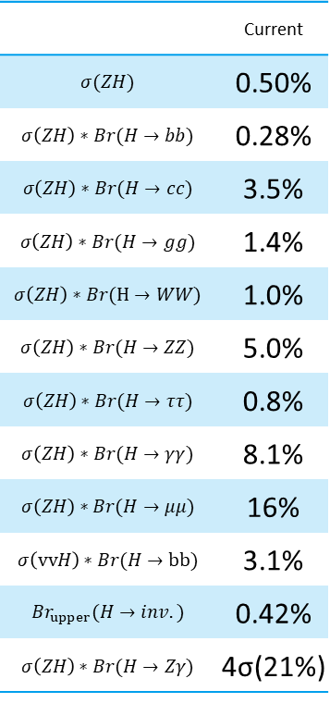
Summary
 | Current
$$σ(ZH)$$ | 0.50%
$$σ\left(ZH\right)∗Br(H→bb)$$ | 0.28%
$$σ\left(ZH\right)∗Br(H→cc)$$ | 3.5%
$$σ\left(ZH\right)∗Br(H→gg)$$ | 1.4%
$$σ\left(ZH\right)∗Br(H→WW)$$ | 1.0%
$$σ\left(ZH\right)∗Br(H→ZZ)$$ | 5.0%
$$σ\left(ZH\right)∗Br(H→ττ)$$ | 0.8%
$$σ\left(ZH\right)∗Br(H→γγ)$$ | 8.1%
$$σ\left(ZH\right)∗Br(H→μμ)$$ | 16%
$$σ\left(vvH\right)∗Br(H→bb)$$ | 3.1%
$${Br}_{upper}(H→inv.)$$ | 0.42%
$$σ\left(ZH\right)∗Br(H→Zγ)$$ | 4σ(21%)
 | 10$κ$ | 7$κ$
$$κ_{b}$$ | 1.6% | 1.0%
$$κ_{c}$$ | 2.3% | 2.1%
$$κ_{g}$$ | 1.6% | 1.2%
$$κ_{γ}$$ | 4.4% | 4.3%
$$κ_{τ}$$ | 1.6% | 1.1%
$$κ_{Z}$$ | 0.21% | 0.17%
$$κ_{W}$$ | 1.4% | 1.0%
$$κ_{μ}$$ | 8.1%
$$Br_{inv}$$ | 0.42%
$$Γ_{H}$$ | 3.2%

Slide 17
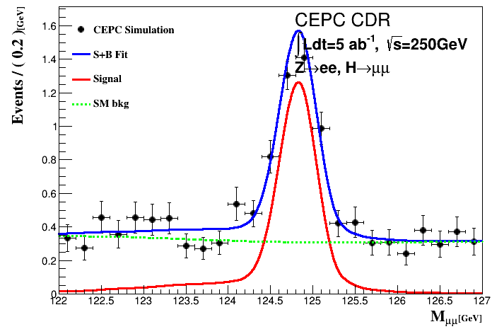
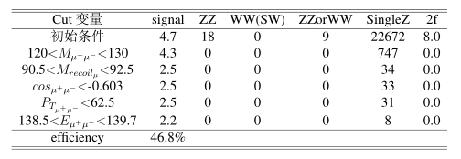

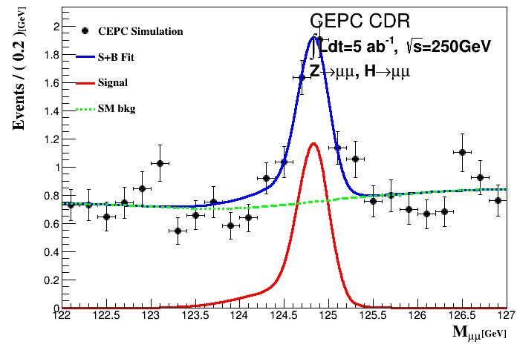
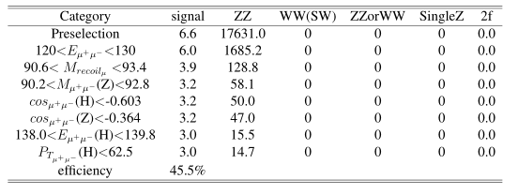

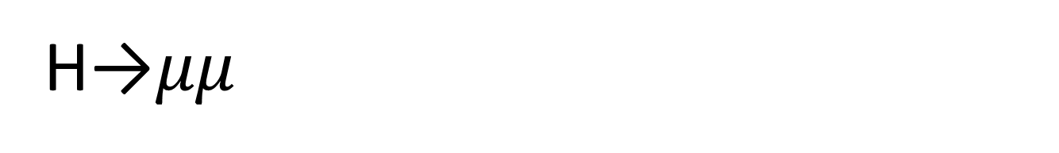
H→$μμ$
More information to be added.
Z->ee
Z->mm consider combination
  Choose $ΔZ=1.5, ΔH=0.75$
bkg shape all after smoothing.

Slide 18
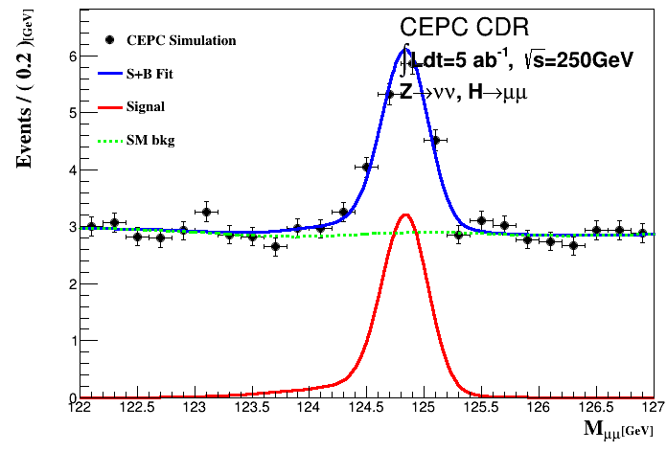
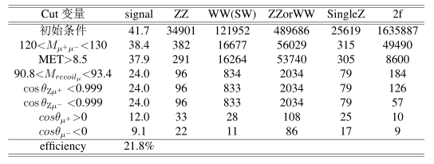
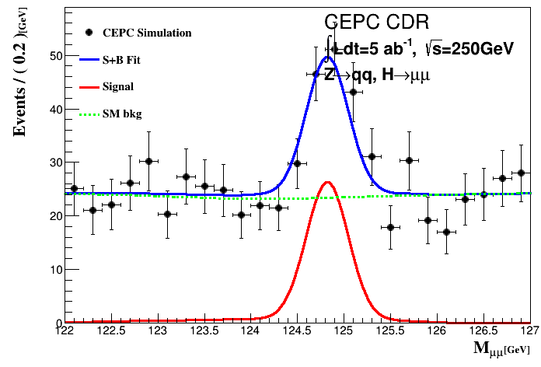
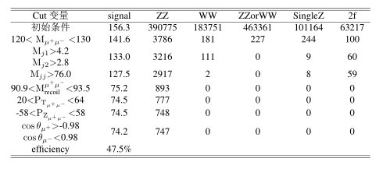
H→$μμ$
Z->vv
  38%
Z->qq
  17%
Combined:15.9%

Slide 19
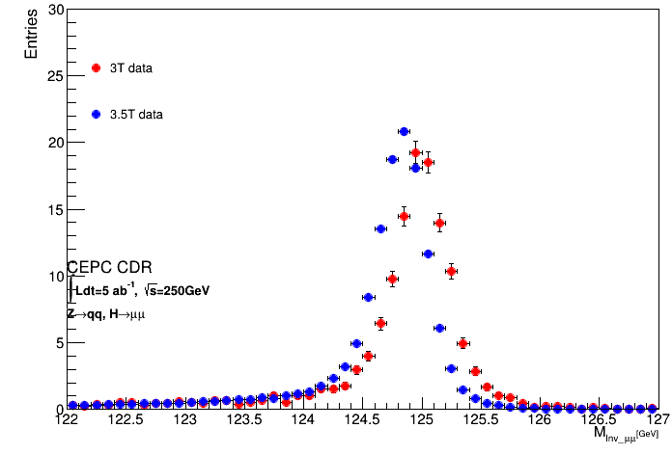
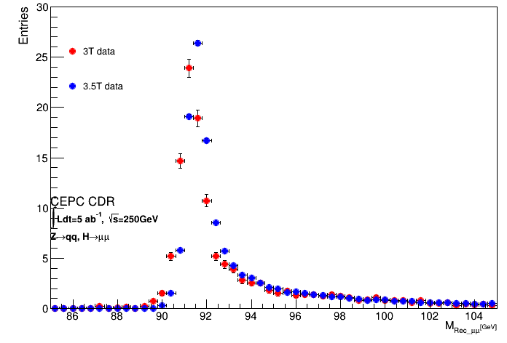
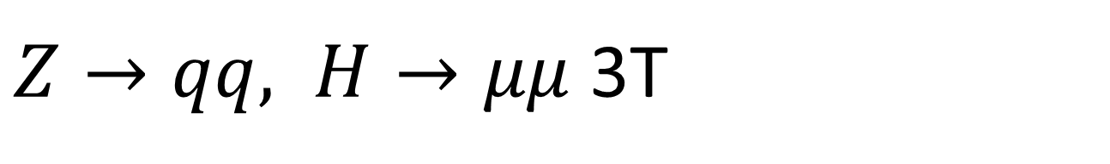
$Z→qq, H→μμ$ 3T
Full Simulation, Signal
Events scaled
H mass
Z mass
Shift in the central value (0.2GeV), width no big change.

Slide 20
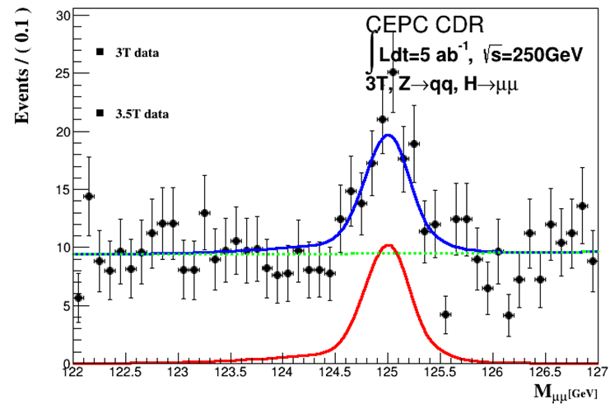
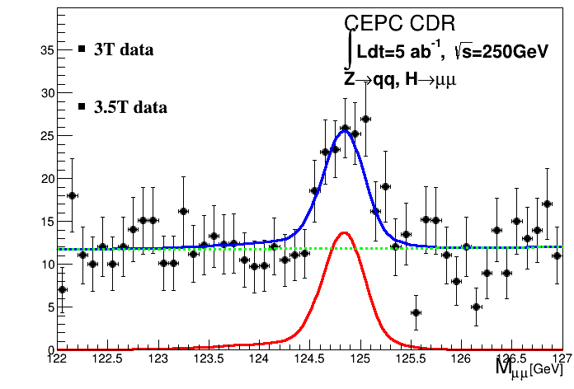
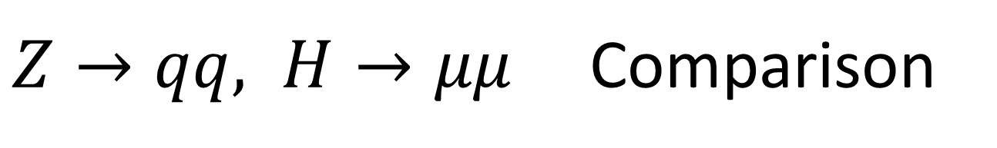
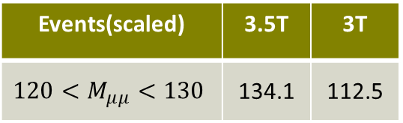
$Z→qq, H→μμ$ Comparison
3T: 20.3%
3.5T: 17.6%
Due to the signal events loss 19% at the beginning.
Reason under study.
Events(scaled) | 3.5T | 3T
$${120<M}_{μμ}<130$$ | 134.1 | 112.5

Slide 21
backup
Individual analysis

Slide 22
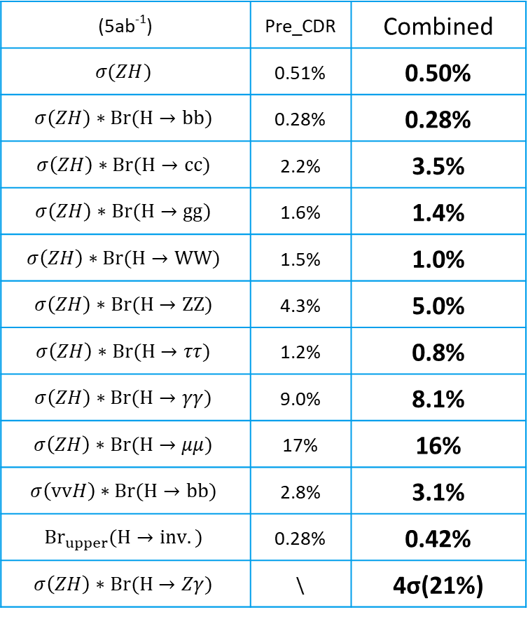
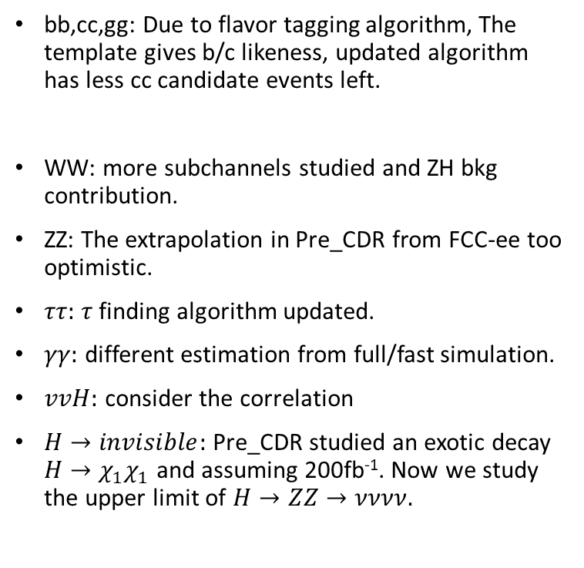
Explanation for difference
(5ab⁻¹) | Pre_CDR | Combined
$$σ(ZH)$$ | 0.51% | 0.50%
$$σ\left(ZH\right)∗Br(H→bb)$$ | 0.28% | 0.28%
$$σ\left(ZH\right)∗Br(H→cc)$$ | 2.2% | 3.5%
$$σ\left(ZH\right)∗Br(H→gg)$$ | 1.6% | 1.4%
$$σ\left(ZH\right)∗Br(H→WW)$$ | 1.5% | 1.0%
$$σ\left(ZH\right)∗Br(H→ZZ)$$ | 4.3% | 5.0%
$$σ\left(ZH\right)∗Br(H→ττ)$$ | 1.2% | 0.8%
$$σ\left(ZH\right)∗Br(H→γγ)$$ | 9.0% | 8.1%
$$σ\left(ZH\right)∗Br(H→μμ)$$ | 17% | 16%
$$σ\left(vvH\right)∗Br(H→bb)$$ | 2.8% | 3.1%
$${Br}_{upper}(H→inv.)$$ | 0.28% | 0.42%
$$σ\left(ZH\right)∗Br(H→Zγ)$$ | \ | 4σ(21%)
bb,cc,gg: Due to flavor tagging algorithm, The template gives b/c likeness, updated algorithm has less cc candidate events left.
WW: more subchannels studied and ZH bkg contribution.
ZZ: The extrapolation in Pre_CDR from FCC-ee too optimistic.
$ττ:$ $τ$ finding algorithm updated.
$γγ:$ different estimation from full/fast simulation.
$vvH:$ consider the correlation
$H→invisible:$ Pre_CDR studied an exotic decay $H→χ_{1}χ_{1}$ and assuming 200fb⁻¹. Now we study the upper limit of $H→ZZ→νννν.$

Slide 23

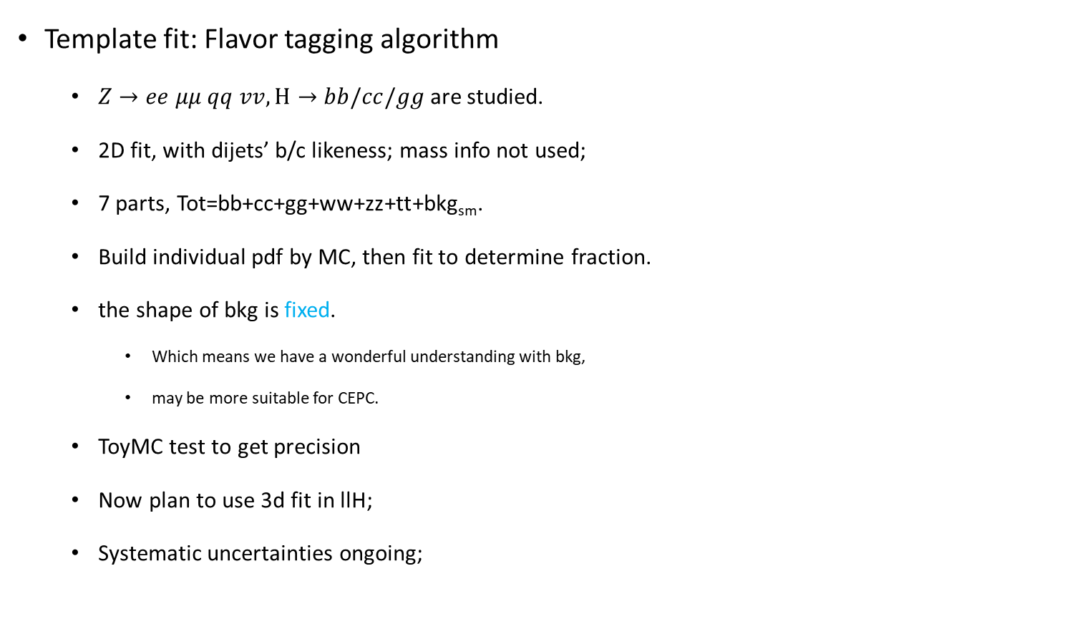
bb/cc/gg
$$B_{likeness}=\frac{b_{j1}b_{j2}}{b_{j1}b_{j2}+(1−b_{j1})(1−b_{j2})}$$
Template fit: Flavor tagging algorithm
  $Z→ee μμ qq vv, H→$ $bb/cc/gg$ are studied.
  2D fit, with dijets’ b/c likeness; mass info not used;
  7 parts, Tot=bb+cc+gg+ww+zz+tt+bkg_{sm}.
  Build individual pdf by MC, then fit to determine fraction.
  the shape of bkg is fixed.
    Which means we have a wonderful understanding with bkg,
    may be more suitable for CEPC.
  ToyMC test to get precision
  Now plan to use 3d fit in llH;
  Systematic uncertainties ongoing;
Scan | μ_bb | μ_cc | μ_gg
eeH | 1.3% | 15.0% | 8.2%
mmH | 1.0% | 11.3% | 5.5%
qqH | 0.5% | 17% | 7.2%
vvH | 0.4% | 3.9% | 1.6%
Combined | 0.28% | 3.48% | 1.44%

Slide 24
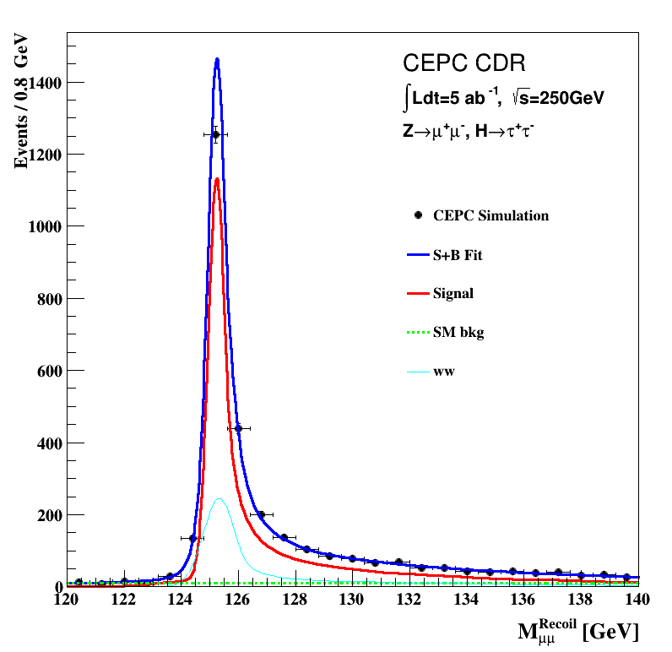
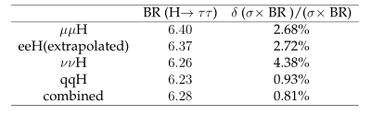
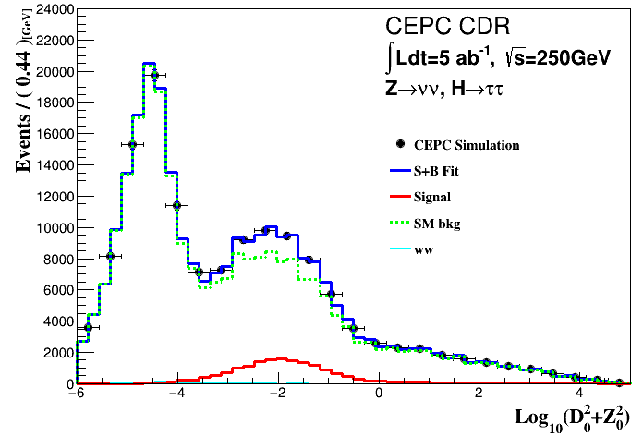

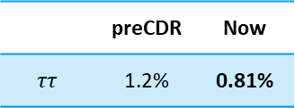
$$ττ$$
 | preCDR | Now
$$ττ$$ | 1.2% | 0.81%
Pre_CDR concludes the precision 1.2% but no description.
Develop LICH to identify lepton. Eff>99%
Signal and ZH events(Main WW) share the same shape
  use $\log_{10}{(D_{0}^{2}+Z_{0}^{2})}$ fit to separate signal
    Impact parameter, Distance from beam spot

Slide 25



WW
 | preCDR | Now
$$WW$$ | 1.5% | 1.0%
Signal |  | Precision
Z | H
H->WW
ee | lvlv | 9.2%
 | evqq | 4.6%
 | μvqq | 3.9%
μμ | lvlv | 7.3%
 | evqq | 4.0%
 | μvqq | 4.0%
vv | qqqq | 2.0%
 | evqq | 4.7%
 | μvqq | 4.2%
 | lvlv | 11.3%
qq | lvqq | 2.2%(ILC)
ZH bkg contribution |  | 3.0%
Currently have 17 channels of WW
Green: studied

Slide 26




ZZ
 | preCDR | Now
$$ZZ$$ | 4.3% | 5.0%
Signal |  | Precision
Z | H
H->ZZ
vv | μμqq | 8.2%
vv | eeqq | 35.2%
μμ | vvqq | 7.3%
ee | eeqq | 35.1%
ee | μμqq | 23.0%
ZH bkg contribution |  | 19.4%
Pre_CDR’s result from extrapolating the FCC-ee.
Now has 5 channels clear and easy to study
Green: studied

Slide 27




$$γγ$$
 | preCDR | Now
$$γγ$$ | 9.0% | 8.1%
Signal |  | Precision
Z | H
H→γγ
μμ+ττ | γγ | 24.8%
vv |  | 11.7%
qq |  | 12.8%

Slide 28




$$H→invisible$$
 | preCDR | Now
$$invisible$$ | 0.28% | 0.42%
Moxin studied H->ZZ->vvvv
  Large irreducible bkg, use BDT and seek upper limit.
  Huge fluctuation, use Asimov Data to get correct fit result.
  precision 148%, upper limit for Br: 0.42%
  Upper limit for BSM H->invisible: 0.31%
 | Precision | significance | Br Upper limit
Z->ee | $$350\%$$ |  | 0.84%
Z->mm | $$242\%$$ |  | 0.62%
Z->qq | $$226\%$$ |  | 0.59%
Combined | $$148\%$$ | 0.68$σ$ | 0.42%

Slide 29




$μμ$, $Zγ$ and others
 | preCDR | Now
$$μμ$$ | 17% | 16%
$μμ$ process
  Pre_CDR’s 17% not reliable;
  Zhen Wei separate Z->ee,mm, vv and qq
$Z→qq, H→Zγ→qqγ$ studied;
  Pre_CDR not conclude;
  Take $m_{Zγ−Z}$ as observable;
  $4σ$ significance; Precision about 21%.
$eμ, ee$ process studied.
  Since low stats and no clear ratio, not taken into fit model.

