Slide 1
Current result of $WW fusion, H→bb$ Cross-section measurement
Hao Liang
25.5 2018
Notes:
My talk is about the WW fusion, H->bb Crossection measurment

Slide 2
Outline
Sample Generation
Cut Chain
Extraction of the WW fusion cross section by fit
The result
Notes:
This is the outline of this report
First I will describe the sample genration.
And then I will show you the numbe of events after
Then I will talk about a little how I did the kinematic fit.
The kinematic fit concerns the jet energy resolution &direction resolution, I will talk about it.
Finnaly, I will give the result.

Slide 3
Sample Generation
Higgs sample:
100k WW fusion(signal) , H->anything
100k ZH (background), H->anything events
Sample for interference between ZH and WW fusion can’t be generated
SM sample:
$5ab^{−1}$ 2fermions + 4fermions

Slide 4
Cut Chain
Defintion:
$N_{PFO}>20$
$105<E<155 \&\& P_{t}>13$
$Isolep veto$
$100<M<135 \&\& 65<M_{recoil}<135$
$y_{12}>0.15 \&\& y_{23}<0.06 \&\&y34<0.01$
${−0.98<θ}_{2jets}<−0.4$
$bb−likeness>0.4 (bb−likeness=bb/(bb+(1−b)(1−b)))$
 | WW fusion, H->bb | ZH, H->bb | qqbar | sw-sl | sznu-sl | ww-sl | zz-sl
Cut chain | 52.8% | 64.9% | 25630 | 124 | 5745 | 3230 | 9764
Fit window with kinematic fit | 51.2%(~10k@5ab^-1) | 63.8%(~79k@5ab^-1) | 22980 | 112 | 4018 | 2187 | 6503

Slide 5
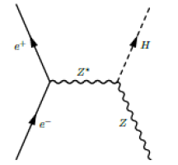
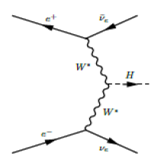
Recoil mass
We can extract the WW fusion events number by fitting the recoil mass and recoil angle
Approach1: The recoil mass is calculated by
$m_{recoil}=\sqrt{{\left(\sqrt{s}−E_{H}\right)}^{2}−p_{H}^{2}}$
Approach2: Where the $E_{H}$ is replaced with $E_{H}=\sqrt{p_{H}^{2}+m_{H}^{2}}$
Where $m_{H}=125GeV$ is substituted.
ZH
WW fusion

Slide 6
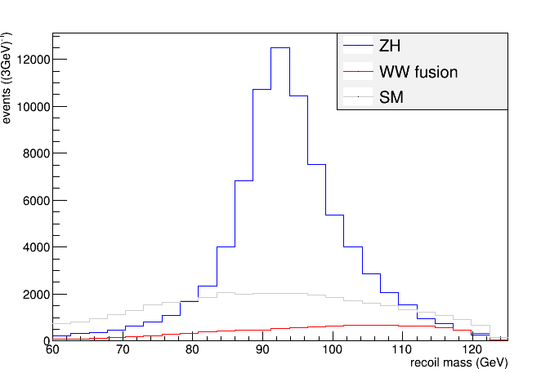
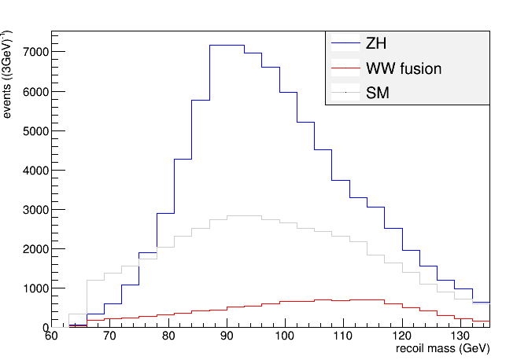
Recoil mass comparision
Approach 1
Approach 2

Slide 7
How to fit to extract the ww fusion, H->bb cross-section (1)
Backgrounds (except ZH, Z->vv, H->bb) can be determined very well in theory and experiments. The signal stress of those were fixed to be 1.
The expected number of ZH, Z->vv,H->bb would be measured via eeH, $μμ$H and qqH channels:
The uncertainties of coupling constants concerns only electroweak part are assumed to be neglegible.
Three signal stresses are proportianal to ZH, Z->vv,H->bb at tree level
The uncertainty of ZH, Z->vv, H->bb = 1/$\sqrt{\frac{1}{σ_{eeH,H→bb}^{2}}+\frac{1}{σ_{μμH,H→bb}^{2}}+\frac{1}{σ_{qqH,H→bb}^{2}}}==1/\sqrt{{(\frac{1}{1.2\%})}^{2}+{(\frac{1}{1.1\%})}^{2}+{(\frac{1}{0.4\%})}^{2}}=0.375\%$

Slide 8
How to fit to extract the WW fusion, H->bb cross-section(2)
Construct the likelihood as
$−logL=0.5{\left(\frac{μ_{ZH}−1}{0.375\%}\right)}^{2}−logP(data|μ_{ZH}N_{ZH}pdf_{ZH}+μ_{WWF}N_{WWF}pdf_{WWF}+N_{bkg}pdf_{bkg})$
The $μ_{ZH},μ_{WWF}$ are events numbers normalized by SM prediction for ZH, Z->vv, H->bb and WW fusion, H->bb respectively.
The statistical uncertainty was determined via the hessian matrix at maximum point of the minus log likelihood.

Slide 9
Result
5$ab^{−1}$ | Fit recoil mass of 2 jets | Fit recoil mass and $θ$ of 2 jets
Raw data | 3.9% | 3.8%
Kinematic fit | 3.2% | 3.1%
0.1% improvement by combining fitting the $θ$

