Slide 1
W/Z physics in CDR
Zhijun Liang
IHEP,CAS

Slide 2
CEPC W/Z physics Plan for CDR
Plan to cover the prospects of 6-7 key parameters.
All studies needed to update to CEPC_v4 geometry
With 240GeV for W mass direct measurement.
Plan to have First draft of CDR about W/Z physics ready by end of May.
http://cepcgit.ihep.ac.cn/cepcdoc/CDR

Slide 3
new samples with new detector geometry
Gang Li has produced new MC samples with CEPC_v4 geometry
Many Thanks to Gang
WW and ZZ at 240GeV with CEPC_v4 geometry ( 1M for ZZ and 1M for WW )
ZZ stdhep : /cefs/data/stdhep/CEPC240/4fermions/E240.Pzz_sl.e0.p0.whizard195/ ZZ after reconstruction slcio : /besfs/groups/higgs/data/SimReco/wo_BS/CEPC_v4/zz_sl/data/ WW stdhep: /cefs/data/stdhep/CEPC240/4fermions/E240.Pww_sl.e0.p0.whizard195/ WW after reconstruction slcio :/besfs/groups/higgs/data/SimReco/wo_BS/CEPC_v4/ww_sl/data/
Z->bb, Z->cc and Z->light jets with CEPC v4 geometry (0.11M for each flavor)
/besfs/groups/higgs/data/SimReco/wo_BS/CEPC_v4/zpole/data/rec/

Slide 4
News: CEPC Workshop
CEPC workshop
24-26 May 2018
Università degli Studi Roma
https://agenda.infn.it/conferenceDisplay.py?confId=14816

Slide 5
Backup

Slide 6
Related talks in CEPC workshop
df
Welcome Dr. Hengne Li joining CEPC electroweak study

Slide 7
Reminder of CEPC W/Z runs
Some discussion about CEPC Z pole running .
http://indico.ihep.ac.cn/event/7709/
E=240GeV, L=1.6 X 10³⁵ cm⁻²s⁻¹, solenoid field = 3T ( new default )
Two year running proposed by accelerator team
WW threshold scan
Proposal from accelerator team
One year running about 160GeV
Total luminosity 3.2 ab⁻¹

Slide 8
Backup

Slide 9
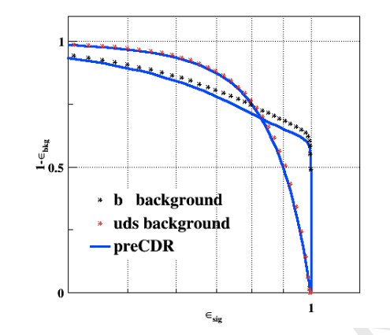
Performance input
Identify some performance input needed to support the W/Z physics prospect study
May need to repeat some study with 3T magnetic field and new detector geometry
Afb(l): lepton angular resolution
R_b: “B jet efficiency” vs “cjet/light rejection “
W mass (direct approach)： jet energy resolution
W mass (threshold scan): ?
N_v : photon energy resolution

