Slide 1
CepC Tracker Summary
Zhijun Liang
IHEP

Slide 2
Detector Conceptual Designs (CDR)

Slide 3
JADEPIX1 studies
Xin Shi
Neutron irradiation at Xi’an pulse reactor to 10¹², 5x10¹², 10¹³
⁵⁵Fe
⁹⁰Sr
Beam test at DESY august 27, September 2, 2018

Slide 4
JadePix2 in CMOS technology
Yang Zhou
Testing two different amplifiers
Diode 4 𝝁m²
Testing ongoing

Slide 5
SOI
Yang Zhou
⁵⁵Fe signal Efficiency versus bias voltage
Resolution of 2.3μm at ~3000e⁻signal level

Slide 6
IDEA Drift Chamber and Tracking system
G.F. Tassielli
IDEA Drift Chamber
Novel approach at construction technique of high granularity and high transparency Drift (very low material)
Chambers (From KLOE DCH to IDEA DCH)
IDEA tracking system (DCH+SVX+PSHW)
KLOE DCH
MEG 2 DCH
Notes:
MEG 2
20 μm gold-plated tungsten anodes.
40-50 μm silver-plated aluminum cathodes and guard wires.
ultra-low mass gas mixture with helium and isobutane
FR4 wire PCBs with PEEK spacers in each sector of the endplate. A carbon ber support structure will guarantee the proper wire tension. In the inner side an aluminated mylar foil will tight the gas volume.

Slide 7
High granularity and high transparency Drift Chambers
Material reduction to ≈ 10⁻³ X₀ for the inner cylinder and to a few x 10⁻² X₀ for the end-plates, including HV supply and signal cables
Feed-through-less wiring: allows to increase chamber granularity and field/sense wire ratio to reduce multiple scattering and total tension on end plates due to thinner wires
Cluster timing: allows to reach spatial resolution < 100 μm for 8 mm drift cells in He based gas mixtures
Cluster counting: allows to reach dN_{cl}/dx resolution < 3% for particle identification (a factor 2 better than dE/dx as measured in a beam test)

Slide 8
CepC full silicon option
Chengdong Fu
CEPCSID: replacing TPC with extra silicon strip barrel ladders and endcap disks
SIDB: expanding the SID design to full tracking volume http://atlaswww.hep.anl.gov/hepsim/detectorinfo.php?id=sidcc
B field is assumed to 3.0 T
The radius of tracking volume is set as 1.87 m, not change the size of calorimeter
some issue in ConformalTracking, discussed with Fcc and CLIC experts.
Three options for barrel ladders
Detached two layers with overlap
Detached two layers without overlap
Conjunct layer with two silicon layers
Two options for endcap petals
Detached two layers
Conjunct layer with two silicon layers

Slide 9
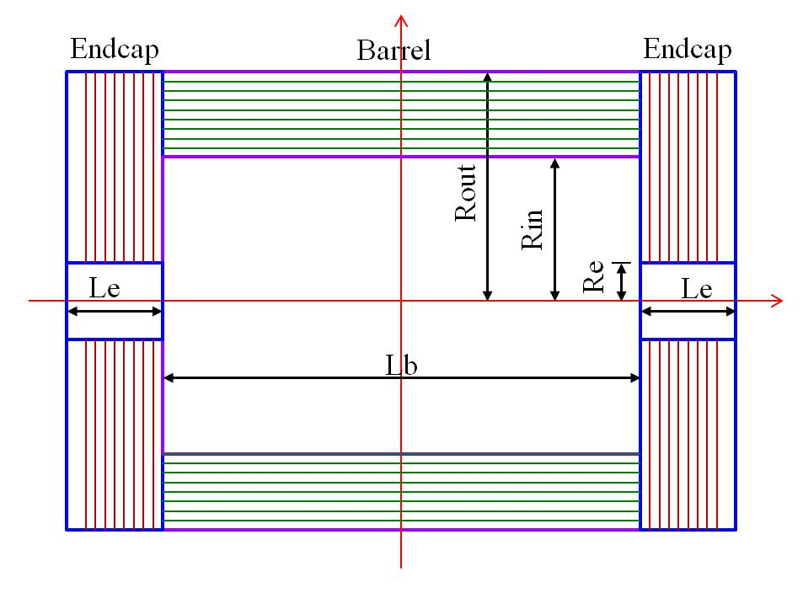
MUON DETECTORS
Paolo Giacomelli, Marco Poli Lener , Liang Li (RPC)
CepC
Eight layers of RPC stations, feedback:
Too many RPC layers, need more optimization
Muon detector position and timing resolution is similar to calorimeter
Why not use last layer of HCAL as muon detector ?
Limited impact to physics
Consider to add one layer of muon detector with good resolution
Other options:
Monitored Drift Tubes, Thin Gap Chamber, Micromegas, GEM
Position resolution: 5-10 mm
10,000 m²
Total surface O(10000) m²
Total surface O(10000) m²
Total surface O(10000) m²
Total surface O(10000) m²

Slide 10
𝜇-RWELL
1.2x0.5m² μ-RWELL
Technology transfer
ELTOS SpA
(http://www.eltos.it)
Low cost, easy construction
Position resolution: 5-10 mm
Time resolution: ~ 1 ns

Slide 11
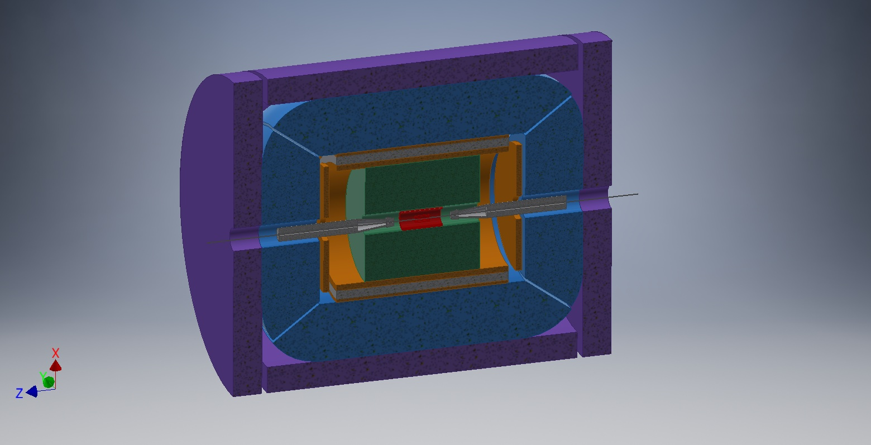
MUON DETECTORS - IDEA
CepC and FCC ee
IDEA detector
3-4 MPGD stations interleaved in the iron return yoke.
The current baseline solution employs 𝜇-RWELL as active detector
2T B field
Compare 2T and 3T tracking performance ?

Slide 12
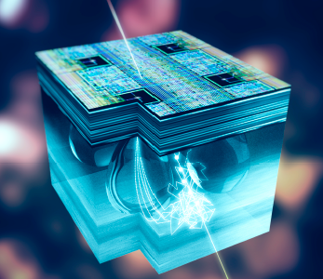
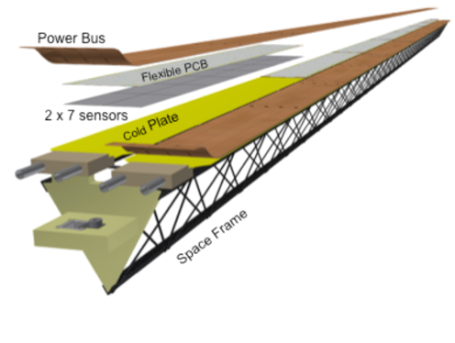
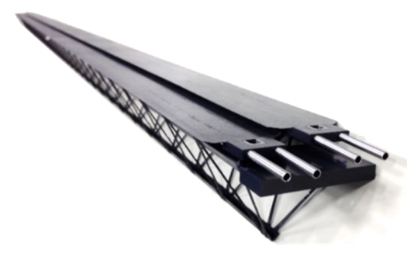
ALICE
CMOS Monolithic Active Pixel Sensors in TowerJazz 180 nm technology
Pixel pitch: 29 × 27 μm²
Low power consumption ~40 mW/cm²
Input capacitance C_{in} = 5 fF
Input charge Q_{in}(MIP) = 1300 e ⟶ V = 40 mV
Spatial resolution 5 μm, Event time resolution < 1 μs
Radiation hardness: expected in Run 3 and 4 < 300 krad (< 2.0 × 10¹² 1 MeV n_{eq}/cm²)
Werner Riegler
7 layers (inner/middle/outer): 3/2/2 from R = 22 mm to R = 400 mm
Ultra-lightweight support structure and cooling (0.30 % X₀ for innermost layers)
Possible to remove and re-install the detector for maintenance during the yearly shutdowns
Outer barrel staves

Slide 13
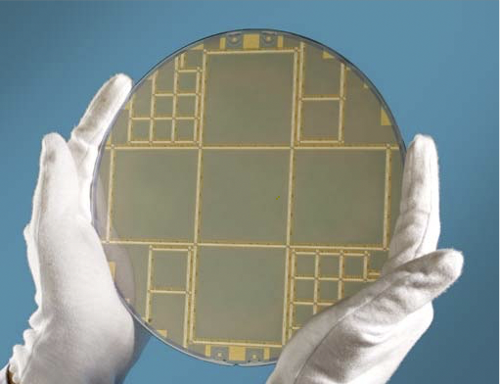
Exploit flexibility of ultra thin silicon
Stitching to build larger sensors (RAL)
Migration to 65 nm

Slide 14
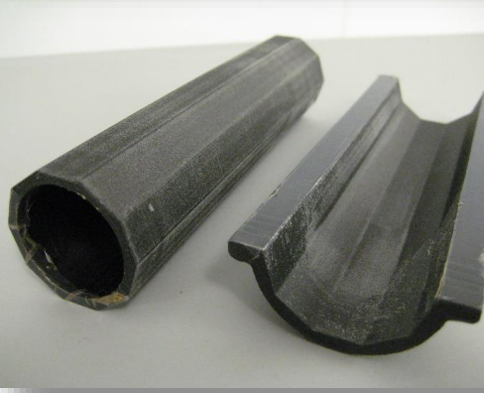
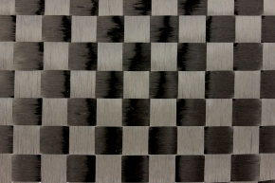
Development of CFRP Structures
Tim Jones
Most low-mass support structures in PP experiments are made from CFRP.
High modulus carbon fibres embedded in a resin matrix
Cured under heat (120°C) and pressure (1-7 bar)
Laminate built up from several laminae at different angles
Primary issue
CFRP laminates cured at elevated temperature need to be balanced to avoid distortions
Balanced: [0], [0/0], [0/90/0], [0/90/90/0], etc…
Increased thickness over mono-layer (eg. Kapton
In Spread-tow pre-preg, the fibre bundles are spread out into strips (typically >15mm wide)
Lower areal weight and higher fibre fraction
Lower mass for equivalent stiffness
Developed techniques to manufacture custom spread-tow woven pre-preg with weave ~ 5mm for vertex detector support

Slide 15
Magnet
Zian and Feipeng
Some progress in the development of specific LTS superconductor, thermal siphon cooling
Constructed 10 meter short length aluminum stabilized NiTi Rutherford superconductor of 10kA@4T
Will add 2T detector magnet design proposed by Italian team into CDR
About the cost of magnet
From Zian: Material fee is similar, but the cost of making cable in China is much cheaper.
From Calo side:
Could we increase thickness of calormeter by 4cm, would that increase the cost for magnet ?
From Zian: yes, not a big deal

Slide 16
Technology R&D for CLIC & FCC-ee
Emilia Leogrande

Slide 17
Integrated HR-CMOS sensors
Integrated CMOS Tests with INVESTIGATOR analog prototype chip in TowerJazz 180 nm
sensor on High-Resistivity substrate
HR-CMOS process (ALICE development): 20x20 - 50x50 μm2 pitch for 28x28 μm2, with external readout:
~99.3% efficiency, <5 ns timing, σSP ~ 4 μm
Ongoing work to design fully integrated CLICTD chip: 30x300 μm² pitch, be thinned to 50-100 μm
Plan to use smaller feature size processes in the future

Slide 18
comments from tracker section conveners
Comments From Werner Riegler, Daniela Bortoletto, Paolo Giacomelli
Very impressive progress in CEPC R & D
Need to consider robustness
What if some modules in TPC/silicon/ wire chambers are not working ?
Detector optimization
Too detailed in fine tuning of detector geometry with fullsim
May learn more with fast simulations
May consider to step back in conceptual design level to consider more possible technologies
Fast timing silicon (LGAD) for PID was not considered
International collaboration
Consider to increase the interaction points from two to four (attract more idea )
Similar R & D are on-going in LHC experiment ( CMOS pixel /TPC …)
Detector R&D for CepC can benefit from experience gained in the ILC/CLIC/FCC-ee R&D/studies and current experiments/ongoing upgrades (ALICE, LHCb, ATLAS…. )

