Slide 1
Selecting detector geometry by Run Number
Long Peixun
2018.5.17

Slide 2
Content
BesVis for BOSS and CgemBOSS
CVS Tags of new BesVis
Detector geometry selection
Current geometry selection
File and class design
New program process

Slide 3
BesVis for BOSS and CgemBOSS
CGEM display will use CGEM geometry packages which don’t exist in normal BOSS.
It is necessary to release 2 different versions of BesVis for BOSS and CgemBOSS at present.
BesVis in CgemBOSS (Version A) includes both MRPC and CGEM display, while BesVis in BOSS (Version B) only includes MRPC display.
After BOSS and CgemBOSS are merged, these 2 versions of BesVis will also be merged.
I have committed these 2 versions of BesVis to CVS.

Slide 4
CVS Tags of new BesVis
Old tags of BesVis
BesVisClient-00-04-04, BesVisLib-00-04-04
New BesVis in BOSS (Version B)
BesVisClient-00-04-06, BesVisLib-00-05-01
[BESIII]/BossCvs/EventDisplay
New BesVis in CgemBOSS (Version A)
BesVisClient-00-05-02, BesVisLib-00-06-02
[BESIII]/CgemBossCvs/EventDisplay

Slide 5
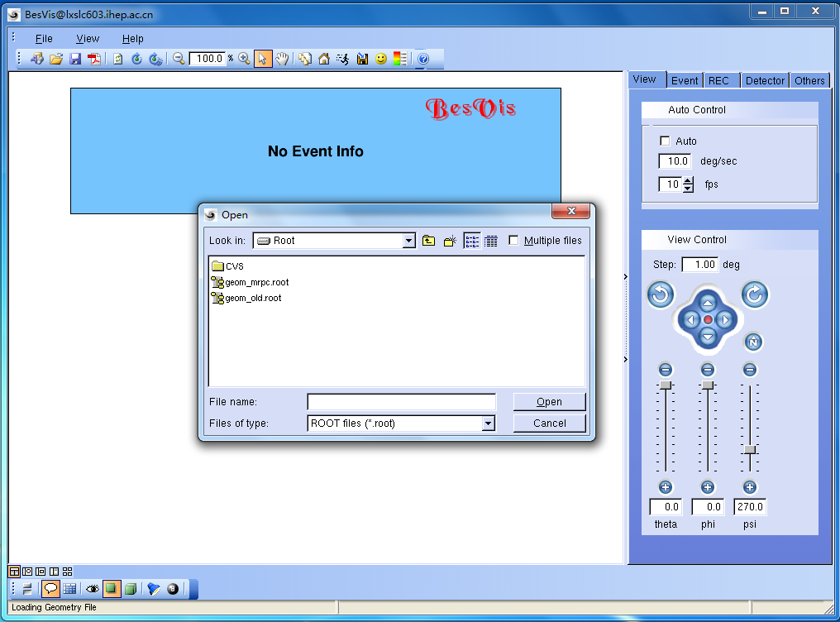
Current geometry selection
When BesVis is launched, it will popup a dialog box for user to select a geometry file.
BesVis loads the geometry file.
User opens an event file.
BesVis loads the event file and displays it.

Slide 6
Current geometry selection
In the past, there was only one kind of geometry. This process is feasible, although it is not convenient.
However, since MRPC was installed, there has been more than one kind of geometry. User doesn’t know which geometry will be used before open the event file.
It is convenient for user that BesVis selects a geometry file automatically.
Detector geometry will be selected by the Run Number of events.

Slide 7
File geom_sel.txt
I created a file to record the list of geometry files.
geom_sel.txt
Each item includes geometry file name and start run number.
Line which contains character ‘#’ will be interpreted as annotation.
Just need to modify this file if a new geometry start to be used.

Slide 8
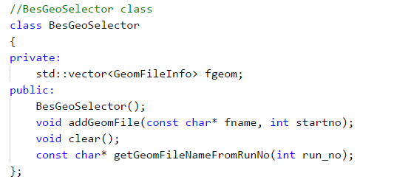
Class BesGeoSelector
I created a class BesGeoSelector to manage the list of geometry files.
Function getGeomFileNameFromRunNo(int run_no)
Input: Run Number
Output: Geometry file name which matches input

Slide 9
New program process
No longer popup geometry selection dialog box when launch BesVis.
User can open an event file without loading detector geometry. If that is so, BesVis will select detector geometry automatically by the run number of the event.
Of course, user can also select a geometry file manually. User just need to open a geometry file as before.

Slide 10
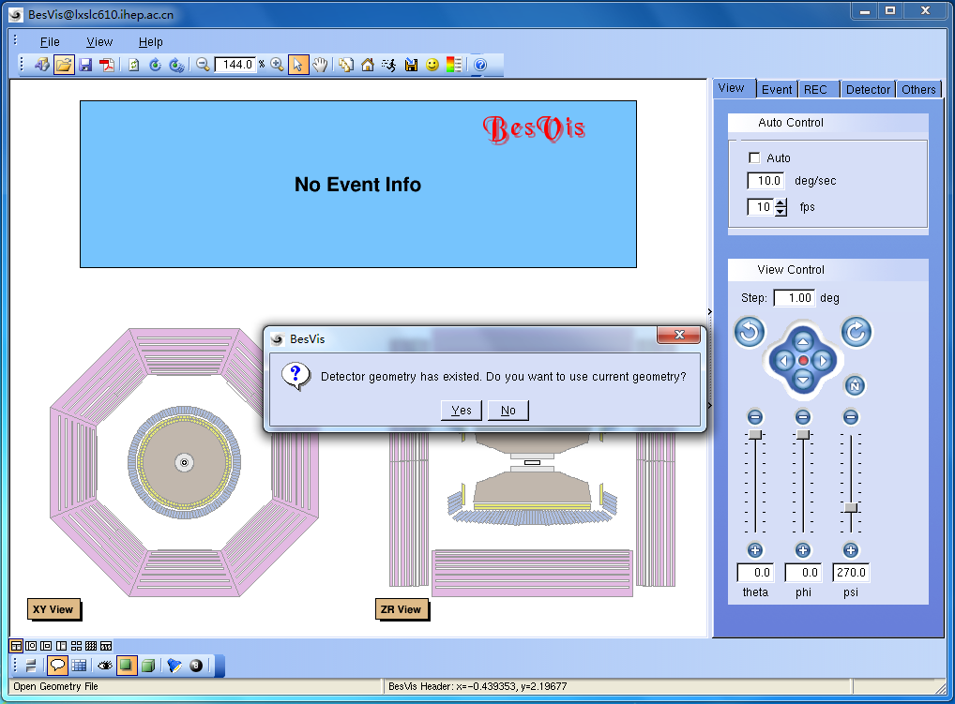
Select a geometry file manually

