Slide 1
The evolution of MRPC TOF technology
Wang Yi
Department of Engineering Physics, Tsinghua University
yiwang@mail.tsinghua.edu.cn

Slide 2
Abstract:
  Introduction of MRPC
  Introduction of three generation MRPC TOF
  Status of TOF of STAR, CBＭ and SoLID
  Conclusions

Slide 3
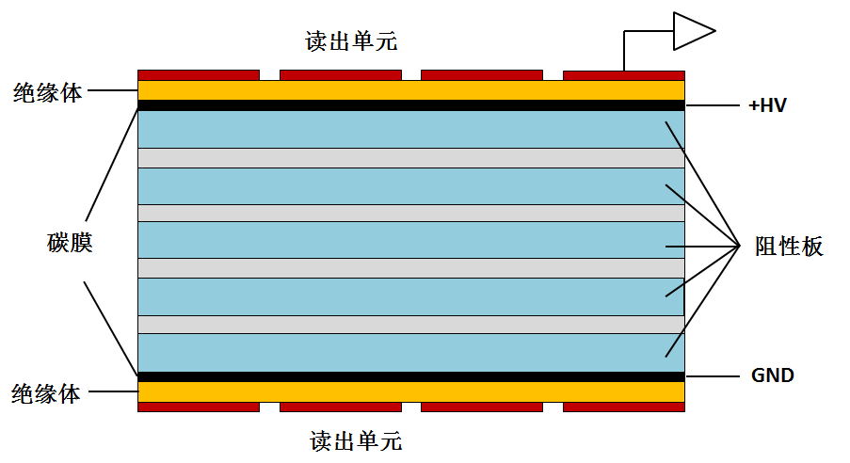
MRPC introduction
Read out
Standard parameters:
Resistivity of glass: ~10¹² Ω.cm
Working gas: 90%Freon+5%iso-butane+5% SF6
Time resolution <100ps
Efficiency >95%
Charge: a few PC
Dark current: a few nA
Noise ~1Hz/cm²
Rate <100 Hz/cm²
Large area, low cost
Insulator
Carbon
Resistive
plate
Insulator
Read out
MRPC structure
MRPC application：
Application in nuclear physics experiments
Application in industry（Muon tomography)
Application in medicine（TOF-PET）

Slide 4
How to increase rate of MRPC
The voltage drop in the gas gap:
The smaller the voltage drop, the higher efficiency and higher rate capability!
Two main ways to improve rate capability:
Reducing bulky resistivity of electrode glass (CBM)
Reducing the avalanche charge (ATLAS)

Slide 5

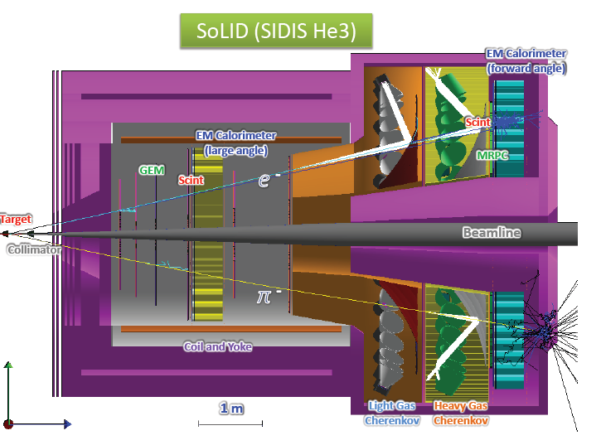
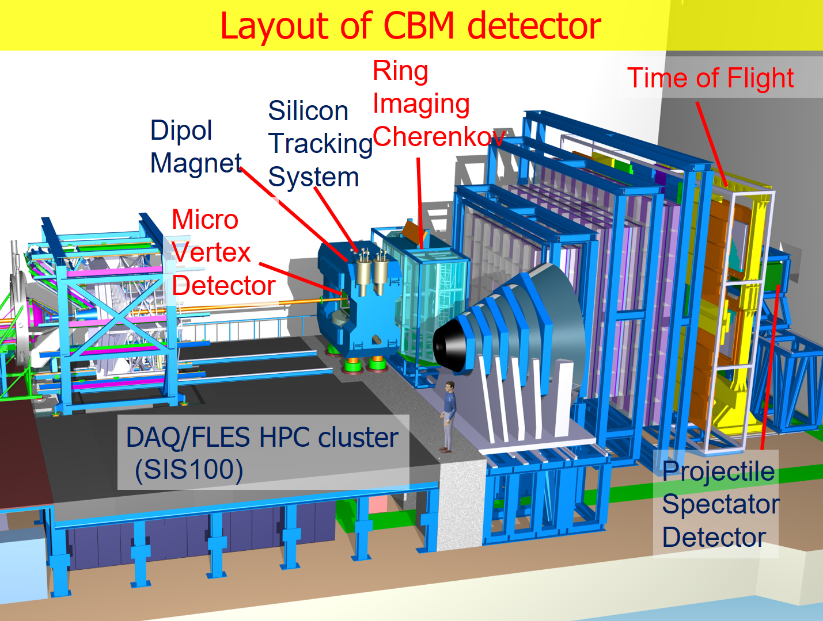
Typical MRPC TOF system
RHIC-STAR TOF
Float glass
JLab-SoLID TOF
High rate and 20ps resolution
FAIR-CBM TOF
High rate- low resistive glass

Slide 6
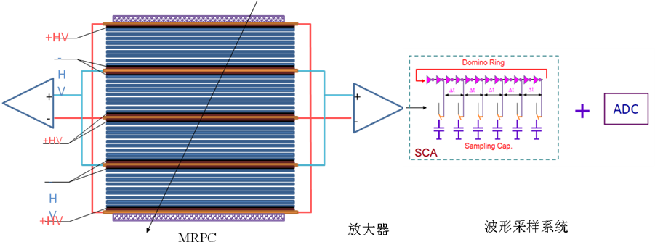
Key technology
1st generation TOF (from 2000):
Requirement: Time resolution: <80ps
Rate : <1kHz/cm²
Technology: common glass MRPC+NINOs +HPTDC
Analysis method: TOT slewing correction
2st generation TOF (from 2008):
Requirement: Time resolution: <80ps
Rate : 30kHz/cm²
Technology: low resistive glass MRPC+PADI +GET4
Analysis method: TOT slewing correction
3st generation TOF (from 2012):
Requirement: Time resolution: <20ps
Rate : 20kHz/cm²
Technology: low resistive glass MRPC+SCA +ADC
Analysis method: TOT slewing correction
Deep learning+ Neural network
MRPC
Differential FEE
TDC
START
T₀
T₁
V_{th}

Slide 7
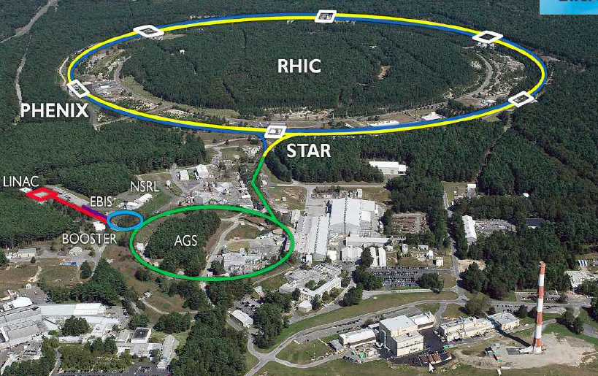
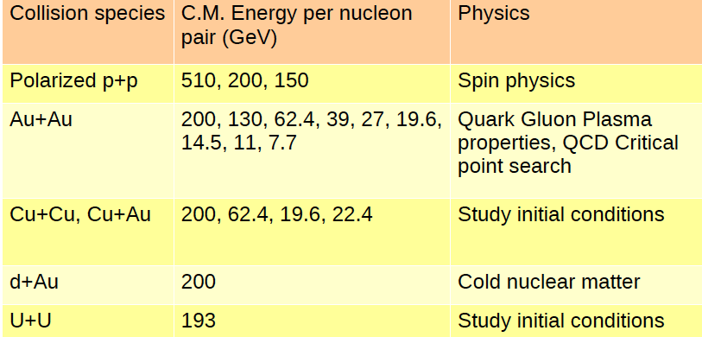
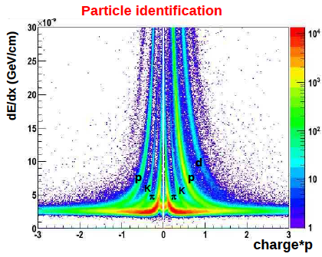
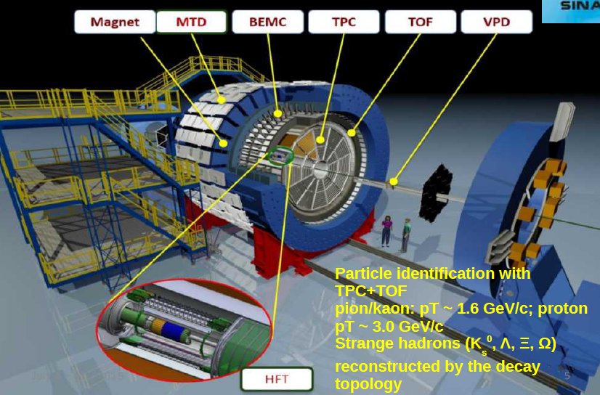
RHIC-STAR

Slide 8
STAR –TOF requirement
System resolution: < 100 ps （Au+Au ）
Occupancy: < 10%
Efficiency: > 90%
Rate: 100 Hz/cm²
Replace CTB

Slide 9
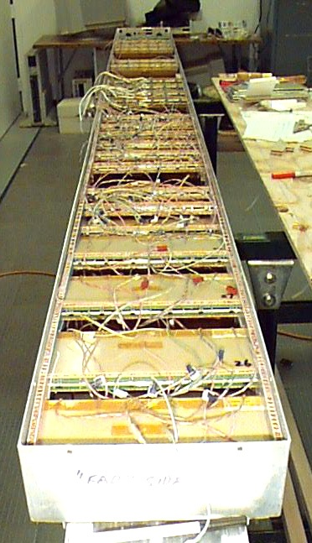
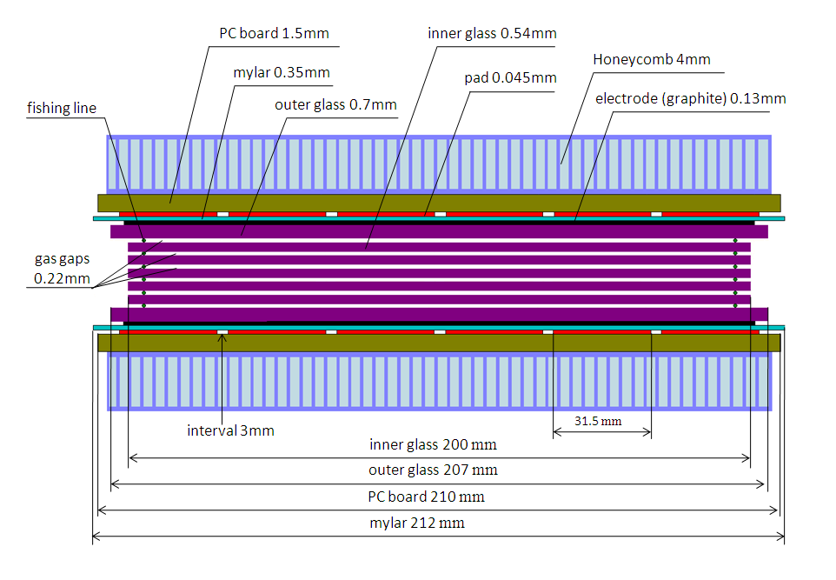
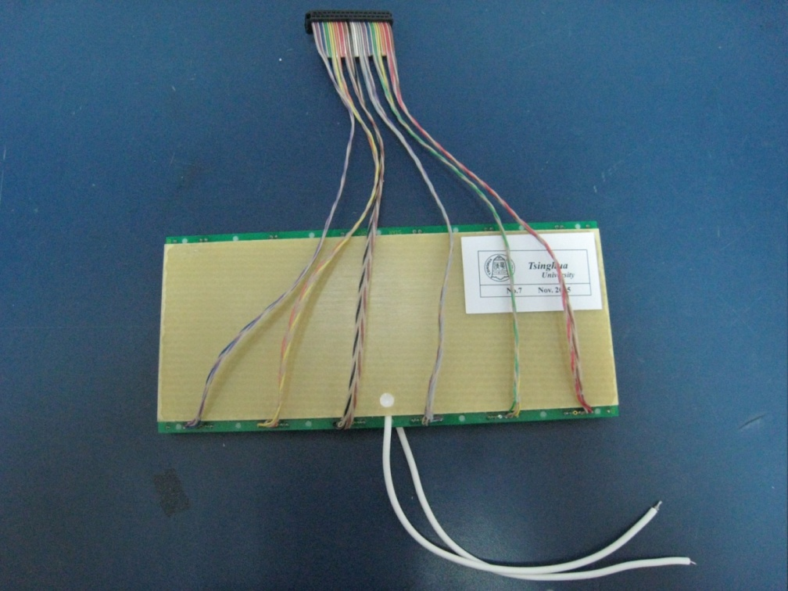
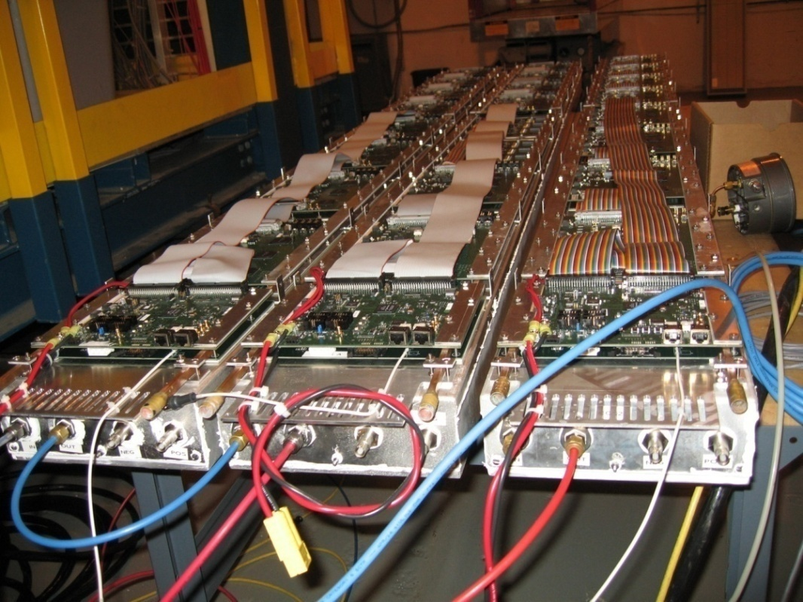
STAR-TOF MRPC
Long side view
9

Slide 10
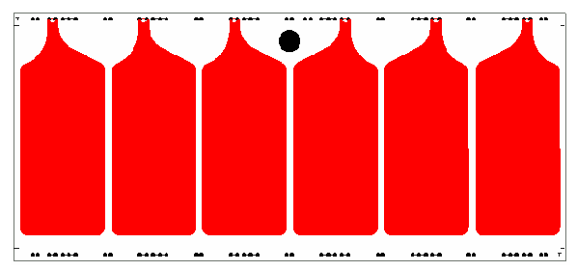
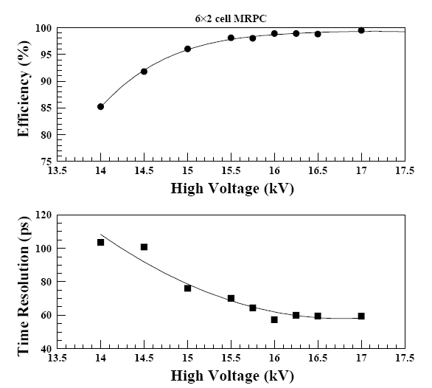
STAR MRPC performance
Readout pad
6cm
3cm
Glass: ～4×10¹²Ω.cm
Carbon tape: 500k Ω/
Gas gap: 6×0.22mm
Working gas: 95% F134a+5% iso-butane
Time resolution: 70ps
Efficiency >90%
Rates capability: <100Hz/cm² !

Slide 11
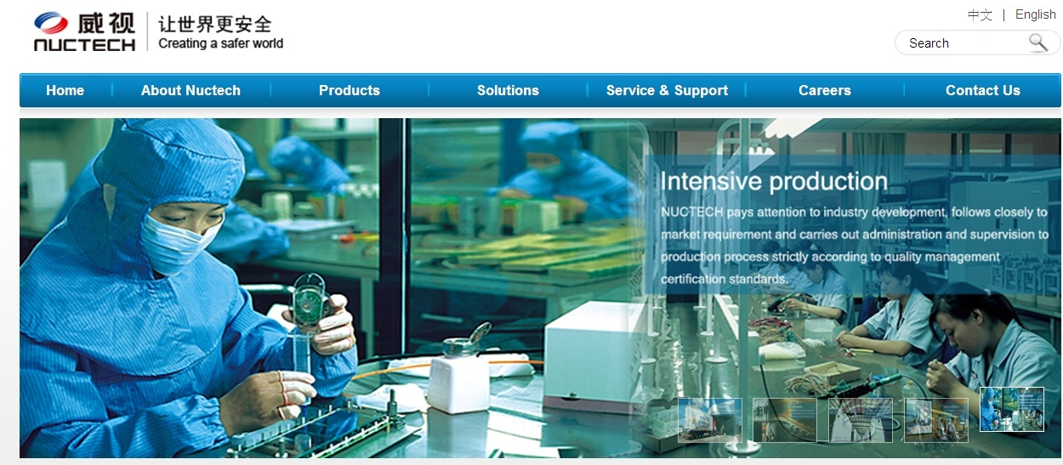
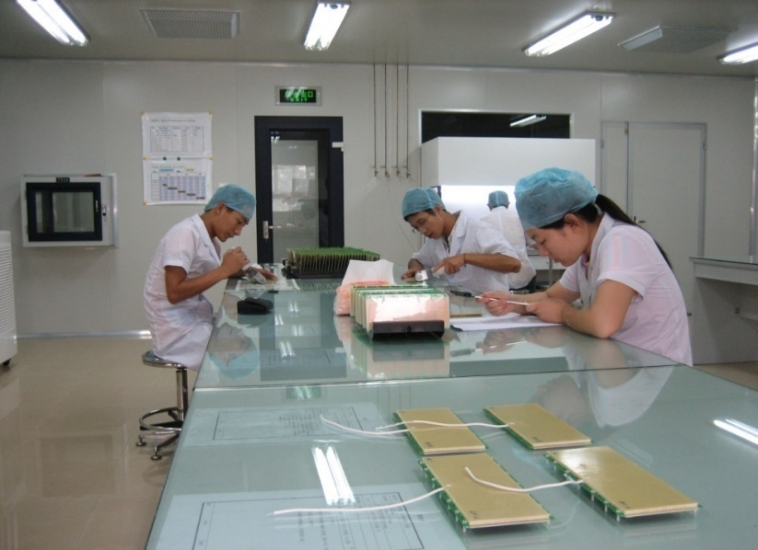
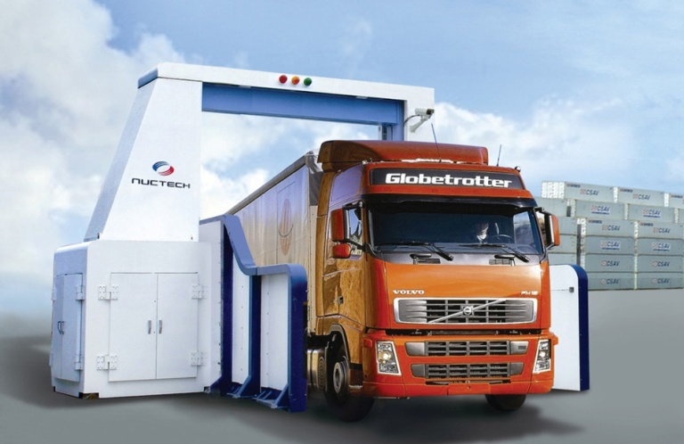
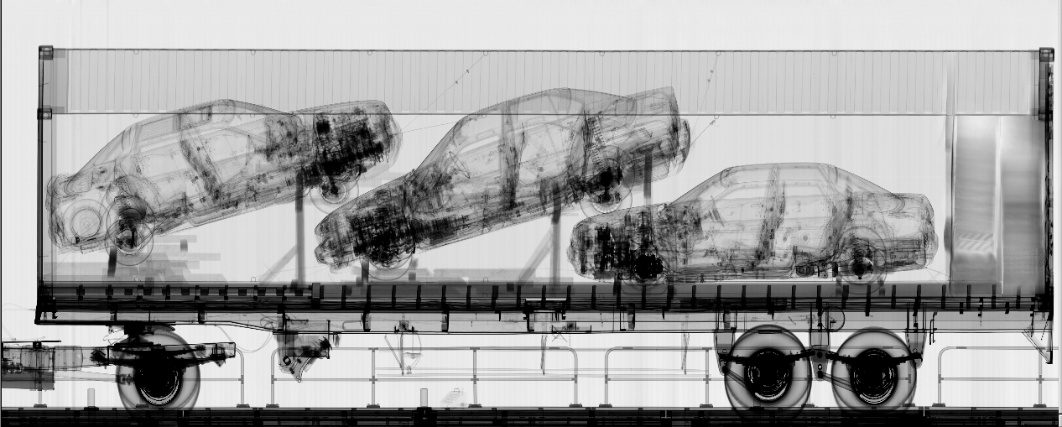
MRPC mass production
11
11

Slide 12
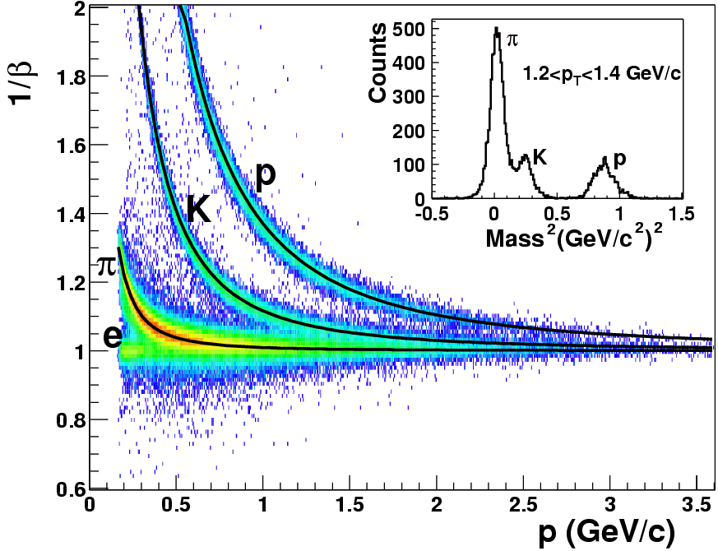
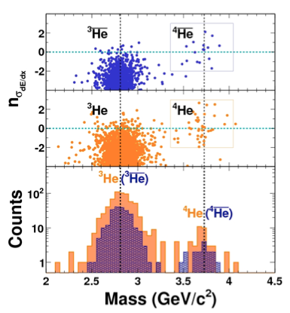
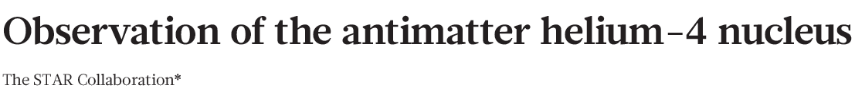
PID of STAR-TOF
TOF
TOF PID:
π /k ~1.6 GeV/c,
(π,k)/p ~ 3.0 GeV/c
Nature 473 (2011) 353

Slide 13

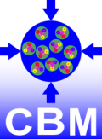
Facility for Antiproton and Ion Research
SIS18
SIS100/300
p-Linac
Atomic, Plasma, Applied Physics
Compressed Baryonic Matter
HESR
Primary Beams
Anti-Proton Physics
Super Fragment-Separator:
Nuclear Structure and Astrophysics
10¹²/s; 1.5 GeV/u; ²³⁸U²⁸⁺
10¹⁰/s ²³⁸U⁷³⁺ up to 35 GeV/u
3x10¹³/s 30 GeV protons
Secondary Beams
CR
range of radioactive beams up to
1.5 - 2 GeV/u; up to factor 10 000 higher in intensity than presently
antiprotons 3 - 30 GeV
FAIR phase 1
FAIR phase 2
100 m

Slide 14
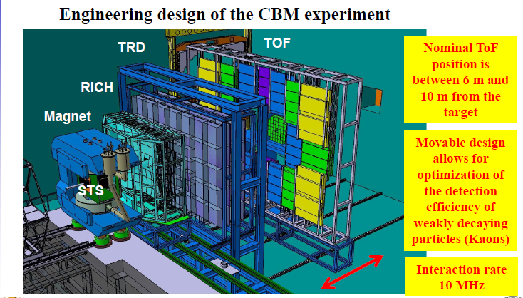
Layout of CBM detector

Slide 15
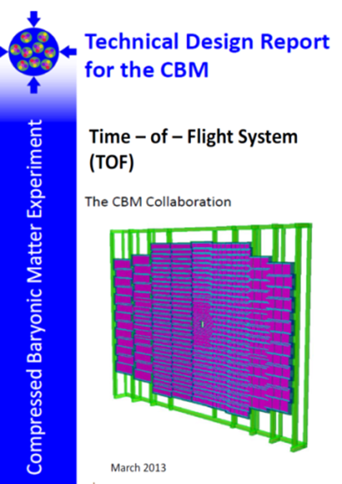
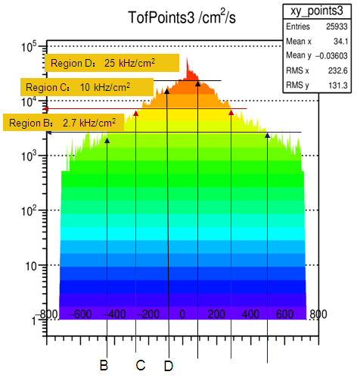
The structure of CBM-TOF wall
CBM-ToF Requirements
Full system time resolution σ_{T} ~ 80 ps
Efficiency > 95 %
Rate capability ≤ 30 kHz/cm²
Polar angular range 2.5°– 25°
Occupancy < 5 %
Low power electronics
(~100.000 channels)
Free streaming data acquisition
Au+Au, Center, 10AGeV
Simulated with CBM ROOT
15
15

Slide 16
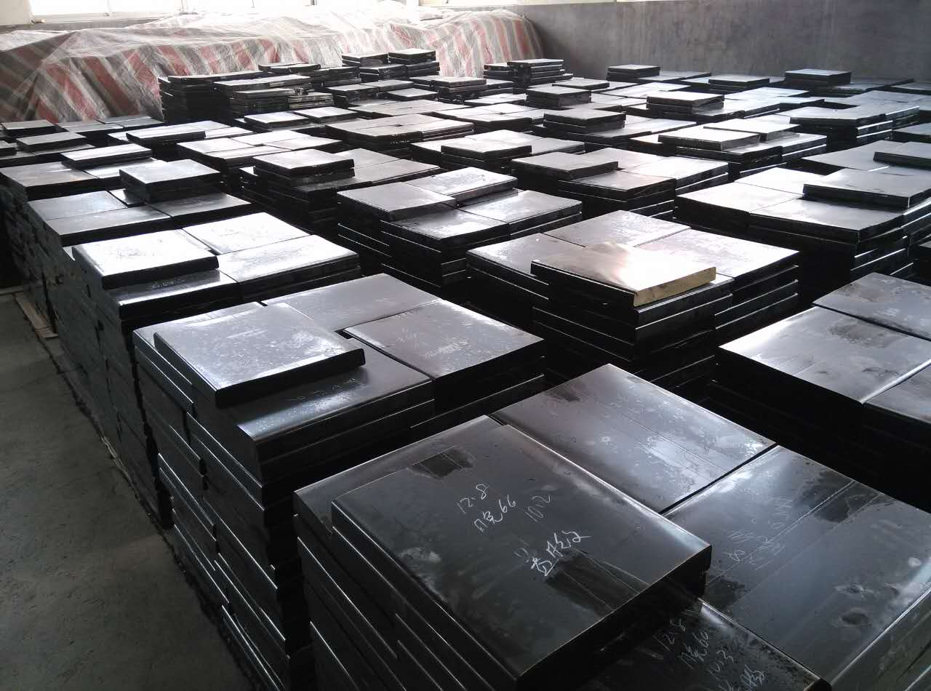
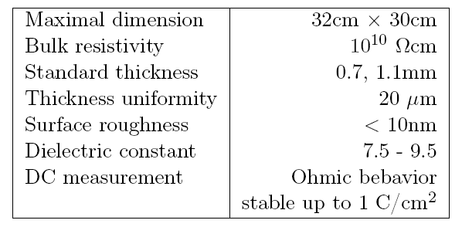
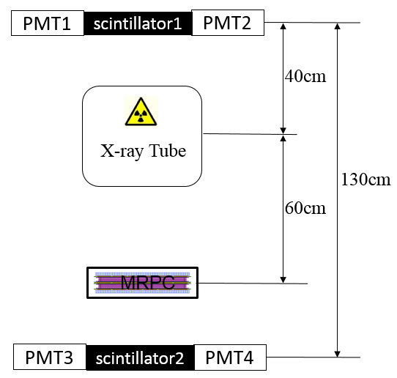
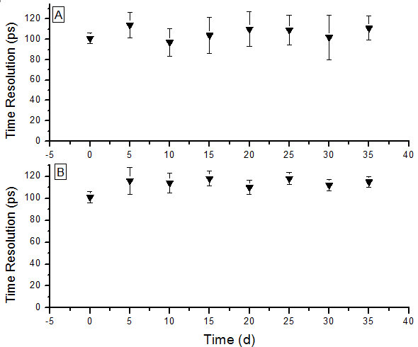
Development of low resistive glass
Performance of the glass
Glass mass production
Yield >100m²/month
Online test system. The efficiency and time resolution can be obtained by cosmic ray while irradiated by X-rays. 0.1C/cm² charge is accumulated in 35 days.
Aging test with X-ray source
16

Slide 17
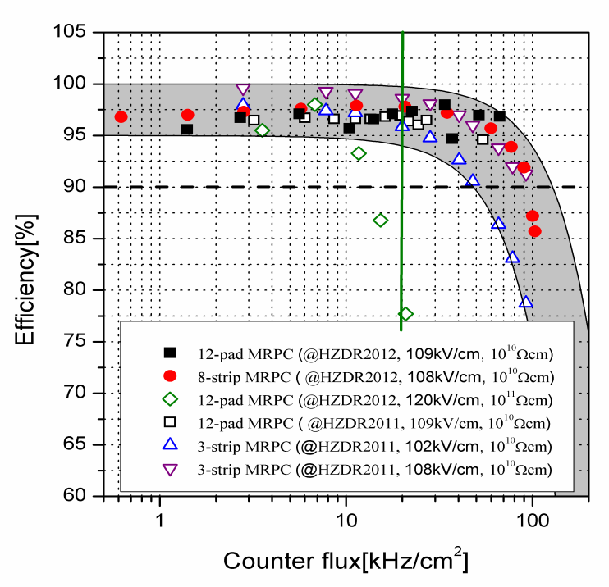
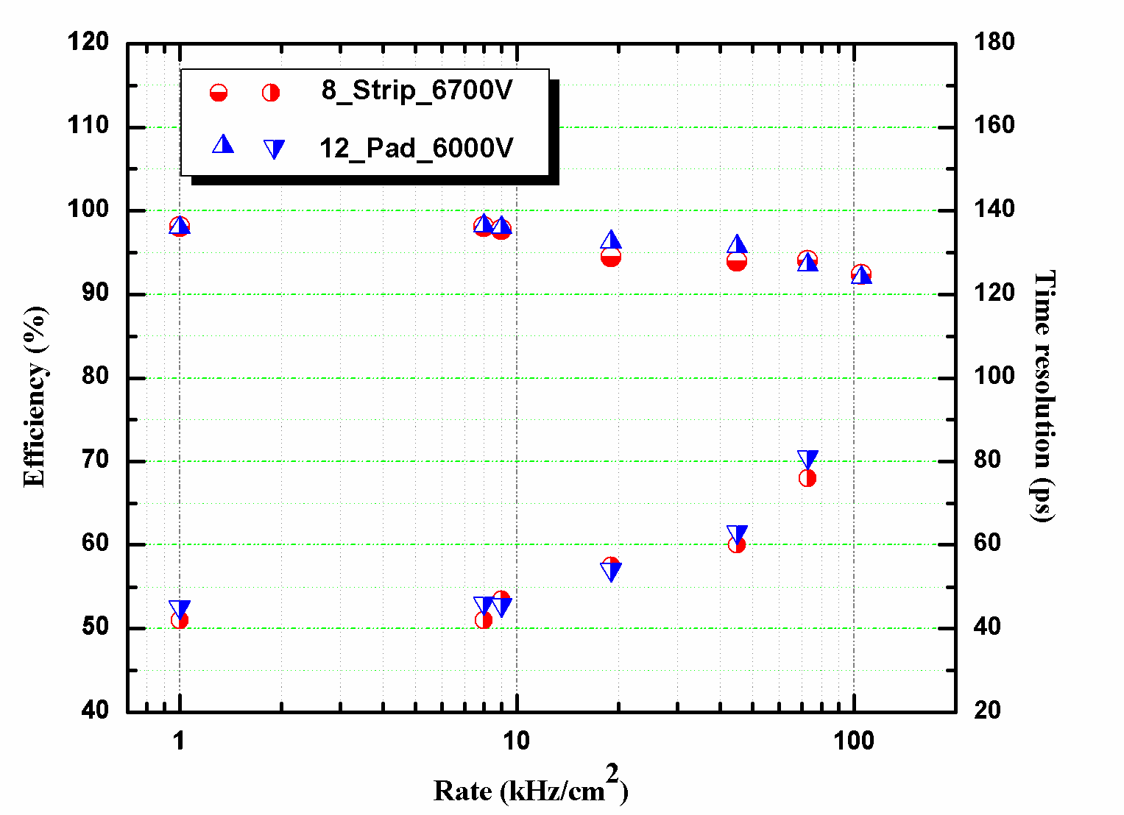
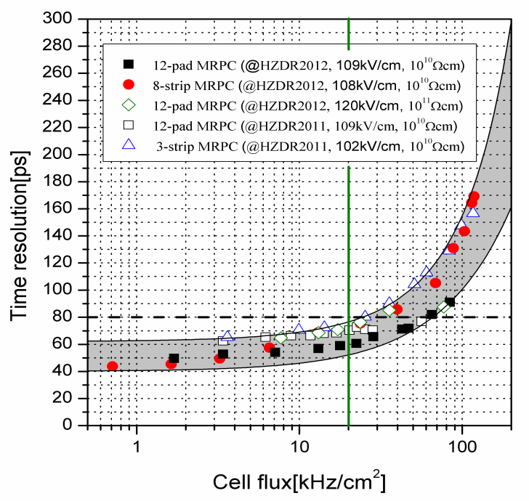
Rate capability of high rate MRPC
Test results at Nuclotron, Dubna，2013
Rate: 70kHz/cm²
Time resolution: 40 ps
Even though the rate is 70kHz/cm², the efficiency is still higher than 90% and the time resolution is about 80ps.

Slide 18
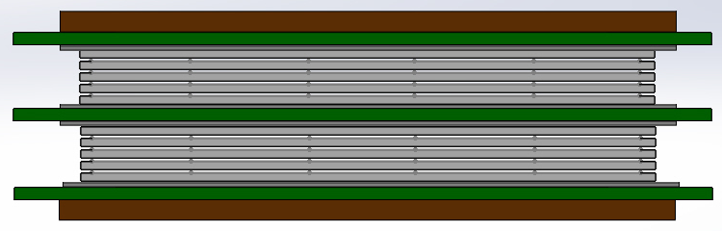
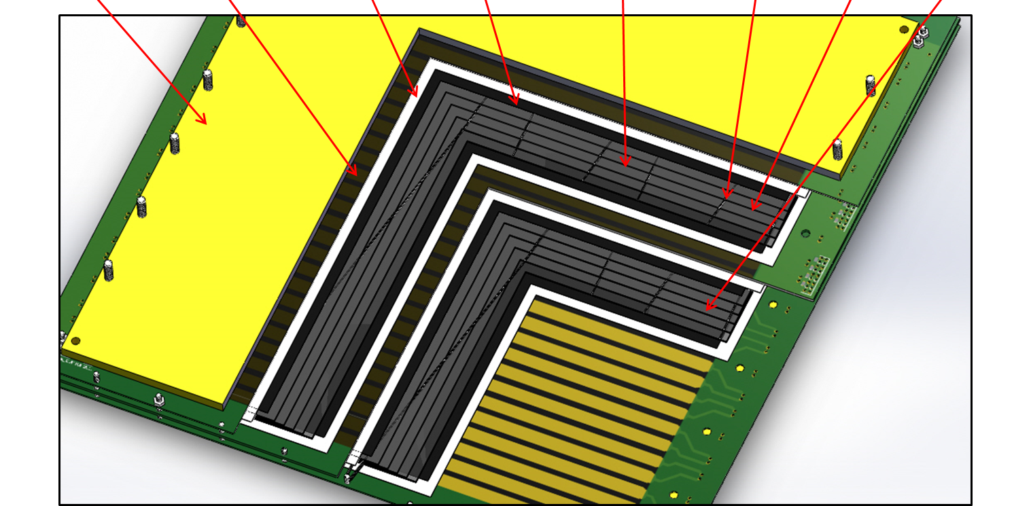
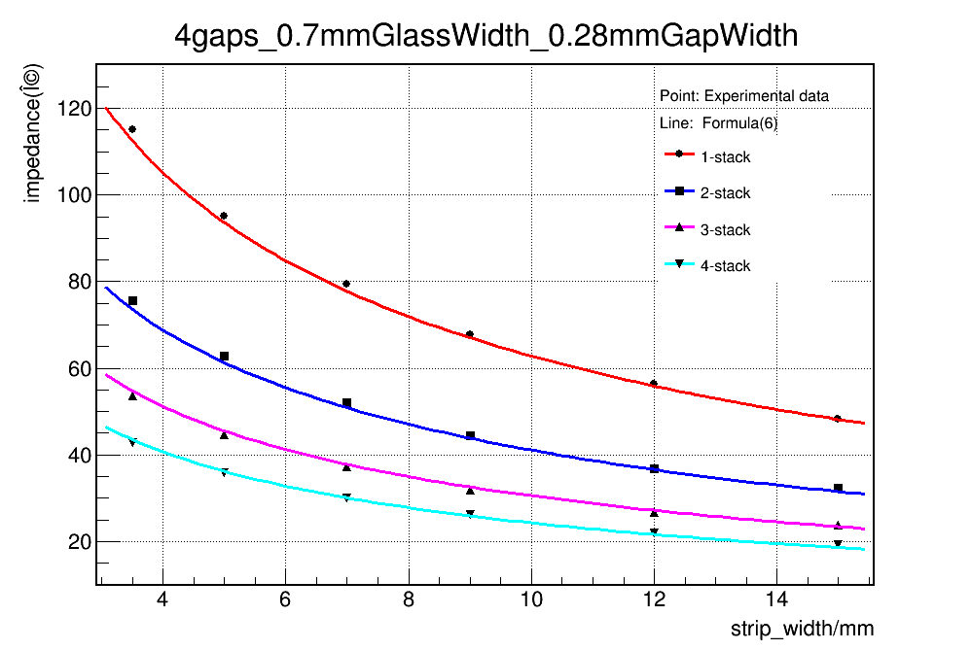
Design of strip-MRPC for high rate region
Glass: low resistive glass
0.7mm thick, 33cm x 27.6cm
Strip: 27cm x 0.7cm, 0.3cm interval, 32 strips
Gas gap: 8 x 0.25mm, two stacks
Honey
PCB
Mylar
Graphite
Glass
Fish line
Upper stack
lower stack
$$Z_{0}=\frac{\frac{\left.a(1\right)}{\sqrt{\left.ε+a(2\right)}}×\log{\frac{a\left(3\right)×n×w2+a(4)×\left(n+1\right)×w1}{\left.w−a(5\right)} }+a\left(6\right)×\sqrt{\frac{w}{n×w2+\left(n+1\right)×w1}}+a(7)×\log{\frac{w1}{w2}}}{\left.ns+a(8\right)}$$

Slide 19
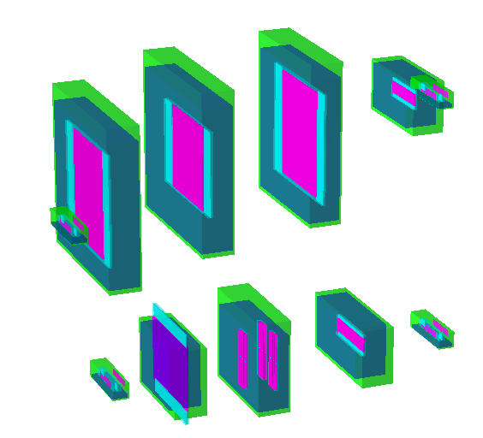
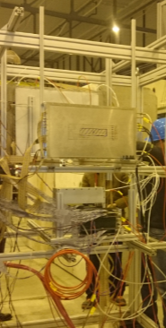
Beam test @ SPS Feb 2015
Experimental Setup:
USTC
THU-Strip
HD-Ref
HD-P2
Up setting
PMT
Down setting
High rate test in February 2015 at SPS CERN
13 GeV Ar beam
Flux rate around 1kHz/cm²
Buc-Ref
Buc-2013
THU-Pad
19

Slide 20
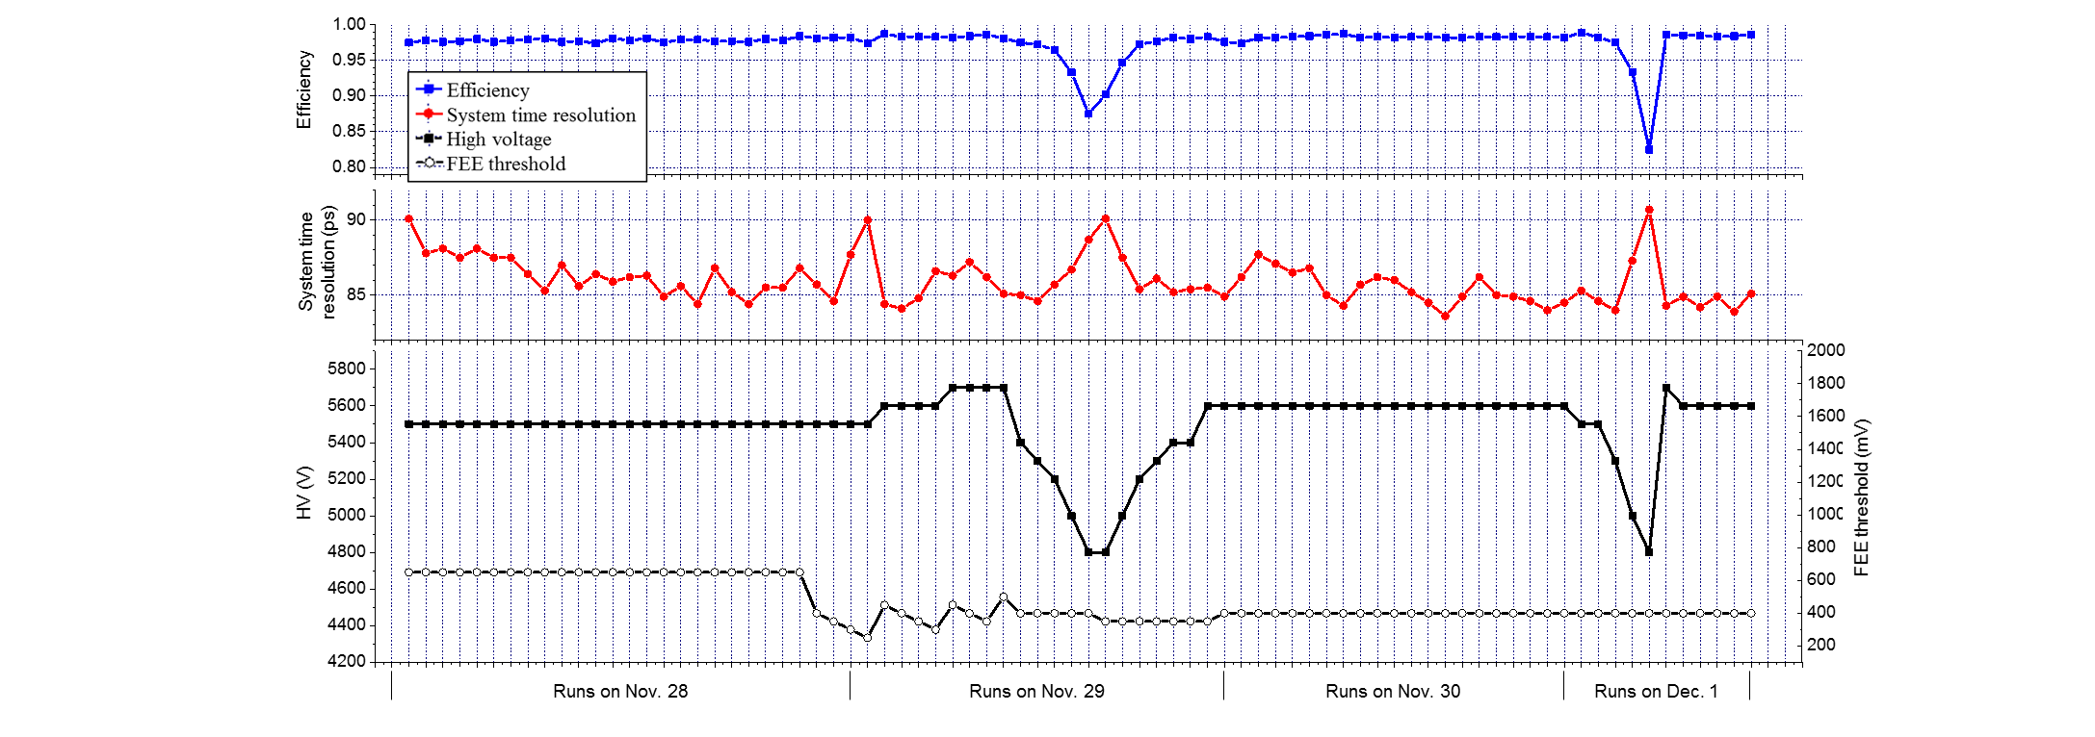
Performance of the prototype
SPS Nov 2015 THU-DU results
Results of each run
Time resolution from tracking method

Slide 21
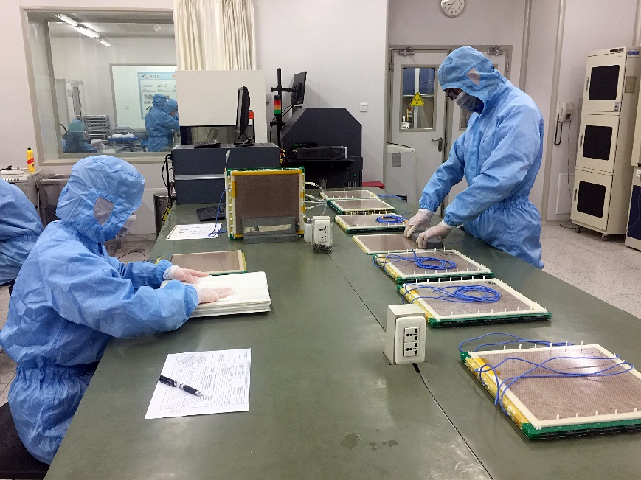

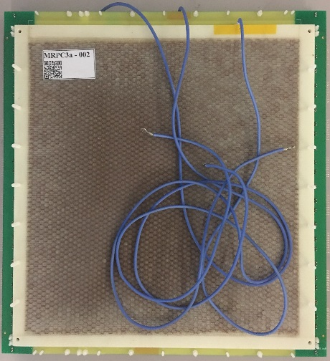
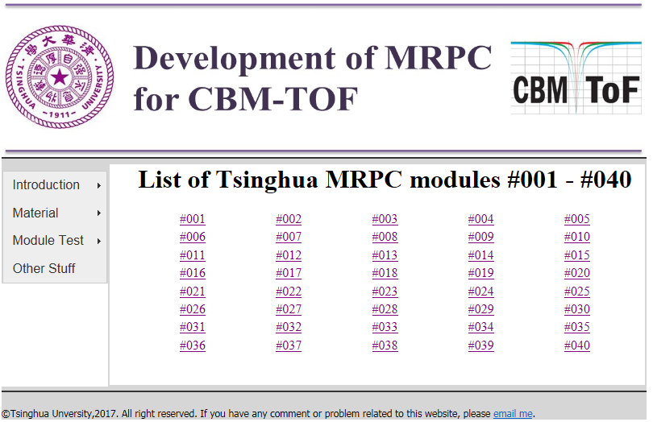
Mass production of high rate MRPC
Two-dimensional code of MRPC
Producttion website:
http://hepd.ep.tsinghua.edu.cn/CBM_TOF/
21

Slide 22
CBM Phase0: eTOF @STAR

Slide 23
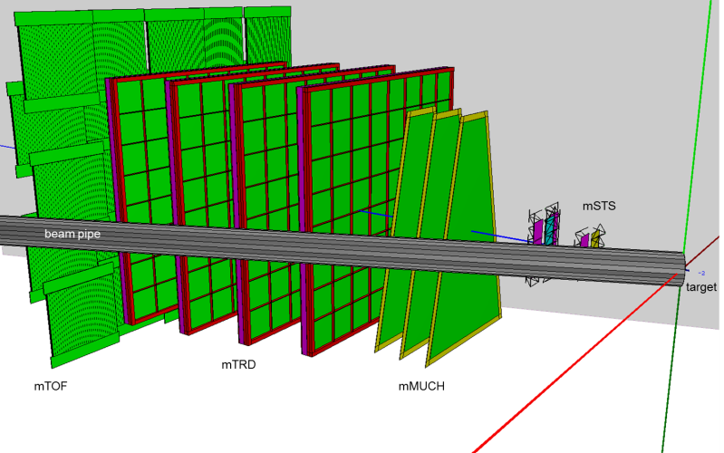
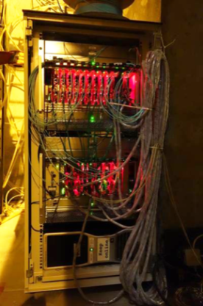
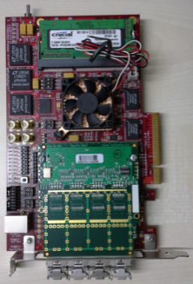
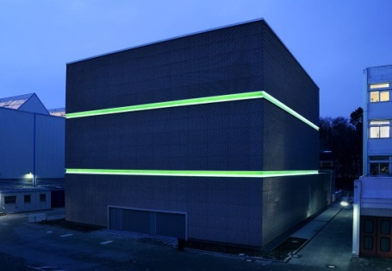
mCBM@SIS18
Schedule
10/2017 | HTD cave & beam line: preparation of construction, start of procurement
11/2017 | HTD cave & beam line: start of construction
11/2017 | mDAQ test stand @ Heidelberg operational
11/2017 | installation of detector subsystems: mechanical design freeze
03/2018 | HTD cave construction completed
04/2018 | mFLES cluster @ Green IT Cube installed
05/2018 | installation of detector stations
06/2018 | start commissioning w/o beam
09/2018 | start commissioning with beam
green IT cube

Slide 24
Production of modules for eTOF and mCBM

Slide 25
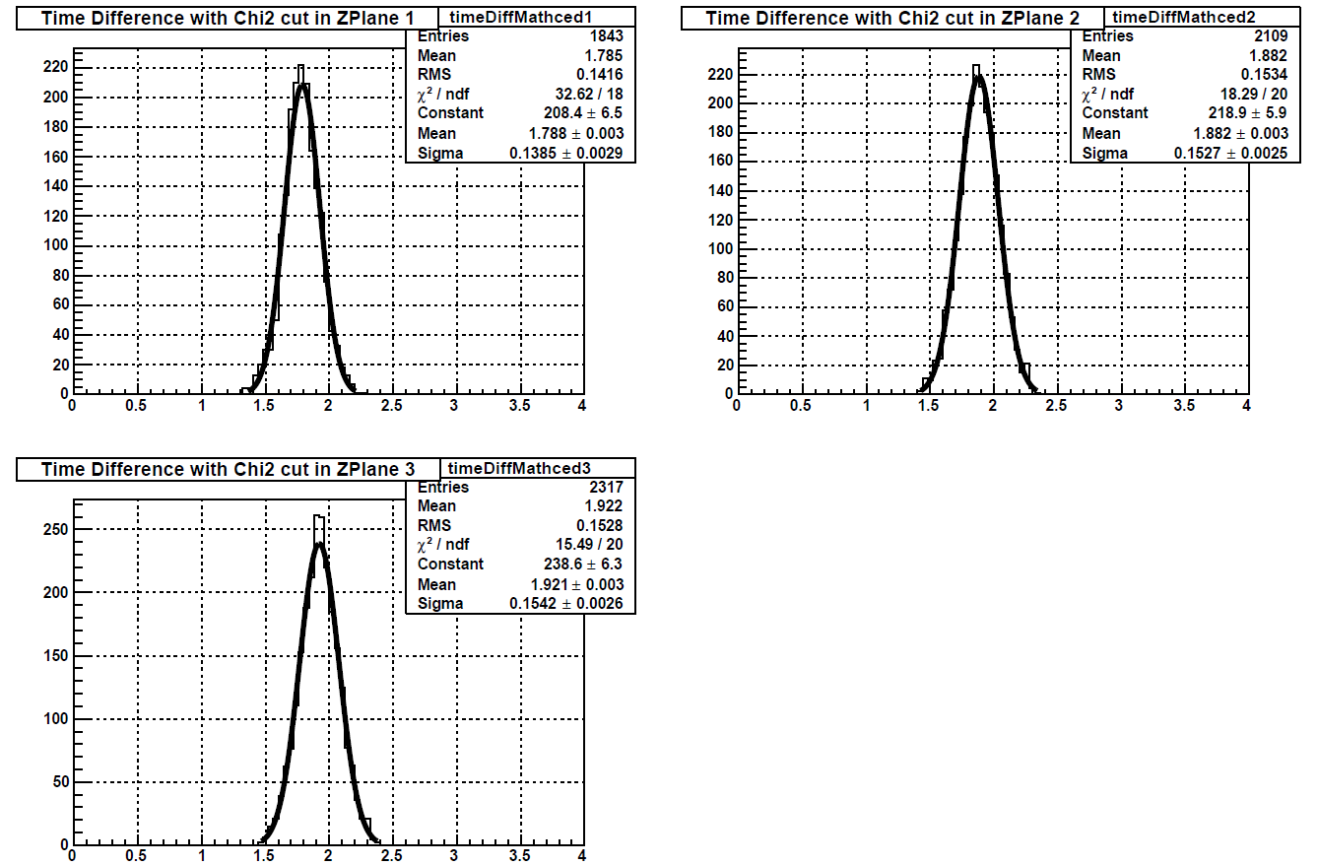
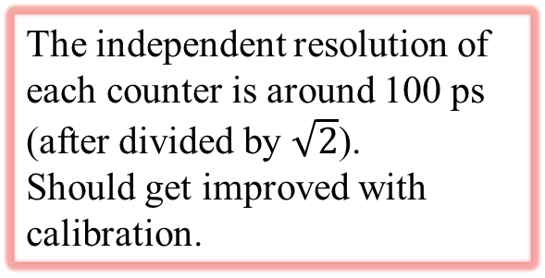
Time resolution
StETofAnalysisMaker – Time Resolution
The independent resolution of each counter is around 100 ps (after divided by $\sqrt{2}$).
Should get improved with calibration.

Slide 26

PID of STAR-eTOF
StETofMatchMaker – PID Information
protons
kaons
kaons
$$m_{π}:139 MeV$$
$$m_{k}:493 MeV$$
$$m_{p}:938 MeV$$
pions
pions

Slide 27
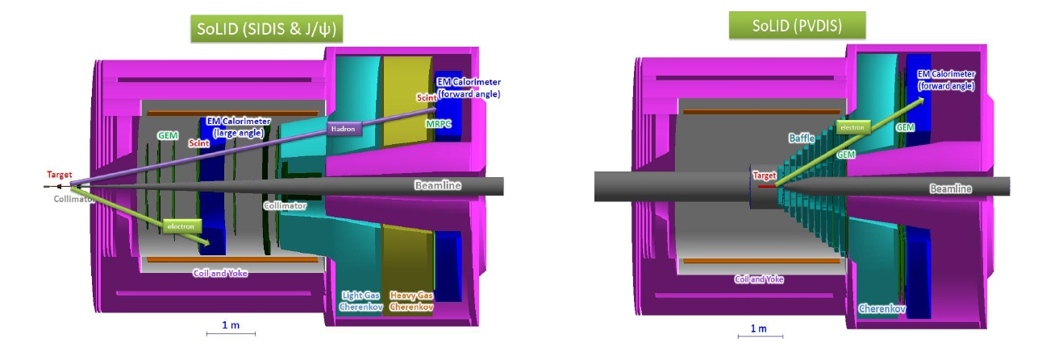
Overview of SoLID
Solenoidal Large Intensity Device
Full exploitation of JLab 12 GeV Upgrade
→ A Large Acceptance Detector AND Can Handle High Luminosity (10³⁷-10³⁹)
Take advantage of latest development in detectors , data acquisitions and simulations
Reach ultimate precision for SIDIS (TMDs), PVDIS in high-x region and threshold J/ψ
5 highly rated experiments approved (+3)
Three SIDIS experiments, one PVDIS, one J/ψ production (+ three run group experiments)
Strong collaboration (250+ collaborators from 70+ institutes, 13 countries)
Significant international contributions (Chinese collaboration)
27

Slide 28
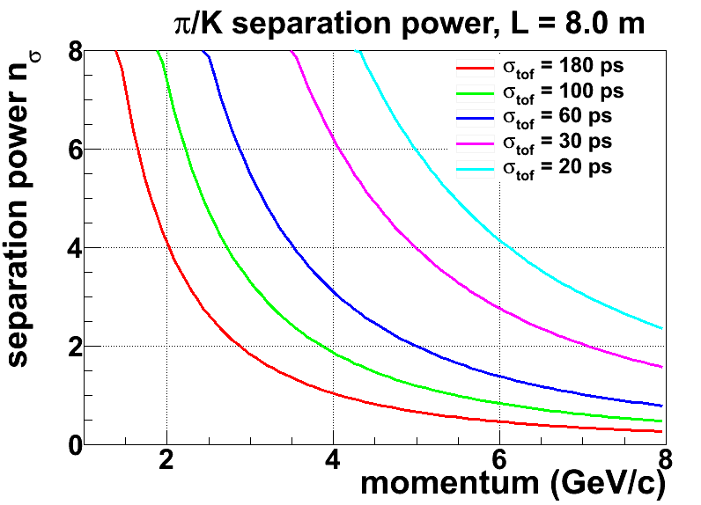

SoLID-TOF structure
The MRPC is developed for the TOF of SoLID
Main Requirements for TOF:
  π/k separation up to 7GeV/c
  Time resolution < 20ps
  Rate capability > 20kHz/cm²
MRPC3
28cm
MRPC2
16cmm
100cm
MRPC1
SoLID-TOF super module
SoLID-TOF structure

Slide 29
Technical route
Challenge for both MRPC and electronics.
Electronics: Fast amplifier + pulse sampling
New analysis method: take the advantage of the entire waveform

Slide 30

Neural network was used to reconstruct timing
The analysis method is based on the neural network.
Artificial neural network(NN): powerful && widely used in high energy physics
Introduce NN to obtain good time resolution:
—— Find out the patterns from the MRPC signal and estimate the particle 1st interaction time more precisely.
Learn from the simulation waveforms
Test with simulation data
1
First interaction time
Test with experiment data
2

Slide 31



Waveform simulation
MRPC structure
Avalanche through drifting
Induced current:
Front-end electronics + noise
Design the structure
6-gas MRPC
Gap/glass thickness: 0.25/0.7 mm
Gas: 90% C2H2F4, 5% C4H10 and 5% SF6
Shoot a particle
Primary interactions
Drifting & Avalanche
Cosmic muons: ~ 4GeV
Original current signal
: Townsend coefficient
: Attachment coefficient
Electronics
*F. Wang, et al., A standalone simulation framework of the mrpc detector read out in waveforms, arXiv:1805.02387.

Slide 32


Simulation data
Simulation dataset :
: first interaction happens
: the signal reach the peak
7 uniformly distributed points along the
leading edge
MRPC
Source
Signal
Fixed threshold
t

Slide 33



One NN：Multilayer perception (MLP)
Multilayer perceptron (MLP)
Output
Input
Activation function: g and h —— tanh
Weights:
“Dropout”: avoid overfitting
The length of the leading edge t l
Time of the very first interaction:
Train/validate/test set: 20/10/10 k
Tensorflow & GPU: GTX 1080 Ti
~ 10 mins for training
Several uniformly distributed points along the leading edge

Slide 34

Another NN：LSTM
Recurrent neural networks(RNN): Long Short Term Memory network(LSTM)
Train/validate/test set: 20/10/10 k
Tensorflow & GPU: GTX 1080 Ti
The length of the leading edge t l
Several uniformly distributed points along the leading edge
f : forget gate: Whether to erase
I : Input gate, whether to write
g: gate gate, How much to write
o: output gate, How much to reveal
F
I
G
O
> 30 mins for training

Slide 35


Simulation results
Define bias:
Accuracy is good and stable
The best time resolution can reach around 20 ps.
Accuracy
Precision
Experiment point
Streamer may happen
35

Slide 36



Experimental setup
Experiment of the cosmic ray
2 identical MRPC: 6-gap, 0.25mm gap, working at E=109 kV/cm
Oscilloscope bandwidth: 1 GHz
Sampling rate: 10 GS/s
PMT1
FEE
MRPC1
FEE
FEE
MRPC2
FEE
PMT2
Oscilloscope
trigger
Leading edge: 700~800 ps
7~8 points along the edge

Slide 37


Signal waveform
Compare the waveform
1L
1R
2L
2R
Waveforms of 1 event
Nearly the same!
Still with differences!

Slide 38




Experimental results
The 4 waveforms are estimated by the LSTM models separately
Define:
for vertical particles
The time resolution of two MRPCs
are independent:
With LSTM model, for vertical
particles, the time resolution is:

Slide 39

Design of 3^{g} MRPC for SoLID
Item | dimension/mm
Honeycomb | 90×265×7.5
Outer PCB | 120×298×0.6
Middle PCB1 | 120×298×1.2
Middle PCB2 | 120×328×1.2
Strip length | 268
Strip width | 7
Mylar | 90×268×0.25
Glass | 80×258×0.5
Carbon | 72×250
Gas gap width | 0.104
Number of gas gap | 32
Honey comb plate
PCB
Mylar
Carbon electrode
Glass
39

Slide 40
Analysis with neural network

Slide 41
Conclusions
MTRC-TOF played an important role in modern high energy nuclear physics experiments.
High rate and high resolution TOF is being developed.
New technology should be studied:
New material (low resistive glass)
New electronics (switched capacitor array (SCA)
and high precision TDC)
New analysis method (deep learning technology)

Slide 42





Slide 43
Thanks for your attention!

