Slide 1
Nuclear modification of full jets and jet structure in PbPb collisions at 2.76 TeV and 5.02 TeV
The 7th Asian Triangle Heavy-Ion Conference (ATHIC 2018)
Ning-Bo Chang
Xinyang Normal University &
Central China Normal University
In collaboration with Guang-You Qin and Yasuki Tachibana
Based on PRC.94.024902, PRC.95.044909 and paper in preparation.

Slide 2
Outline
Motivation and Framework
Jet energy loss
Jet shape modification
Medium response
Summary and Outlook

Slide 3

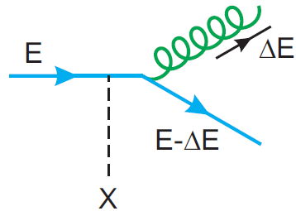
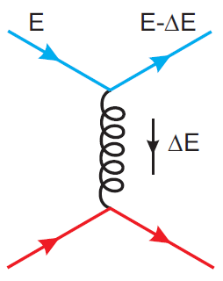
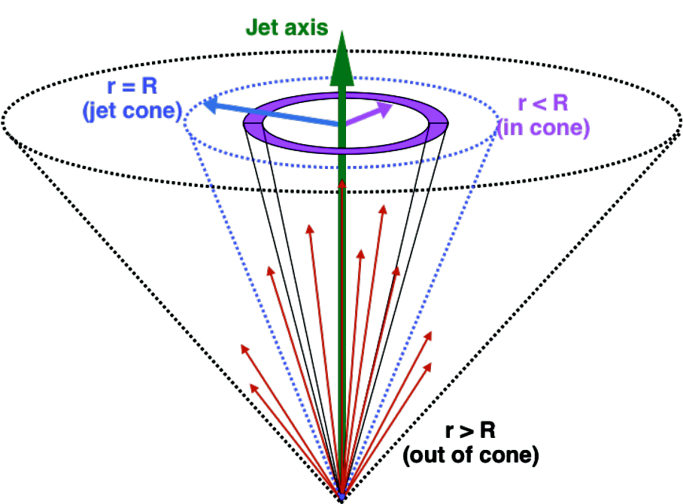
Full jet evolution in medium
Inelastic scattering
Radiative energy loss for full jet may be not so important as it for leading parton.
Collisional energy loss may be more important for full jets than single hadrons.
Jet structure and its modification provides more observables, can reveal more detailed information.
Elastic scattering

Slide 4
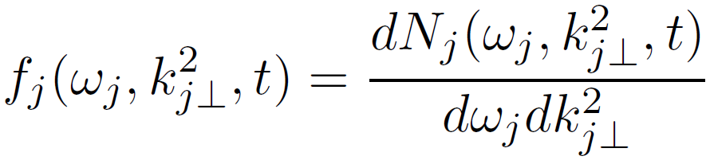
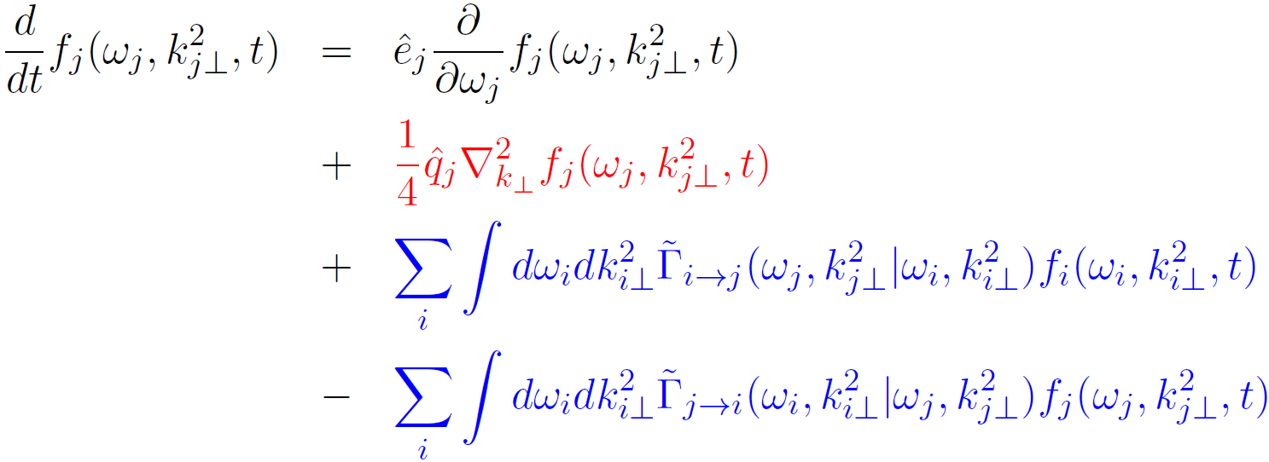



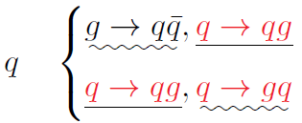
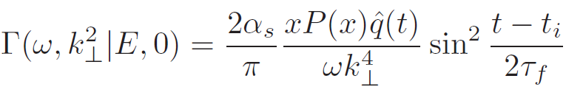
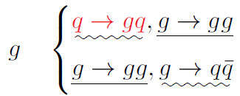
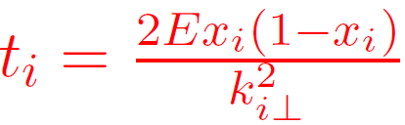
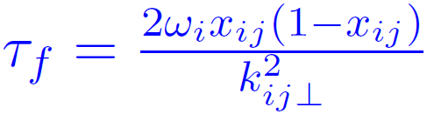
Framework: Boltzmann transport equation
Collisional energy loss
K_{T} broadening
gain
Radiation
loss

Slide 5

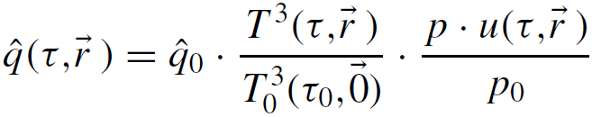
Framework: input from Pythia and Hydro.
Parameters in Pythia differ from 2.76A TeV to 5.02A TeV.
At same jet energy, jets at 2.76A TeV are steeper.
Hydrodynamic simulation from VISH2+1 or Yasuki Tachibana

Slide 6
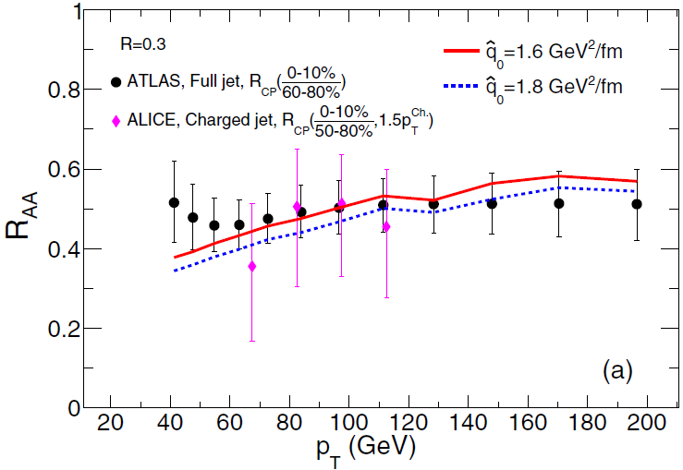
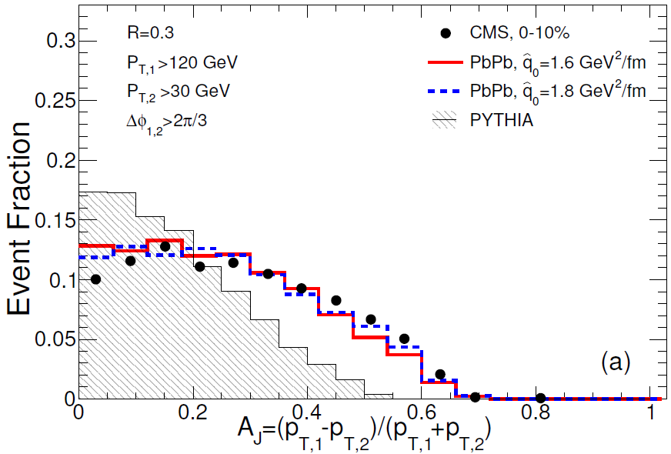
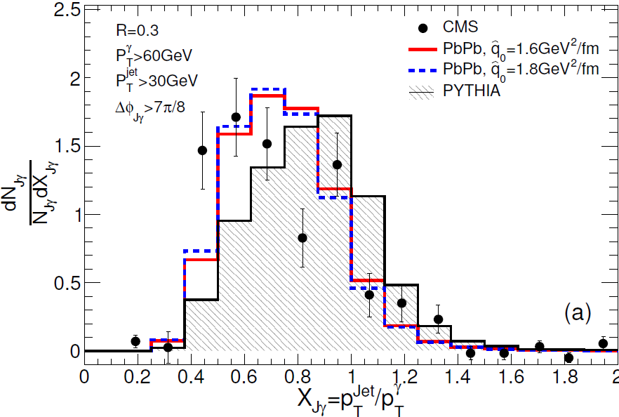
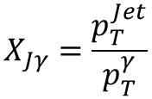

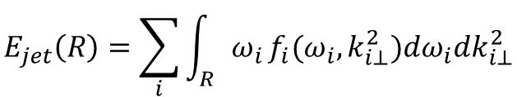
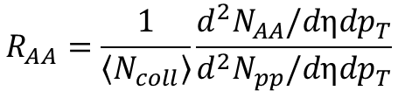
Jet R_{AA} and dijet/ γ-jets asymmetry @ 2.76A TeV
$$E_{jet}\left(R\right)=\sum_{i}{\int_{R}{ω_{i}}}f_{i}(ω_{i},k_{i⊥}^{2}){dω}_{i}dk_{i⊥}^{2}$$
$$R_{AA}=\frac{1}{\left\langle N_{coll}\right\rangle }\frac{d^{2}N_{AA}/dηdp_{T}}{d^{2}N_{pp}/dηdp_{T}}$$
$A_{J}=\frac{p_{T,1}−p_{T,2}}{p_{T,1}+p_{T,2}}$
$$X_{Jγ}=\frac{p_{T}^{Jet}}{p_{T}^{γ}}$$

Slide 7
Jets energy loss observables @ 5.02A TeV
ALICE-PREL-147158
ATLAS-CONF-2017-009
ATLAS-CONF-2018-007
CMS, Phys.Lett.b785,14

Slide 8
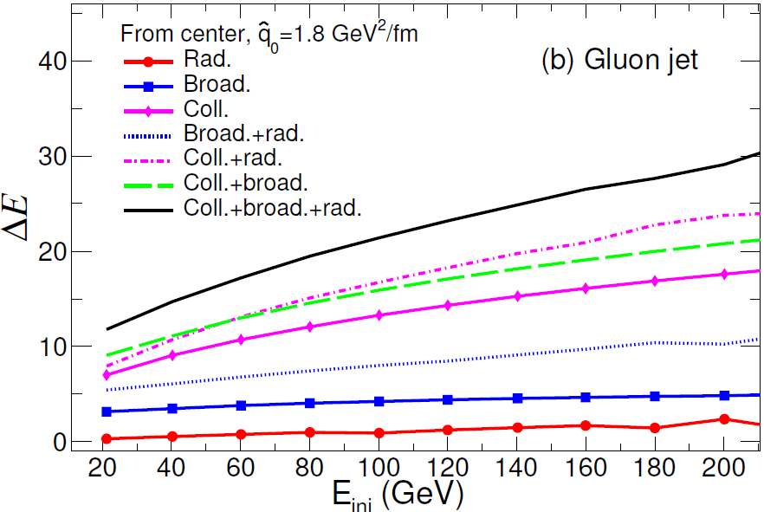
Jet Energy Loss from different mechanisms
@ 2.76A TeV
Collisional energy loss contributes the most,
medium induced radiation contributes least,
but can enhance other mechanism.

Slide 9
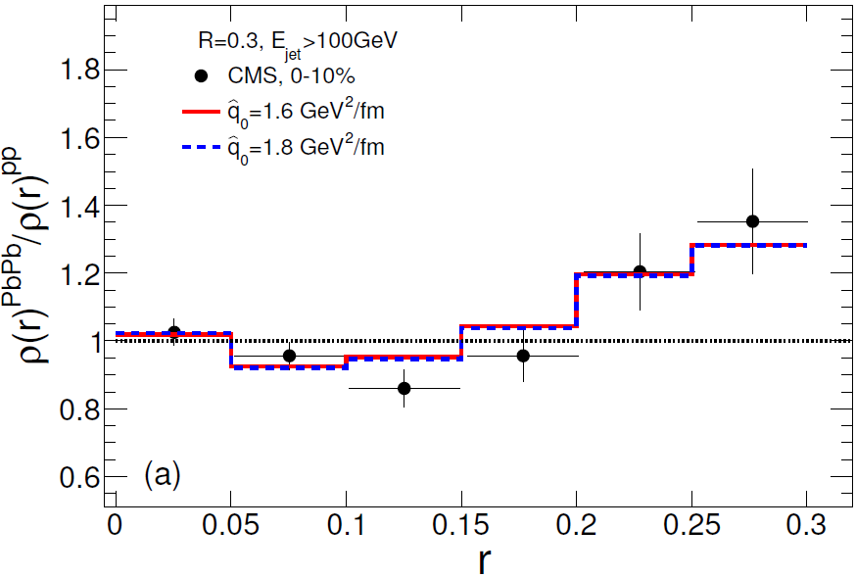
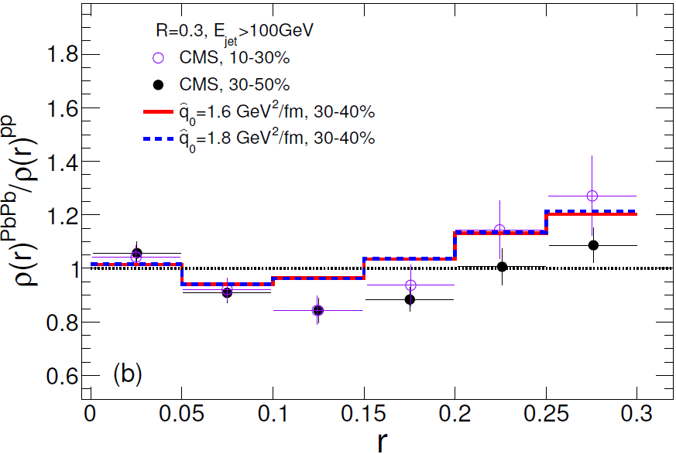
Nuclear modification of Jet shape @ 2.76A TeV
CMS, Phys.Let.B730(2014),243
Jet shape is modified little at small r, suppressed at middle r and enhanced at large r.

Slide 10
Jet shape modification in γ-jets and inclusive jets @ 5.02A TeV
CMS, PAS HIN-18-006
CMS, JHEP.1805(2018),006
Describe the jet shape modification
for γ-jets and inclusive jets, in two p_{T} ranges .

Slide 11



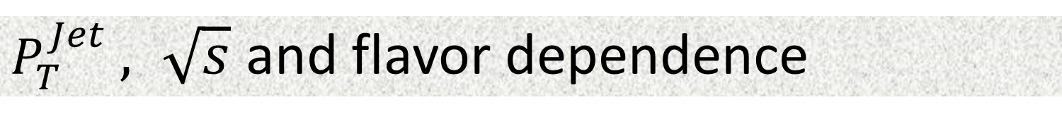

$P_{T}^{Jet}$ $, \sqrt{s}$ and flavor dependence
$$\sqrt{s}=2.76 TeV$$
$$\text{γ}\text{−}\text{jets}$$
$$\text{inclusive} \text{jets}$$
$$\sqrt{s}=5.02 TeV$$

Slide 12
$P_{T}^{Jet}$ $, \sqrt{s}$ and flavor dependence
$$\sqrt{s}=2.76 TeV$$
Modification of $ρ(r)$ is sensitive to $P_{T}^{Jet}$ and $\sqrt{s}$, less to flavor.
$$\text{γ}\text{−}\text{jets}$$
$$\text{inclusive} \text{jets}$$
$$\sqrt{s}=5.02 TeV$$

Slide 13
Effects of different mechanisms on Jet shape
@ 2.76A TeV
Rad. and Broad. transport energy from center to periphery,
Coll. leads inner core losing less fraction of energy than outer part.
For lower energy jet, its inner core is changed more.

Slide 14

Medium response
Yasuki Tachibana, Ning-Bo Chang and Guang-You Qin, PRC.95.044909
$$∆e=e|_{w/jet}−e|_{w/ojet}$$

Slide 15
Effect of medium response
Lost energy is transported to medium at large r,
Medium response dominates jet shape at large r.

Slide 16
Effect of medium response
Rise R_{AA} value, important to cone size dependence of jet R_{AA} .

Slide 17
Effect of medium response
Medium response rise the jet shape function at large r.

Slide 18
Effect of medium response
Modification of $ρ(r)$ is still sensitive to $P_{T}^{Jet}$ and $\sqrt{s}$ .

Slide 19
Summary
Coupled differential transport equations are constructed to study the evolution of the partonic jet shower in the QGP medium, can describe the nuclear modification of the full jet energy and jet structure at both 2.76A TeV and 5.02A TeV.
Collisional energy loss contributes most to full jet energy loss, and must be combined with other mechanisms to explain the modification of jet shape function.
Modification of jet shape is sensitive to jet energy and collision energy, and not much to jet flavor. Need more measurements.
Medium response feeds back some energy, and is important to jet shape at large r and cone size dependence of jet R_{AA.}
Outlook：R_{AA} at very high p_{T}, Energy dependent transport coefficients, hadronization, jet FF…

Slide 20
Thanks for your attention!

Slide 21
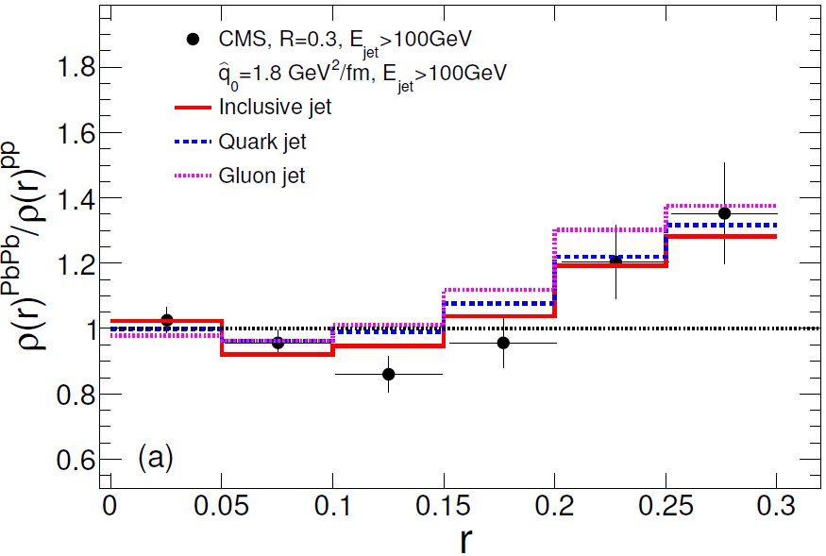
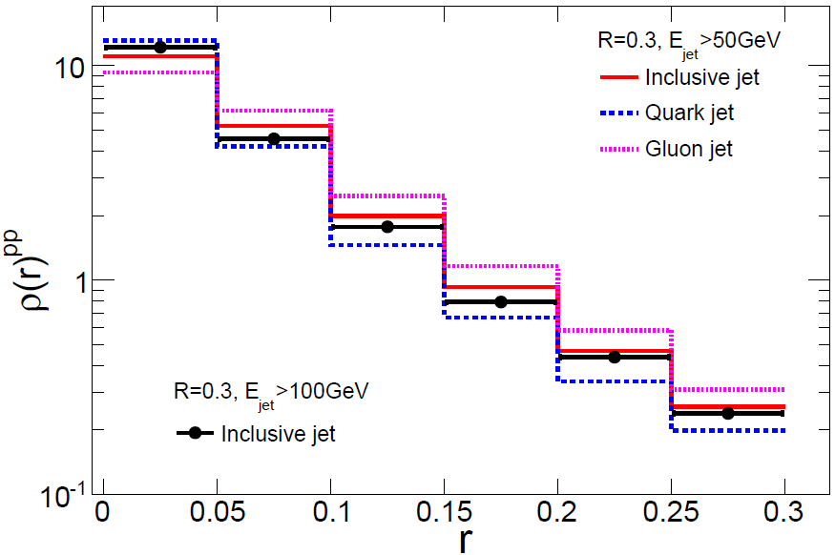
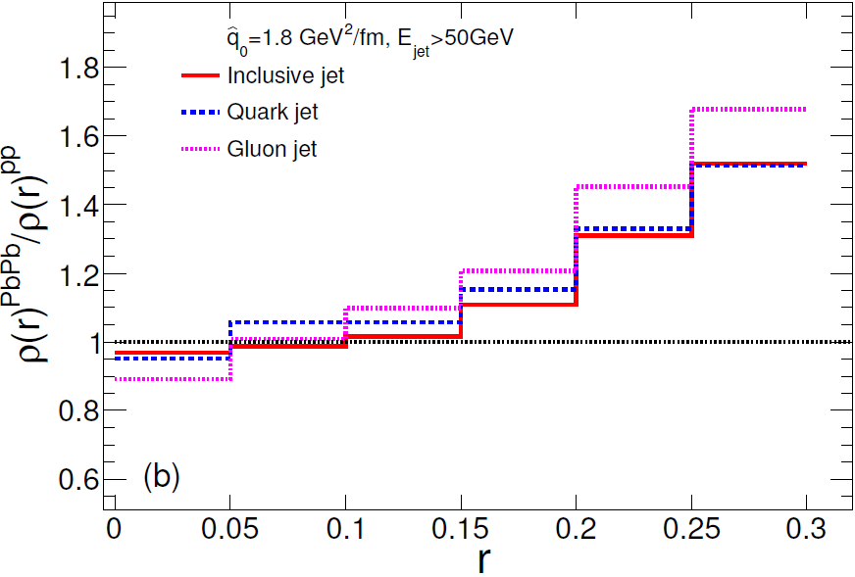
Jet energy and flavor dependence
Lower energy jet is broader,
gluon jet is broader.
Modification of jet shape function is
sensitive to jet energy, less to flavor.

Slide 22
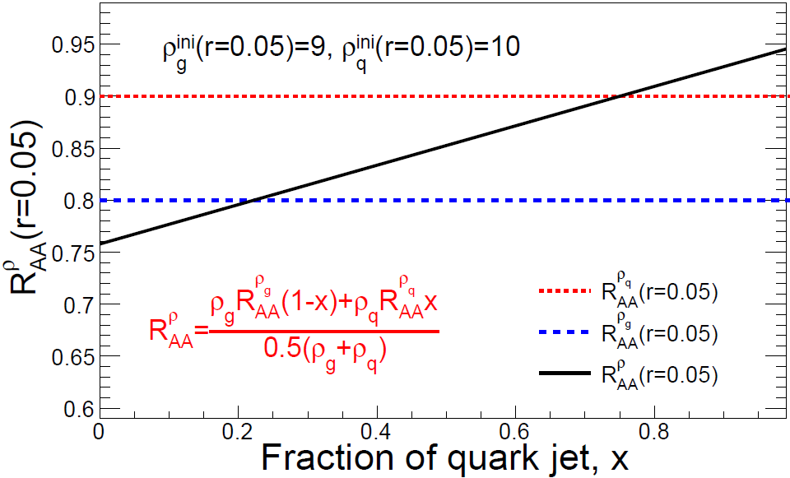

Slide 23

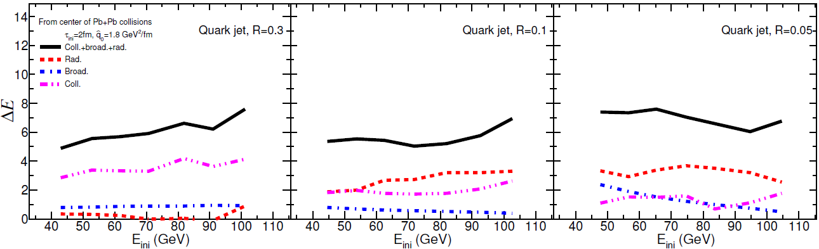
Jet cone size dependence
Jet shape modification in γ-jets and inclusive jets
When jet cone size decreases, radiative energy loss increases, collisional energy loss decreases.

Slide 24
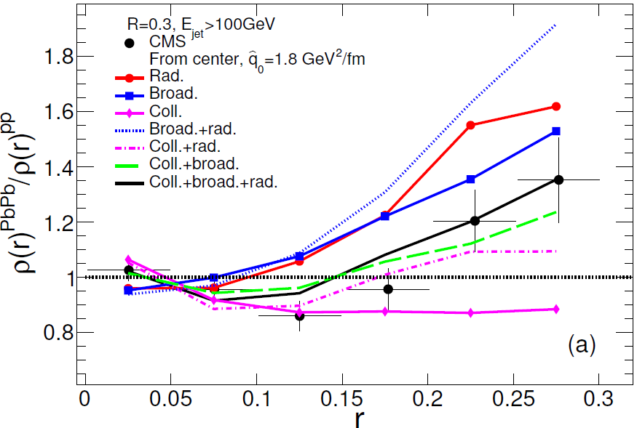
Effects of different mechanisms on Jet shape
@ 2.76A TeV
@ 5.02A TeV
Rad. and Broad. transport energy from center to periphery,
Coll. leads inner core losing less fraction of energy than outer part.
For lower energy jet, its inner core is changed more.
Notes:
(see the situation at 5.02 TeV)

Slide 25
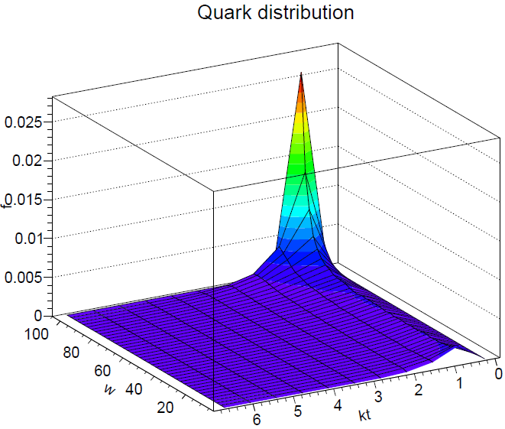
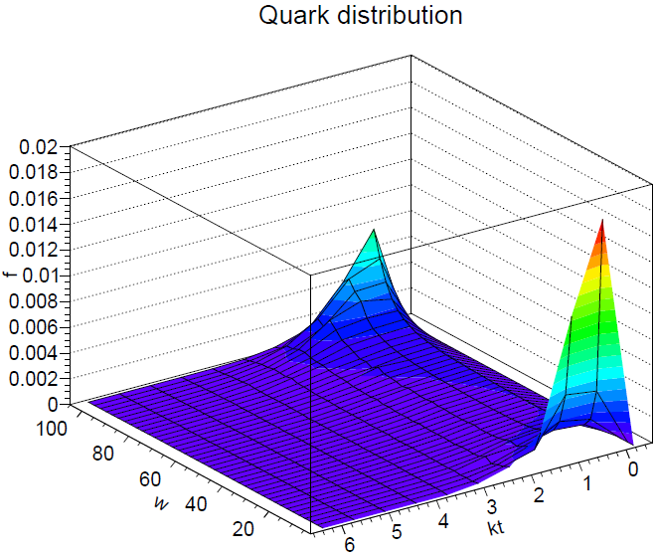
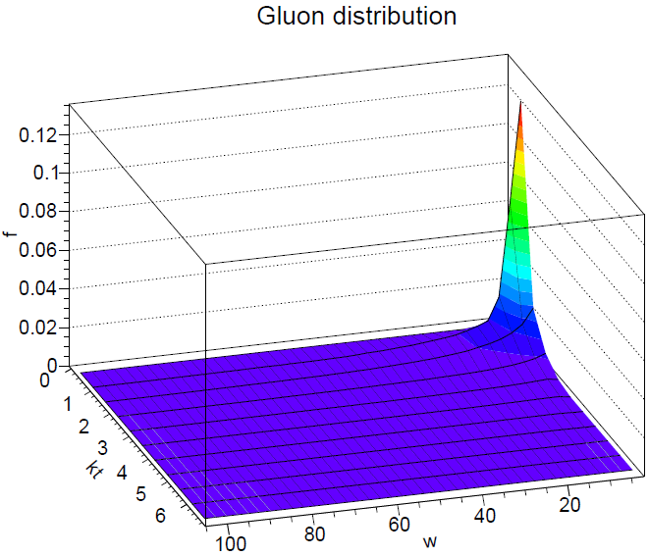
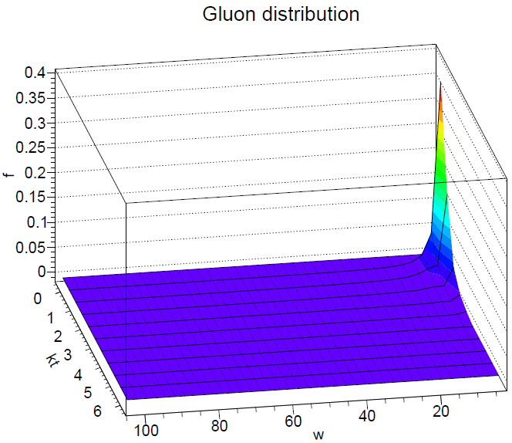
quark jet

