Slide 1
Charmed Hadron Production in Nuclear Collisions
Pengfei Zhuang (Tsinghua University, Beijing)
$∎$Sequential coalescence
$∎$ Correlations of $u(d)$, $s$ and $c$ quarks
$∎$ Charmed hadron production from CBM to LHC
$◼$Borromean ring and Efimov state at in nuclear collisions
work by Xingyu Guo, Shuzhe Shi, Jiaxing Zhao, Nu Xu and PZ
Pengfei Zhuang, ATHIC2018, USTC, 20181103-06 1

Slide 2
Hadronization
●Hadronization in vacuum
a non-perturbative process, unsolved problem in physics
●Hadronization of quark matter
statistical distribution at freeze-out:
P.Braun-Munzinger, J.Stachel, J.Wessels and N.Xu, PLB344, 43(1995)
coalescence (recombination) models:
V.Greco, C.Ko and P.Levai, PRL90, 202302(2003)
R.Hwa and C.Yang, PRC70, 024905(2004)
$$N_{meson}\sim \int{dσ^{μ}p_{μ}}W(x,p)f_{q}(x_{1},p_{1})f_{\overline{q}}(x_{2},p_{2})$$
●Two assumptions
1) the coalescence probability (Wigner function)
$W\left(x,p\right)\sim e^{−\frac{x^{2}}{{\left\langle x\right\rangle }^{2}}}e^{−\frac{p^{2}}{{\left\langle p\right\rangle }^{2}}}$ with parameters $\left\langle x\right\rangle$ and $\left\langle p\right\rangle$
2) all the hadrons (light and heavy) are created at $T_{c}$
●Limit: quarkonia at finite temperature
Schroedinger equation with lattice simulated potential
H.Satz, JPG32, R25(2006)
$→$ 1) sequential suppression $T_{J/ψ}> T_{ψ^{′}}≃T_{χ_{c}}$
charmed hadrons are sequentially produced !
$→$ 2) calculable Wigner function $W\left(x,p\right)=\int{d^{4}ye^{−ipy}ψ(x+\frac{y}{2})ψ^{∗}(x−\frac{y}{2})}$
X.Guo, S.Shi and PZ, PLB718, 14392012)
Pengfei Zhuang, ATHIC2018, USTC, 20181103-06 2

Slide 3
Sequential coalescence model
$∎$Step 1: Sequential production temperature from 2- (3-) body Dirac equations from 2-body $→$ binding energy $ε(T)$ and wave function $ψ(x)$
production temperature $ε\left(T_{D}\right)=0$
$∎$Step 2: Sequential production time from hydrodynamics for QGP evolution
$→$ production time $t_{D}\left(\vec{x},T_{D}\right)$
$∎$ Step 3: Sequential coalescence
$$N\sim \int{dσ^{μ}p_{μ}}W(x,p)f_{q}(x_{1},p_{1})f_{\overline{q}}(x_{2},p_{2})$$
Pengfei Zhuang, ATHIC2018, USTC, 20181103-06 3

Slide 4
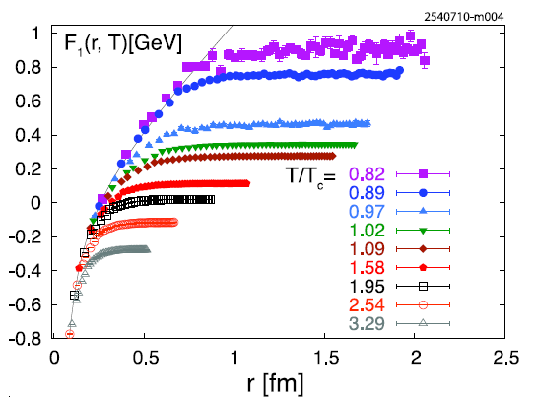
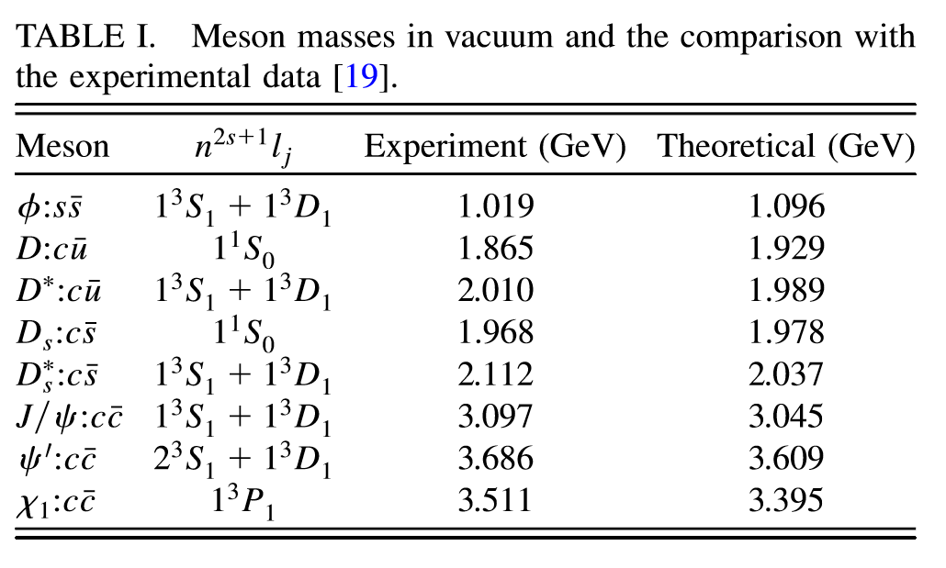
Step 1: Dirac equations
$T=0$: H.Crater, J.Yoon and C.Wong, PRD79, 034011(2009)
O.Kaczmarek, EPJC 61, 811(2009)
$$V=F$$
$$T_{D}/T_{c}≃\left\{\begin{aligned}1.20 D_{s} \\ 1.15 D^{0} \\ 1 Λ_{c}\end{aligned}\right.$$
S.Shi, X.Guo and PZ, PRD88, 014021(2013)
Pengfei Zhuang, ATHIC2018, USTC, 20181103-06 4

Slide 5
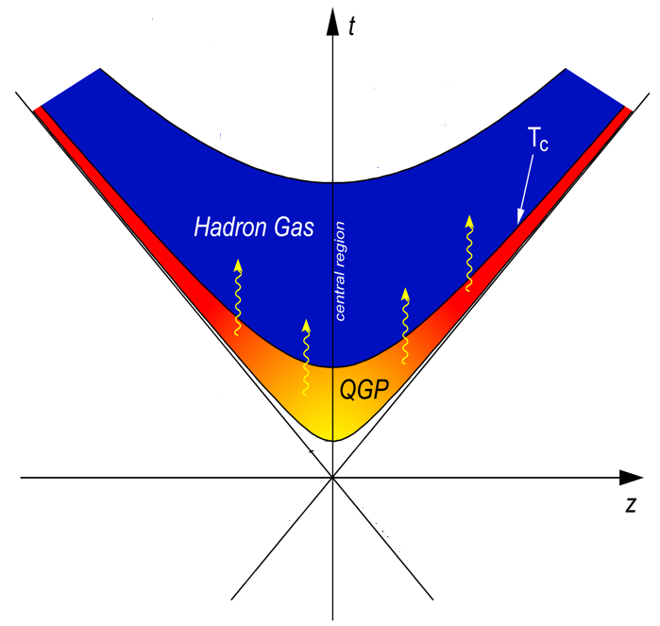
Step 2: Hydrodynamic equations
Sequential production time
ideal hydrodynamics:
$$∂^{μ}T_{μν}=0 + ∂^{μ}n_{μ}=0 → τ(\vec{x}|T_{D})$$
$$π,K,N$$
$$Λ_{c}$$
$$D_{s}$$
$$D^{0}$$
$$τ_{J/ψ}<τ_{D_{s}}<τ_{D^{0}}<τ_{Λ_{c}}<τ_{π,K,N}$$
Pengfei Zhuang, ATHIC2018, USTC, 20181103-06 5

Slide 6
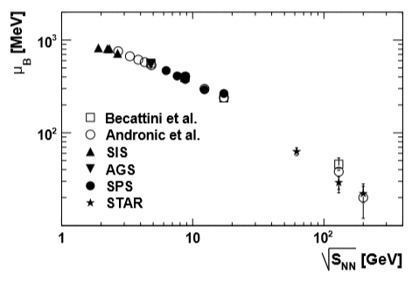
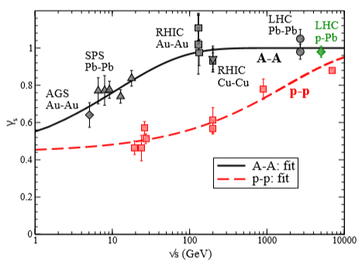
Step 3: Coalescence
$\frac{dN}{d^{2}P_{T}dη}=C\int{\frac{P^{μ}dσ_{μν}\left(R\right)}{{\left(2π\right)}^{3}}}\frac{d^{4}rd^{4}p}{{\left(2π\right)}^{3}}f_{c}{\left(r_{1},p_{1}\right)f}_{\overline{q}}\left(r_{2},p_{2}\right)W\left(r,p\right)$
Hydrodynamics Thermalization Dirac equations
$$W\left(x,p\right)=\int{d^{4}ye^{−ipy}ψ(x+\frac{y}{2})ψ^{∗}(x−\frac{y}{2})}$$
● light quarks $u$ and $d$:
equilibrium distribution
$f_{q}=\frac{N_{q}}{e^{{(u}^{μ}p_{μ}−μ_{q})/T}+1}$
● strange quark $s$:
equilibrium distribution with strangeness fugacity
$f_{s}=\frac{N_{s}λ_{s}}{e^{u^{μ}p_{μ}/T}+1}$
$λ_{s}=\left\{\begin{aligned}0.85 at RHIC \\ 1 at LHC\end{aligned}\right.$
STAR Collaboration. Phys. Rev. C79,034909(2009)
H.Satz et al. Int. J. Mod. Phys. E26, 1750081(2017)
Pengfei Zhuang, ATHIC2018, USTC, 20181103-06 6

Slide 7
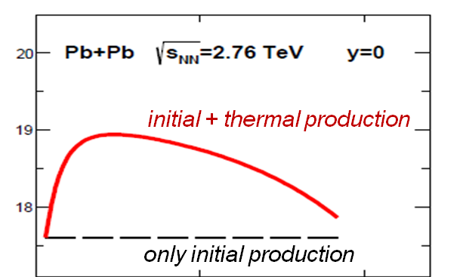
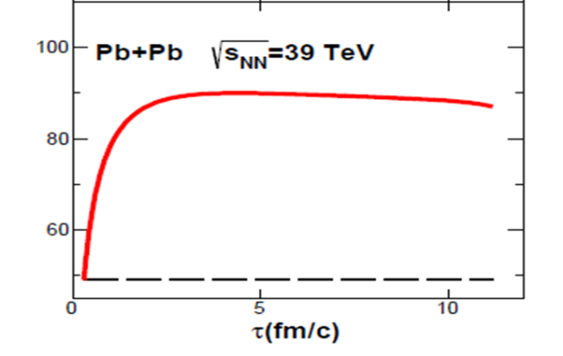
Charm conservation
K.Zhou, Z.Chen, C.Greiner and PZ,. PLB758, 434(2016)
Charm quark number $N_{c}$ is conserved in HIC at RHIC and LHC !
◼ If all charmed hadrons are simultaneously produced, the charm conservation is introduced via a normalization constant,
$→$ the same effect on all the charmed hadrons !
P.Braun-Munzinger and J.Stachel, PLB490, 196(2000)
M.Gorenstein, A.Kostyuk, H.Stoecker and W.Greiner, PLB509, 277(2001)
Y.Oh, C.Ko, S.Lee and S.Yasui, PRC79, 044905(2009)
S.Plumari, V.Minissale, S.Das and V.Greco, EPJC78, 348(2018)
$∎$ If charmed hadrons are sequentially produced, however, more charm quarks are involved in the earlier production and less in the later production,
$$r_{c}=\frac{involved charm quark number}{{total charm quark number N}_{c}}=\left\{\begin{aligned}1 for D_{s} \\ 1−N_{D_{s}}/N_{c}(\sim 90\%) for D^{0} \\ 1−{(N}_{D_{s}}+N_{D^{0}})/N_{c} (\sim 60\%) for Λ_{c}\end{aligned}\right.$$
Pengfei Zhuang, ATHIC2018, USTC, 20181103-06 7

Slide 8
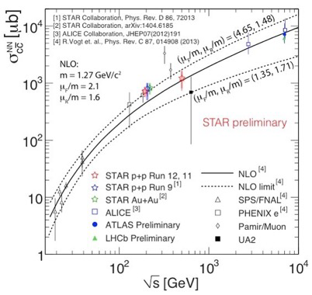
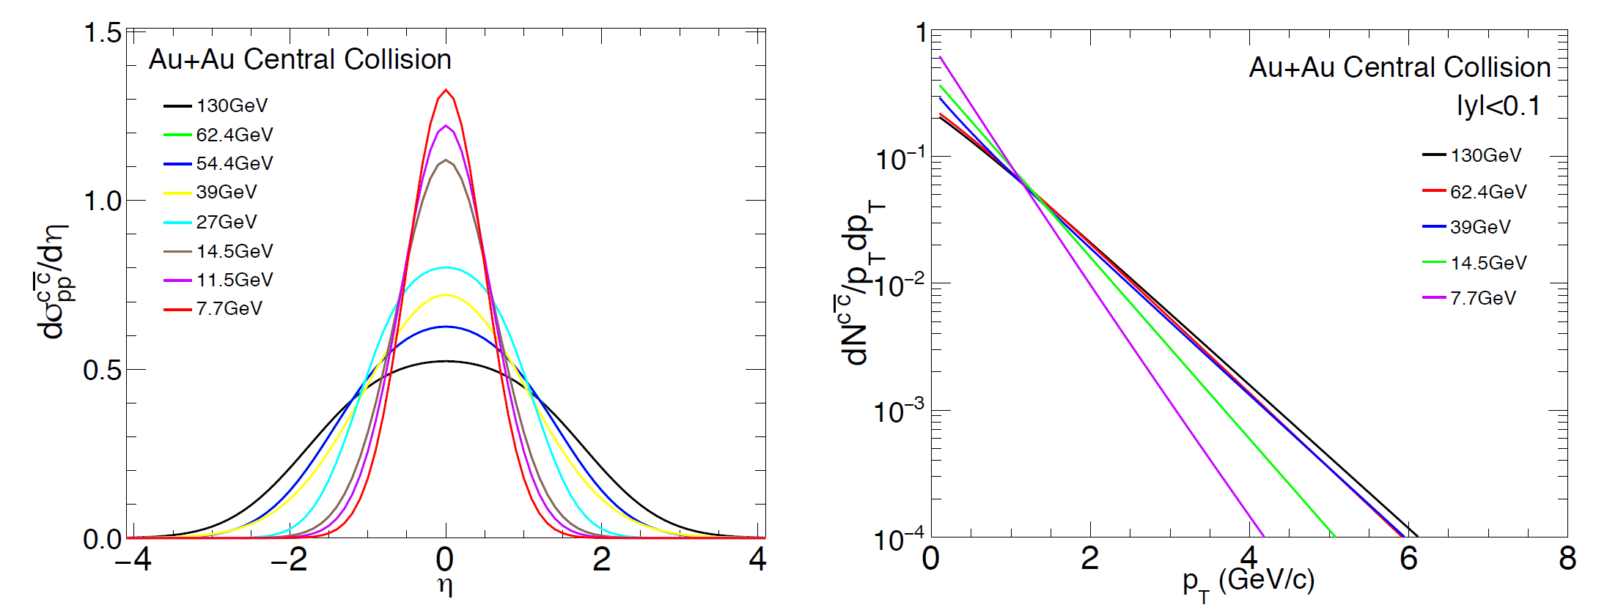
Continuous charm quark thermalization
$f_{c}=r_{c}ρ_{c}\left(x\right)\left[αf_{th}\left(p\right)+βf_{pp}\left(p\right)\right]$
$ρ_{c}\left(x\right)=T_{A}(x_{T})T_{B}(x_{T}−b)\frac{\cosh{η}}{τ}\frac{dσ_{pp}^{c\overline{c}}}{dη}$
$\left(α,β\right)=\left\{\begin{aligned}\left(0.4, 0.6\right) D_{s} \\ \left(0.5, 0.5\right) D^{0} \\ \left(0.6, 0.4\right) { Λ}_{c}\end{aligned}\right.$
Normalized rapidity and transverse momentum distributions with PYTHIA8
Pengfei Zhuang, ATHIC2018, USTC, 20181103-06 8

Slide 9
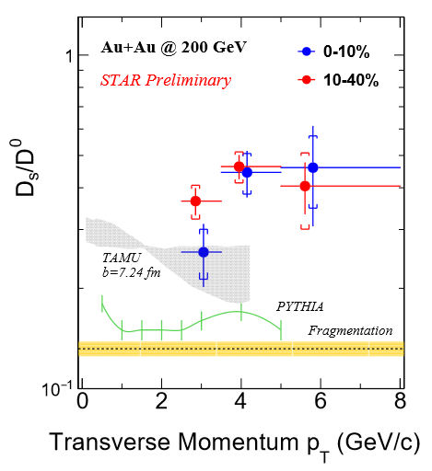
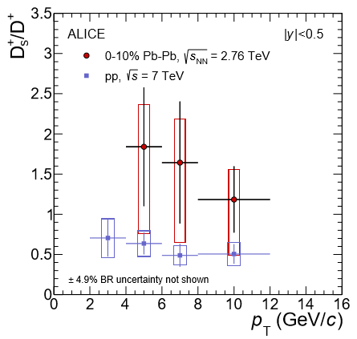
Strangeness enhancement
$∎$Strangeness enhancement in heavy ion collisions
P.Koch, B.Muller and J.Rafelski, Phys. Rept. 142, 167(1986)
$∎$ Strong $D_{s}/D^{0}$ enhancement at RHIC and LHC
$∎$ $D_{s}$ enhancement via strangeness enhancement
L.Zhou [STAR], NPA967, 620(2017) J.Adam et. al. [ALICE], JHEP 1603, 082(2016)
M.He, R.Fries and R.Rapp, PRL110, 112301(2013)
there is still a sizeable difference between strangeness enhancement and data.
Pengfei Zhuang, ATHIC2018, USTC, 20181103-06 9

Slide 10
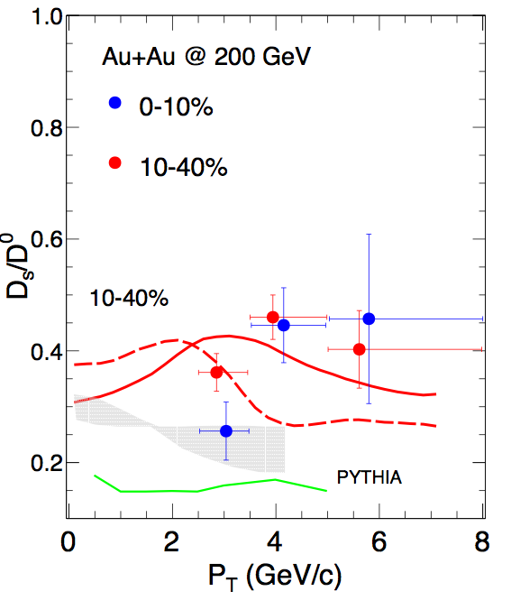
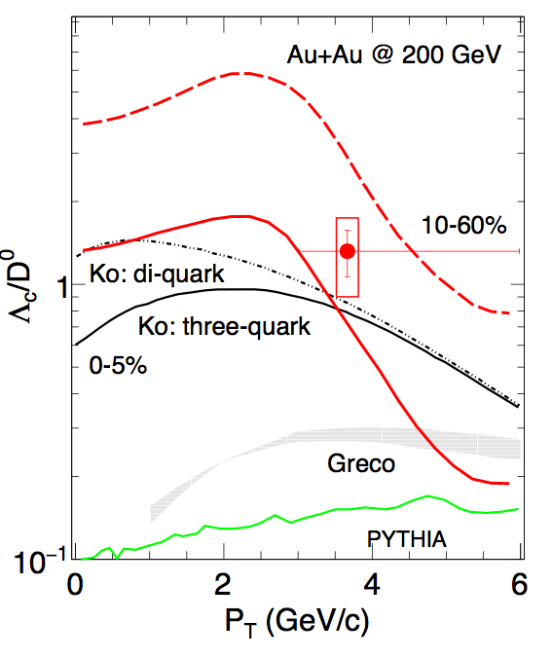
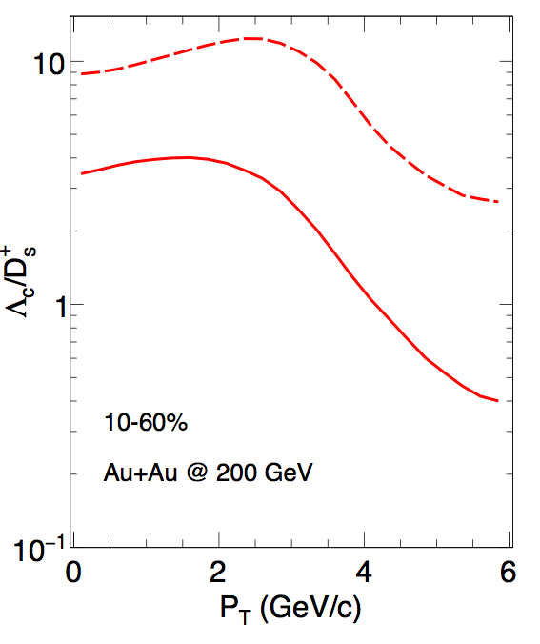
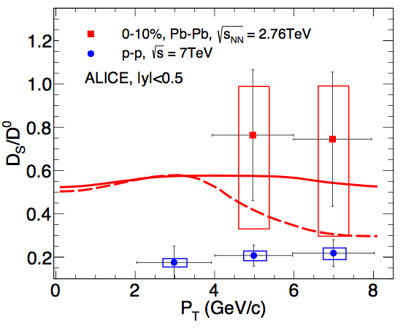
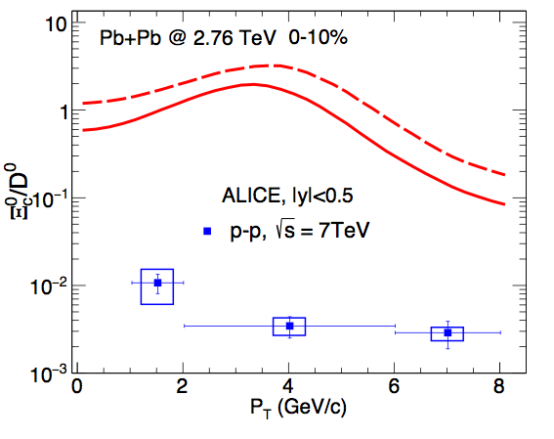
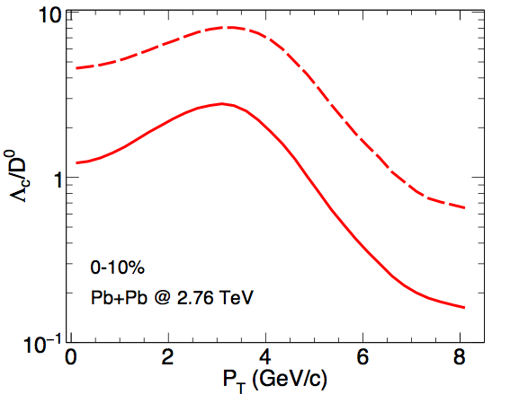
Correlation between strangeness enhancement and charm conservation
$D_{s}$ enhancement by strangeness enhancement results in $D_{0}$ suppression by charm conservation !
$→$ an extra $D_{S}/D^{0}$ enhancement !
J.Zhao, S.Shi, N.Xu and PZ, arXiv: 1805.10858
RHIC
LHC
Solid lines: with charm conservation, Dashed lines: without charm conservation
Opposite charm conservation effect on $D_{s}/D^{0}$ and $Λ_{c}/D^{0}$, depending on the production sequence.
Pengfei Zhuang, ATHIC2018, USTC, 20181103-06 10

Slide 11
Correlation between strangeness enhancement and baryon density
$∎$Baryon density effect
at high baryon density, more $u$ and $d$ quarks, less $\overline{u}$ and $\overline{d}$ quarks, and probably $n_{\overline{u}}<n_{\overline{s}}$ !
$∎$ Strangeness enhancement at high $μ_{B}$ !
$D_{s}(c\overline{s})$ enhancement and $D^{0}(c\overline{u})$ supression!
$f_{u,d}=\frac{N_{u,d}}{e^{{(u}^{μ}p_{μ}−μ_{B}/3)/T}+1}$
$$f_{s}=\frac{N_{s}λ_{s}}{e^{u^{μ}p_{μ}/T}+1}$$
Quark number density at $\vec{r}=0:$
$$D_{s}/D^{0}$$
$$\sqrt{s}$$
pp limit
J.Zhao, S.Shi, N.Xu and PZ, in progress
Pengfei Zhuang, ATHIC2018, USTC, 20181103-06 11

Slide 12
$$D_{s}/D^{0}\left(\sqrt{s}\right)$$
J.Zhao, S.Shi, N.Xu and PZ, in progress
$∎$ Significant strong $D_{s}/D^{0}$ enhancement at about $\sqrt{s}=10$ GeV where the baryon density is the largest.
$∎$ The decreasing ratio at very low $\sqrt{s}$ is due to the disappearance of s-quark thermal production, or the disappearance of the QGP fireball.
Pengfei Zhuang, ATHIC2018, USTC, 20181103-06 12

Slide 13
Comparison with $K/π$
J.Zhao, S.Shi, N.Xu and PZ, in progress
$∎$ The behavior of $D_{s}^{+}/D^{0}$ ${(D}_{s}^{−}/{\overline{D}}^{0})$ is similar to $K^{+}/π^{+}$ $(K^{−}/π^{−})$ .
$∎$ The two peaks locate at the largest baryon density.
Pengfei Zhuang, ATHIC2018, USTC, 20181103-06 13

Slide 14
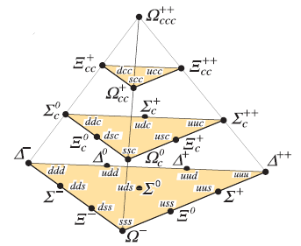
Significant $Ξ_{cc}$ and $Ω_{ccc}$ enhancement in AA
Why $Ξ_{cc}$ and $Ω_{ccc}$ in AA at LHC ?
1) $N_{c}∼100,$ $N\left(Ξ_{cc}\right)$ ~ $N_{c}^{2}, N\left(Ω_{ccc}\right)$ ~ $N_{c}^{3} !$ It is most probable to study $Ξ_{cc}$ properties and discover $Ω_{ccc}$ in AA at LHC.
2) the discovery of $Ω_{ccc}$ is a unique signal of QGP.
3) Exotic quantum states at quark level.
Results:
$Ξ_{cc}$: effective cross section per binary collision
$σ_{pp}^{Ξ_{cc}}=\frac{N_{AA}^{Ξ_{cc}}}{N_{coll}}σ_{pp}^{in}=412 nb in Pb+Pb at \sqrt{s_{NN}}=2.76 TeV$ $≫σ_{pp}^{Ξ_{cc}}=61 nb in p+p at \sqrt{s_{NN}}=14 TeV !$
$Ω_{ccc}$: effective cross section per binary collision
$σ_{pp}^{Ω_{ccc}}=\frac{N_{AA}^{Ω_{ccc}}}{N_{coll}}σ_{pp}^{in}=9 nb in Pb+Pb at \sqrt{s_{NN}}=2.76 TeV$ $≫σ_{pp}^{Ω_{ccc}}=(0.06−0.13) nb in p+p at \sqrt{s_{NN}}=7 TeV !$
J.Zhao, H.He and PZ, PLB771,349(2017)
H.He, Y.Liu and PZ, PLB746, 59(2015)
$Ξ_{cc}$ and $Ω_{ccc}$ are extremely enhanced in nuclear collisions at LHC!
Pengfei Zhuang, ATHIC2018, USTC, 20181103-06 14

Slide 15
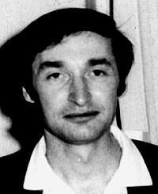
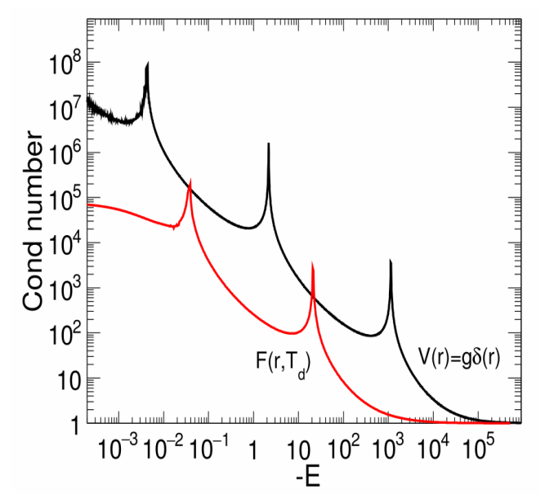
$Ω_{ccc}$ as a Borromean Ring and an Efimov State
Efimov state is introduced in nuclear physics, PLB33, 563(1970).
It was firstly discovered in cold atom gas, T.Kraemer et al., Nature 440, 315(2006).
Is it possible to realize Efimov state at quark level? In vacuum, no, because of the long range interaction.
At finite temperature, probably yes, due to the screened quark potential.
Borromean ring
short range potential at high T !
$\frac{E_{n}}{E_{n+1}}=e^{2π/s_{0}}=515$, Efimov states !
J.Zhao and PZ, PLB775,84(2017)
Pengfei Zhuang, ATHIC2018, USTC, 20181103-06 15

Slide 16
Summary
● We developed a sequential coalescence model for charmed hadron production: Dirac equations + hydrodynamic equations + coalescence.
● The charm conservation changes significantly the charmed hadron ratio, like $D_{s}/D^{0}$ and $Λ_{c}/D^{0}$.
●The charmed ration, like $D_{s}/D^{0}$, is extremely enhanced in the energy region of FAIR, NICA and HIAF.
● It is most probable to discover $Ω_{ccc}$ in nuclear collisions at LHC.
● $Ω_{ccc}$ can be in exotic quantum states (Borromean ring and Efimov state) at finite temperature.
Pengfei Zhuang, ATHIC2018, USTC, 20181103-06 16

Slide 17
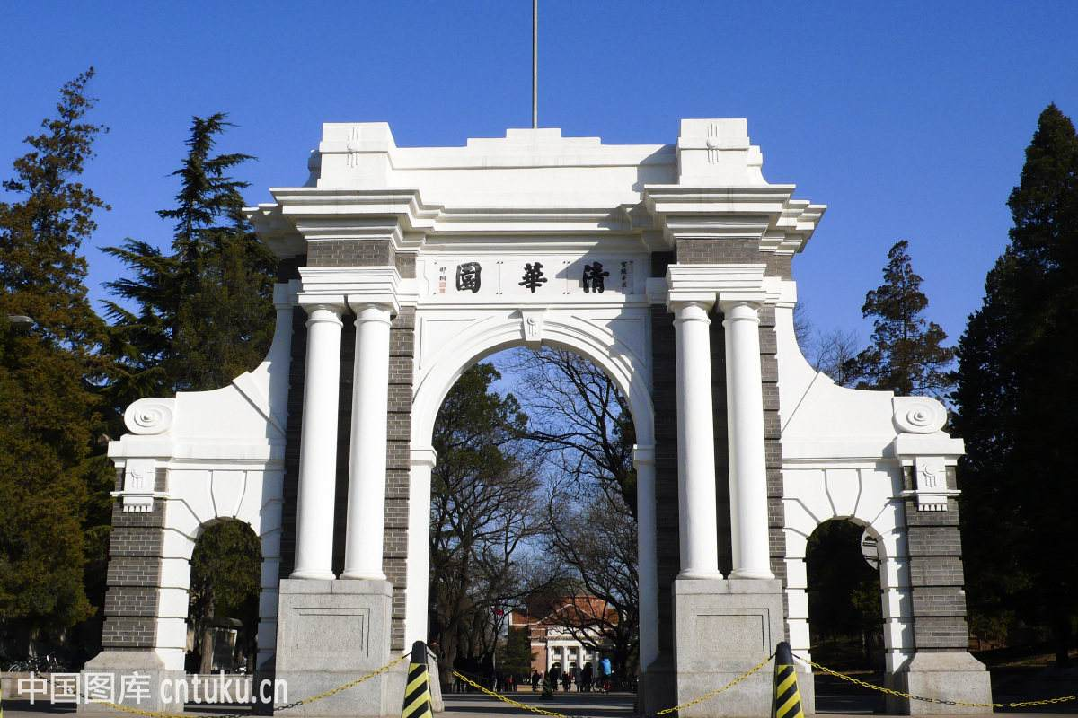
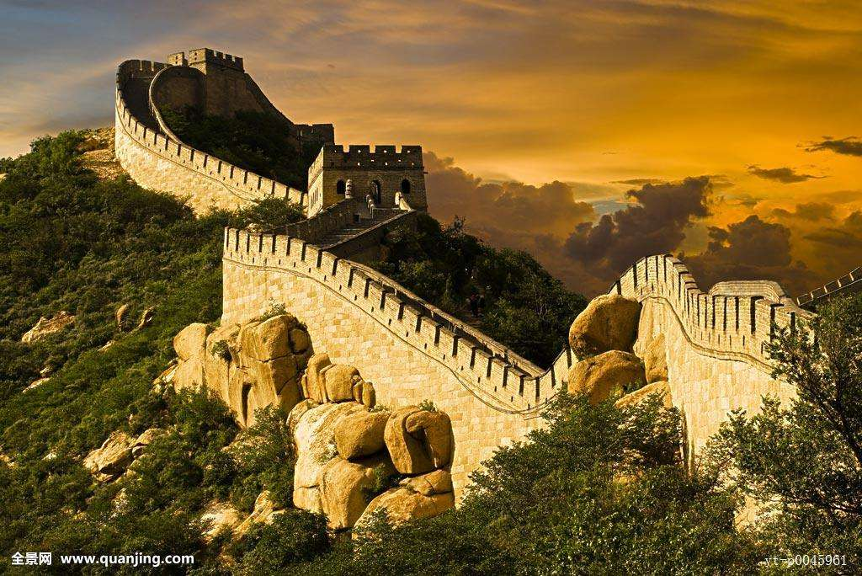
Chirality Workshop 2019
The 5th Workshop on Chirality, Vorticity and Magnetic Field in Heavy Ion Collisions
The 1st (2015), 2nd(2016), and 3rd (2017) workshops at UCLA
The 4th workshop at Florence
● Place: Tsinghua University, Beijing
● Date: April 8-12, 2019
这里：清华二校门和北京长城的图片
You are welcome to join the workshop!

