Slide 1
https://github.com/Letianwu/ZMCintegral
ZMCintegral
---an easy to Use Python Package
for Monte Carlo Integration on Multi-GPU Devices
WU Hongzhong, ZHANG Junjie, PANG Longgang, WANG Qun
To appear soon …

Slide 2
Random Sampling within a Domain
$$f(x)$$
$$f(x_{1})$$
$$f(x_{2})$$
$$+$$
$$f(x_{3})$$
$$∑f(x_{i})$$
$$\int_{x_{a}}^{x_{b}}{f\left(x\right)dx}≈(x_{b}−x_{a})\frac{1}{3}∑f(x_{i})$$
$$x$$
$$x_{a}$$
$$x_{b}$$

Slide 3
Random Sampling within a Domain
Uniform sampling is sufficient for “stable” domain regions.
The convergence slowly follows $\frac{1}{\sqrt{N}}$.
Ineffective for multi-dimensional, rapid oscillating or high peaking functions.
Details of the integrands would be difficult to extract.

Slide 4
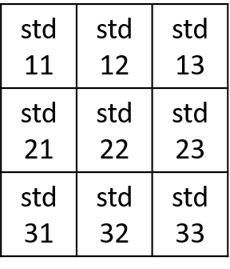
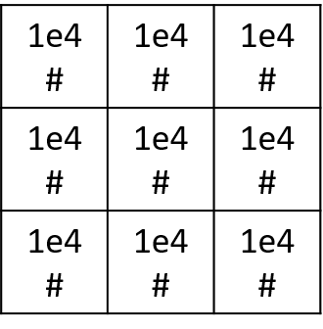
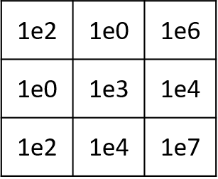
Adaptive Importance Sampling: Vegas as an example
Vegas, adaptively adjusts the number of points in each grid domain such that more points would be evaluated for anxious domains.
$$f(x)$$
$$x$$

Slide 5
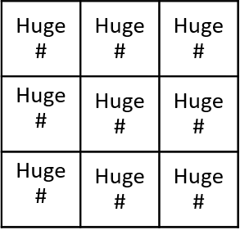
Adaptive Importance Sampling: ZMCintegral with Tensorflow-GPU backend
ZMCintegral amplifies the anxious domains iteratively, and with the benefit of GPU, it samples a huge amount of points in each domain， with a heuristic tree search.
Very easy to use
Huge amount (1,000,000,000) of points for each anxious domain
$$f(x)$$
$$x$$

Slide 6
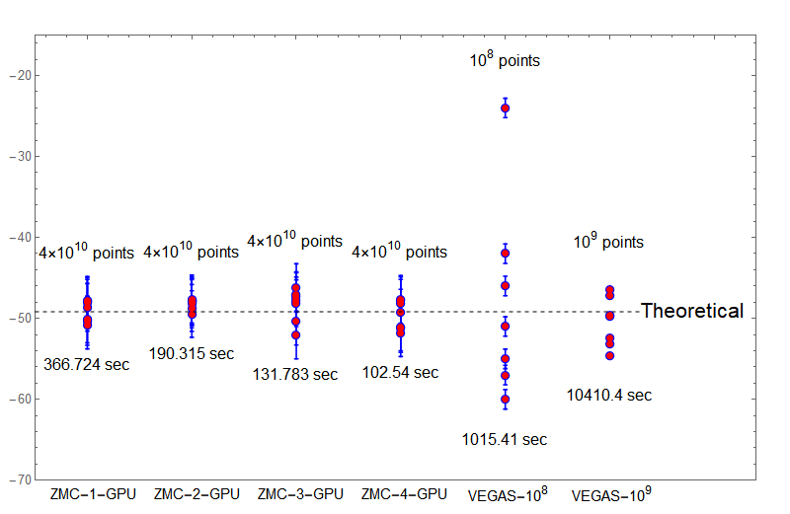
$$\int_{0}^{10}{sin⁡[x1+x2+x3+x4+x5+x6]dx_{1}dx_{2}dx_{3}dx_{4}dx_{5}dx_{6}}$$
Result: ZMCintegral VS VEGAS

Slide 7
Thank you
ZHANG Junjie

