Slide 1
Full 3D dynamical modeling based on fluctuating hydrodynamics
Koichi Murase Sophia University
The 7th Asian Triangle Heavy-Ion Conference (ATHIC 2018)
Nov 4, 2018, USTC, Hefei, China

Slide 2
Introduction

Slide 3
Fluctuating hydrodynamics
Subject: Thermal fluctuations of fluids
Two keywords:
Hydrodynamic fluctuations (HF) = thermal fluctuations of fluid fields
Fluctuating hydrodynamics = dissipative hydrodynamics with hydrodynamic fluctuations as noise terms
Hydrodynamic eqs. become Stochastic Partial Differential Equations (SPDEs) like the Langevin equation
c.f. L. D. Landau and E. M. Lifshitz, Fluid Mechanics (1959)

Slide 4
Fluctuations in heavy-ion collisions
Final observables
flow harmonics v_{n}, etc.
Initial-state fluctuations
nucleon distribution
quantum fluctuations
time
Response of
Matter
EoS, η, ζ, τ_{R}, λ, …
collision axis
0

Slide 5
Fluctuations in heavy-ion collisions
Final observables
flow harmonics v_{n}, etc.
Initial state fluctuation
nucleon distribution
quantum fluctuations
time
Other fluctuations
+ hydro fluctuations
+ jets/mini-jets
+ critical phenomena
+ …
Relativistic hydrodynamics
(～QGP)
collision axis
0

Slide 6
Hydrodynamics
Hydro = Basically, conservation laws
“Hydrodynamics” works iff… fluxes T^{ij} (～ pressure, stress, etc.) are uniquely determined by conserved densities T^{0μ} (～e, u^{μ}).
e.g.
e.g. EoS & Constitutive eqs. near equilibrium
～V^{-1/2}
Thermodynamic limit
V→∞
w/ fixed E/V
unique!
Probability
P(e)
Pressure

Slide 7
Hydrodynamic fluctuations
= deviation from the equilibrium value
e.g.
HF
ensemble/event averaged
Balance
thermal fluctuations
at each spacetime x
FDR
Fluctuation-Dissipation Relation
decrease anisotropy
increase anisotropy
V: 3+1 dim. volume
HF are important in e-by-e description of HIC

Slide 8
Relativistic fluctuating hydrodyamics

Slide 9
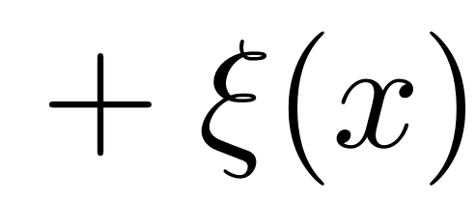
FDR in higher-order constitutive eqs
Constitutive equation for
1st order term
hydrodynamic fluctuations
1 + (higher order terms)
finite-order in derivatives. (D: time derivative)
FDR, causality, etc. → white noise
K. Murase and T. Hirano, arXiv:1304.3243;
K. Murase, Ph.D. Thesis (The University of Tokyo), Sec. 4.4 (2015)

Slide 10
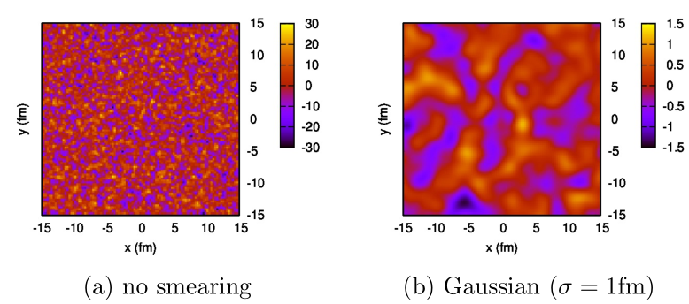
Smeared fluctuating hydrodynamics
Noise terms with autocorrelations ～ δ⁽⁴⁾(x-x’)
Hydrodynamic eqs are non-linear
→ Continuum limit is non-trivial
Regularization: cutoff length λ (or cutoff momentum Λ=1/λ)
～ coarse-graining scale > microscopic scale
Noise terms w(x) are smeared by, e.g., Gaussian of width σ = λ

Slide 11
Stochasitic Integrals
Structure of 2nd order fluctuating hydrodynamics
noise
τ: proper time
→ No difference between Ito/Stratonovich SDE
Stratonovich product
dτ
0
Ito product
K. Murase, Ph.D. Thesis (The University of Tokyo), Sec. 6.4 (2015)

Slide 12
Effects on observables

Slide 13
Integrated dynamical model
5. Observables
4. Hadronic cascades (JAM)
time
3. Particlization at T_{sw} = 155 MeV Cooper-Frye formula: f₀ + δf
2. (3+1)-dim. Relativistic Fluctuating Hydrodynamics EoS: lattice QCD & HRG, η/s = 1/4π
collision axis
0
1. Initial condition MC-KLN, MC-Glauber/modified BGK

Slide 14
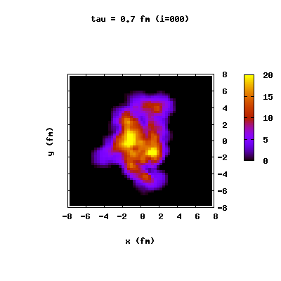
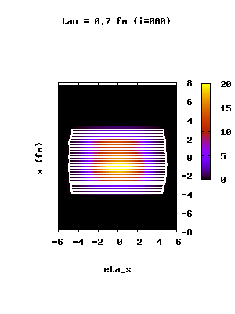
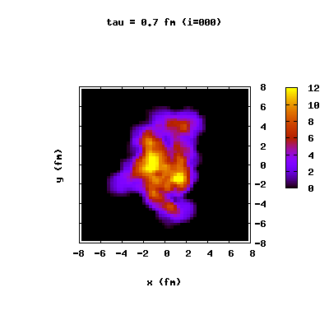
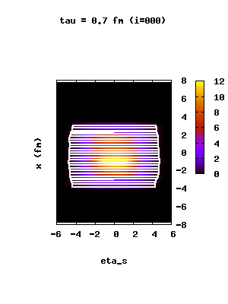
Numerical Simulation: Evolution
Hydrodynamic evolution
without HF
τT ^{ττ}
conventional 2nd-order
viscous hydro
y [fm]
x [fm]
x [fm]
η_{s}
with HF
2nd-order fluctuating hydro
y [fm]
x [fm]
x [fm]
η_{s}

Slide 15
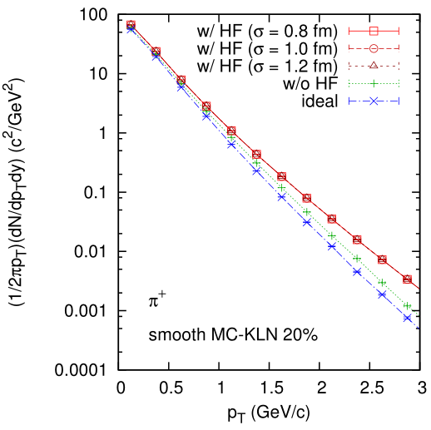
p_{T}-spectra (pions)
local flows by hydro fluctuations
AuAu 200 GeV
For fixed I.C.
High-pt particles increase with HF ← accelerated by local flows

Slide 16
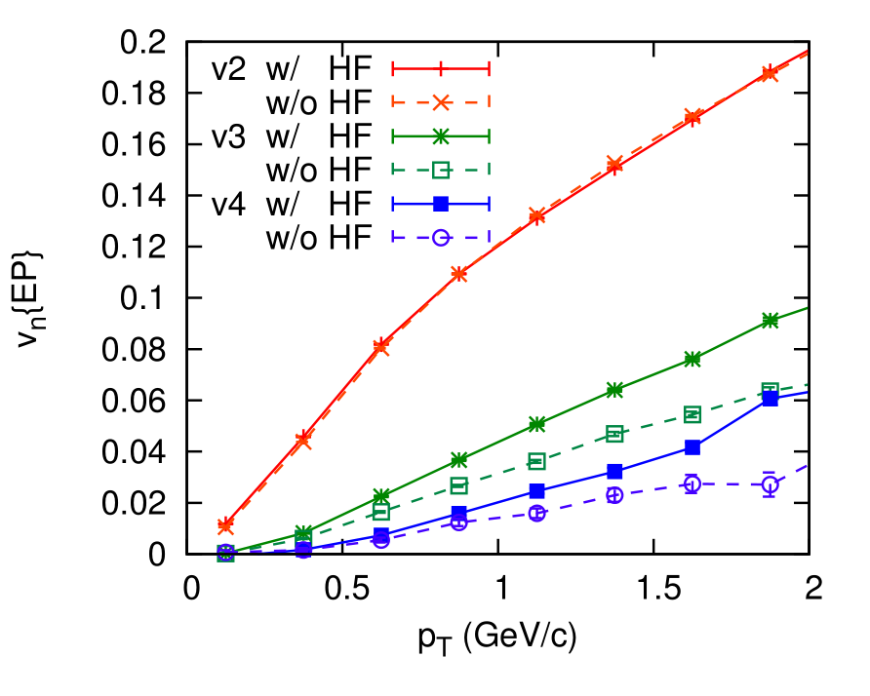
v_{n}{EP} vs p_{T}
EP: η-sub,
|η| = 1.0-2.8
AuAu 200 GeV, MC-KLN
20-30%
v2: (IS Fluct.) + (HF) + (Collision geometry)
v3, v4: (IS Fluct.) + (HF)

Slide 17
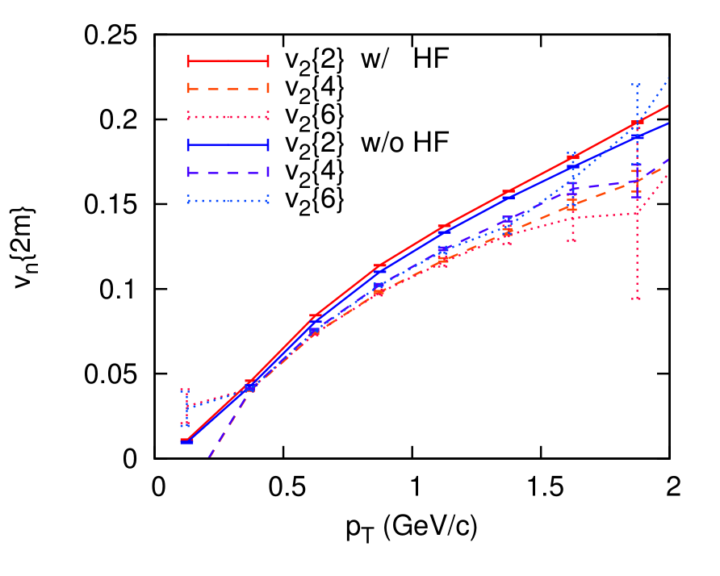
v_{n}{2m} vs p_{T}
v{2}² ＝ v² ＋ σ²,
v{4}² , v{6}² ～ v² － σ²,
～ flow fluct.
AuAu 200 GeV, MC-KLN
20-30%
v{4}² ＝ v{6}² ＜ v{2}²
flow fluctuations σ: larger with HF

Slide 18
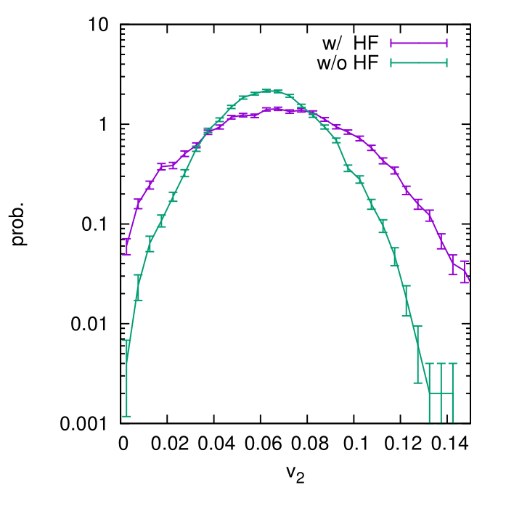
E-by-E distribution of v₂
v{2}² ＝ v² ＋ σ²,
v{4}² , v{6}² ～ v² － σ²,
AuAu 200 GeV, MC-KLN
20-30%
Broader distribution of v₂

Slide 19
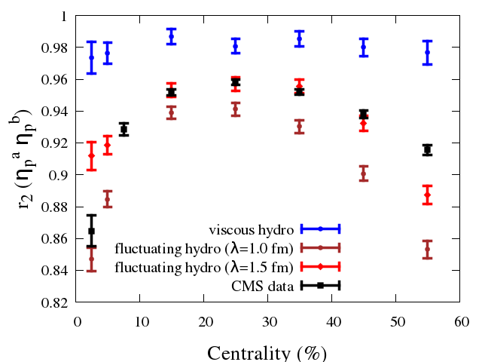
Factorization ratio $r_{2}\left(η_{p}^{a},η_{p}^{b}\right)$
Talk by Azumi Sakai 11/3 Parallel III.2
Pb+Pb 2.76 TeV MC-Glauber
$2.0<η_{p}^{a}<2.5$,$3.0<η_{p}^{b}<4.0$
Longitudinal decorrelation by hydrodynamic fluctuations

Slide 20
Discussion

Slide 21
FDR under background evolution
When background is non-static / non-uniform, FDR have corrections:
K. Murase, Ph.D. Thesis (The University of Tokyo), Sec. 4.4 (2015)
Otherwise, Fluctuation theorem (FT) from non-equilibrium statistical mechanics is broken in 2nd-order fluctuating hydrodynamics
T. Hirano, R. Kurita, K. Murase, arXiv:1809.04773

Slide 22
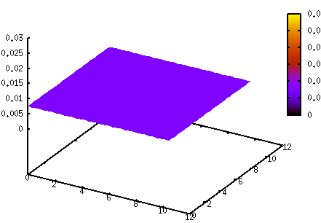
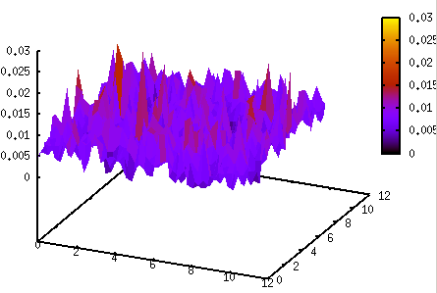
Renormalization of EoS/viscosity
λ-dependence of EoS and transport coefficients
e.g. Decomposition of energy density in equilibrium
〈T⁰⁰〉 = e = 〈e_{λ}〉 + 〈(e_{λ}+P_{λ})u_{λ}² + π_{λ}⁰⁰〉
internal energy
in ordinary sense
“internal” energy
“kinetic” energy
Global equilibrium in Conventional hydrodynamics
Global equilibrium in Fluctuating hydrodynamics

Slide 23
Renormalization of EoS/viscosity
λ-dependence of EoS and transport coefficients
e.g. Decomposition of energy density in equilibrium
〈T⁰⁰〉 = e = 〈e_{λ}〉 + 〈(e_{λ}+P_{λ})u_{λ}² + π_{λ}⁰⁰〉
internal energy
in ordinary sense
“internal” energy
“kinetic” energy
Every “macroscopic” quantities (e_{λ}, u_{λ}, etc.) are redefined for each cutoff λ.
Macroscopic relations such as viscosity, EoS, etc. should be renormalized not to change the bulk properties (k→0, ω→0)
Additional terms in hydrodynamic eqs: “long-time tail”
P. Kovtun, et al., Phys. Rev. D68, 025007 (2003); P. Kovtun, et al., Phys. Rev. D84, 025006 (2011); P. Kovtun, J. Phys. A45, 473001 (2012); Y. Akamatsu, et al., Phys. Rev. C95, 014909 (2017); Y. Akamatsu, et al., Phys. Rev. C97, 024902 (2018)

Slide 24
Other renormalization
Cooper-Frye formula: How to sample hadrons from (e_{λ}, u_{λ}^{μ}, π_{λ}^{μν}, Π_{λ})?
Initialization model (from partons, etc.): Width and shape of smearing kernel should match with those in fluctuating hydrodynamics?
?
(e_{λ}, u_{λ})
Larger λ
Smaller λ
Renormalization?
larger internal energy e_{λ}
smaller initial flow u_{λ}
smaller internal energy e_{λ}
larger initial flow u_{λ}

Slide 25
Summary

Slide 26
Summary
Hydrodynamic fluctuations are thermal fluctuations of hydrodynamics
Fluctuating hydrodynamics is dissipative hydrodynamics with hydrodynamic fluctuations
Hydrodynamic fluctuations have non-negligible effects on heavy-ion observables, in particular, on longitudinal dynamics
Further development for physical consistency? FDR corrections, FT, Renormalization, non-Gaussian statistics, etc.

