Slide 1


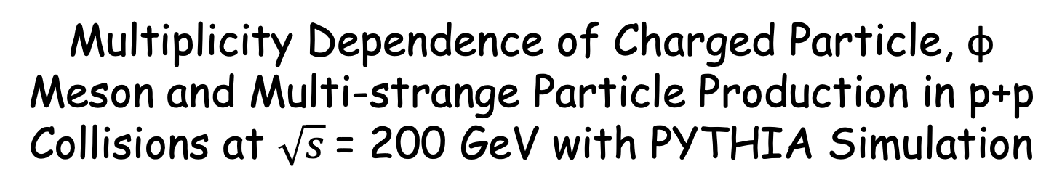
Multiplicity Dependence of Charged Particle, φ Meson and Multi-strange Particle Production in p+p Collisions at $\sqrt{s}$= 200 GeV with PYTHIA Simulation
Shenghui Zhang (张生辉)
University of Science and Technology of China (USTC)
State Key Laboratory of Particle Detection and Electronics
ATHIC 2018, Nov. 03-06 2018, USTC, Hefei, China

Slide 2
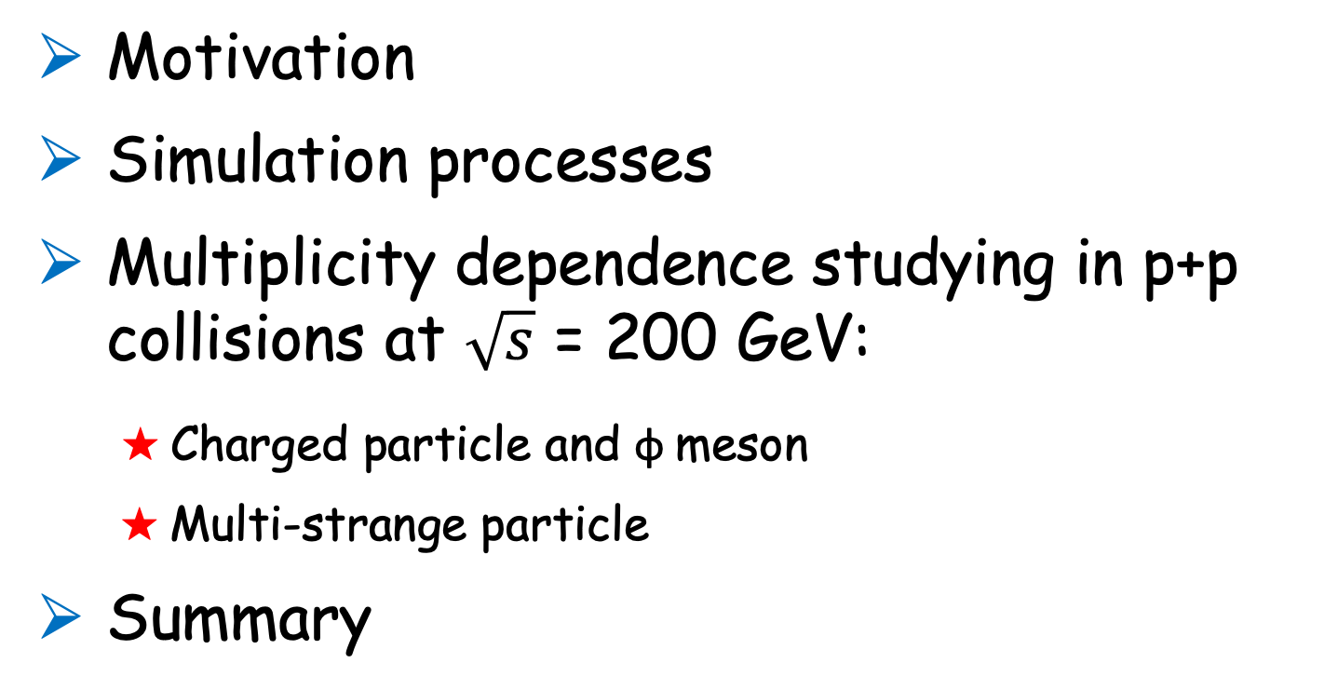
Outline
Motivation
Simulation processes
Multiplicity dependence studying in p+p collisions at $\sqrt{s}$ = 200 GeV:
★ Charged particle and φ meson
★ Multi-strange particle
Summary
Shenghui Zhang
ATHIC 2018
1

Slide 3
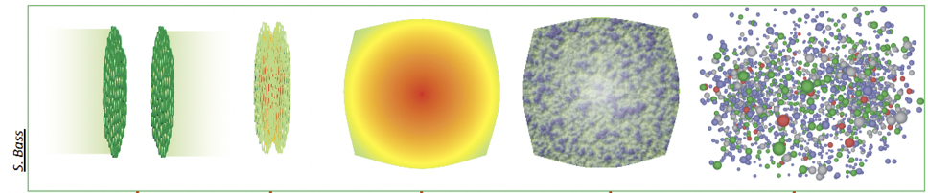
Motivation
QGP
Searching for QGP in ultra-relativistic heavy-ion collisions is the main goal of high energy nuclear physics.
Measurements in p+p collisions provide the reference for heavy-ion collisions.
Shenghui Zhang
ATHIC 2018
2
Notes:
Searching for QGP in heavy-ion collisions is the main goal of high energy nuclear physics. And emerges its properties by experimentally comparing with p+p collisions.

Slide 4
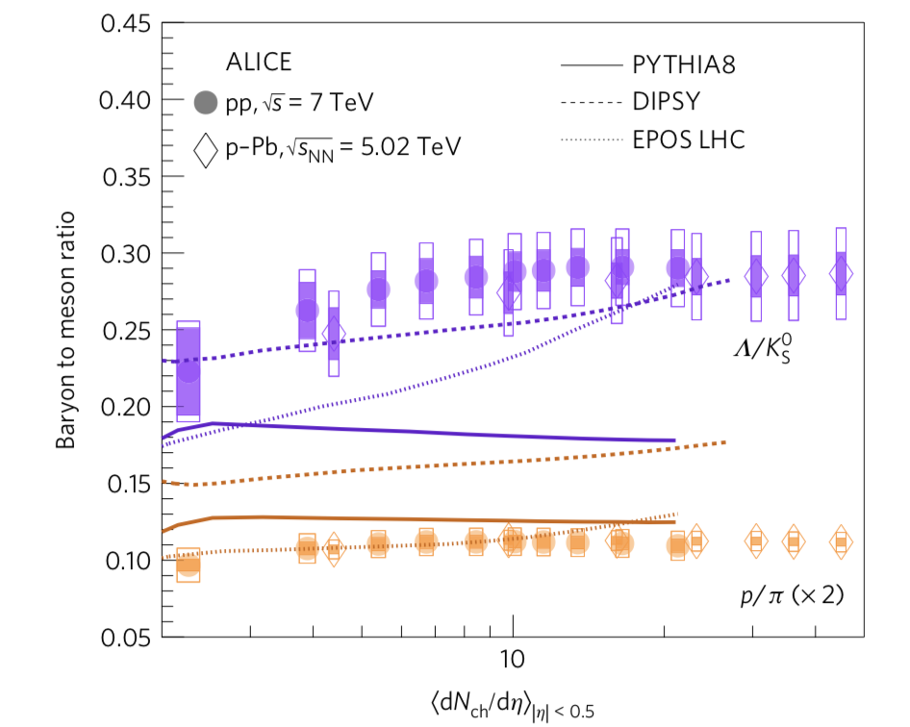
Motivation
Similar strangeness enhancement in high-multiplicity p+p collisions was observed by ALICE experiment.
Particle production with respect to multiplicity of the p+p colliding system is barely studied, especially at a colliding energy of a few hundred GeV at RHIC.
Shenghui Zhang
ATHIC 2018
3
Notes:
there have been many measurements on the multiplicity or centrality dependence of particle production in heavy-ion collisions. In particular, the production mechanism of hadrons containing strangeness is believed as a signature for QGP formation in heavy-ion collisions. To support this, it is worthy of studying the multi-plicity dependence of strangeness production in p+p collisions without any medium effect. Recently, the strangeness enhancement in high-multiplicity p+p collisions was observed by ALICE experiment which is similar to that observed in the heavy-ion collisions. thus drawing a lot of interest. Thus, it is also of interest to study these in p+p collisions at RHIC energy to see if there is any similarity in Au+Au collisions.

Slide 5
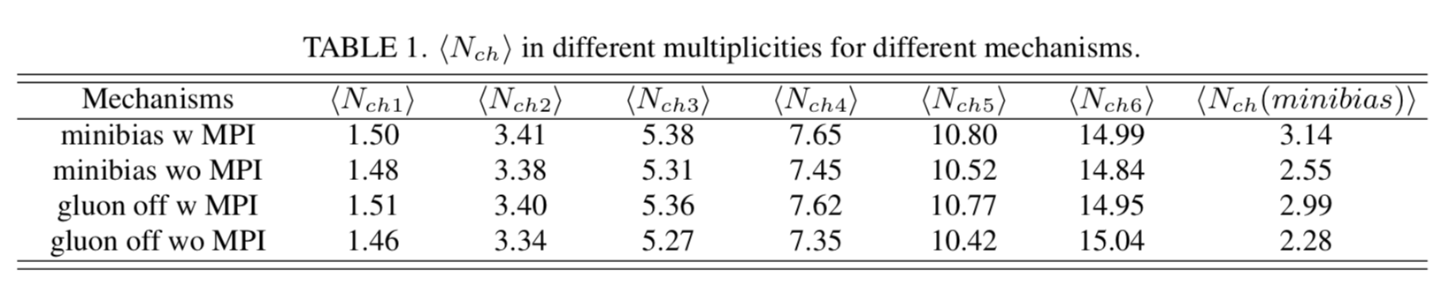
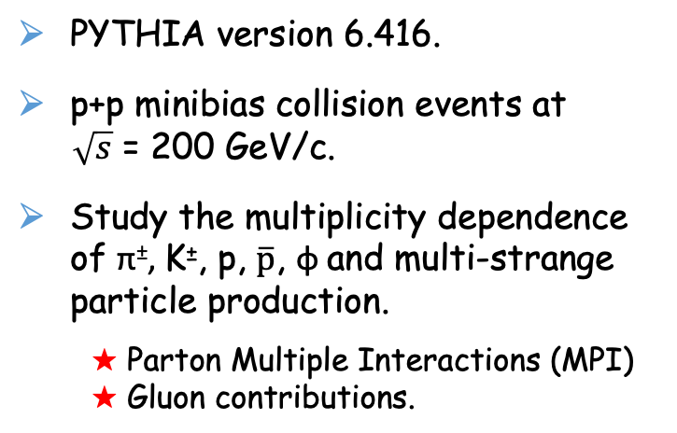
Simulation processes
PYTHIA version 6.416.
p+p minibias collision events at
$\sqrt{s}$ = 200 GeV/c.
Study the multiplicity dependence of π±, K±, p, $\overline{p}$, φ and multi-strange particle production.
★ Parton Multiple Interactions (MPI)
★ Gluon contributions.
Shenghui Zhang
ATHIC 2018
4
Notes:
Six multiplicity bins are chosen according to the equal number of events in each multiplicity bin. The events without any multiplicity selection are called minibias events.

Slide 6
p_{T} spectra
A clear hardening of the p_{T} spectra for the π⁻ meson from low to high multiplicity.
Consistent with the ALICE results (J. Phys. Conf. Ser. 779, 012071).
Spectra of kaon, proton and φ meson versus multiplicity are similar as pion.
Shenghui Zhang
ATHIC 2018
5
Notes:
pT spectra of π- in different multiplicity bins with and without MPI and gluon contributions in p+p collisions

Slide 7
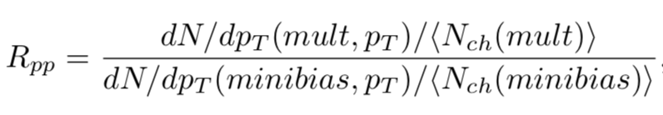
R_{pp} spectra
A clear R_{pp} splitting with different production mechanisms.
Splitting is getting more obvious when p_{T} goes higher.
MPI suppress the splitting at higher p_{T} range
Gluon contribution is small in changing the relative momentum shape with respect to multiplicities.
Shenghui Zhang
ATHIC 2018
6

Slide 8
Integral R_{pp} as a function of ⟨N_{ch}⟩
Increase of integrated R_{pp} could be due to the jet fragmentation.
MPI are the dominant source of R_{pp} splitting suppression.
Gluon contributions have small impact on the R_{pp} splitting.
No obvious particle species dependence for the splitting is observed.
Shenghui Zhang
ATHIC 2018
7

Slide 9
⟨p_{T}⟩ as a function of dN_{ch}/dy
⟨p_{T} ⟩ distributions of pion, kaon and proton in p+p collisions increase significantly with multiplicity.
Tendency is same as that in Au+Au collisions but with slightly larger slope.
Shenghui Zhang
ATHIC 2018
8

Slide 10
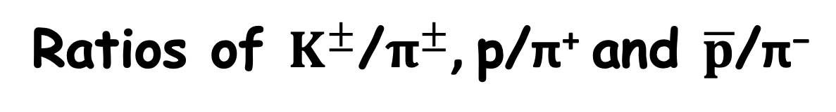
Ratios of $K^{±}$/$π^{±}$, p/π⁺ and $\overline{p}$/π⁻
Similar tendency of the particle ratios in p+p and Au+Au collisions indicates the similar production mechanisms hold in different collision systems.
Shenghui Zhang
ATHIC 2018
9

Slide 11
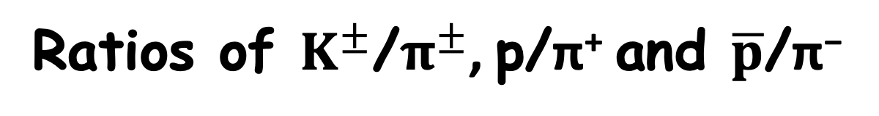
Ratios of $K^{±}$/$π^{±}$, p/π⁺ and $\overline{p}$/π⁻
Weak multiplicity dependence are observed in the whole p_{T} region.
Clear difference between particle to π⁺ and antiparticle to π⁻ ratios in low multiplicity region at high p_{T} region.
Shenghui Zhang
ATHIC 2018
10
Notes:
This may suggest that the high pT gluon jet composition are different in terms of particle-to-π+ and antiparticle-to-π− ratios.

Slide 12

Ratios of Λ/$K_{S}^{0}$as a function of p_{T}
Ratio at high multiplicity in p+p collisions is consistent with data in peripheral Au+Au collisions.
A complementary support to the coalescence hadronization in nuclear medium.
Shenghui Zhang
ATHIC 2018
11

Slide 13
Ratios of Λ/$K_{S}^{0}$as a function of dN_{ch}/dy
Ratio decreases as a function of dN_{ch}/dy in p+p collisions while it keeps constant in Au+Au collisions in the same collision energy.
Shows smooth connection to that in Au+Au collisions at √s_{NN} = 200 GeV.
Indicates some similar production mechanisms transfer p+p collisions to a more hot and dense system.
Shenghui Zhang
ATHIC 2018
12

Slide 14
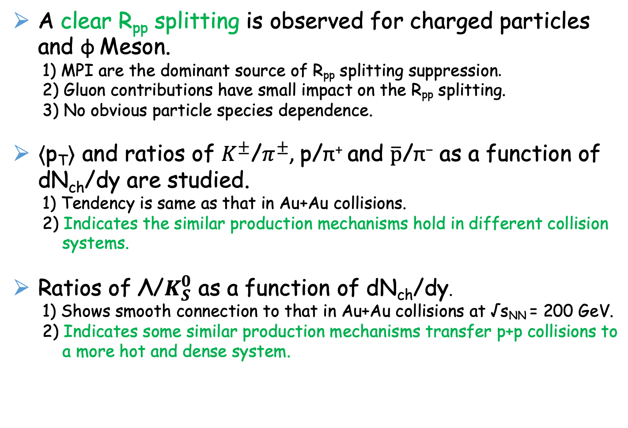
Summary
A clear R_{pp} splitting is observed for charged particles and φ Meson.
1) MPI are the dominant source of R_{pp} splitting suppression.
2) Gluon contributions have small impact on the R_{pp} splitting.
3) No obvious particle species dependence.
⟨p_{T}⟩ and ratios of $K^{±}$/$π^{±}$, p/π⁺ and $\overline{p}$/π⁻ as a function of dN_{ch}/dy are studied.
1) Tendency is same as that in Au+Au collisions.
2) Indicates the similar production mechanisms hold in different collision
systems.
Ratios of Λ/$K_{S}^{0}$ as a function of dN_{ch}/dy.
1) Shows smooth connection to that in Au+Au collisions at √s_{NN} = 200 GeV.
2) Indicates some similar production mechanisms transfer p+p collisions to
a more hot and dense system.
Shenghui Zhang
ATHIC 2018
13

Slide 15
Back up
Shenghui Zhang
ATHIC 2018
14

Slide 16
Ratios of antiparticle to particle
as a function of dN_{ch}/dy
Shenghui Zhang
ATHIC 2018
15

