Slide 1
Memorize my Mentor prof. Hongfang CHEN
- her career and life at USTC
Ming Shao
USTC

Slide 2
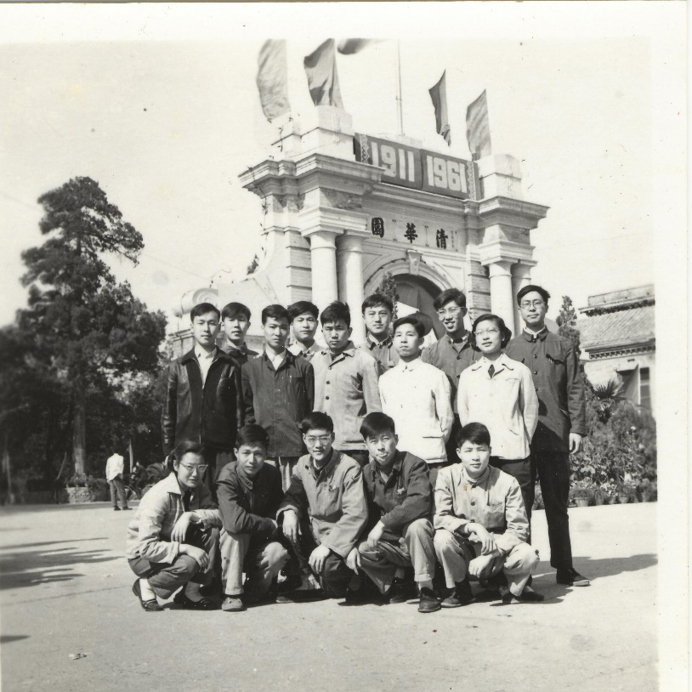
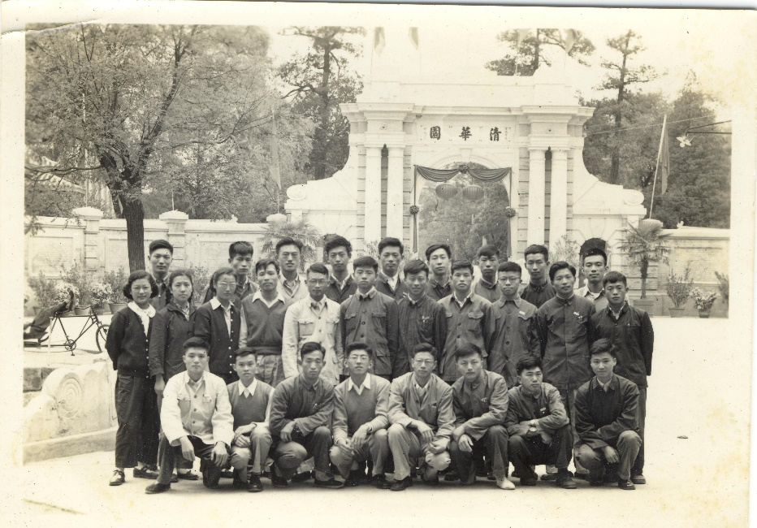
Born on Jan 21, 1938, in Shanghai
Graduated in 1961, from Department of Engineering Physics, Tsinghua University
Join University of Science and Technology of China (USTC) in 1961

Slide 3
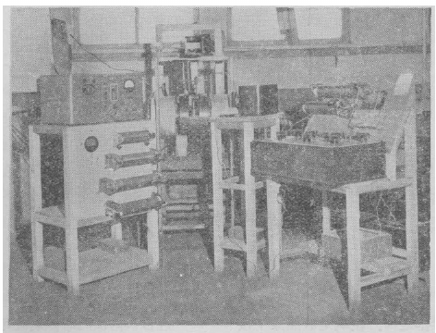
1961-65
Establishment of a Magnetic Spectrometer Laboratory
180° focusing β spectrometer
Iron-free double focusing β magnetic spectrometer
Single-lens β magnetic spectrometer
Scientific Bulletin
1966 11 (2): ISSN: 0023-074X CN: 11-1784/N
A simple 180° focusing β spectrometer
MEI Zhengyue, CHEN Hongfang,
FENG Jie, TAN Bolian, CHEN Jingfeng

Slide 4
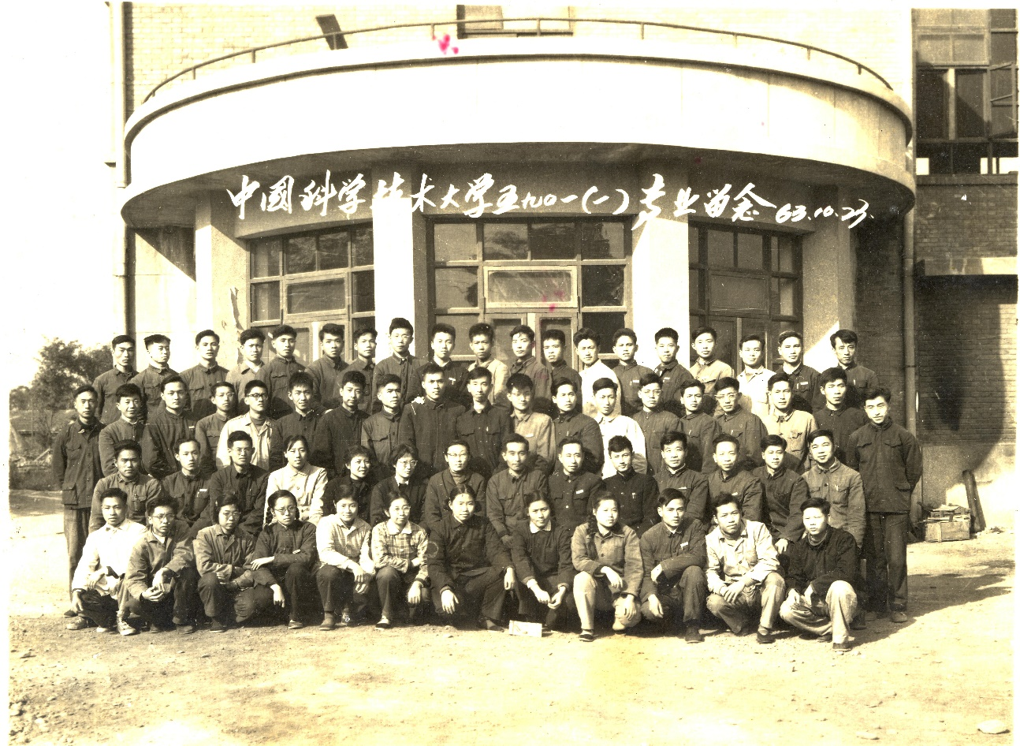
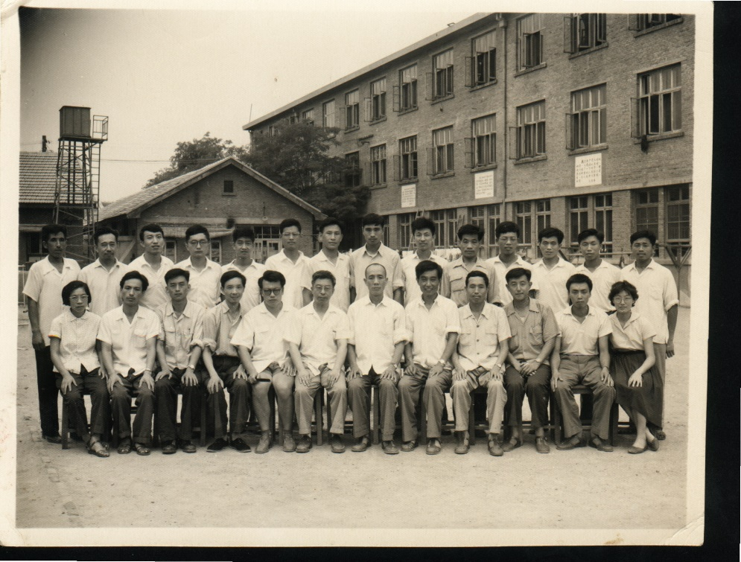
1960 ~ 1970

Slide 5
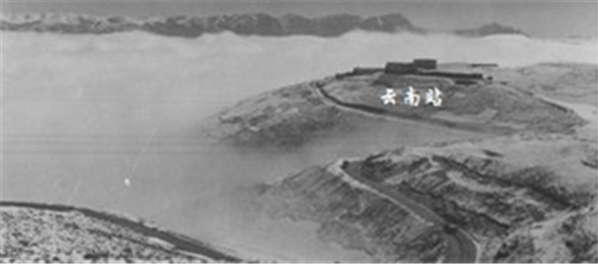
1974~1979 Development of MWPC
Funded by Chinese Academy of Science (CAS) in 1973
R&D MWPC, FEE and DAQ
10×10 cm² MWPC prototyped and tested
  Efficiency, spatial and energy resolution
50×150 cm² MWPC detector built
  for application at Yunnan cosmic ray high-altitude observatory
Electronics group: YANG Yanming (PI), YU Xiaoqi, WANG Baoxing, ZHU Junjie, CHENG Kangchou, WU Xiaoyi, ZHOU Heqin …
Detector group: CHEN Hongfang, ZHANG Yiqun, ZHOU Zhongping, TAN Bolian, WANG Xiaolian, XU Zizong …
Awarded (1981):
Second-class Prize for Scientific and Technological Progress, CAS

Slide 6
1979~1982 Visiting Scholar, University of Wisconsin, USA
E609 Collaboration, Fermi Lab
Development of 150cm×250 cm² MWDC and Delay Line MWDC Operational Experience With A 2.5-Meter×1.5-Meter Delay Line Chamber, Nucl. Instrum. Meth. A 237:493,1985
Development and Test of HCAL
Performance Of A Segmented Hadron Calorimeter, IEEE Trans.Nucl.Sci.29:307-313,1982
Physics analysis
Evidence for multiple scattering of high-energy partons in nuclei,
Phys.Lett.B259:209-215,1991
Jet production from nuclei at 400 GeV/c,
Phys.Lett.B207:222,1988
Energy flow in hard proton – nucleus collisions 400-GeV/c,
Phys.Lett.B244:347-351,1990
Measurement of the dijet cross section in 400-GeV/c pp interactions,
Phys.Rev.D31:984-995,1985
Evidence for higher twist effects in hard pi p collisions at 200-GeV/c,
Phys.Rev.Lett.56:808,1986
Measurement of the single jet invariant cross-section at Fermi lab,
Phys.Lett.B150:322,1985
Measurement of the dijet cross-section in 400-GeV p p collisions,
Phys.Rev.Lett.53:1988,1984.
Notes:
Along with the reform and open up in Chinese politics and economy

Slide 7
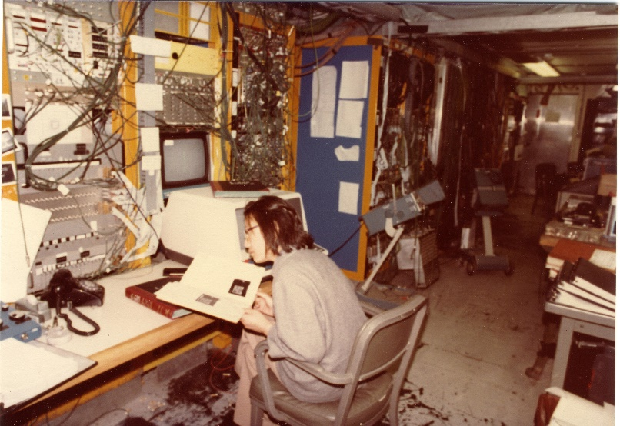
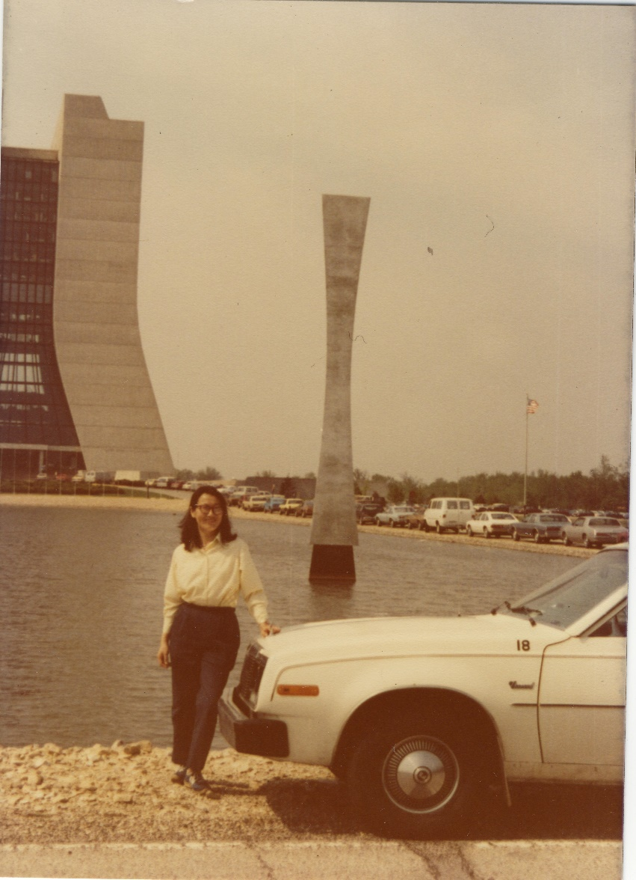
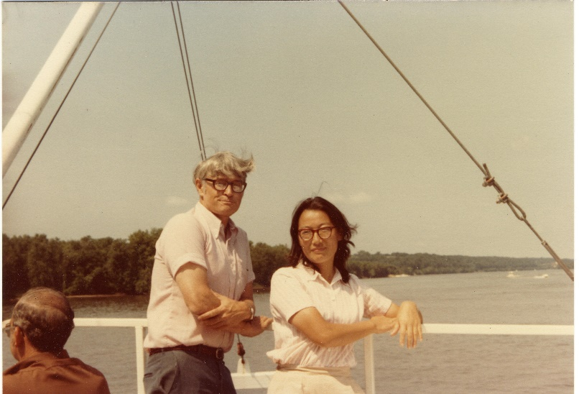

Slide 8
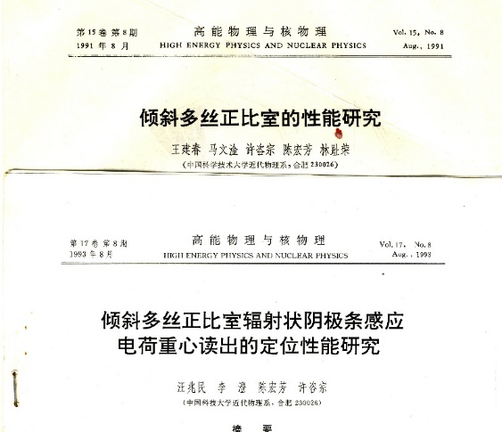
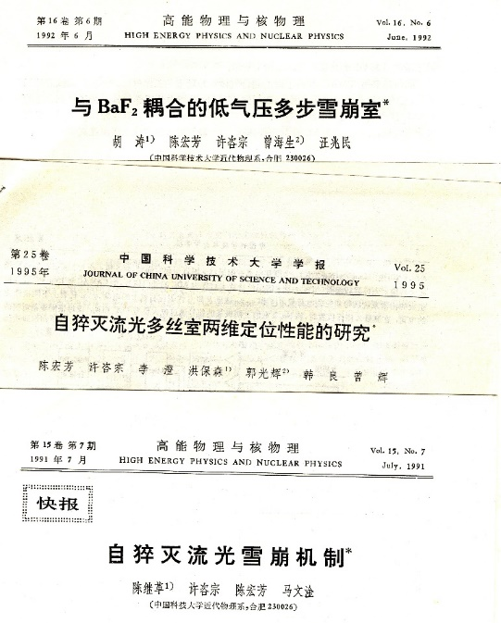
1983~ L3 Collaboration
Luminosity monitor, Muon DC, HCAL
τ physics
Establishment of HEP group at USTC:
CHEN Hongfang, XU Zizong, ZHOU Zhongping, WANG Xiaolian, YOU Tiejian, LIN Zirong, GONG Zhufang, YANG Baozhong, WANG Zhaomin, MA Wengan, LI Cheng, SUN Lazhen, BIAN Hequan, FENG Zhengyong …
Study on the mechanism of self-quenched streamer (NSFC)
BaF2 coupled photo-sensitive proportional chamber (NSFC)
Self-quenching streamer discharge
under extremely large amounts
of quenching gas, Nucl. Instrum. Meth. A 252: 61-64, 1986

Slide 9
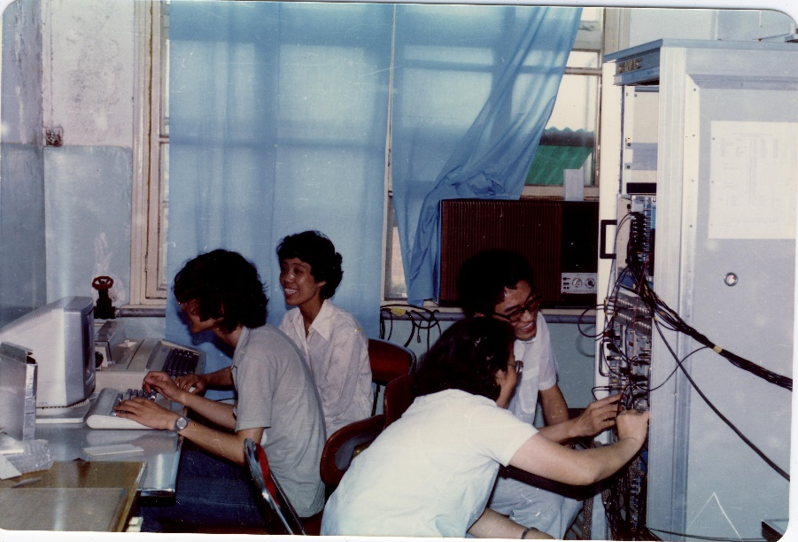
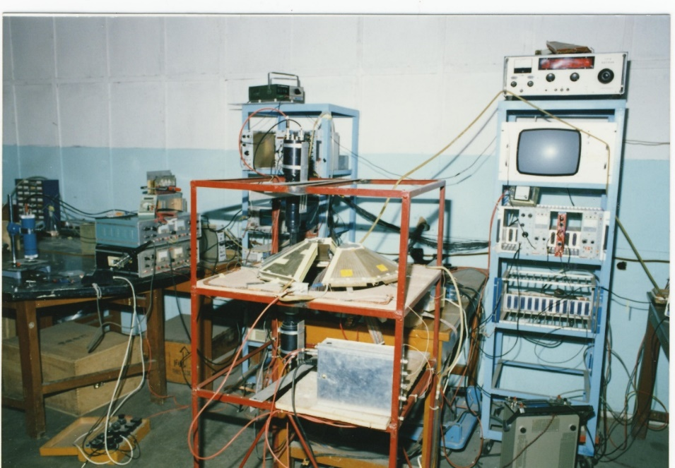
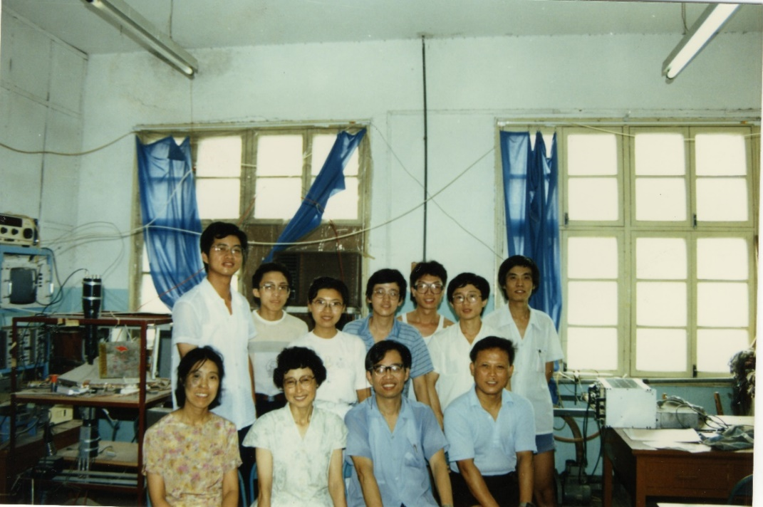
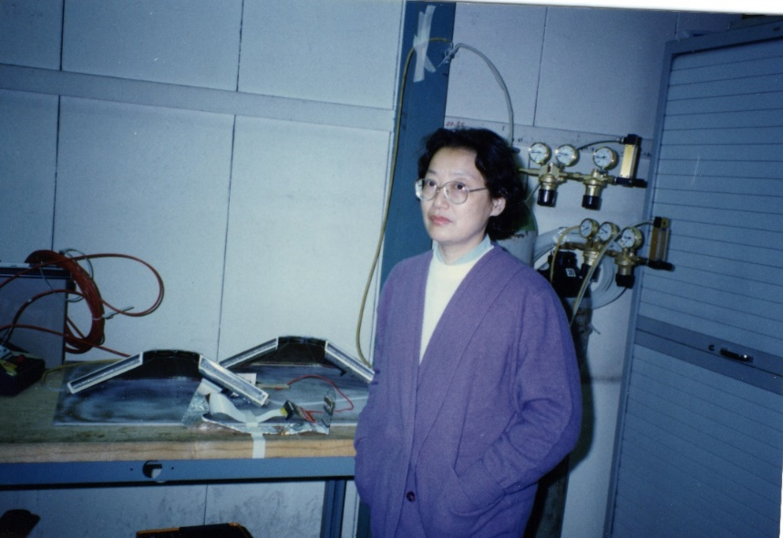
Test of MWPC based luminosity monitor (L3)
@USTC, @CERN, 1988

Slide 10
1991~ BESI and BESII Collaboration
τ mass measurement, ψ’ physics, D physics, J/ψ radiactive decay …
CHEN Hongfang, ZHANG Ziping, WU Jian, YE Shuwei, ZHAO Jiawei, PENG Haiping, YANG Jie
1993~2000 CMS Collaboration
EMC, R&D of new scintillator
CHEN Hongfang, XU Zizong, WANG Zhaomin, WANG Xiaolian, LI Cheng, XU Tong, SHAO Ming …
Study on PWO crystal scintillator, 1997-1998 (CAS)
Study on CMS ECAL, 1999-2001 (NSFC)
1994~2000 AMS Collaboration
LEP physics and development of new-type detector (NSFC)
1999~2005 Cooperation – Flemish (Belgium) and MOST (China)
Study on new scintillator and application in life science and HEP

Slide 11
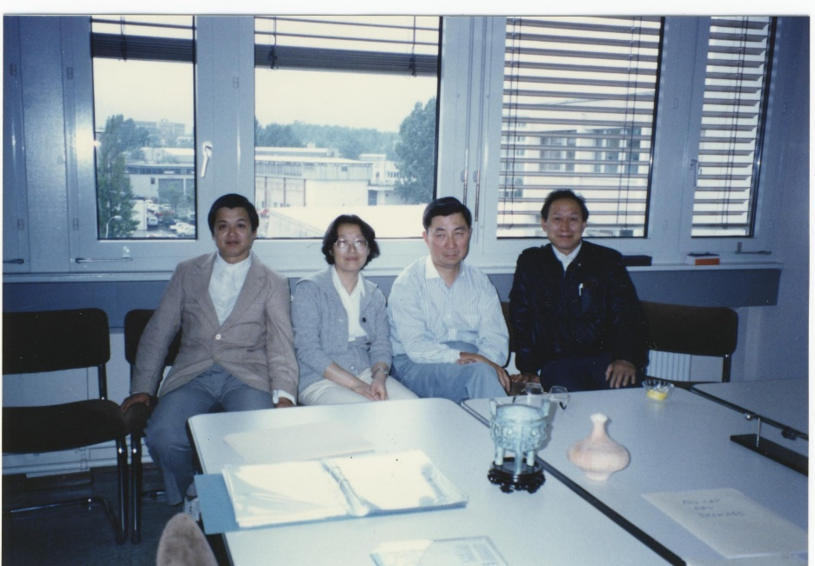
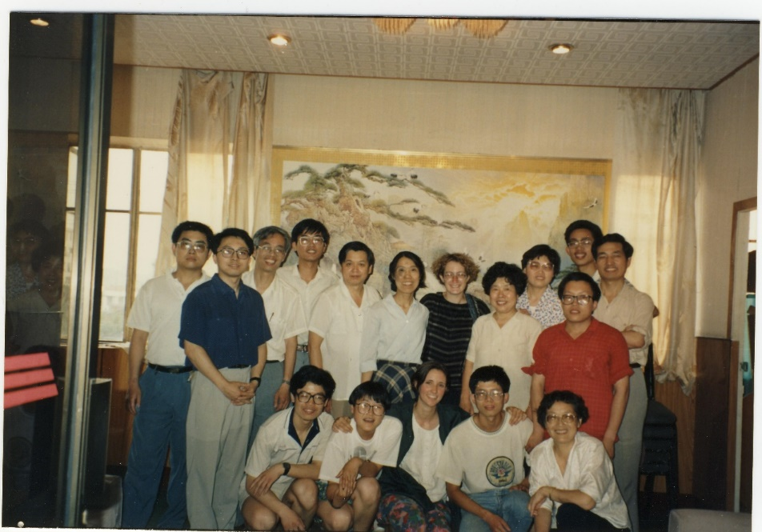
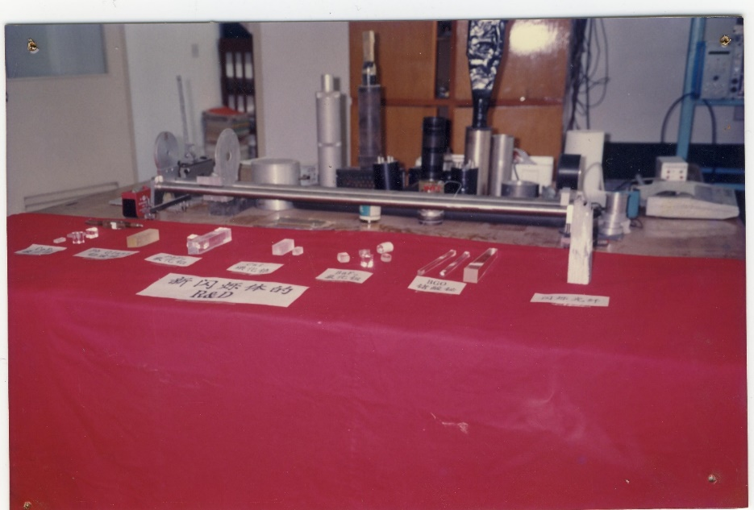
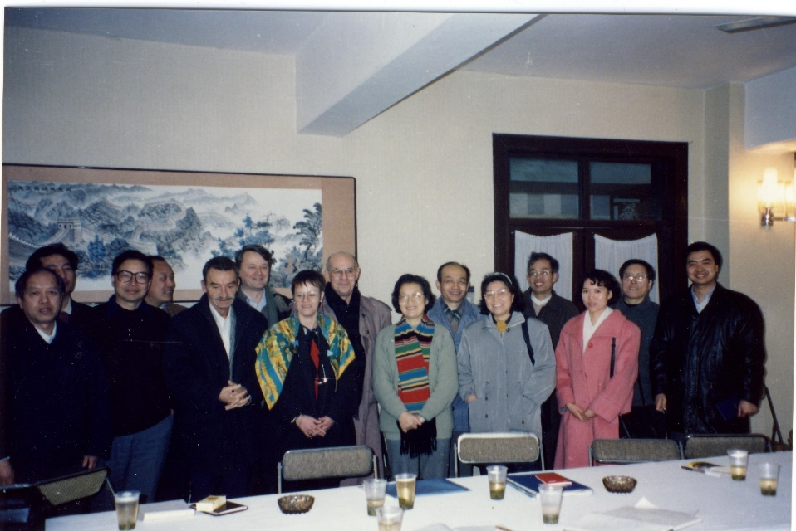
Collaboration with SICCAS
Joint Institute of High Energy Physics (ETHZ－USTC). Deputy

Slide 12
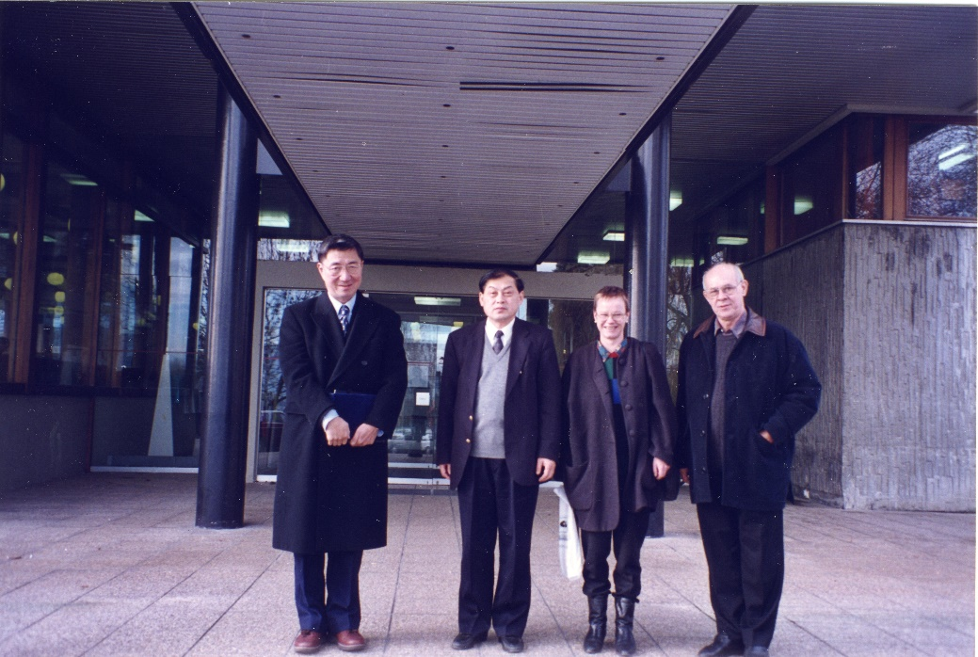
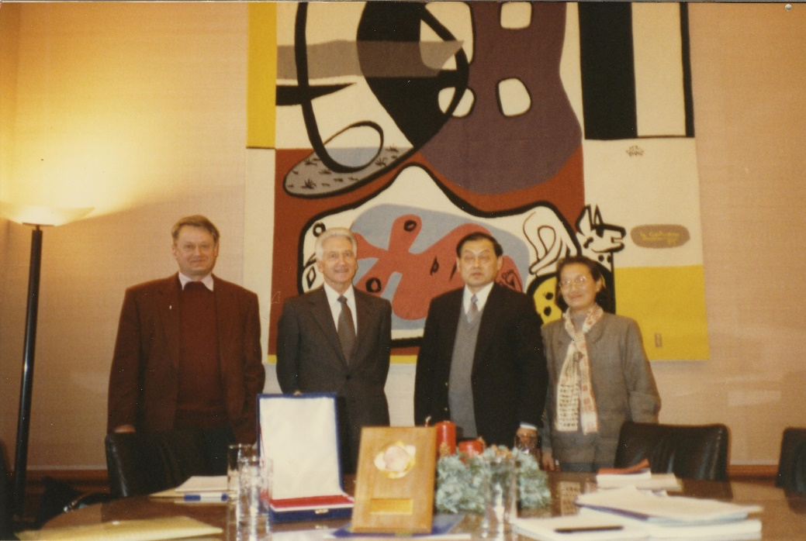
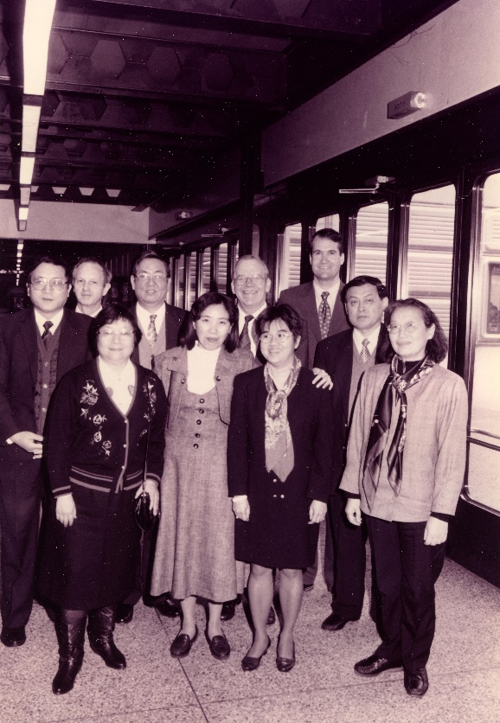
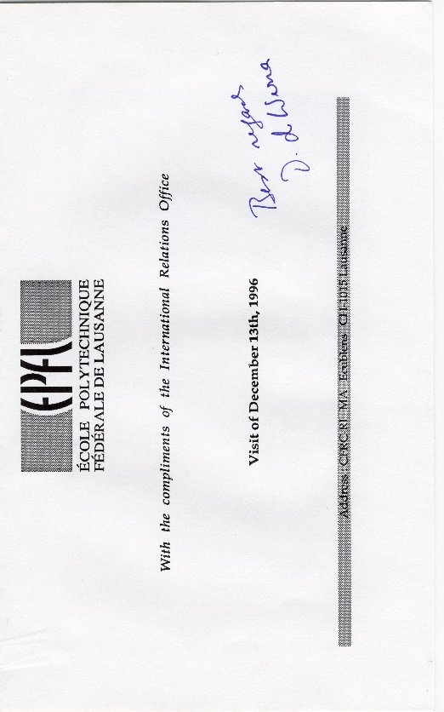
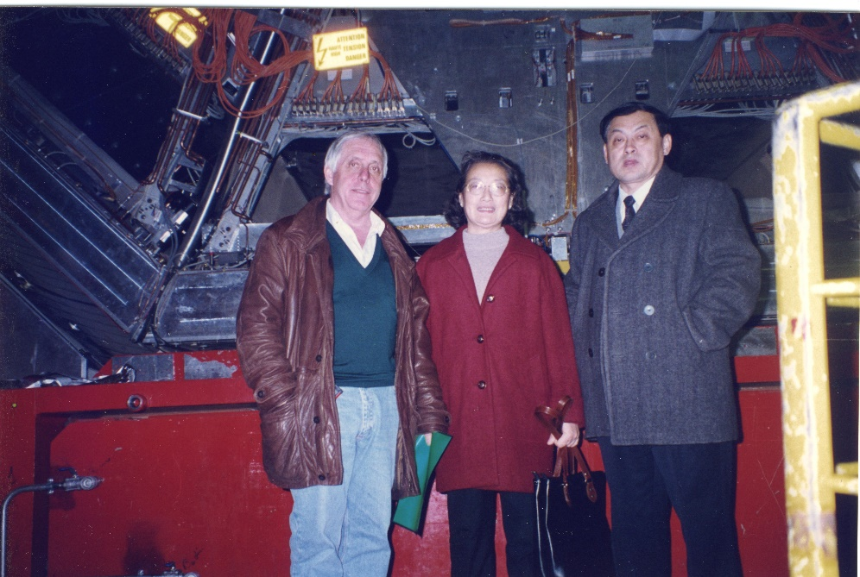
President TANG (USTC) visited ETHZ，L3，EPFL
1996
Notes:
苏黎世联邦理工学院: Zurich Federal Institute of Technology (Eidgenössische Technische Hochschule Zürich)
洛桑联邦理工学院： Lobsang Federal Institute of Technology (Ecole Polytechnique Federale de Lausanne)

Slide 13
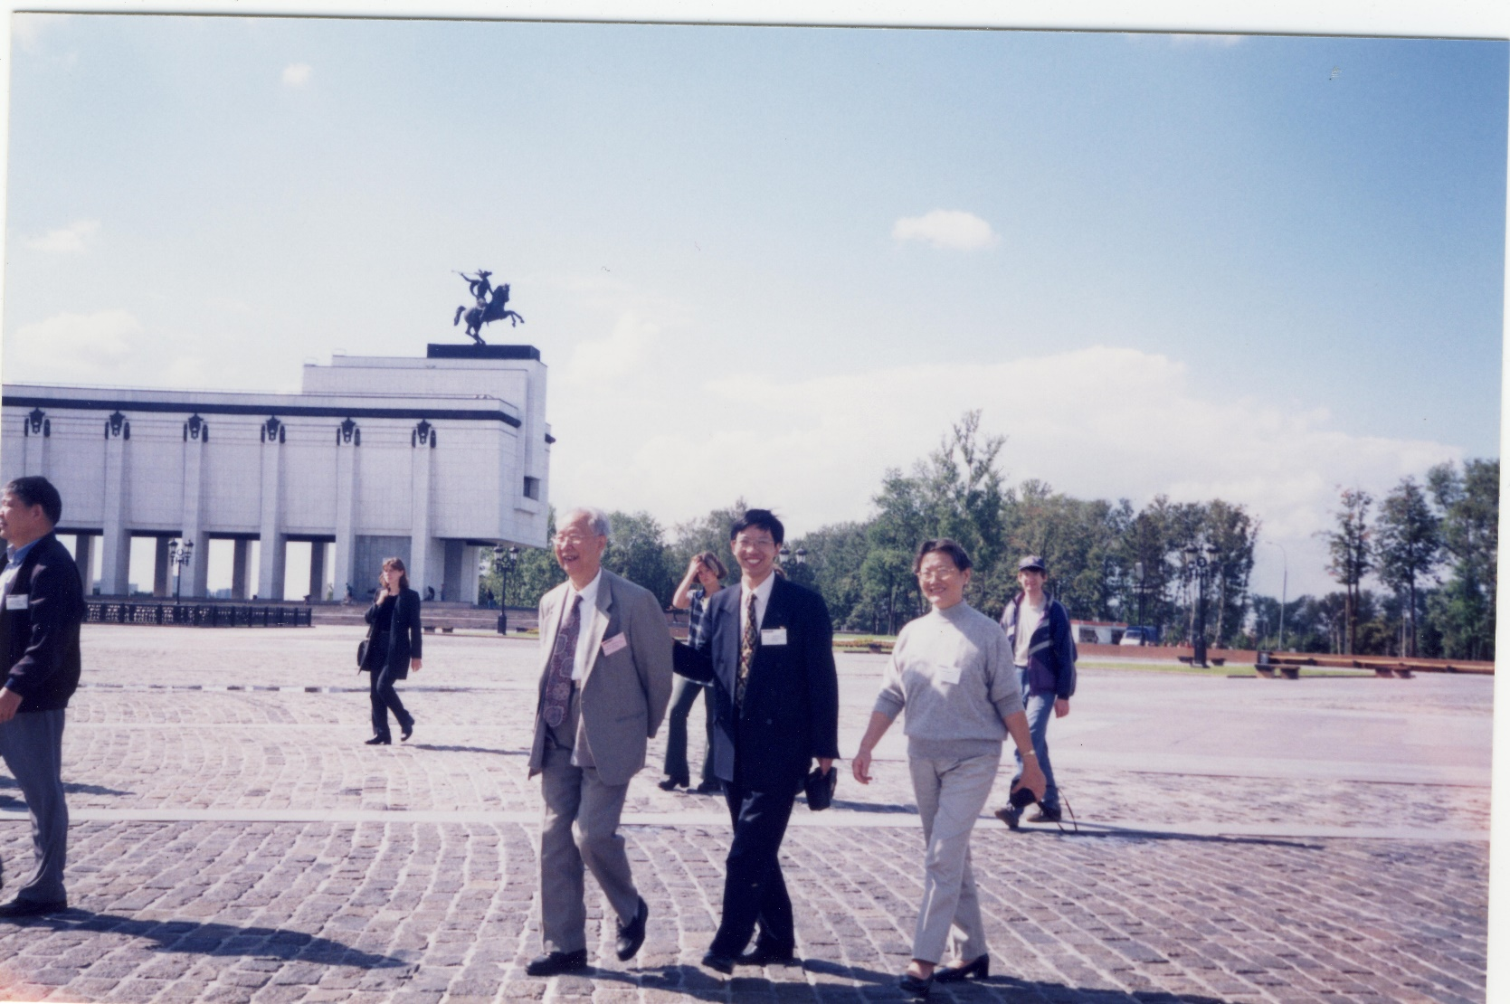
5th International Conference on Inorganic Scintillators (SCINT 1999), Moscow, 1999

Slide 14
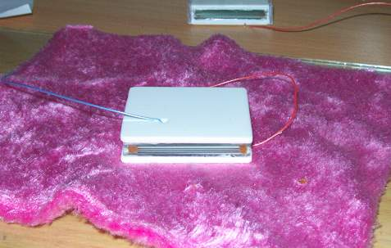
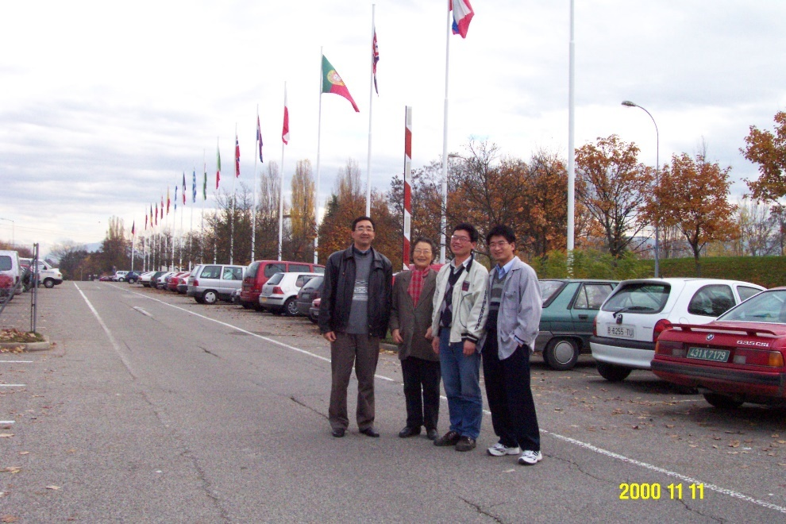
2000~ STAR Collaboration
Development of STAR-TOF based on MRPC technology

Slide 15
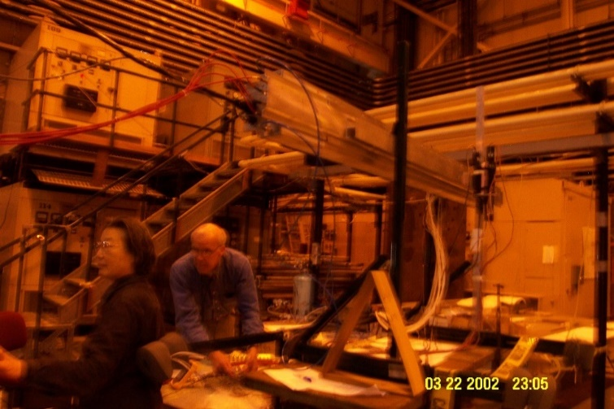
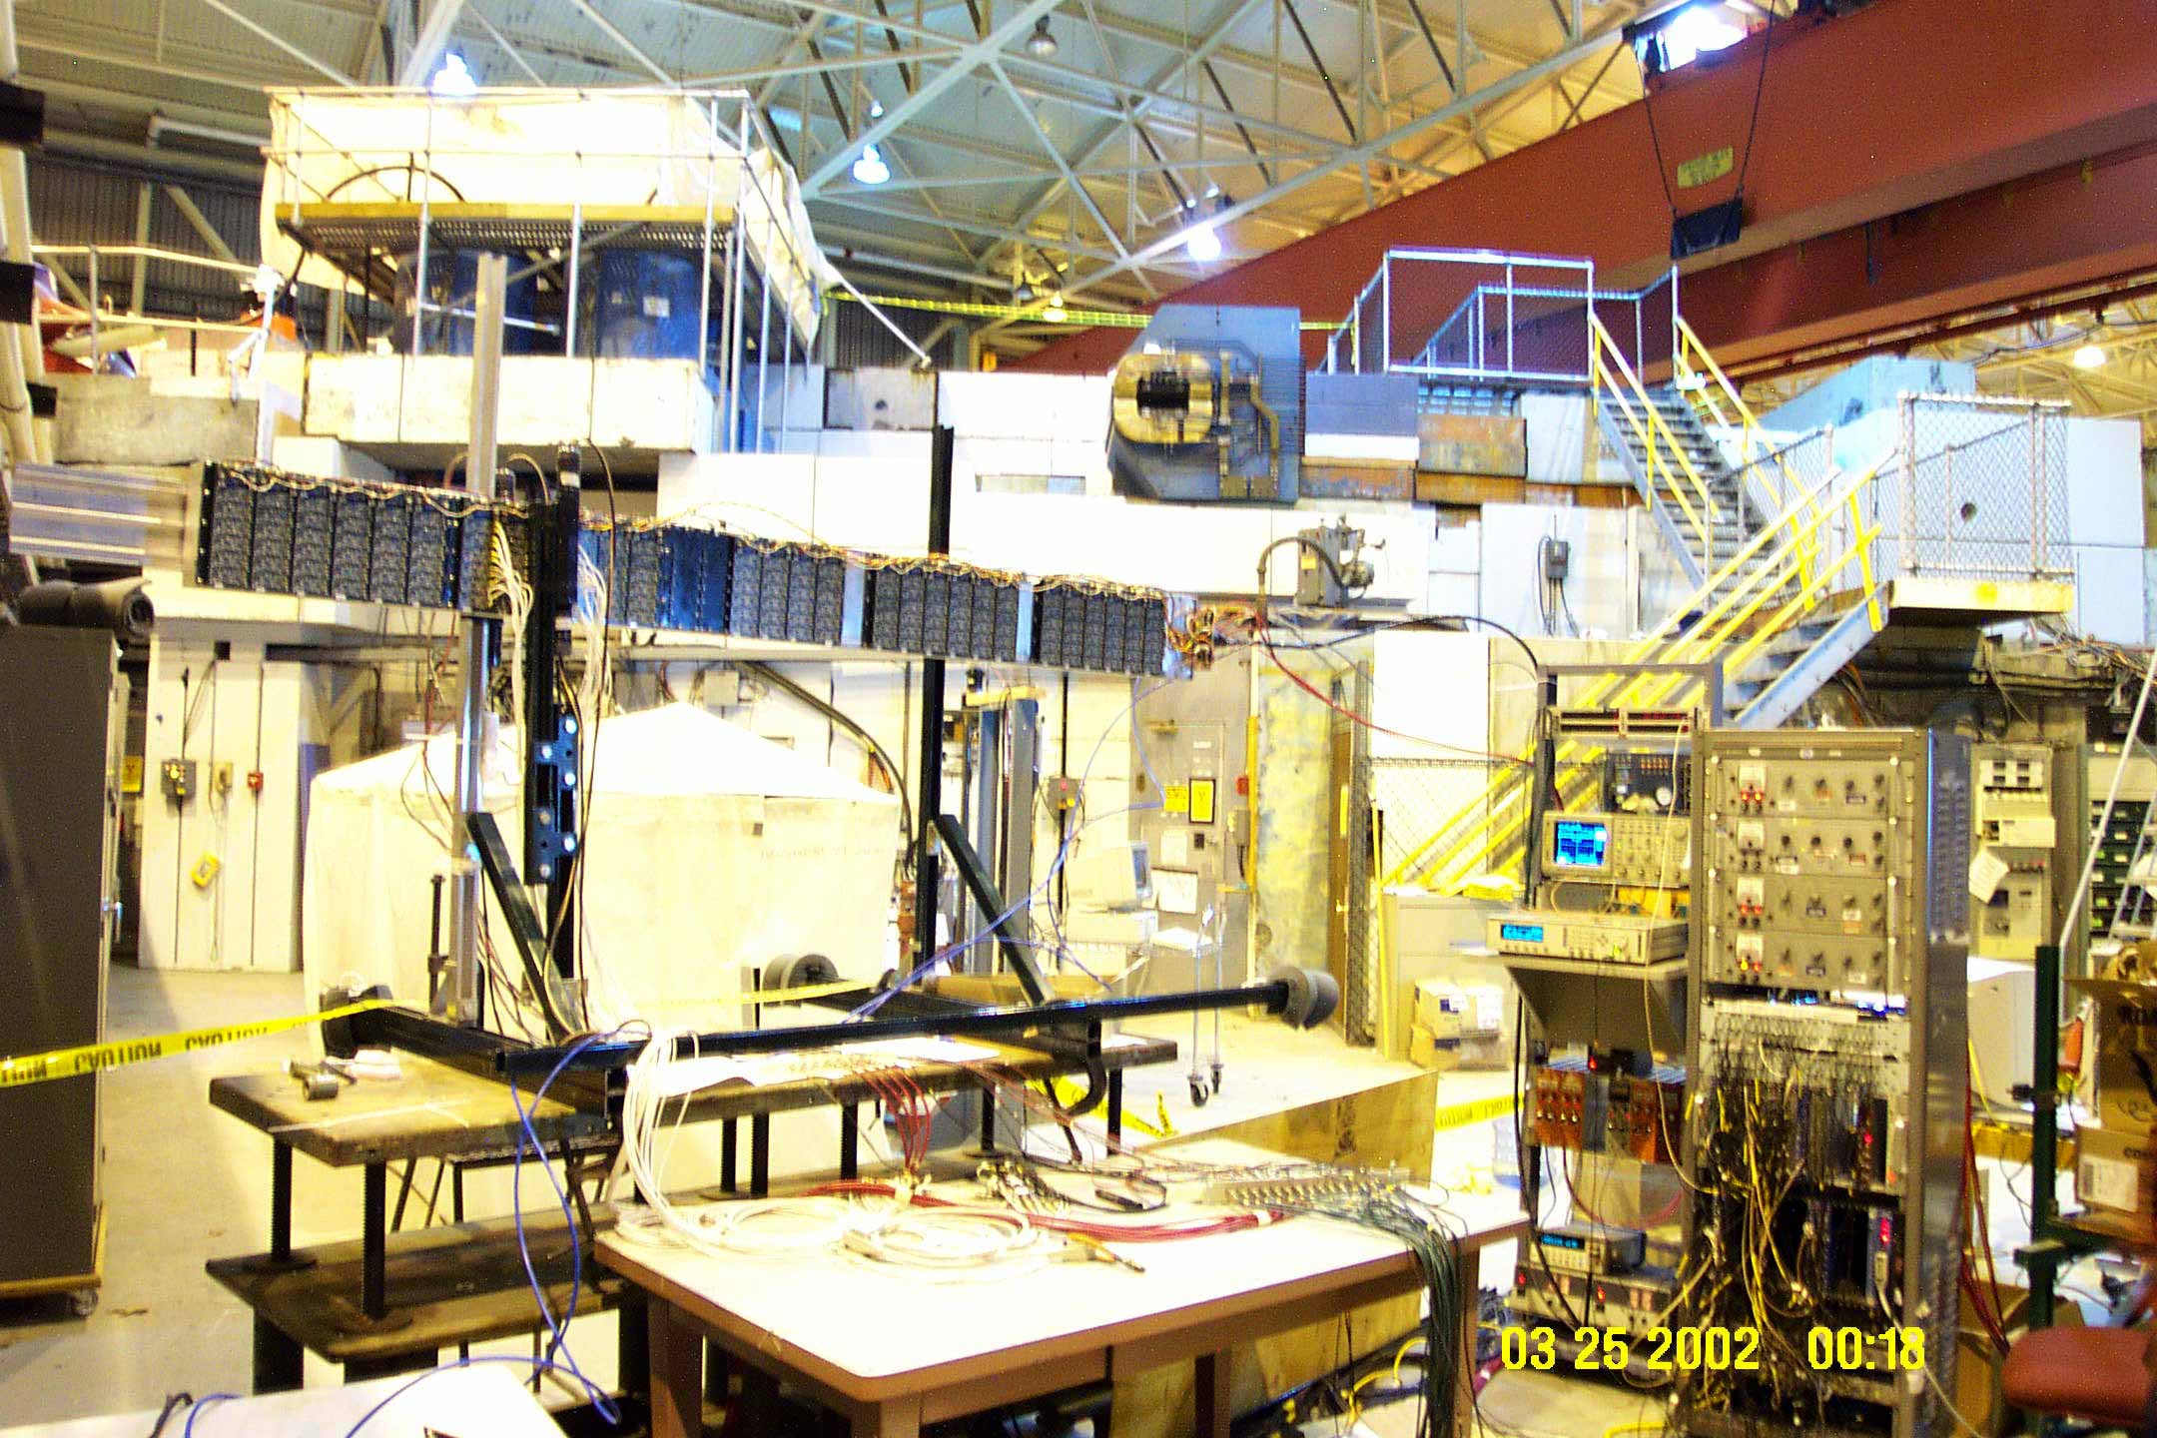
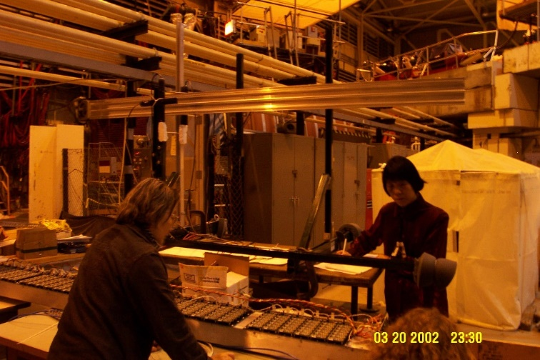
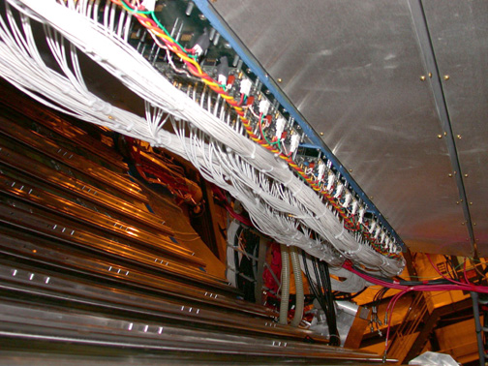
Construction of TOFr (Δη~1, Δϕ～6°) - STAR-TOF demonstrator
Aug 2001, MRPC batch production
Jan 2002, 24 MRPC modules sent to US
Mar-May 2002, “beam” test at AGS
Oct 2002, integrated in STAR
MRPC TOF Tray (28 modules) installed in STAR Oct. ‘ 02 in place of existing central trigger barrel tray
Neighbor
CTB Tray
EMC
Rails
FEE

Slide 16
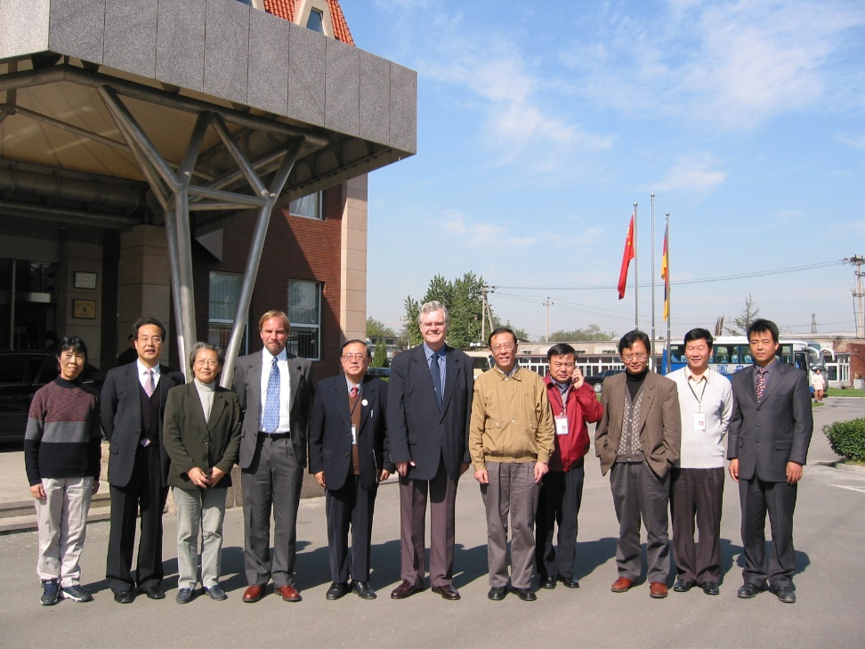
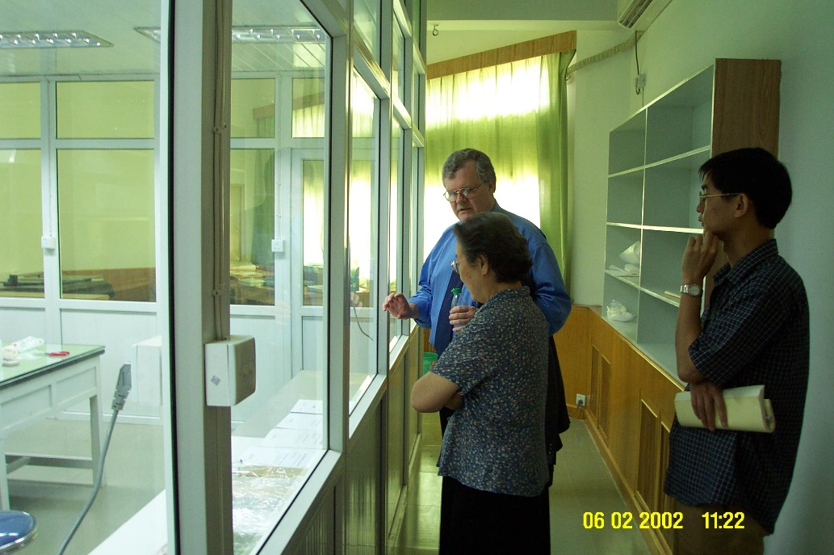
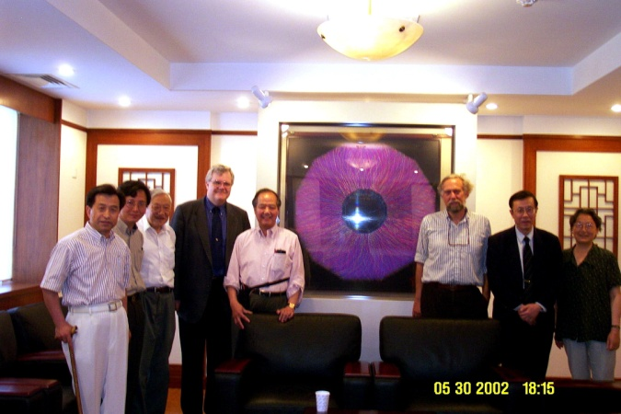
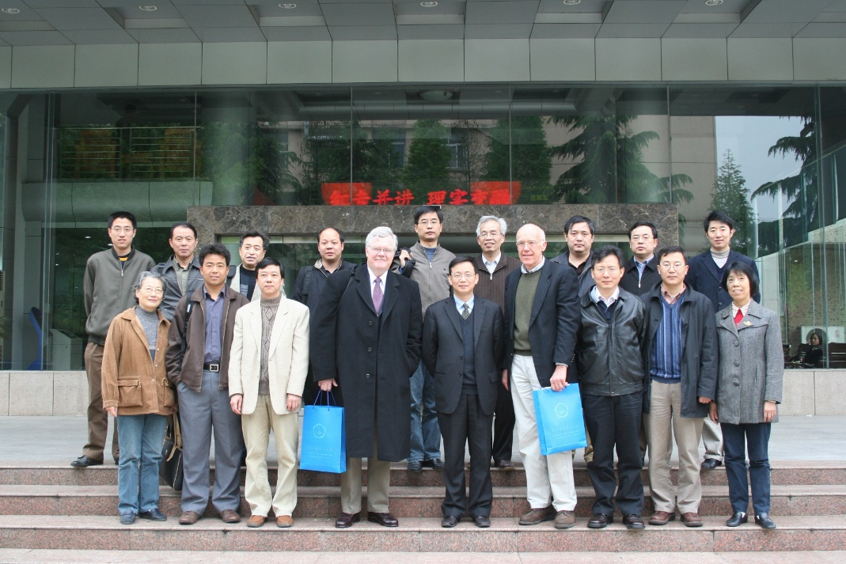

Slide 17
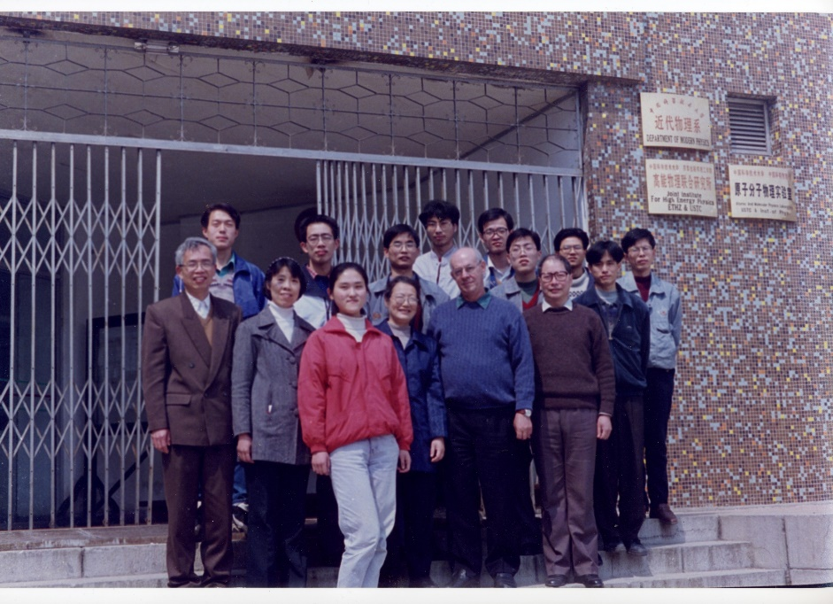
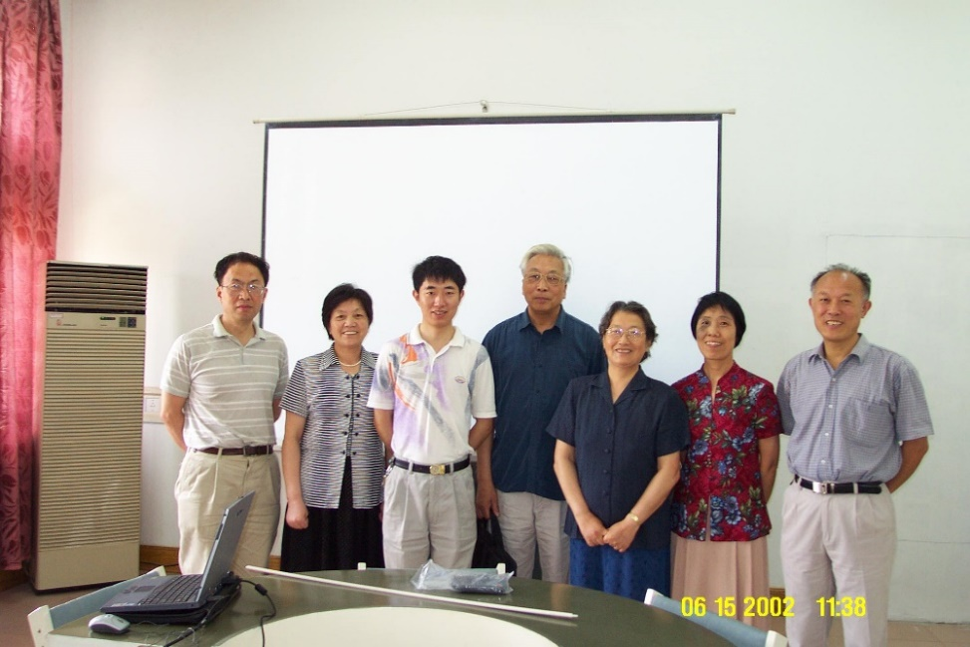
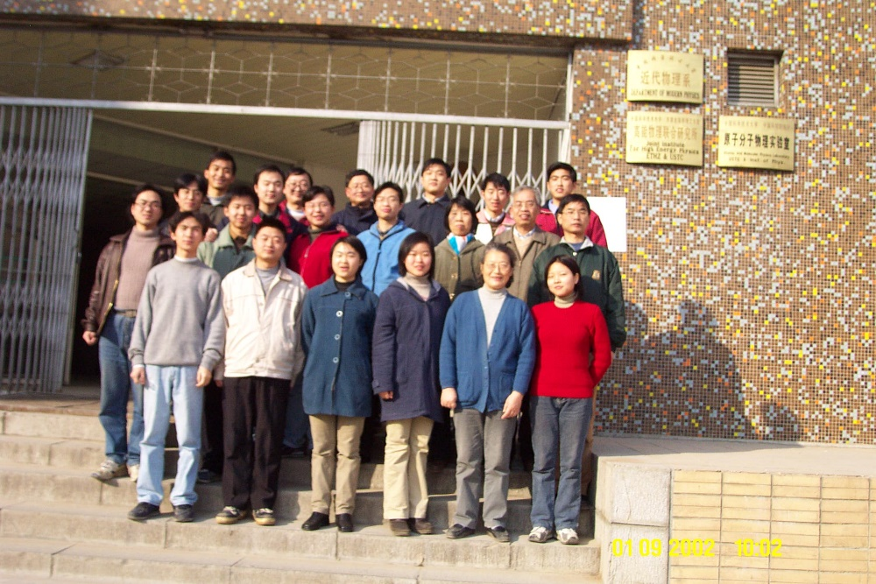
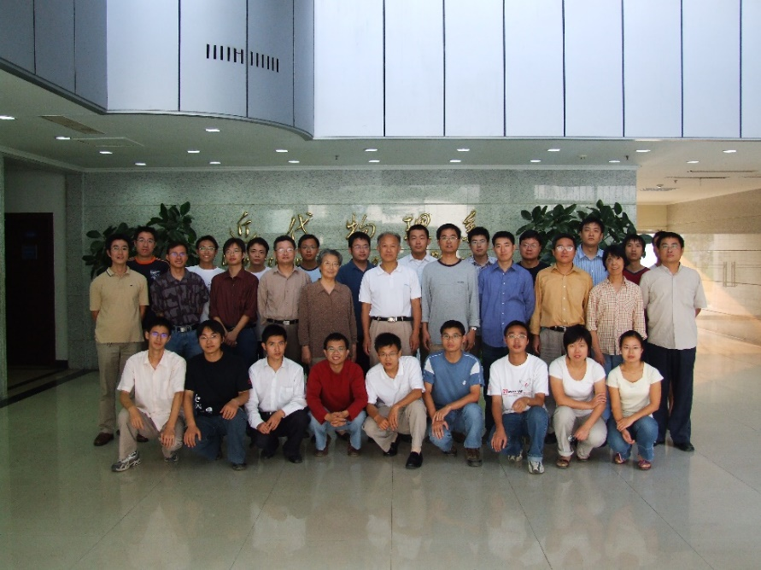

Slide 18
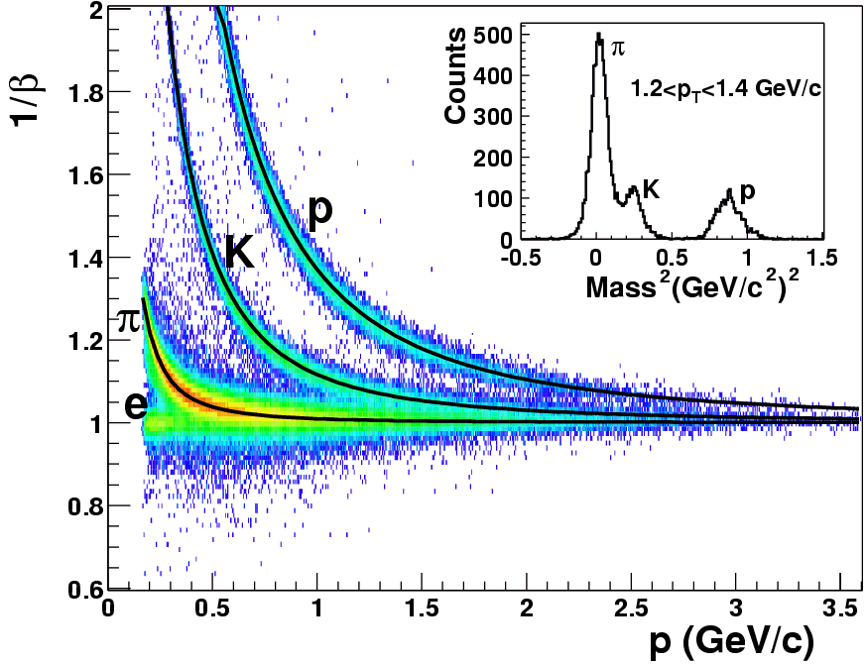
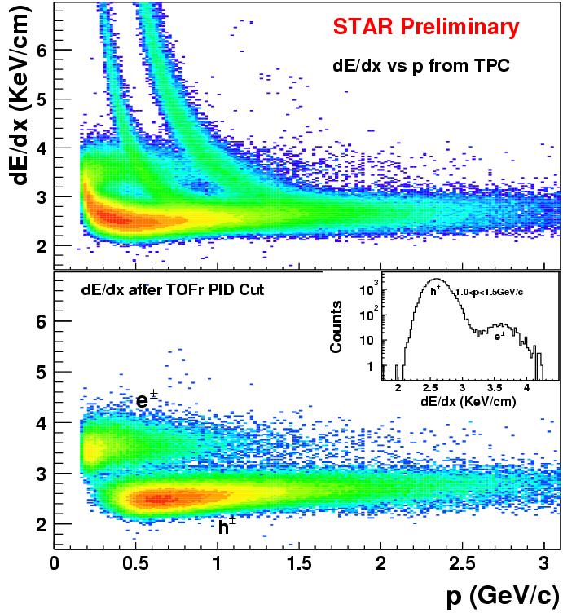
Performance of STAR-TOF prototypes
Hadron PID: (π, K) ~1.6 GeV/c, p ~ 3 GeV/c
Electron ID (TPC+TOF): (e, π) ~ 4GeV/c
|1/β-1|<0.03
Lijuan Ruan for STAR Collaboration,
PLB 616(2005)8
Xin Dong for STAR Collaboration,
PRL 94(2005)062301

Slide 19
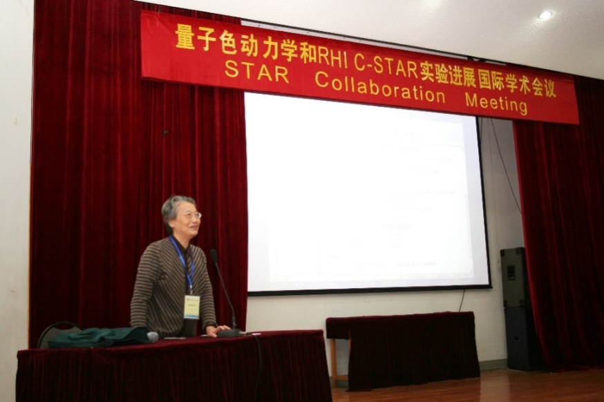
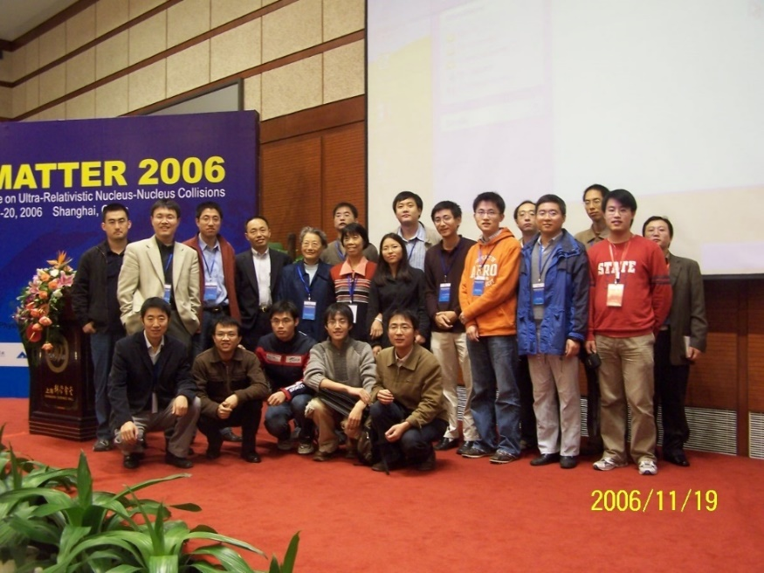
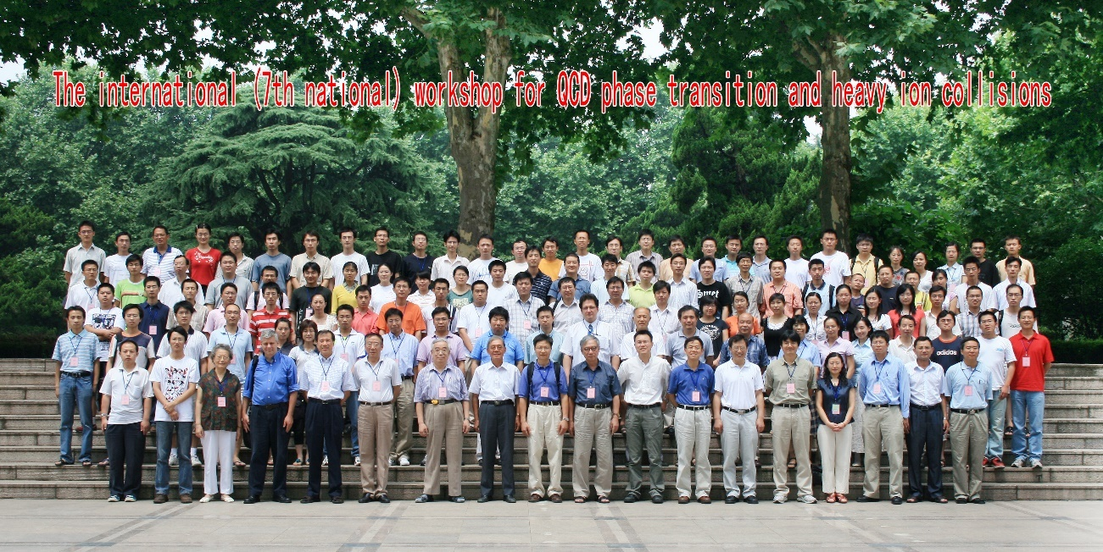
STAR Collaboration meeting, 2006, Hefei
QM 2006, Shanghai
Workshop on QCD phase transition and heavy ion collisions, 2008

Slide 20
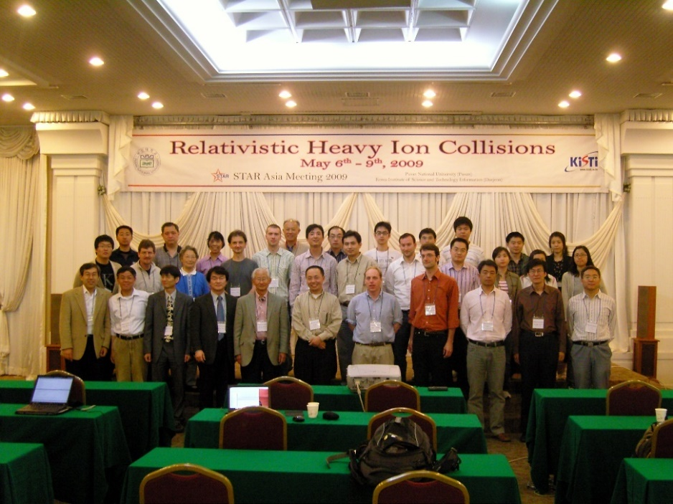
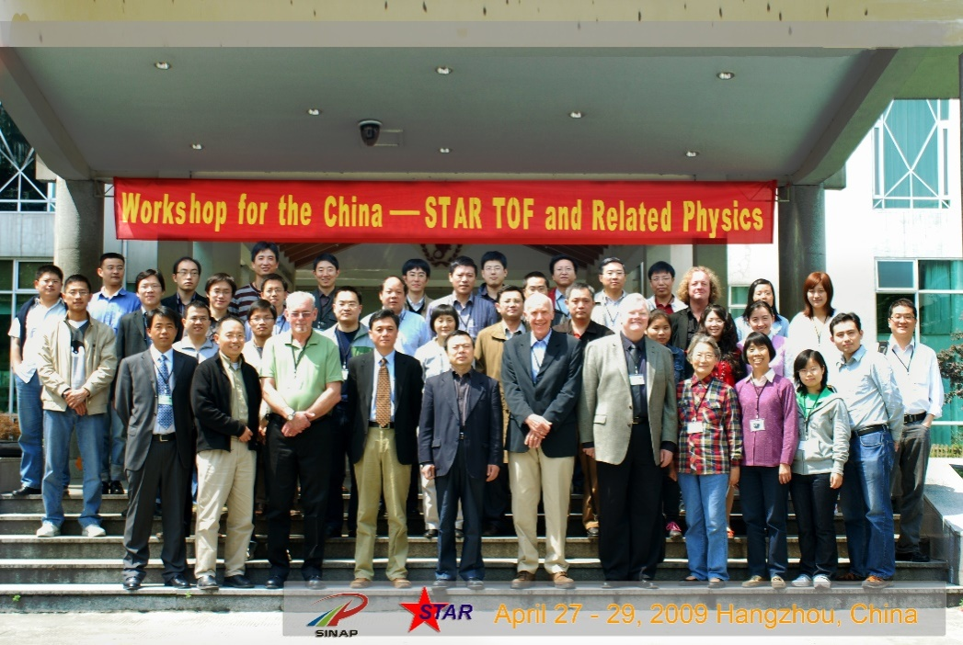
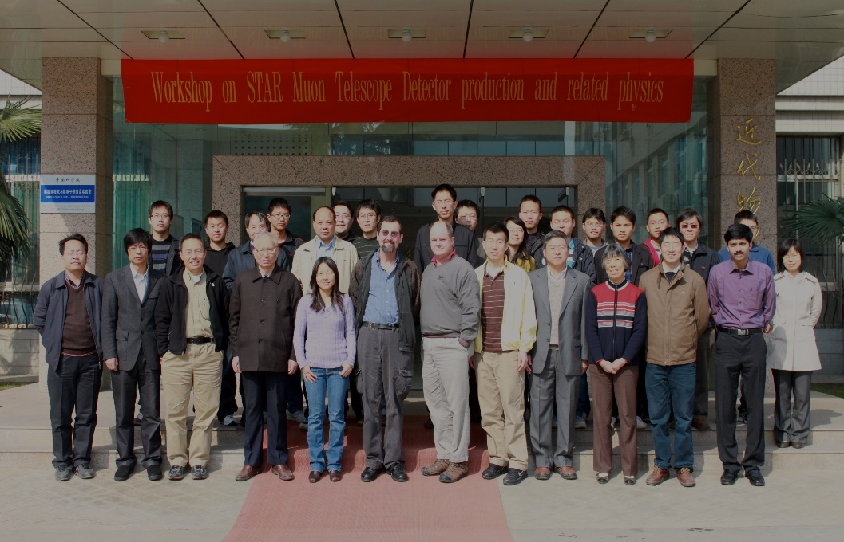
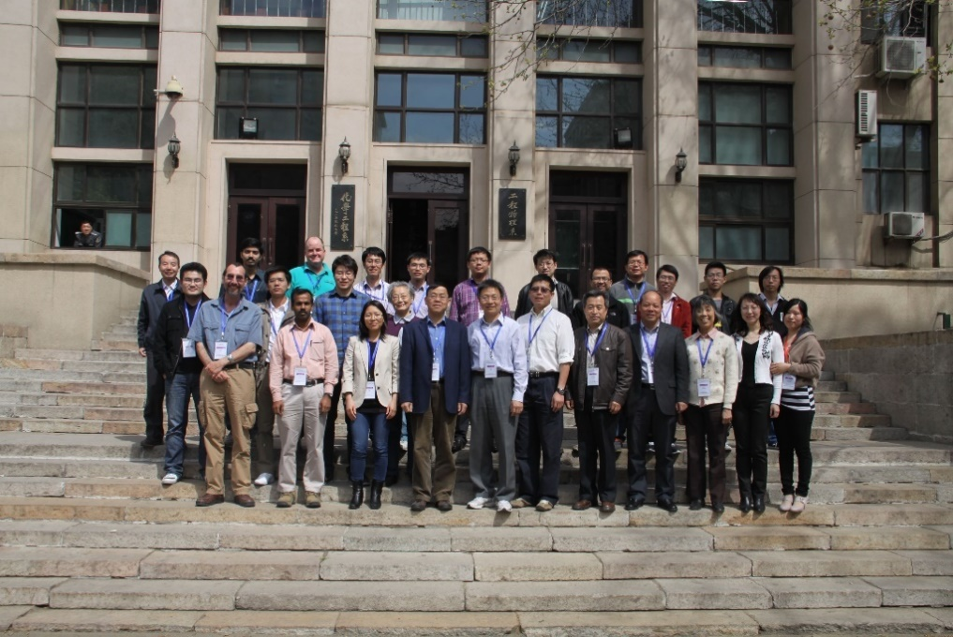
STAR Asia Meeting, 2009, Busan, Korea
STAR TOF workshop, 2009, Hangzhou
STAR/ MTD workshop, 2011, Hefei
STAR/ MTD workshop, 2012, Beijing

Slide 21
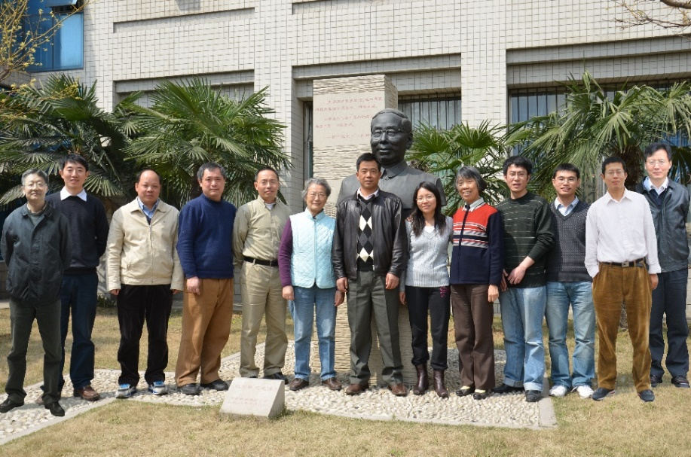
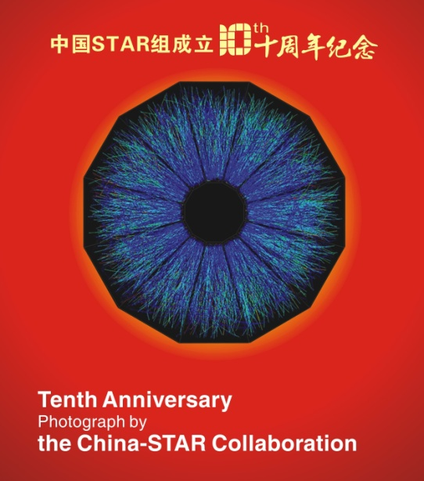

STAR in China, 10th anniversary, 2012
Notes:
Dr. Timothy J. Hallman, Associate Director – NP, Nuclear Science Advisory Committee (NSAC)

Slide 22





“Antimatter detection, hadron spectroscopy and collective properties of quark matter in relativistic heavy ion collisions” awarded First-class Shanghai Natural Science Award (2014) and Second-class National Natural Science Award (2016)
…

Slide 23
Education
Courses: Atomic Physics, Topics on Modern Physics and High-energy Collision Physics
Books: Atomic Physics, Particle detection technology, Cosmic code (translation), Modern Physics, Atomic Physics and Quantum Mechanics
Prizes: First-class Anhui Education Commission Excellent Teaching Achievement Award (special class for gifted young), 1989; The National Education Commission Award for Excellence in Teaching Achievement,1989; The Second-class National Education Commission Prize for Excellent Teaching Textbook, 1995; Lifetime Achievement Award in Teaching (Learning & Teaching Devotee, 困学守望), 2008

Slide 24






2004~ BESIII (IB chair)
2006~ CBM
JinPing, 2010
GSI, 2010
DAMPE, 2008, Nanjing
Notes:
暗物质粒子探测（dark matter particle explorer, DAMPE）
中国锦屏地下实验室 (China Jinping Underground Laboratory, CJPL)

Slide 25






Yellow mountain
West Lake, Hangzhou
EXPO2010, Shanghai
Yunnan

Slide 26





Slide 27





Slide 28


iTPC review, Dec 2016, Shandong University, Jinan
Qian Yang Ph.D thesis defense, May 2017, USTC, Hefei

Slide 29

Notes:
She left us in Dec 14, 2017, due to organ failure induced by pulmonary fibrosis (lung disease).

