Slide 1
Status of Higgs analyses
Yaquan Fang (IHEP), Gang Li (IHEP), Manqi Ruan (IHEP)
June 6, 2018

Slide 2
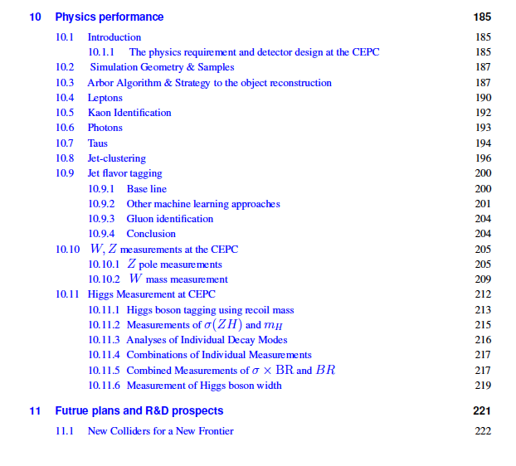
Higgs physics for CDR

Slide 3
Slides from Rome workshop

Slide 4
Status of each channel (V4)
H->bb,cc,gg Yu Bai : Z(->μμ)H->bb,cc,gg Z(->vv,qq)
H->γγ Fangyi Guo : all channels with fast simulation
H->ττ Dan Yu : Z->ll,qq H->ττ : Z->vv H->ττ
H->μμ Kaili Zhang : Z->qq H->μμ, Zhaoru Zhang: Z->llH->μμ
H->WW Tong Li & Lianliang Ma : Z(->vv)H(->WW->4j)
Mila Pandurovic (Serbia): Z(->jj)H(->WW->4j)
H->ZZ Ryuta Kiuchi , Xin Shi: Z(->mm)H(->ZZ->vvjj)
Shih-Chieh Hsu & Alex Schuy : Z(->vv)H(->ZZ->mmjj)
WW fusion Hao Liang (IHEP) to be updated
H->Invisible Xin Shi & Maoqian Jing (IHEP) to be updated
H->Zγ Weiming Yao (LBNL) will be rescaled
Combination : Kaili Zhang (IHEP) collecting inputs.
The one with greeen color (to be done or ongoing)
If it can be finished on time, we will use rescaled v1 results.

Slide 5
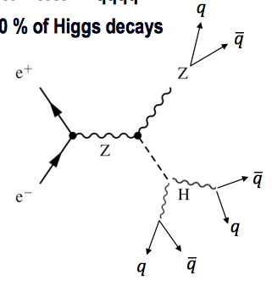
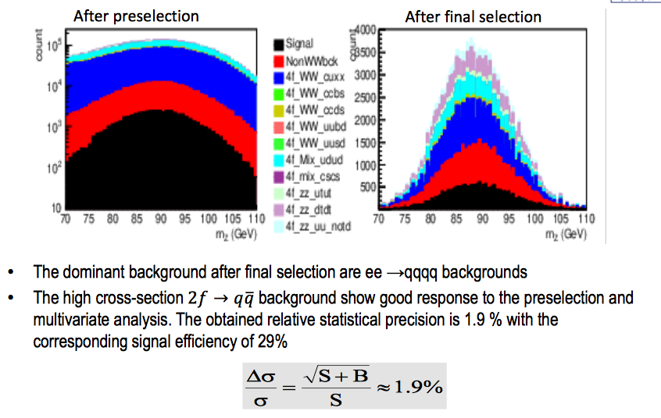
Some progresses
Which is comparable to vv4j

