Slide 1
Electroweak physics at CEPC
Zhijun Liang
Institute of High Energy Physics , Chinese Academy of Science
ICHEP 2016, August 6, 2016
Chicago, USA

Slide 2
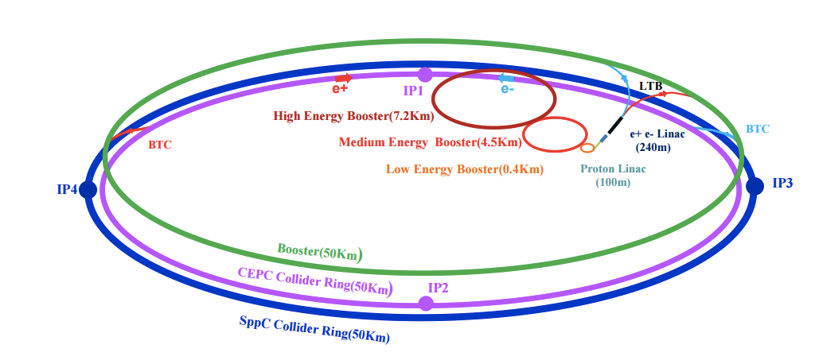
CEPC accelerator
Electron-positron circular collider
Higgs Factory（E_{cms}=250GeV , 10⁶ Higgs)
Precision study of Higgs coupling in ZH runs
complementary to ILC
See Manqi and Gang’s talk this morning in Higgs section for more details
Z factory（E_{cms}=91 GeV, 10¹⁰ Z Boson）:
Precision Electroweak measurement in Z pole running
Major focus of this talk
Preliminary Conceptual Design Report( Pre-CDR) available :
http://cepc.ihep.ac.cn/preCDR/volume.html
Aiming to finalize Conceptual Design Report (CDR) next year

Slide 3
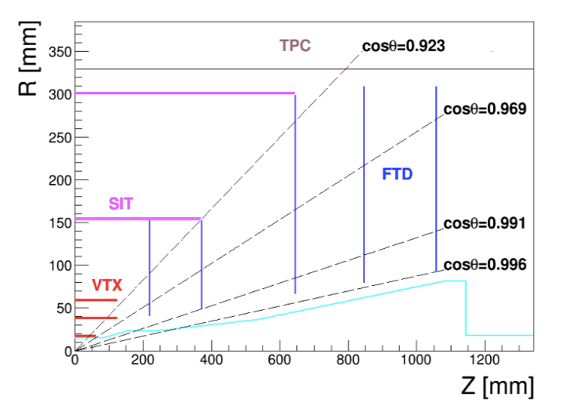
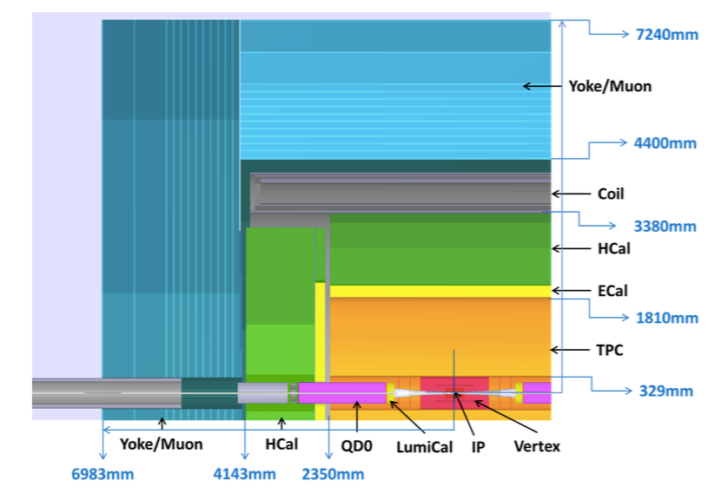
CEPC detector (1)
ILD-like design with some modification for circular collider
No Power-pulsing
Tracking system (Vertex detector, TPC detector , 3.5T magnet)
Expected Pixel size in vertex detector : less than 16x 16μm
Expected Impact parameter resolution: less than 5μm
Expected Tracking resolution : δ(1/Pt) ~ 2*10⁻⁵(GeV⁻¹)

Slide 4
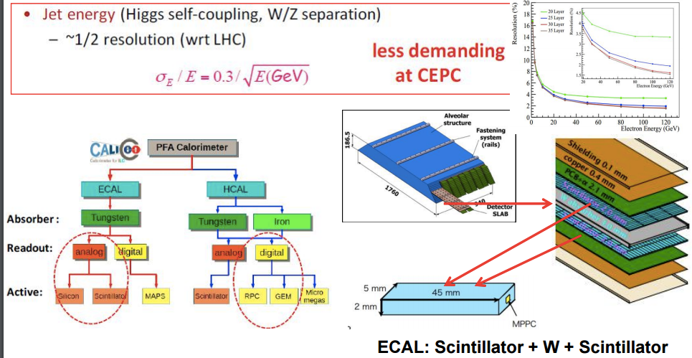
CEPC detector (2)
Calorimeters:
Concept of Particle Flow Algorithm (PFA) based
EM calorimeter energy resolution: σ_{E}/E ~ 0.16/√E
Had calorimeter energy resolution: σ_{E}/E ~ 0.5/√E
Expected jet energy resolution : σ_{E}/E ~ 0.3/√E

Slide 5
Motivation
CEPC have very good potential in electroweak physics.
Precision measurement is important
It constrain new physics beyond the standard model.
Eg: Radiative corrections of the W or Z boson is sensitive to new physics

Slide 6
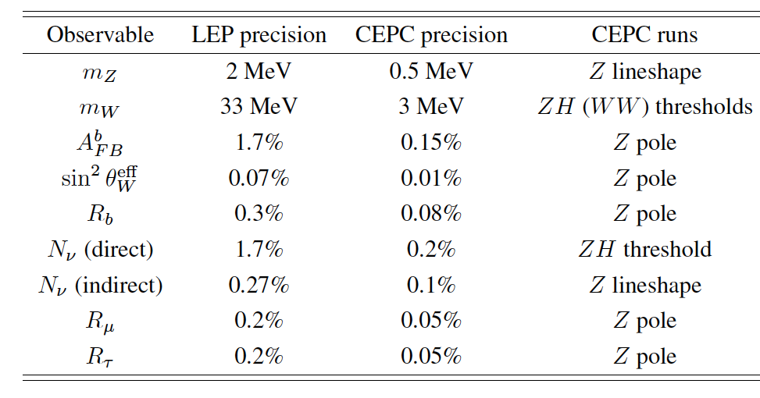
The prospect of CEPC electroweak physics in pre-CDR study
Expected precision on some key measurements in CEPC Pre-CDR study based on projections from LEP and ILC.
http://cepc.ihep.ac.cn/preCDR/volume.html
From now to next year, plan to update the study for Conceptual Design Report (CDR) with full detector simulation

Slide 7
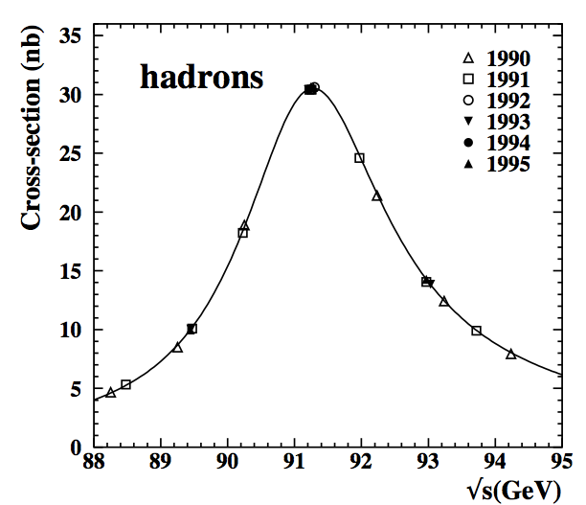
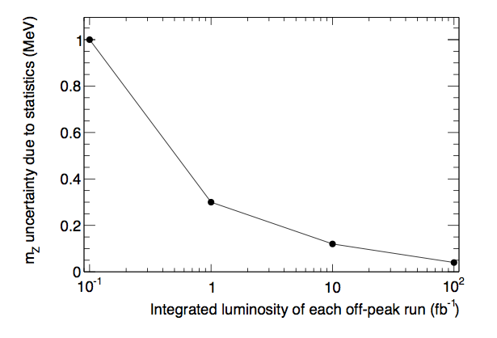
Z mass measurement
LEP measurement : 91.1876±0.0021 GeV
CEPC possible goal: 0.5 MeV
Z threshold scan runs is needed to achieve high precision.
Stat uncertainty : 0.2MeV
Better to have more than 10fb⁻¹ for off-peak runs ( 6 off-peaks runs)
Syst uncertainty: ~0.5 MeV
Beam energy uncertainty need to be better than 5ppm
start to Establishing a accelerator model relating the measured beam energy
Study of the resonant depolarization technique to measure beam energy (LEP approach)
CEPC off-peak runs stat
LEP

Slide 8
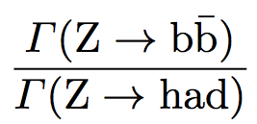
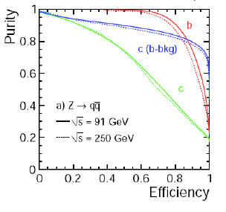
Branching ratio ( R^{b})
LEP measurement 0.21594 ±0.00066
Stat error : 0.44%
Syst error : 0.35%
Typically using 65% working points
CEPC
Expected Stat error ( 0.04%)
Expected Syst error (0.07%)
Expect to use 80% working points
15% higher efficiency than SLD
20-30% higher in purity than SLD
Uncertainty | LEP | CEPC | CEPC improvement
charm physics modeling | 0.2% | 0.05% | tighter b tagging working point
hemisphere tag correlations for b events | 0.2% | 0.1% | Higher b tagging efficiency
gluon splitting | 0.15% | 0.08% | Better granularity in Calo

Slide 9
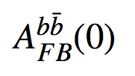
Backward-forward asymmetry measured from b jet
LEP measurement : 0.1000+-0.0017 (Z peak)
Method 1: Soft lepton from b/c decay (~2%)
Method 2: jet charge method using Inclusive b jet (~1.2%)
Method 3: D meson method (>8%, less important method)
CEPC
Focus more on method 2 (inclusive b jet measurement)
Expected Systematics (0.15%) :
Uncertainty | LEP | CEPC | CEPC improvement
charm physics modeling | 0.2% | 0.05% | tighter b tagging working point
tracking resolution | 0.8% | 0.05% | better tracking resolution
hemisphere tag correlations for b events | 1.2% | 0.1% | Higher b tagging efficiency
QCD and thrust axis correction | 0.7% | 0.1% | Better granularity in Calo

Slide 10
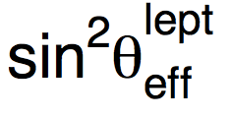
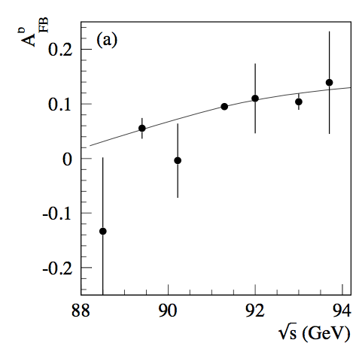
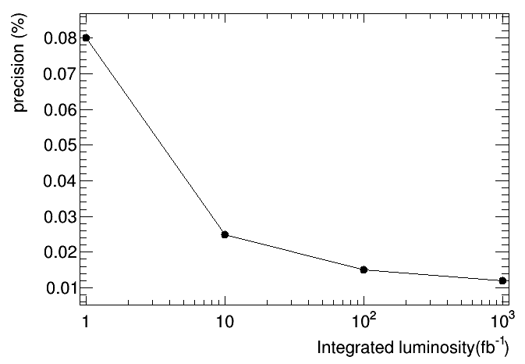
Weak mixing angle
LEP/SLD: 0.23153 ± 0.00016
0.1% precision.
Stat error in off –peak runs is one of limiting factor.
CEPC
Stat error : 0.02% ;
systematics error : 0.01%
Input From Backward-forward asymmetry measurement
The statistics of off-Z peak runs is one of the important issue.
Need at least 10 fb⁻¹ for off-peak runs to reach high precision.
CEPC off-peak runs stat
LEP

Slide 11
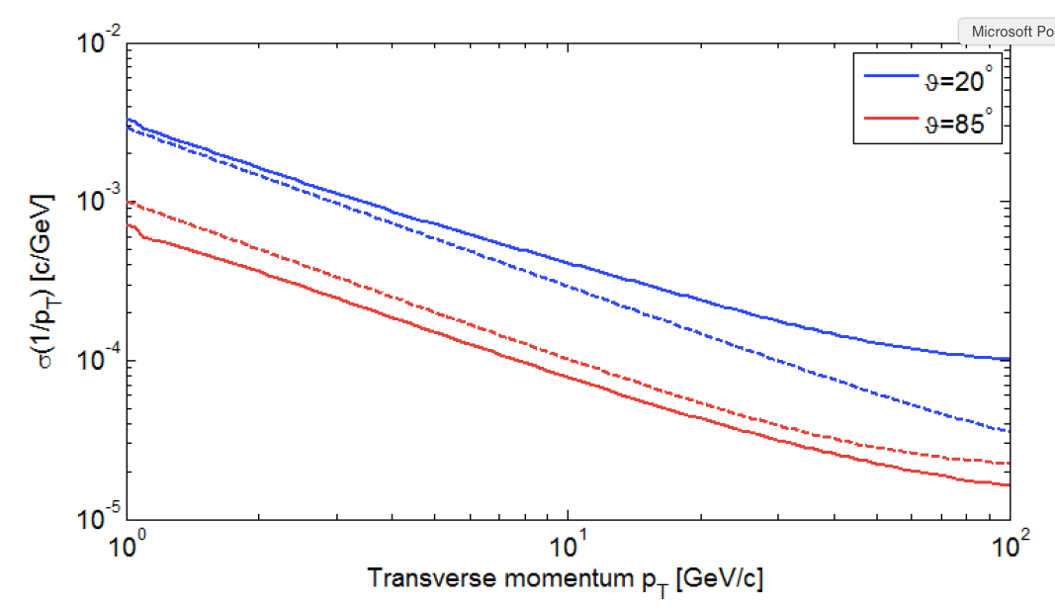
Branching ratio ( R^{mu})
LEP result: 0.2% total error (Stat : 0.15%, Syst : 0.1%)
CEPC : 0.05% total error expected
Better EM calorimeter is the key
Momentum scale resolution in CEPC
Systematics source | LEP | CEPC
Radiative events (Z->μμγ) | 0.05% | 0.05%
Photon energy scale | 0.05% | 0.01%
Muon Momentum scale | 0.009% | <0.003%
Muon Momentum resolution | 0.005% | <0.003%

Slide 12
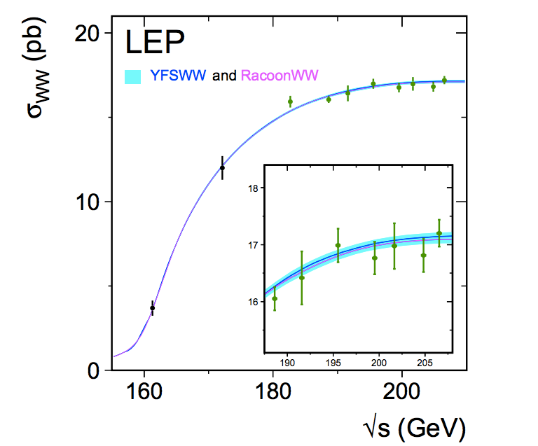
W mass measurement
Current PDG precision : 80.385±0.015 GeV
Possible goal for CEPC : 3 MeV
Three methods for W mass measurements:
1.WW Threshold scan (√s=160GeV):
Advantage: Very robust method, can achieve high precision.
Disadvantage
Beam polarization design has not finished.
Higher cost , Require dedicated runs >100fb⁻¹ on WW threshold(~160GeV)
2.Kinematic Reconstruction
Need good understanding of ISR
3.Direct measurement of the hadronic mass (major method for CDR)
Based on 10¹⁰ Z->hadrons sample to calibrate jet energy scale ( < 3MeV )
Advantage :
No additional cost :measured in ZH runs (sqrt(s)=250GeV)
Higher statistics: 10 times larger than WW threshold region
Lower requirement on beam energy uncertainty.
For CEPC CDR next year,
Plan to compare these three methods with full simulation study
Major questions : whether we need WW threshold scan and beam polarization

Slide 13
Summary
CEPC electroweak physics in Preliminary Conceptual Design Report.
Expected precision based on projections from LEP and ILC.
Aim for more realistic study with full simulation for CDR next year.
Mainly focus on a few key measurements.
m_{W}
Weak mixing angle
Welcome to join this effort

