Slide 1



粒子物理与粒子辐照教育部重点实验室
R&D of CMOS pixel sensor @ Shandong University
Liang Zhang on behalf of pixel group
Outline
Introduction of silicon tracker requirements for CEPC
R&D for silicon tracker
  TCAD simulation
  Chip design
  Chip test

Slide 2
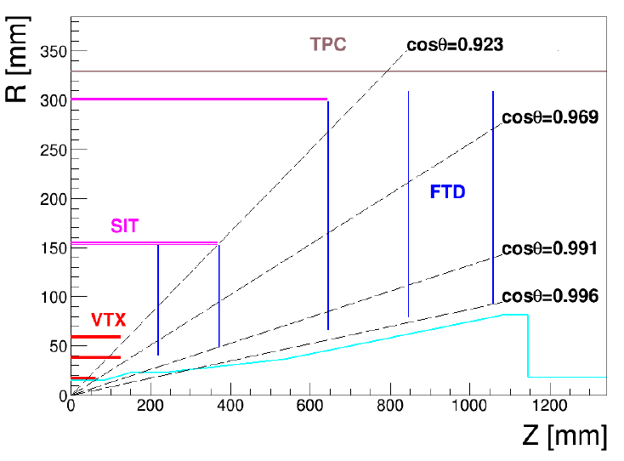
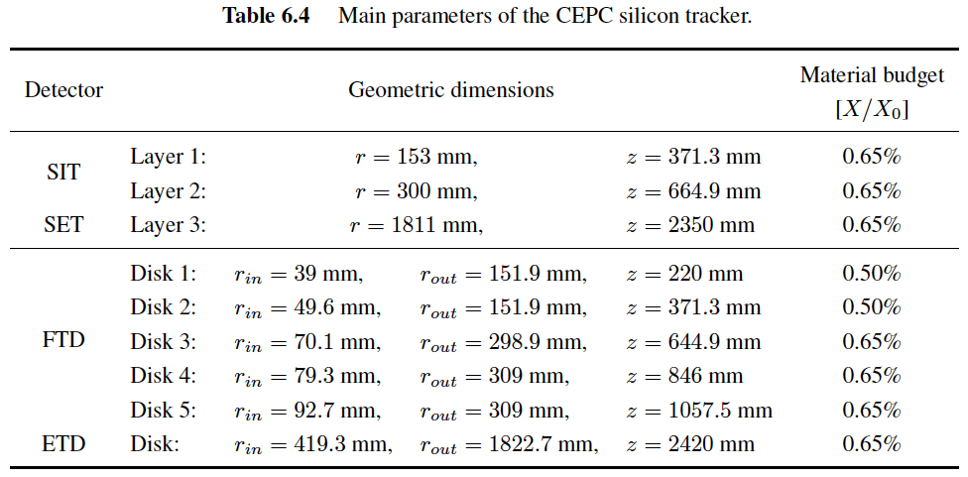
Introduction
Silicon tracker
  SIT (Silicon Inner Tracker)
  SET (Silicon External Tracker)
  FTD (Forward Tracking Disk)
  ETD (End-cap Tracking Disk)
Basic sensor for the silicon tracker
  Silicon microstrip sensors
    P⁺-on-n technology
    Area of 10 × 10 cm²
    Pitch of 50 µm, σ_{sp} < 7 µm
    Thickness < 200 µm
  Pixel detectors as VTX for the two innermost FTD
Alternative option
  Pixelated silicon sensors based on CMOS technology
Preliminary layout of the silicon tracker

Slide 3
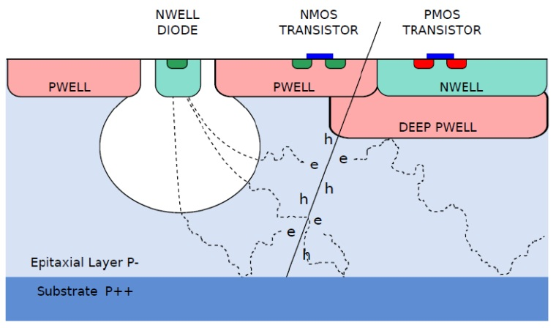
R&D for silicon tracker
Using a 0.18 μm CMOS process (TowerJazz) for R&D
  Deep P-well (quadruple well technology)
    Full CMOS circuit implementation in-pixel such as discriminator & ADC
  6 metal layers (instead of 4)
    High integration, reduce dead zone
  High-res epitaxial layer 1 – 8 kΩ∙cm with 15 ~ 40 μm
    Improve charge collection efficiency
  Thin gate oxide
    Improve radiation tolerance
  Stitching
    multi-chip slabs
Purpose
  Study charge collection efficiency (CCE) depending on pixel dimensions and diode geometries

Slide 4
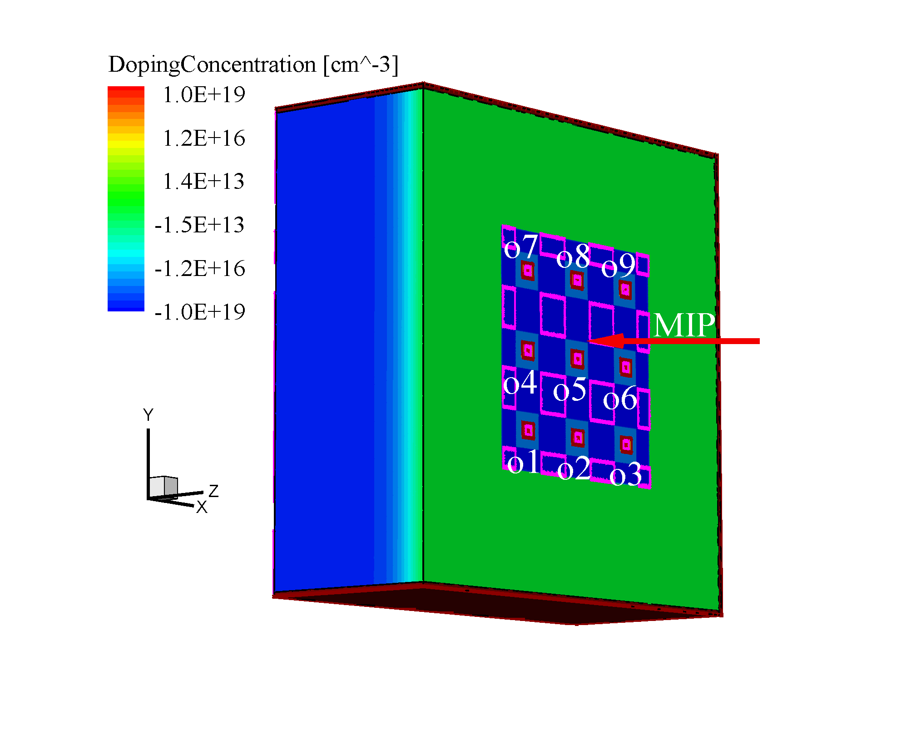
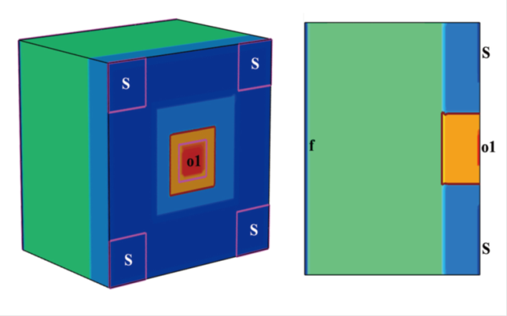
TCAD simulation
Simulation with TCAD tool
  Pixel size
  Diode geometry
  Thickness of the epitaxial layer: 18 µm
  Resistivity of the epitaxial layer: 1 kΩ∙cm
  Power supply: 1.8 V
  Simulation structure: 5×5 cluster
  Particle hits right at the center of the pixel
Pixel size selection
  21 × 21 µm², 21 × 42 µm², 21 × 84 µm²
    Compare with the pixel in MIMOSA34
    Observe the CCE variation

Slide 5
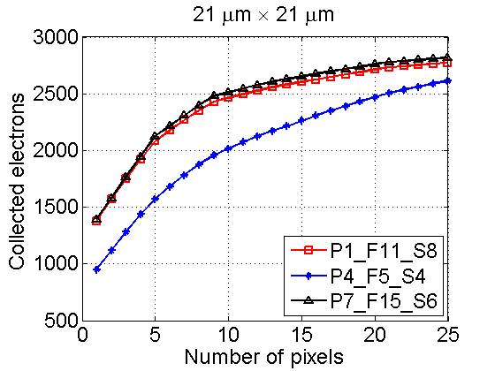
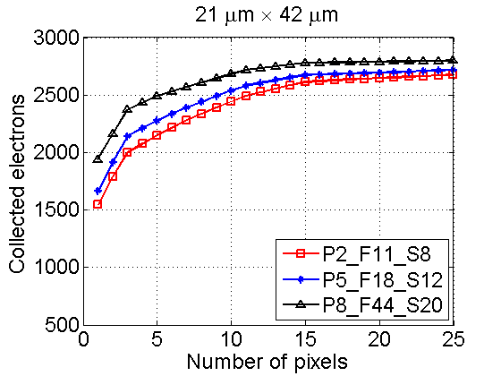
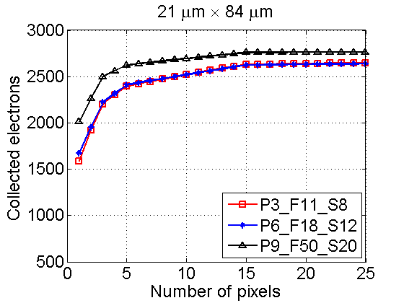
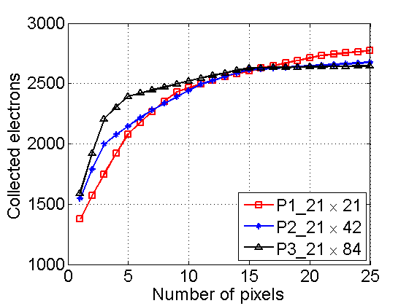
Charge collection simulation
Collected electrons in a cluster of 5 × 5 pixels
Pixel | P1 P2 P3 | P4 P5 P6 | P7 P8 P9
Pitch(x)(µm) | 21 42 84 | 21 42 84 | 21 42 84
N(D) | 1 1 1 | 1 1 1 | 1 1 1
F(D)(um²) | 11 11 11 | 5 18 18 | 15 44 50
S(D)(um²) | 8 8 8 | 4 12 12 | 6 20 20
N(D) = number of diodes in each pixel (1 )
F(D) = footprint of diode (diode area + pwell opening): 5, 11, 15, 18, 44 & 50 µm²
S(D) = surface of diode: 4, 6, 8, 12 & 20 µm²

Slide 6
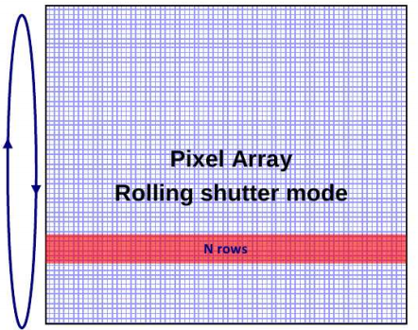
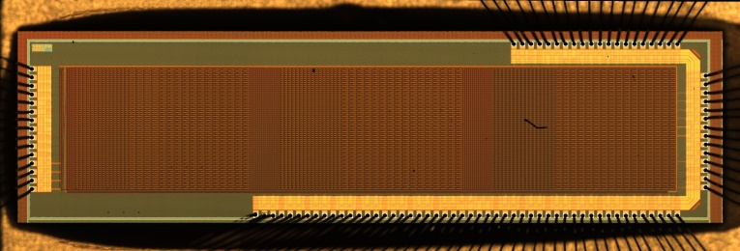
Prototype chip design
The chip contains:
  9 submatrices
    Each matrix: 16 × 64
    Rolling shutter readout mode
    32 µs integration time at 2 MHz clock frequency
    16 parallel analog outputs
    Sensitive area: 2 × 7.88 mm²
  3T pixel structure
    The reset transistor is connected in permanent reloading (similar behavior of a diode)
    50 µA current load in each column
    Diode is staggered in large pixel
      Improve charge collection efficiency (charge sharing)
    Gate-enclosed NMOS transistors
      Improve radiation tolerance
    P+ guide ring

Slide 7
Prototype chip test
SE: Single Ended
DUT
SE
Main Board
SE
Xilinx FPGA board
PCIe
PC
LVDS
LVDS
RS232
SSD
Sketch of the test setup for CMOS sensor test
External power
Oscilloscope
The test setup consists of:
DUT board: carry the chip, bias the chip, buffer the output
Main board (designed by IHEP): supply the power to the chip, sample the output signals, etc…
FPGA board: communicate with PC via PCIe, control the data loading/receiving
SSD high speed data store → >1Gb/s.
Could support both the vertex pixels and the tracker pixels.

Slide 8
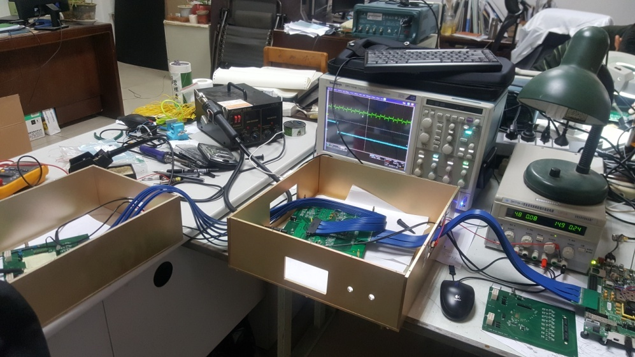
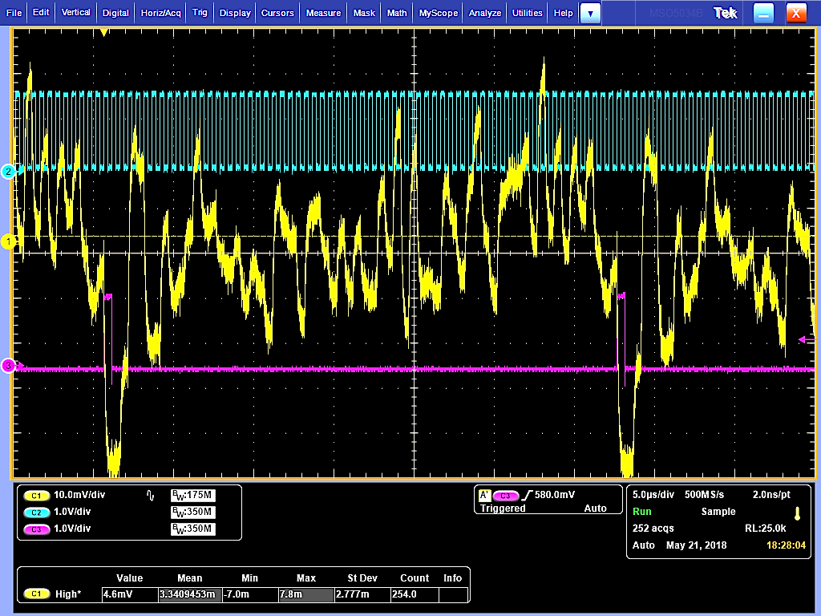
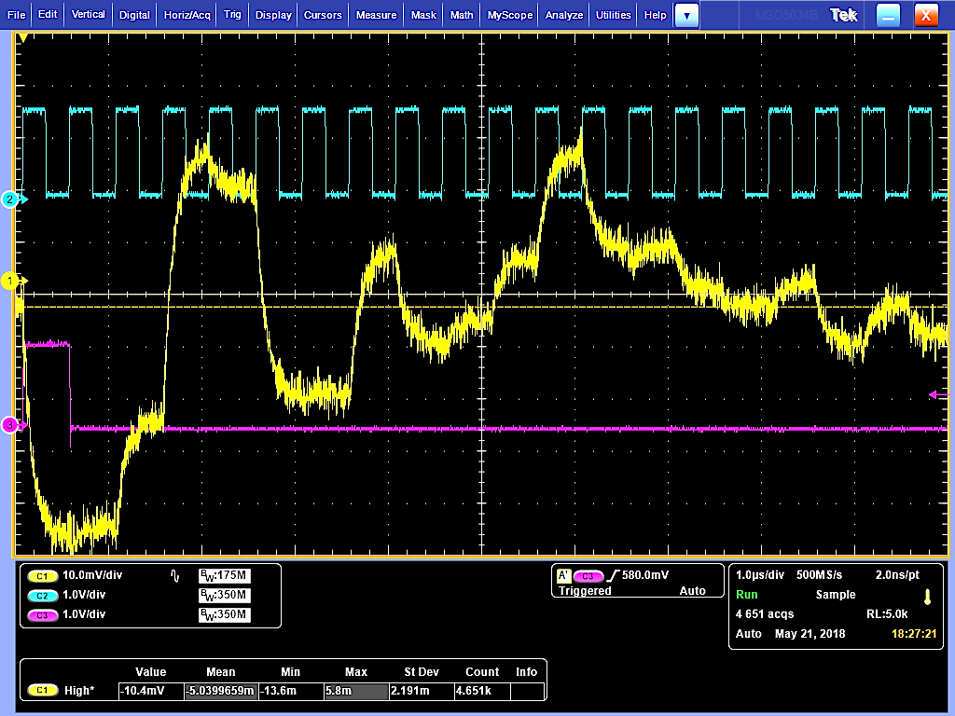
Prototype chip test
DUT board
Main board
FPGA board
Test setup for the chip
Clock
The chip was provided with a 2MHz clock through the FPGA board.
Frame out: the signal from the DUT chip when 64 rows of pixels have been read out.
DC output : output of the pixels without particle.
DC output
Frame out

Slide 9
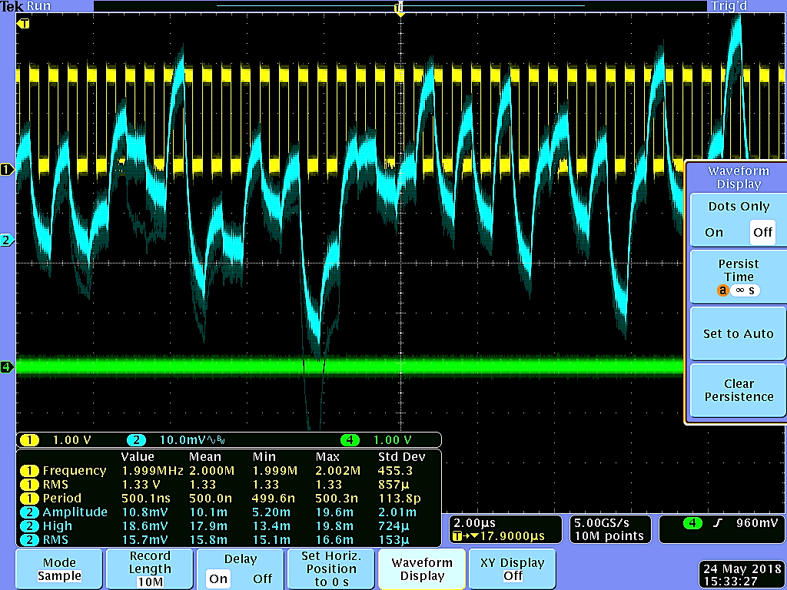
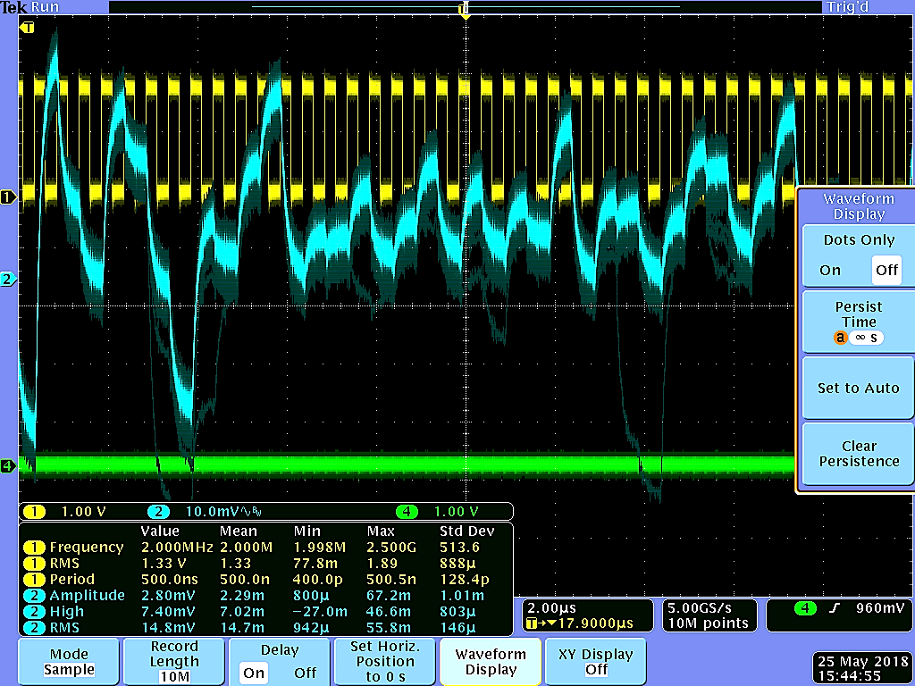
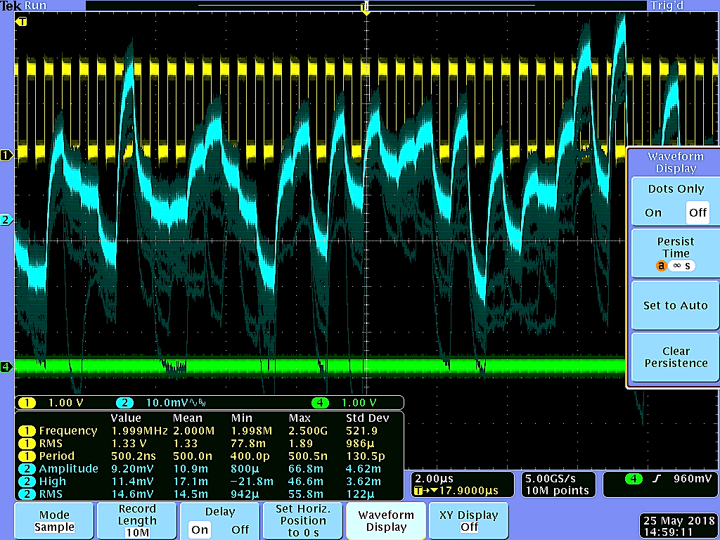
Prototype chip test
Test with Co-60 source, 3 submatrices in the chip have been tested (P1, P8, P9)
The signal was acquired by oscilloscope using persistence mode
It can be observed that the chip works with Co-60, since the DC value drops
Next step: do the calibration with Fe-55 source, charge collection efficiency (CCE) etc.

