Slide 1
STFC Rutherford Appleton Laboratory
Jens Dopke for the
Particle Physics Department

Slide 2
Who we are
STFC is one of the UK’s Research Councils, now operating under the lately formed umbrella organisation, UK Research & Innovation (UKRI)
Science & Technology Facilities Council provides access to large scale scientific facilities for researchers in the UK as well as the international science community:
UK Astronomy Technology Centre
Diamond Light Source
ISIS Neutron Spallation Source
Central Laser Facility
UK Interface to CERN

Slide 3
Particle Physics Department
Not quite a facility, but a Particle Physics support group
We do not operate Particle Physics Machinery at the Lab
However:
Boulby Underground Laboratory is operated through PPD
Strong connections to Technology Department for matters of technical developments as well as large scale productions (e.g. the ATLAS Tracker Upgrade)
Staff:
Headcount is about 75 at the moment
Largest Projects:
ATLAS, CMS, T2K/HyperK, DUNE, LZ…
Notes:
I am currently working in the ATLAS group, so this may well be as seen through the ATLAS goggles

Slide 4
ATLAS Group
L1 Calorimeter Group
Lots of expertise in High Speed Signal processing (FPGA/DSP)
Higher Level Trigger
Software algorithms, performance, GPUs
Tracker Group
Operation of the current ATLAS Strip Tracker
Assembly and testing of the future tracker
Large interest in developments towards next generation tracker systems

Slide 5
Interest in CEPC
Came up through our current interaction with IHEP
Module assembly for the ATLAS Itk Strip Tracker
Generic CMOS developments, where we had colleagues from IHEP over to work with us in our labs here
Laser injection testing
Semiconductor Analysis
TCAD
Reasonable Infrastructure available for qualification of new Sensors
Expertise in operation of Detector Systems, particularly from our ATLAS background

Slide 6
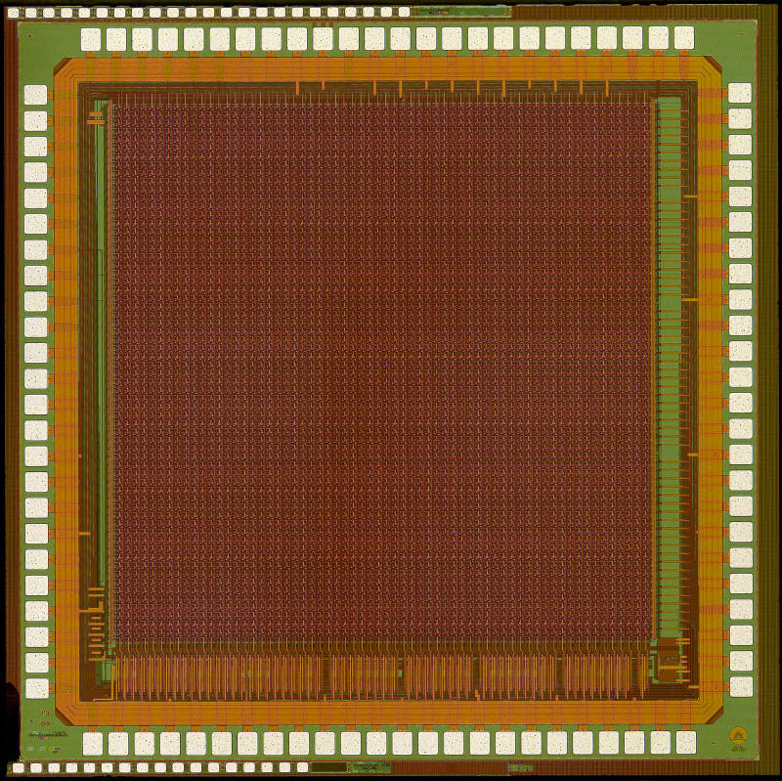
CMOS related details
Developments towards CMOS started early within the Framework of ILC and continued under the umbrella of the ATLAS Tracker Upgrade
Currently one project in aiming at future Digital Electromagnetic CALorimeters (DECAL)
Chip-design in house, as well as all related developments
Currently working on understanding the delivered ASICs, their charge collection as well as analogue functionality
Long standing connection with TowerJAZZ
Have full simulation setup for their 180nm

Slide 7
Effort
Currently all effort bound to the ATLAS upgrade
Yet, we manage a small fraction of work towards future trackers and are happy to try and help where we can
Provided a general setup with STFC can be established, there could be O(50%) of an experienced Chip Designer involved, as well as significant contributions from within PPD (TCAD simulation, sensor testing, but also more generic help with system design and test)
Our friends in Technology Department would certainly be interesting to talk to, but out of scope for today

