Slide 1
SRF technology - cavity and tuner
Feisi He
Institute of High Energy Physics (IHEP)

Slide 2
Outline
Cavity RF design
Cavity fabrication
Performance limit
Post processing
LFD, microphonics, and tuners
Back to beginning: realistic good cavity design

Slide 3
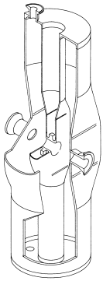
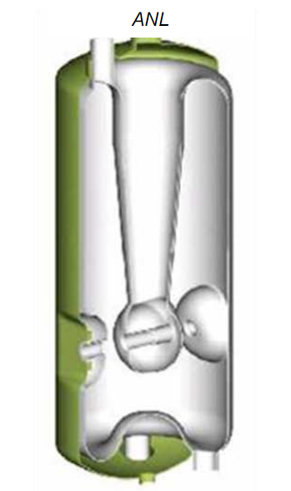
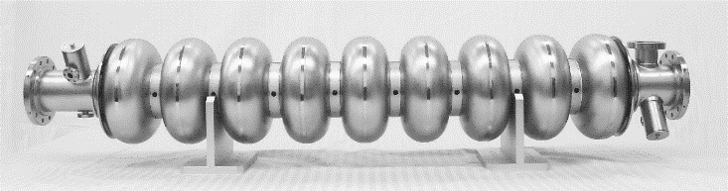
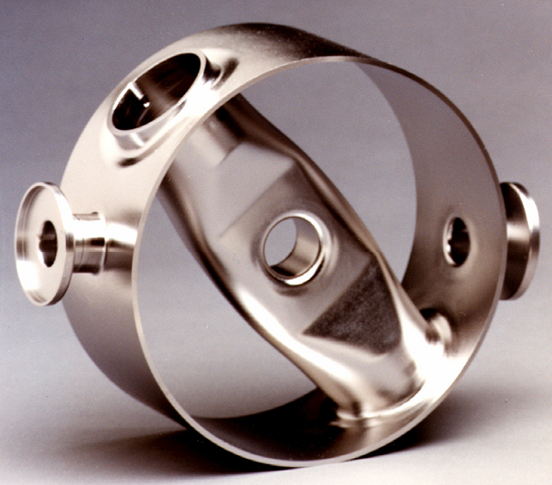
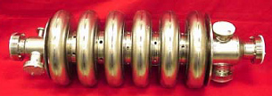
Example of SRF cavities
SRF cavity: standing wave structure made of superconducting metal (Niobium, or Nb film on Cu)
Two types of structures are most commonly used:
  TM class (elliptical cavity, for β>0.6)
  TEM class (QWR, HWR, Spoke, for β<0.6)

Slide 4
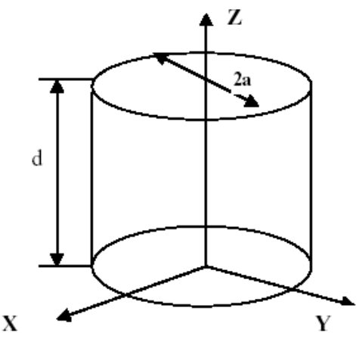
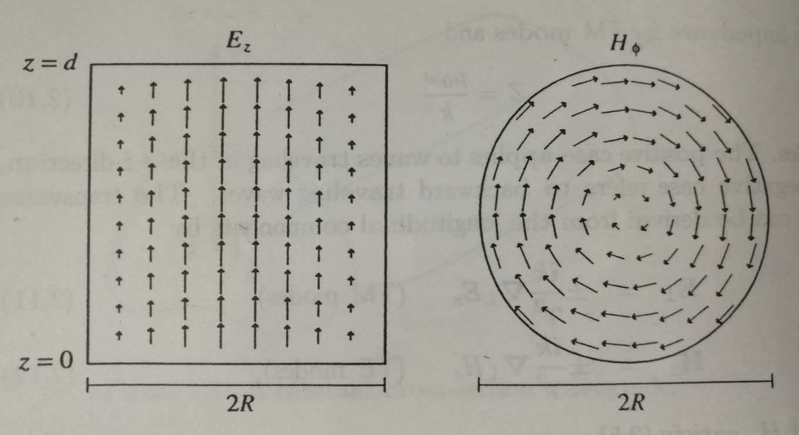
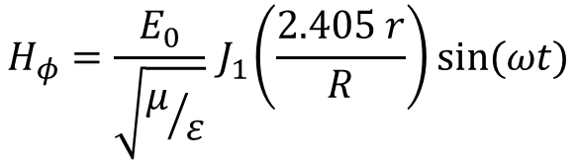
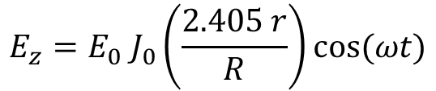
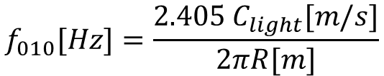
Origin of TM class: pillbox cavity
All elliptical cavities are evolved from an enclosed cylindrical waveguide, which is so called pillbox cavity
The 1st mode TM010 is used for beam acceleration
$$f_{010}[Hz]=\frac{2.405 C_{light}[m/s]}{2πR[m]}$$
$$E_{z}=E_{0} J_{0}\left(\frac{2.405 r}{R}\right)cos⁡(ωt)$$
$$H_{φ}=\frac{E_{0}}{\sqrt{μ/ε}}{ J}_{1}\left(\frac{2.405 r}{R}\right)sin⁡(ωt)$$

Slide 5
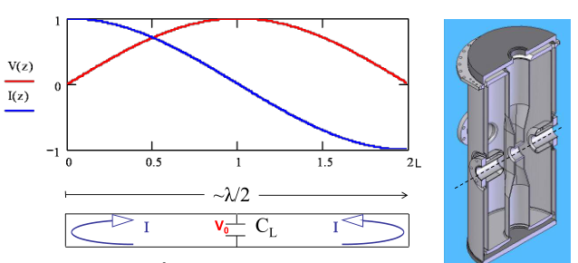
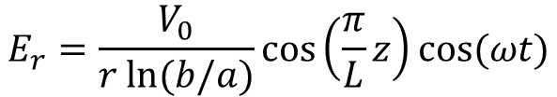
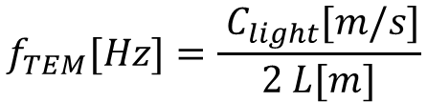
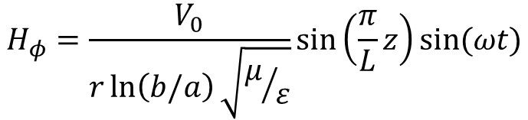
Origin of TEM class: Half wave resonator
All TEM cavities are evolved from an enclosed coaxial line
The 1st mode TEM is used for beam acceleration
$$f_{TEM}[Hz]=\frac{ C_{light}[m/s]}{2 L[m]}$$
$$E_{r}=\frac{V_{0}}{r ln⁡(b/a)}\cos\left(\frac{π}{L}z\right)cos⁡(ωt)$$
$$H_{φ}=\frac{V_{0}}{r\ln\left(b/a\right)\sqrt{μ/ε}}sin\left(\frac{π}{L}z\right)sin⁡(ωt)$$

Slide 6
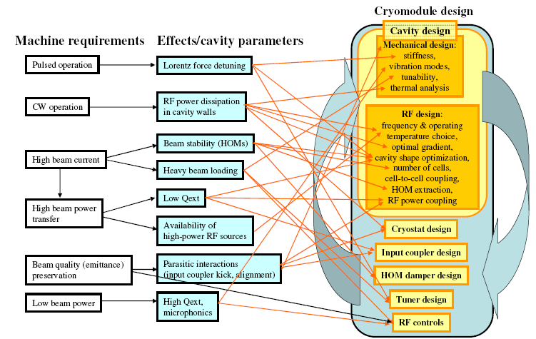
Cavity design considerations
Nikolay Solyak, Lecture 7a in ILC school 2008

Slide 7
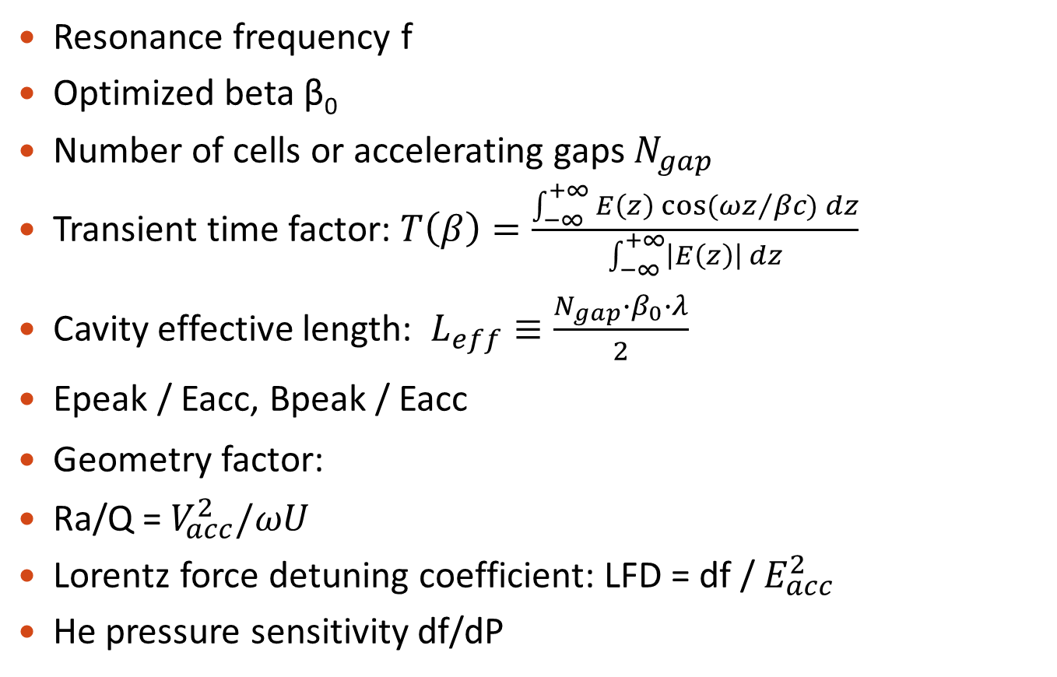
Some important cavity parameters
Resonance frequency f
Optimized beta β₀
Number of cells or accelerating gaps $N_{gap}$
Transient time factor: $T\left(β\right)=\frac{\int_{−∞}^{+∞}{E\left(z\right) cos⁡({ωz}/{βc) dz}}}{\int_{−∞}^{+∞}{\left|E\left(z\right)\right| dz}}$
Cavity effective length: $L_{eff}≡\frac{N_{gap}∙β_{0}∙λ}{2}$
Epeak / Eacc, Bpeak / Eacc
Geometry factor:
Ra/Q = $V_{acc}^{2}/ωU$
Lorentz force detuning coefficient: LFD = df / $E_{acc}^{2}$
He pressure sensitivity df/dP
Beam
dynamics
related
Technics
related

Slide 8
Cavity design procedure
Define optimization goal:
  Ep/Ea, Bp/Ea, G*R/Q, HOM damping, and so on
Sweep cavity shape
Add cleaning and coupling ports, check antenna length and heating on flange.
Check multipacting
Mechanical design:
  Change wall thickness, stiffeners, and helium vessel
  Safety analysis: yielding stress, buckling
  Reduce LFD, df/dP, increase intrinsic vibration frequency

Slide 9
Cavity design tools
Elliptical cavity RF optimization:
  2D free code Superfish. You have to write input files to use it. https://laacg.lanl.gov/laacg/services/download_sf.phtml
  BuildCavity by Paolo Pierini, VB based user dialog to control superfish (need installation): http://wwwsrf.mi.infn.it/Members/pierini/buildcavity/BuildCavity_v143_exe.zip
  Another superfish user dialog by He Feisi (need Mathmatica8.0 or later): https://docs.google.com/file/d/0B7jeOkUDj9HMUHFyUmJMTzhfRG8/edit?usp=sharing
  Fishpact by Wu Genfa, 2D tracking code for MP analysis (with superfish field)
TEM cavity RF optimization and MP analysis:
  Typically CST is used (paid software)
HOM analysis and damping design:
  Typically CST is used (paid software)
Mechanical design and analysis:
  Typically ANSYS or COMSOL are used (both paid software)

Slide 10
Outline
Cavity RF design
Cavtity fabrication
Post processing
Performance limit
LFD, microphonics, and tuners
Back to beginning: realistic good cavity design

Slide 11
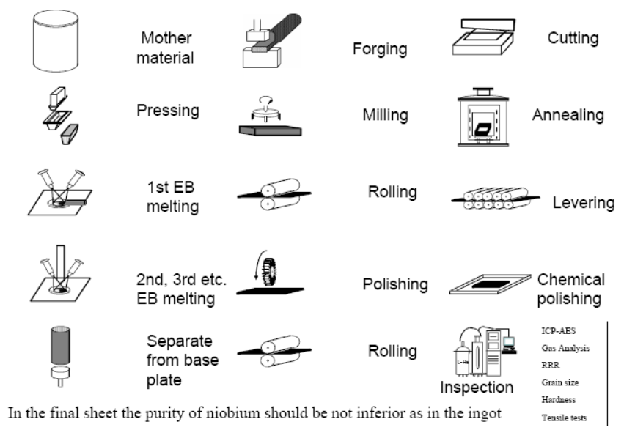
Niobium material
Cavtity fabrication: RRR>250 Nb is made by multiple electron beam melting steps under good vacuum, resulting in elimination of volatile impurities.
Nikolay Solyak, Lecture 7a in ILC school 2008

Slide 12
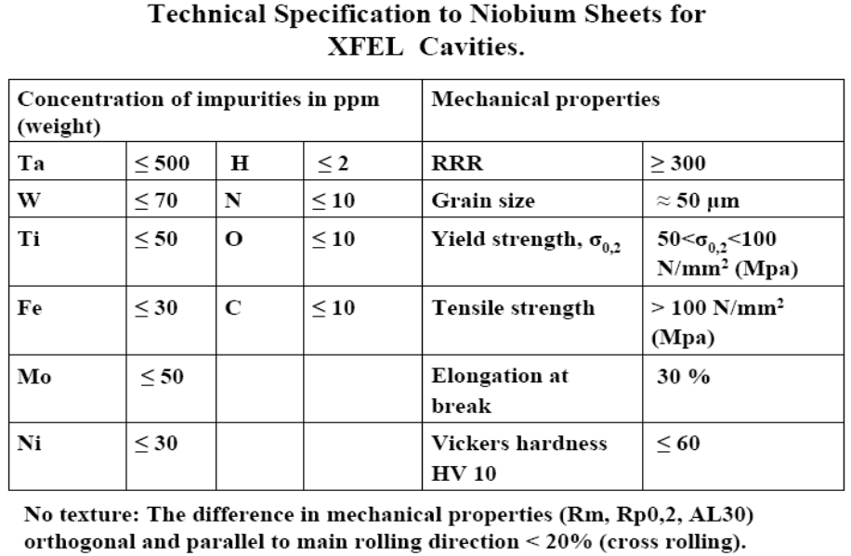
Niobium material specification
Nikolay Solyak, Lecture 7a in ILC school 2008

Slide 13
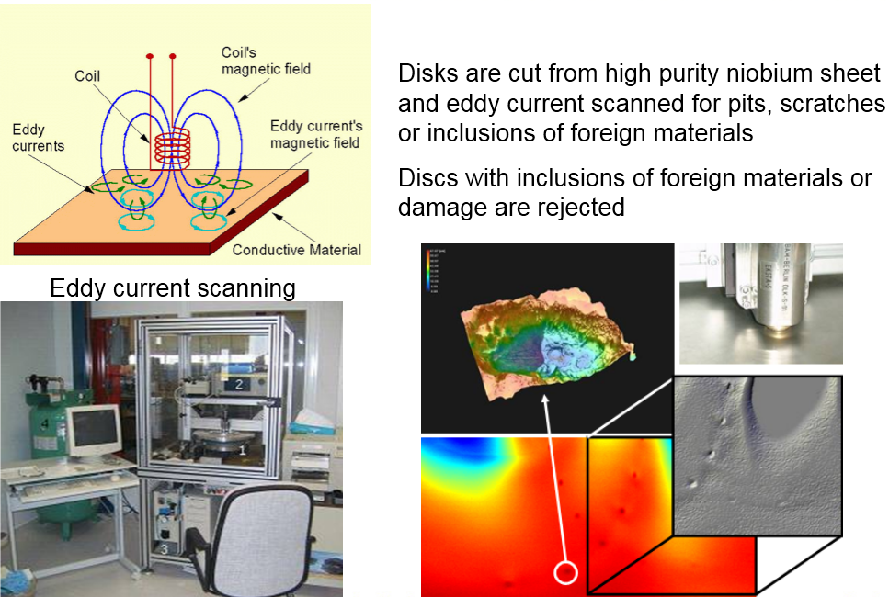
Nb material inspection
Nikolay Solyak, Lecture 7a in ILC school 2008

Slide 14
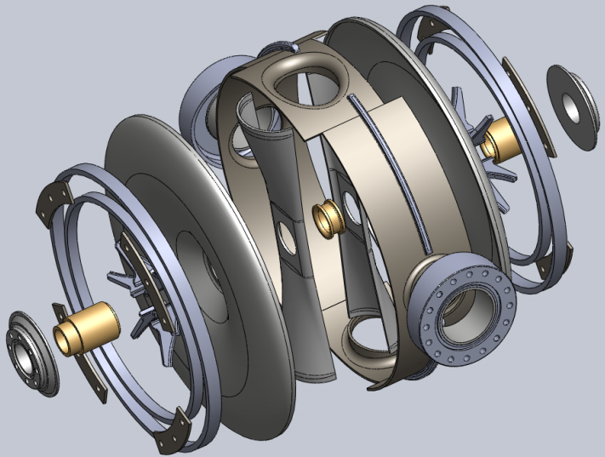
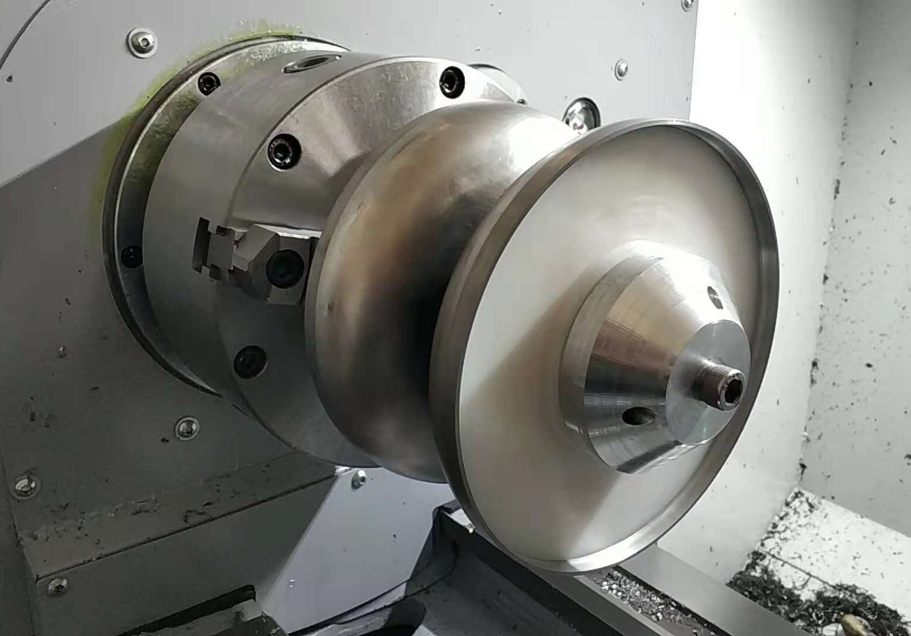
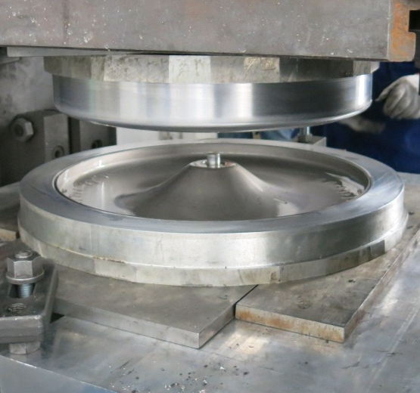
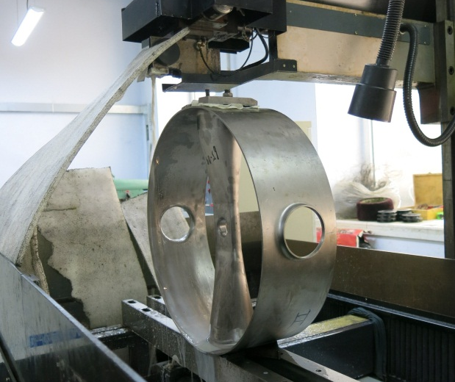
Fabrication of the cavity
Fabrication process:
  Deep drawing
  Machining
  Frequency control
  Grinding
  Parts cleaning
  EBW
Notes:
端盖+中间环（内导体两半、相邻两片、圆环）；

Slide 15
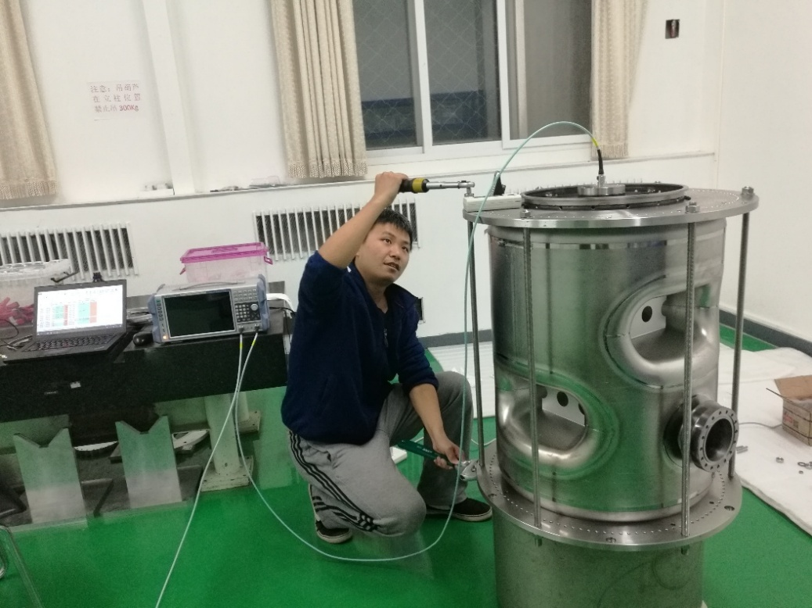
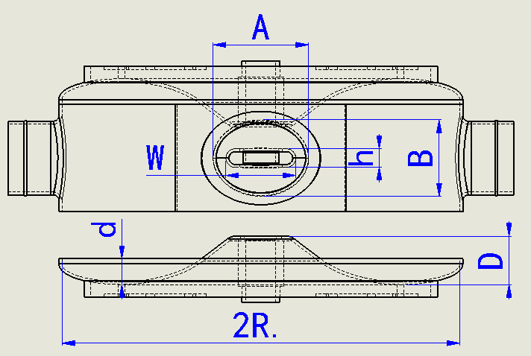
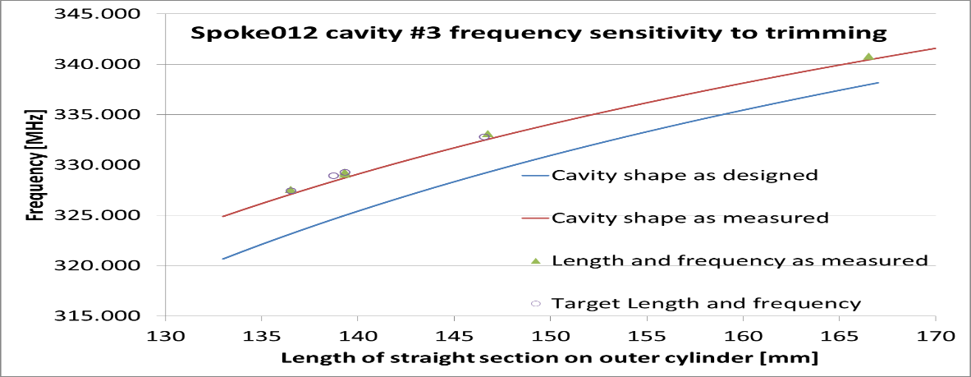
Cavity frequency control
TEM cavity: end-cover and cylinder are stacked to measure frequency; then length of cylinder is trimmed to tune frequency
Frequency trimming sensitivity may need to be re-calculated based on measured critical sizes.

Slide 16
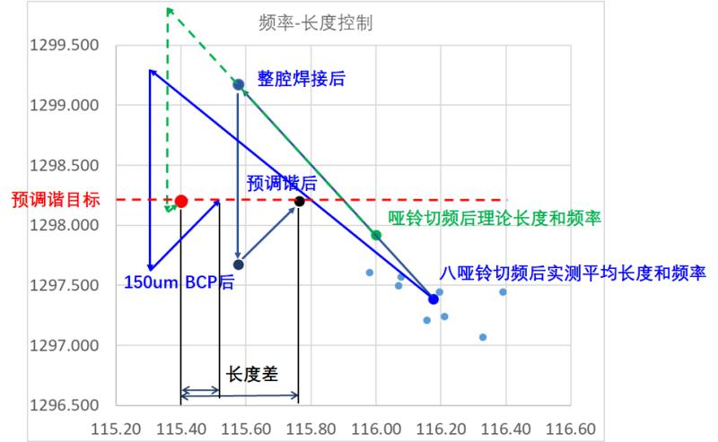
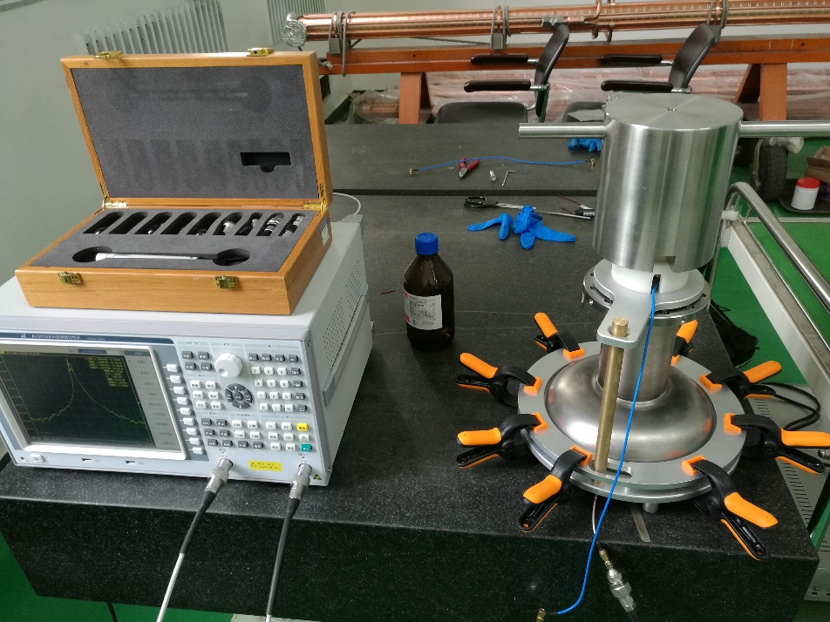
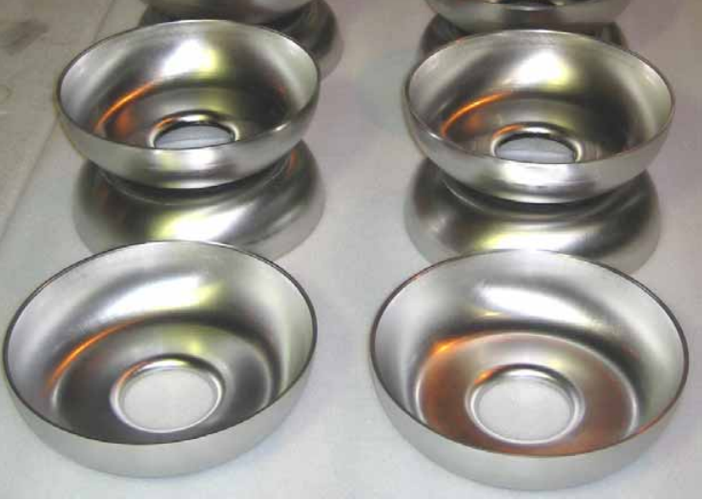
Cavity frequency control (2)
TM cavity: it is not realistic to stack multiple cells together
So frequency of each dumb-bell and end-cell is measured by perturbation method
The equator is trimmed then

Slide 17
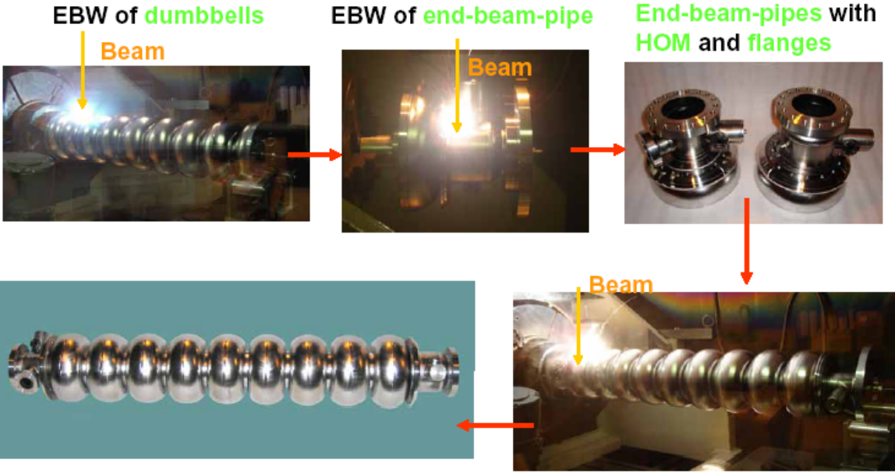
Cavity EBW
Welding zones are BCP cleaned 5-20um before EBW
Vacuum better than 5e-5mbar before welding starts
K. Saito, RF technology – superconducting RF, ILC school 2009

Slide 18
Outline
Cavity RF design
Cavtity fabrication
Performance limit
Post processing
LFD, microphonics, and tuners
Back to beginning: realistic good cavity design

Slide 19
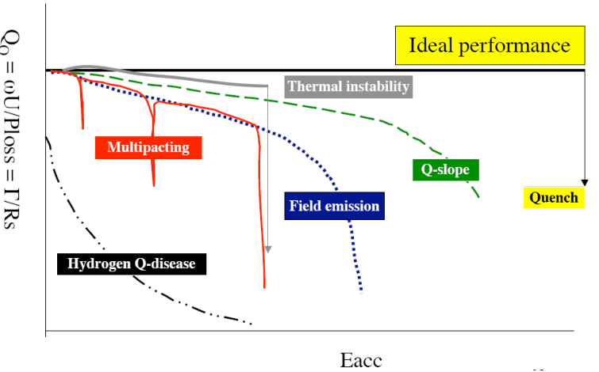
Performance limit:
.
P. Michelato, Cavity processing, SRF13 tutorial

Slide 20
Performance limit
Quench (local thermal instability)
  material + fabrication (or cleanliness)
Field emission
  Cleanliness of surface treatment, assembly, handling + vacuum
Multipacting
  Cavity shape + rf surface condition
Hydrogen Q-disease
  Chemical surface treatment; stay at 50-120K for several hours
Increased residual surface resistance
  Cleanliness of surface treatment, assembly, handling + vacuum
Q-drop (without field emission) + Q-slope
  May be defect or insufficient etching
P. Michelato, Cavity processing, SRF13 tutorial

Slide 21
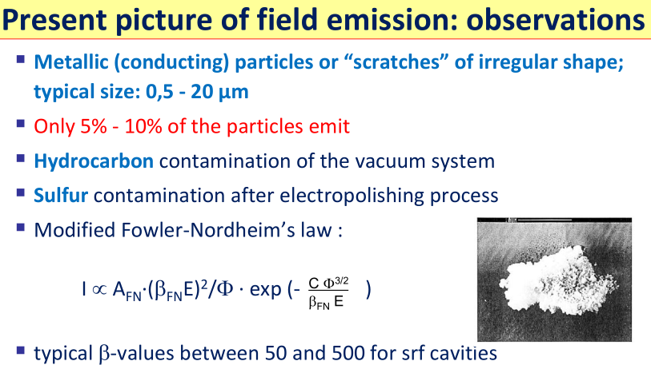
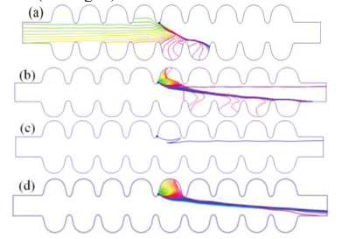
Field emission
Hard limit of most SRF accelerators:
The key requirement to SRF cavity is to keep clean on every step
Ep 25 – 40 MV/m is reasonable
Li Yongming, et.al. Research on Field Emission and Dark Current in ILC Cavities, SRF2013, 2013.
P. Michelato, Cavity processing, SRF13 tutorial

Slide 22
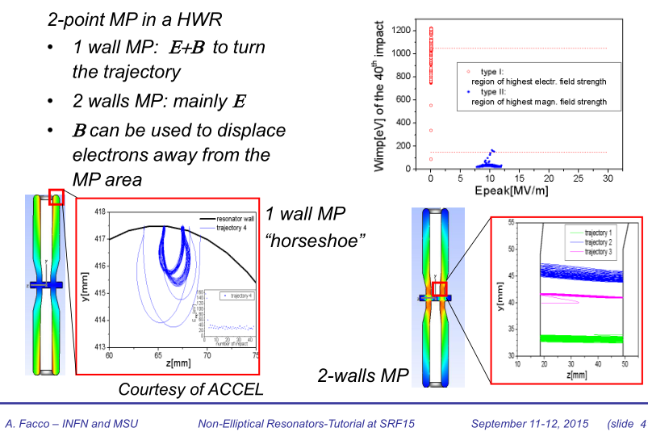
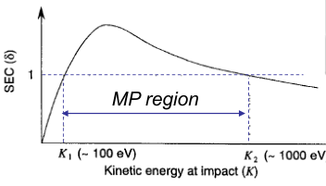
Multipacting
Multipacting is a resonant process of secondary electrons absorbing RF power in the cavity

Slide 23
Outline
Cavity RF design
Cavtity fabrication
Performance limit
Post processing
LFD, microphonics, and tuners
Back to beginning: realistic good cavity design

Slide 24
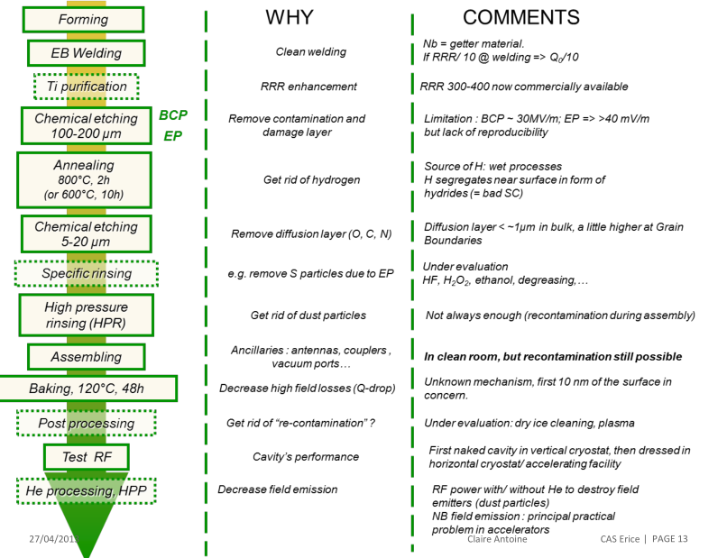
Post processing
Post processing

Slide 25
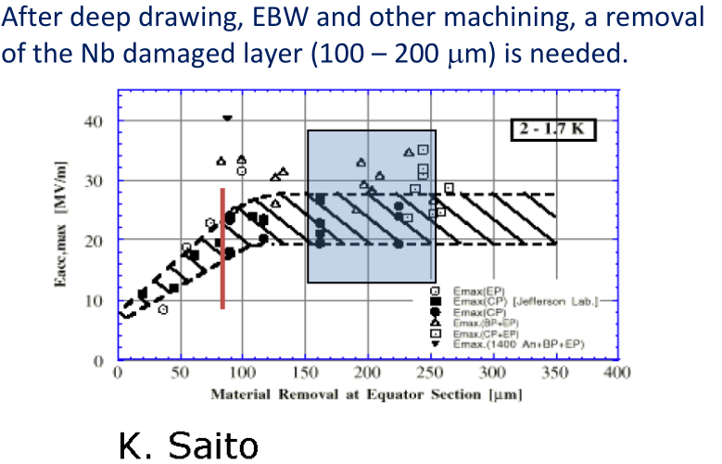
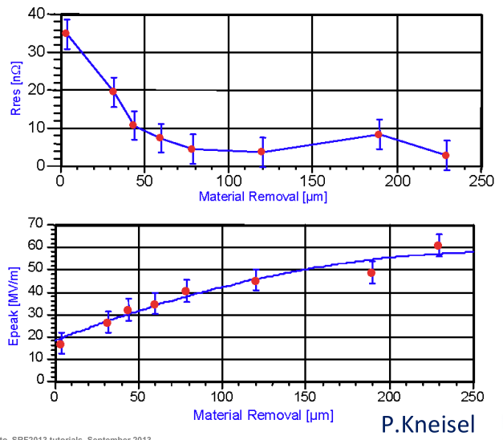
BCP/EP: remove damaged layer

Slide 26
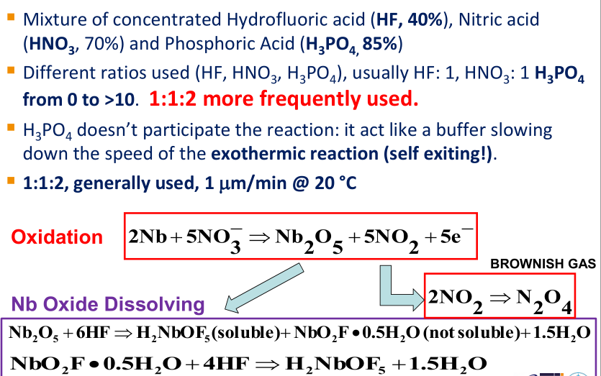
BCP: Buffered Chemical Polishing

Slide 27
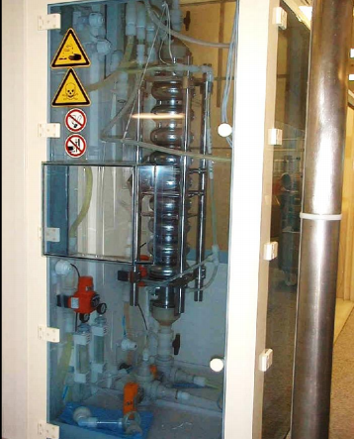
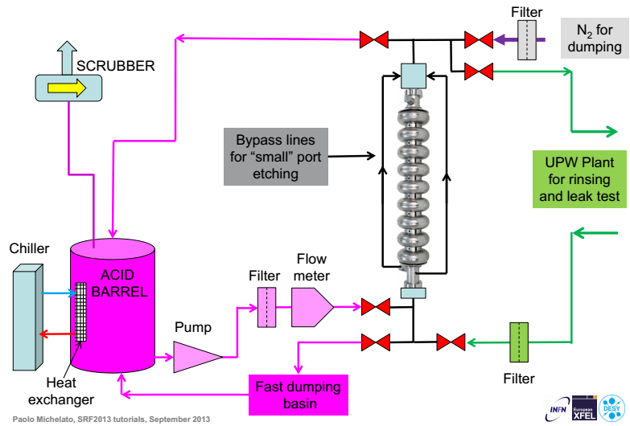
BCP system
BCP is an exothermic reaction; temperature ↑, etching rate ↑
BCP at >20C increases H₂ in Nb; typically at 15-20^{O}C, ~1μm/min
Nb concentration ↑, etching rate↓; typically Nb < 12-15g/L for bulk BCP, <4 g/L for flash BCP (XFEL)
Typical Eacc 25-30MV/m.

Slide 28
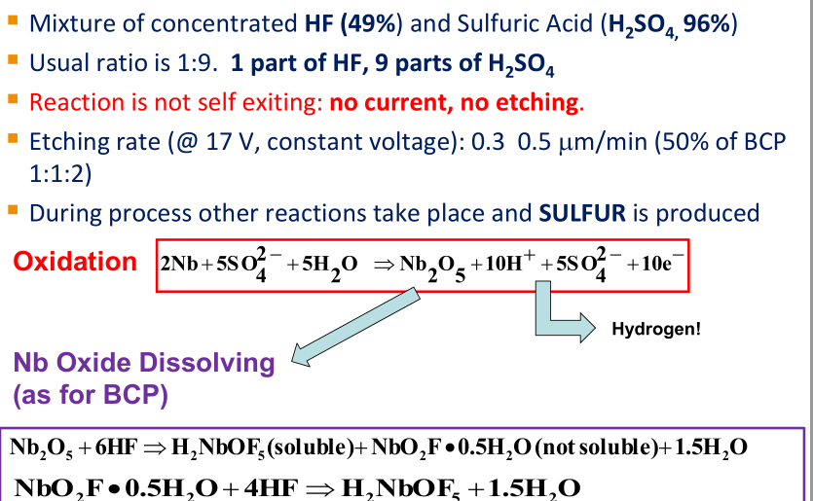
EP: electron polishing

Slide 29
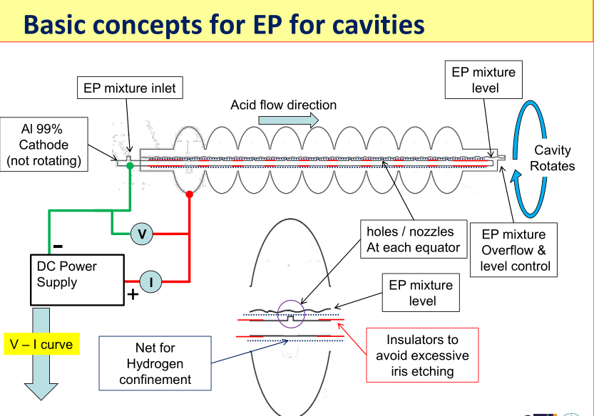

Slide 30
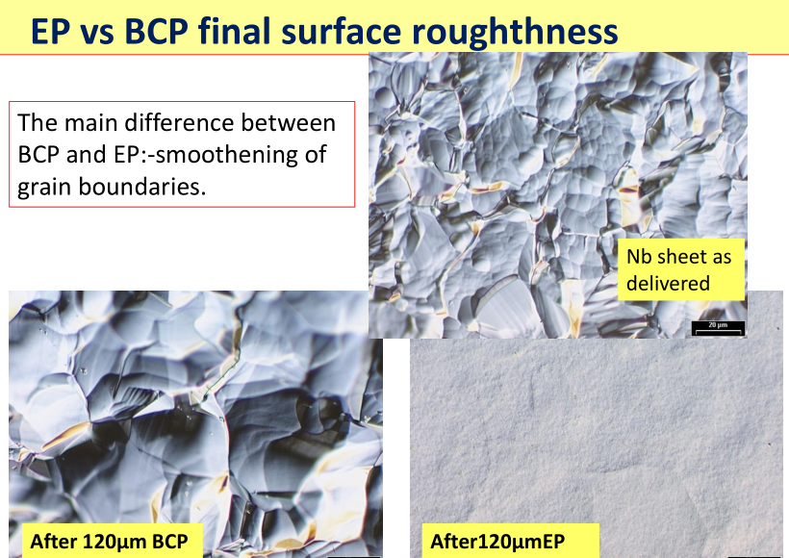

Slide 31
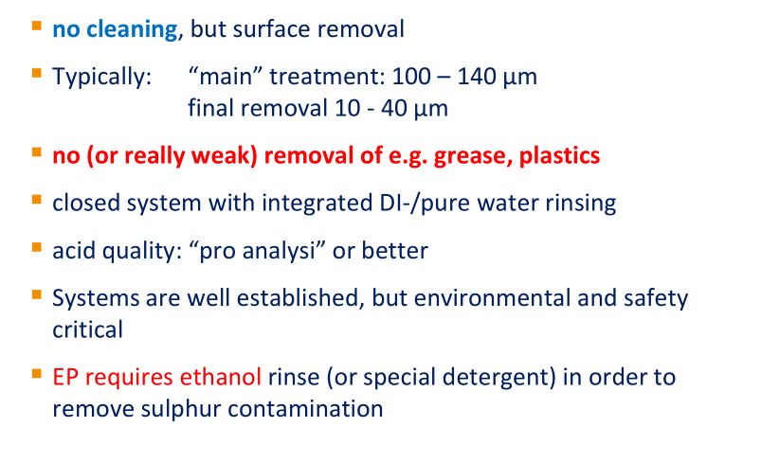
Comments on BCP and EP

Slide 32
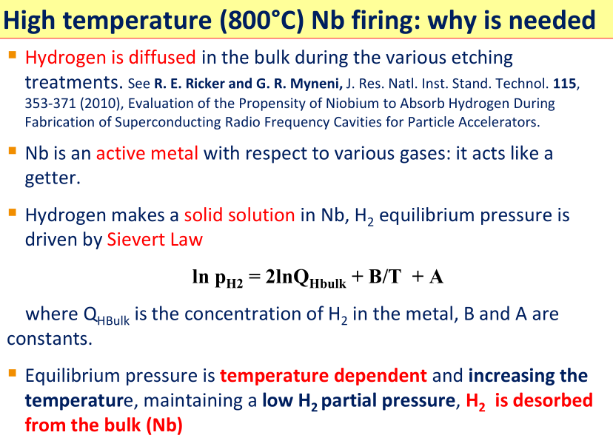

Slide 33
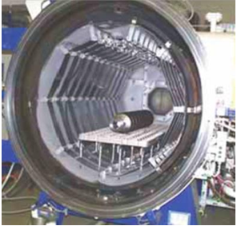
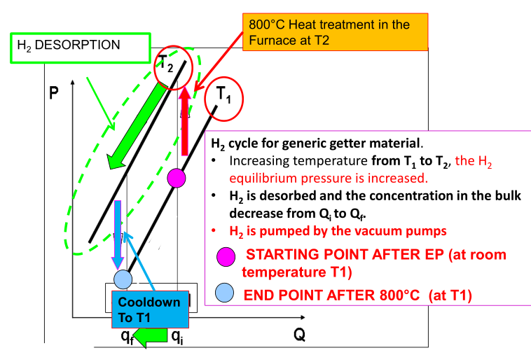
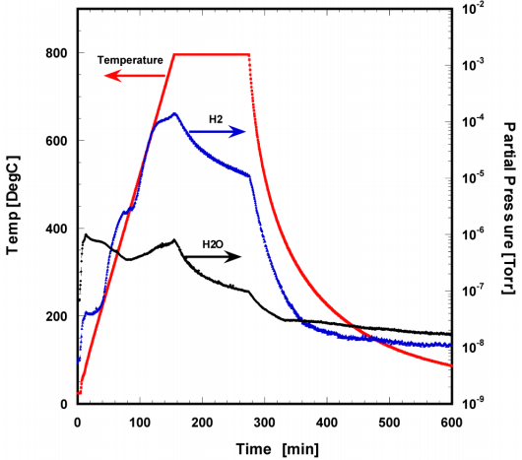
High baking

Slide 34
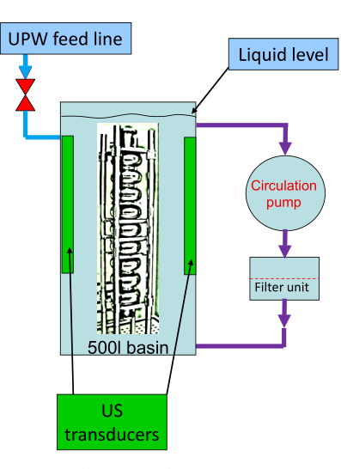
Ultrasonic cleaning and UPW rinsing
Ultra pure water (18 MΩ.cm ) + detergent (like liquinox 1%), @ 45C – 60C, duration about 20-30 min
It removes grease, particulates, residues from former treatments
US power: 10 W/liter
Component MUST be fully immersed, with no air bubbles inside.
NO partial or two step (top and bottom) cleaning accepted!
Rinsing with UPW, continuous flow
Detergent for large production should be changed many times a week (even once / 1 – 2 days)

Slide 35

HPR

Slide 36


HPR: how it works
Direct effects of high speed water on particles:
  Particles are removed if the force of the jet and high speed water (especially the droplet) is > adhesion force of particles
Large particle are more easily removed

Slide 37

Post processing
Post processing

Slide 38



Cleanroom
Clean is the key issue for cavity performance
Typically ISO4 (class 10) for cavity HPR and assembly; ISO6-7 (class 10³-10⁴) for ultrasonic cleaning.
The largest cause of contamination is personnel

Slide 39


Key points for clean room operation
Correct items entering procedure, mainly based on the use of WATER rinsing
Well cleaned components subcomponents (flanges, bolts, nuts, gasket, external parts of cavities, valves, etc) using standardized procedure, if applicable, on all components.
Blowing of components to assembled just in time
Precisely defined procedures
Well-trained and motivated personal
Keep duration of actions at open cavity as short as possible

Slide 40
Outline
Cavity RF design
Cavtity fabrication
Post processing
Performance limit
LFD, microphonics, and tuners
Back to beginning: realistic good cavity design

Slide 41


Lorentz force detuning
Electromagnetic fields produces pressures that act on the cavity wall, causing the cavity wall to distort
Distortion changes the resonance frequency of the cavity
When LFD is of the order of bandwidth, ponderomotive instability may occue

Slide 42


Microphonics (vibration)
Noise sources (.e.g. pumps, cryo-system; seismic waves, etc. ) excite cavity vibrations
Any small shift in the cavity frequency requires significant increase in power to maintain Eacc=const, produces phase errors that affect the beam
$$P_{forward}=\frac{{Vc}^{2}}{4 R/Q Qe}⁢\left({\left(1+\frac{Qe}{Q0}+R/Q⁢ \frac{I_{beam}⁢Qe}{Vc}\right)}^{2}+{\left(2 \frac{⁢df⁢}{f0} Q_{e}\right)}^{2}\right)$$

Slide 43
Frequency tuners
Oscillations can be excited
  Deterministically (Lorentz Force)
  Non-Deterministically (Microphonics)
Slow Tuner
  Stepper motor changes length of the cavity to bring it to the desired resonance frequency)
  Compensates Static Detuning Forces
  Techniques: mechanical tuner
Fast Tuner
  Compensates Lorentz Force Detuning & Microphonics
  Techniques: Piezoelectric actuators

Slide 44

Slow tuner: an example
Requirements for Slow Tuner
  Enough tuning Range
  Small hysteresis
  Group delay small
  High Stiffness
  Boring transfer function
  High enough resolution

Slide 45


Slide 46


Slide 47


Slide 48


Slide 49

Fast tuner: an example

Slide 50
Outline
Cavity RF design
Cavtity fabrication
Post processing
Performance limit
LFD, microphonics, and tuners
Back to beginning: realistic good cavity design

Slide 51






Realistic good cavity design
Reducing Ep/Eacc while keeping Bp < 60-70mT at operation
Easy to fabricate (high reproducibility, low risk of failure, no low quality EBW)
Enough access for BCP/EP and HPR

Slide 52
Thanks for your attention!

