Slide 1
Background
BEPCII machine parameters
Parameters | Values
Energy (GeV) | 1.89
Beam current (mA) | 910
RF frequency (MHz) | 500
RF Cavity voltage (MV) | 1.5
Q0 of RF cavity | 1e9
Shunt impedance of the accelerating mode (Ω) | 93.5*Q0
Radiation losses per turn/per charge (keV) | 145.4
Reference: “RF superconductivity for Accelerators”, Hasan Padamsee.

Slide 2
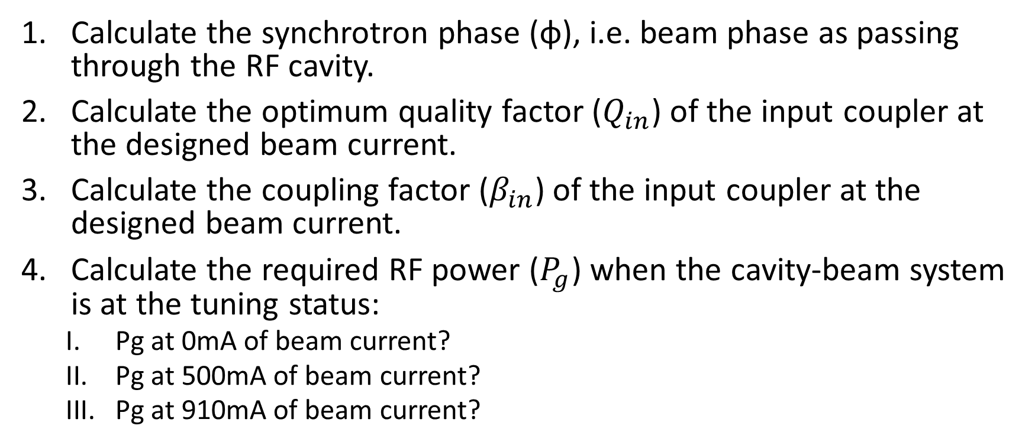
Problems
Calculate the synchrotron phase (φ), i.e. beam phase as passing through the RF cavity.
Calculate the optimum quality factor ($Q_{in}$) of the input coupler at the designed beam current.
Calculate the coupling factor ($β_{in}$) of the input coupler at the designed beam current.
Calculate the required RF power ($P_{g}$) when the cavity-beam system is at the tuning status:
  Pg at 0mA of beam current?
  Pg at 500mA of beam current?
  Pg at 910mA of beam current?

