Slide 1
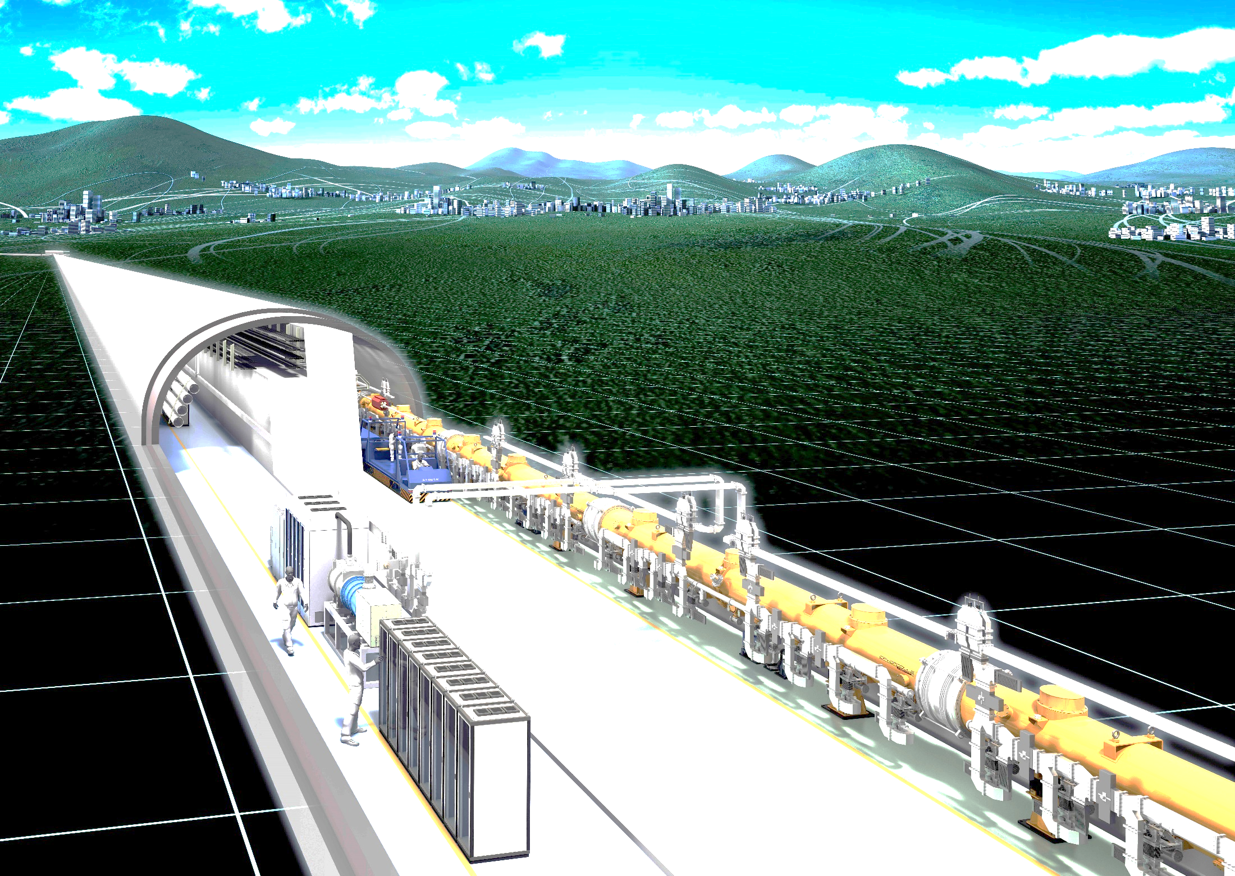
ILC Introduction
Kaoru Yokoya, KEK
2018.12.10 ASSCA2018, IHEP

Slide 2
Electron-Positron Linear Collider
Circular collider LEP at CERN finally reached 209GeV
To go beyond E_{CM} = 209GeV, linear collider is the natural choice
electron linac
positron linac
Proposal in early 1960’s
  About the same time as the first circular collider AdA
  Energy recovery was the original concern
M. Tigner, Nuovo Cimento 37 (1965) 1228

Slide 3
Key Technologies for Linear Collider
Difficulties of LC come from single pass nature
  The beam goes through the accelerating structure only once
  The beam is thrown away after collision
High Accelerating Gradient
  Linac (linear accelerator) technology was mature by 1980’s but LC required higher gradient
  Also, high power efficiency needed
High-quality, intense beam needed to gain high luminosity
  Create low emittance beam
  Focus the beam to a tiny spot
  High intensity beam needed (especially, positron)

Slide 4
Development of LC Technology
Serious R&D started in mid 1980’s
  US, Germany, Soviet Union, CERN, Japan
  Many machine names were born
  NLC, TESLA, VLEPP, CLIC, JLC
Acceleration method
  New advanced schemes proposed in early stages
    Laser grating, inverse FEL, dielectric accelerator, plasma
  Settled to the conventional microwave method but with improved technologies
  SCRF, Xband NC, C-band NC, Xband single bunch, two beam
  R&D’s unified to SCRF for the next (after SLC) generation LC in 2004 → ILC

Slide 5
SLC：The First Linear Collider
Single linac
  One revolution was possible if up to 46GeV
Completed in 1987 at SLAC
First Z⁰ event in May 1989
Competition with LEP
Polarized electron beam (~80%)
Finished in 1998
luminosity 3x10³⁰ /cm²/s (design 6x10³⁰ )

Slide 6
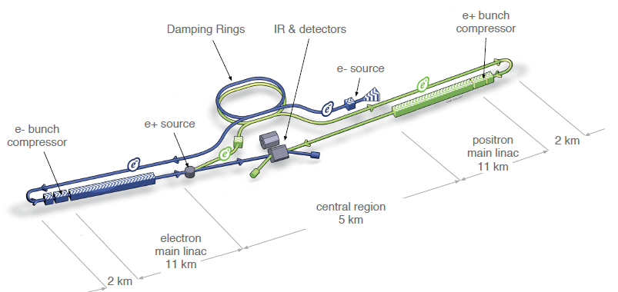
ILC Accelerator Layout

Slide 7
Constituents of ILC Complex
Electron source
Positron source
Damping rings（DR）
RTML (Ring To Main Linac)
Main Linac
BDS (Beam Delivery System)

Slide 8
New 250GeV Parameters
TDR (Technical Design Report was completed in 2013.
It is concentrated on the center-of-mass energy E_{CM} 500GeV
Later E_{CM} was reduced to 250GeV as the first step to Higgs study
Luminosity reoptimized

Slide 9
Main Linac Parameters
Lengths and component numbers are for E_{CM}=500GeV

Slide 10
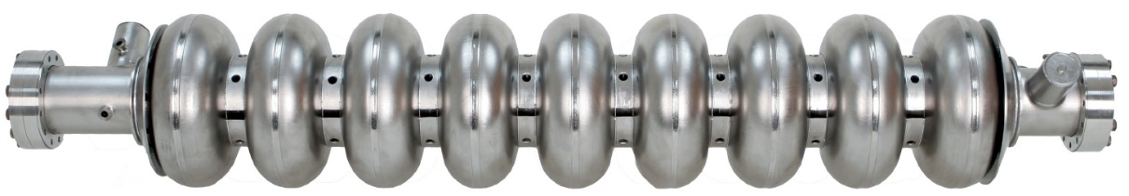
ILC Accelerating Cavity
9-cell niobium
Cell length = half of the wavelength of 1.3GHz
  11.5cm, ~1m 9cell
Power coupler
HOM coupler
Total length ~1.3m
Accelerating gradient 35MV/m (average), minimum 28MV/m
Q-value > 1x10¹⁰ at 31.5MV/m (2 Kelvin)

Slide 11
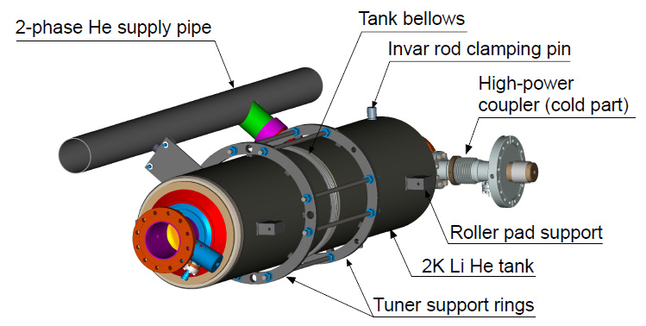
Cavity Package
Attach “Jacket”
Helium tank
Tuner

Slide 12
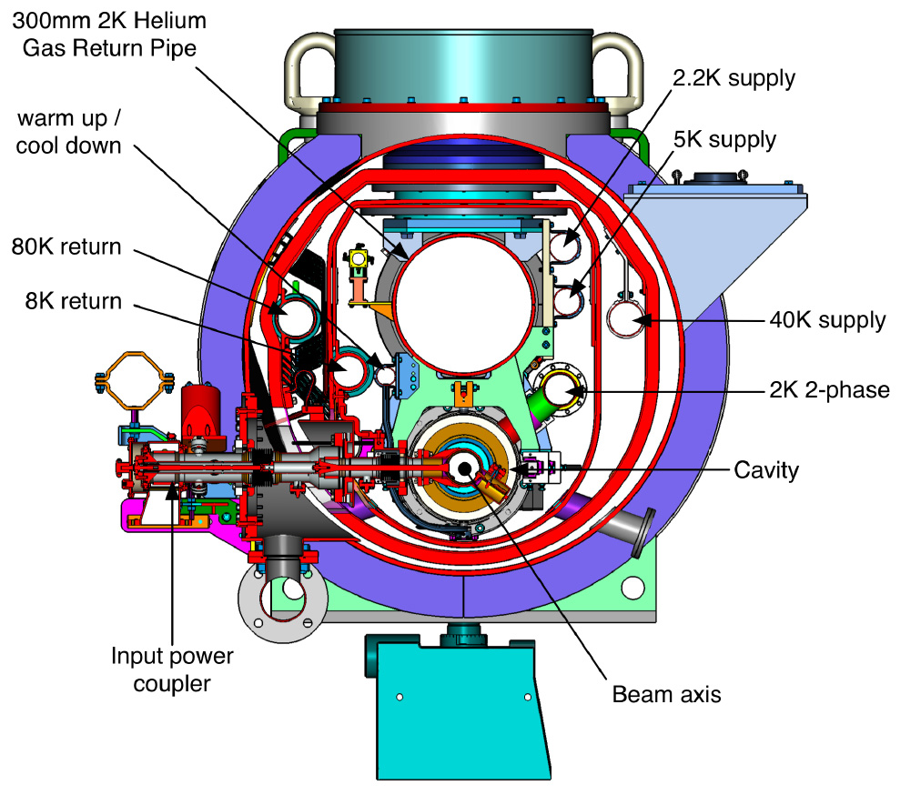
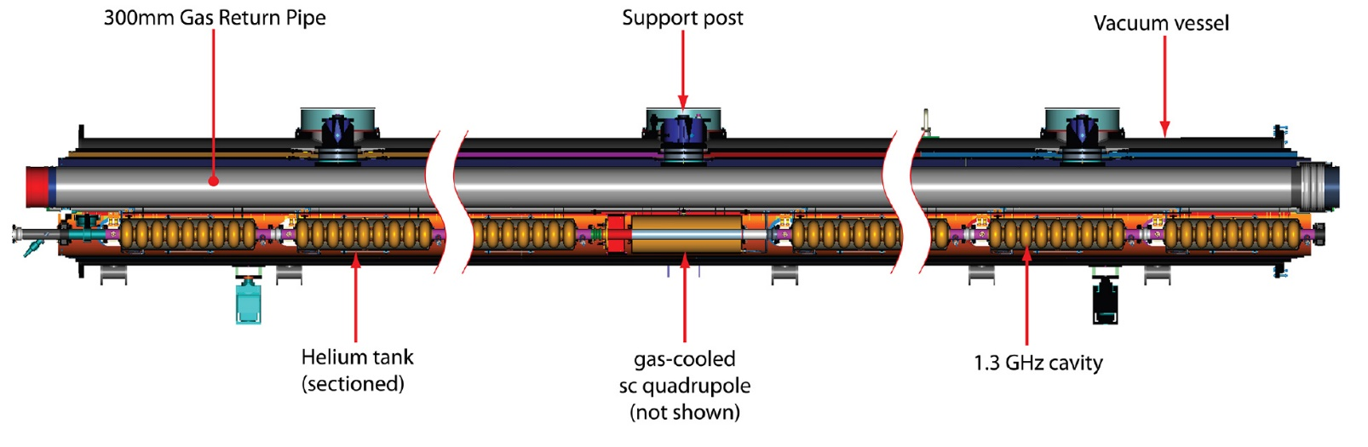
Cryomodule
Connect 9（or 8）cavities
Thermal shield, magnetic shield
Gas Return Pipe
SC quadrupole magnet
Total length ~13m
~2000 modules needed for E_{CM}=500GeV
Average accelerating gradient in module 31.5MV/m (+-20%)

Slide 13
Cryogenics System
Cryogenic plant distribued every 2.5km
5 cryoplants for each linac (E_{CM}=500GeV)
Each cryo unit
  Heat load ~20kW (4.5K equivalent)
  Installed power ~4MW
Total operating power for E_{CM}=500GeV is ~35MW

Slide 14
NC vs. SC --- Power Efficifiency
 |  | ILC 500GeV | CLIC 3TeV
Loaded gradient | MV/m | 31.5 | 100
Beam power/beam | MW | 5.2 | 14
Total power consumption | MW | 163 | 582
Beam power/total AC power | % | 6.4 | 4.8
Main linac power efficiency*⁾ | % | 12 | 6
*) = beam power gain / AC power for main linac
  Including cryogenics (ILC), drive linac and drive beam manipulation (CLIC), linac magnets,
  Not including AC high power line

Slide 15
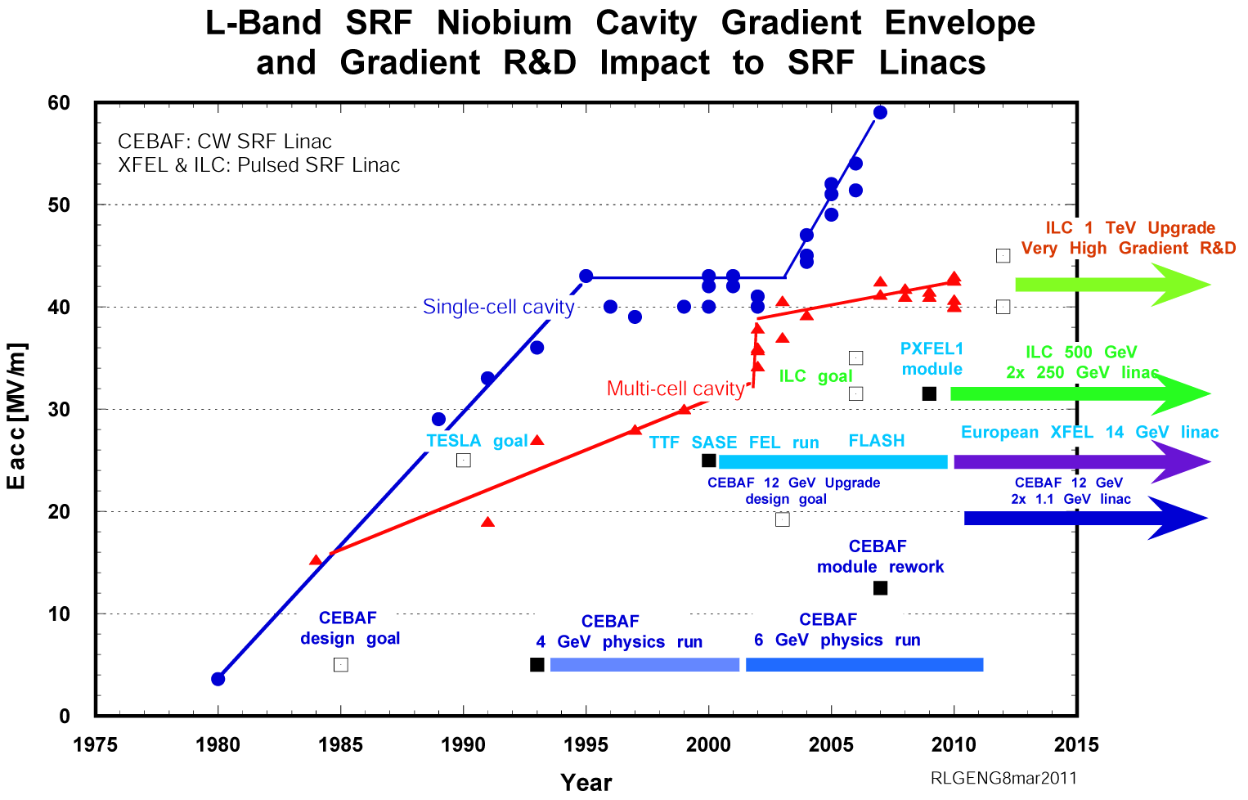
History of Gradient of SCRF Cavities
Björn Wiik
vision
Note: these are champion data
R&D needed
ILC design
TDR by 2012
Under construction
Under construction
ITRP Recommendation

Slide 16
Status of Accelerating Gradient
Design value:
  Vertical measurement 35MV/m
  Average accelerating gradient 31.5MV/m
  These are adopted in Snowmass Workshop in summer, 2005
  The practical gradient at that time ~17MV/m, good cavities around 25MV/m
  Expected 10% reduction from vertical to average gradient
The design values have been nearly reached by R&D since then
ILC-TDR (Technical Design Report)
  Accept down to -20%（vertical 28MV/m）. Average 31.5MV/m
  Allow surface re-treatment up to twice for bad cavities. Cost was estimated by taking int account 90% pass yield
Design values almost reached at KEK & FNAL with O(10) cavities
Mass-production data only from European XFEL
  All cavities (~800) fabricated and tested

Slide 17
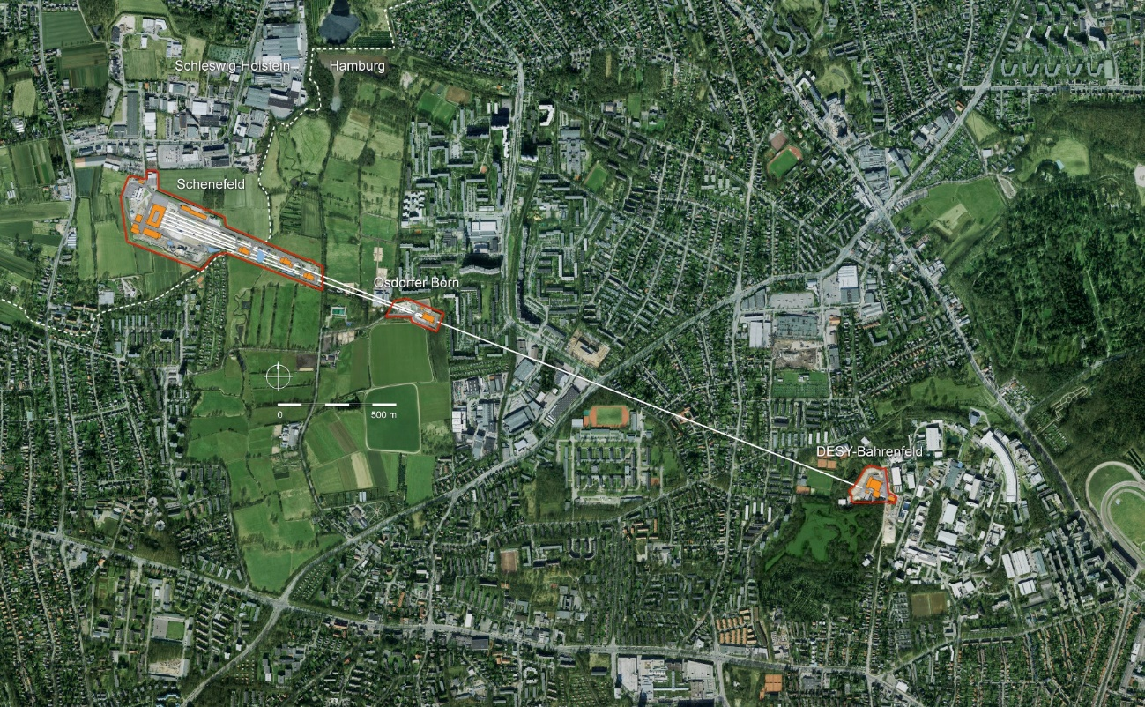
European XFEL
X-ray free electron laser built at DESY, Hamburg
Acceleration technology almost identical to ILC
  Accelerating gradient lower (~24MV/m,
  ILC: 35MV/m）
  Total accelerator length 1.7km (ILC: 11km x 2)
  Cavities ~800台
    ILC ~16000 (500GeV)
  Installed and tested in crymodules
  Commissioning done

Slide 18
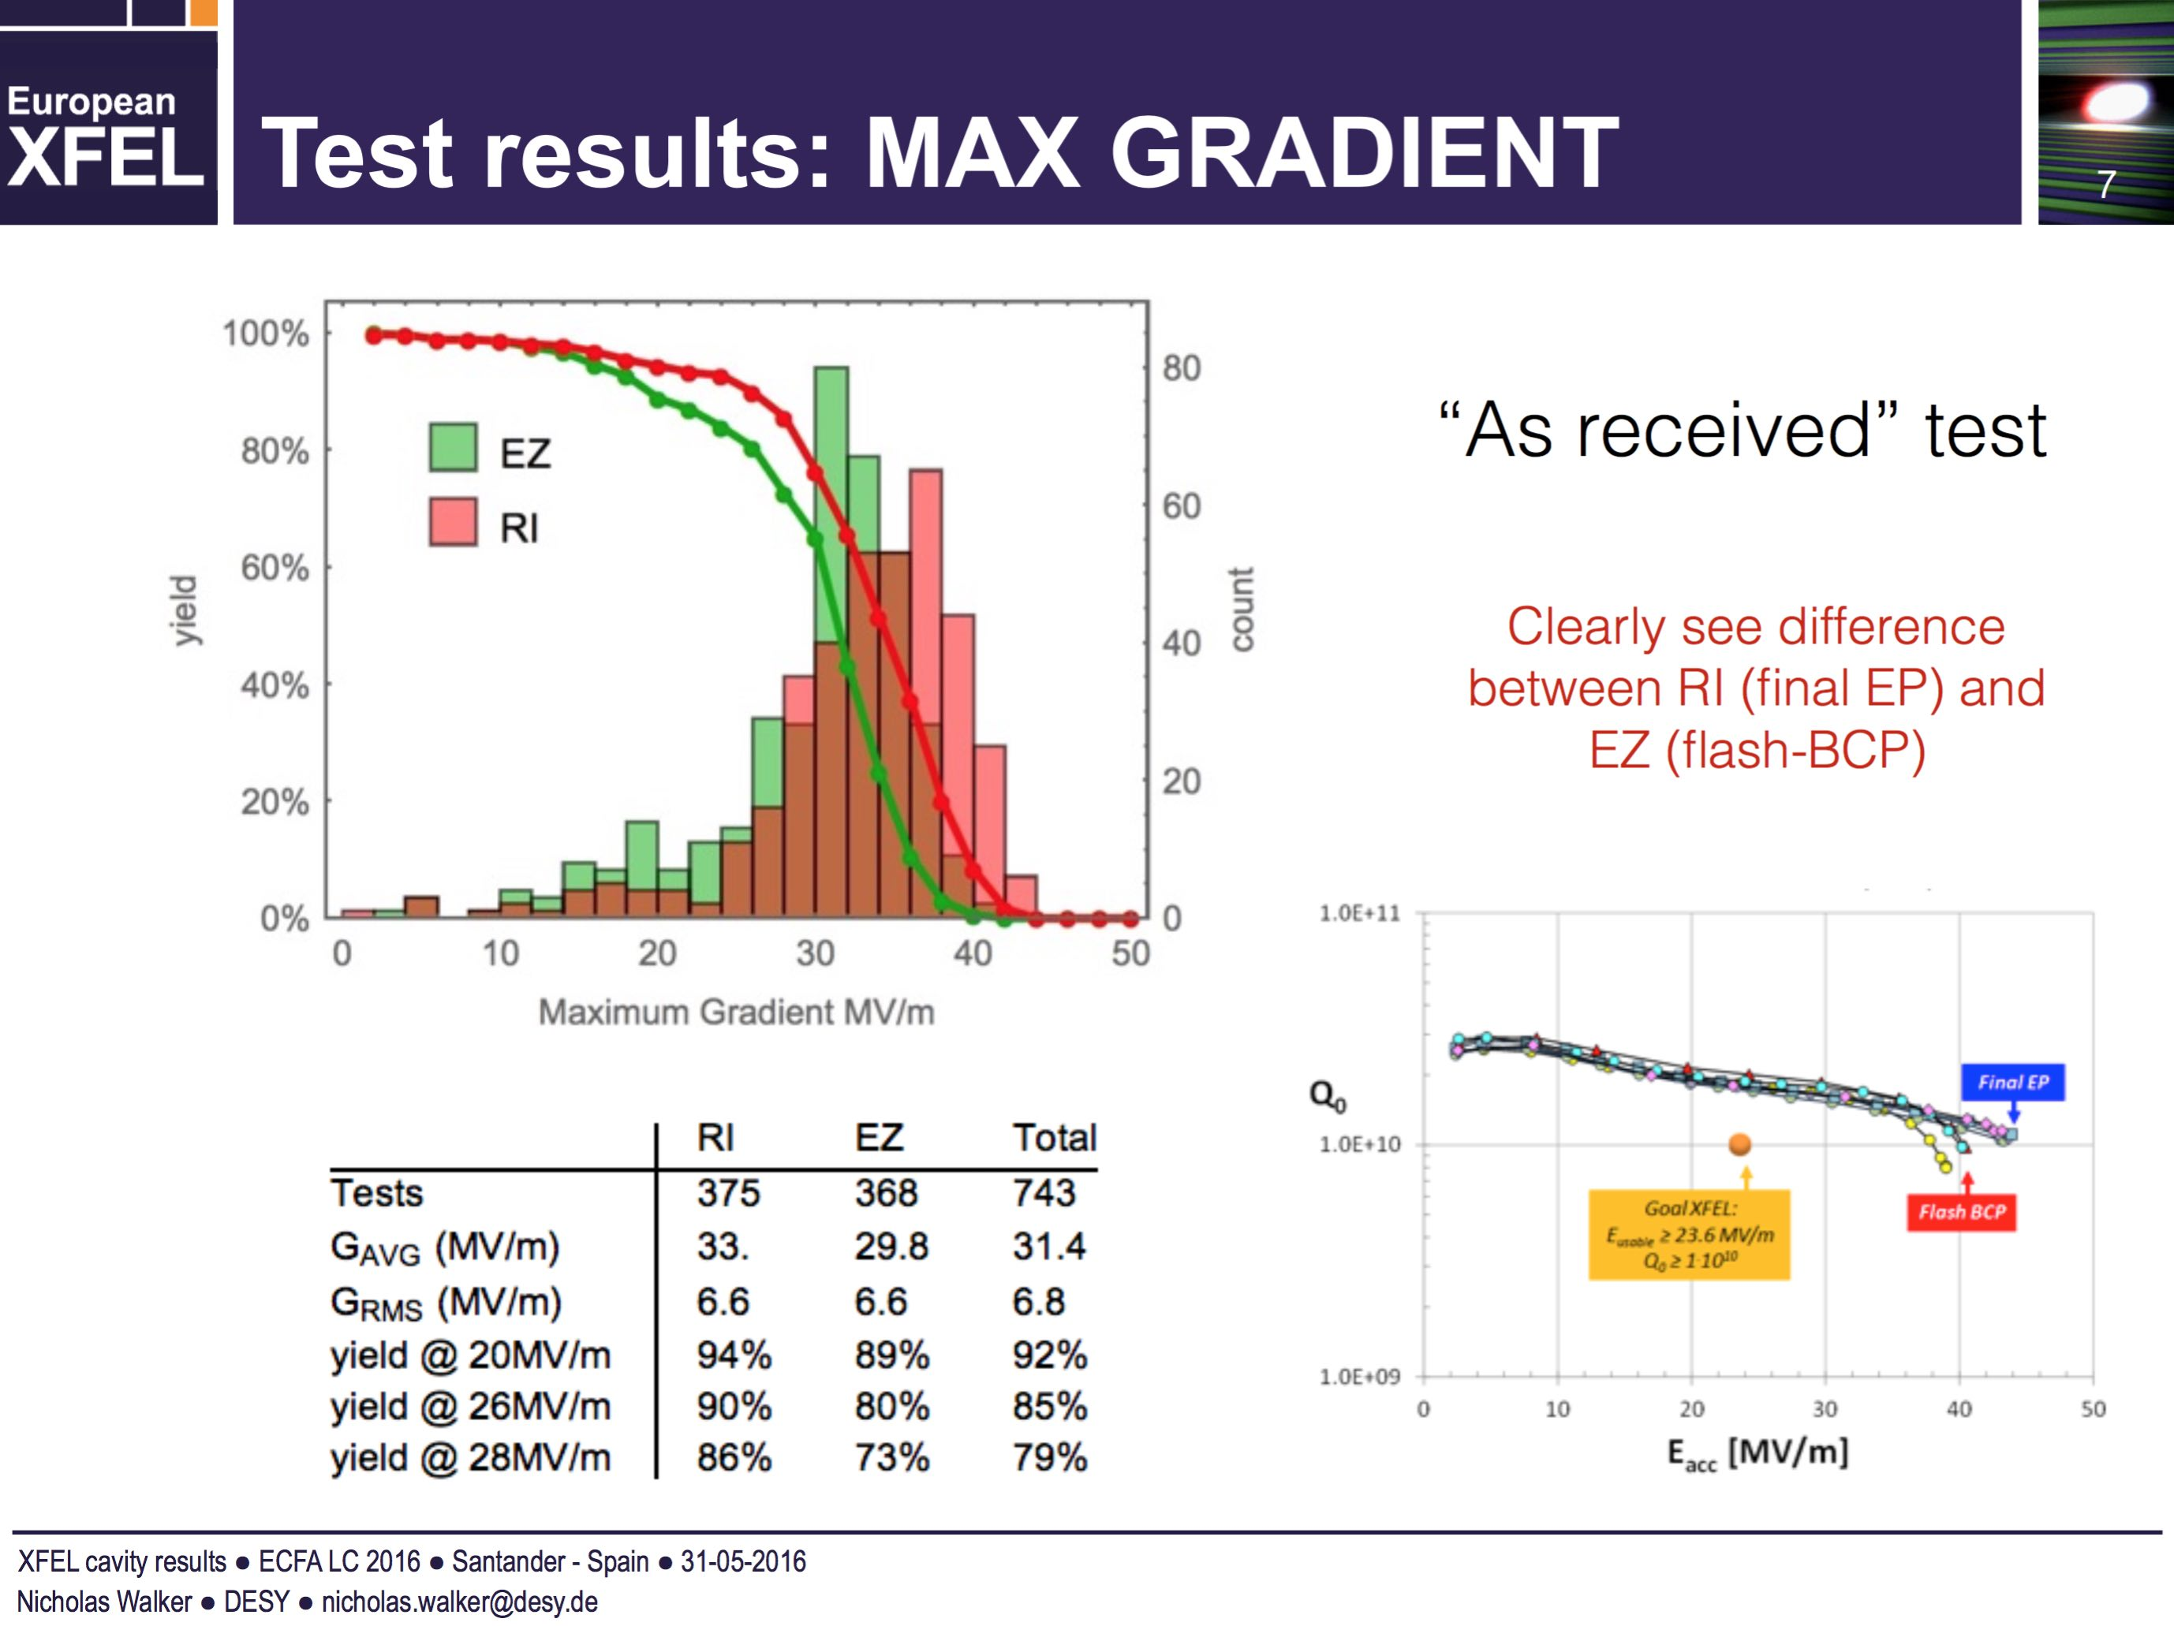
From N.Walker, TTC Jul.2016
RI : EP110um + EP40um
Zanon: EP140um + BCP10um
Different surface treatment in 2 companies.
Cavities below 20MV/m a re-treated (mainly high pressure rinsing, BCP if needed)

Slide 19
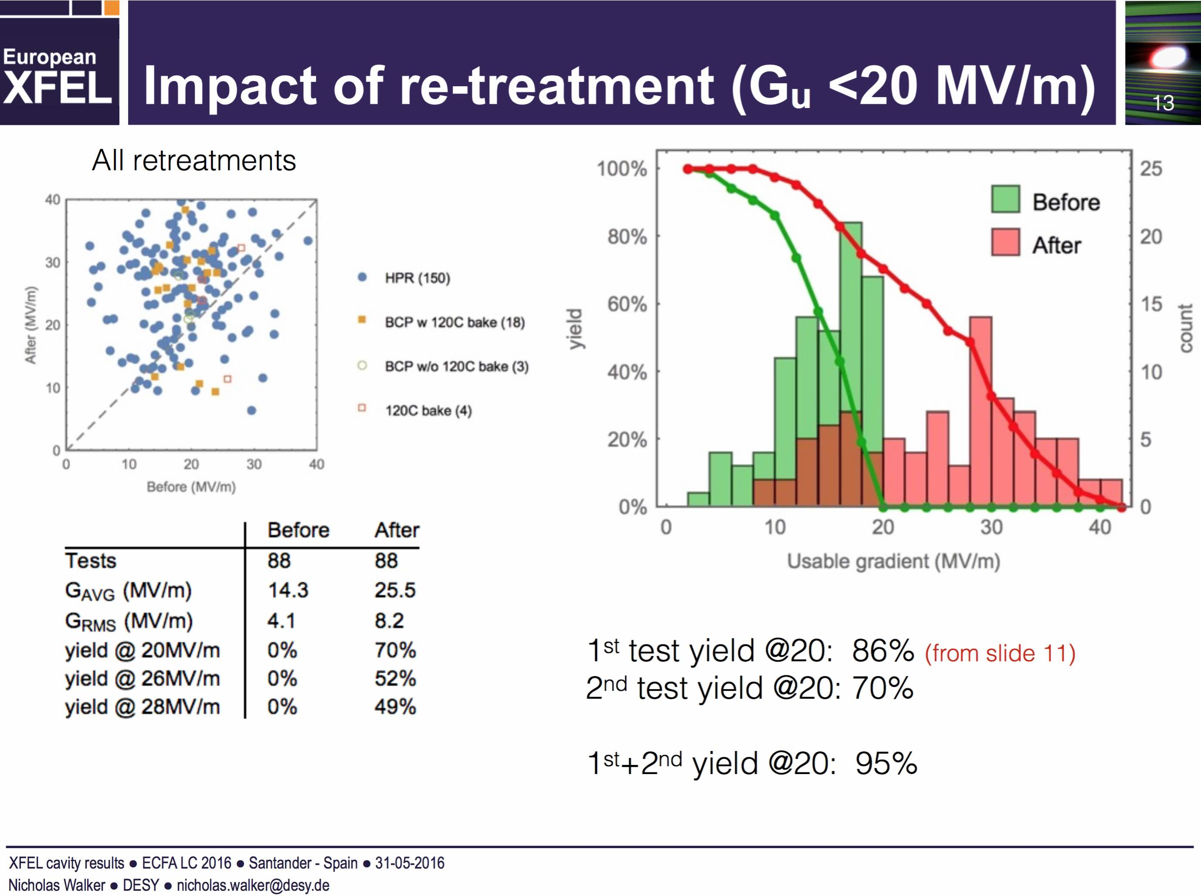
From N.Walker
About half of re-treated cavities exeeded 28MV/m
But cannot be immediately used to ILC because of different design gradient

Slide 20
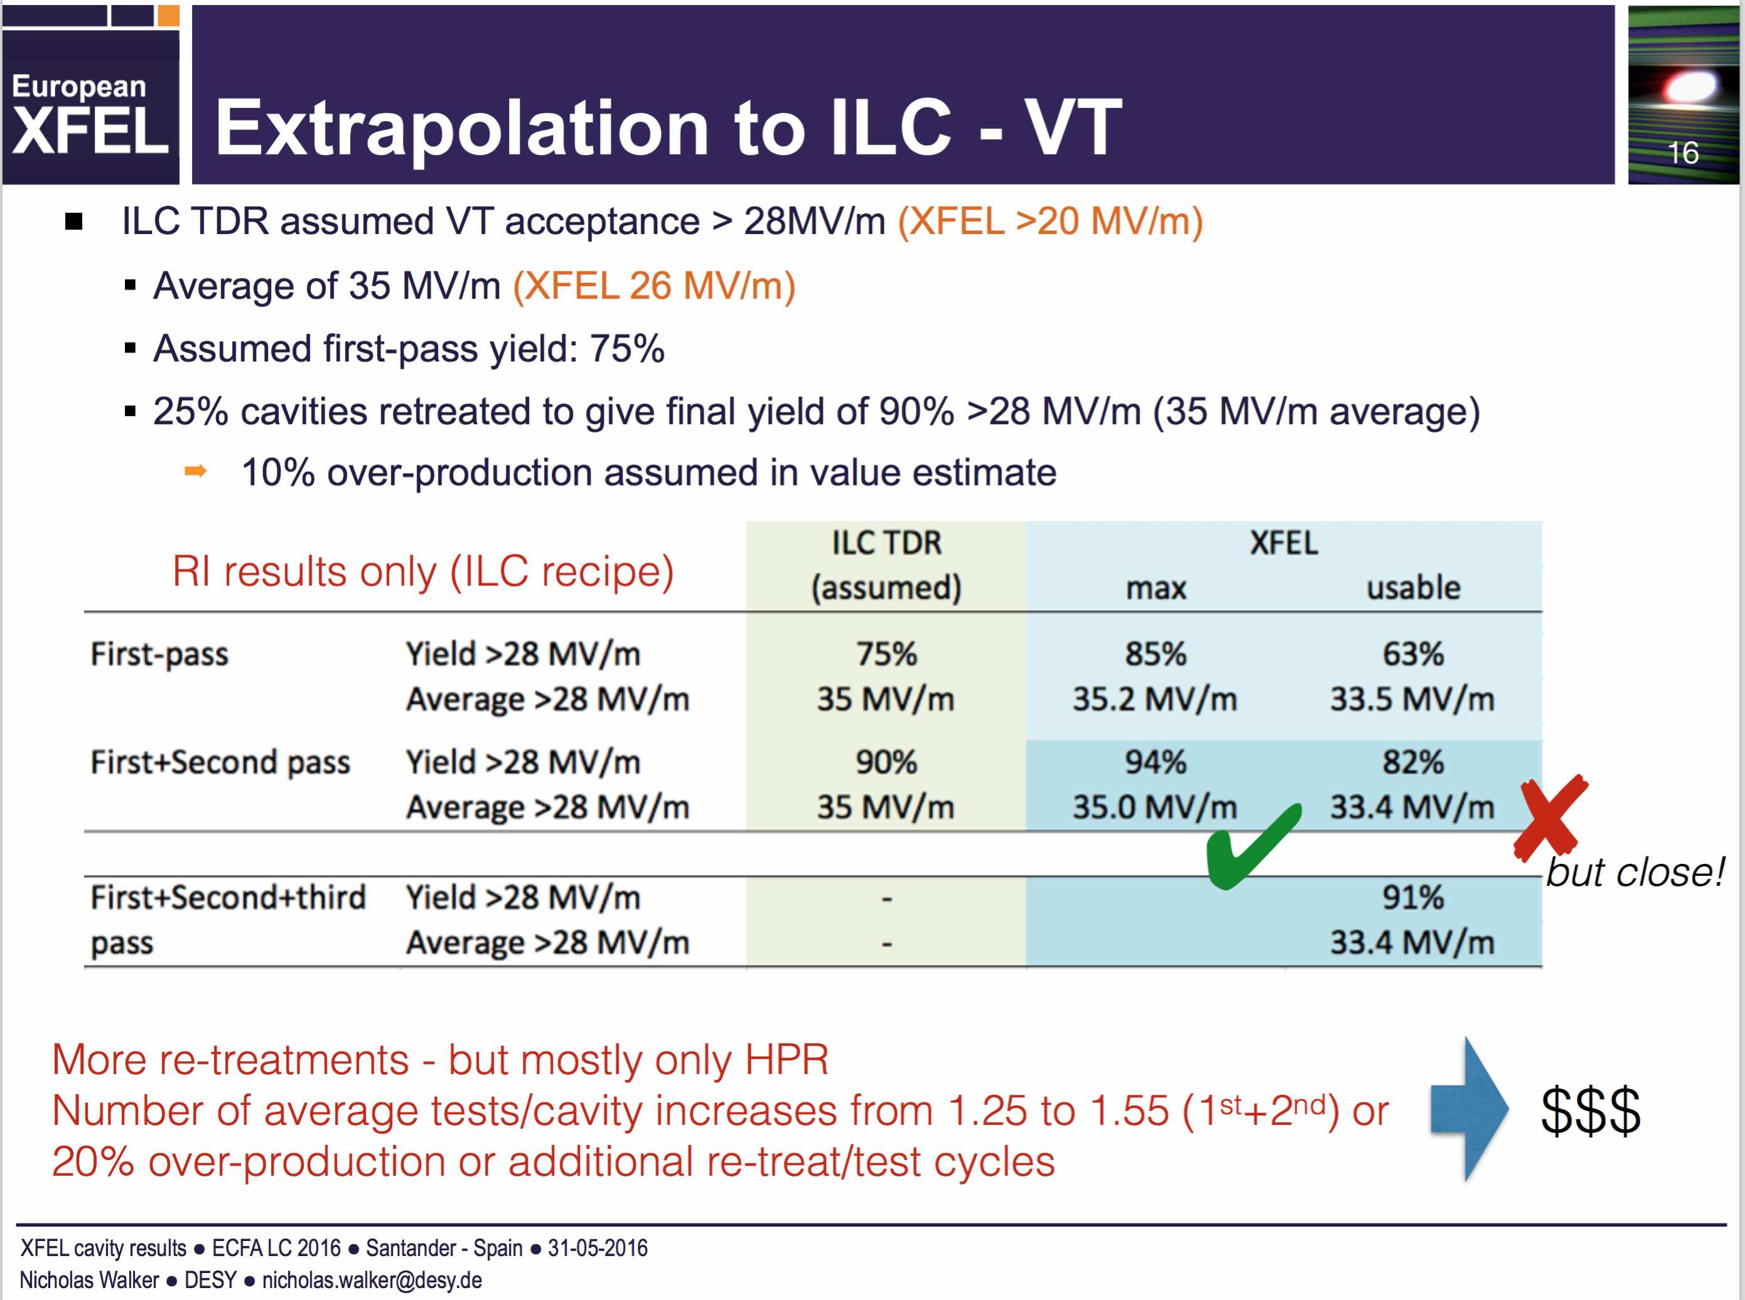
N.Walker

Slide 21
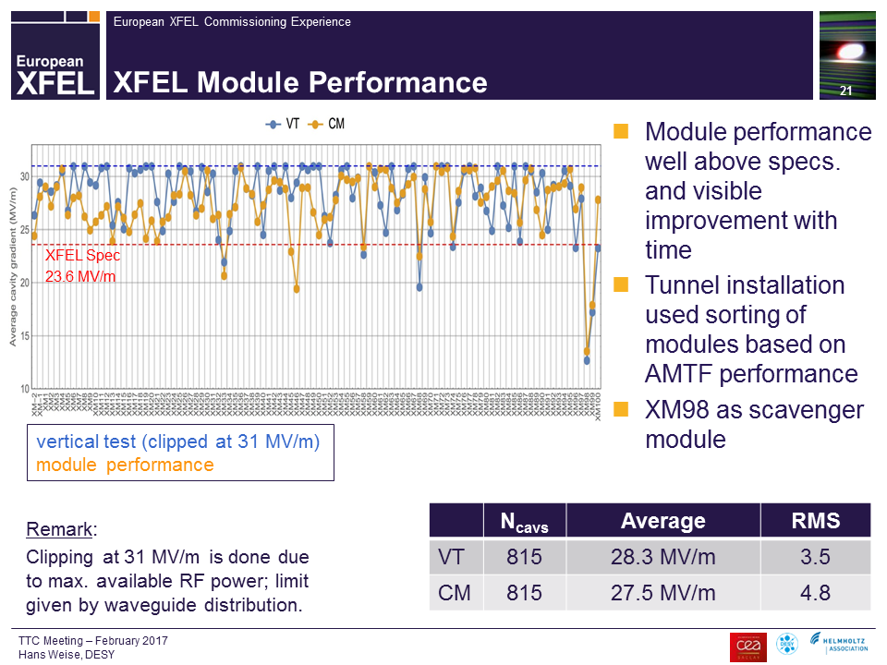
Accelerating Gradient
Hayano, Feb. 2017, TTC
In the ILC specification,
E_{acc} @V.T. = 35.0 MV/m
E_{acc} @C.T. = 31.5 MV/m
with ±20% distribution for each.
Gradient extrapolated to ILC ~ 30MV/m

Slide 22
SRF Cost Reduction R&D
In the framework of J-US cooperation
Short-term R&D (2–3 years)
A-1. Niobium material preparation
- with new processing for sheeting and piping
A-2. SRF cavity fabrication for high gradient and high Q
- with a new surface process recipe provided by Fermilab
A-3. Power input coupler fabrication
- with new-ceramic window (w/o additional coating)
A-4. Cavity chemical treatment
- with vertical configuration and new chemical

Slide 23
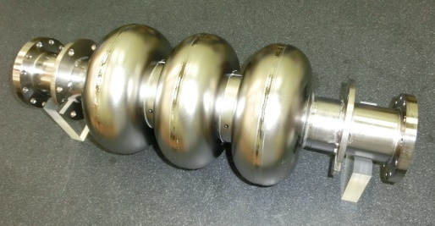
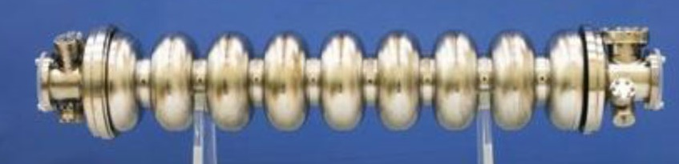
R&D plan for Nb material
JFY2017:
- Produce total 4 three-cell cavities
  High Ta medium RRR（100〜200）material
  High Ta high RRR（200〜300）material
- Evaluate these cavities from the view points of material cost, chemical cost, etc.
- Select the material
JFY2018,2019:
Produce 8 nine-cell cavities (satisfying the high pressure regulation)
Optimize materail of end-group (including HOM coupler)
Carry out chemical processing, vertical test
Schedule
 | 2016 | 2017 | 2018 | 2019
KEK Masashi Yamanaka
Feasibility study using
4x3-cell cavities (ongoing)
Preparing
materials
Manufacture
8x9-cell cavities
Evaluation
(Vertical&Horizontal tests)

Slide 24
R&D plan for High-Q High-G
JFY2016:
- Process single-cell KEK-cavity at FNAL (done)
- Measure Q-value at FNAL (done)
JFY2017:
- Measure Q-value at KEK (to confirm the measurement system configuration)
Produce new single-cell cavities
Process single-cell cavities at small vacuum furnace
（iteration with electro-polishing & vertical test)
- Procure new vacuum furnace for 9-cell cavity
JFY2018:
- Process High-Q High-G to 3 nine-cell cavities
- Produce 8 nine-cell cavities
JFY2019：
- Check performance
- Prepare the installation to STF-2
 | 2016 | 2017 | 2018 | 2019
KEK Hitoshi HAYANO
FNAL process
1 cell processing
Performaｎce test
Preparation for cyromodule
Preparation of vacuum furnace
3-9cell performance
8 - 9cell cavities fabrication
Performace test

Slide 25
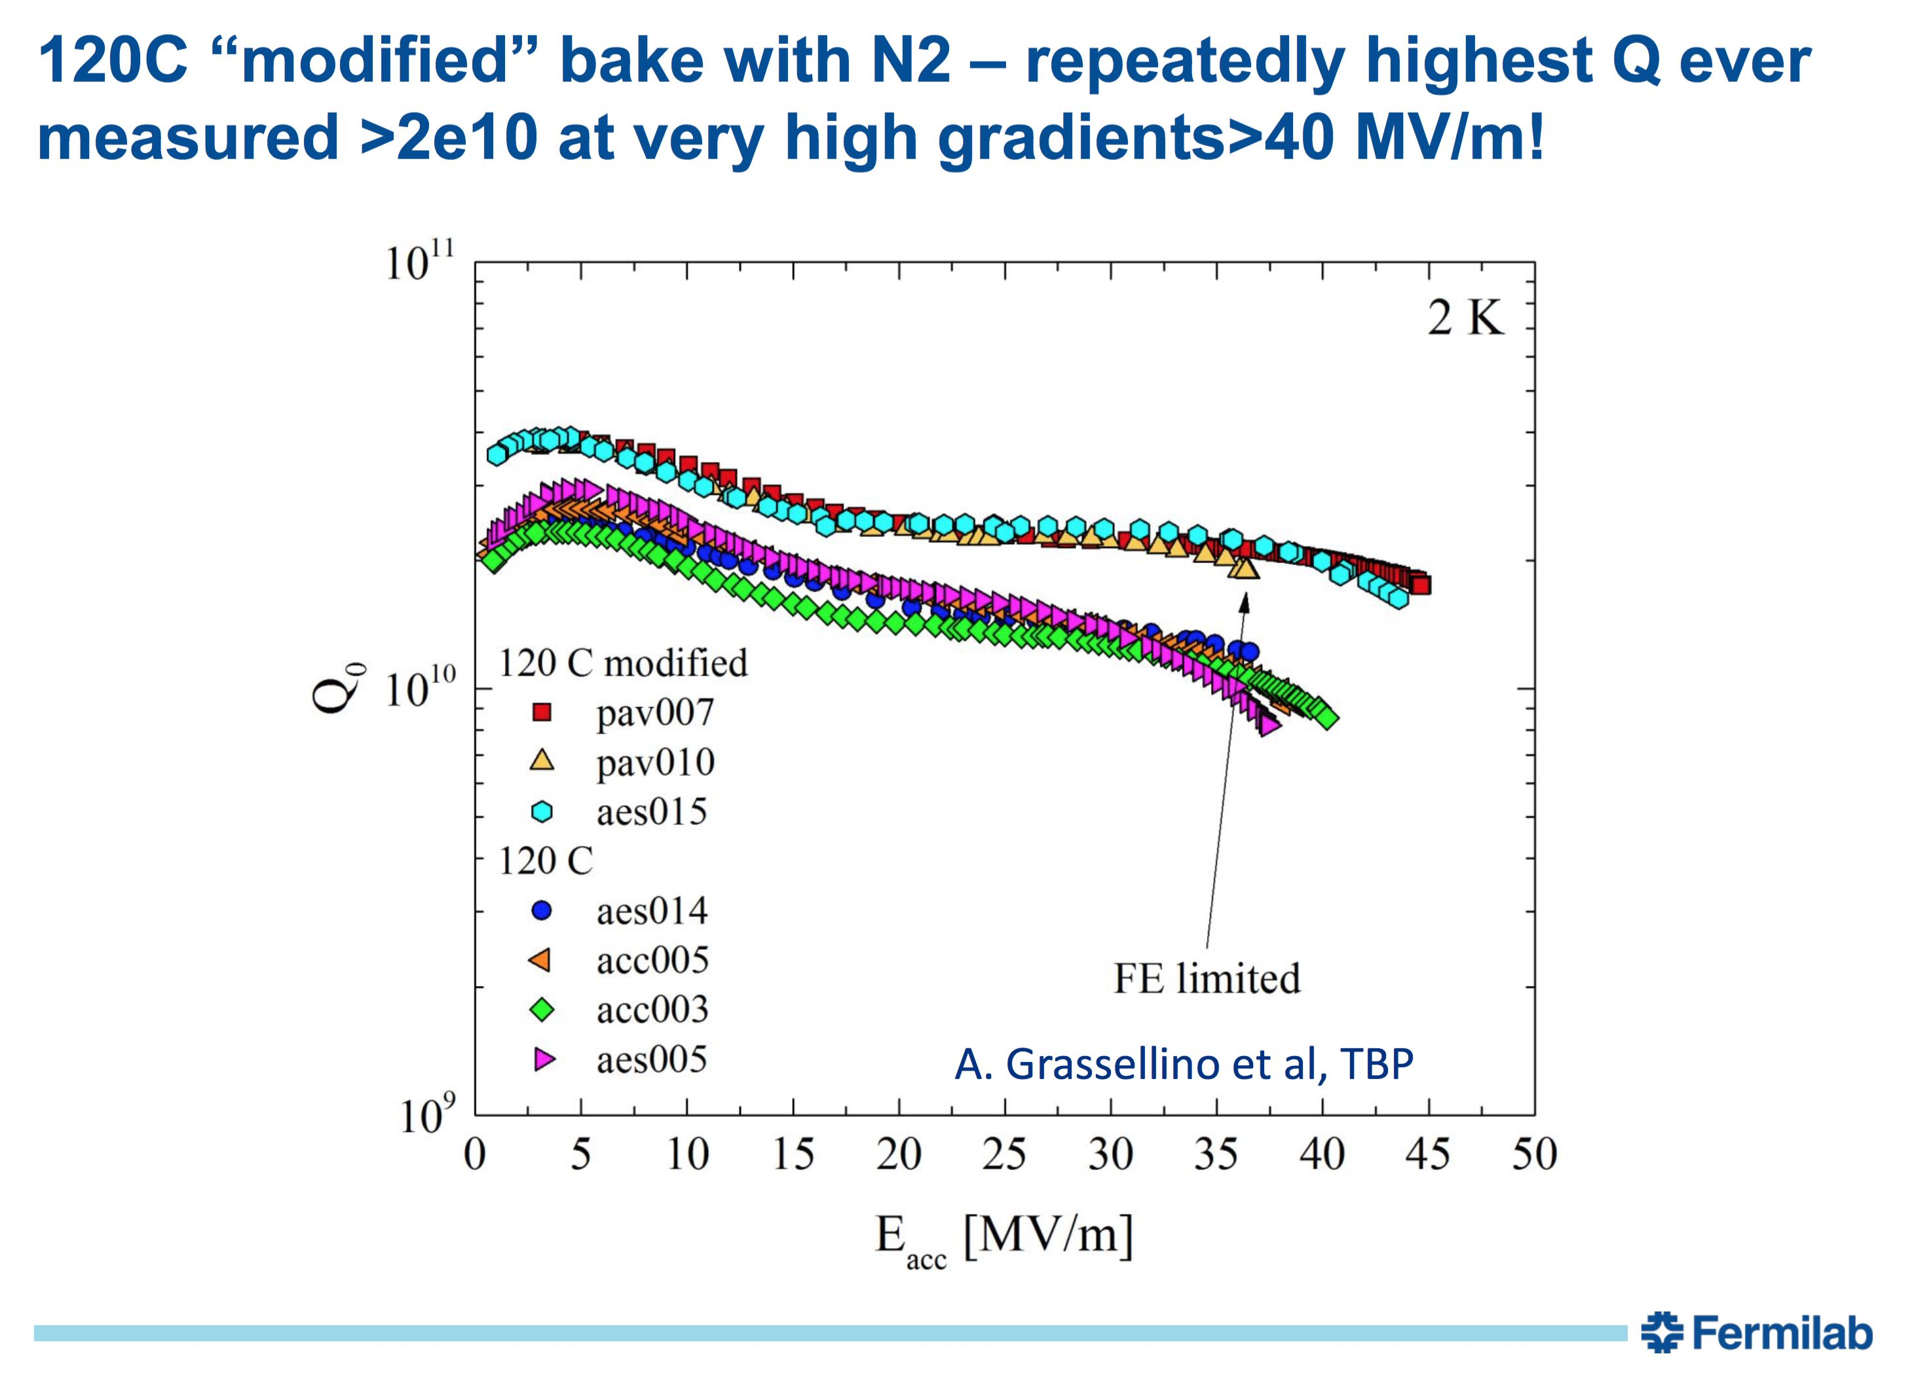
Nitrogen Doping
Q0 can be raised by nitrogen doping after surface treatment (FNAL)
To be adopted at SLAC LCLSII
This year: further new technology of nitrogen doping at low temperature → high Q and High G
Can be adopted in the next couple of years?
If realized, up to 10% cost reduction of ILC
New N₂-dope recipe
Standard ILC recipe
Hayano ILC camp2016

Slide 26
N-Infusion in Japan
Start N-dope at KEK
  2015 Feb: First N-dope trial at KEK
  2015 Apr: Second trial at KEK (small furnace)
  2015 May: Third trial (large furnace)
  Failure in all cases (Q-value became worse)
Umemori
Start N-dope/infusion at JParc
  JParc has oil-free furnace
  2016 Summer~ start N-infusion
  First test showed Q-slope above Eacc>5MV/m

Slide 27
N-infusion Test at JParc
Pumping system improved for better background vacuum level during 120deg infusion
10⁻² Pa → 10⁻⁵ Pa
Showed first success of N-infusion in Japan
Umemori

Slide 28
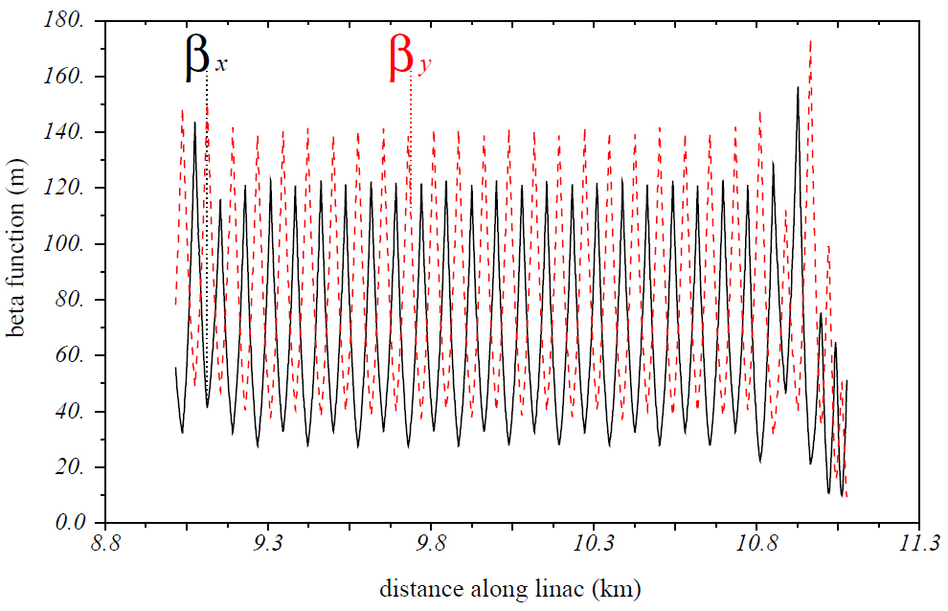
Linac Beam Dynamics
Initial alignment tolerance of Main linac
200-300μm

Slide 29
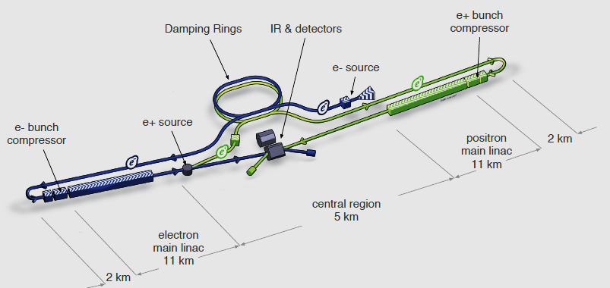
Components other than the Main Linac
Electron source (polarized electron)
Positron source
Damping rings（DR） (low emittance beam)
RTML (Ring To Main Linac) (compress bunch length, etc)
BDS (Beam Delivery System) (focus the beam)

Slide 30
Baseline Beam Parameters
(baseline, 5Hz, 250GeV）
Repitition rate 5Hz
Number of bunches per pulse 1312
Number of particles per bunch 2x10^10
Bunch interval 554 ns
Rms bunch length 0.3 mm
Horizontal normalized emittance 5 μm
Vertical normalized emittance 35 nm
Horizontal rms beam size at IP 515nm
Vertical rms beam size at IP 7.7nm

Slide 31
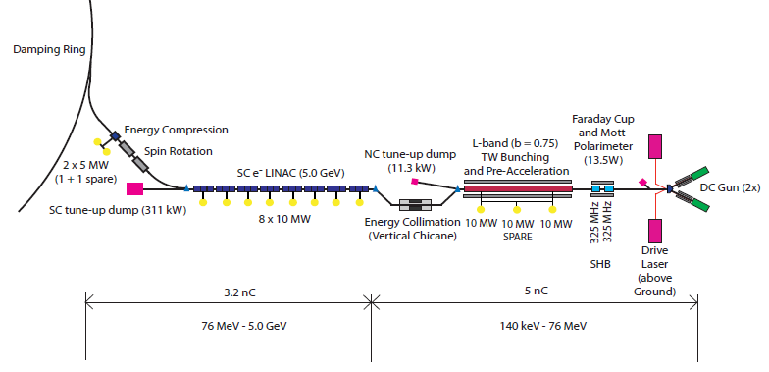
Electron Source
Polarized beam demanded （>80%）: advantage of LC
No serious problems

Slide 32
Efforts for Higher Electron Polarization
Strain-Compensated Superlattice
  Higher crystal quality
  Thicker superlattice
Obtained
  Pol. ~92%
  With QE 2.2%
~90% looks realistic
Almost no depolarization expected to IP
N.Yamamoto (Nagoya Univ.) LCWS2014

Slide 33
Positron Source
3 possible schemes of positron beam generation
Undulator method (adopted in ILC baseline)
Conventional Method
  Hit a few GeV electrons on a target, and collect the generated positrons
  adopted in many accelerators, well established
  Issues in the application to ILC
    Survivability of the target→ OK
    Emittance of the generated positron → OK (improved DR optics)
    Transport to DR entrance under study
    No polarized positron
Laser-Compton method (far future)

Slide 34
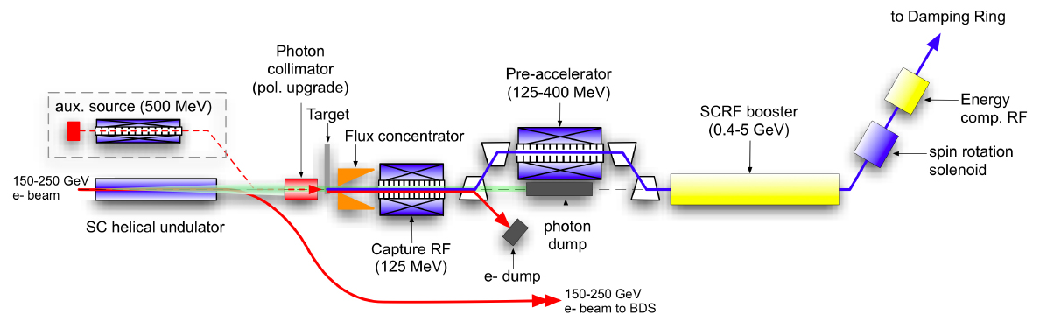
ILC Design (undulator method)
Electron energy >150GeV
Undulator
  At the end of the electron linac
  Helical, superconducting
  K=0.92, λ=1.15cm, (B=0.86T on the axis)
  beam aperture 5.85mm (diameter)
  Total length 231m (1.75m x 2 x 66)
Target: rotating titanium alloy
Flux Concentrator for positron capture → QWT (Quarter Wave Transformer)
Normal-conducting acceleration up to 400MeV
Polarization ~30% (~60% with photon collimator and longer undulator)

Slide 35
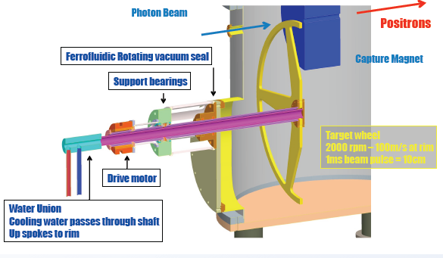
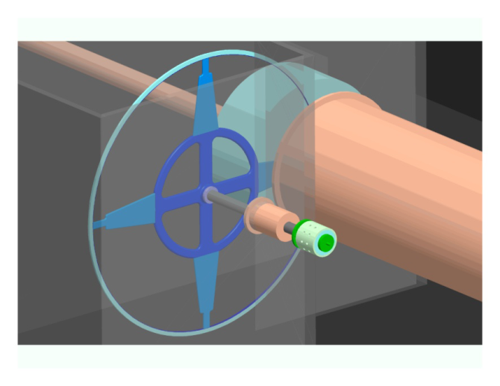
Target
Wheel of Titanium alloy, diameter 1m
Must rotate at 100m/s (2000 rpm) in vacuum
Test at LLNL using Ferromagnet seal was not successful
  Outgassing spikes still being observed
New idea being studied
  Radiation cooling

Slide 36
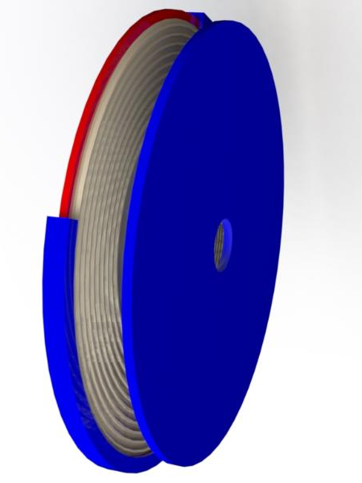
Radiation-Cooling Target
Avoid cooling water inside
Radiation cooling
~ σT⁴
Heat transfer
  Ti → Cu : conduction
  rotating Cu
  → sitting Cu : radiation
  sitting Cu → water
Rotation axis supported by magnetic bearing
  In vacuum
  No magnetic fluid
photons
Ti6Al4V
Radiator
Cooler
Sketch: Felix Dietrich

Slide 37
Key Issues on Radiation Cooling Target
Ti-Alloy - Copper joint
  Large temperature variation
  Cyclic stress
  Eddy current
  must guarantee thermal conduction
  2000rpm
  Maybe rotating copper omitted
    Direct radiation from Ti
    Maybe enough for 2kW (250GeV CM, 1312 bunches)
Magnetic bearing
  Weight of the wheel ~ 50kg
Is Titanium alloy the optimum ?
No concrete design yet
Pizza slice model being planned as the first step for heat issues

Slide 38
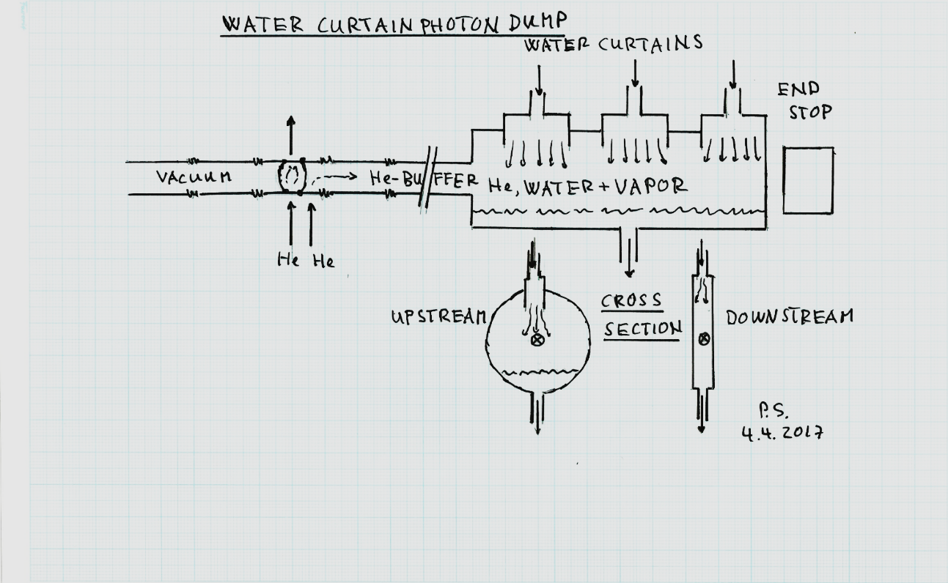
Photon Dump
TDR design (pressured water) won’t work due to high radiation damage (dpa, dislocation per atom)
Water curtain dump proposed in Santander WS (2016)
Another design : graphite with shallow angle (~10mrad) with the beam
Both of these require further detail

Slide 39
Photon Collimator
Higher photon polarization, hence higher positron polarization, can be obtained by collimating the photons from undulator

Slide 40
e-Driven Scheme
Conventional e-driven scheme is being studied as a backup
Freedom of the beam format
→ can dilute the beam heating on the target
Detailed design in progress
  Detailed calculation of the beam loading effects
  Traveling-wave part seems to be OK
  Standing-wave part (just after the flux concentrator) is being studied
Target development
  Rotation in vacuum
  Initial test presented at AWLC and Strasbourg
    Good, stable vacuum in the first 2 months
    Started showing spikes every few hours (factor 1.5-2)
    Influence on the positron system was expected to be negligible, but the reason of spike unknown
  Test being continued

Slide 41
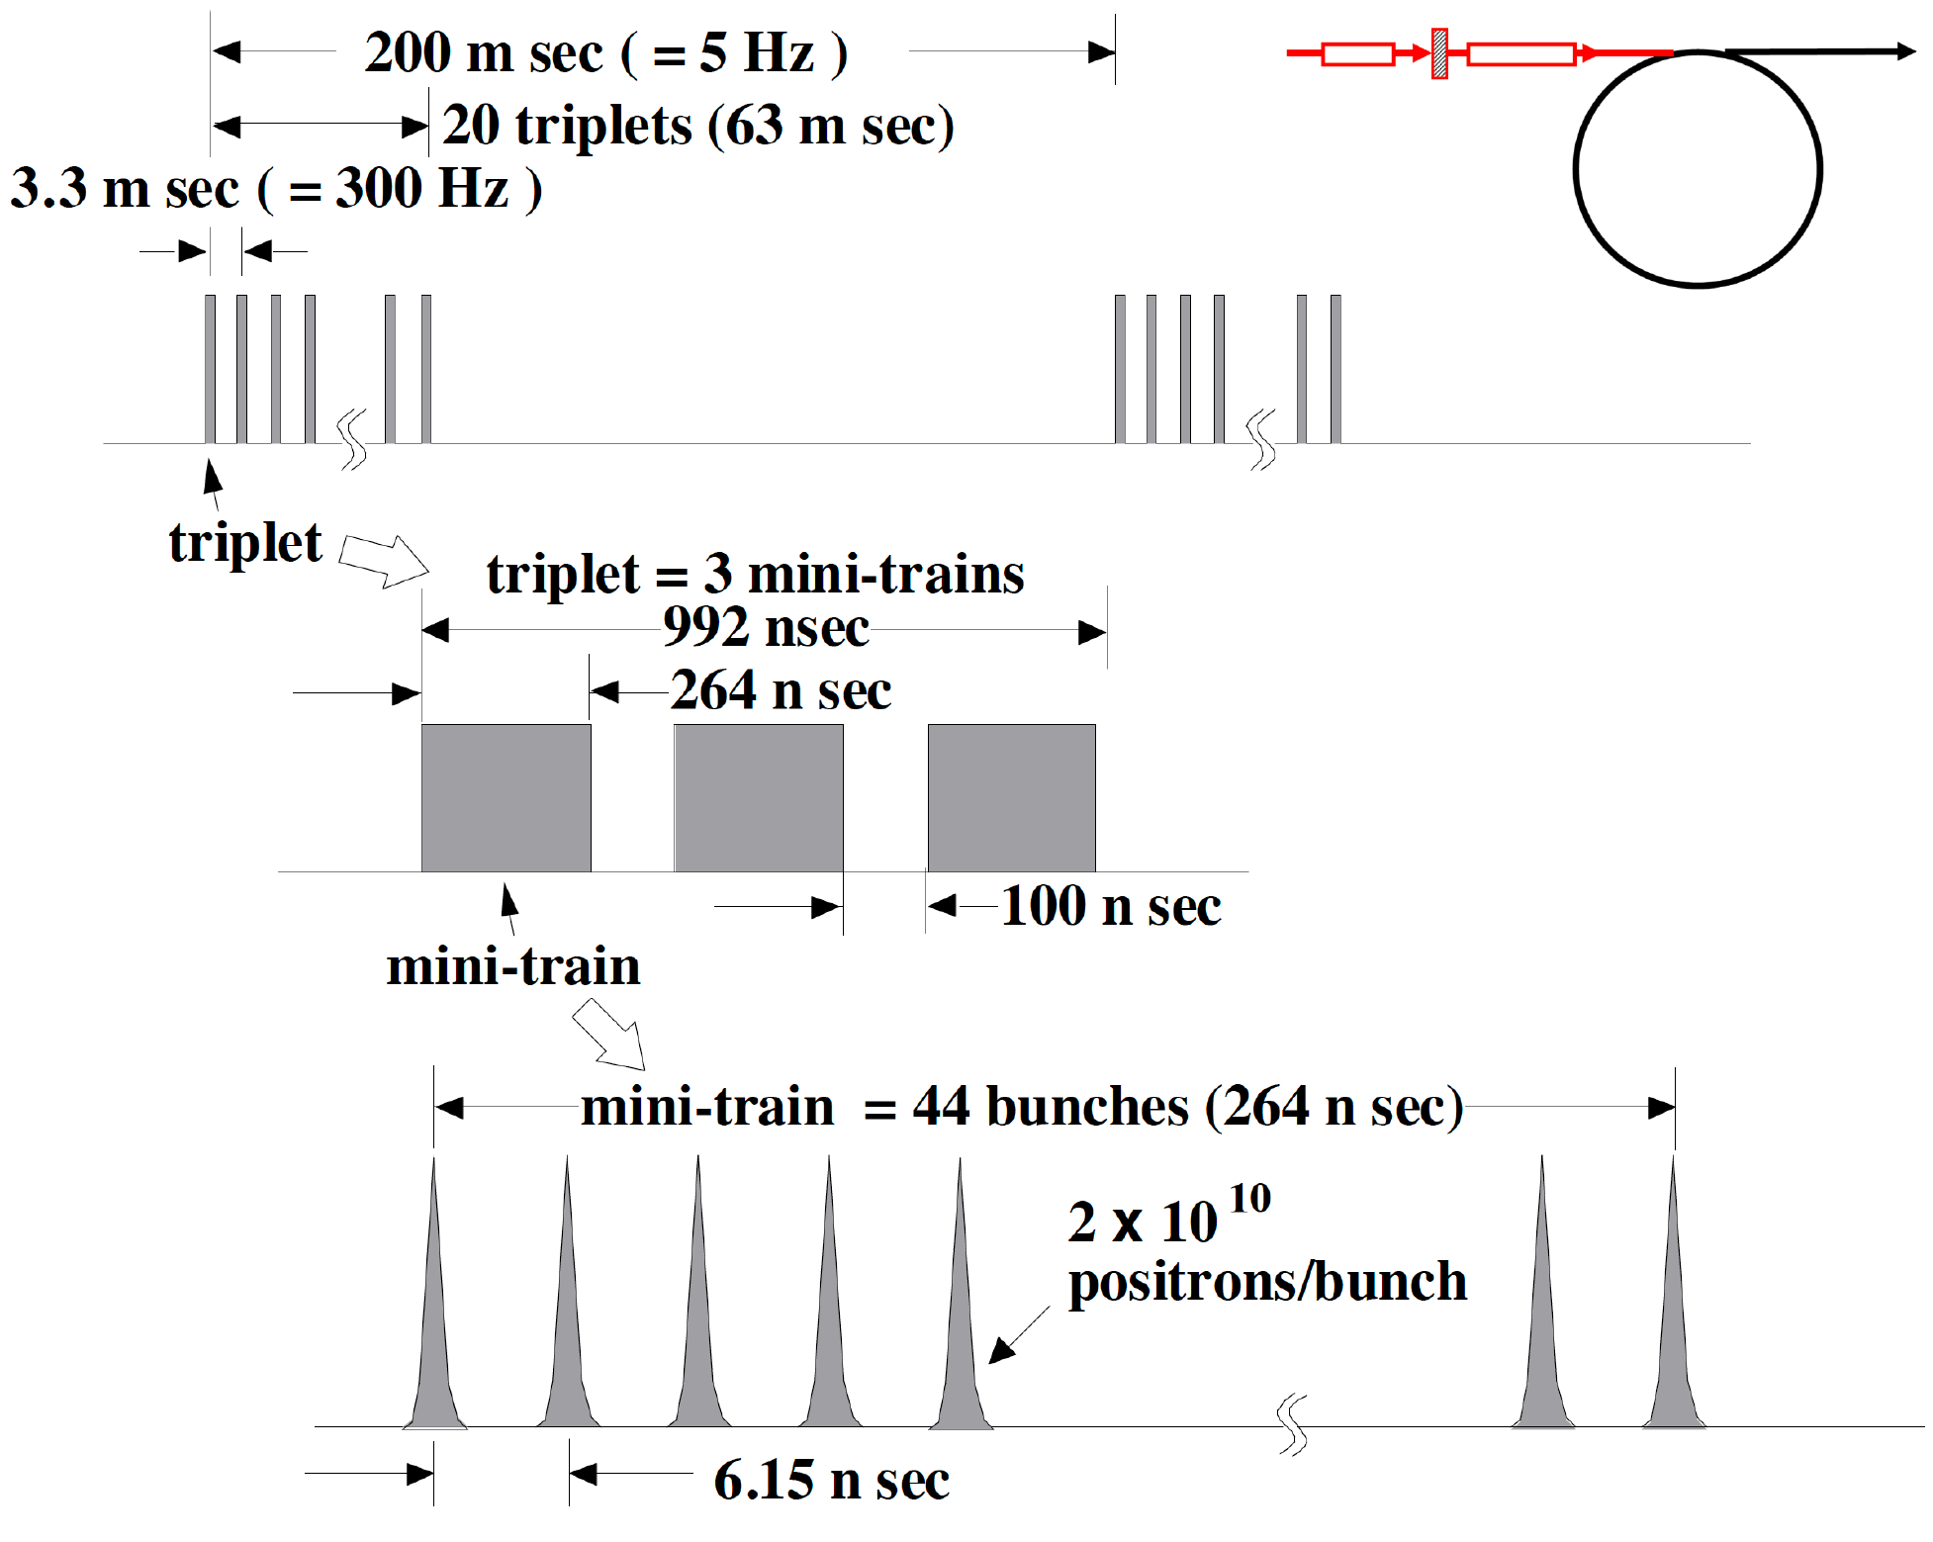
Bunch Pattern for e-driven source
=132 bunches
Moving target still needed but much slower
<-- the 100 ns gap is required to cure
an e- cloud problem in e+ DR.
T.Omori

Slide 42
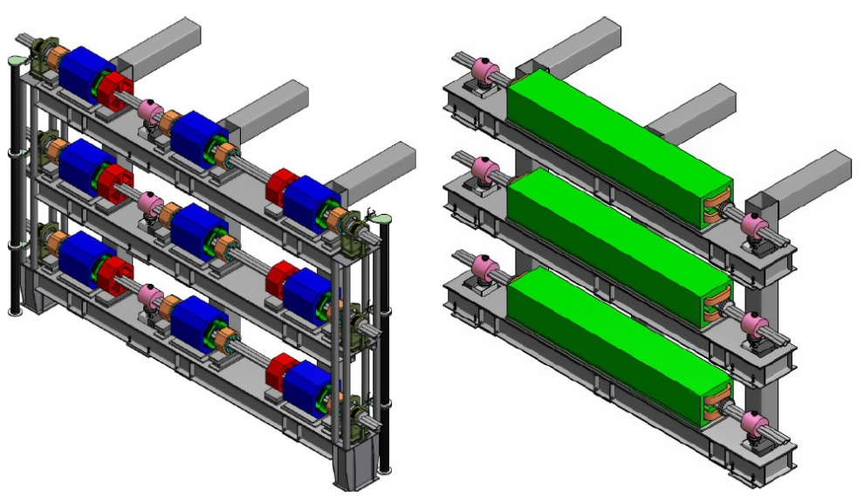
Damping Rings
Requirements
  γε_{x} = 4 μm (5.5 μm in TDR), γε_{y} = 20nm
  Available time for damping 100ms (for 10Hz operation)
  1st stage 1312 bunches, maximum 2625 bunches
  bunch-by-bunch injection/extraction
Circumference ~3km
1 electron and 1 positron ring in the 1st stage
  Bunch distance ~6ns
Add 1 positron ring when going to 2625 bunches
  Depends on electron cloud
  Electron still 1 ring (bunch distance 3ns)
quadrupole section
dipole section

Slide 43
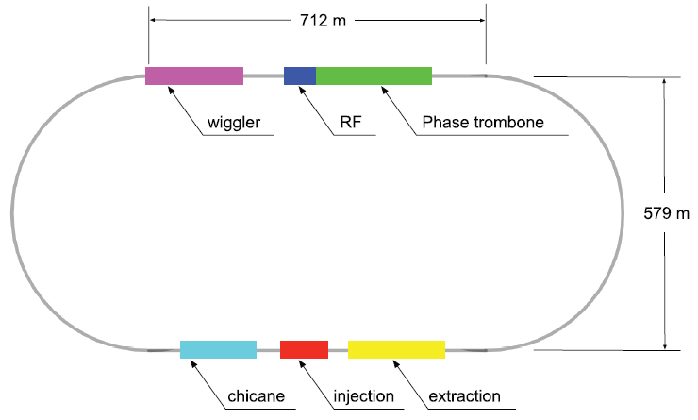
Damping Ring Configuration

Slide 44
Damping Ring Requirements

Slide 45
Injection/Extraction
Many bunches (1312~2625 )
Long bunch interval in main linacs (600~300ns)
If this beam is stored in DR as it is in linac, the ring circumference would be
2625 x 300ns x (3x10⁸m/s) = 240km
Bunch distance must be compressed for storage
Injection/extraction in bunch-by-bunch using fast kicker
Kicker speed determines the ring size (but e-cloud also)
Development almost done

Slide 46
Electron-Cloud Instability
Positron DR
Synchrotron radiation hits the beam pipe and creates electrons by photo-electron effect.
These electrons are attracted by the positron beam, concentrate on the positron orbit and disturb the motion
Residual gas also emits electrons via ionization by thr positron beam
Very important is that the electrons accelerated by swing-by effect by positron beam, hit the chamber and create secondary electron （SEY: Secondary Electron Yield）

Slide 47
Cure for Electron-Cloud Instability
Study has been made at CESR-TA
Gave recommendation for the mitigation method (table below)
  Arc and wiggler sections requires antichamber
  Full power in 3.2km ring needs aggressive mitigation plan
No significant difference between 6.4km with 2600 bunches and 3.2km with 1300 bunches
EC Working Group Baseline Mitigation Recommendation
 | Drift* | Dipole | Wiggler | Quadrupole*
Baseline Mitigation I | TiN Coating | Grooves with TiN coating | Clearing Electrodes | TiN Coating
Baseline Mitigation II | Solenoid Windings | Antechamber | Antechamber
Alternate Mitigation | NEG Coating | TiN Coating | Grooves with TiN Coating | Clearing Electrodes or Grooves
ECLOUD`10 (October 13, 2010, Cornell University)

Slide 48
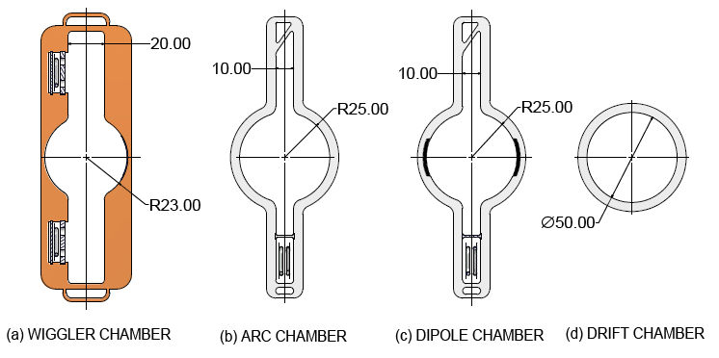
Damping Ring Vacuum Chamber
Adopt following vacuum chambewrs in positron DR, following the recommendation of CESR-TA team
FII (Fast Ion Instability) is the most important in electron DR

Slide 49
Components in BDS(Beam Delivery System)
The main aim of BDS is to focus the beam at IP, but there are many other components in BDS line
Machine Protection System
Tune-up/emergency dump
Collimator
Beam diagnostics section (beam energy, emittance, polarization)
Muon absorber
Crab cavity
Feedback system
Beam diagnostics after IP (beam energy, polarization)
Main beam dump

Slide 50
BDS Main Parameters

Slide 51
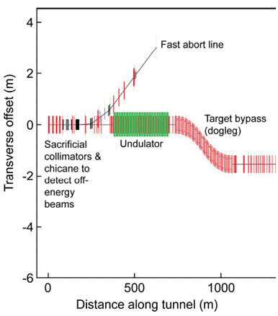
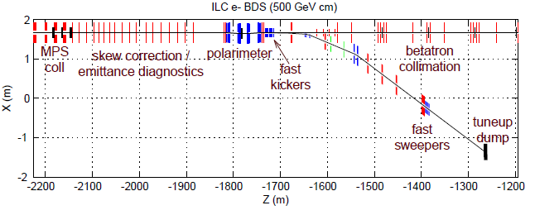
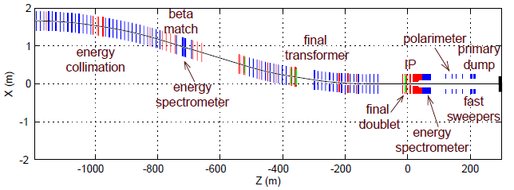
BDS Layout

Slide 52
Local Chromaticity Correction
Place Quadrupole and Sextupole magnets where the dispersion is non-zero.
The pair of Sextupole magnets on the right eliminates the chromaticity coming from the final 2 Quadrupole magmets (final doublet)
The pair of Sextupole magnets on the right cancels the nonlinearity coming from the pair on the right
This scheme is also adopted in the ATF2

Slide 53
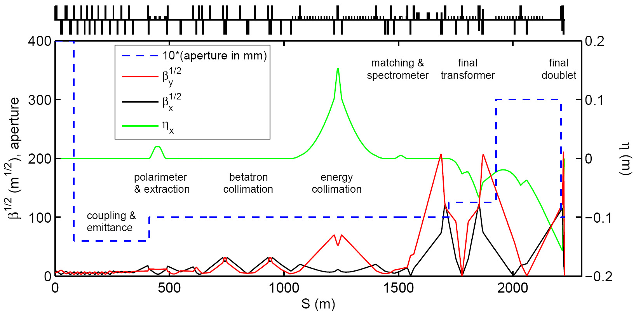
ILC FF (Final Focus) Optics
Single IR BDS optics (2006e)

Slide 54
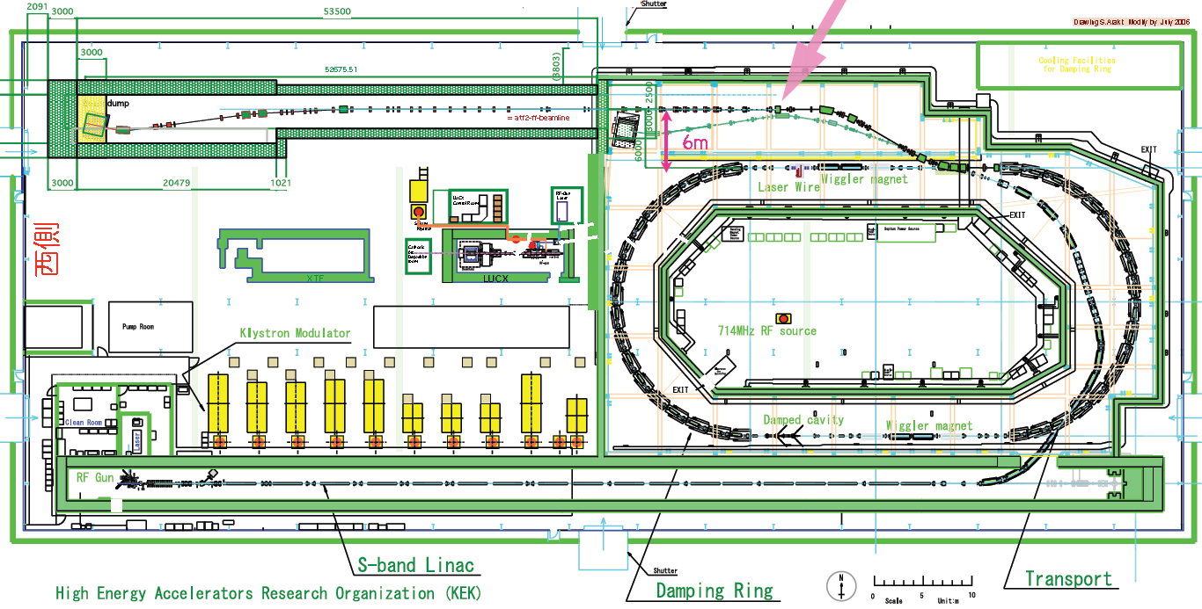
ATF
Constructed at KEK in 1993 as a prototype of JLC damping ring、
Achieved vertical emittance ~4pm around 2002
Since 2005, ATF has been managed under international MoU as ILC test bench of DR
Later it has also been in use as the beam source for ATF2

Slide 55
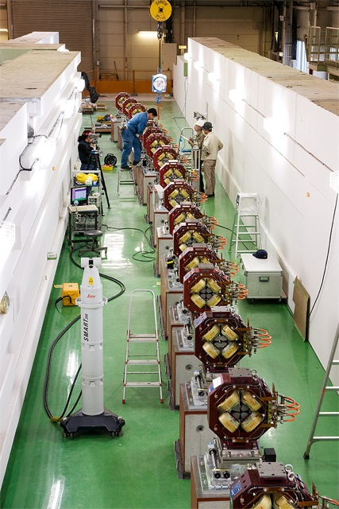
ATF2
ATF2 was added on ATF extraction line to test the FF system for ILC
FF for ILC requires ~600m beamline (corresponding to 500GeV beam, i.e., for E_{CM} = 1TeV)
ATF2 is ~50m long (beam energy up to 1.3GeV)
But with the same magnet sequence as the real ILC

Slide 56
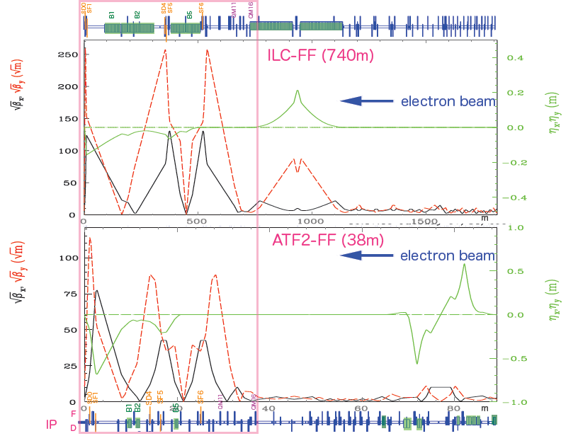
T.Tauchi, ILC camp 2013

Slide 57
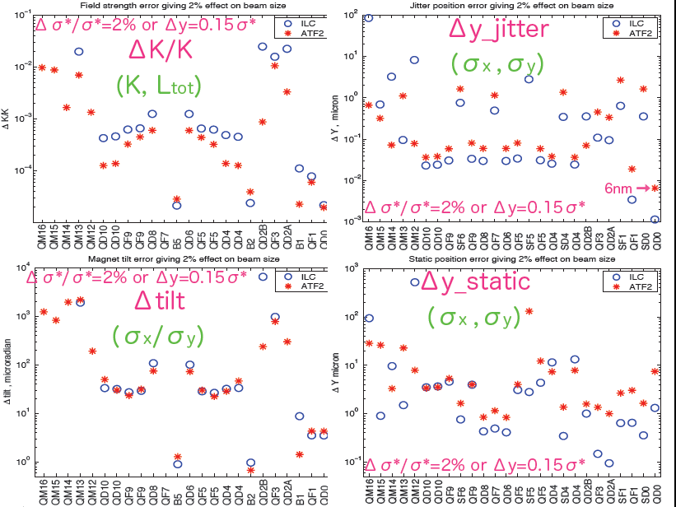
Comparison of Tolerances
T.Tauchi, ILC camp 2013

Slide 58
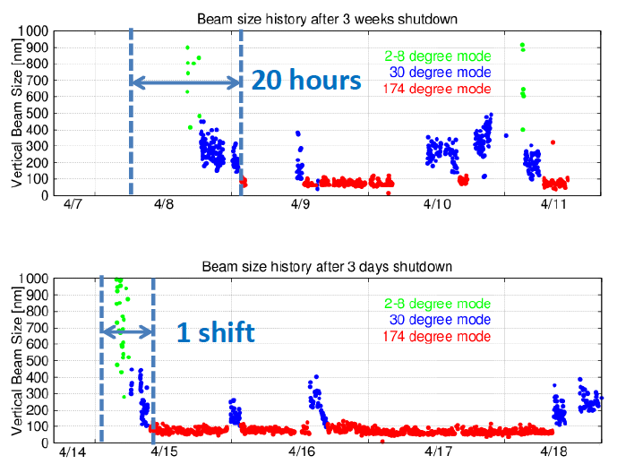
ATF2 Beam Size Tuning
Reached 44nm in 2014 (goal 37nm – corresponding to 6nm @ILC)
Now ~ 41nm
Quick tuning in ~20 hrs

Slide 59
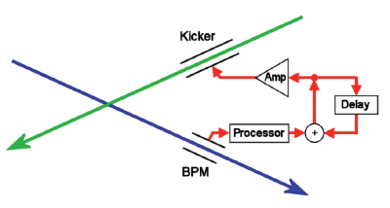
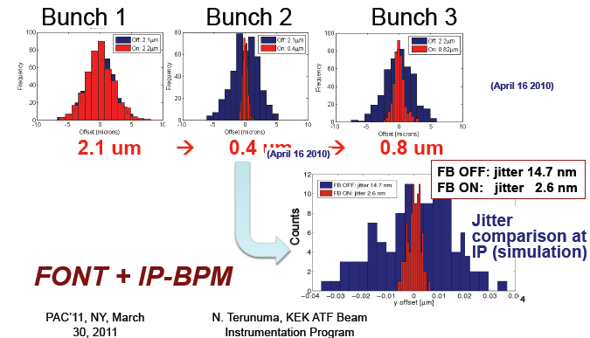
IP Feedback
Bunch interval is long enough for intra-train digital feedback
  Advantage of SC collider
Large disruption parameter
  Dy = 25 → 35 (revised 2017)

Slide 60
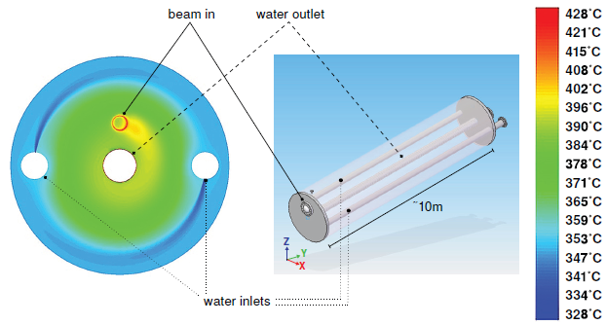
Beam Dump
2 Main dumps maximum 14MW (prepare for 1TeV)
Stainless steel vessel, diameter 1.8m, length 11m (30X₀)
High pressure water (10atm) → boiling point 180 degC
Window: Ti alloy 30cmφ, 1mm thick
Beam draws a circle of r=6cm during 1ms pulse
Temperature < 155 degC

Slide 61
Where?
Possible sites had been surveyed for JLC before ILC started
Stable ground
At least 50km with future extension
Report of Site Study Group (2002)

Slide 62
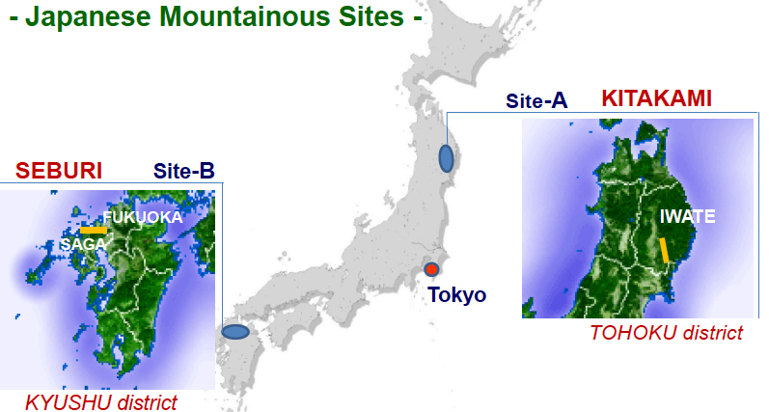

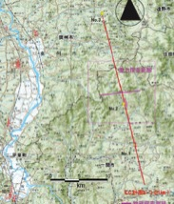
Candidate Sites in Japan
10 possible sites have been studied since “JLC” time
2 sites selected as best ones
SEFURI
Intensive site studies by government budget have been done
To be down-selected to be one in July

Slide 63
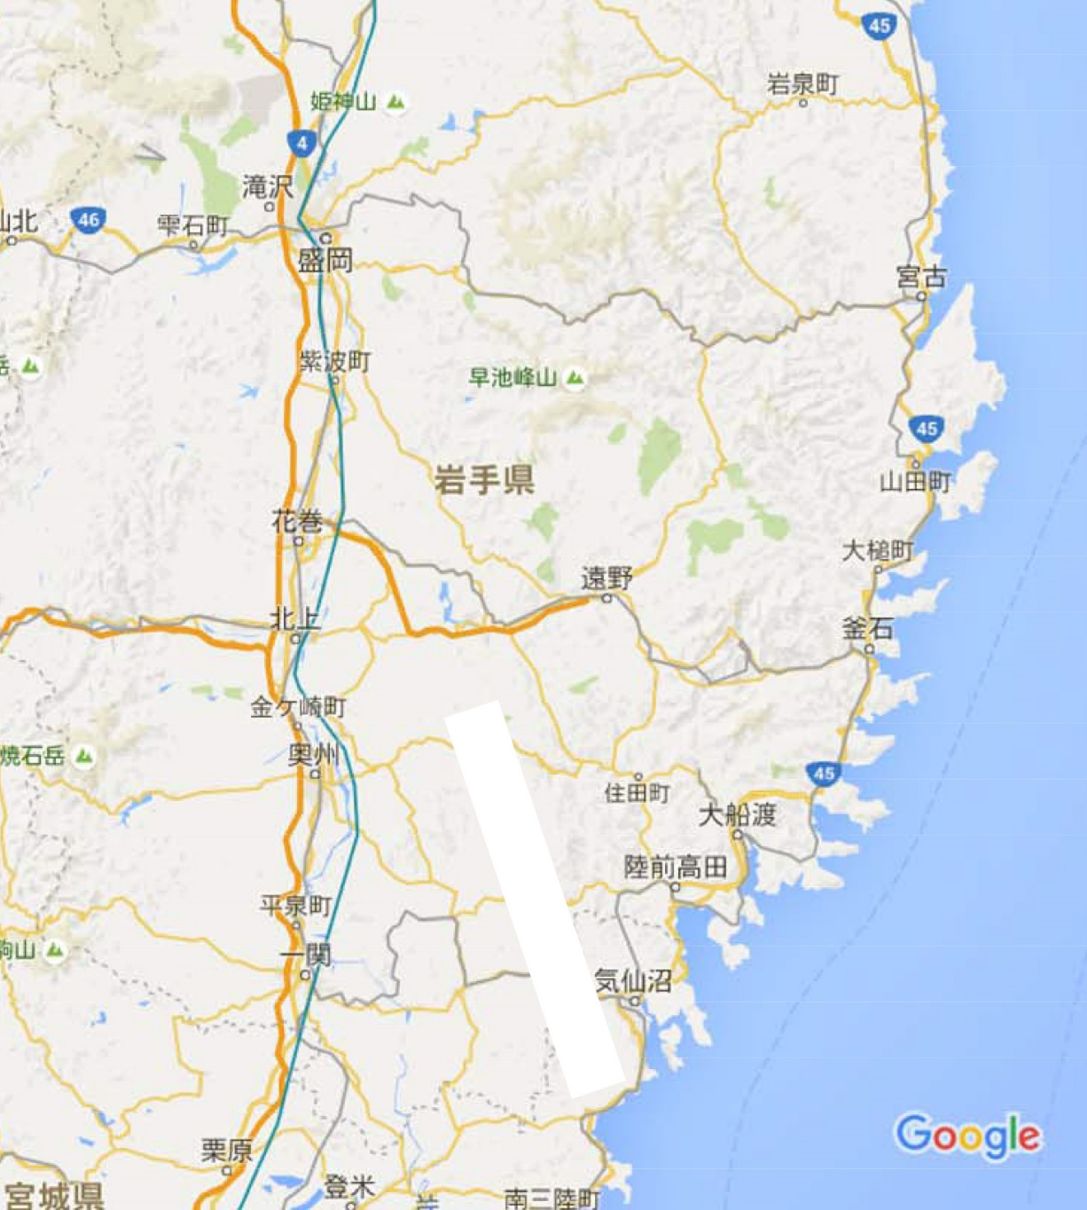
Down-selection process
Scientist committee recommended Kitakami site in 2013
Detailed design ongoing with site condition taken into account
図は不正確です

Slide 64
Summary
ILC is technically (almost) ready
  Accelerating cavities
  Low emittance beam
  Focusing
  Positron production (some R&D still needed)
Detailed design based on the candidate site
Under negotiation with Japanese government
Some decision will be made within this year

