Slide 1
A Brief Introduction to
Superconducting Accelerator Magnets
Qingjin Xu
Institute of High Energy Physics,
Chinese Academy of Sciences
2018.12

Slide 2
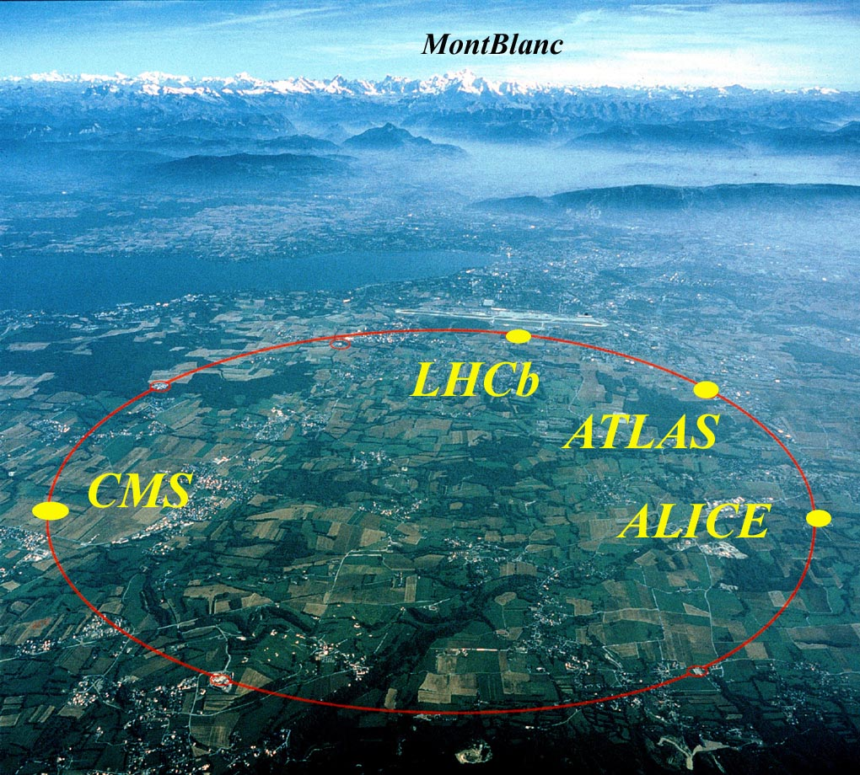
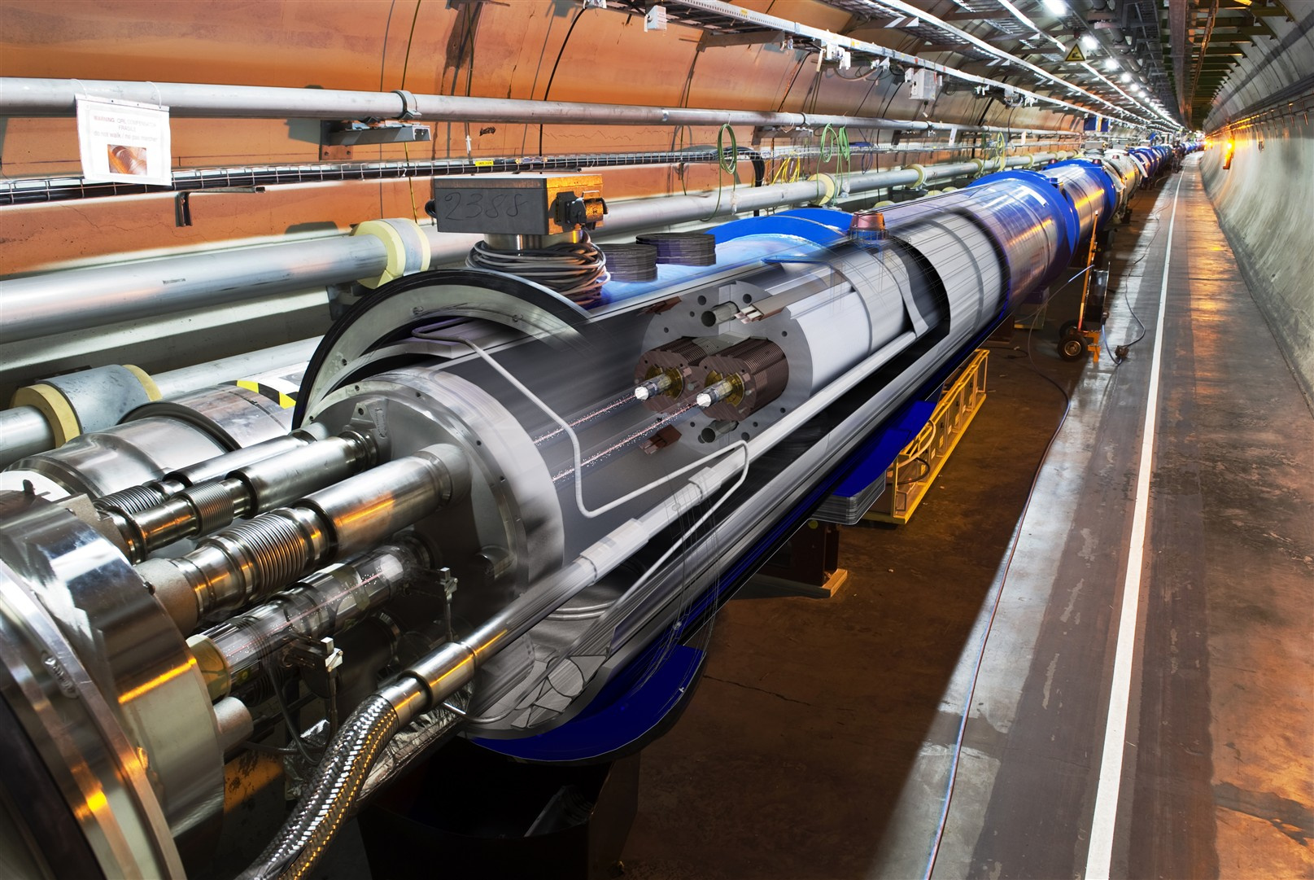
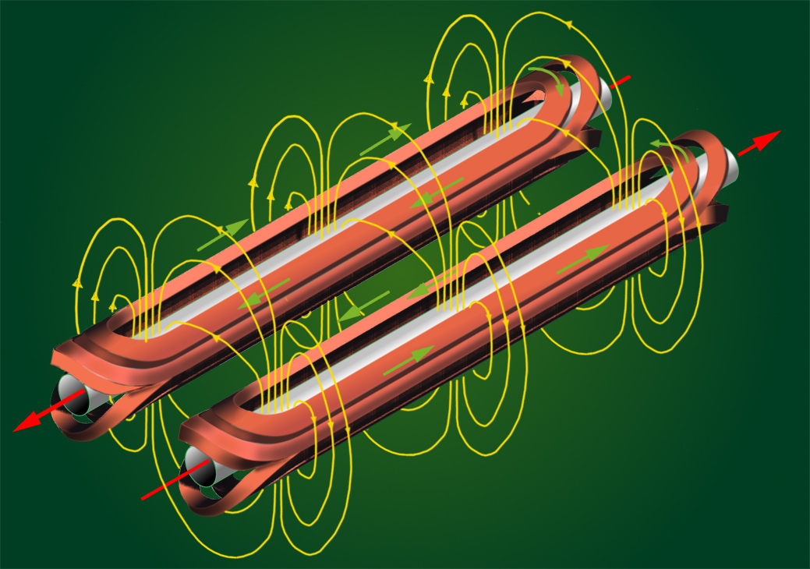
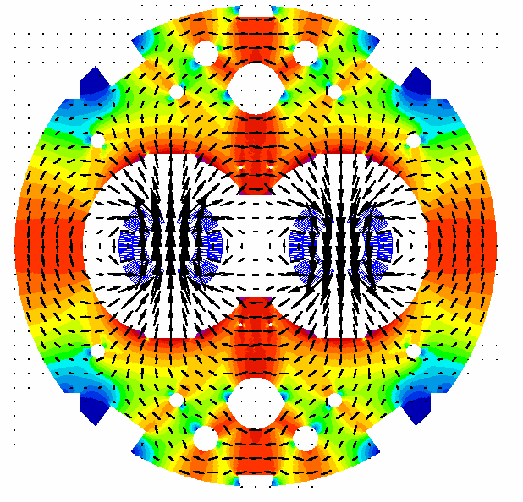


Slide 3
Outline
Basic Knowledge of the Superconducting Accelerator Magnets
PRINCIPLES of a Circular Collider
Design of Superconducting Accelerator Magnets
Superconducting Materials for Accelerator Magnets
Case Study: R&D of High Field Magnets for SPPC
Overview of SPPC Design Scope
Design Study of the SPPC Dipole Magnets
R&D Steps and Status

Slide 4
Outline
Basic Knowledge of the Superconducting Accelerator Magnets
PRINCIPLES of a Circular Collider
Design of Superconducting Accelerator Magnets
Superconducting Materials for Accelerator Magnets
Case Study: R&D of High Field Magnets for SPPC
Overview of SPPC Design Scope
Design Study of the SPPC Dipole Magnets
R&D Steps and Status

Slide 5
Acknowledgement
The materials of this section are based on USPAS (U.S. Particle Accelerator School) courses:
“Superconducting Accelerator Magnets” by Soren Prestemon (LBNL), Paolo Ferracin and Ezio Todesco (CERN), June 2015
“Superconducting Accelerator Magnets” by Paolo Ferracin (LBNL), Ezio Todesco (CERN), Soren O. Prestemon and Helene Felice (LBNL), January 2012
“Superconducting Accelerator Magnets” by Ramesh Gupta and Animesh Jain (BNL), January 2006
“Applied Electromagnetism: Magnet and RF-Cavity Design” by Mau Lopes and Jeremiah Holzbauer (FNAL), January 2016
Learn more at USPAS website: http://uspas.fnal.gov/materials/materials-table.shtml
and textbooks:
  Martin N. Wilson, "Superconducting Magnets", 1983.
  K.-H. Mess, P. Schmuser, S. Wolff, “Superconducting accelerator magnets”, Singapore: World Scientific, 1996.
  Fred M. Asner, "High Field Superconducting Magnets", 1999.

Slide 6
PRINCIPLES of a Circular Collider
Colliders: two beams with opposite momentum collide
The arcs: region where the beam is bent
  Dipoles for bending
  Quadrupoles for focusing
  Correctors
Long straight sections (LSS)
  Interaction regions (IR)
    Quadrupoles for strong focusing in interaction point
    Dipoles for beam crossing in two-ring machines
  Regions for other services
    Beam injection (dipole kickers)
    Accelerating structure (RF cavities)
    Beam dump (dipole kickers)
    Beam cleaning (collimators)
A schematic view of a synchrotron
The lay-out of the LHC

Slide 7
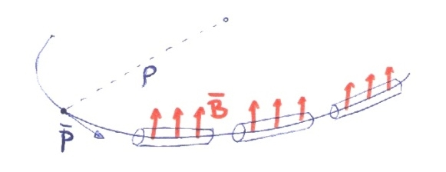
PRINCIPLES of a Circular Collider

Slide 8
PRINCIPLES of a Circular Collider
Arc

Slide 9
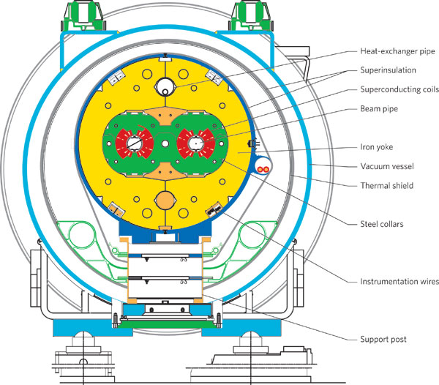
Design of Superconducting Accelerator Magnets

Slide 10
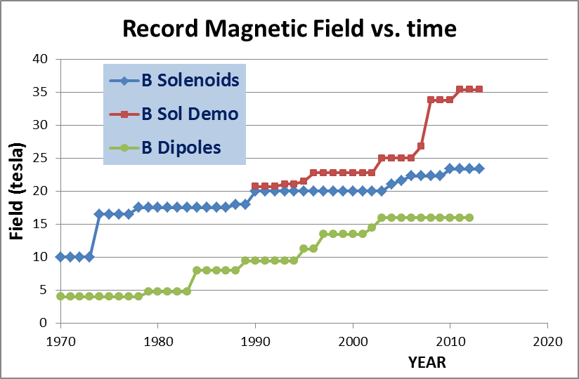
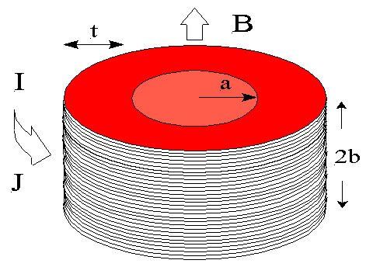
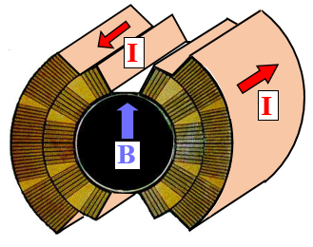
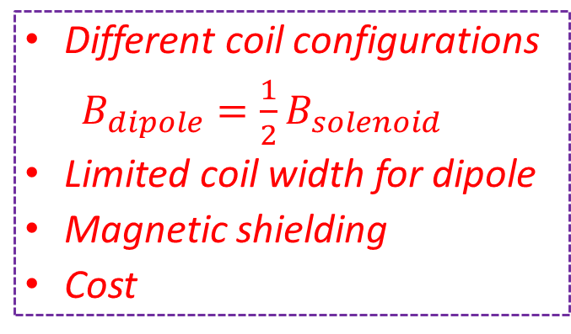
Dipole vs. Solenoid
Dipole
Different coil configurations
$B_{dipole}=\frac{1}{2}B_{solenoid}$
Limited coil width for dipole
Magnetic shielding
Cost
Solenoid
J_{e} – Current density
t – Coil thickness
J_{e} – Current density
t – Coil thickness
LHC dipole
Martin Wilson
Lucio Rossi

Slide 11

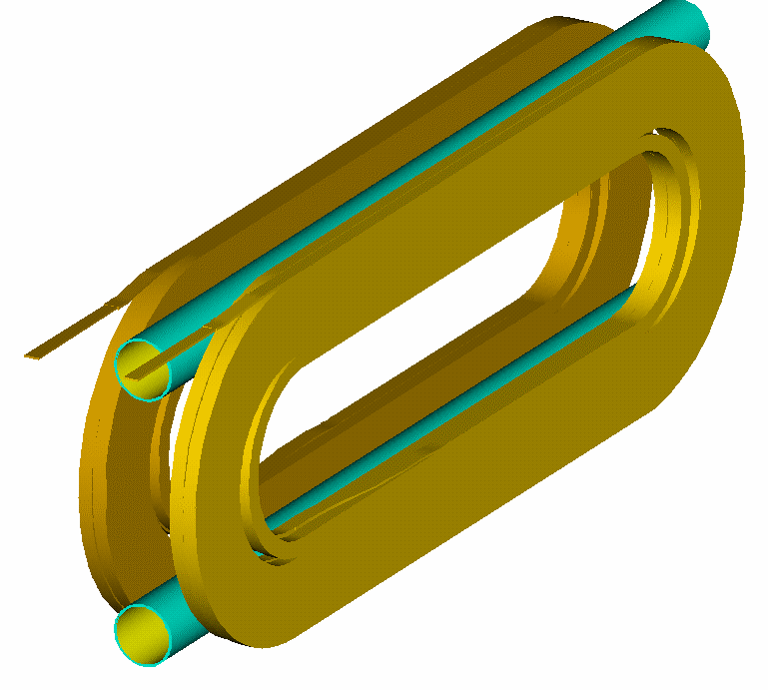
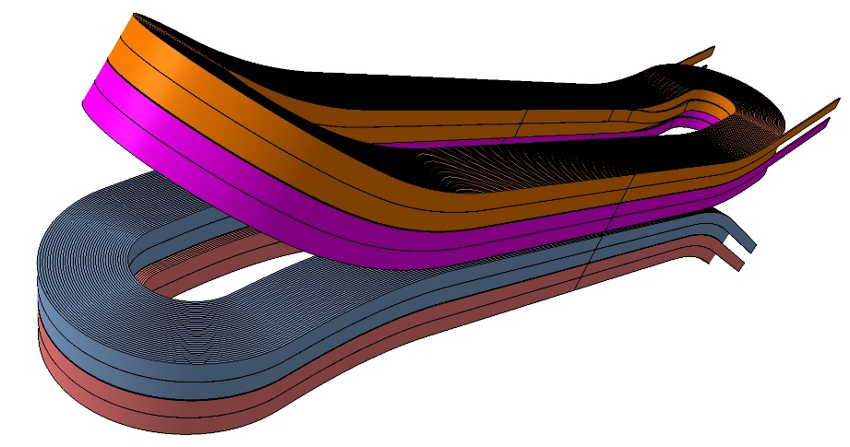
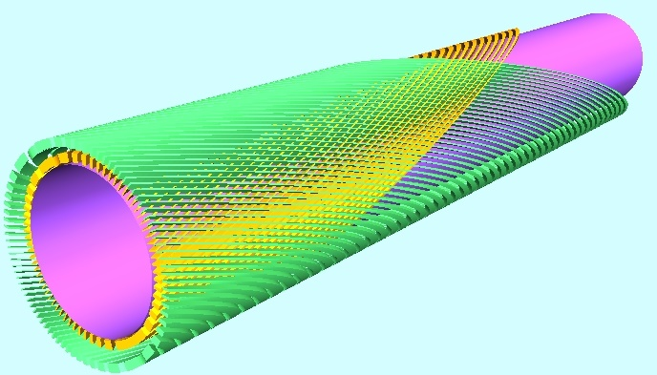
Different coil configurations for dipole magnets
Efficiency, field quality, stress management, fabrication method…
Cos-theta dipole
Highest efficiency, complicated ends with hard-way bending
Common coil dipole
Simplest structure with large bending radius, lower efficiency
Block type dipole
Simpler structure with hard-way bending, lower efficiency
Canted cos-theta dipole
Lowest stress level in coil, lowest efficiency

Slide 12
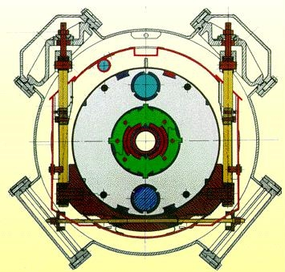
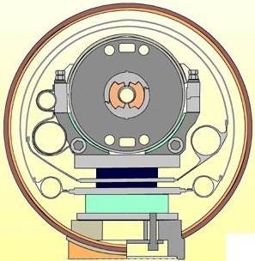
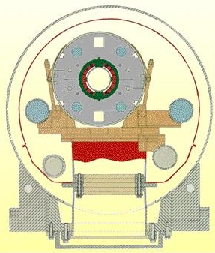
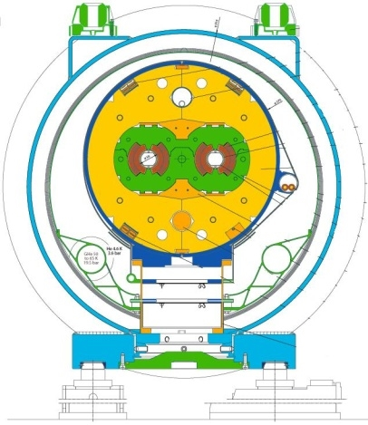
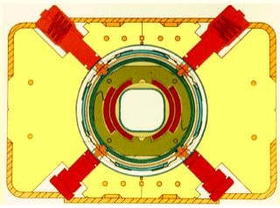
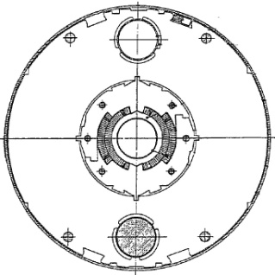
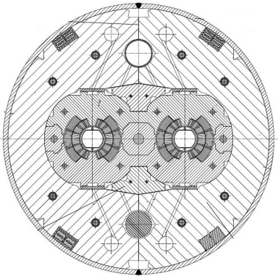
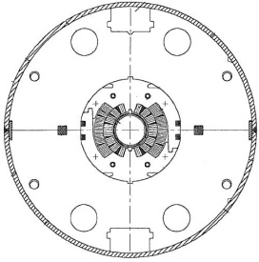
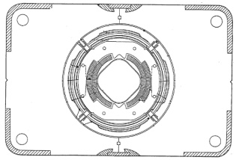
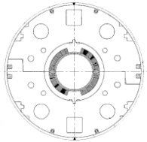
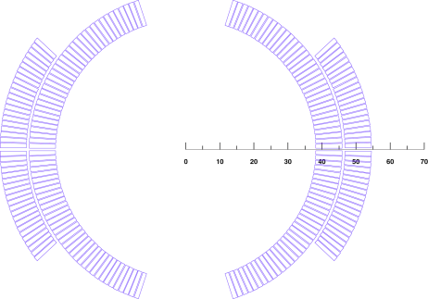
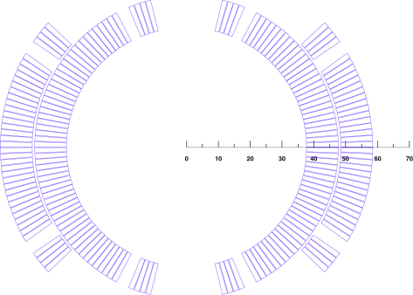
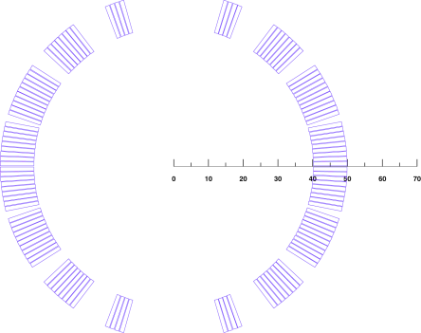
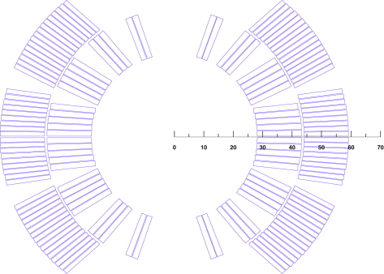
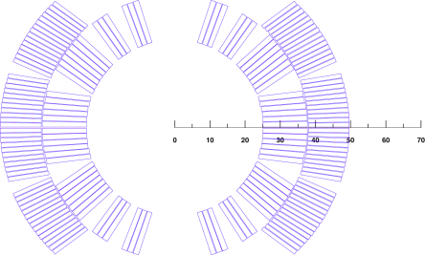
Overview of accelerator dipole magnets
Tevatron
HERA
SSC
RHIC
LHC

Slide 13

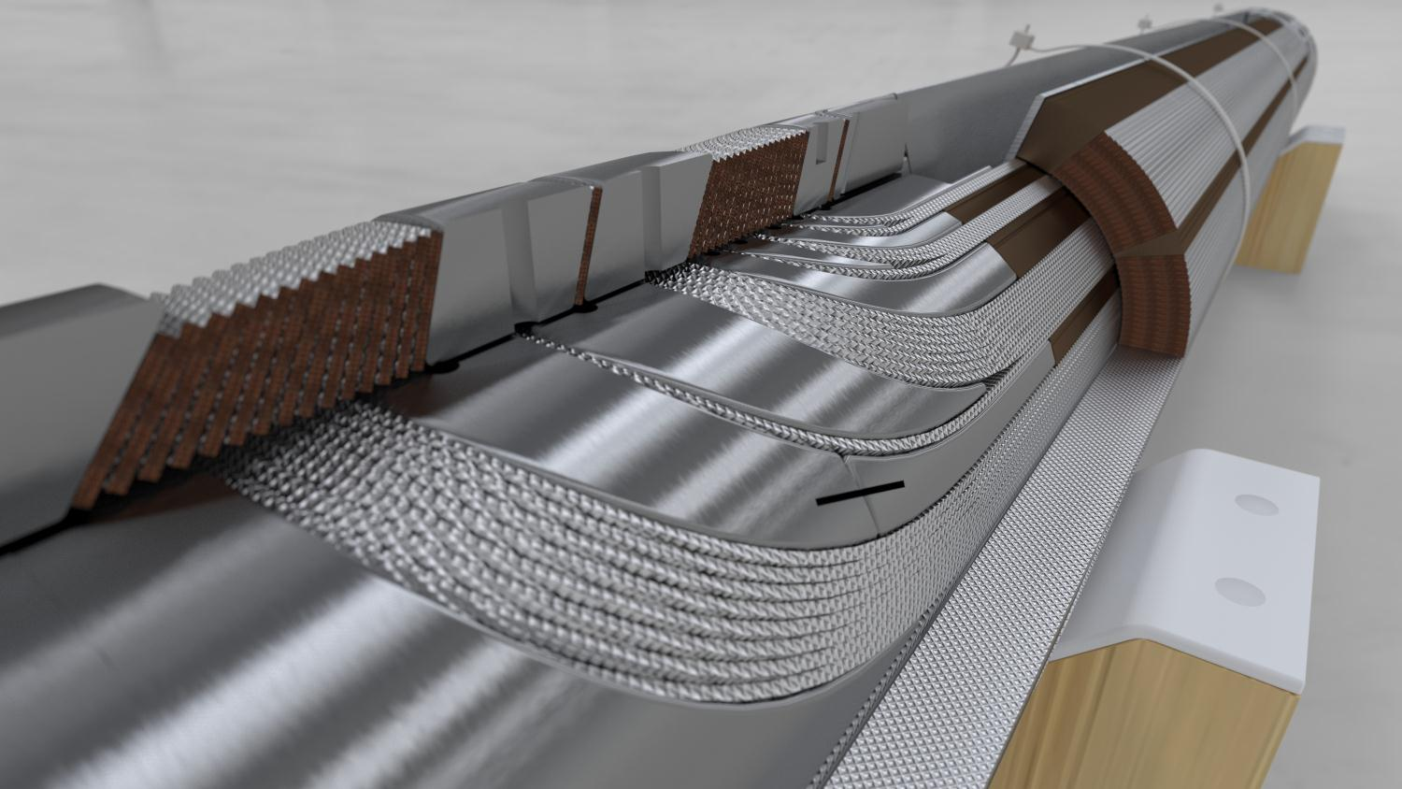
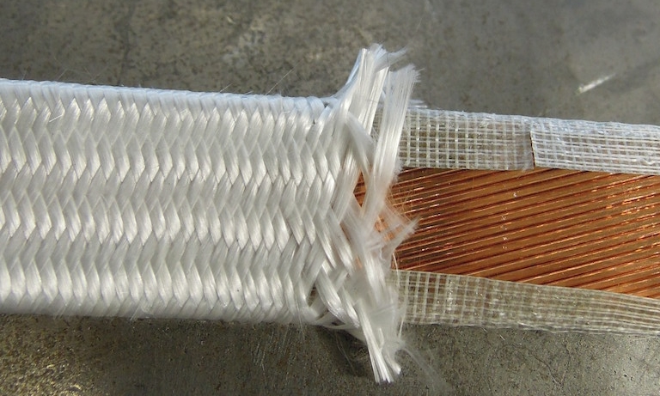
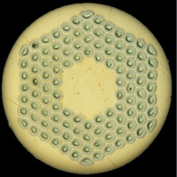

HL-LHC 11 T Dipole Coil
SLS (Selective Laser
Sintering) End Spacers
with “springy legs”
Loading plate
2 mm 316LN
Courtesy of D. Mitchell, FNAL
ODS (Oxide Dispersion
Strengthened) Cu-alloy
Wedges
Braided 11-TEX S2-glass
on “open-C” Mica sleeve
14.85
Ø0.7
OST RRP-108/127

Slide 14
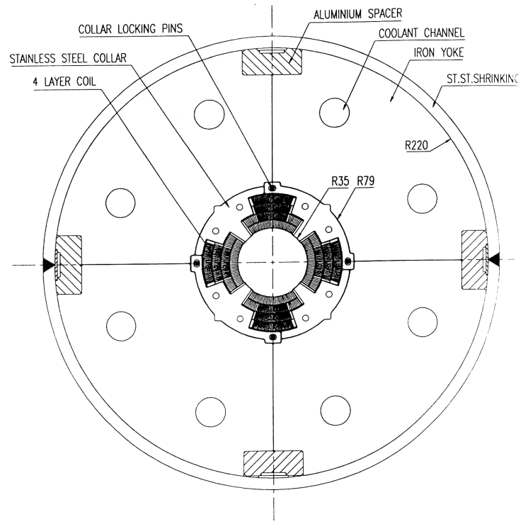
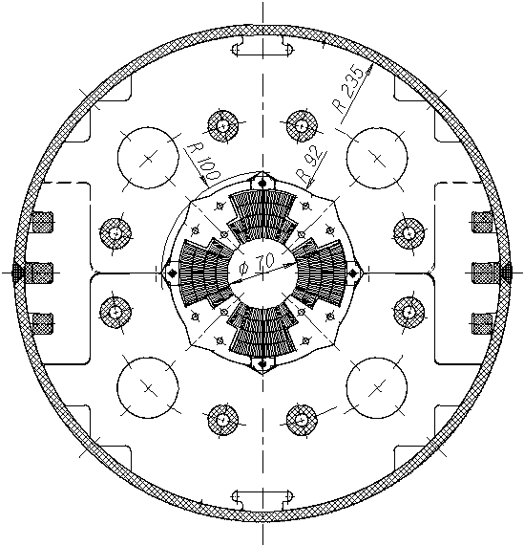
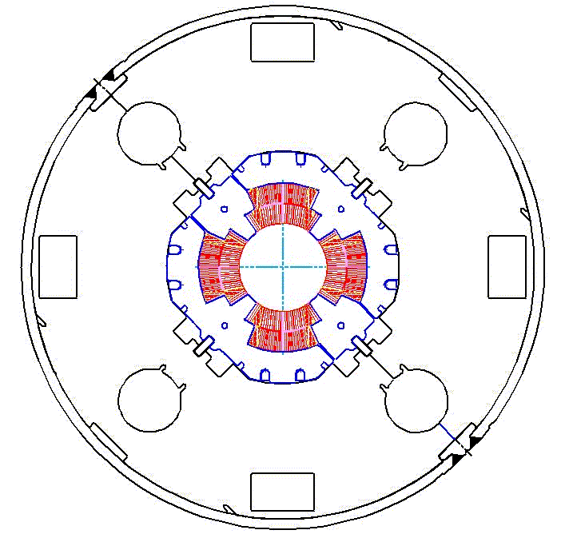
Practical accelerator magnets –
LHC IR quadrupole
Support structure based on collars and welded stainless steel shell are also used for quadrupole magnets.
During the collaring operation, 4 keys/rods are inserted at the four mid-planes.
CERN-Oxford Inst. (MQY)
KEK
(MQXA)
Fermilab
(MQXB)
L. Rossi, [1]

Slide 15
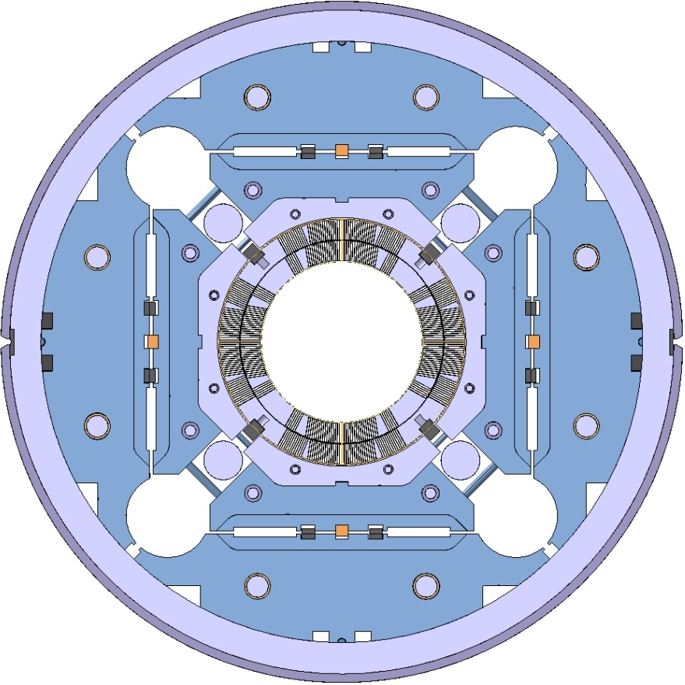
HL-LHC MQXF
Target: 132.6 T/m in 150 mm coil aperture
To be installed in 2023
Q1/Q3
  2 magnets with 4.2 m of magnetic length within 1 cold mass
Q2
  1 magnet of 7.15 m within 1 cold mass, including MCBX (1.2 m)
Different lengths, same design
by E. Todesco

Slide 16
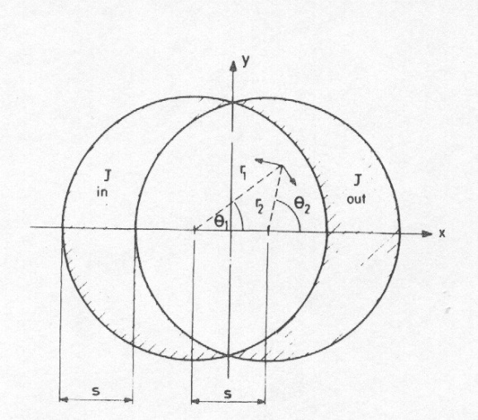
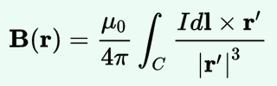
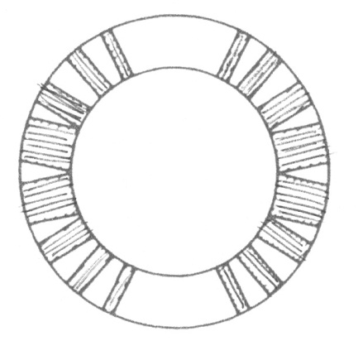
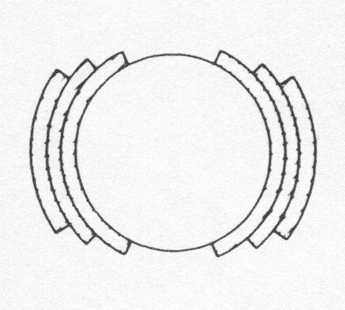
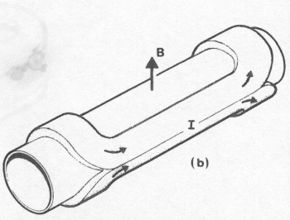
Field Harmonics
Perfect Dipole
Biot-Savart law
  Cosθ: a current density proportional to cosθ in an annulus - it can be approximated by sectors with uniform current density
From M. N. Wilson, pg. 28
A practical winding with one layer and wedges
[from M. N. Wilson, pg. 33]
A practical winding with three layers and no wedges
[from M. N. Wilson, pg. 33]
Artist view of a cosθ magnet
[from Schmuser]
An ideal cosθ

Slide 17
Field Harmonics
  Perfect quadrupole
  Cos2θ, a current density proportional to cos2θ in an annulus- approximated by sectors with uniform current density and wedges
  (Two) intersecting ellipses
    Perfect sextupoles: cos3θ or three intersecting ellipses
    Perfect 2n-poles: cosnθ or n intersecting ellipses
Quadrupole as an ideal cos2θ
Quadrupole as two intersecting ellipses

Slide 18
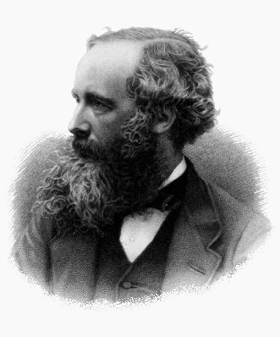
Field Harmonics
Maxwell equations for magnetic field
In absence of charge and magnetized material
If (constant longitudinal field),
then
  and
Gauss's law for magnetism
Ampère's circuital law
James Clerk Maxwell,
Scottish
(13 June 1831 – 5 November 1879)
Cauchy-Riemann conditions

Slide 19
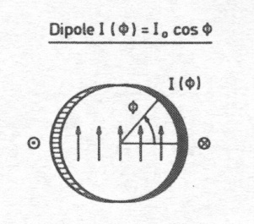
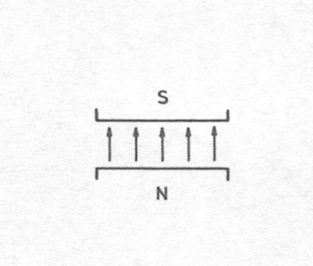
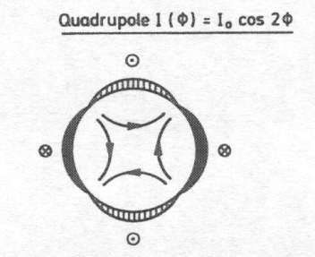
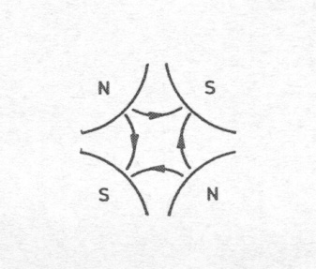
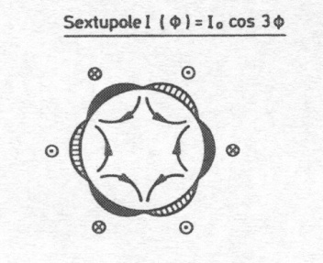
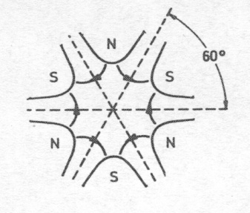
Field Harmonics
Each coefficient corresponds to a “pure” multipolar field
A dipole
A quadrupole
[from P. Schmuser et al, pg. 50]
A sextupole
The field harmonics are rewritten as (EU notation)

Slide 20
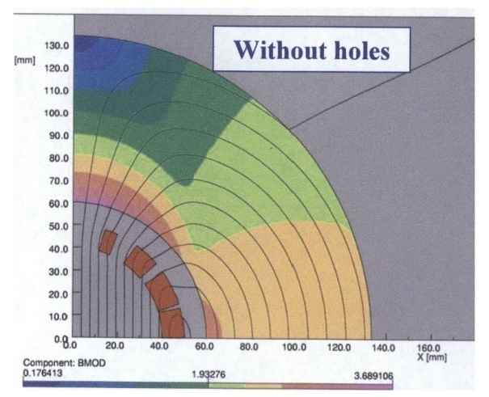
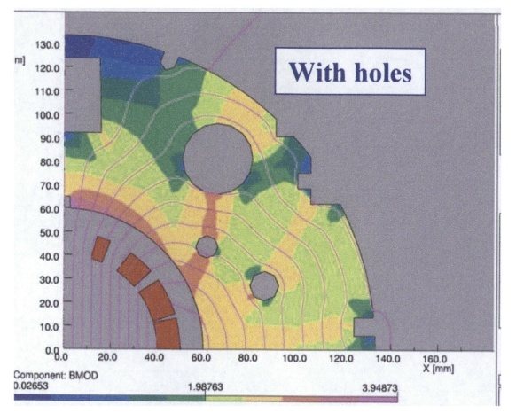
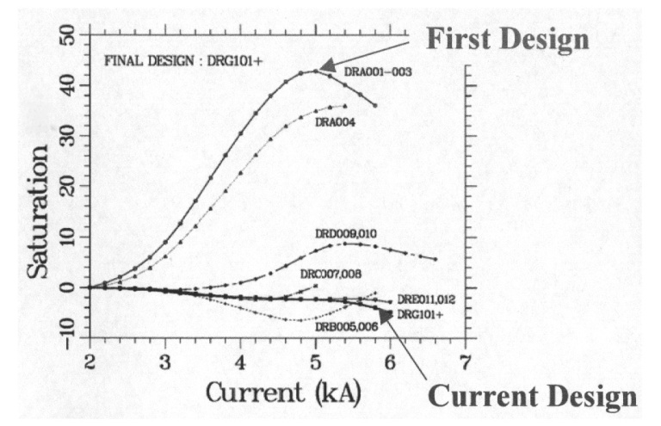
Field Harmonics
Corrective actions: shaping the iron – the RHIC dipole
    The field in the yoke is larger on the pole
    Drilling holes in the right places, one can reduce saturation of b₃ from 40 units to less than 5 units (one order of magnitude), and to correct also b₅
Field map in the iron for the RHIC dipole, with and without holes
From R. Gupta, USPAS Houston 2006, Lecture V, slide 12
Correction of b3 variation due to saturation
for the RHIC dipoles, R. Gupta, ibidem

Slide 21







Electro-magnetic Force
The e.m. forces in a dipole magnet tend to push the coil
- Towards the mid-plane in the vertical-azimuthal direction (F_{y} , F_{θ} < 0)
- Outwards in the radial-horizontal direction (F_{x} , F_{r} > 0)
Tevatron dipole
HD2

Slide 22


Practical accelerator magnets –
LHC main dipole
Two-in-one configuration
  Both beam pipes are contained within one cold mass
Stainless steel collars are locked by three full-length rods.
Magnetic insert
  It transfers vertical force from the yoke to the collared coils
  It improves field quality
Iron yoke vertically split
  At the end of the welding operation the yoke gap is closed
Stainless steel shell halves are welded around the yoke to provide He containment, a 9 mm sagitta, and to increase rigidity.
MJB Plus, Inc., [2]

Slide 23


Electro-magnetic Force
LHC dipole at 0 T LHC dipole at 9 T
Usually, in a dipole or quadrupole magnet, the highest stresses are reached at the mid-plane, where all the azimuthal e.m. forces accumulate (over a small area).
Displacement scaling = 50

Slide 24






Electro-magnetic Force
The e.m. forces in a quadrupole magnet tend to push the coil
Towards the mid-plane in the vertical-azimuthal direction (F_{y}, F_{θ} < 0)
Outwards in the radial-horizontal direction (F_{x}, F_{r} > 0)
TQ
HQ

Slide 25


Electro-magnetic Force
In the coil ends the Lorentz forces tend to push the coil Outwards in the longitudinal direction (F_{z} > 0)
Similarly as for the solenoid, the axial force produces an axial tension in the coil straight section.

Slide 26



Electro-magnetic Force
Nb-Ti LHC MB (values per aperture)
  F_{x} = 340 t per meter
    ~300 compact cars
    Precision of coil positioning: 20-50 μm
  F_{z} = 27 t
    ~weight of the cold mass
Nb₃Sn dipole (HD2)
  F_{x} = 500 t per meter
  F_{z} = 85 t
  These forces are applied to an object with a cross-section of 150x100 mm !!!
    and by the way, it is brittle

Slide 27







Support Structures
Collars were implemented for the first time in the Tevatron dipoles.
Since then, they have been used in all but one (RHIC) the accelerator magnets and in most of the R&D magnets.
They are composed by stainless-steel or aluminum laminations few mm thick.
By clamping the coils, the collars provide
  coil pre-stressing;
  rigid support against e.m. forces (it can be self-supporting or not);
  precise cavity (tolerance ± 20 μm).
Tevatron
SSC
LHC
MJB Plus, Inc., [2]
L. Rossi, [1]

Slide 28




Support Structures
Collaring of a dipole magnet
Collaring of a quadrupole magnet
L. Rossi, [4]

Slide 29


Support Structures
The purpose of the collar is to pre-compress the coil inside a “rigid” cavity.
  The collar cavity fixes the dimension of the coil.
  Coil geometry is given by the collars.
Coil stress-strain is given by
  ε_{coil}=(l_{coil_0}-l_{cavity})/l_{coil_0}
  σ_{coil}=E_{coil}ε
A good knowledge of the coil properties (l_{coil_0} and E) is mandatory to predict final coil status.
In addition, collar deformation must be taken into account.
S. Wolff, [3]

Slide 30

Support Structures
As the collars, iron yoke are made in laminations (several mm thick), with a packing factor > 95%.
Magnetic function
  The yoke contains and enhances the magnetic field.
Structural function
  Except for the cases where the collars are self supporting (i.e. like in Tevatron and HERA dipoles), the yoke is in tight contact with the collar. Therefore, it contributes to increase the rigidity of the coil support structure and limit radial displacement.
Holes/slots are included in the yoke design for
  Correction of saturation effect
  Cooling channel
  Assembly features
  Electrical bus
L. Rossi, [4]

Slide 31

Support Structures
The cold mass is contained within a shell (or shrinking cylinder).
The shell constitutes a containment structure for the liquid Helium.
It is composed by two half shells of stainless steel welded around the yoke with high tension (about 150 MPa for the LHC dipole).
  With the iron yoke, it contributes to create a rigid boundary to the collared coil.
If necessary, during the welding process, the welding press can impose the desired curvature on the cold mass.
  In the LHC dipole the nominal sagitta is of 9.14 mm.
L. Rossi, [4]

Slide 32



Support Structures
End plates, applied after shell welding, provide
  axial support to the coil under the action of the longitudinal e.m. forces
    Torque may be applied to end bolts;
  Liquid Helium containment.
A. Devred, [5]
L. Rossi, [4]

Slide 33


Quench Protection
Magnetic energy
Quench
Normal zone growth
Detection
Converted to heat by Joule heating
Power supply switched off
Trigger protection options
Protection heaters
Extraction
Quenchback
Current decay in the magnet
The faster this chain happens the safer is the magnet

Slide 34




Quench Protection
In most accelerator magnets, the “natural” resistance growth is insufficient to provide a good protection => Need to enhance the resistance
Method 1:
  Add an external resistor
Method 2:
  Protection heaters mounted on the coils
    Optimized to minimize thermal diffusion time
Method 3:
  Use of couple secondary circuits
    Can be external or internal to the coil
    Quench back
Method 4:
  Coil subdivision
Cold

Slide 35

Quench Protection
In the LHC main ring, the dipoles are connected in series. The principle is
  to “by-pass” the quenching magnet to avoid dumping all the string energy in one magnet
  To de-excite the rest of the magnets into a dump resistor
Combination of various methods: heaters, dump resistor, diodes

Slide 36


Superconducting materials
Critical surfaces
Nb-Ti
Nb₃Sn

Slide 37


Superconducting materials
Cu
Nb-Ti
Nb₃Sn
Typical operational conditions (0.85 mm diameter strand)
J_{e} ~ 5 A/mm²
I ~ 3 A
B = 2 T
J_{e} ~ 600-700 A/mm²
I ~ 300-400 A
B = 8-9 T
J_{e} ~ 600-700 A/mm²
I ~ 300-400 A
B = 12-13 T

Slide 38



Superconducting materials
The superconducting materials used in accelerator magnets are
  subdivided in filaments of small diameters
    to reduce magnetic instabilities called flux jumps
    to minimize field distortions due to superconductor magnetization
  twisted together
    to reduce interfilament coupling and AC losses
  embedded in a copper matrix
    to protect the superconductor after a quench
    to reduce magnetic instabilities called flux jumps
NbTi LHC wire (A. Devred, [1])
NbTi SSC wire (A. Devred, [1])
Nb₃Sn bronze-process wire (A. Devred, [1])
Nb₃Sn PIT process wire (A. Devred, [1])

Slide 39
Superconducting materials
Flux jumps
  An external magnetic field penetrates in a type-II superconductor in the mixed state through fluxoids.
  If the superconductor is subjected to a thermal disturbance, the local change in J_{c} produces a motion or “jump” of fluxoids, which is accompanied by power dissipation.
  The stability criteria for a slab in the adiabatic condition
  where a is the half-thickness of the slab, j_{c} is the critical current density [A m⁻²], γ is the density [kg m⁻³], C is the specific heat [J kg⁻¹], and θ_{c} is the critical temperature.
  Nb-Ti filament diameters are usually less than 50 µm.
  High conductivity copper reduces instability.

Slide 40

Superconducting materials
Superconductor magnetization
According to the critical state model, when a filament is in a varying external field, its inner part is shielded by a current distribution in the filament periphery.
The shielding currents are proportional to the amplitude of the applied field and do not decay when the external field is held constant.
  When the filament is fully penetrated, the magnetization M is proportional to J_{c}r_{f}.
  Field distortions are proportional to r_{f}. LHC filament diameter 6-7 µm; HERA filament diameter 14 µm.
K.-H. Mess, et al., [5], p. 84.

Slide 41

Superconducting materials
Interfilament coupling
  When a multifilamentary wire is subjected to a time varying magnetic field, current loops are generated between filaments.
  If filaments are straight, large loops are generated, with large currents
    Big losses
  If the strands are magnetically coupled the effective filament size is larger
    Flux jumps
  To reduce these effects, filaments are twisted with a twist pitch of the order of 20-30 times of the wire diameter.
M.N. Wilson, [4], p. 148.

Slide 42
Superconducting materials

Slide 43
Superconducting materials
Quench protection
  Superconductors have a very high normal state resistivity. A filament of Nb-Ti, if quenched in free space, could reach very high temperatures in few ms.
  If the filament is embedded in a copper matrix, when a quench occurs, the current redistributes in the low-resistivity matrix and the peak temperature can typically be maintained below 300 K.
  The copper matrix facilitates quench protection: it allows the quench to propagate and it provides time to act on the power circuit.
  In the case of a small volume of superconductor heated beyond the critical temperature (for instance because of a flux jump), the current can flow in the copper for a short moment, allowing the filament to cool-down and recover superconductivity.
    The matrix also helps stabilizing the conductor against flux jumps (dynamic stability).
by L. Bottura

Slide 44
Summary
Challenges of the High Field Superconducting Magnets
Performance of Superconductors: J_{c}, cost, mechanical behaviors,…
Magnetic force in superconducting coils at high field: F ̴ B²
Field quality: magnetization effect, iron saturation effect, current distribution in tape conductors,…
Quench protection: High stored energy and operating current
Fabrication methods: Strain sensitive superconductors

Slide 45
Outline
Basic Knowledge of the Superconducting Accelerator Magnets
PRINCIPLES of a Circular Collider
Design of Superconducting Accelerator Magnets
Superconducting Materials for Accelerator Magnets
Case Study: R&D of High Field Magnets for SPPC
Overview of SPPC Design Scope
Design Study of the SPPC Dipole Magnets
R&D Steps and Status

Slide 46
Acknowledgement
Team Members & Collaborators
IHEP-CAS: Chengtao Wang, Kai Zhang, Zhan Zhang, Shaoqing Wei, Lingling Gong, Da Cheng, Yingzhe Wang, Ershuai Kong, Zhen Zhang, Xiangchen Yang, Quanling Peng, Qing Qin, Yifang Wang,
IEE-CAS: Xianping Zhang, Dongliang Wang, Yanwei Ma
HIPS-CAS: Huajun Liu, Tao Zhao, Yanlan Hu,…
IMP-CAS: Wei Wu, Yu Liang, Wenjie Liang, Lizhen Ma,…
WST: Meng Li, Chao Li, Bo Wu, Yanmin Zhu, Jianwei Liu, Jianfeng Li,…
Toly Electric: Yu Zhao, Hean Liao, Bingxing Lu,…
*The work is supported by the Strategic Priority Research Program of the Chinese Academy of Sciences (CAS) Grant No. XDB25000000, the key research program of CAS Grant No. XDPB01, Hundred Talents Program of CAS and National natural Science Foundation of China Grant No. 11675193, 11575214, 11604335, U1632276.

Slide 47
CEPC-SPPC
CEPC is an 240-250 GeV Circular Electron Positron Collider, proposed to carry out high precision study on Higgs bosons, which can be upgraded to a 70-150 (Upgrading phase) TeV pp collider SPPC, to study the new physics beyond the Standard Model.
e+
IP1
e-
LTB
SPPC HE Booster
e+ e- Linac
BTC
BTC
SPPC ME Booster
Proton Linac
SPPC LE Booster
IP4
IP2
CEPC Booster
50/100 km in circumference
CEPC Collider Ring
IP3
SPPC Collider Ring

Slide 48




SPPC Magnet Design Scope (V201701)
SPPC
100 km in circumference
C.M. energy 70-150 (Upgrading) TeV
Timeline
Pre-study: 2013-2020
R&D: 2020-2030
Eng. Design: 2030-2035
Construction: 2035-2042
Main dipoles
Field strength: 12~24 (Upgrading) Tesla
Aperture diameter: 40~50 mm
Field quality: 10⁻⁴ at the 2/3 aperture radius
Outer diameter: 650-900 mm in a 1.5 m cryostat
Tunnel cross section: 6 m wide and 5.4 m high
6-m Tunnel for CEPC-SPPC
Conceptual design of the SPPC 12-T magnet with IBS and common coil configuration
SPPC collider
CEPC booster
CEPC collider

Slide 49
SPPC Magnet Design Scope
Baseline design
  Tunnel circumference: 100 km
  Dipole magnet field: 12 T, iron-based HTS technology (IBS)
  Center of Mass energy: >70 TeV
  Injector chain: 2.1 TeV
Upgrading phase
  Dipole magnet field: 20 -24T, IBS technology
  Center of Mass energy: >125 TeV
  Injector chain: 4.2 TeV (adding a high-energy booster ring in the main tunnel in the place of the electron ring and booster)
Development of high-field superconducting magnet technology
  Starting to develop HTS magnet technology before applicable IBS wire is available
  ReBCO & Bi-2212 and LTS wires be used for model magnet studies and as options for SPPC: stress management, quench protection, field quality control and fabrication methods
Top priority: reducing cost!
Instead of increasing field
Make IBS the High-T_{c} and High-Field
“NbTi” superconductor in 10 years!

Slide 50
J_{e} of IBS: 2016-2025

Slide 51







Domestic Collaboration for HTS R&D
“Applied High Temperature Superconductor Collaboration (AHTSC)” formed in Oct. 2016.
Including 18 institutions and companies in China. Regular meeting every 3 months.
Goal：
1) To increase the J_{c} of iron-based superconductor (IBS) by 10 times, reduce the cost to 20 Rmb/kAm @ 12T & 4.2K, and realize the industrialization of the conductor;
2) To reduce the cost of ReBCO and Bi-2212 conductors to 20 Rmb/kAm @ 12T & 4.2K;
3) Realization and Industrialization of IBS magnets and SRF cavities.
Working groups：1) Fundamental sciences study; 2) IBS conductor R&D; 3) ReBCO conductor R&D; 4) Bi-2212 conductor R&D; 5) Performance evaluation; 6) Magnet and SRF technology.

Slide 52



The 12-T Fe-based Dipole Magnet
Yoke OD
500mm
I_{o}=9500A
Design with expected J_{e} of IBS in 2025
Strand | diam. | cu/sc | RRR | Tref | Bref | Jc@ BrTr | dJc/dB
IBS | 0.802 | 1 | 200 | 4.2 | 10 | 4000 | 111
The required length of the 0.8 mm IBS is 6.1 Km/m
For 100-km SPPC, 3000 tons of IBS is needed
Target cost of IBS: 20 RMB (~2.6 Eur) /kAm @12 T

Slide 53




The 12-T Fe-based Dipole Magnet
Field quality in the aperture
<3*10⁻⁴ within 2/3 bore
(ROXIE simulation results)
Field quality | 2D with R_{f}= 13.3mm | 3D with R_{f}= 8/13.3 mm
b3 | 0.45 | 0.79/1.91
b5 | 1.01 | -0.65/-2.24
b7 | 0.46 | 0.08/0.67
b9 | -0.27 | -0.13/-0.22
a2 | 3.53 | -1.00/-2.31
a4 | 0.49 | -0.46/0.69
a6 | 0.33 | 0.26/2.49
a8 | 0.58 | -0.12/0.84
a10 | 2.23 | 0.06/2.18
Flare ends

Slide 54





R&D of High Field Dipole Magnets
R&D Roadmap for the next 10~15 years
NbTi+Nb₃Sn, 2*ф10 aperture
Nb₃Sn+HTS, 2*ф20 aperture
All HTS, 2*ф40 aperture
Magnetic flux distribution
3d coil layout
3D magnetic field distribution
Components and assembly

Slide 55



R&D of High Field Dipole Magnets
The 1st High Field Dipole LPF1: NbTi+Nb₃Sn
Cross section of LPF1
Magnetic field distribution
Main parameters of the strands
Strand | diam. (mm) | cu/sc | RRR | Tref (K) | Bref (T) | Jc@ BrTr (A/mm2) | Ic@ BrTr (A)
Nb3Sn | 0.802 | 1 | 200 | 4.2 | 12 | 2700 | 682
NbTi | 0.82 | 1 | 130 | 4.2 | 5 | 2613 | 690

Slide 56




R&D of High Field Dipole Magnets
Mechanical FEA magnet model
3D CAD configuration of LPF1
Assembly
4.2 K
5,950 A

Slide 57












R&D of High Field Dipole Magnets
Stress analysis of the coils
σx
σy
σz
Mises stress
Preloading at room temperature
(Load 1)
Cooling down
(Load 2)
Excitation
(Load 3)

Slide 58












R&D of High Field Dipole Magnets
Displacement analysis of the coils
X displacement
Y displacement
Z displacement
Displacement Sum
Preloading at room temperature
(Load 1)
Cooling down
(Load 2)
17μm
17μm
3μm
11μm
Excitation
(Load 3)

Slide 59



R&D of High Field Dipole Magnets
Schematic of the quench protection system
Quench protection circuit
Adiabatic analysis
MIITs Hot spot temperature
Hot spot temperature vs. MIITs for different cables

Slide 60










R&D of High Field Dipole Magnets
Current decay
Magnet inductance
Hotspot temp.
Temperature distribution
In coil after quench
Voltage
Resistance
Quench simulation with dump resistor only
Thickness (μm) | Resistance （Ω） | Peak power（w/cm^2) | Charge voltage (V) | Max current (A) | Capacitance (mF)
50 | 3.1 | 100 | 341 | 110.07 | 9.67
Quench heater
Current decay
Temperature distribution
In coil after quench
Hotspot temp.
Voltage
Heat delay
Resistance
Quench simulation with dump resistor and heaters

Slide 61









R&D of High Field Dipole Magnets
Fabrication of the 1st model dipole magnet (NbTi+Nb₃Sn)
Cabling Coil winding HT VPI Magnet assembly Test
Cabling Machine
Rutherford Cable
Coil Winding
Impregnated
Coil
Magnet Assembly
VPI
VPI Coil Package
Heat Reaction

Slide 62







R&D of High Field Dipole Magnets
Test results of the 1st high-field dipole magnet in China Feb. 2018
Magnet fabrication @ Beijing
10.2 T @ 4.2 K dipole field
in two apertures
(Performance limited by NbTi coils)
Magnet under test @ Hefei
Test system setup @ Hefei

Slide 63



Concept of the SPPC 20-T Dipole Magnet
With common coil configuration
20-T dipole magnet with common coil configuration two Φ50 mm beam pipes; load line 80% @ 1.9 K
Main parameters of the magnet
Integrated field quality
Integrated b_{n} & a_{n} | Value (10⁻⁴)
b3 | 0.14
b5 | 1.42
b7 | -0.40
a2 | -0.29
a4 | -1.81
a6 | 0.03
Q. Xu et. al., 20-T Dipole Magnet with Common Coil Configuration: Main Characteristics and Challenges, IEEE Trans. Appl. Supercond., VOL. 26, NO. 4, 2016，4000404

Slide 64






Concept of the SPPC 20-T Dipole Magnet
With common coil configuration
Lorentz force per aperture:
Fx=23.4 MN/m ; Fy=2.38 MN/m
2D & 3D structure of the 20T dipole magnet
Stress distribution after excitation
K. Zhang et. al., 2-D Mechanical Design Study of a 20-T Two-in-One Common-Coil Dipole Magnet for High-Energy Accelerators, IEEE Trans. Appl. Supercond., VOL. 26, NO. 4, 2016, 4003705

Slide 65






Design Study of the SPPC Dipole Magnets
Comparison of different coil configurations
Common coil vs Cos-theta
Different coil configurations for 20-T dipole magnet
Left: Common coil
Right: Cos-theta
Common coil
Common coil
Coil ends
Cos-theta
Cos-theta

Slide 66
All-HTS High Field Magnet?
Precondition (Iron based conductor, ReBCO, Bi-2212)
The Je of the HTS conductors is high enough for accelerator application
The cost is lower than or similar with the LTS conductors
Mechanical performance is qualified
Main challenges of the HTS technology
Field quality control：10⁻⁴ field uniformity needed for accelerators
Quench protection：quench propagation speed of HTS conductors is about two orders of magnitude lower than the LTS case
Cable fabrication：how to fabricate high-current cable with tapes?
Coil layout：compact, high efficiency, stress control, …
Advantages of the all-HTS magnet：
Possibility of reducing the cost significantly (Iron based conductor, ReBCO)
Possibility of raising the operation temperature of the magnet（4.2K -> ?K）

Slide 67
Summary
Magnet & CEPC-SPPC: High field magnet technology is the key to the success of the high energy accelerators in future.
SPPC design scope: 12 T IBS magnets to reach 70TeV with 100 km circumference. Upgrading phase: 20~24 T IBS magnets to reach 125~150 TeV.
Strong domestic collaboration for the advanced HTS conductor R&D: Make IBS the High-T_{c} and High-Field “NbTi” conductor in 10 years!
R&D of high field magnet technology: Starting to develop Nb₃Sn+HTS magnet technology before applicable iron-based wire is available: ReBCO & Bi-2212 and LTS wires be used for model magnet studies and as an option for SPPC.

Slide 68
Questions and Discussions

