Slide 1
RF & Beam-Cavity Interaction
Jiyuan Zhai (IHEP, China)
Third Asian School on Superconductivity & Cryogenics for Accelerators
IHEP, Beijing, China, December 12, 2018

Slide 2
About this Lecture
In this lecture, we will go from superconducting cavity surface to the volume. In principle, all the RF-cavity and beam-cavity interaction problems can be solved by Maxwell equation and special relativity (though sometimes hopeless) or numerical simulation.
Powerful models, theorems or theories with proper approximations and simplifications (mainly perturbation and black box) have been developed to deal with these complicated systems. They provide the scaling formulas and physical insight (rather than to replace the accurate numerical results), and sometimes the only approach we have.
Due to time limit, we will not discuss this topic in a systematic way. Instead, we shall pickup 5 important theories, explain the underlying concepts and give practical examples.

Slide 3
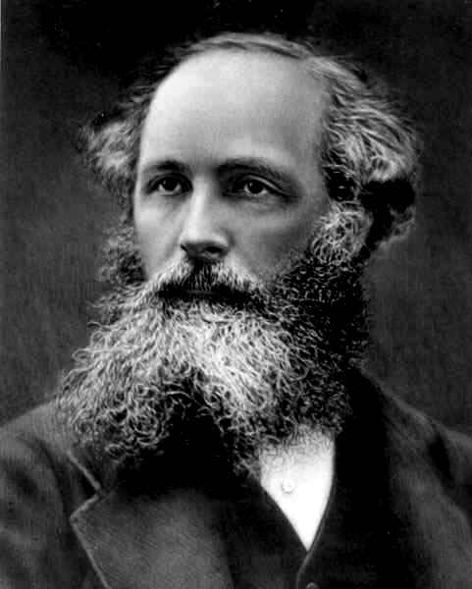
Simplify Maxwell
For RF-cavity interaction in a complex system, other than solving Maxwell equation or use EM simulation code, we have:
Slater perturbation theorem (frequency change)
Bethe theory (coupling), Floquet theorem (periodic structure)
RF circuit model (external properties)
For beam-cavity interaction in a complex system, other than solving Vlasov-Maxwell equation or use PIC simulation code, we have:
Beam loading theory (beam induced voltage)
Panofsky-Wenzel theorem (wake field and instability)
James C. Maxwell
(1831-1879)

Slide 4
Outline
Maxwell equation (cavity modes, accelerating voltage)
Slater perturbation theorem (scaling, tuning, field measurement)
Bethe theory (small hole coupling, cavity chain)
RF circuit theory (cavity model, RF measurement, multi-cell field tuning)
Beam loading theorem (vector analysis, Robinson instability, gap transient)
Panofsky-Wenzel theorem (wake field, impedance, coupled bunch instabilities)

Slide 5
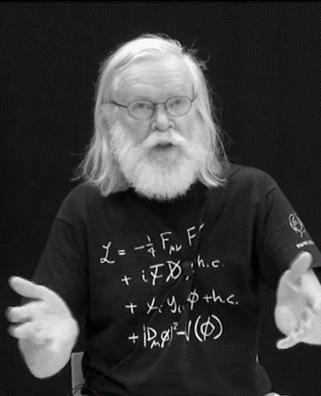
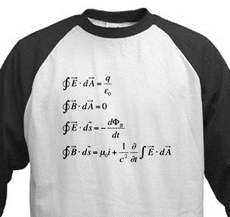
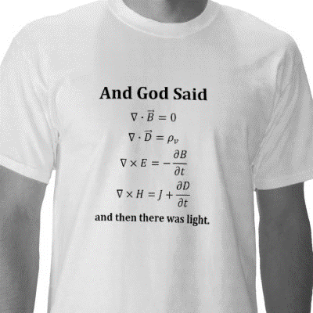
1. Maxwell Equation
Freshman
Sophomore
Graduate Student

Slide 6
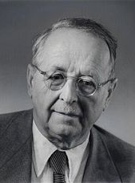
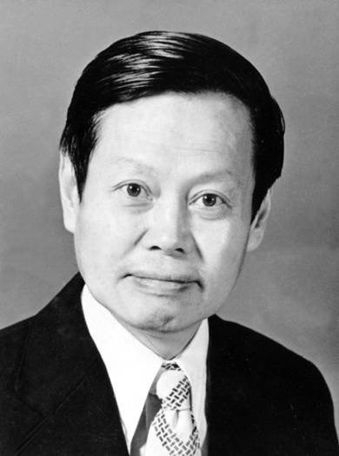
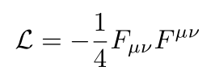
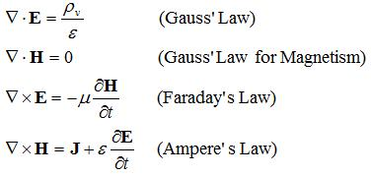
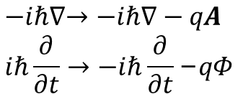
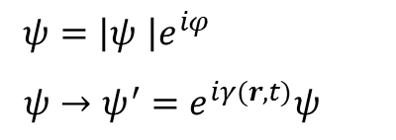
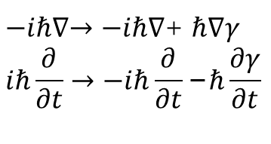
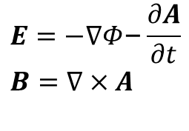
Local Gauge Principle
$ψ=\left|ψ \right|e^{iφ}$
$ψ→ψ^{′}=e^{iγ(r,t)}ψ$
$−iℏ∇→−iℏ∇$+ $ℏ∇γ$
$$iℏ\frac{∂}{∂t}→−iℏ\frac{∂}{∂t}\text{−}ℏ\frac{∂γ}{∂t}$$
$$−iℏ∇→−iℏ∇−qA$$
$$iℏ\frac{∂}{∂t}→−iℏ\frac{∂}{∂t}\text{−}qΦ$$
$$E=−∇Φ\text{−}\frac{∂A}{∂t}$$
$$B=∇×A$$
Maxwell equation (or photon or the Light) is a logic result of the gauge principle and relativistic principle.
Hermann Weyl
(1885-1955)
Chen-Ning Yang
(1922- )
Only a historic theoretical result of experiments? What is the origin of laws of nature?

Slide 7
Solving Maxwell Equation with Perfect Conducting Boundary
Steady-state sinusoidal electromagnetic waves propagating in vacuum or nonconducting simple media:
Variational Principle of Eigenvalues
An error of 10% in the field gives an error of only 1% in the eigenvalue

Slide 8
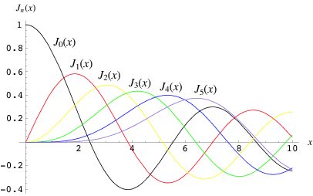
Circular Cylindrical Cavity Modes
TM mode
l
a
p_{ni} and q_{ni} is the n^{th} root of i^{th} Bessel function and its derivative respectively
TE mode

Slide 9
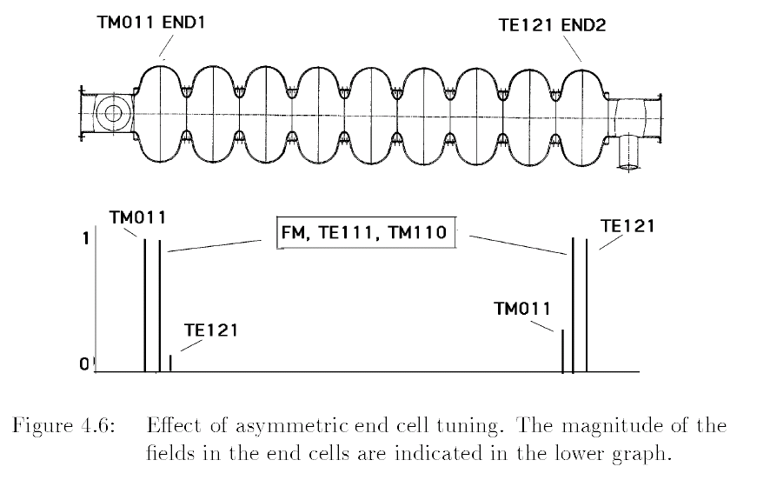
Field Patterns Exercise

Slide 10
Intrinsic Quality Factor
Complex frequency
Damped oscillation of the field
What is the scaling law of Q₀ and G with frequency of TM010 and other TM modes for a superconducting cavity?
Does the loss change eigen frequency?
What happened when a cavity quenches?

Slide 11
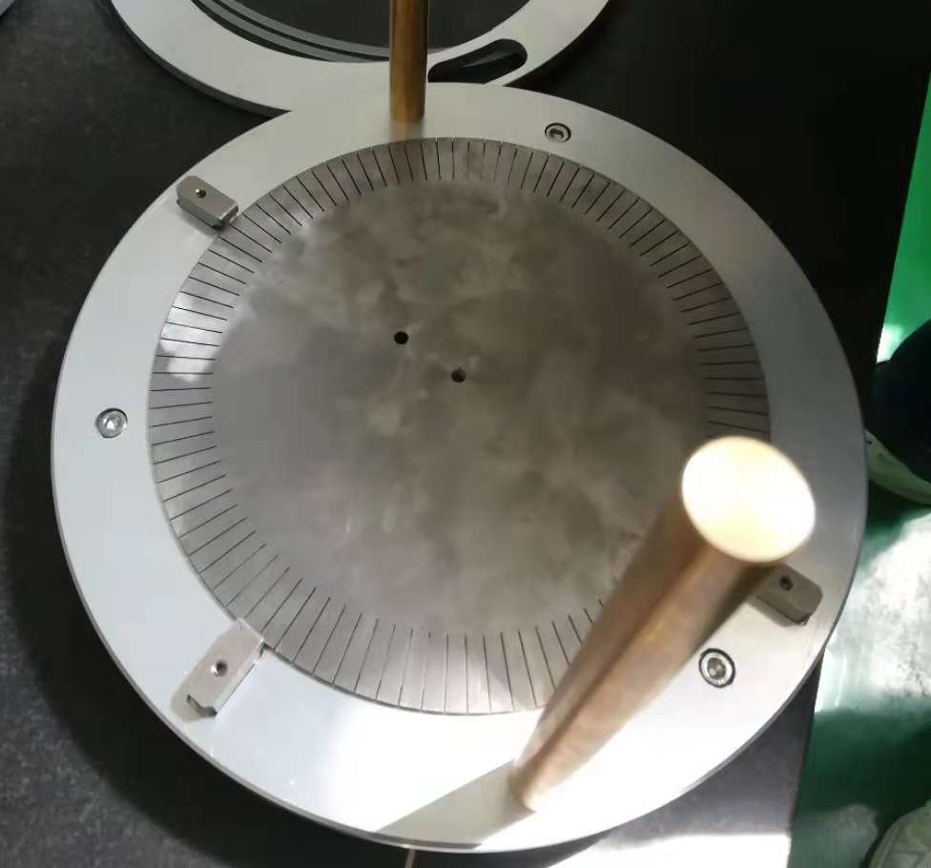
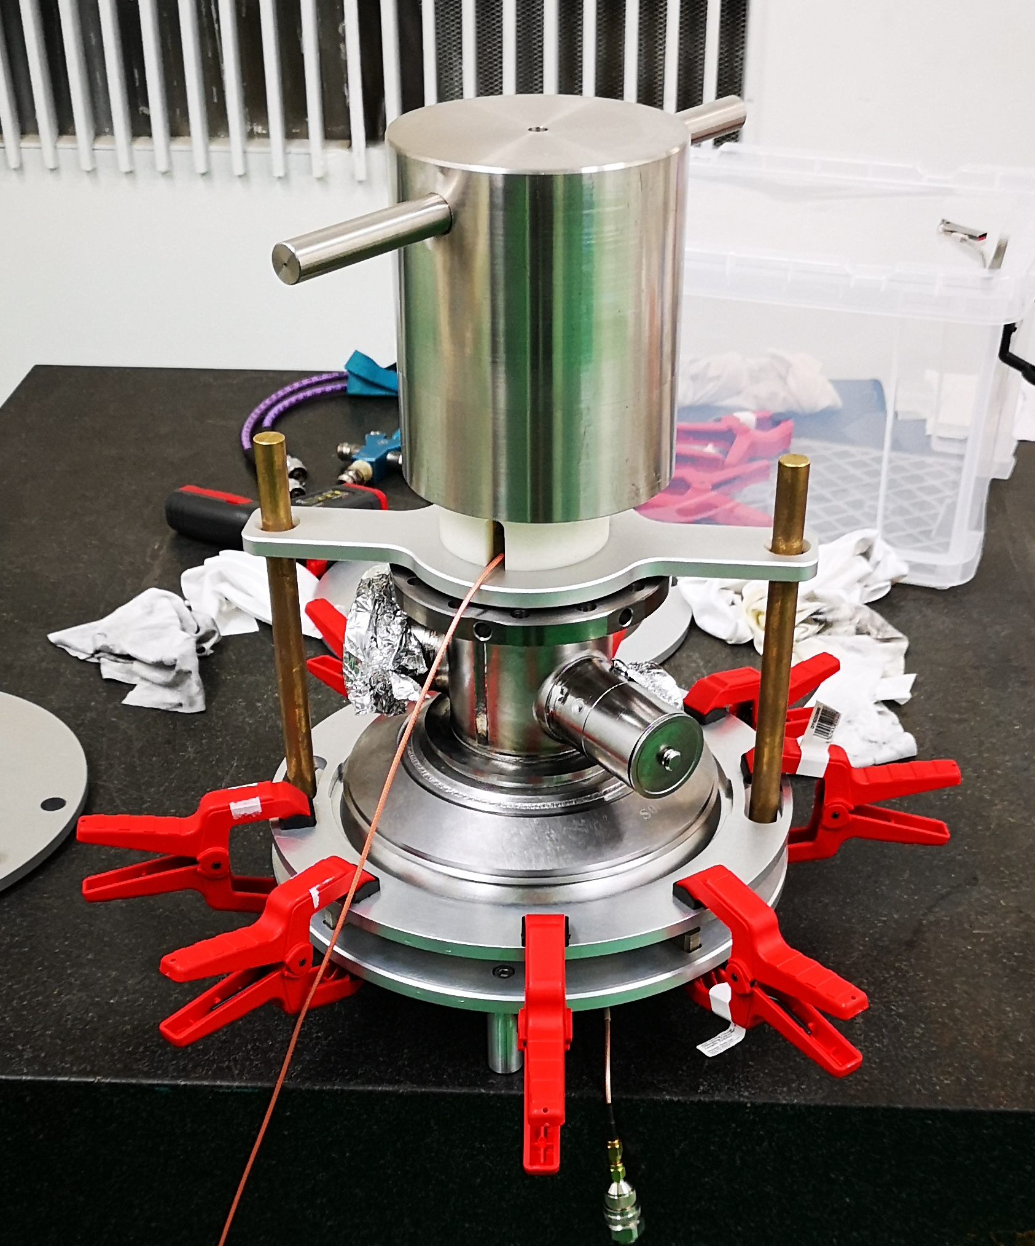
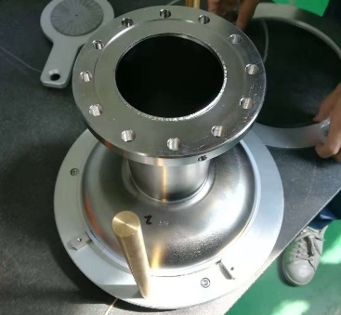

TM010 Accelerating Mode
Surface current in the end wall of TM010 mode is radial, so in the half-cell or dumbbell frequency measurement fixture for a 9-cell cavity, we can make radial fingers in the end plate to have better RF contact (compensate the uneven equator) without RF leak.
$$J_{0}\left(0\right)=1 J_{0}^{′}\left(0\right)=0$$
What is the scaling law of Q₀ and R/Q with frequency of TM010 mode for normal and superconducting cavity?

Slide 12
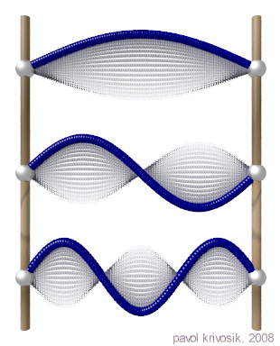
Accelerating Voltage (1)
Standing wave accelerating electric field on axis:
We choose the coordinate system and time axes that the particle passes the origin (center of cavity) at time t=0. Therefore
The accelerating voltage is
If the particle injection is delayed by a time
The electric field see by the particle

Slide 13
Accelerating Voltage (2)
Define as the phase due to the delay, the accelerating voltage acting on the particle is
For symmetric field distribution, the second integral vanishes. We define V_{c} the “Cavity (RF) voltage” and φ the accelerating phase. Accelerating gradient E_{acc} = V_{c} / L (L is the cell length).
If sin φ is used, φ + 90 deg.
In a (high energy) linac, the phase is determined by the injection time. In a ring, the phase is determined by the RF voltage and synchrotron radiation loss and other parasitic loss.

Slide 14
Accelerating Voltage (3)
We define the direct integral of axis electric field:
Transit Time Factor:
What if E(z) is not symmetric?
What is T of TM010 pill box accelerating cavity?
What is T of a TM110 cavity?
T is a measure of the reduction in the energy gain caused by the sinusoidal time variation of the field in the cavity.

Slide 15

TM110 Dipole Mode
Fields:
One polarization (near axis):
(why uniform? so what?)
(linear with y)
Near axis field:
Transverse gradient of E_{z}:
$$J_{1}\left(0\right)=0 J_{1}^{′}\left(0\right)=1/2$$

Slide 16
Frequency Correction for Measurement Conditions
where α = 7.3 × 10⁻⁶ K⁻¹ is the thermal expansion coefficient of niobium at room temperature, T₀ = 293 K. For small deviations from normal conditions (p = 760 mm Hg, humidity = 50%, T = T₀):
Why square root of the permittivity?
For 1.3 GHz cavity:
Normal condition to vacuum due to permittivity change: +420 kHz
+1 K thermal expansion: -10 kHz
+1 K permittivity change: -2.5 kHz
+10 % humidity: - 13 kHz
- 7.7 mmHg (-1 kPa) : + 3.6 kHz
(-1.1 kPa / 100 m)

Slide 17
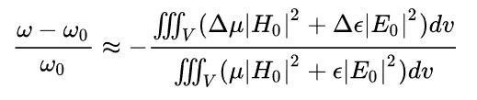
2. Slater Perturbation Theorem
Shape perturbation. either introduction of a small foreign object into the cavity or a small deformation of its boundary
Why different sign of electric and magnetic field?
time average of the stored energy
time average of the stored magnetic energy removed
John C. Slater
(1900-1976)
time average of the stored electric energy removed
Material perturbation (Why always lower the frequency?)

Slide 18
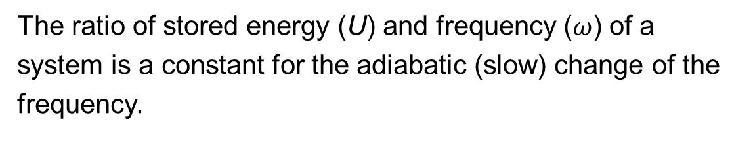


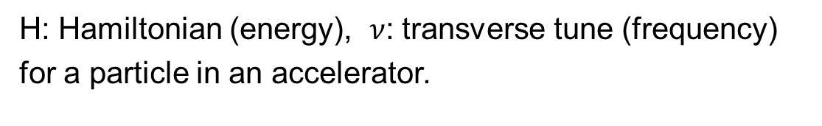
Boltzmann-Ehrenfest Principle
$$∆\left(\frac{U}{ω}\right)=\frac{∆U}{U}−\frac{∆ω}{ω}=0$$
$$\frac{H}{ν}=constant$$
The ratio of stored energy (U) and frequency ($ω$) of a system is a constant for the adiabatic (slow) change of the frequency.
H: Hamiltonian (energy), $ν$: transverse tune (frequency) for a particle in an accelerator.
$$H=qΦ+c\sqrt{{(p−qA)}^{2}+{m_{0}}_{}^{2}c^{2}}$$

Slide 19
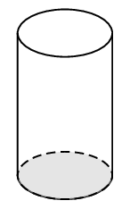
Cavity Parameter Scaling
If the frequency-length sensitivity for a 1.3 GHz 9-cell cavity is 300 kHz/mm, what is that for a 1.3 GHz single cell? (x9) What is that for a 650 MHz 2-cell cavity?
  1/2 [frequency] * 4 [end wall area] * 1 [length change 1mm] / (4 [end wall area] * 4/9 [length]) = 9/8
If the equator trimming sensitivity for a 1.3 GHz half cell is 5.2 MHz/mm, what is that for a 650 MHz half cell?
  1/2 [frequency] * 4 [end wall area] *1 [length change 1mm] / (4 [end wall area] * 2 [length] =1/4

Slide 20
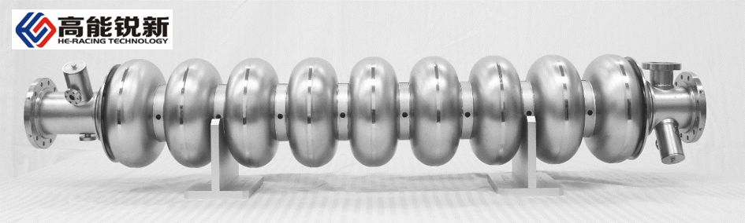
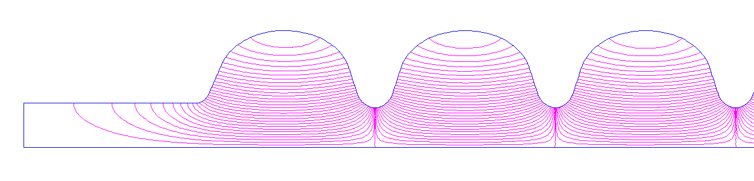
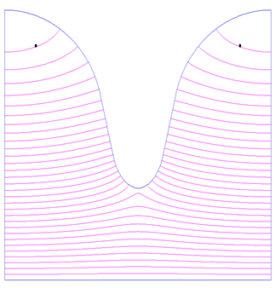
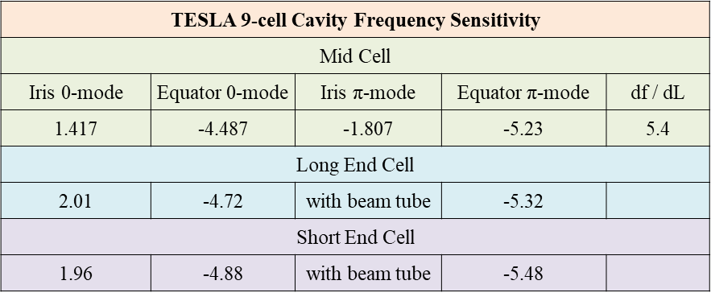
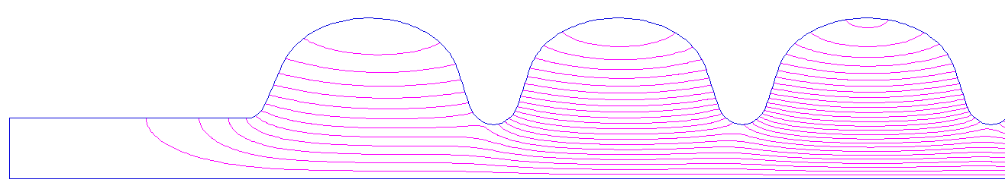
Cavity Boundary Perturbation
9-cell Pi-mode
Dumbbell 0-mode
9-cell 1/9-mode
Why there is no 0-mode for 9-cell cavity?

Slide 21
Cavity Field Measurement
Bead pull to measure the field profile of the cavity. In a multicell cavity, we need uniform (flat) field in the cells to assure uniform peak field in the cells and maximize the acceleration.
Details in Hands-on Training 3: Cavity RF Measurement.
Why we measure the bead pull phase shift instead of frequency shift with a network analyzer?

Slide 22
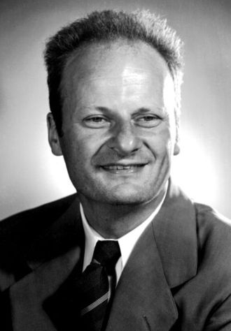
3. Bethe Theory
Bethe’s theory describes the perturbing effect on the cavity fields of a hole in the cavity wall. When the hole size is small compared with the wavelength, the effect of a hole is equivalent to adding electric and/or magnetic dipoles located at the center of the hole, whose dipole moments are proportional to the unperturbed electric and/or magnetic fields at the center of the hole.
For a small circular aperture, the equivalent electric-dipole moment representing the field inside the cavity caused by the perturbation of the hole is
The electric-dipole direction is normal to the plane of the hole.
Hans Bethe (1906-2005)

Slide 23
Asymmetric Coupled Oscillators
For
and

Slide 24
Dumbbell Frequency Tuning
Slater perturbation theory

Slide 25
Cavity Chain (Periodic Structure)
For an array of identical TM010-mode cavities separated by small circular apertures of radius a:

Slide 26
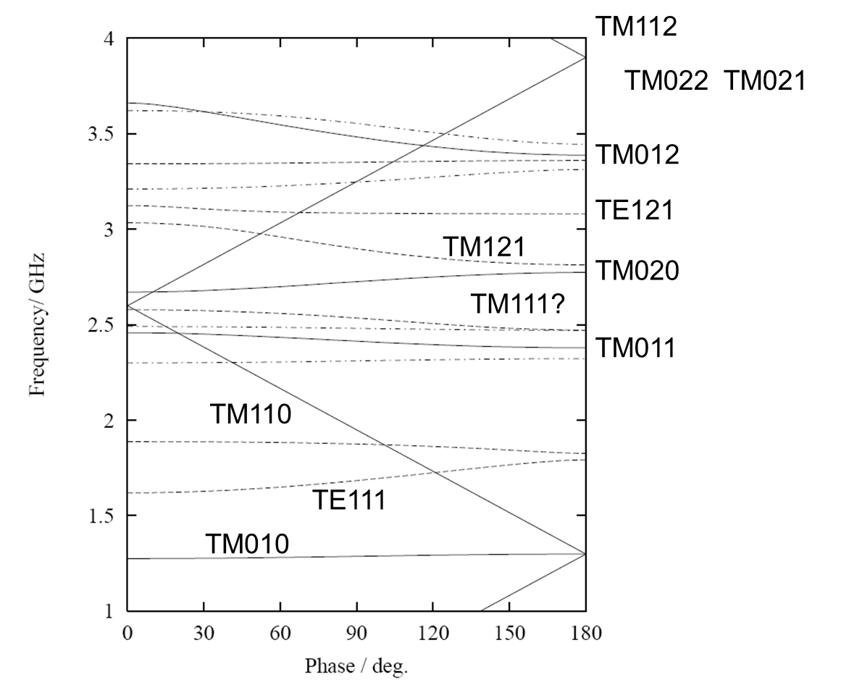
Dispersion Diagram of Slow Wave Structure
A particle only interacts with the space harmonic with similar phase velocity. The 0-order amplitude (by Fourier transformation) is just the accelerating field E_{acc}.
Dispersion of TESLA 9-cell cavity

Slide 27
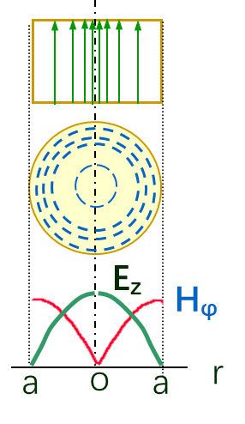
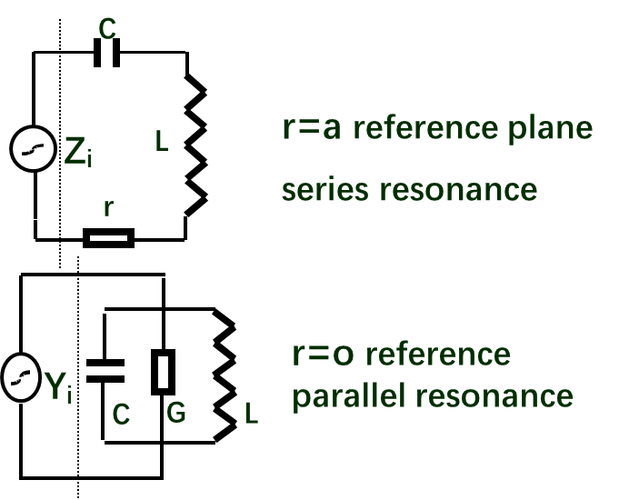
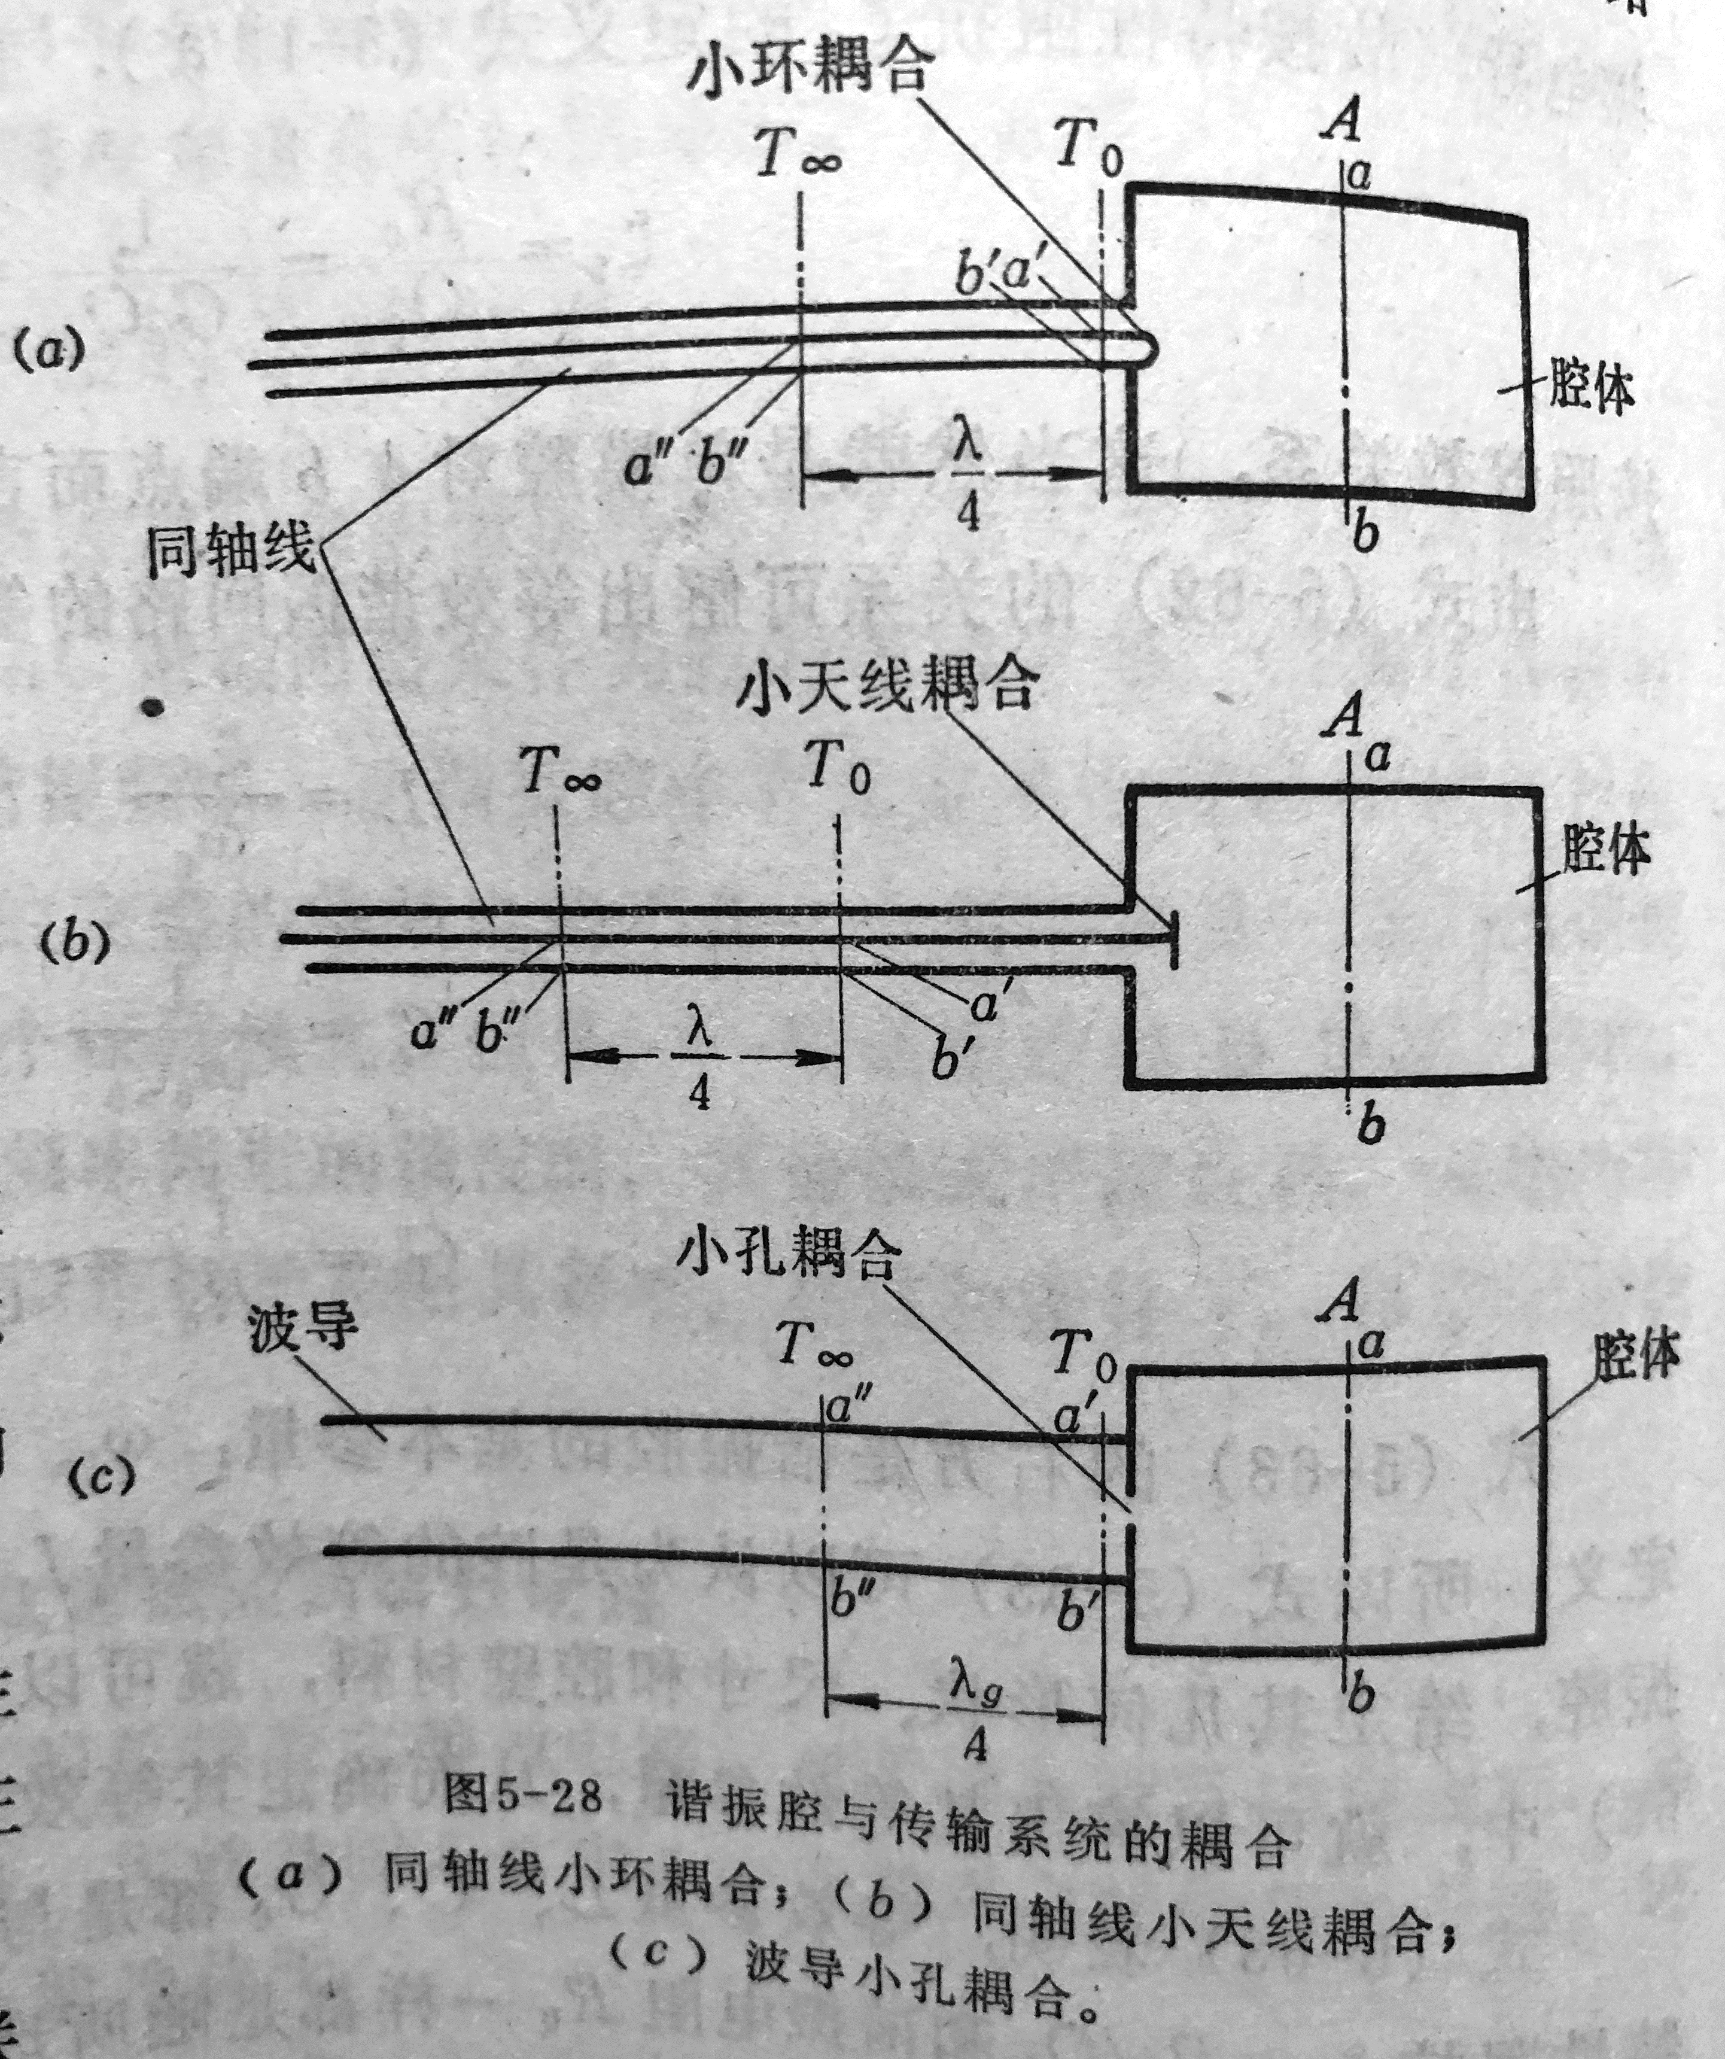
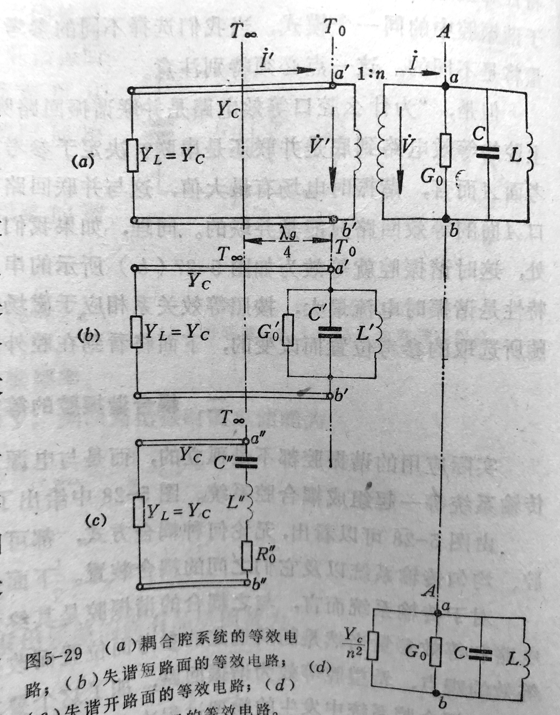
3. RF Circuit Theory
A cavity can be modeled by a RLC circuit depend on the reference plane position. When cavity is detune, very weak field and few loss in the cavity. Detuned short planes (parallel resonance) and detuned open planes (series resonance) in the transmission line.
For a small hole coupling, the detuned short plane almost coincides with the plane of the hole. For a antenna, it is the detuned open plane.

Slide 28
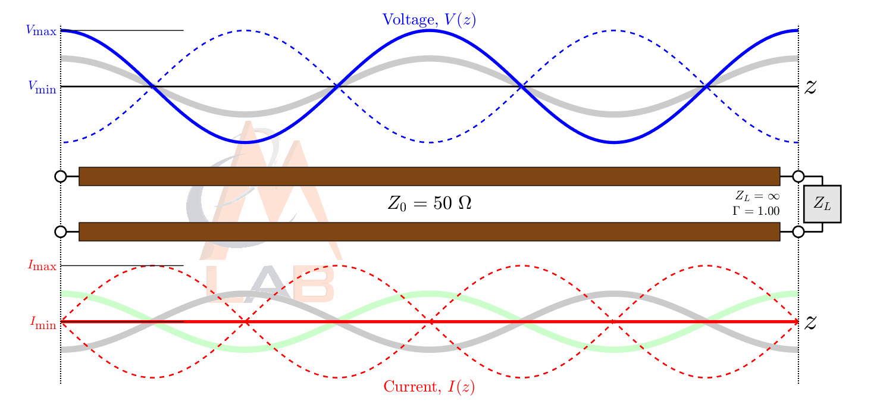
The phase difference between the field of the forward wave at the end of the coupler and the cavity field is the detuning angle Ψ plus 90 deg. Ψ was defined such that it is zero on resonance while in reality the system on resonance follows an excitation with 90 deg phase shift.
The excitation of the cavity field on the waveguide is subject to exponential evanescence. The phase advance however is 90 deg (and not Ψ + 90 deg), since the waveguide is a broadband system. The added phase advance therefore is Ψ + 180 deg from the forward traveling wave to the reflection at the cavity.
What about at the plane of detuned short?
Superposition of the open-end reflection and the cavity reflection form the (total) reflected wave.

Slide 30
RF Circuit Model of
One Port Cavity
Normalized equation
Transient
Step response

Slide 31
Cavity Parameters

Slide 32
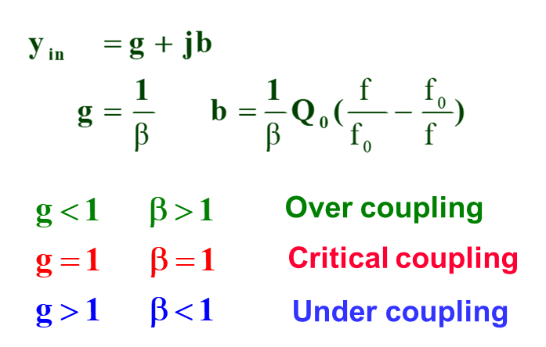
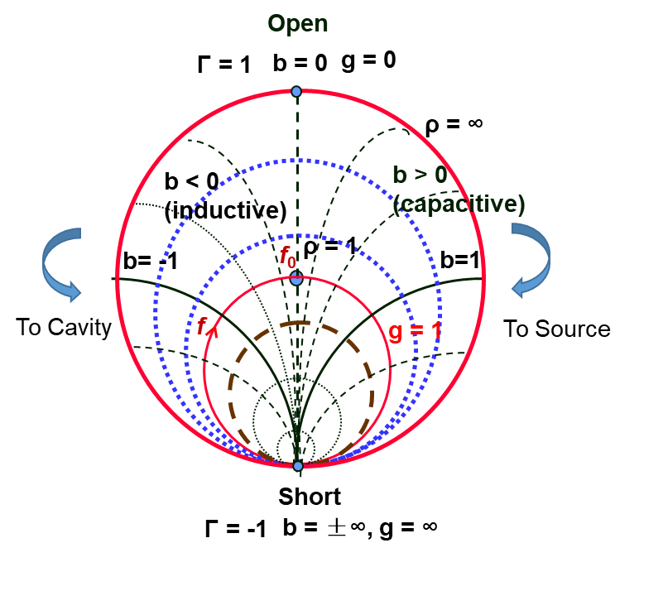
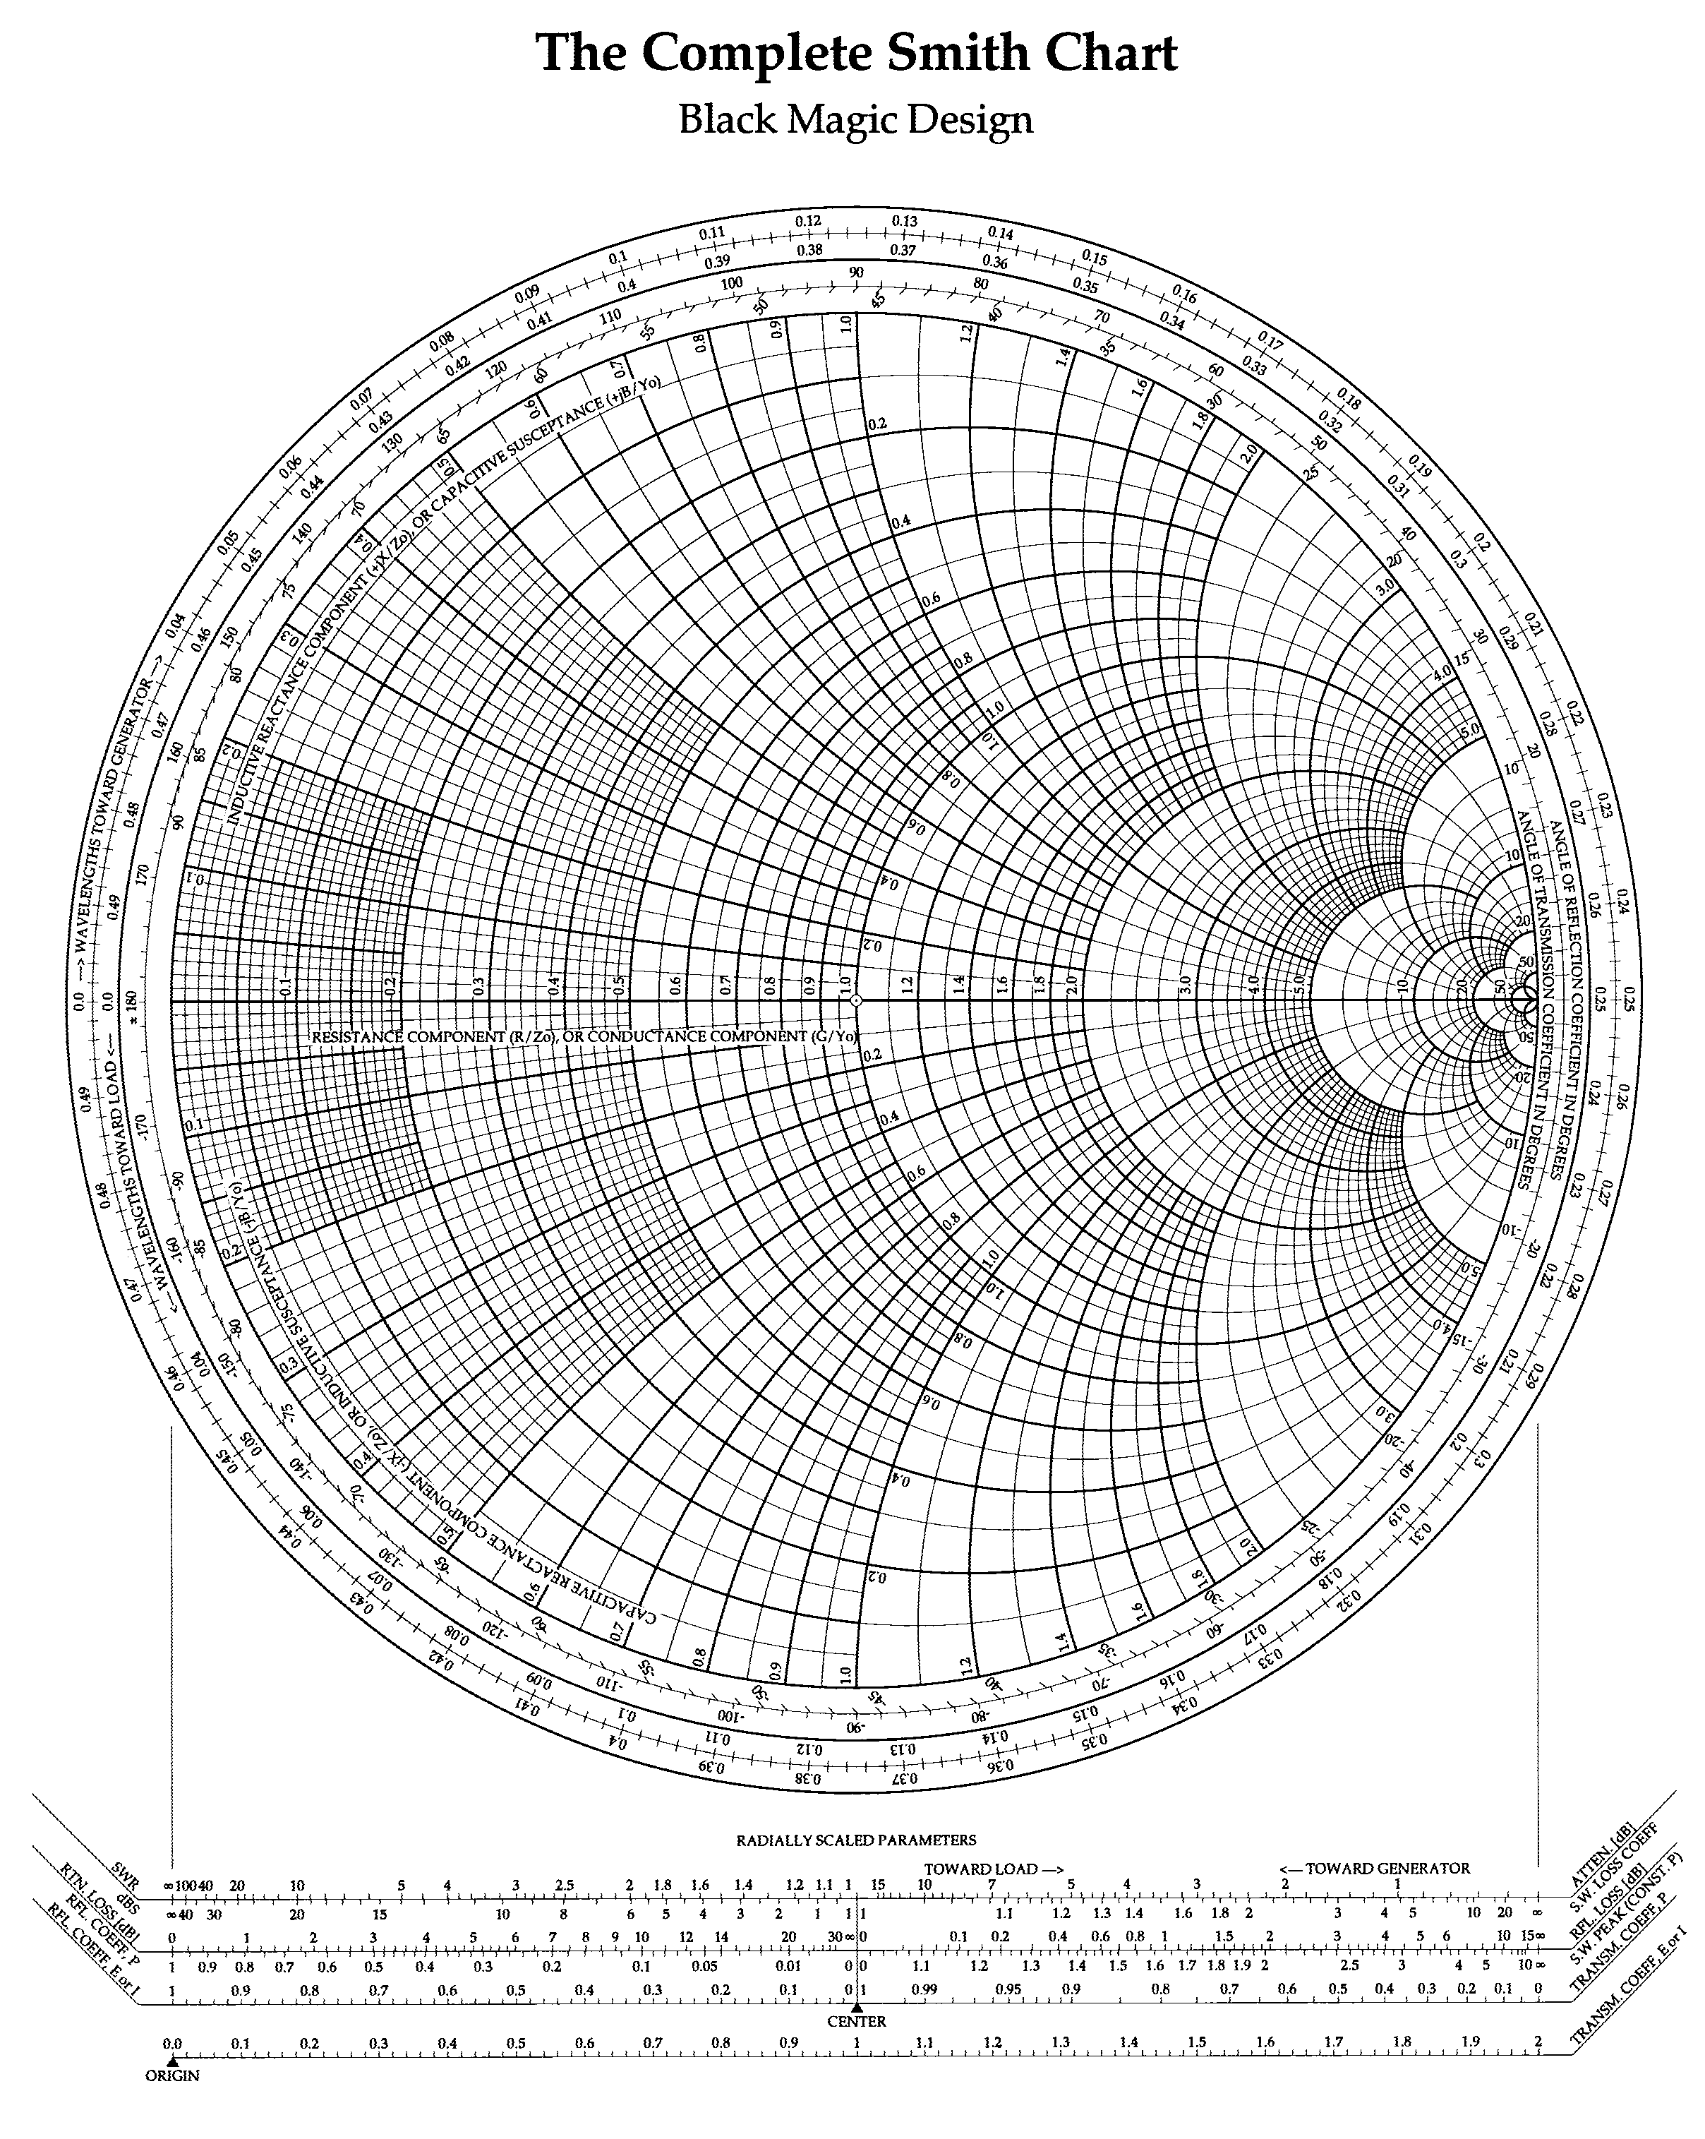
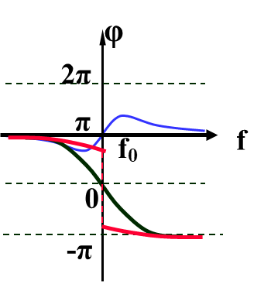
Cavity Impedance/Admittance in Smith Chart
Normalized admittance (conductance and susceptance) of the cavity from detuned short plane

Slide 33
Cavity RF Measurement Phenomenology
Mismatch
Not calibrated cable or remained mismatch section
Rotation: reference plane move
Balloon shape: cable larger phase shift for larger f
Coupling loss and reactance
Cross talk

Slide 34
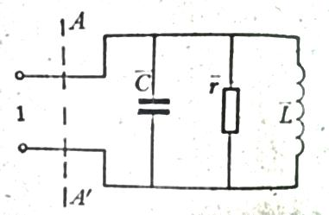
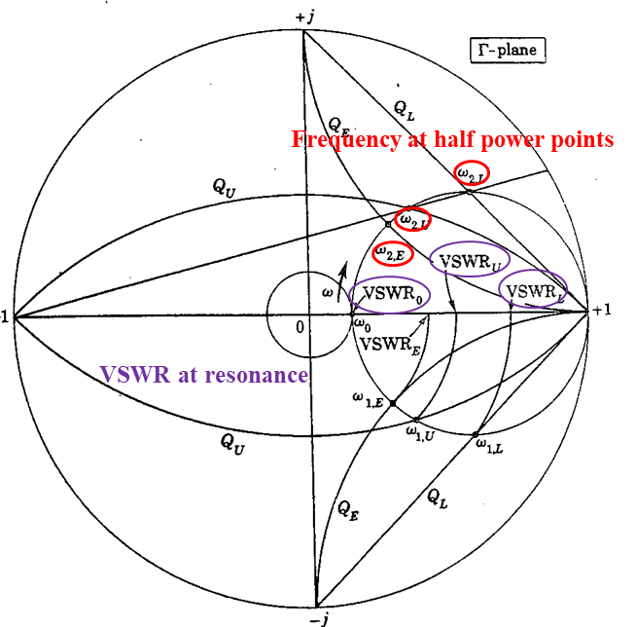
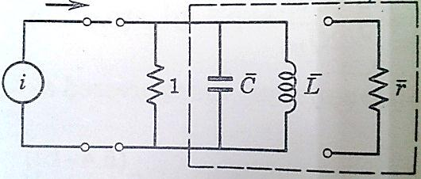
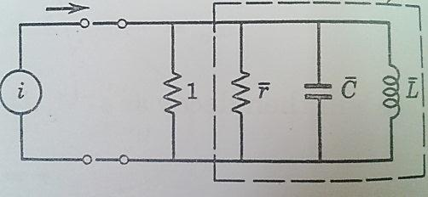
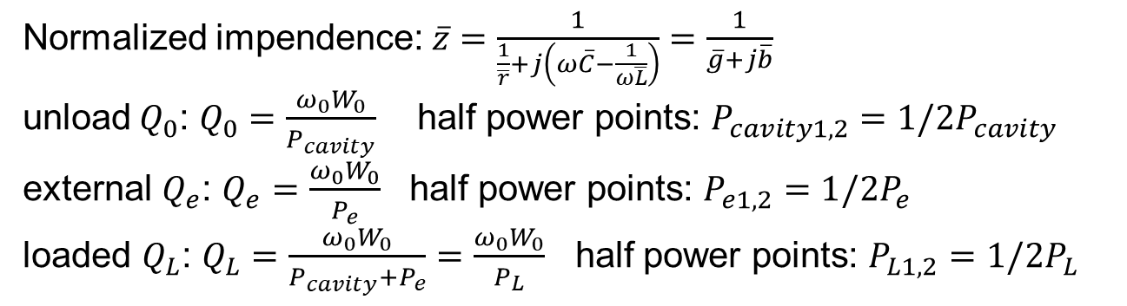
Q Circles
cavity
cavity
Equivalent circuit with normalized parameter(for Q₀ considerations)
Equivalent circuit for Qe considerations
Equivalent circuit for Q_{L} considerations
Normalized impendence:$\overline{z}=\frac{1}{\frac{1}{\overline{r}}+j\left(ω\overline{C}−\frac{1}{ω\overline{L}}\right)}=\frac{1}{\overline{g}+j\overline{b}}$
unload$Q_{0}$: $Q_{0}=\frac{ω_{0}W_{0}}{P_{cavity}}$ half power points: $P_{cavity1,2}=1/2P_{cavity}$
external $Q_{e}$: $Q_{e}=\frac{ω_{0}W_{0}}{P_{e}}$ half power points: $P_{e1,2}=1/2P_{e}$
loaded $Q_{L}$: $Q_{L}=\frac{ω_{0}W_{0}}{P_{cavity}+P_{e}}=\frac{ω_{0}W_{0}}{P_{L}}$ half power points: $P_{L1,2}=1/2P_{L}$
$${\overline{b}}_{1,20}=±\overline{g} {\overline{b}}_{1,2e}=±1 {\overline{b}}_{1,2L}=±(1+\overline{g})$$

Slide 35
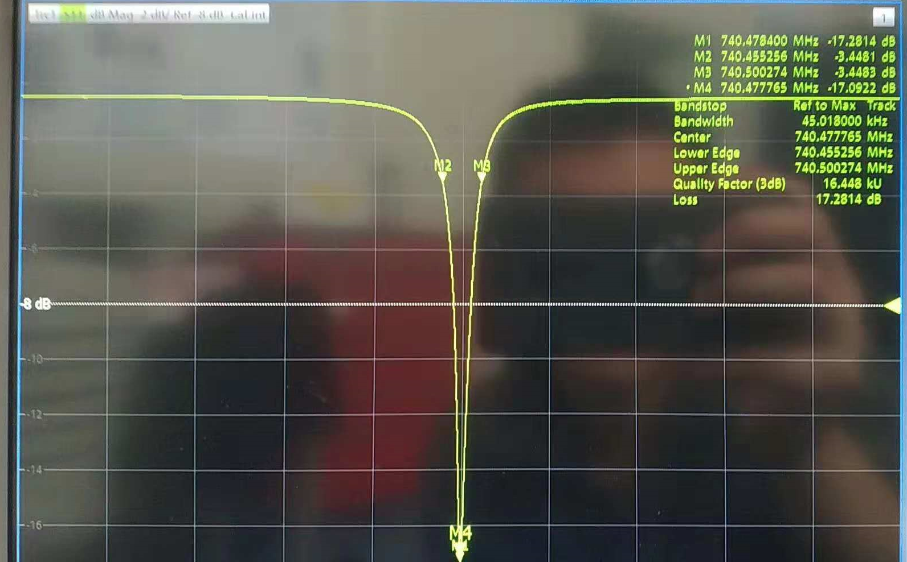
How to measure Q_{L} with s₁₁?
-3dB?
-3dB?
Only the quantity proportional to the excited energy in the cavity can use -3 dB to have Q_{L}.
Give the Q_{L} formula with s11 (Hint: solve the black triangle).

Slide 36
Vector Diagram

Slide 37
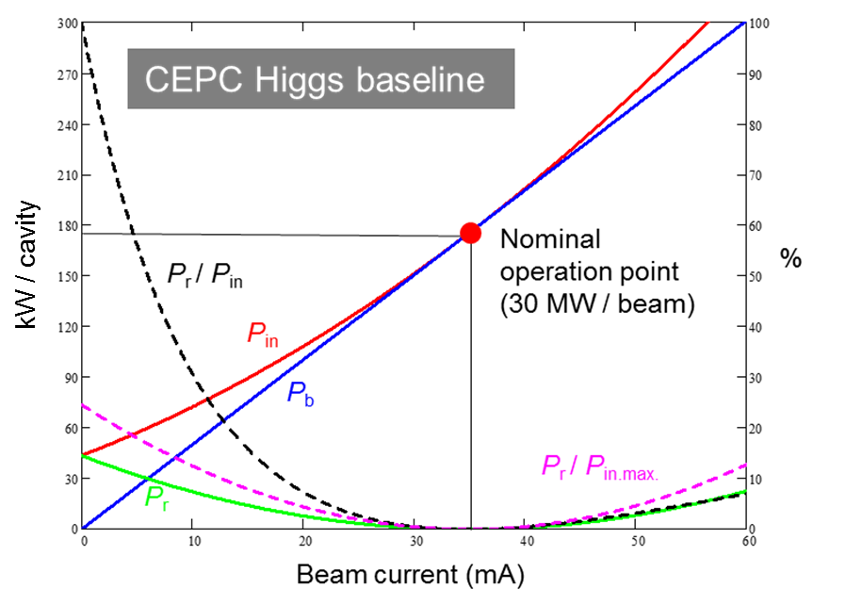
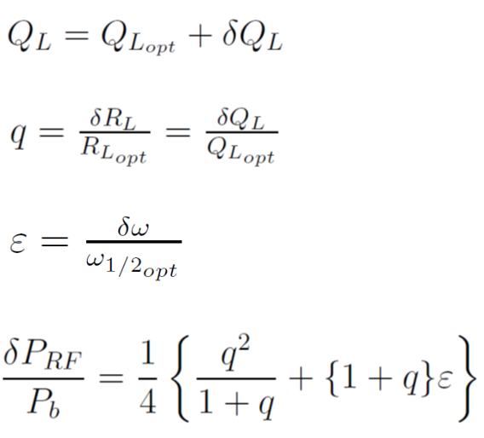
Generator Power
Additional RF power for
non optimized coupling and detuning

Slide 38
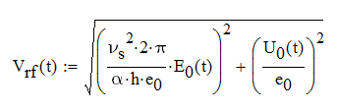
Booster Voltage Ramp
Beam energy increase linearly with time.
RF voltage ramp with constant synchrotron tune to avoid synchrotron-betatron oscillation.
Equilibrium bunch length and quantum lifetime not too short.
Multipacting during voltage ramp
Counter-phasing can be used to ramp the effective RF voltage
Gradient E_{acc} / MV/m
Energy acceptance η / 0.2 %
Synchrotron tune ν_{s} / 0.01
Beam energy E₀ / 10 GeV
Very narrow bandwidth SRF cavity operation with microphonics and Lorentz detuning in a fast ramp synchrotron. Challenging but doable.

Slide 39
Booster Voltage Ramp
I₀ / 0.53 mA
E₀ / 120 GeV
E₀ / 120 GeV
Δf_{OD} / - 339 Hz
φ_{s} / 90 deg
V_{rf} / 1.83 GV
E_{acc} / 18.4 MV/m
P_{g} / 14 kW
Δf_{LFD} / - 452 Hz
V_{rf} / 1.83 GV
E_{acc} / 18.4 MV/m
I₀ / 0.53 mA
φ_{s} / 90 deg
P_{g} / 14 kW
Δf_{LFD} / - 452 Hz
Δf_{OD} / - 339 Hz
Assume 10 % Lorentz force detuning (LFD) remains not compensated by piezo actuators, 10 Hz peak-to-peak microphonics (need careful cryomodule design and quiet operation condition). LFD factor for TESLA 9-cell cavity with helium vessel and tuner: 1 Hz / (MV/m)²
Ensure the detuning not to cause Robison instability during injection and ramping.
With detuning, forward power 14 kW / cavity for + 20 Hz microphonics, 20 kW for - 20 Hz microphonics.

Slide 40
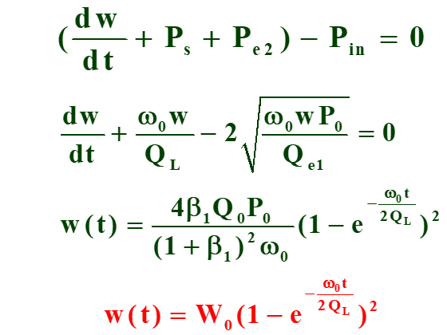
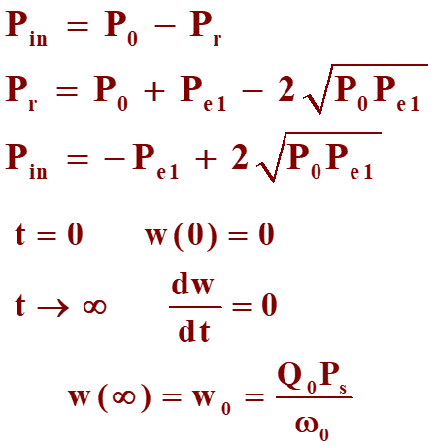
On-resonance Transient
RF-off

Slide 41
Off-resonance Transient

Slide 42

Two Port Coupling (on resonance)
P₀: forward power
P_{r}: reflected power
P_{in}: power into the cavity
P_{s}: cavity wall loss
P_{e1}: port 1 emitted power
P_{e2}: port 2 emitted power

Slide 43
RF Measurement of Weak Coupling at RT and Vertical Test at 2 K

Slide 44
Measurement Uncertainty of Network Analyzer
Why coupling of the dummy input coupler should not be too small?

Slide 45


Slide 46



Slide 47


RF Measurement of Near Critical Coupling at RT

Slide 48


RF Measurement of Accelerating Mode at 2 K

Slide 49

RF Measurement of HOM at 2 K

Slide 50
Field Flatness Calculation and Tuning

Slide 52

Why? $f=1/2π\sqrt{LC}$

Slide 53









π
8 π / 9
7 π / 9
6 π / 9
5 π / 9
4 π / 9
3 π / 9
2 π / 9
π / 9

Slide 54
9-cell Cavity Field Flatness Estimation with Cell Frequencies

Slide 55
9-cell Cavity Field Flatness Tuning Calculation

Slide 57

5. Beam Loading Theorem
What really happened when a charged particle or bunch(es) pass through a cavity? We will go into this large black box and get some useful conclusions in time domain, but still have many small black boxes.
Four basic principles: superposition, conservation of energy (black box), orthogonality of modes, causality.
This analysis breaks down when the charge is actually inside the cavity. It would be an extremely difficult task indeed to work out in detail the development of the beam-induced fields as a function of time for a cavity of arbitrary shape. It can be assumed that the beam-induced fields appear instantaneously when the charge crosses the reference plane in the cavity.
Perry B. Wilson
(1927-2013)

Slide 58
Cavity voltages are taken to be complex (or phasor) quantities, written with a tilde. The absolute value of the voltage, written without a tilde, is the maximum energy in electron volts that can be gained by a small non-perturbing test charge which traverses the cavity at the velocity of light. Assuming , a reference plane is defined in the cavity by the position of this maximally accelerated test charge at t = 0. Thus the projection of V on the real axis gives the energy gain for a test charge which crosses the reference plane at an arbitrary phase. It is almost self-evident that the phase of the beam-induced voltage must lie along the negative real axis.
The analysis following will be carried out assuming a point bunch. Effects due to non-zero bunch length are then readily computed by considering the bunch to be composed of an infinite number of vanishingly small slices and performing an appropriate integration (superposition).
The total voltage seen by a charge crossing a cavity is the vector sum of an externally applied generator voltage and a component due to the voltage induced by the charge itself. The magnitude and phase of each component is assumed to be unaffected by the presence of the other component.
The energy lost (or gained) by the charge be equal to the increase (or decrease) of energy stored in the cavity fields.

Slide 59
The Fundamental Theorem of Beam Loading
The fact that a charge sees exactly one-half of its awn beam-induced voltage we will call the fundamental theorem of beam loading.
Energy lost to an initially empty cavity
Loss parameter k for radiation into an empty cavity is defined by
V is the maximum voltage seen by a nonperturbing
test charge traveling across the cavity at the speed of light when the stored energy is W.

Slide 60
Explanation?
The factor 1/2 in the theorem comes from the fact that charges in a beam see the wake produced only by those charges in front of it and as a result see on the average only half of the total beam charge.
What about a point-like electron?

Slide 61
Single Pass Build-up of the Beam-induced Voltage

Slide 62
Multiple-pass Build-up of the Beam-induced Voltage
The reference phase is rotating at the angular frequency of the external rf generator. It is natural to use the external generator as the basic clock for describing field variations in the cavity, since the spacing of bunches in a storage ring is determined by the generator frequency and not by the cavity resonant frequency. The rotation of the vector is due to the frequency difference of the cavity frequency and generator frequency. The beam included voltage always has the frequency of the cavity eigen mode.

Slide 63
Steady State Phasor Diagram

Slide 64
Steady State Beam Loading of CEPC
One bunch extracts energy from the cavity immediately and changes the amplitude and phase of the cavity voltage.
The forward power re-fills the stored energy and recovers the voltage. This is how the RF power level is determined.
The bunch see half of the voltage change induced by itself.
e+e- bunch pair loses 0.021 J (FM 0.008 J, HOM 0.013 J), gets cavity FM 1.005 J, net gain 0.992 J (0.6 % cavity stored energy, 7.65 % max).
Here assume in CEPC SR, electron and positron bunch pass through the cavity at the same time. In reality, there is a gap between electron and positron, resulting in small voltage and power fluctuations.

Slide 65
Machine Beam Time Structures
CEPC-SR (T_{b1}: 0.6~2.7 μs)
LEP, LEP2, BEPC
BEPCII (Ion clearing)
LHC (kicker rise time)
ILC
XFEL
CEPC-PDR (assume 6% for all modes and circumferences)
Ring? Large gap.
Linac? High repetition rate.
Injection and extraction: non-periodic transient beam loading

Slide 66
Transient Phasor Diagram for a Beam with a Gap

Slide 67

Transient Beam Loading
Phase shift caused by beam loading
  A bunch extracts cavity stored energy when passing through, and power source will recover the cavity voltage when the next bunch comes. When the bunch spacing is much smaller, cavity stored energy and voltage will drop continuously due to lack of power. The latter bunch will move towards voltage peak by auto-phasing, resulting in less longitudinal focusing, smaller energy acceptance, lifetime and luminosity, and possible other dynamical problem. Small phase shift can be estimated by:
Correction methods
  Increase cavity stored energy (less cell number, higher RF voltage, low RF freq)
  More uniform distribution (increase bunch train number or length)
  Pulsed power (power source hardware limit and low RF-to-beam efficiency)
  Beat cavity (small frequency shift of part of RF sources and cavities, beating)
$$Δθ_{1N}≈\frac{−2kq}{V_{c0}\sin{φ_{0}}}\left[\frac{T_{t}T_{g}/T_{b}}{T/N_{t}}\right]≈\frac{−2kI_{0}T_{g}}{V_{c0}\sin{φ_{0}}}≈\frac{−2kqN}{V_{c0}\sin{φ_{0}}}$$
Refer to Jiyuan Zhai’s talk in the CEPC-SPPC Workshop, Apr. and Sept. 2016
http://indico.ihep.ac.cn/event/5277/session/9/contribution/45/material/slides/
http://indico.ihep.ac.cn/event/6149/session/2/contribution/55/material/slides/

Slide 68

Beam Gap Phase Shift of CEPC
Gaps for beam abort and mitigate ion-trapping and fast beam ion instability (FBII), and avoid collision in RF section (Higgs), as well as the bunch trains of the PDR and APDR scheme proposed by Jie Gao.
~ 10 % total gap needed for Z. But one gap will have too large phase shift and beam loss. Use many bunch trains with short gaps.
 | H | W | Z
Beam gap in number of buckets | 3091 | 550 | 24832
Beam gap length [us] | 4.76 | 0.85 | 38.20
Max relative voltage drop | 0.5% | 0.7% | 460%
Max bunch train phase shift [deg] | 0.5 | 0.6 | /
Phase shift for Higgs end cavity
Simulation based on D. Teytelman’s code with transfer functions.

Slide 69
Phase Shift of Z with Bunch Trains
48 trains of 250 bunches located symmetrically in the ring. Bunch spacing is 24.6 ns (16 RF buckets), gaps are 820 ns (533 buckets).
D. Teytelman.

Slide 70

Transient Beam Loading Compensation
Constant amplitude and phase of the cavity voltage.
To avoid complicated Lorentz force detuning correction in ring.

Slide 71

Transient Beam Loading Compensation
Perfect (Fixed Point) Correction
(HL Higgs, cavity near IP1&IP3)

Slide 72




Longitudinal Dynamics and Phase Stability

Slide 73




Robinson Stability
Phase Stability
> 0, real load and First Robinson Stability (next session).
$$i_{T}$$
Only the generator voltage is able to provide a restoring force, and thus the condition for stability (Second Robinson Stability) is as below. The longitudinal focusing is lost due to heavy beam loading.
$$φ_{L}$$
$$i_{b}$$
$$φ_{L}$$
load angle ~ 0
Ψ
detunig angle < 0

Slide 74


Robinson Stability (CEPC Z mode)
by Haipeng Wang’s Mathcad code
Fast direct feedback (group delay 2 us, loop gain 22).
~ 10 % more power to have Robinson stable operation of high current Z-pole.

Slide 75

6. Panofsky-Wenzel Theorem
Collective instabilities. As the beam intensity is increased, the electromagnetic fields self-generated by the beam, particularly the fields generated by the beam interacting with its immediate surroundings, will perturb the external prescribed field. When the perturbation becomes sufficiently strong, the beam becomes unstable. To describe this aspect of the beam dynamics, the single-particle picture described above does not suffice and a multi-particle picture is introduced.
The beam interacts electromagnetically with its surroundings to generate an electromagnetic field, known as the wake field. This field then acts back on the beam, perturbing its motion. Under unfavorable conditions, the perturbation on the beam further enhances the wake field; the beam-surroundings interaction then leads to an instability, known as a collective instability, and often a subsequent beam loss.
Wolfgang K. H. Panofsky
(1919-2007)

Slide 76

Wake Field

Slide 77
Impulse Approximation

Slide 78
Panofsky-Wenzel Theorem
electric
magnetic
magnetic
vanishes for cavity with a beam pipe at each end, if z = 0 and d are chosen far enough beyond the cavity end walls that the fields have attenuated
The total momentum impulse is proportional to the transverse gradient of the longitudinal electric field.
For a pure TE mode (no Ez), impulse is zero. But in real cavity, usually there is no pure TE mode (hybrid TE and TM).

Slide 79
Panofsky-Wenzel Theorem
A TM mode can give a nonzero ∇⊥Ez, and can give a nonzero transverse deflection. For example, the TM010 mode produces a nonzero ∇⊥Ez for an off-axis particle, and the TM110 mode produces a large nonzero ∇⊥Ez on axis.
Generalized Panofsky-Wenzel Theorem:
For a cylindrically symmetric system:
the transverse gradient of the longitudinal wake potential is equal to the longitudinal gradient of the transverse wake potential.

Slide 80
If the radial displacements are small compared to a, the dominant terms will be the m = 0 monopole term for the longitudinal wake potential, and the m = 1 dipole term for the transverse wake potential.
the longitudinal wake potential is independent of the transverse coordinates of both the source and test charges, and the transverse wake potential is linearly proportional to the source-charge radius, is independent of the transverse coordinates of the test charge, and is everywhere directed along the x-axis, the direction of the source displacement.

Slide 82
Impedance

Slide 83




Longitudinal Loss Factor Calculations and Normalization to Bunch Length and Aperture
Define the normalized loss factor k_{n//} which bunch length σ is normalized to wavelength λ and the beam pipe radius a and the k_{n//} is inversely proportional to cavity iris radius r:
for pill box cavity:
power close to -1

Slide 84

Beam Spectrum

Slide 85


Longitudinal Coupled Bunch Instabilities
τ > 0 exciting instability
τ < 0 damping instability
coupled eigen modes
determine the onset of an instability at arbitrarily
small amplitudes
The instability growth rate should be lower than the radiation damping rate otherwise use beam feedback system to add another damping term.

Slide 86

Fundamental Mode Coupled Bunch Instability
Fundamental mode CBI of CEPC Z-pole due to large cavity bandwidth and detuning and large circumference (small revolution frequency).
For M bunches, there are M coupled-bunch modes, the phase shift between adjacent bunches for mode number n:
n = 0, 1, 2, ... M-1
CBI growth rate :
$$\begin{matrix}{\text{f}}_{ \text{p}}^{ \text{μ}\text{+}}\text{=} \text{(}\text{pM} \text{+} \text{μ}\text{)} {\text{f}}_{\text{0}} \text{+} {\text{f}}_{\text{s}} \\ {\text{f}}_{ \text{p}}^{ \text{μ}\text{−}}\text{=} \text{[(}\text{p}\text{+1)}\text{M} \text{−} \text{μ}\text{]} {\text{f}}_{\text{0}}\text{+} {\text{f}}_{\text{s}}\end{matrix}$$

Slide 87

Fundamental Mode Instability
upper 0: exciting, lower 0: damping (first) Robinson instability
upper +1: p=h/M, f0*pM=frf, f_upper=frf+1*f0+fs (right +1 in the plot), exciting
lower +1: p=-h/M, f0*pM=-frf, f_lower=-frf+1*f0+fs, and then symmetry to the positive axis f_lower=frf-1*f0-fs (left +1 in the plot), damping
upper -1: p=-2h/M, f0*pM=-2frf, f_upper=-2frf+(M/h-1)*f0+fs, and then symmetry to the positive axis f_upper=frf+1*f0-fs (right -1 in the plot), damping
lower -1: p=0, f0*pM=0, f_lower=0+(M/h-1)*f0+fs=frf-1*f0+fs (left -1 in the plot), exciting

Slide 88


Fundamental Mode CBI of CEPC Z
Longitudinal coupling-impedance
$$Z^{||}(f)=\frac{1}{β}\frac{{R_{sh}}/2}{\left.1+iQ_{L}(\frac{f}{f_{res}}−\frac{f_{res}}{f}\right)}$$
Cavity resonance frequency

Slide 89
Simulation of Growth Rate and Direct RF Feedback
3 ms growth time (1/4 synchrotron period)
Optimal direct loop gain of 14 the growth rates are reduced to a very reasonable 7.2 1/s (139 ms growth time, 11.6 synchrotron periods). That residual growth rate should be easy to control with standard bunch-by-bunch feedback.

Slide 90
HOM Coupled Bunch Instability
Higher order modes excited by the intense beam bunches must be damped to avoid additional cryogenic loss and multi-bunch instabilities.
Monopole HOMs can lead to energy spread, timing/phase errors, causes longitudinal emittance growth or instability
Transverse modes can deflect the beam from its reference orbit, causes instable beam motion, transverse emittance growth or even beam loss
HOMs (dominantly monopole modes) also cause extra losses in cavity walls
Impedance budget
To keep the beam stable, the radiation damping time should be less than the rise time of any of the oscillation modes.
If the beam spectrum coincide with the cavity impedance spectrum(~resonant case), the beam maybe unstable, and the HOM power loss will be huge (~hundred kilo watts).
In the resonant condition, the threshold shunt impedances are

Slide 91


HOM CBI
When consider the whole RF system, HOM frequency spread due to the actual tolerances of the cavity construction can further relax the instability.
With feedback damping of 5 turns in transverse and one synchrotron period in longitudinal, the beam could be stable with HOM frequency spread > 1 MHz.
Z:
Impedance spectrum of the RF HOMs compared to the threshold determined by radiation damping and feedback damping (Left: longitudinal HOMs, Right: transverse HOMs )

Slide 92

CEPC Collider HOM CBI Q_{ext} Threshold
3 kHz beam spectrum lines, impossible to detune the HOMs (or just no damping? Q₀__{TM0mp} = Q_{0_TM010}* f_{rf} / f_{HOM})
Average beta_x,y in RF cavity ~ 30 m

Slide 93

Collider HOM CBI with all Effective Q_{ext} = 2E3

Slide 94






HOM Coupler Damping Design
equivalent circuit (transmission line model) → optimize each part according to S21 curve
→ change to 3D model → electromagnetic optimization
Port2
Port1
Port3
Modes | f (GHz) | R/Q (monopole Ω, dipole Ω/m) | Q_{e} simulation
TM011 | 1165.574 | 65.2 | 2.46E+05
TM020 | 1383.898 | 1.3 | 1.55E+05
TE111 | 844.738 | 279.8 | 1.50E+04
TM110 | 907.592 | 420.1 | 4.58E+02

Slide 95

Fill Pattern and Beam Power Spectrum
Normalized beam power spectrum in terms of the fill pattern parameters:
h (f [frequency], n_{t} [number of bunch trains], n_{b} [bucket number between bunches], M_{b} [number of bunches in one train])
Train repetition: n_{t} f₀
Fine structure repetition: f₀
Bunch repetition: f_{rf} / n_{b}
Fine structure repetition: f_{rf} / n_{b} / M_{b}
Amplitude ~ 1 / (M_{b} n_{t})²
Bunch structure dominates when M_{b} >> n_{t}
Train structure dominates when n_{t} >> M_{b}
Red: h (1, 1, 10900)
Blue: h (10, 19, 1090)
Green: h (1, 19, 10900)
Pink: h (1090, 4, 10)
Detuned cavities are not always safe. Different fill pattern will move the beam spectrum peaks to generate large power. Slightly change the detune of each cavity to avoid resonance. Same attention should be paid to HOMs.
162.5 MHz
3.3 MHz
h
16.25 MHz
60 kHz
Frequency (MHz)

Slide 96






Cavity HOM Power of Z (48 trains)
cavity wideband impedance
Beam spectrum and cavity impedance
(bunch repetition rate 40 MHz dominated)
Power spectrum
Cut-off frequency: 1.47 GHz
HOM Power (W) | Average calculation | Spectrum calculation
< 1.85 GHz | 970 | 50
1.85 ~ 14 GHz | 966 | 976
Total | 1936 | 1026
~ kHz bandwidth
Total HOM power lower than single pass assumption: Safe pattern for the ideal cavity.
With HOM frequency spread and fill pattern change, HOM power could be very large in some cavities. Slightly detune the cavity will reduce the HOM power drastically while not affecting the accelerating mode.
Note that the CBI related frequency is revolution frequency 3 kHz, much smaller than HOM power related bunch frequency (~ MHz).

Slide 97




HOM Power of Different Fill Patterns
CEPC Z-pole, bunch spacing 16 buckets (25 ns)
The HOM resonance shift is varied from -1 MHz to 1 MHz, the scanning step is 3 kHz and the maximum HOM power is chosen for every filling pattern.
48 trains (CDR)
48 trains (CDR)
TM011 Mode
TM011 Mode
48 trains (CDR)
TM011 Mode

Slide 98
Thank you

