Slide 1
The Third Asian School on
Superconductivity and Cryogenics for Accelerators (ASSCA2018)
Dec. 10-16, 2018, IHEP, Beijing, China
Hands-on training (Cryogenics)
Temperature Measurement and Calibration/ high-Tc superconductors/ Liquid oxygen

Slide 2
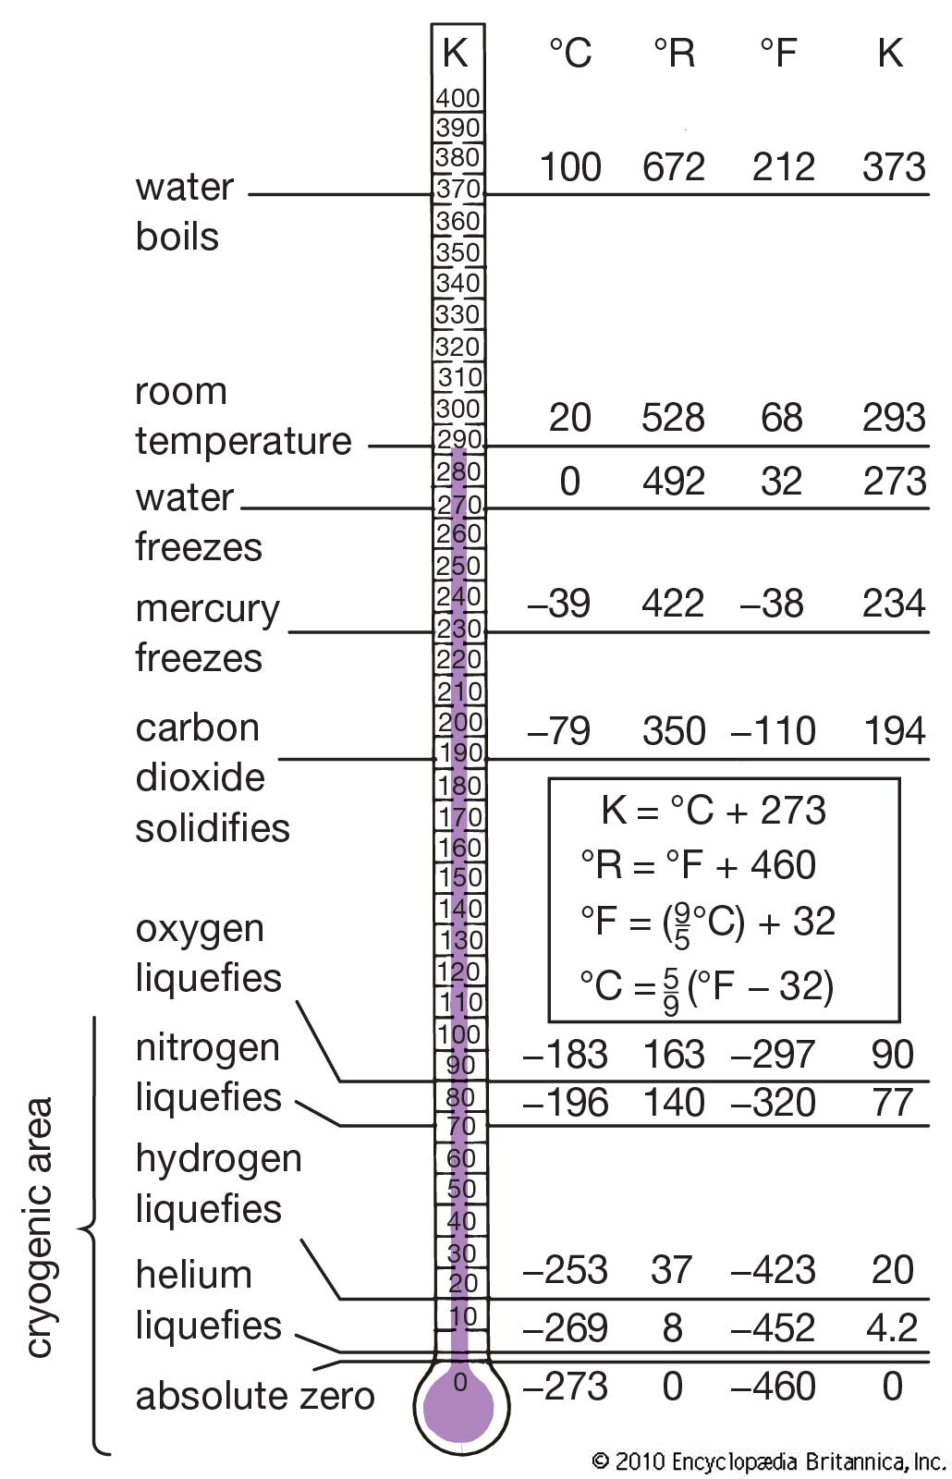
The cryogenic temperature range
In physics, cryogenics is the production and behaviour of materials at very low temperatures.
The cryogenic temperature range has been defined as from −150 °C (−238 °F) to absolute zero (−273 °C or −460 °F), the temperature at which molecular motion comes as close as theoretically possible to ceasing completely. Cryogenic temperatures are usually described in the absolute or Kelvin scale, in which absolute zero is written as 0 K, without a degree sign. Conversion from the Celsius to the Kelvin scale can be done by adding 273 to the Celsius scale.

Slide 3
Basic Theory of Temperature Measurement
Thermal conductivity
Thermal conductivity integral
Thermodynamic properties for various cryogenic liquids
Thermal contraction of selected materials between 293 K and 4 K
Resistivity of alloys
Saturated vapor pressure of helium
Notes:
低温-测量-注意点

Slide 4
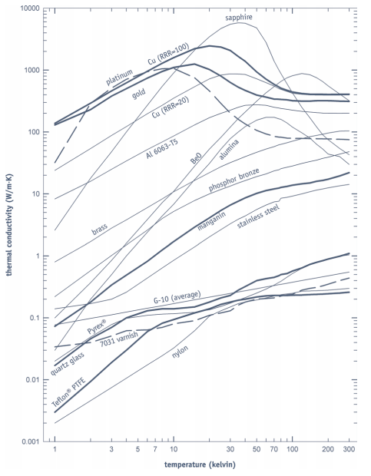
Cryogenic heat flow
K ：the thermal conductivity
A ：the cross-sectional area
∆T ：the temperature difference
L ：the length of the heat conduction path

Slide 5
Heat sinking length for wire sizes
—Wire heat-sinking length required to thermally anchor to a heat sink at temperature T to bring the temperature of the wire to within 1 mK of Tlower
— Values are calculated assuming wires are in a vacuum environment, and the specified thermal conductivity.
Thermal conductivity W/(m • k)
1 K | 0.034
4.2 K | 0.062
77 K | 0.22
100 K | 0.24
300 K | 0.44
Notes:
传感器引线长度参考

Slide 6
Sensor selection

Slide 7
Sensor wiring
4-wire: For accurate sensor measurements, 4-lead connections are by far the superior option when adding a lead extension to both diodes and resistive temperature sensors.
2-wire: This option is useful if the number of electrical connections inside a system must be kept to a minimum. However, 2-lead connections add measureable resistance to sensor measurements. This additional resistance will cause a significant (but repeatable) shift on all sensors except diodes.
To avoid uncertainties associated with lead resistance
Notes:
传感器接法

Slide 8
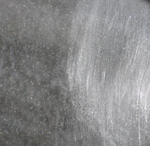
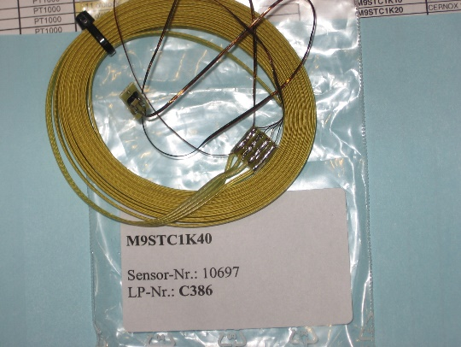
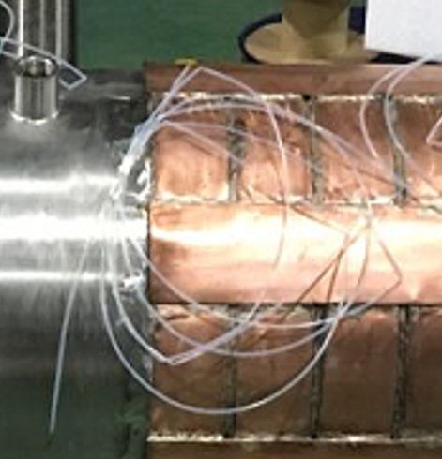
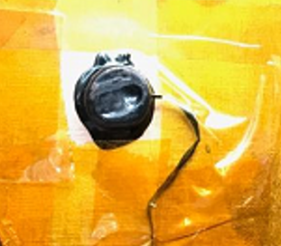
Procedure for Mounting The Sensor
Confirm the Serial number
Assemble location
Verify the room temperature resistance
Sand the sensor mount area/sensor PCB/Interface PCB
Clean the area
Stycast epoxy/Grease
Fixed
attach the wires to the surface
Record the temperature of the room

Slide 9
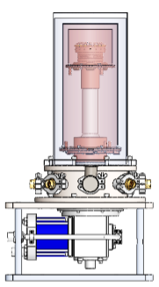
Introduction of test stand
cryostat
Control system
Computer
Lakeshore 336
High pressure intake pipe
Low pressure return pipe
signal line
Temperature
acquisition
instrument
Compressor
GM refrigerator
Vacuum pump
The number of thermometers
can be installed : 16+

Slide 10
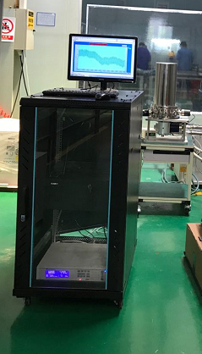
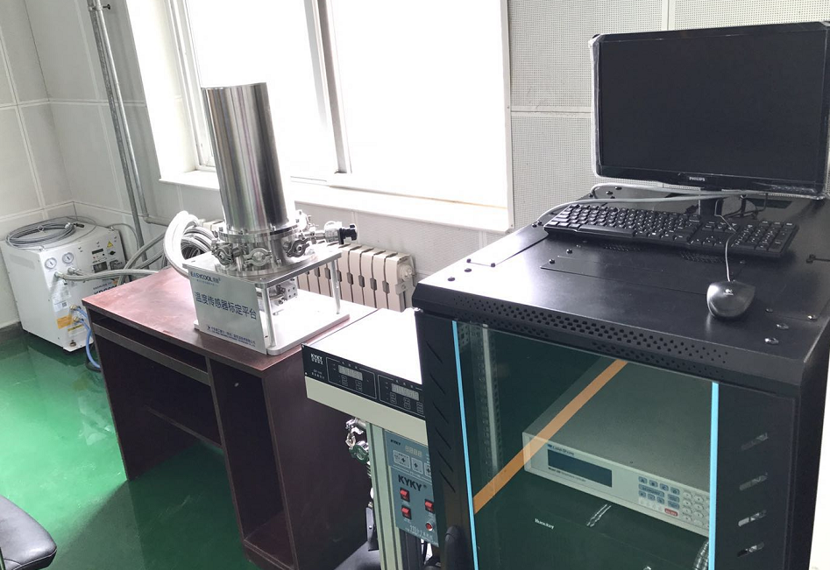
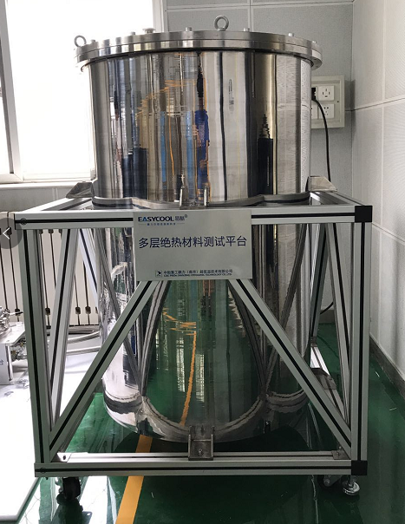
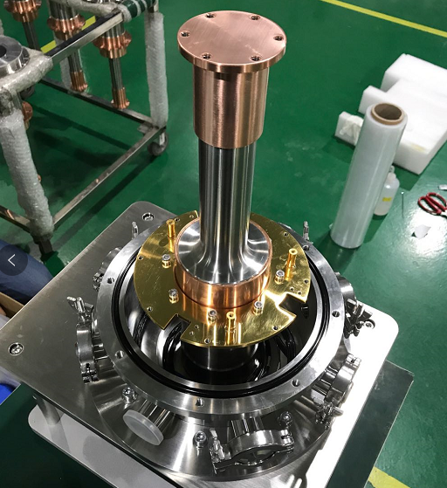
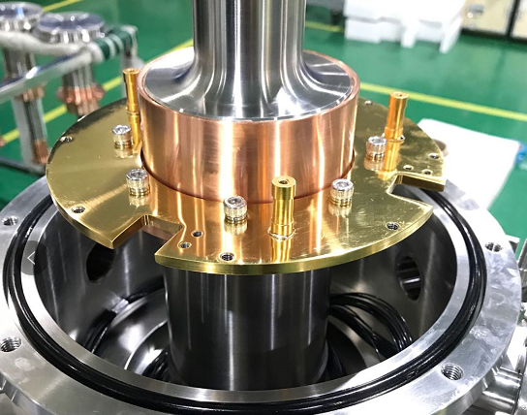
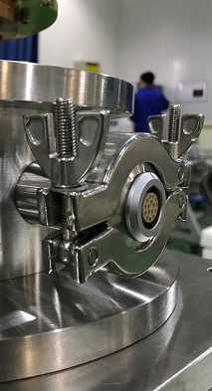
The test stand

Slide 11
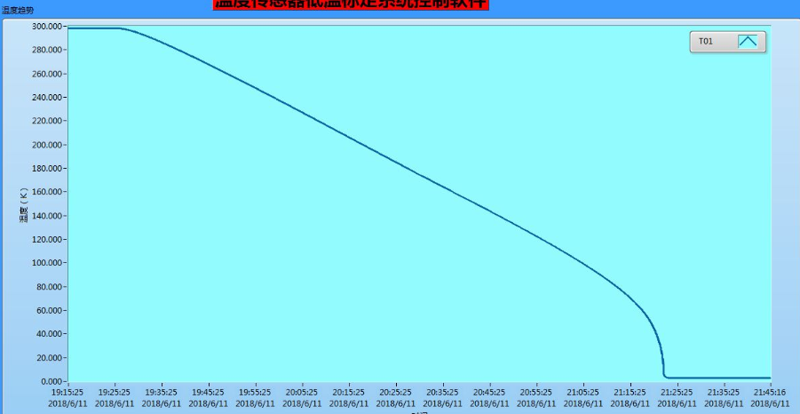
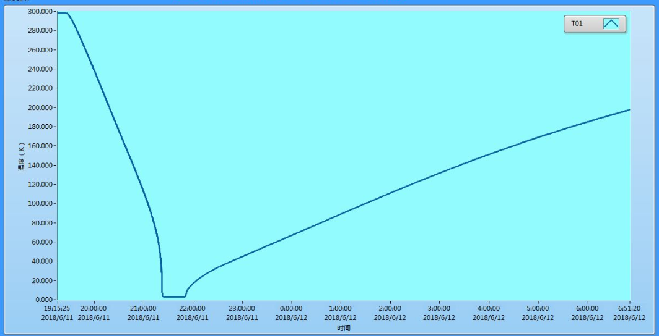
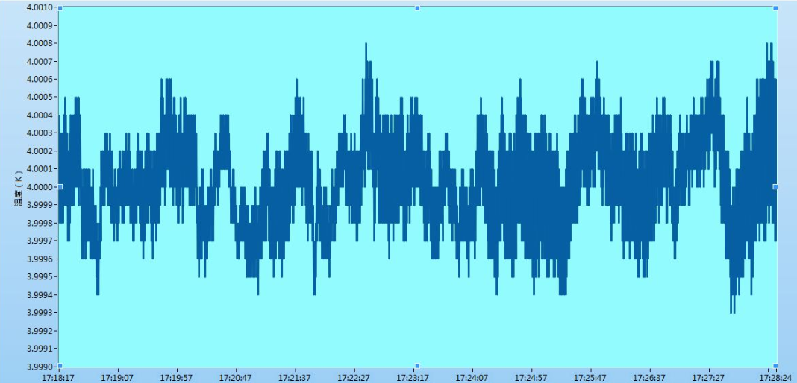
The Interface of test stand
rewarming speed 22K/h
300K->2.72K : 2Hours
the accuracy of measurement 3.9993-4.0008
Lakeshore CU 5mk

Slide 12
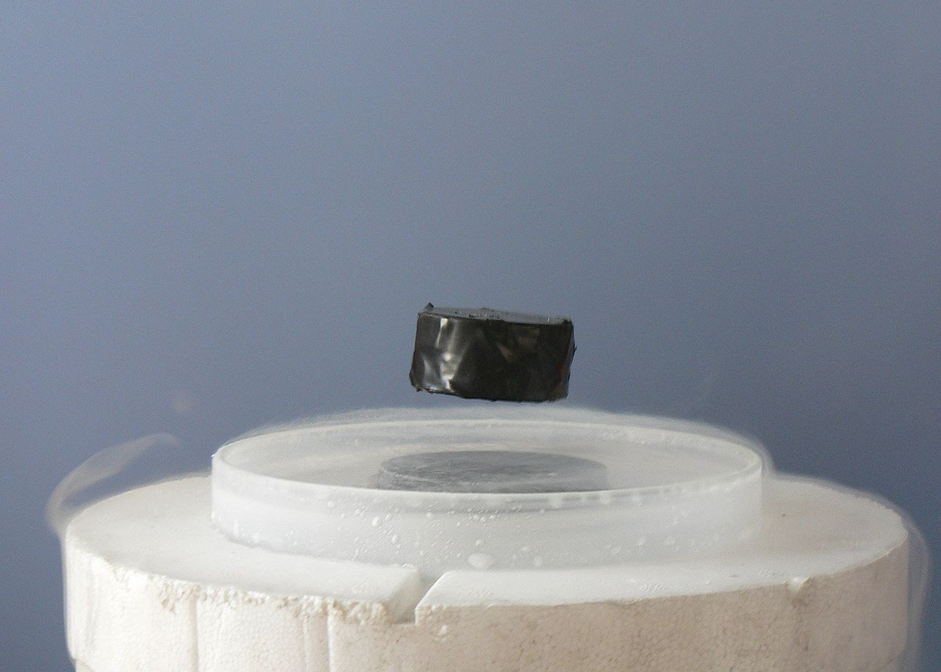
Superconductivity
A magnet levitating above a high-temperature superconductor, cooled with liquid nitrogen. Persistent electric current flows on the surface of the superconductor, acting to exclude the magnetic field of the magnet (Faraday's law of induction). This current effectively forms an electromagnet that repels the magnet.

Slide 13
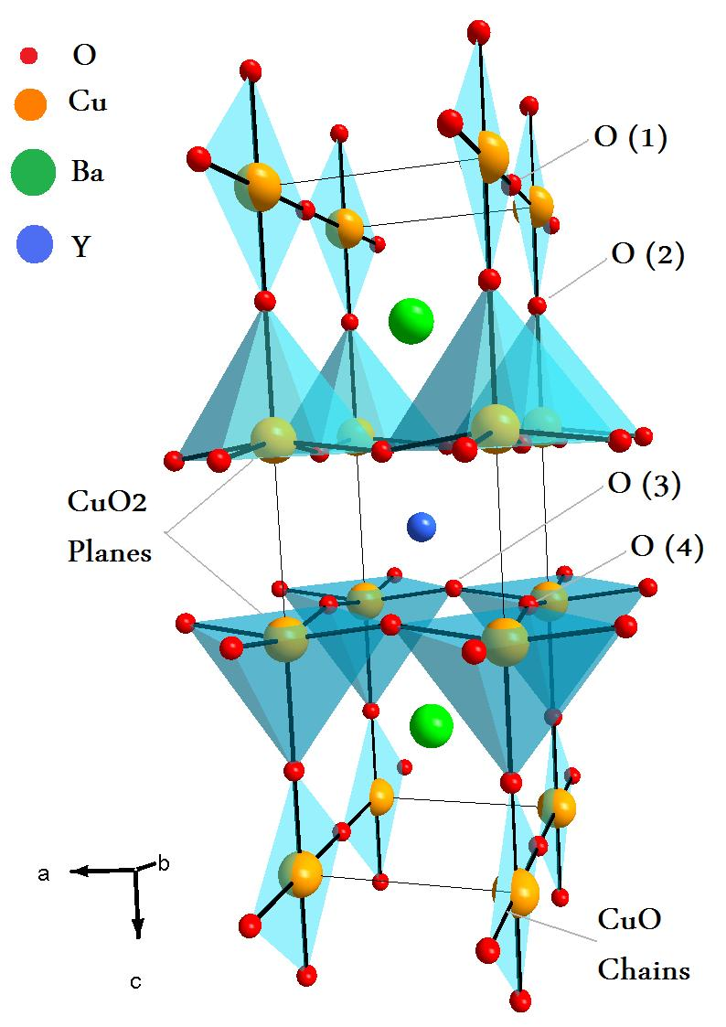
Critical temperature (T_{c}), crystal structure and lattice constants of some high-T_{c} superconductors
The first superconductor found with Tc > 77 K (liquid nitrogen boiling point) is yttrium barium copper oxide (YBa2Cu3O7−x); the proportions of the three different metals in the YBa2Cu3O7 superconductor are in the mole ratio of 1 to 2 to 3 for yttrium to barium to copper, respectively. Thus, this particular superconductor is often referred to as the 123 superconductor

Slide 14
Liquid oxygen
Liquefy oxygen in the atmosphere.
Watch paramagnetism.
Check the color
Composition of dry air

Slide 15
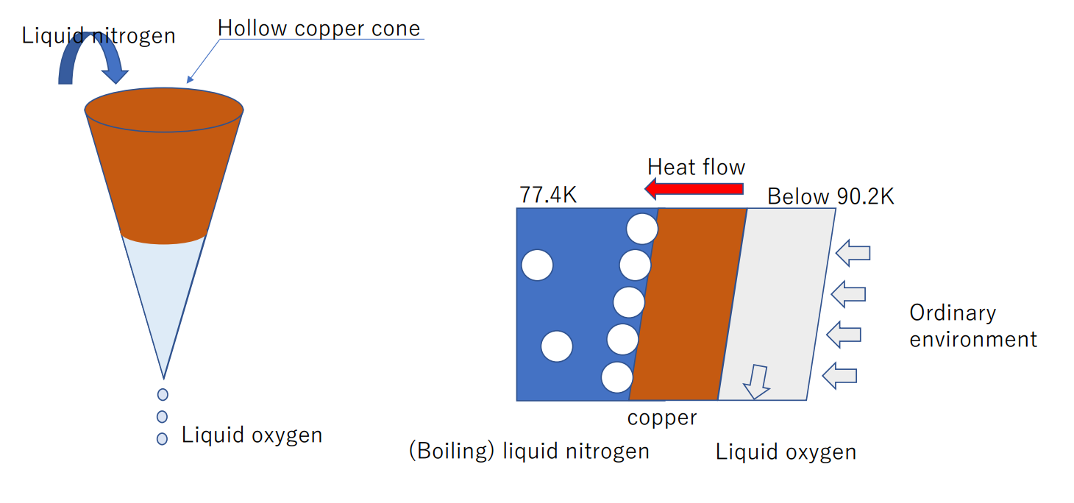
Liquid oxygen

Slide 16
15:00-18:00

Slide 17
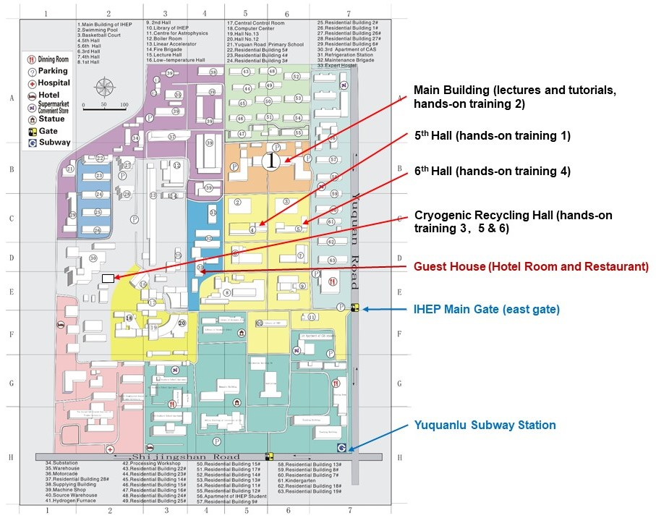

Slide 18
