Slide 1
Hands-on Training (SC Cavity)
Peng SHA (shapeng@ihep.ac.cn),
Chao DONG, Lingxi YE

Slide 2
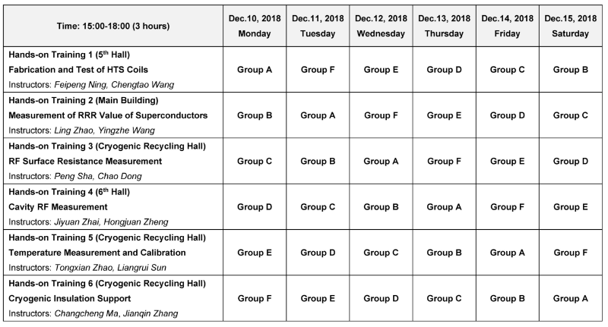
School Time Table

Slide 3
Course Outline
Science Background : Surface resistance
RF Surface Resistance Measurement
Q Measurement of Nb Cavity Loaded with Dielectric
(1) Basic Physics Formulas
(2) Apparatus and Setup
(3) Procedures and Data Analysis

Slide 4
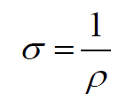
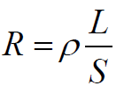
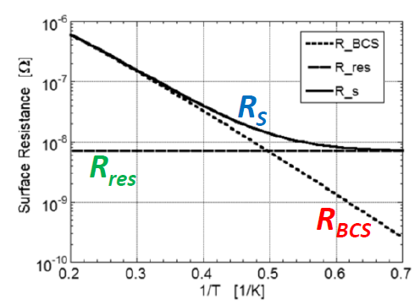
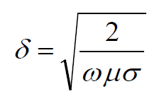
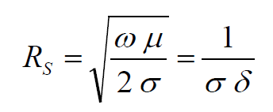
Surface resistance——Rs
Comparison of Rs between NC and SC cavity
NC Cavity | SC Cavity
1. Conductivity/Resistivity 2. DC resistance 3. Skin depth 4. RF surface resistance | RF surface resistance temperature-dependent term : BCS resistance temperature-independent term : Residual resistance
kB : Boltzmann constant
Δ : Gap energy of Cooper pair

Slide 5
Surface resistance——Rs
An example of Rs and Q0 of NC and SC cavity
NC Cavity | SC Cavity
Freq. = 1.3 GHz G = 270 Ω Cu (20⁰C) ：σ = 0.58e+8 [1/Ωm] Rs = 9.4 mΩ (δ = 1.8 um) Q0 = G/Rs = 2.9e+4 | Freq. = 1.3 GHz G = 270 Ω Rs = 17 nΩ (δ = 44 nm) Q0 = G/Rs = 1.6e+10
Rs(Cu)/Rs(Nb) = 5.5e+5 Q0(Nb)/Q0(Cu) = 5.5e+5

Slide 6
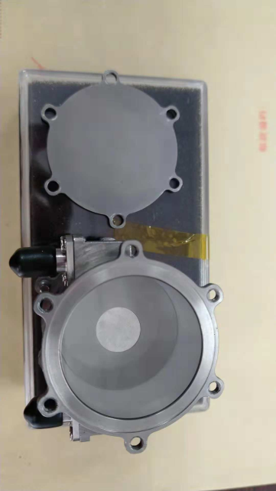
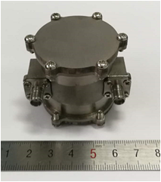
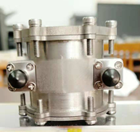
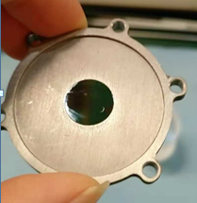
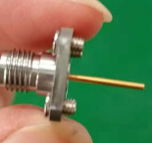
RF Rs of Small Sample Measured by Nb Cavity Loaded with Dielectric Sapphire
Freq：4GHz 和 6.9GHz
Mode：TE₀₁₁ 和 TE₀₂₁
Why choose sapphire?
Loss angle tangent is very small at low temperature,
~10^-8 or ~10^-9 at 4K.
Input
antenna
Transmitted antenna
upper cover plate
Filled with sapphire
Phi12mm sample:
In the middle of
lower cover plate
Niobium cavity
Fixed input antenna

Slide 7
Principle of RF Rs measurement
$\frac{1}{Q_{0TE0i1}}={tanδ}_{i}+a_{i}∗{Rs}_{nbi}+b_{i}∗{Rs}_{samplei}$
i=1, working mode is TE₀₁₁ (~4GHZ); i=2, working mode is TE₀₂₁ (~6.9GHz);
(2) $Q_{0TE0i1}$ is the unloaded Q of the whole cavity for different modes;
(3) $a_{i}$、$b_{i}$ are integral value of electromagnetic field of this cavity;
(4) ${tanδ}_{i}$is the loss angle tangent of Sapphire ($tanδ∝$ f);
(5) ${Rs}_{nbi}$is the surface resistance of Nb cavity (Rs $∝$ f ² );
(6) ${Rs}_{samplei}$ is the surface resistance of sample.
Specific experimental steps:
Using Nb sample (same material as cavity, here, ${Rs}_{nbi}$= ${Rs}_{samplei}$ ) to get
S parameters and QL at two modes.
Calculating $Q_{0TE0i1}$ using S parameter and QL.
Then we can get the value of ${tanδ}_{i}$ and ${Rs}_{samplei}$. From now, ${tanδ}_{i}$ and
${Rs}_{nbi}$ can be seen as constants.
After that, if we want to measure other materials, we can just use one stable mode
TE011 . But we can’t get this yet, because sapphire used is not good enough!

Slide 8
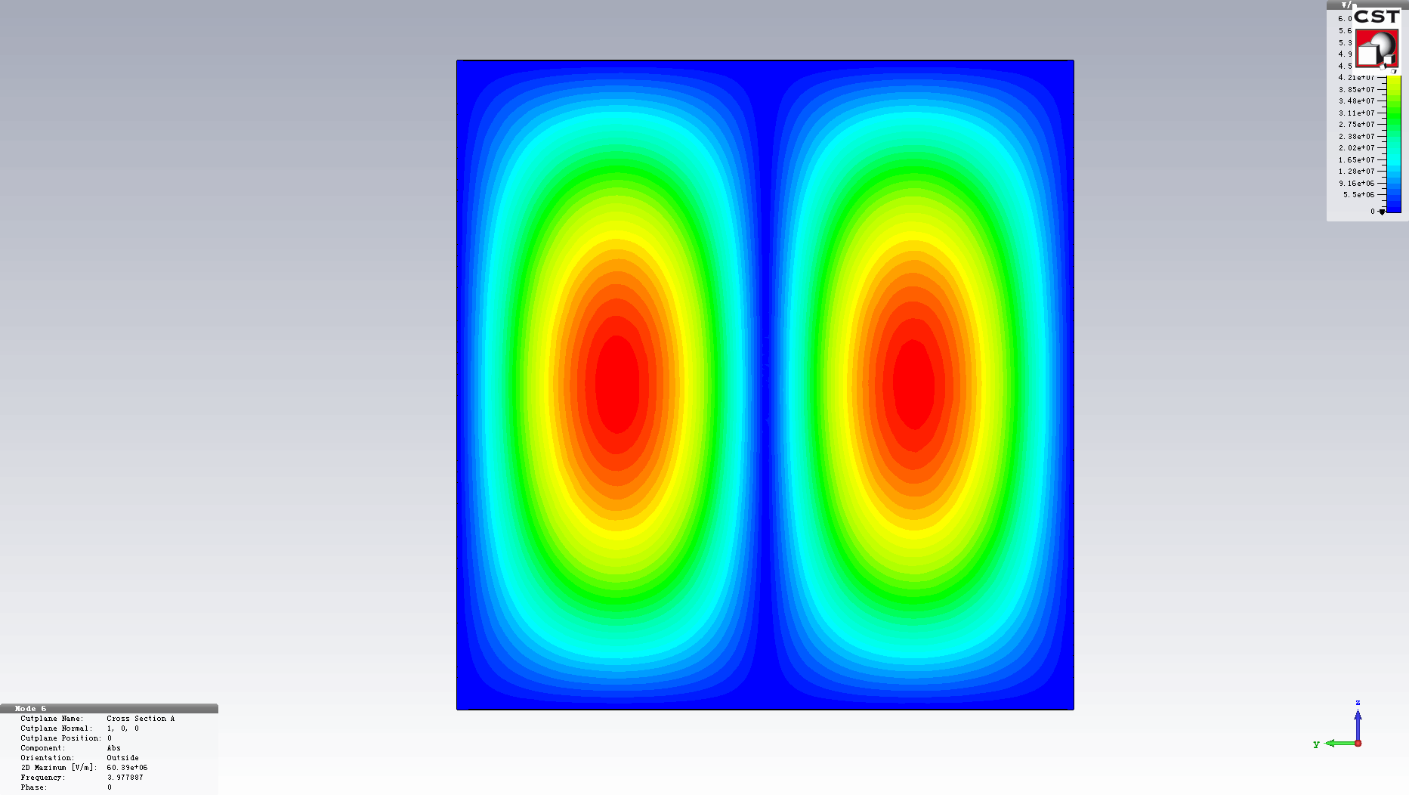
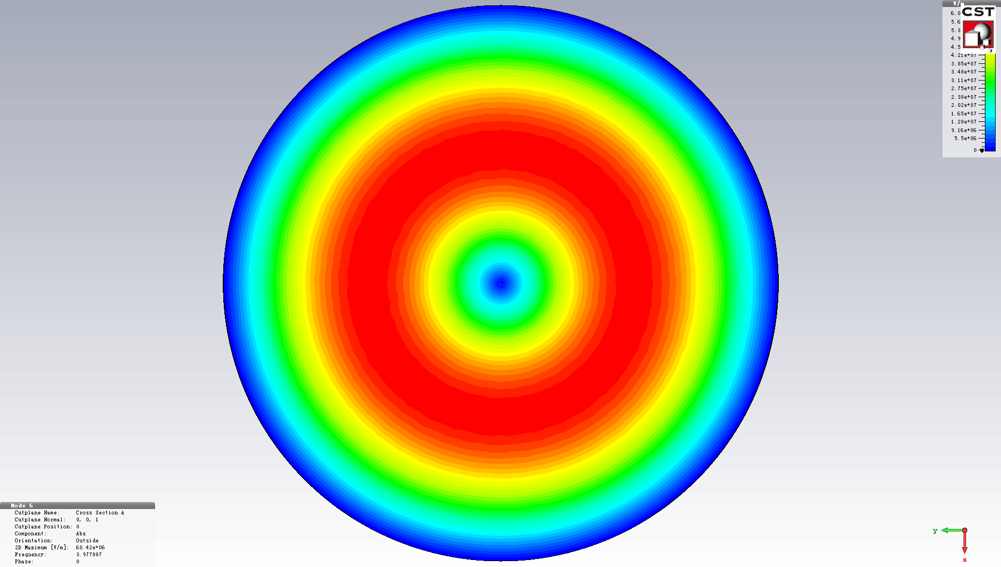
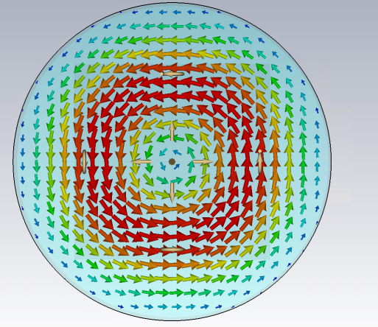
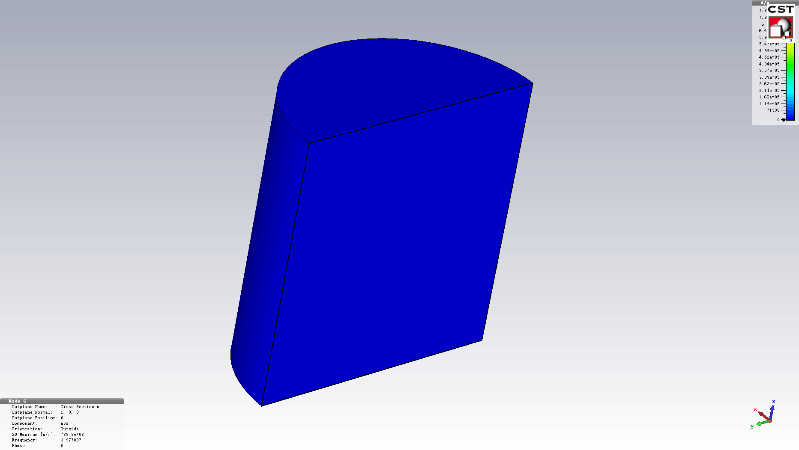
Electromagnetic field simulation of TE011 4GHz
Electric Field
Magnetic Field

Slide 9
Q Measurement of Nb Cavity Loaded with Dielectric

Slide 10
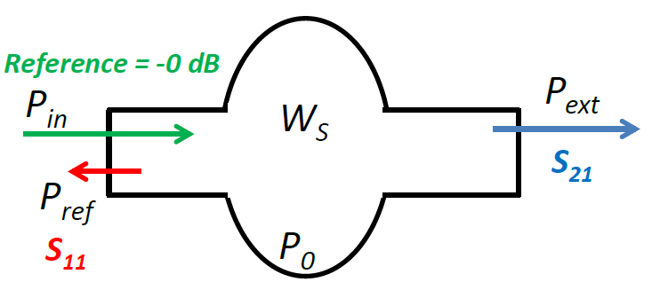
Basic Physics Formulas
$$P_{r}= {10}^{\frac{S_{11}}{10}}∗P_{in} [W]$$
$$P_{e}= {10}^{\frac{S_{21}}{10}}∗P_{in} [W]$$
(1) Coupling constant
(over/under coupling)：
$β^{∗}= \frac{1 ± \sqrt{{P_{r}}/{P_{in}}}}{1 ∓\sqrt{{P_{r}}/{P_{in}}}}$
(2) Input coupling:
$β_{in }= β^{∗}∗(1+ β_{e})$
(3) Monitor coupling:
$β_{e}=$ ${P_{e}}/{P_{0}}$
(4) Unloaded Q of cavity:
$Q_{0}= Q_{L} ∗(1+β_{in }+β_{e})$
(5) External Q:
$Q_{e}=Q_{0}P_{0}/P_{e}$
Cavity stored energy :
$$W_{s}= \frac{μ_{0}}{2}\int_{0}^{V}{{\vec{H}}^{2}dV=\frac{ξ_{0}}{2}\int_{0}^{V}{{\vec{E}}^{2}dV }}$$
Cavity RF loss : $P_{0}= P_{in }−P_{r }−P_{e }$
Loaded Q: $\frac{1}{Q_{L}}= \frac{1}{Q_{0}}+\frac{1}{Q_{in}}+\frac{1}{Q_{e}}$
(QL is measured by bandwidth of -3dB. )

Slide 11
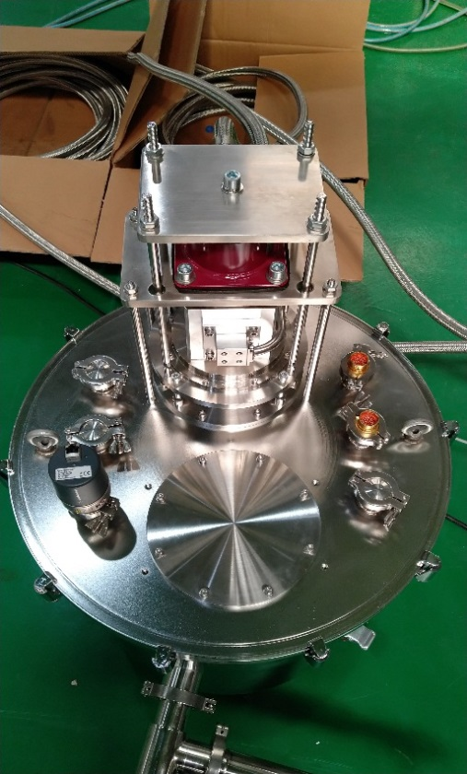
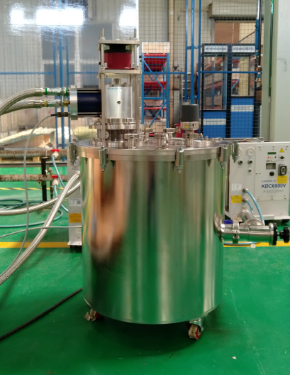
Apparatus and Setup
Connecting thermometer
Connecting
Heater
4.2k, 1.5W
Network Analyzer
Cable
A cryogenic experimental platform
from 300K to ~3.2K.

Slide 12
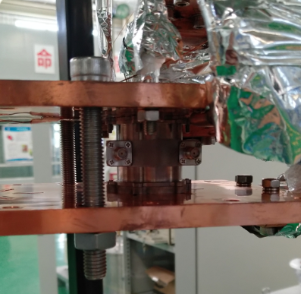
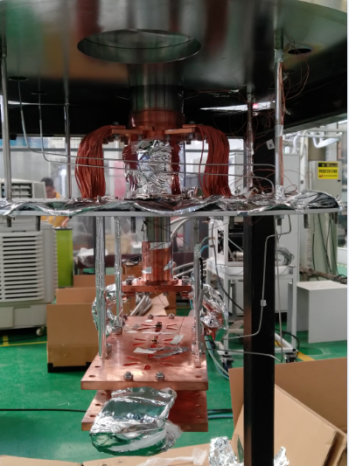
Apparatus and Setup
2-level
cold head
cold dust
Hoisting cold head and top flange,
install cavity on cold dust

Slide 13
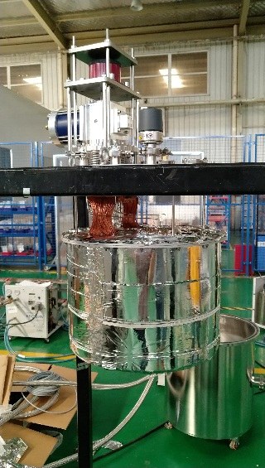
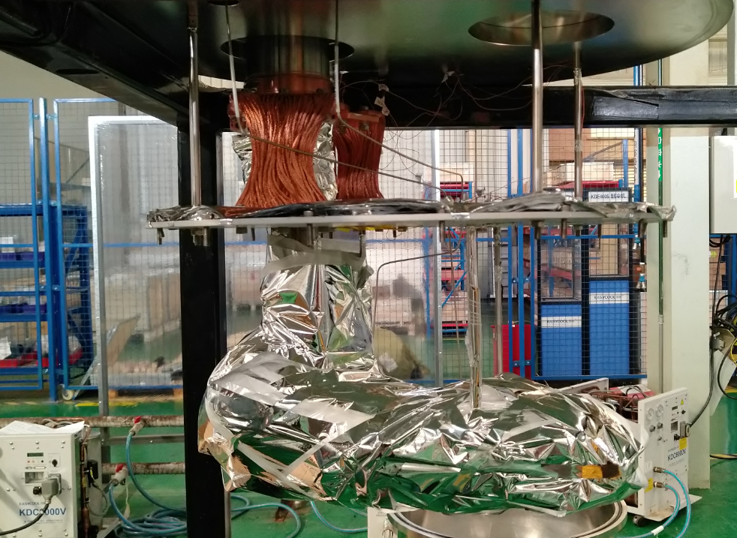
Apparatus and Setup
Packing well with Heat insulation material

Slide 14
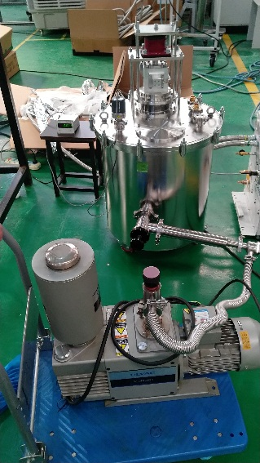
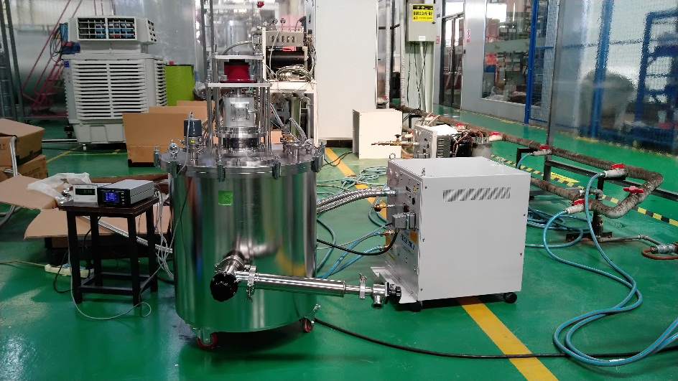
Apparatus and Setup
Start vacuum pumping. Turn on compressor when vacuum is about 10Pa.

Slide 15
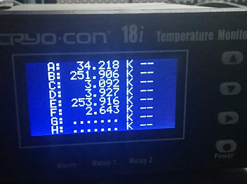
Apparatus and Setup
5 temperature sensor:
A: level1 cold head
B: Spare
C: Sample cavity
D: heat sink
E: Spare
F: level2 cold head

Slide 16
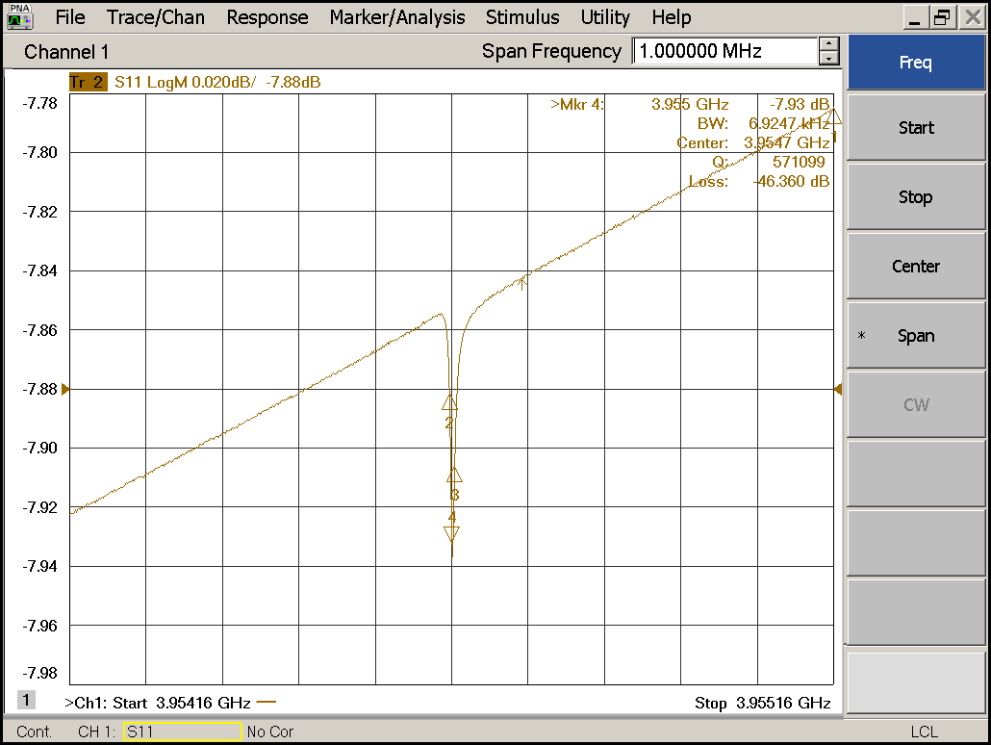
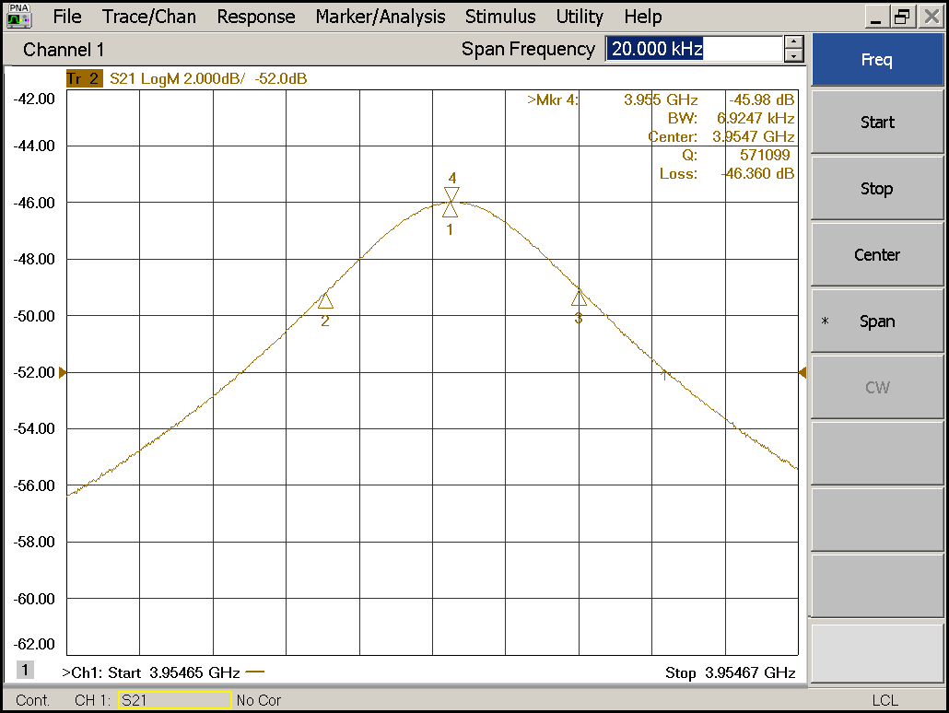
Procedures and Data Analysis (10K)
Frequency : 4GHz (TE011)
First, getting the value of S11、S21 and QL at different temperatures.
S11 = ? S21 = ? QL = ? Temp of cavity = ?

Slide 17
Procedures and Data Analysis (10K)
Second, please calculate the following parameters using the formula in Slide 10.
(1) Coupling constant
(over/under coupling)：
$β^{∗}=$
(2) Input coupling:
$β_{in }=$
(3) Monitor coupling:
$β_{e}=$
(4) Unloaded Q of cavity:
$Q_{0}=$
(5) External Q:
$Q_{e}=$

Slide 18
Procedures and Data Analysis (3.5K)
Frequency : 4GHz (TE011)
First, getting the value of S11、S21 and QL at different temperatures.
S11 = ? S21 = ? QL = ? Temp of cavity = ?

Slide 19
Procedures and Data Analysis (3.5K)
Second, please calculate the following parameters using the formula in Slide 10.
(1) Coupling constant
(over/under coupling)：
$β^{∗}=$
(2) Input coupling:
$β_{in }=$
(3) Monitor coupling:
$β_{e}=$
(4) Unloaded Q of cavity:
$Q_{0}=$
(5) External Q:
$Q_{e}=$

Slide 20
Thanks for your attention!

