Slide 1
Fabrication and Test of HTS Coils
Ning Feipeng, Wang Chengtao
Liu Xuyang, Xie Zongtai
IHEP,CAS, China
2018-12

Slide 2
Outline
1. Introduction of HTS
2. Fabrication of HTS coils
3. Ic test of HTS short sample and coils

Slide 3
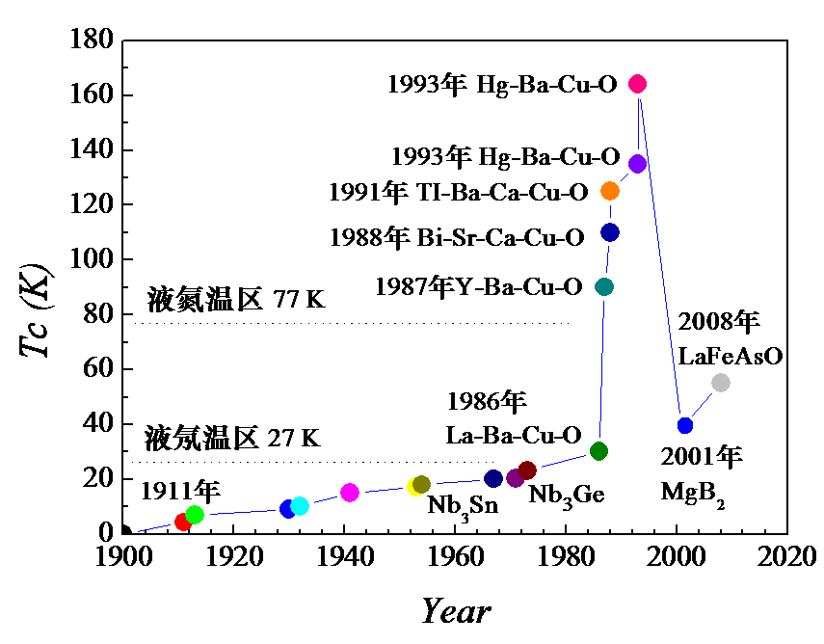
1. Introduction of HTS
HTS (High Temperature Superconducting)
Usually refers to the superconductors with critical temperature greater than 77 K (liquid Nitrogen temperature) .
Since 1987, very short history.
Three products: Bi-2223,Bi-2212,YBCO(Yttrium barium copper oxide)
Liquid Nitrogen
Liquid Neon

Slide 4
Introduction of HTS
2G HTS:
YBCO:
Yttrium Barium Copper Oxide, YBa₂Cu₃O₇ , Tc=90 K, Tape
produced by coating method (CCC - coated conductor composite): using chemical deposition or physical coating methods coating a layer of YBCO superconducting film on the hastelloy substrate.
Hastelloy
Substrate
Al₂O₃
Y₂O₃
MgO
Seed Layer
CeO₂
Cap Layer
(Y,Gd)BCO
Superconducting Layer
Ag
Overlayer
Amorphous Layer
Architecture of YBCO superconductor from SSTC

Slide 5
1. Introduction of HTS

Slide 6
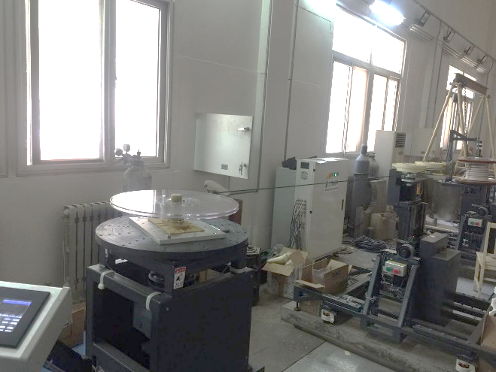
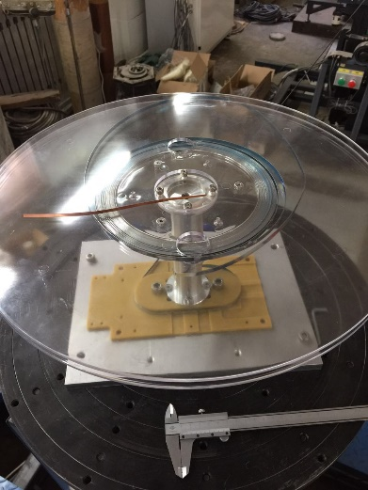
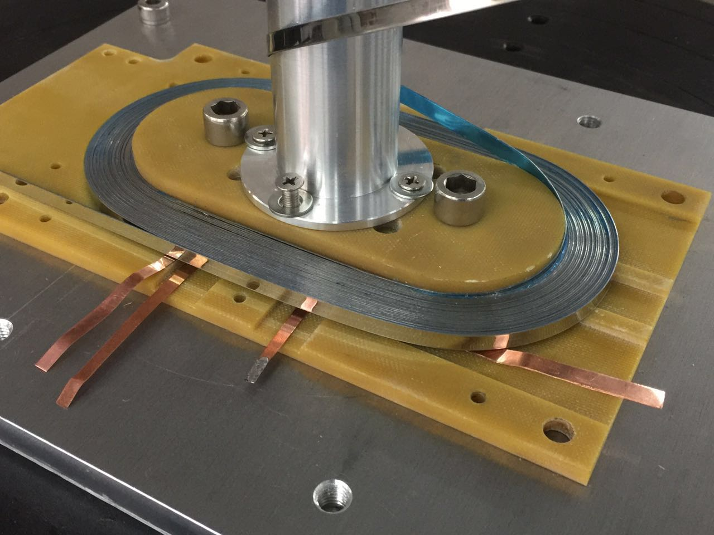
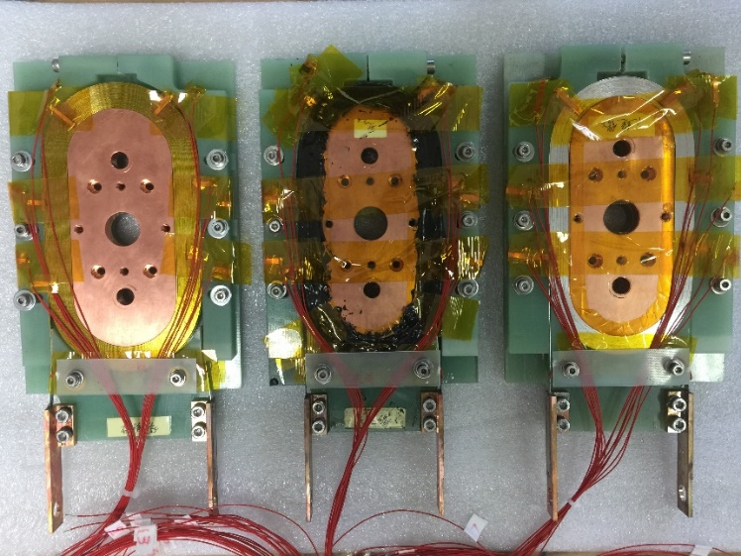
2. Fabrication of HTS coils
Race track double-pancake YBCO coil fabrication.
Winding machine
Stainless steel instead of YBCO

Slide 7
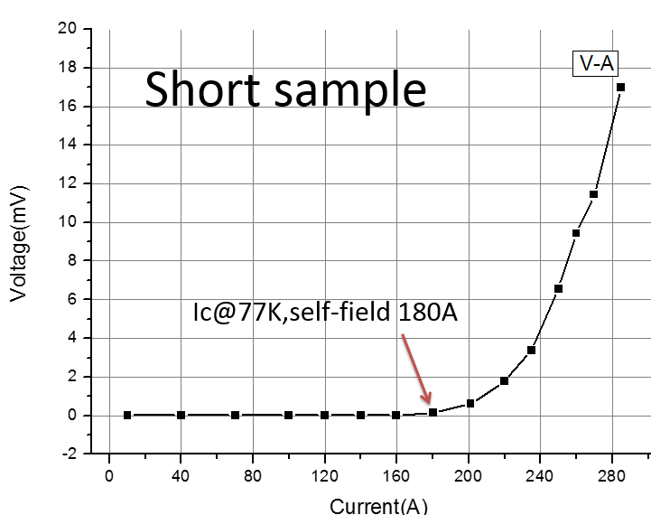
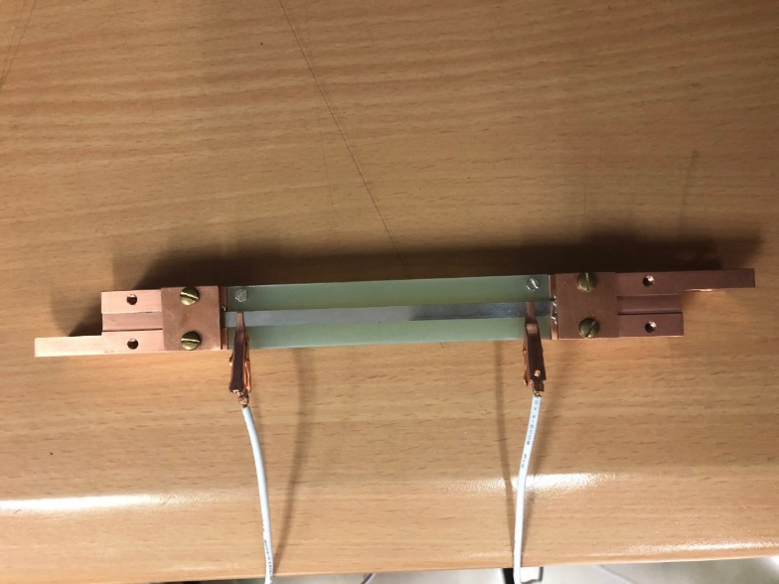
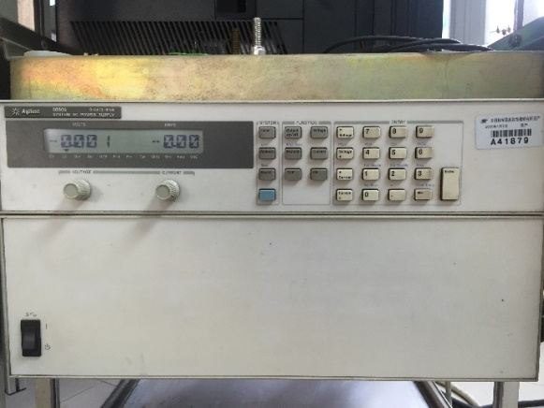
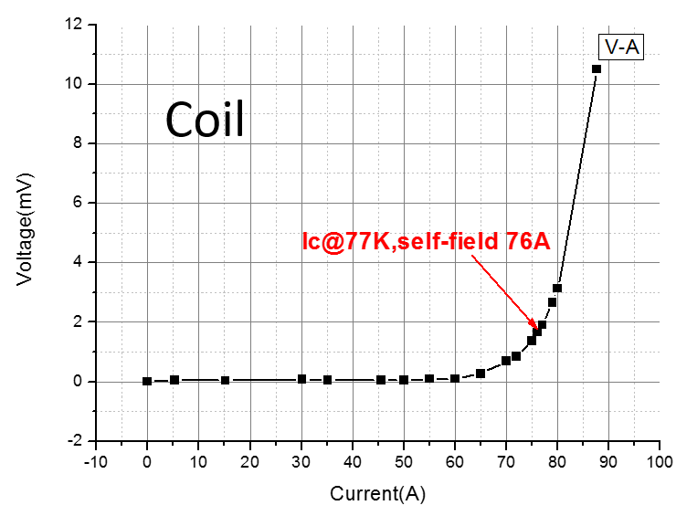
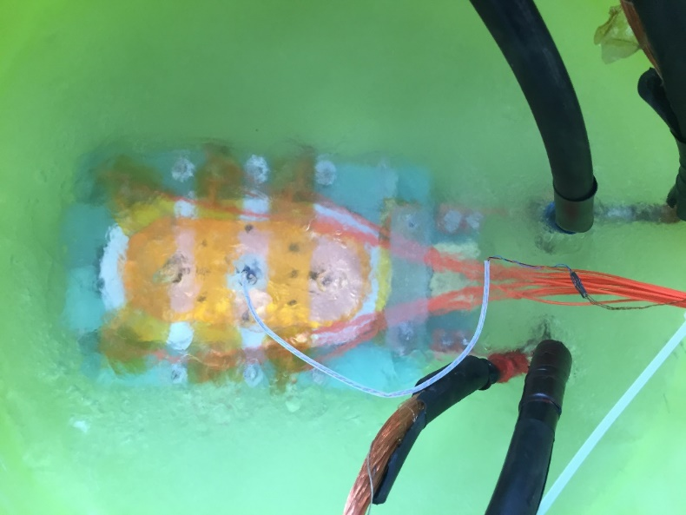
3. Ic test of HTS short sample and coils
U-I table and curve
U (mV) | I (A) | Field(Gs)

Slide 8
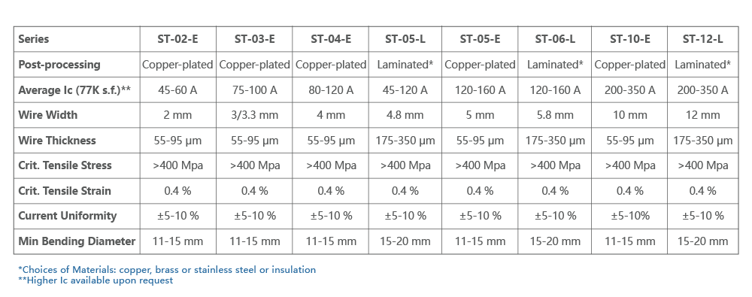
Questions 1
Four YBCO tapes, for example, ST-04-E and ST-05-L,
55 μm
175 μm
ST-04-E
ST-05-L
What is the critical tensile force of each tape?
95 μm
350 μm

Slide 9
Question 2
n value is an important parameter of superconducting materials. What is the n value of the your tested YBCO short sample and coil?
$$\frac{V}{E_{C}L}={(\frac{I}{I_{C}})}^{n}$$
Ec is the quench criteria 1 μV/cm, L is the length of the tape, Ic is the critical current.
The length of the coil is 23.4 m. Give your own understanding of n.

Slide 10
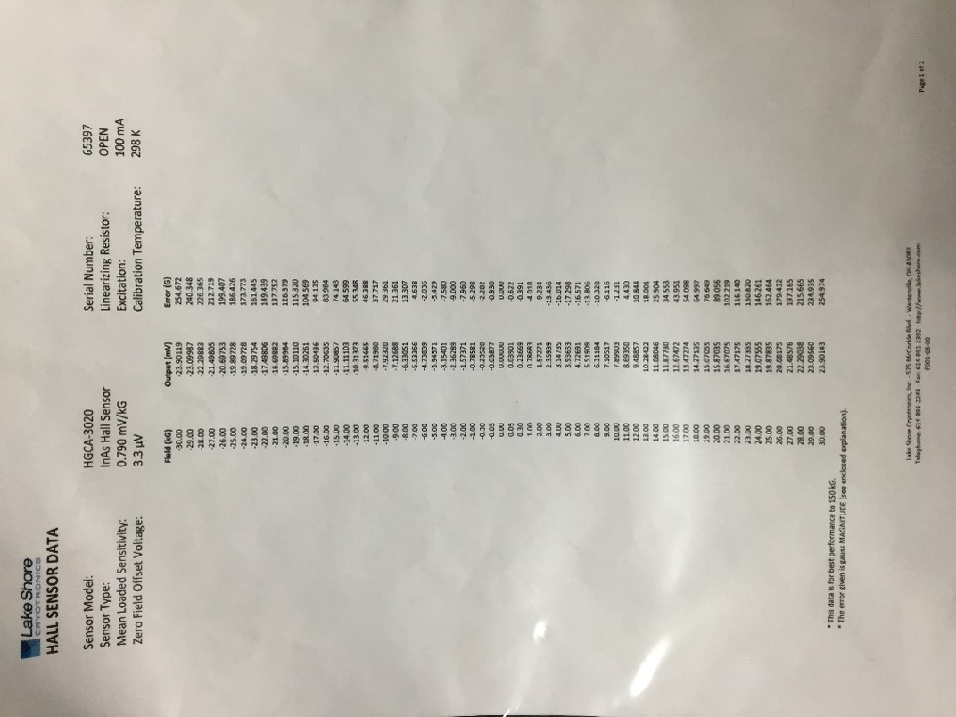
The hall sensor data

