Slide 1
Introduction
Zhijun Liang
IHEP,CAS

Slide 2
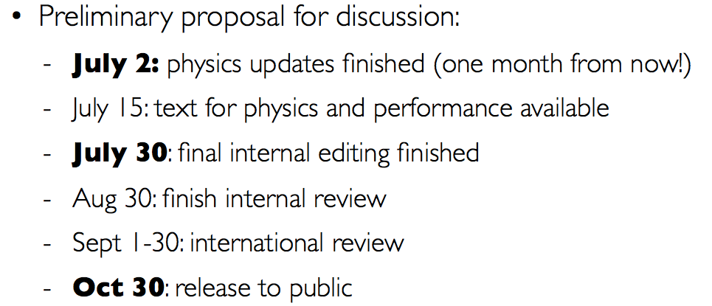
CEPC CDR time scale
Timeline Proposal from Joao:
Here is the link to current draft of CEPC CDR in Git :
http://cepcgit.ihep.ac.cn/cepcdoc/CDR

Slide 3
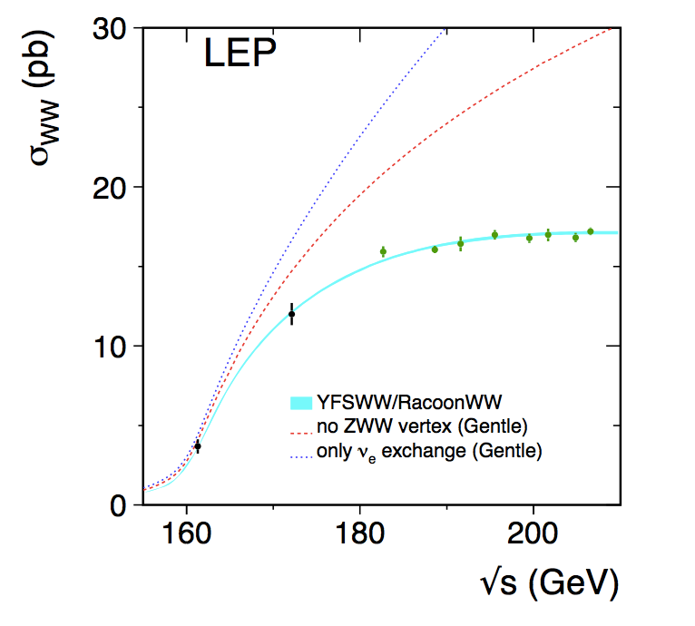
WW threshold scan proposal
Accelerator team is asking for data taking proposal for WW threshold scan runs for CDR writing.
Draft proposal Based on Peixun and Gang study：
1 year Data taking in WW threshold (2.5 ab⁻¹)
Four energy scan points:
157.5, 161.5, 162.5( W mass, W width measurements)
172.0 GeV (⍺_{QCD} measurement, Br (W->had) , CKM |V_{cs}|)
16M WW events in total （40k WW events in LEP2)
400 times larger than LEP2 comparing WW runs
E_{cm} (GeV) | Lumiosity(ab⁻¹) | Cross section (pb) | Number of WW pairs (M)
157.5 | 0.5 | 1.6 | 0.8
161.5 | 0.2 | 5.1 | 1.0
162.5 | 1.3 | 6.6 | 8.6
172.0 | 0.5 | 12.4 | 6.2

Slide 4
Expected precision in WW scan
Statistics is enough for Branching ratio measurement Br (W->had) and ⍺_{QCD} (mW) measurements.
Statistics uncertainty is one of the limiting factor for W mass and W width measurement in CEPC one year running plan (2.5 fb⁻¹)
Energy (GeV) | Systematics | Statistics uncertainty | limiting factor
W mass | 1MeV Beam energy | 1.3 MeV | Statistics
W width | 1 MeV | 3.6 MeV | Statistics
Br (W->had) & ⍺_{QCD} (mW) | 10⁻⁴ | 10⁻⁴ | /
Estimation based of ⍺_{QCD} (mW) based on
Physics Letters B 763 (2016) 465–471

