Slide 1
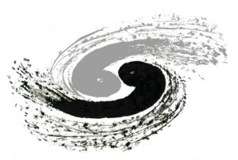
Digitization & Tuning update
R. Farinelli – L. Lavezzi – NN. Miao – LL. Wang – LH. Wu
2018-06-14

Slide 2
Status in March (reminder)
FULLY IMPLEMENTED
in standalone code (based on planar GEM)
Shockley–Ramo theorem
instantaneous current induced by a charge in motion on an electrode
i(t) = q_{e-} x v_{drift} x W_{loc}
APV25 simulation
RC circuit (τ = 50 ns) + charge threshold
Parameters we can tune
noise (ADC)
transparency (%)
APV-25 threshold (ADC)
conversion factor
Variables we must monitor
cluster size
cluster charge
CC position resolution
uTPC position resolution
uTPC angle

Slide 3
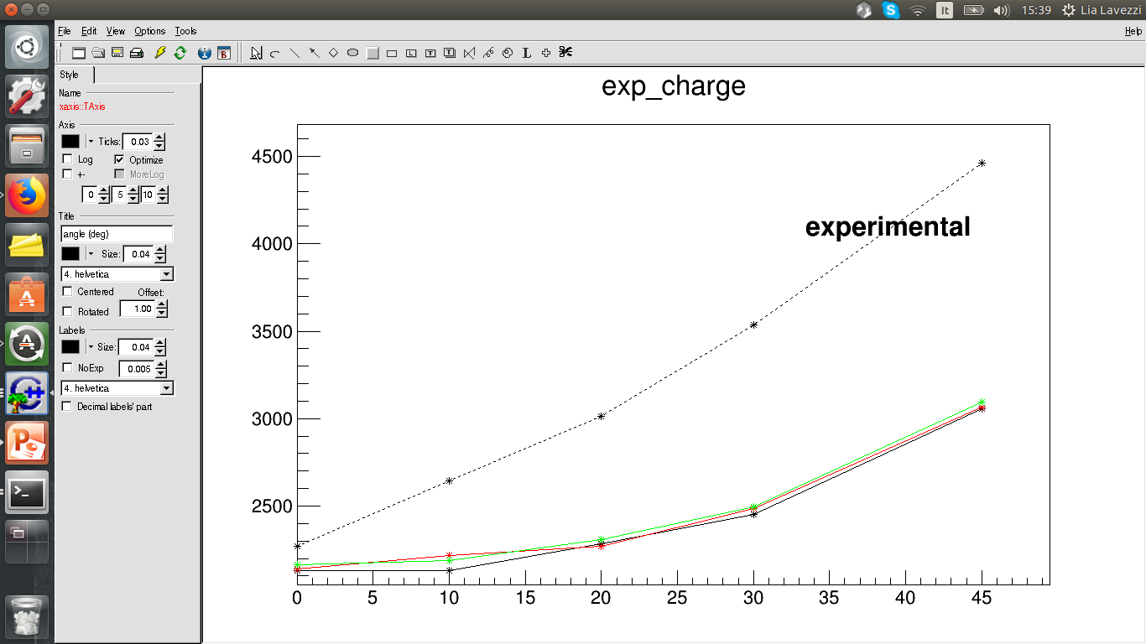
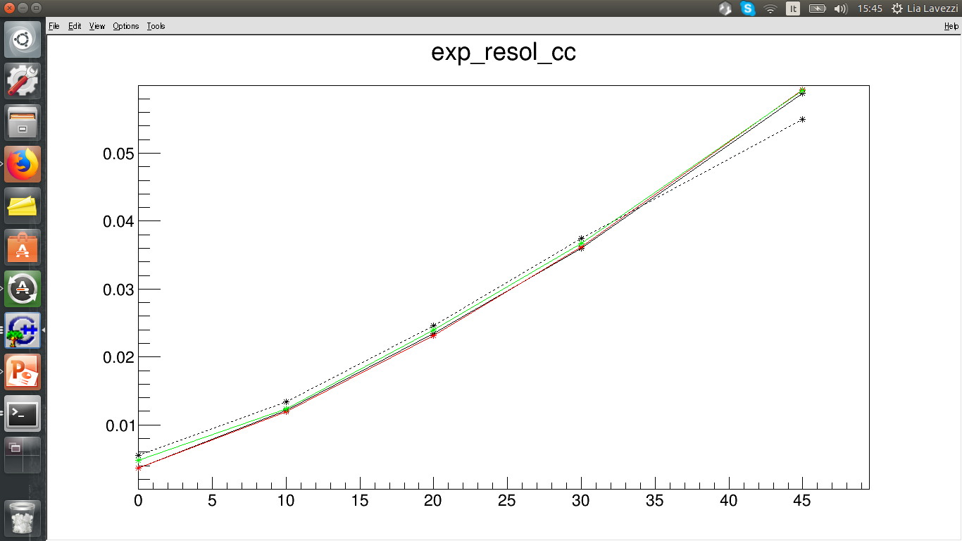
Tuning @ March 1st, 2018 (already “old story”)
Charge (ADC) vs angle (deg)
Angle scan 0, 10, 20, 30, 45 deg
HV = 820 V
Fields = 1.5/3/3/5 kV/cm
Within 30%
With induction
CC resolution vs angle (deg)
Cl.size vs angle (deg)
Noise level = 0, 1, 5 ADC
APV threshold = 45 ADC
Conversion Factor = 30 ADC = 1fCc
Perfect match!

Slide 4
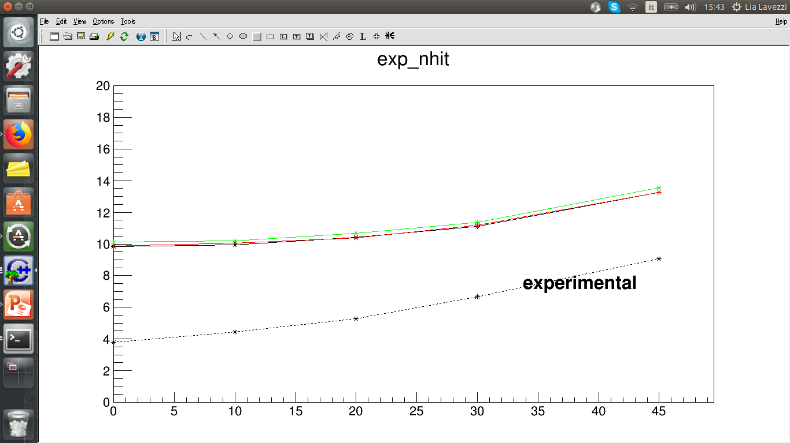
Tuning @ March 1st, 2018 (already “old story”)
Cl.size vs angle (deg)
Twice!! → work on it!
Added
missing clusterization
Fixed
induced current calculation
Old
New

Slide 5
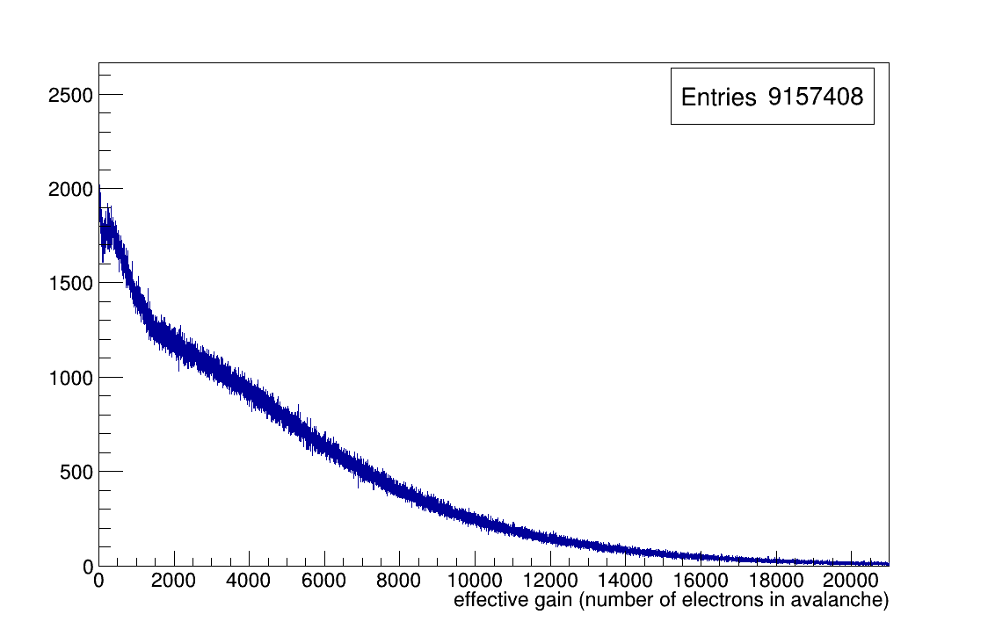
Now, June 2018
Parameters we can tune
noise (ADC)
transparency (%)
APV-25 threshold (ADC)
conversion factor
Conversion factor
remeasured in lab: 30 ADC = 1 fC
Threshold
In testbeams was 45 ADC
No more transparency + gain, but effective gain from histo

Slide 6
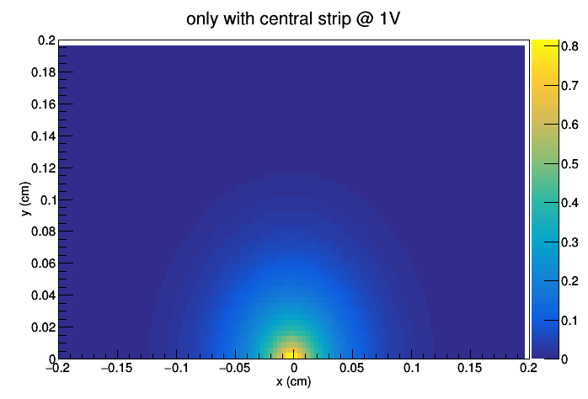
Now, June 2018
Weighting field
GARFIELD computed WF, then not under control.
Let’s compute it with finite elements calculation
1st version: just one strip @ 1V; I actually used the field
I_curr = ele_ch * drift_velocity * Eloc
2nd version: one strip @1V AND the others @0V (Ramo’s theorem); I want to use the potential
Q_induced = ele_ch * ΔV

Slide 7
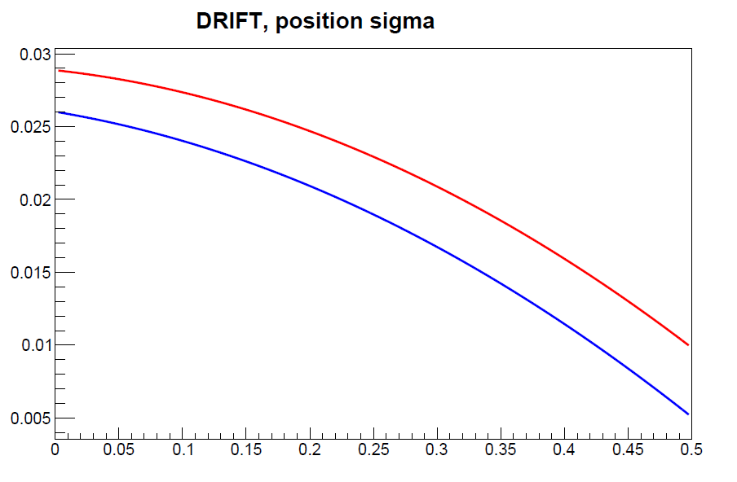
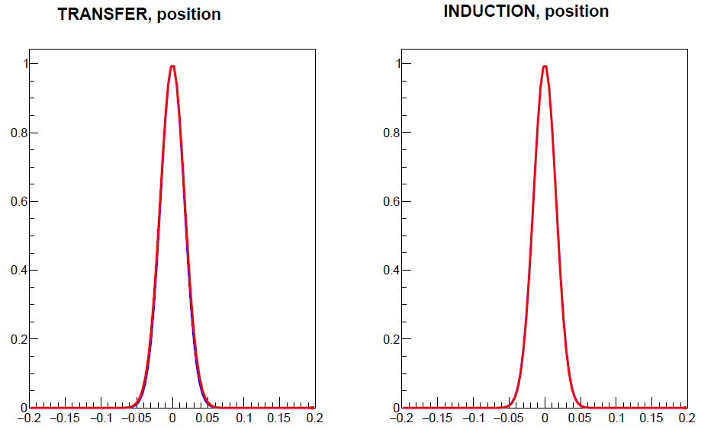
Now, June 2018
After bug fixing of the ANSYS field maps we did new iffusion studies [NO MAG FIELD]
position
sigma(x_{END}- x_{START}) cm)
OLD
NEW
z (cm)
x_{END}- x_{START} (cm)
x_{END}- x_{START} (cm)
less diffusion in drift gap
same in the other gaps

Slide 8
Now, June 2018
After bug fixing of the ANSYS field maps we did new iffusion studies [NO MAG FIELD]
Time
mean (x_{END}- x_{START}) cm)
OLD
NEW
sigma(x_{END}- x_{START}) cm)
z (cm)
x_{END}- x_{START} (cm)
x_{END}- x_{START} (cm)
shift in time smaller in drift gap BUT bigger smearing
shift in transf & induct gaps agrees with v_{D} = 35 μm/ns

Slide 9
Angle scan
simulated
simulated
experimental
experimental
CHARGE
CL. SIZE
RESOL CC
simulated
experimental

Slide 10
HV scan
CL. SIZE
CHARGE
simulated
experimental
Fit with 1 Gaussian
experimental
simulated
RESOL CC
Fit with 2 Gaussians

Slide 11
Now, June 2018
ANGLE SCAN
(MC – EXP)/EXP
±30%

Slide 12
Now, June 2018
HV SCAN
charge
cl.size
(MC – EXP)/EXP
±30%
resol CC

