Slide 1
Beam Instrumentation of CEPC
Yanfeng Sui
On behalf Beam Instrumentation Group
Accelerator Center, IHEP
JUN. 28–30, 2018, IHEP, Beijing, China

Slide 2
Outline
Principle of design
Detailed information of sub-systems
R&D of Beam instrumentation of CEPC
Summary

Slide 3
Principle of CDR
BI system provides precise and sufficient information of the beam
Improves the injection efficiency, optimizes the lattice parameters, monitors the beam behaviors and increase the luminosity
The main design philosophy is listed:
  To satisfy the requirement of long-term stable operation
  Appropriate precision and speed for the parameter measurement with large dynamic range
  Coupling impedance must be as small as possible
  The home-made products should be used as much as possible to reduce budget
  New technology for future machine

Slide 4
Detailed information of sub-systems
 | Item |  | Method | Parameter | Amounts
Storage ring | Beam position monitor | Closed orbit | Button electrode BPM | Measurement area (x × y)：±20mm×±10mm Resolution：<0.002mm Measurement time of COD：< 4 s | 2900
 |  | Bunch by bunch | Button electrode BPM | Measurement area (x × y)：±40mm×±20mm Resolution：0.1mm | 2900
 | Bunch current |  | BCM | Measurement range：10mA / per bunch Relatively precision：1/4095 | 2
 | Average current |  | DCCT | Dynamic measurement range：0.0~1.5A Linearity：0.1 % Zero drift: <0.05mA | 2
 | Beam size |  | Double slit interferometer x ray pin hole | Resolution:0.2 µm | 4
 | Beam length |  | Streak camera Two photon intensify interferometer | Resolution:0.1ps | 2
 | TUNE measurement |  | Frequency sweeping method | Resolution:0.001 | 2
 |  |  | DDD | Resolution:0.001
 | Beam loss monitor |  | PIN-diode | Dynamic range:120 dB Maximum counting rates≥10 MHz | 5800
 | Feedback system |  | TFB | Damping time<=0.5*rise time | 2
 |  |  | LFB | Damping time<=0.5*rise time | 2

Slide 5
Detailed information of sub-systems
 | Item |  | Method | Parameter | Amounts
Booster | Beam position monitor | Closed orbit | Button electrode BPM | Measurement area (x × y)：±20mm×±10mm Resolution：<0.002mm Measurement time of COD：< 4 s | 1808
 |  | Bunch by bunch | Button electrode BPM | Measurement area (x × y)：±40mm×±20mm Resolution：0.1mm | 1808
 | Bunch current |  | BCM | Measurement range：10mA / per bunch Relatively precision：1/4095 | 2
 | Average current |  | DCCT | Dynamic measurement range：0.0~1.5A Linearity：0.1 % Zero drift: <0.05mA | 2
 | Beam size |  | Double slit interferometer x ray pin hole | Resolution:0.2 µm | 2
 | Beam length |  | Streak camera Two photon intensify interferometer | Resolution:0.1ps | 2
 | TUNE measurement |  | Frequency sweeping method | Resolution:0.001 | 2
 |  |  | DDD | Resolution:0.001
 | Beam loss monitor |  | Quartz fiber | Dynamic range:120 dB Maximum counting rates≥10 MHz | 400
 | Feedback system |  | TFB | Damping time<=0.5*rise time | 2

Slide 6
Detailed information of sub-systems
Beam position monitor
Beam current monitor
Beam loss monitor
Beam profile and length measurement
Tune measurement system
Feedback systems
Other

Slide 7
Beam Position monitor
To provide the beam position and orbit
To calculate machine parameters related to beam position
Apart from specific BPMs, there are 4708 BPMs in booster and storage ring
Along the entire tunnel, auxiliary short tunnels can be used as the local station to install electronics of BPMs. Two layer of shielding are adopted, polyethylene and lead.
Button type electrode will be adopted, for its good high frequency response and small beam impedance
The resolution of BPM will be ~2um level

Slide 8
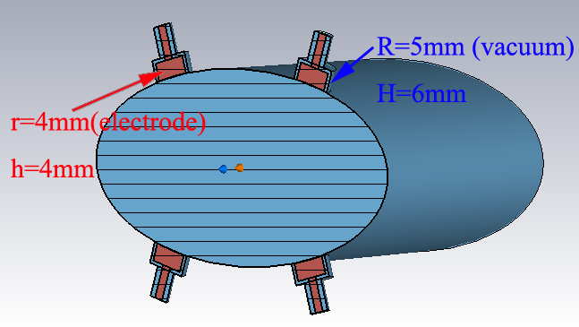
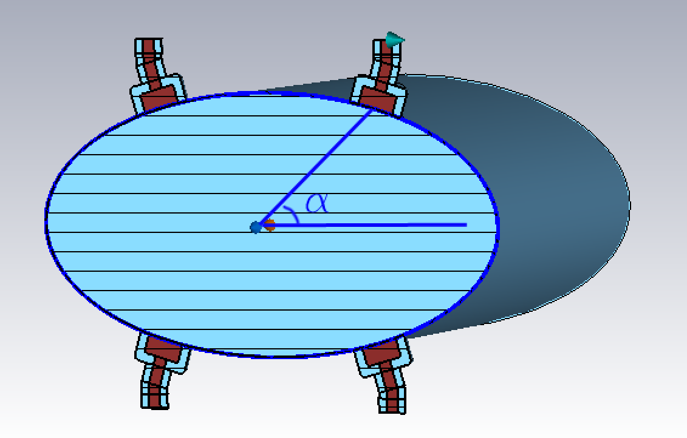
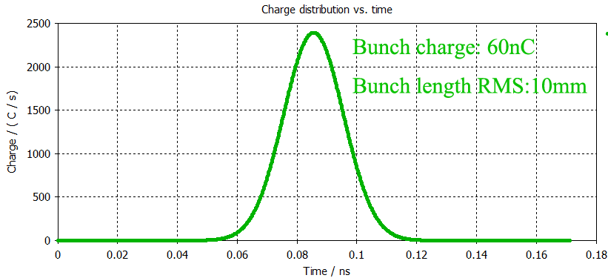
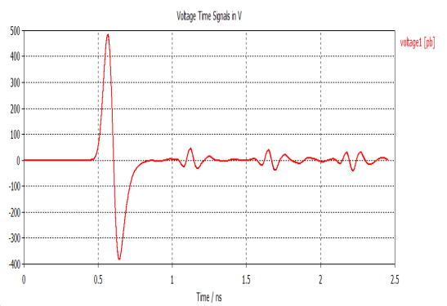
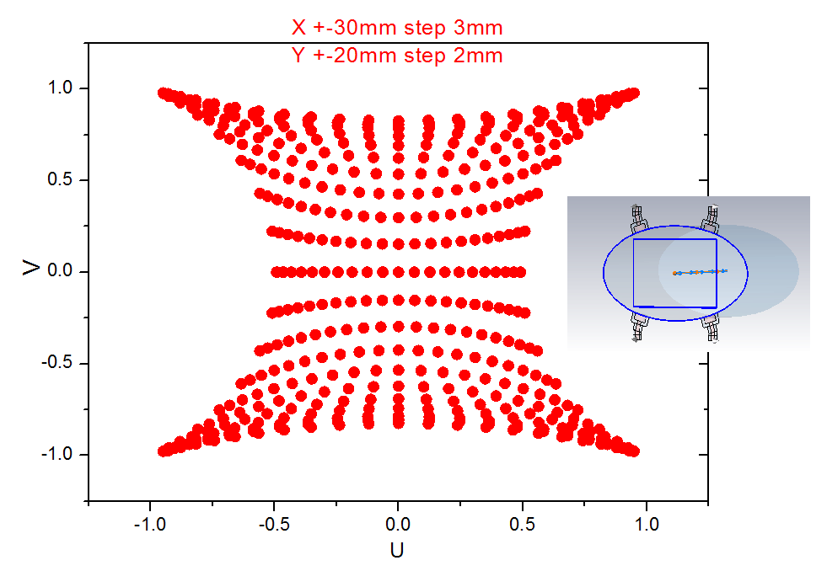
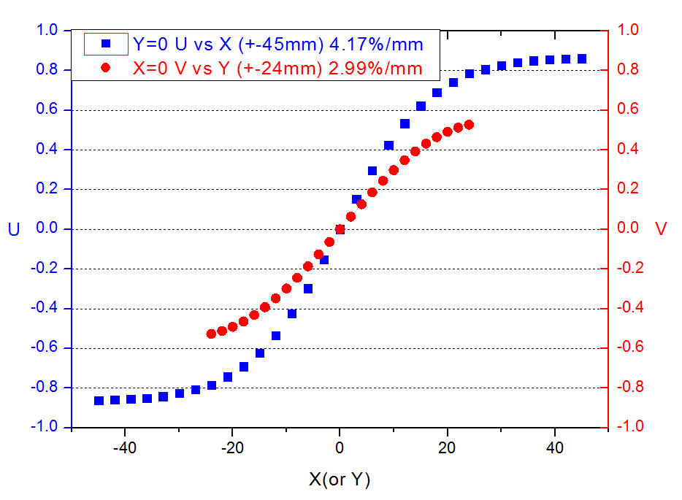
BPM simulation
Volts get on the pickup is more than 100V when button diameter is 4mm
Sensitivity be simulated at the different angle

Slide 9
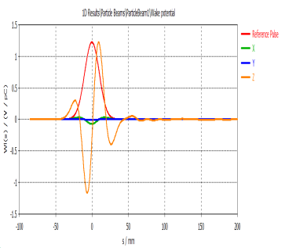
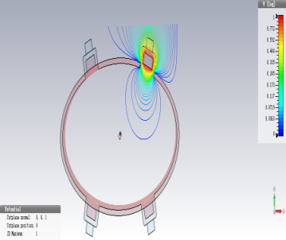
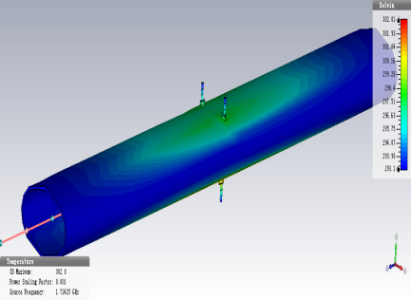
BPM simulation
Heat of pickup induced by beam is simulated
The highest temperature 303K near the pick-ups

Slide 10
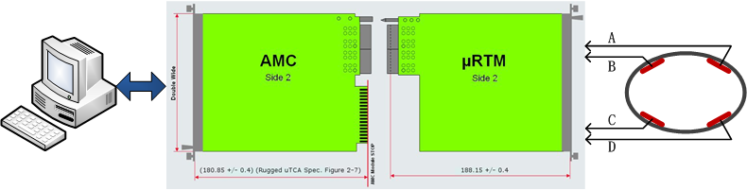
Electronics design
Adopt MicroTCA.4 standard
Electronics including three parts: RF Frontend board, Digit board, Timing module
The timing trigger can be adjusted to make ADCs peak sampling

Slide 11
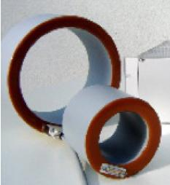
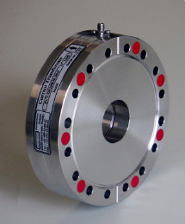
Beam current monitor
Including BCM (bunch current monitor) and DCCT (for average current)
Using Bergoz-type DCCT to measure the average current of the beam and to calculate the life time of beam. The resolution will be µA level;
Bunch current monitor can give current of every bunch, we can used Fast ADC to measure the sum signal of BPM.

Slide 12
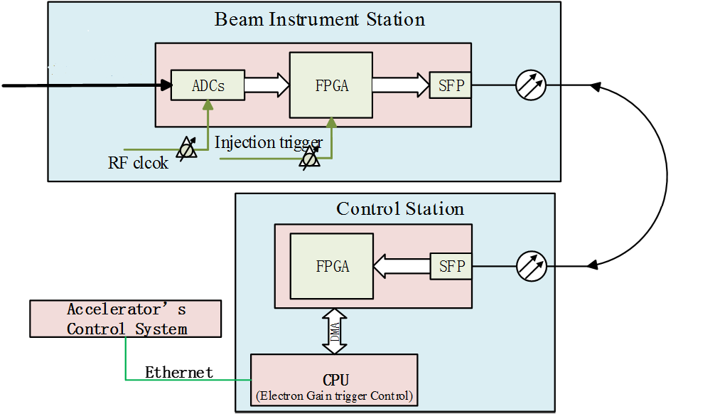
Bunch current monitor
Picking up signal from the BPM
High speed digital signal acquire and processing module
The bucket select program

Slide 13
Beam loss monitor
This system can be used to study the beam loss and to understand the beam behavior.
Ionization chamber, Cherenkov counters, PIN-photodiode and scintillators + photomultiplier tubes (PMT) are common BLM monitors
The following important factors are focused for selecting the right type of BLM for a specific application in CEPC: intrinsic sensitivity, dynamic range, radiation hardness, response time and sensitivity to synchrotron radiation (SR).

Slide 14
The parameters of the four type BLMs
Type of BLM | Dynamic range | Response time | Sensitivity (for MIPs) | Radiation resistance | Sensitivity to SR
Ionization chamber | 10⁸ | 89μs | 600(Elec_{gain}) (1L) | >100Mrad | Sensitive
PIN-photodiode | 10⁸ | 5ns | 100(Elec_{gain}) (1cm²) | >100Mrad | Insensitive
Cherenkov counters | 10⁵~10⁶ | 10ns | 270 (PMT_{gain})(1L) | 100Mrad | Insensitive
Scintillators+PMT | 10⁶ | 20ns | ≈18·10³ (PMT_{Gain}) | ≈20Mrad | Sensitive

Slide 15
Comparison to four types BLMs
Ionization chambers ×
Wide dynamic range and high irradiation capability.
Being slower and being sensitive to synchrotron radiation
Scintillators+PMT ×
Very fast and bunch by bunch
Expensive and sensitive to synchrotron radiation
The scintillator darkening when used in a high dose level
Cherenkov based fibers ×
Insensitive to the background radiation
Unable to shield against synchrotron radiation photons
The common PIN-photodiode ?
Very fast and cheap
Large dynamic range and a high sensitivity
Insensitive to synchrotron radiation photons

Slide 16
Comparison to four types BLMs
The improved PIN-photodiode √
Pin-photodiode will be saturated when the beam energy larger than 45GeV in LEP;
A thin copper (or lead) layer between the two diodes can resolve this problem when beam energy are 80GeV;
But how is for higher energy(120GeV)like as in CEPC? the synchrotron radiation photons energy is (349 keV), 300 μm copper between the diodes is sufficient to stop .
Need to consider
Multiple photons which interact at the same time in the two diodes will
cause the BLMs response, so lead shielding around the BLMs is necessary

Slide 17
Beam profile and length measurement
Beam size measurement based on synchrotron light, Double Slit Interferometer and x ray pinhole will be used；
Streak camera can be used to measure the bunch length, the resolution will be ~0.1ps (the beam length is 9ps), Hamamatsu and Optronis both have precision streak cameras whose resolution can reach to sub-picoseconds.
Two photon intensify interferometer can be used to measure the beam length(very shortly)
Four beam line is needed, visible light and x ray beam line separately for positron and electron.
Thermal loading of first mirror should be considered.

Slide 18
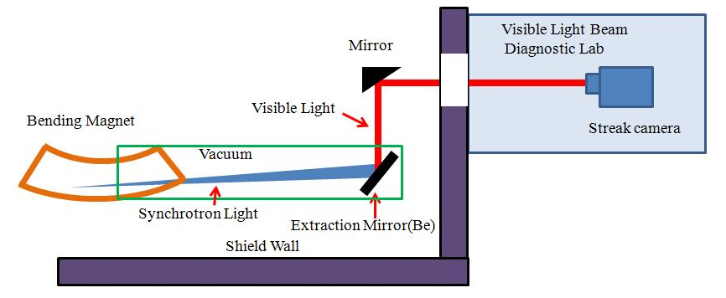
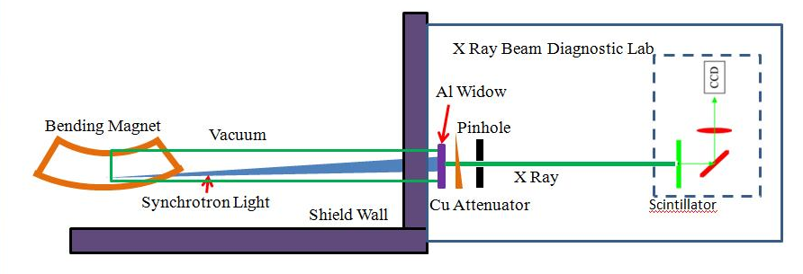
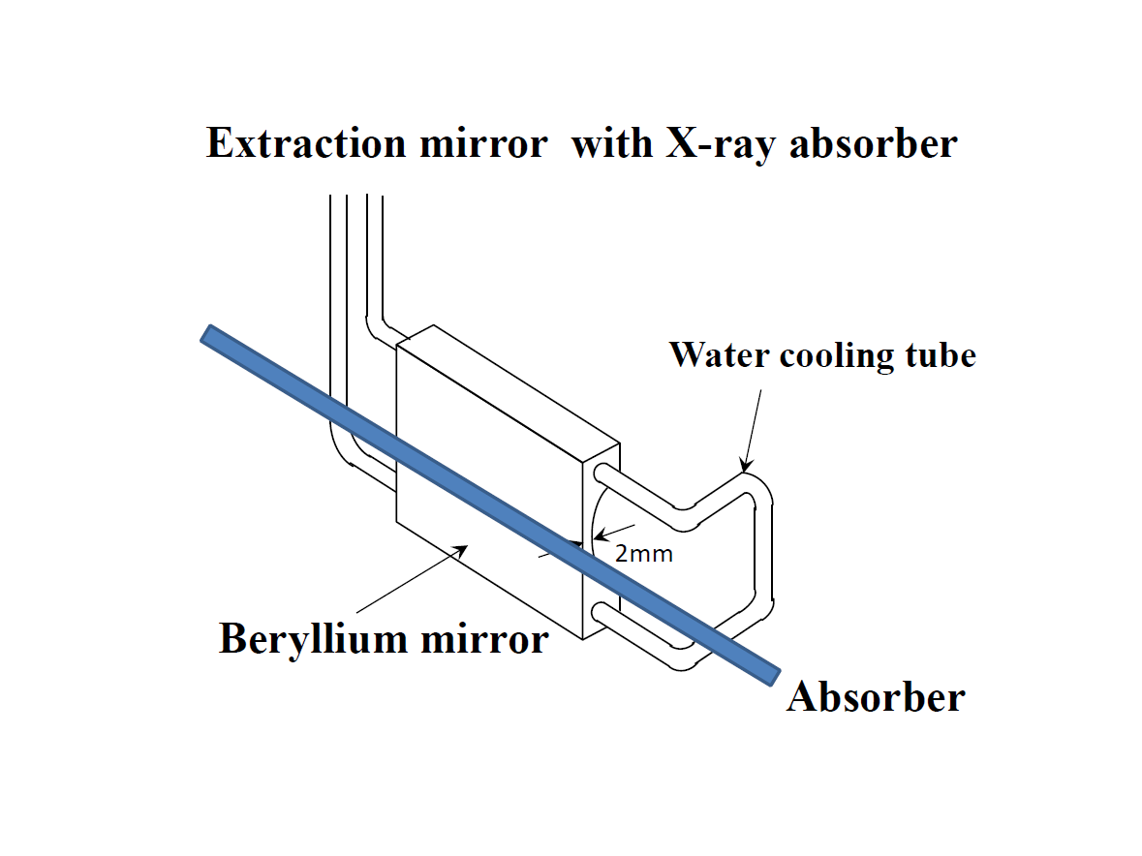
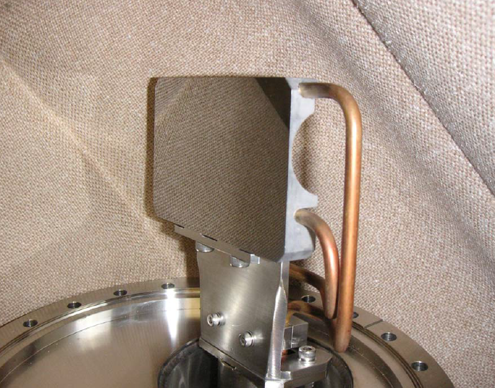
Special diagnostic beam line
Visible light beam line
X ray beam line
KEK type Be extracted mirror

Slide 19
Two photon intensify interferometer

Slide 20
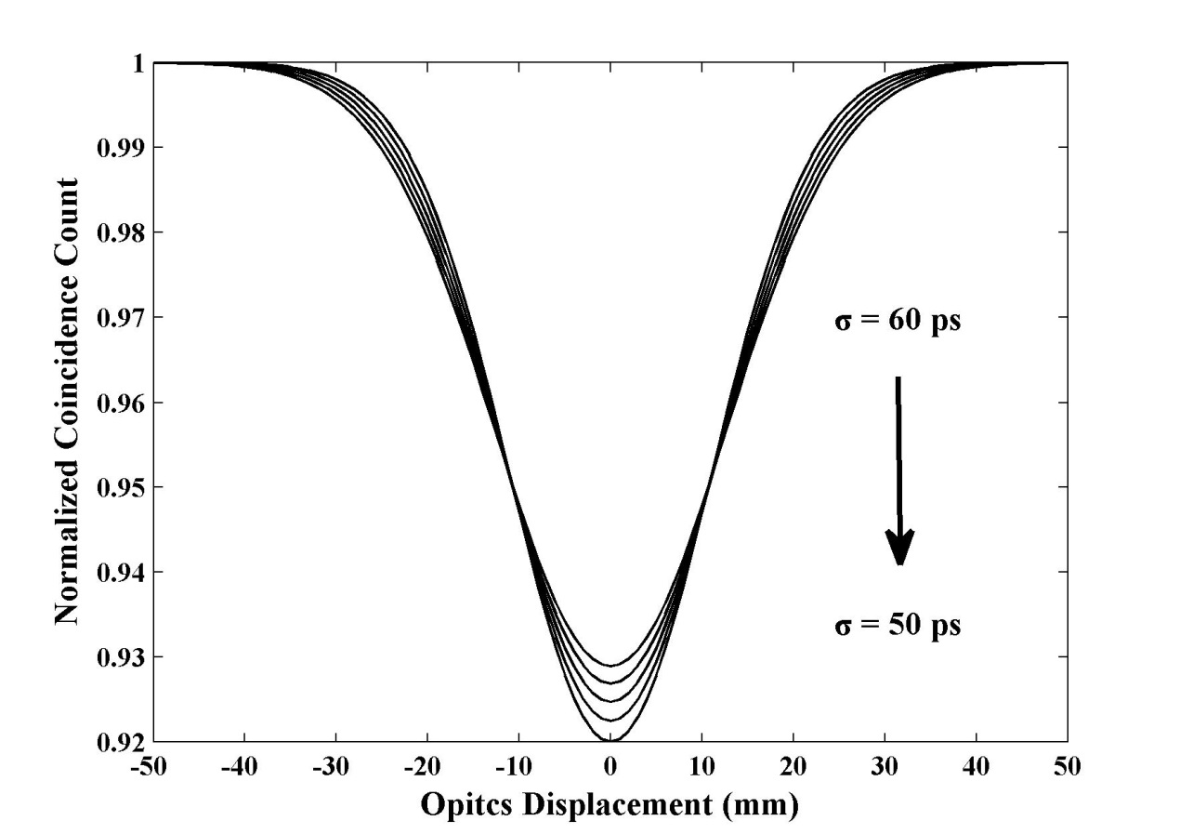
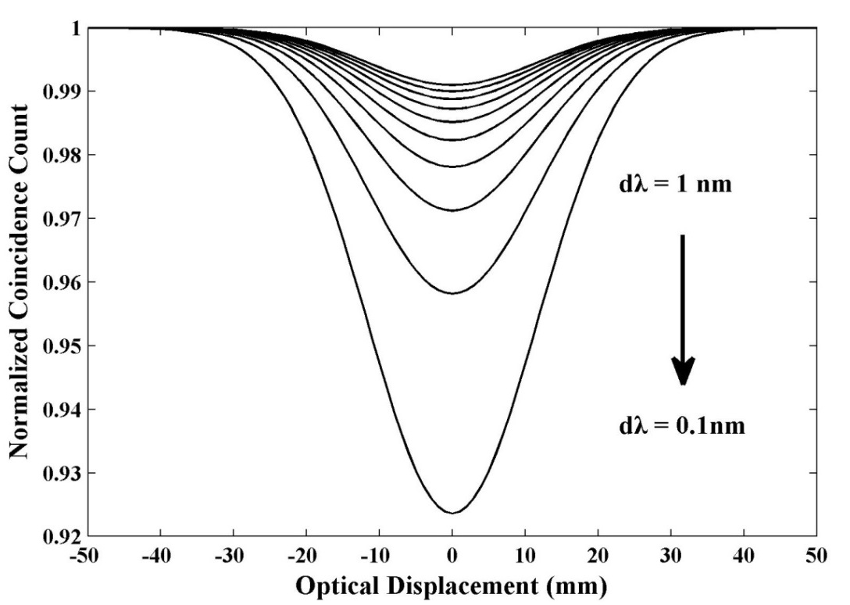
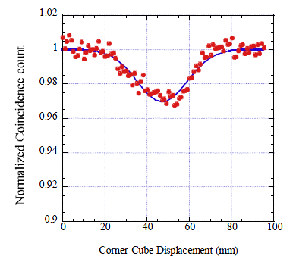
Calculation and experiment results
JP PF 54ps

Slide 21
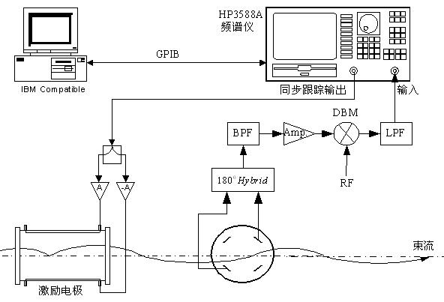
Tune measurement system
Tune is one of the important parameters of the machine, need to be show in real time.
Frequency sweeping method with gated pulse or FFT analyzing to the data from the digital BPM.
The BPM monitor, signal processing unit and the kicker form the entire system.

Slide 22
DDD(3D) tune measurement
Direct Diode Detection（3D）is a technique developed at CERN initially for the LHC tune measurement system and recently for observing beam motion of very small amplitude.
The basic idea is to time stretch the beam pulse from the pick-up in order to increase the betatron frequency content in the baseband. This can be accomplished by a simple diode detector followed by an RC low pass filter.
3D method has many advantages: simplicity and low cost, revolution frequency suppression, robustness against saturation, flattening out the beam dynamic range, independent to filling pattern.
At the same time, it also has disadvantages: operation in the low frequency range, response dominated by largest bunches, cannot measure bunch by bunch tune .

Slide 23
Feedback system
Coupled bunch instabilities may occur due to the HOMs, the nature damping time in not enough to damping the beam。
Two sets of feedback system for x/y/z directions.
Beam pickup signal can be used for both horizontal direction and longitudinal direction.
Multi feedback system in same ring can be used to reduce damping time.
For the booster, the tunes will change during the ramp and the FB system must take this into consideration.
One option is to design the ramp in a way that maintains transverse and longitudinal tunes in a relatively small range of values
Another option is to have multiple feedback filters designed for different parts of the tune range (with overlap) and to switch from one to another during the ramp

Slide 24
R&D of Beam instrumentation of CEPC
Digital electronics for BPM need to R&D, radiation protection need to be considered in design
High vacuum feed through for BPM and high power kicker need to study. Also feed through material for high temperature baking (No R&D budget)
Pin diode type BLM monitor need to study and fabricated by ourselves ( No R&D budget)
New type DCCT using the MR(Magneto Resistance) effects should be studied ( No R&D budget)
……

Slide 25
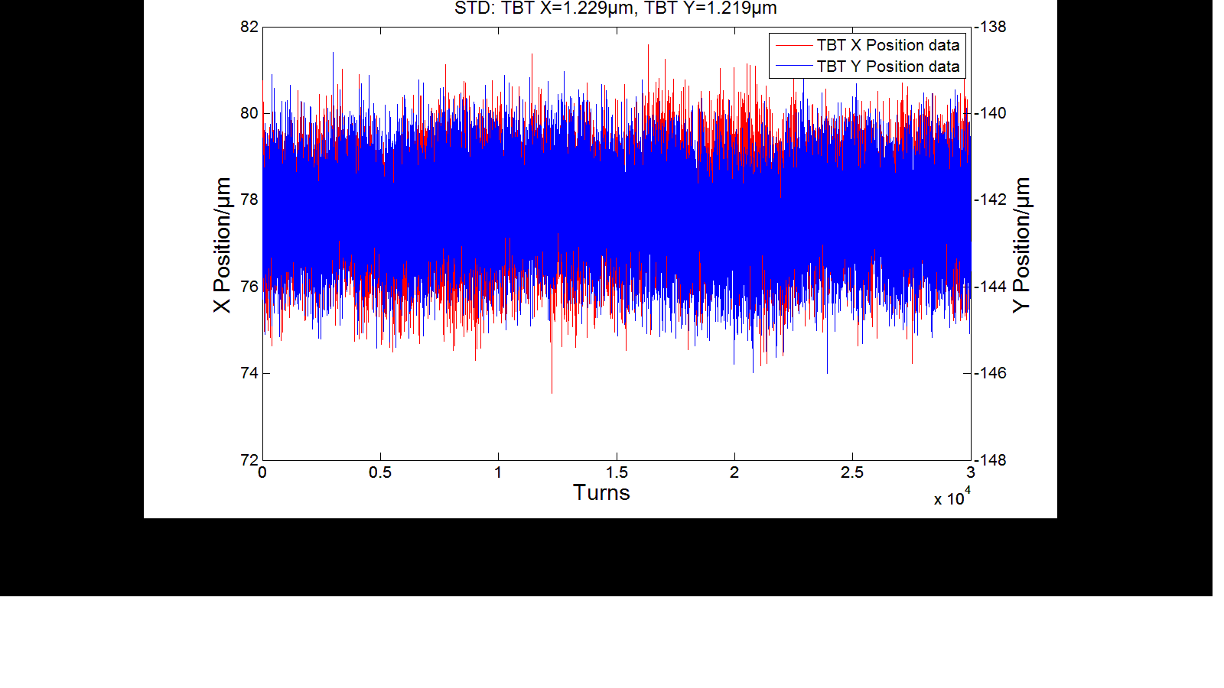
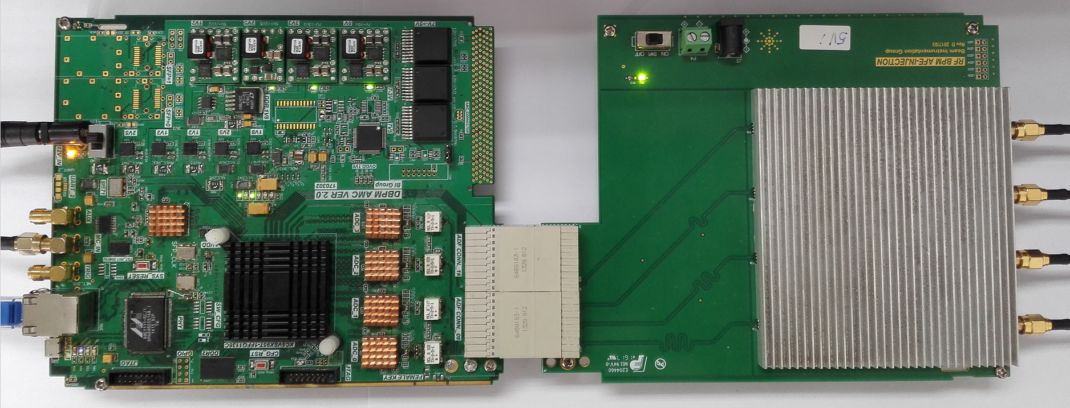
R&D of Beam instrumentation of CEPC
The first version of BPM electronics prototype has been finished
The resolution (RMS) is 1.229 µm for turn by turn data, 0.4 µm (3 s) for FA data, and 0.19 µm (10 s) for SA data.
New version based Micro TCA is under developing.
Beam test will be done in BEPCII.

Slide 26
summary
Digital BPM electronics is under developing. The standalone prototype is finished and test in lab.
For the average current measurement, a new type DCCT based MR effects would be studied and developed.
Pin-diode BLM loss monitor should be adopted. High energy photon should be considered
CEPC Feed back systems can be based on the designs developed for previous e+/e- colliders. Multi feedback systems in the same ring can used to reduce damping times. The tune change during ramping should be consideration in the Booster.

Slide 27
summary
Beam size measurement based on synchrotron radiation light should be setup. X ray beam line and visible light beam line are included.
For beam length measurement, apart from the streak camera, two photon intensify interferometer would be studied.
Tune measurement is important for the accelerator, diode direct detection method is a new method for tune measurement.

Slide 28
Thanks for your attention !

