Slide 1



Overview of CEPC
  J. Gao
  On behalf of CEPC Accelerator Team
  Institute of High Energy Physics
  CAS, Beijing
  CEPC International Review
  June 28-30, 2018, IHEP, Beijing, China

Slide 2
Contents
CEPC CDR accelerator design goals
CEPC CDR overall design concept and path from Pre-CDR to CDR completion
CEPC alternatives and new ideas
CEPC CDR accelerator hardwares and R&D towards TDR
Conclusions

Slide 3
CEPC – The Physics Case
Lots of questions with the Higgs boson (+ Z, W)
Is H(126) the SM Higgs as expected? Is it fundamental? Does it cause SSB?
Is the vacuum stable?
Naturalness – what form and what energy scale?
Is H(126) connected to dark matter/energy? How (if yes)?
Full exploration of H(126) is an important path to finding new physics
Precision measurement of the Z, W bosons, by an order of magnitude or
more, is another way to probe new physics
CEPC: 1 M H(126) events, >10¹⁰ Z, W events will allow us to reach the necessary precision

Slide 4
CEPC Design –Higgs Parameters
Parameter | Design Goal
Particles | e+, e-
Center of mass energy | 2*120 GeV
Luminosity (peak) | >2*10^34/cm^2s
No. of IPs | 2
CEPC Design – Z-pole Parameters
Parameter | Design Goal
Particles | e+, e-
Center of mass energy | 2*45.5 GeV
Integrated luminosity (peak) | >10^34/cm^2s
No. of IPs | 2
Polarization | to be considered in the second round of design
*Be noted that here the luminosities are the lowest reuiqrement to accomodate different collider schemes

Slide 5
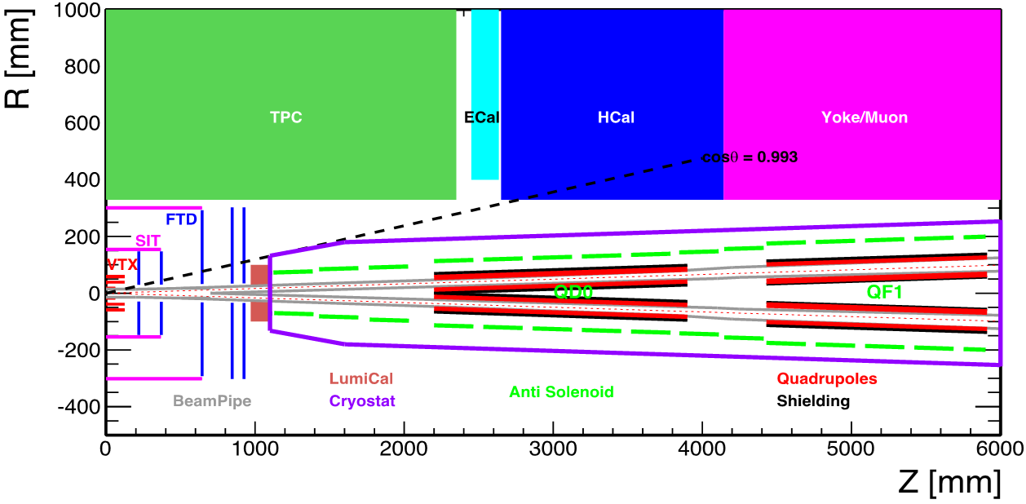
CEPC CDR Accelerator Chain and Systems
Energy Ramp
10 ->45/120GeV
10 GeV
Electron
1) Injector
2) Booster
L=1.2km
Positron
C=100km
Three rings in the sane channel：
  CEPC & booster
  SppC
Booster Cycle (0.1 Hz)
The key systems of
CEPC:
1) Linac Injector
2) Booster
3) Collider ring
4) MDI
5) Civil Eng.
5) Civil Eng.
3) Main Ring
C=100km
2IP
45/120 GeV
4) Detector Machine
Interface (MDI)
CEPC Booster
CEPC Collider
SppC

Slide 6
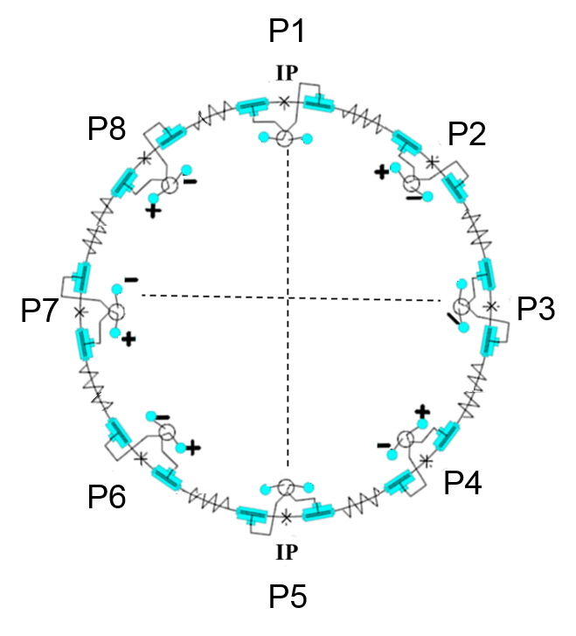
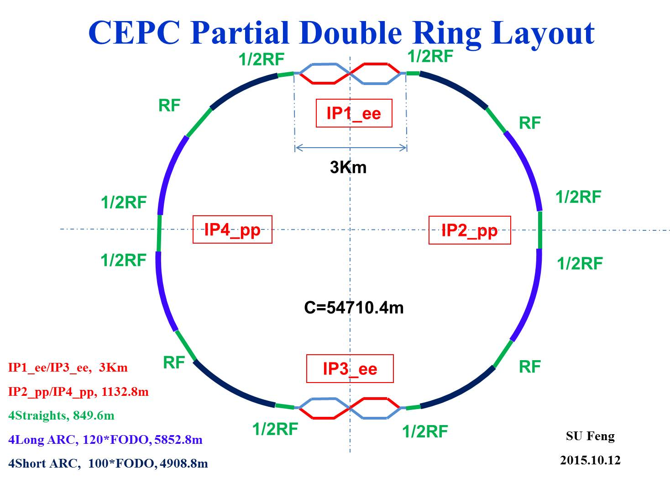
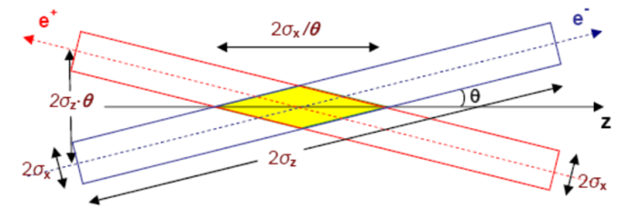
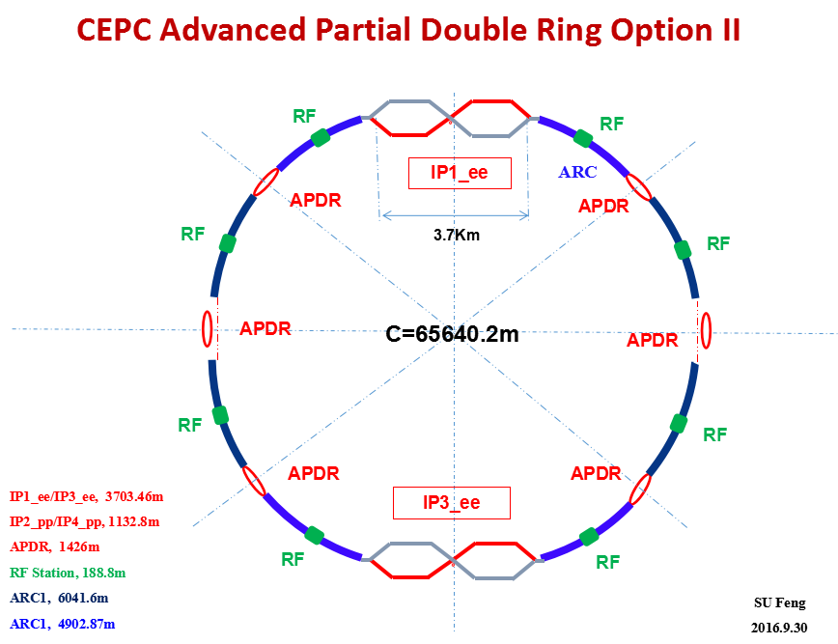
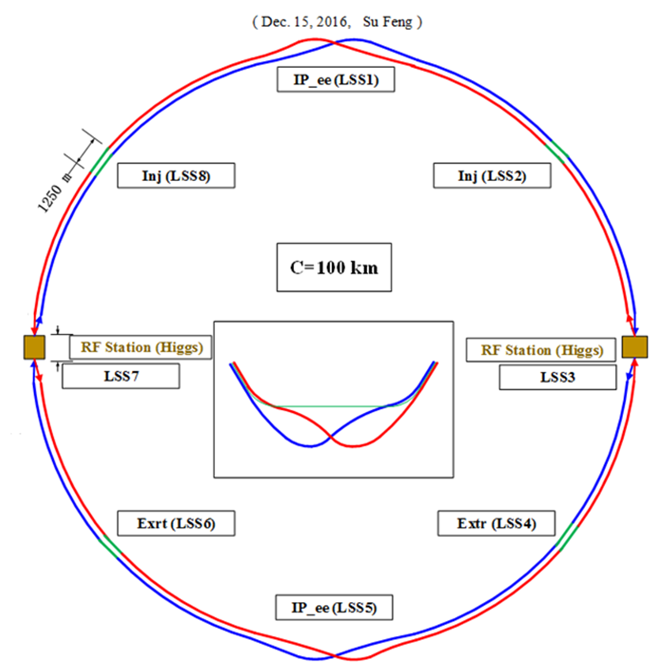
CEPC Four Options Evoluting towards CDR
CEPC Pre-CDR Scheme (head -on collision)
Crab-waist collision
in CEPC CDR
Since Oct 2012
Since May 2015
CEPC Alternative Design
Lower cost and reaching the
fundamental requirement for
Higgs and Z luminosities, under the condition that sawtooth and beam loading effects be solved
CEPC Baseline Design
Better performance for Higgs and Z compared with alternative scheme, without bottle neck problems, but with higher cost
30MW synchrotron
radiation power/beam
Since May 2016
Since Nov 2016
CEPC 100km circumference was decided by CEPC SC based on the recommendation from IAC in Nov. 2016
CEPC baseline and alternative options have been decided on Jan. 14, 2017

Slide 7
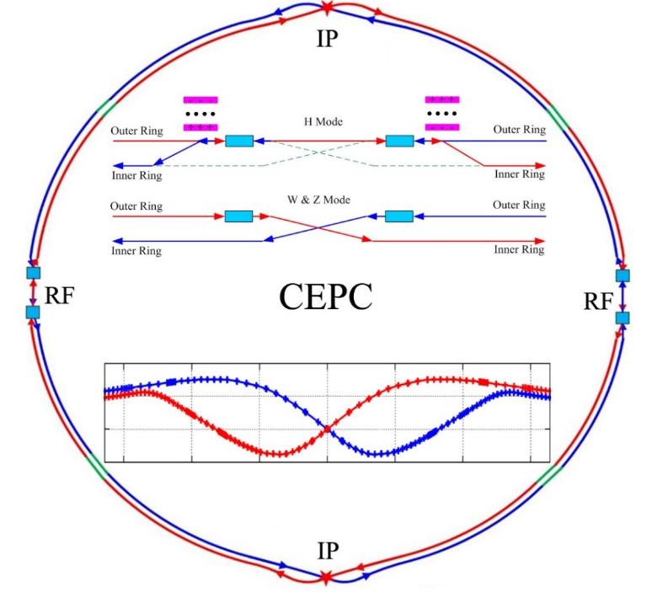
CEPC SRF Design for H,W, and Z
Higgs factory as first piority (fully partial double ring, with common SRF system for e+ and e- beams)
W and Z factories are incorperated by beam swithyard (W and Z factories are double ring, with
independent SRF system for e+ and e- beams)
Higgs factory baseline SR per beam 30 MW to Minimize AC power
Economic CEPC baseline design as Higgs factory:
W, Z factories incoperated with the same SRF system hardwares by using beam
switchyard to change from Higgs factory and W, Z factories
Synchrotron radiation power per beam at Higgs energy is set to 30MW to minimize
AC power consumption

Slide 8
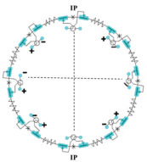
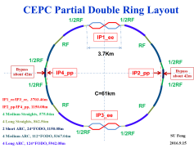
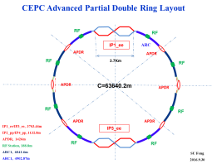
Collider Schemes vs Luminosity Potentials
CEPC
Single
CEPC
PDR
CEPC
APDR
CEPC
FPDR
LEP
LEPII
CDR Alternative
CDR Baseline
Key limitations:
Sawtooth effects
Beam loading
Dynamic apertures
-
-
Luminosity H 10^32 (102GeV) <~2*10^34 >2~5*10^34 (cm^-2s^-1)
Luminosity Z 10^32 <~1*10^34 >10*10^34 (cm^-2s^-1)

Slide 9
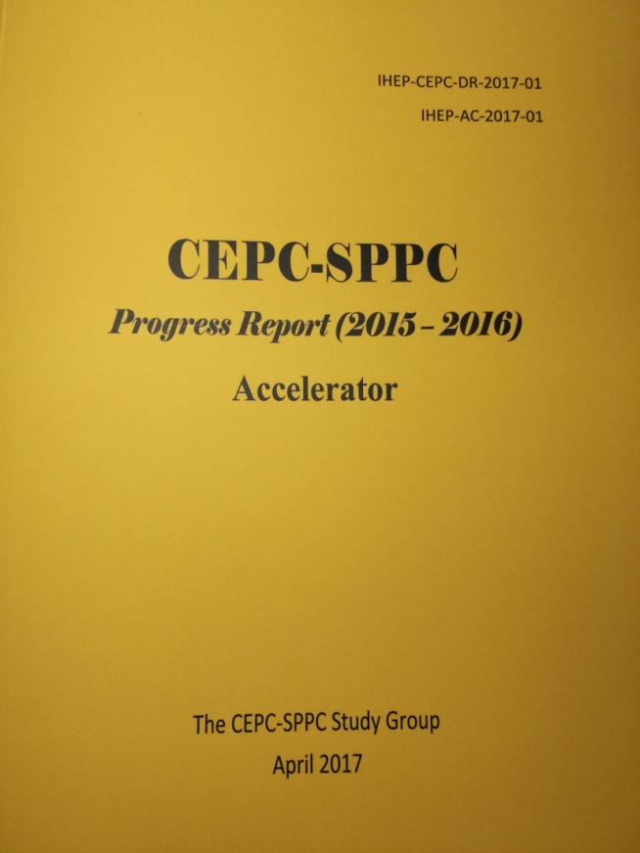
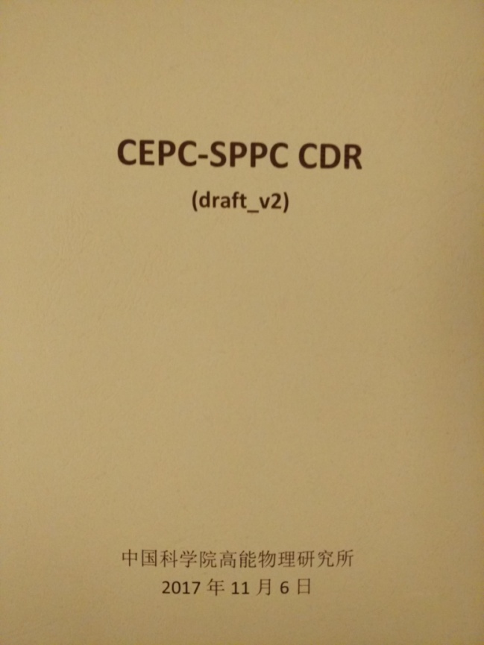
CEPC Accelerator from Pre-CDR to CDR
CEPC accelerator CDR completed in June 2018 (to be printed in July 2018)
  Executive Summary
  Introduction
  Machine Layout and Performance
  Operation Scenarios
  CEPC Collider
  CEPC Booster
  CEPC Linac
  Systems Common to the CEPC Linac, Booster
  and Collider
  8. Super Proton Proton Collider
  9. Conventional Facilities
  10. Environment, Health and Safety
  11. R&D Program
  12. Project Plan, Cost and Schedule
  Appendix 1: CEPC Parameter List
  Appendix 2: CEPC Technical Component List
  Appendix 3: CEPC Electric Power Requirement
  Appendix 4: Advanced Partial Double Ring
  Appendix 5: CEPC Injector Based on Plasma Wakefield Accelerator
  Appendix 6: Operation as a High Intensity γ-ray Source
  Appendix 7: Operation for e-p, e-A and Heavy Ion Collision
  Appendix 8: Opportunities for Polarization in the CEPC
  Appendix 9: International Review Report
Draft CDR for
Mini International
Review in Nov. 2017
March 2015
April 2017
CDR Version for International
Review June 2018

Slide 10
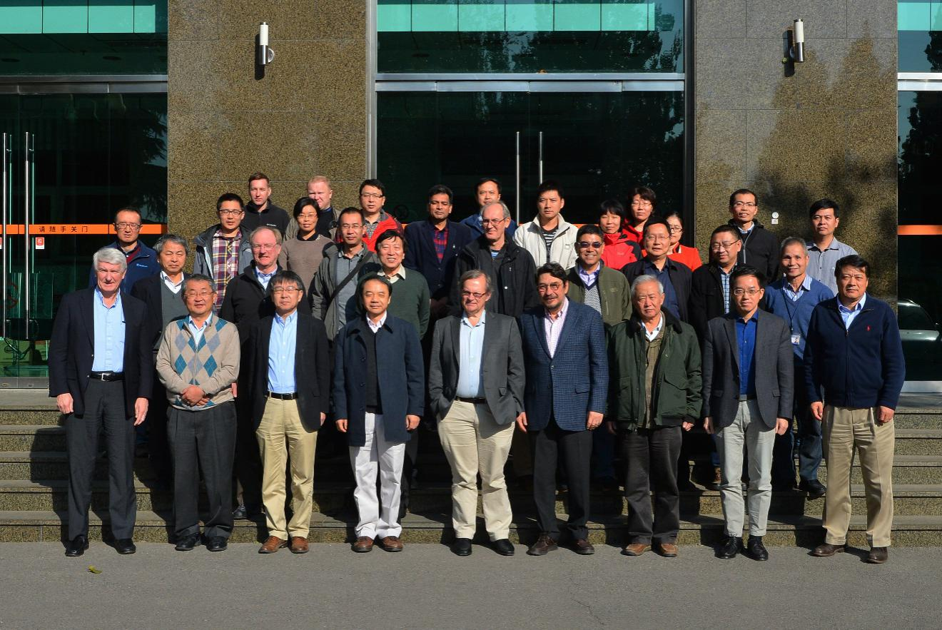
Mini-Review Workshop of CEPC-SPPC CDR
(Nov. 4-5, 2017, IHEP)
CEPC-SPPC CDR Mini-review members
Name (alphabetical order)
Anton Bogomyakov BINP Russia
Brian Foster Oxford U. U.K.
Eugene Levichev BINP Russia
Kexin Liu（刘克新） Peking U. China
Ernie Malamud Fermilab USA
Kazuhito Ohmi KEK Japan
Katsunobu Oide CERN / KEK Switzerland
Carlo Pagani U. of Milan / INFN Italy
John Seeman SLAC USA
Sergey Sinyatkin BINP Russia
Mike Sullivan SLAC USA
Chuanxiang Tang（唐传祥）Tsinghua U.China
Lin Wang （王林） USTC China
Xiangqi Wang（王相綦） USTC China
Akira Yamamoto KEK Japan

Slide 11
CEPC CDR Parameters
 | Higgs | W | Z（3T） | Z（2T）
Number of IPs | 2
Beam energy (GeV) | 120 | 80 | 45.5
Circumference (km) | 100
Synchrotron radiation loss/turn (GeV) | 1.73 | 0.34 | 0.036
Crossing angle at IP (mrad) | 16.5×2
Piwinski angle | 2.58 | 7.0 | 23.8
Number of particles/bunch N_{e} (10¹⁰) | 15.0 | 12.0 | 8.0
Bunch number (bunch spacing) | 242 (0.68μs) | 1524 (0.21μs) | 12000 (25ns+10%gap)
Beam current (mA) | 17.4 | 87.9 | 461.0
Synchrotron radiation power /beam (MW) | 30 | 30 | 16.5
Bending radius (km) | 10.7
Momentum compact (10⁻⁵) | 1.11
β function at IP β_{x}* / β_{y}* (m) | 0.36/0.0015 | 0.36/0.0015 | 0.2/0.0015 | 0.2/0.001
Emittance ε_{x}/ε_{y} (nm) | 1.21/0.0031 | 0.54/0.0016 | 0.18/0.004 | 0.18/0.0016
Beam size at IP σ_{x} /σ_{y} (μm) | 20.9/0.068 | 13.9/0.049 | 6.0/0.078 | 6.0/0.04
Beam-beam parameters ξ_{x}/ξ_{y} | 0.031/0.109 | 0.013/0.106 | 0.0041/0.056 | 0.0041/0.072
RF voltage V_{RF} (GV) | 2.17 | 0.47 | 0.10
RF frequency f _{RF} (MHz) (harmonic) | 650 (216816)
Natural bunch length σ_{z} (mm) | 2.72 | 2.98 | 2.42
Bunch length σ_{z} (mm) | 3.26 | 5.9 | 8.5
HOM power/cavity (2 cell) (kw) | 0.54 | 0.75 | 1.94
Natural energy spread (%) | 0.1 | 0.066 | 0.038
Energy acceptance requirement (%) | 1.35 | 0.4 | 0.23
Energy acceptance by RF (%) | 2.06 | 1.47 | 1.7
Photon number due to beamstrahlung | 0.1 | 0.05 | 0.023
Lifetime _simulation (min) | 100
Lifetime (hour) | 0.67 | 1.4 | 4.0 | 2.1
F (hour glass) | 0.89 | 0.94 | 0.99
Luminosity/IP L (10³⁴cm⁻²s⁻¹) | 2.93 | 10.1 | 16.6 | 32.1

Slide 12
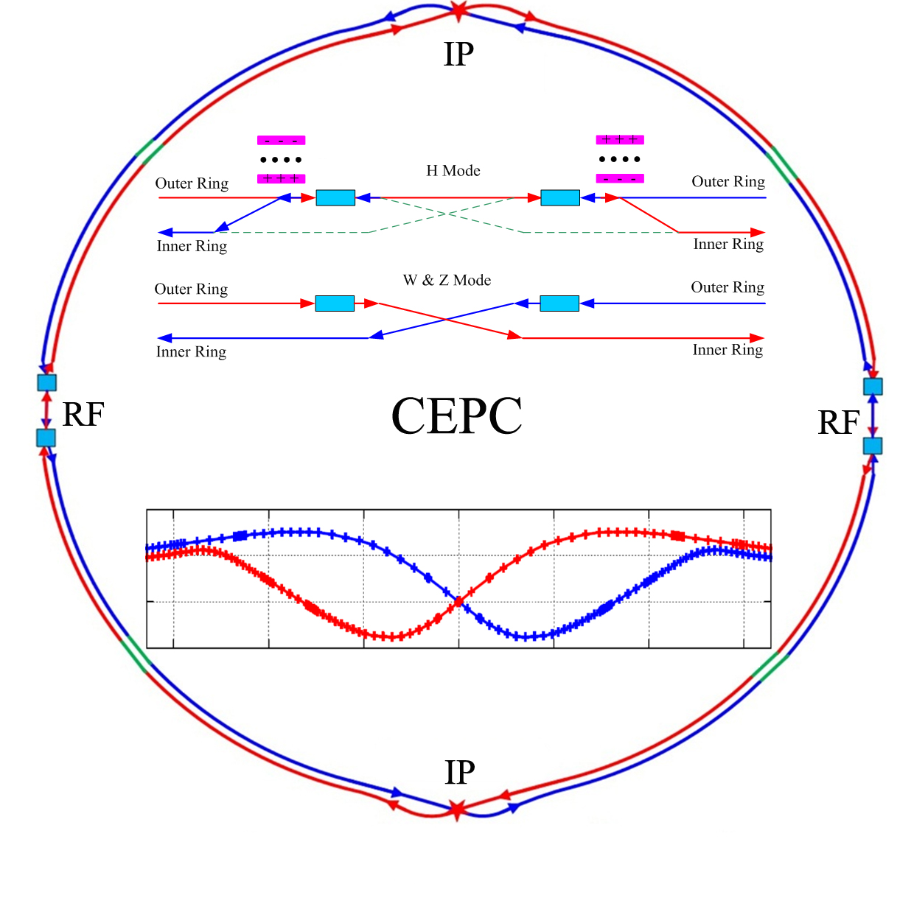
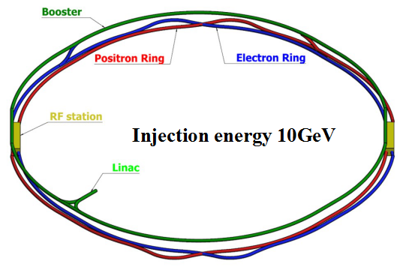
CEPC CDR Layout
CEPC collider ring (100km)
CEPC booster ring (100km)
CEPC Linac injector (1.2km, 10GeV)

Slide 13
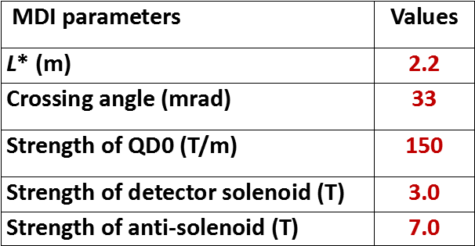
CEPC MDI Layout and Parameters
The Machine Detector Interface of CEPC double ring scheme is about ±7m long from the IP.
The CEPC detector superconducting solenoid with 3 T magnetic field and the length of 7.6m.
The accelerator components inside the detector without shielding are within a conical space with an opening angle of cosθ=0.993.
The e+e- beams collide at the IP with a horizontal angle of 33mrad and the final focusing length is 2.2m
Lumical will be installed in longitudinal 0.95~1.11m, with inner radius 28.5mm and outer radius 100mm.

Slide 14
CEPC CDR Design Status
CEPC Collider Ring
Parameter | Symbol | Unit | Goal | Status
Beam Energy | E | GeV | 120 | 120
Circumference | C | km | 100 | 100.006
Emittance | ε_{x/}ε_{y} | nm⋅rad | 1.21 / 0.0036 | 1.208 / -
Beta functions at IP | β_{x/}β_{y} | m | 0.36 / 0.002 | 0.36 / 0.002
Energy acceptance | ΔP/P | % | 1.35 | 1.8
DA requirement | DA_{x/}DA_{y} | σ | 13 / 12 | 20 / 20 (w/o errors)
* Z and W satisfies CDR requirement as well
CDR goal reached

Slide 15
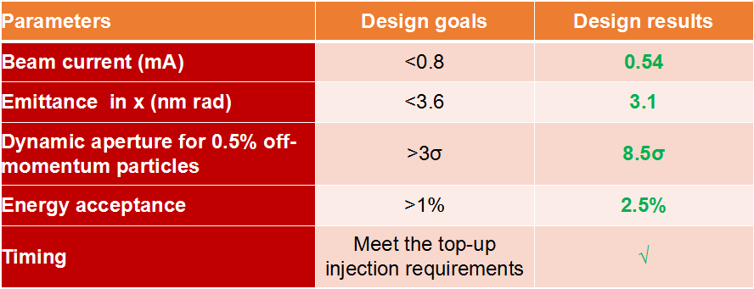
CEPC Booster Design Status
CDR goal
reached
CEPC Linac Injector CDR Status
Parameter | Symbol | Unit | Goal | Status
e⁻ /e⁺ beam energy | E_{e-}/E_{e+} | GeV | 10 | 10/10
Repetition rate | f_{rep} | Hz | 100 | 100
e⁻ /e⁺ bunch population | Ne-/Ne+ |  | >6.25×10⁹ | ~1.875×10¹⁰ ~1.875×10¹⁰
 | Ne-/Ne+ | nC | >1.0 | 1.0/3.0*
Energy spread (e⁻ /e⁺ ) | σ_{E} |  | <2×10⁻³ | 1.5×10⁻³ 1.4×10⁻³
Emittance (e⁻ /e⁺ ) |  | mm⋅ mrad | <0.3 | 0.005/0.12**
e⁻ beam energy on Target |  | GeV | 4 | 4
e⁻ bunch charge on Target |  | nC | 10 | 10

Slide 16
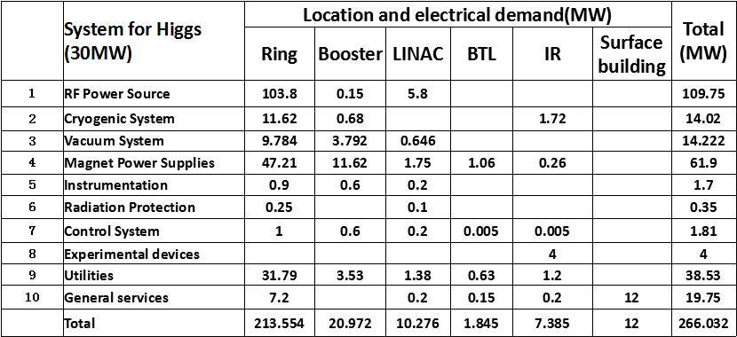
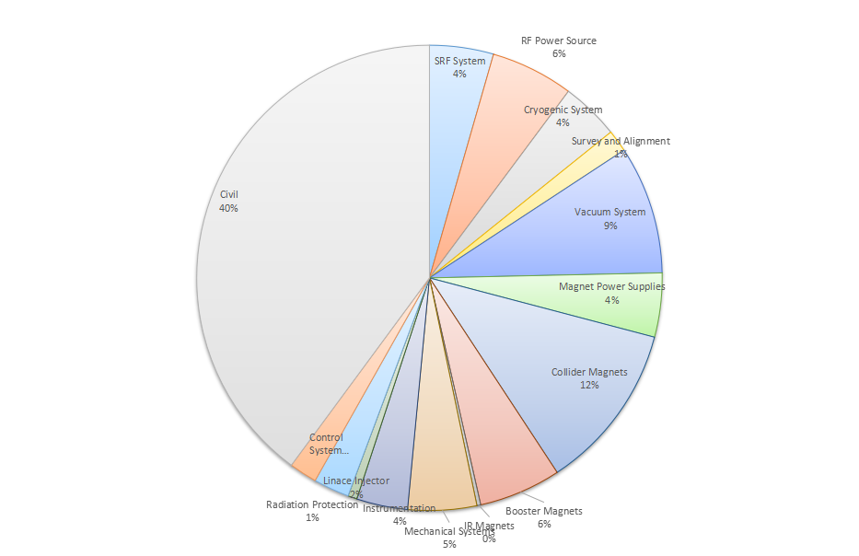
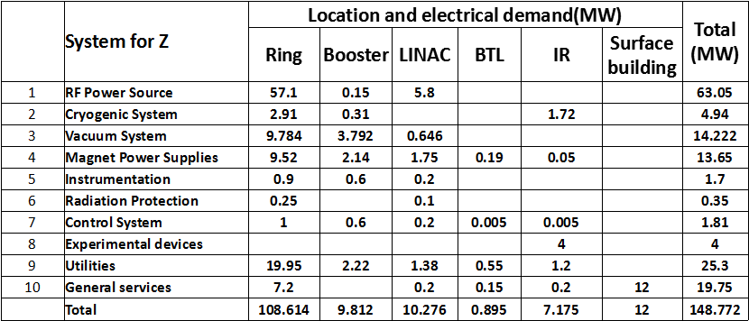
CEPC Power for Higgs and Z
CEPC Cost Breakdwon
(no detector)
266MW
149MW

Slide 17
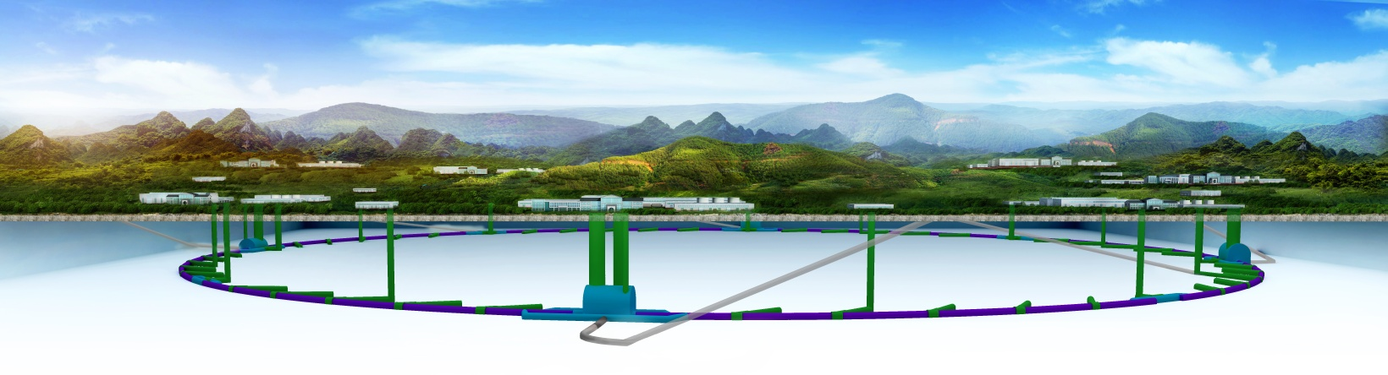
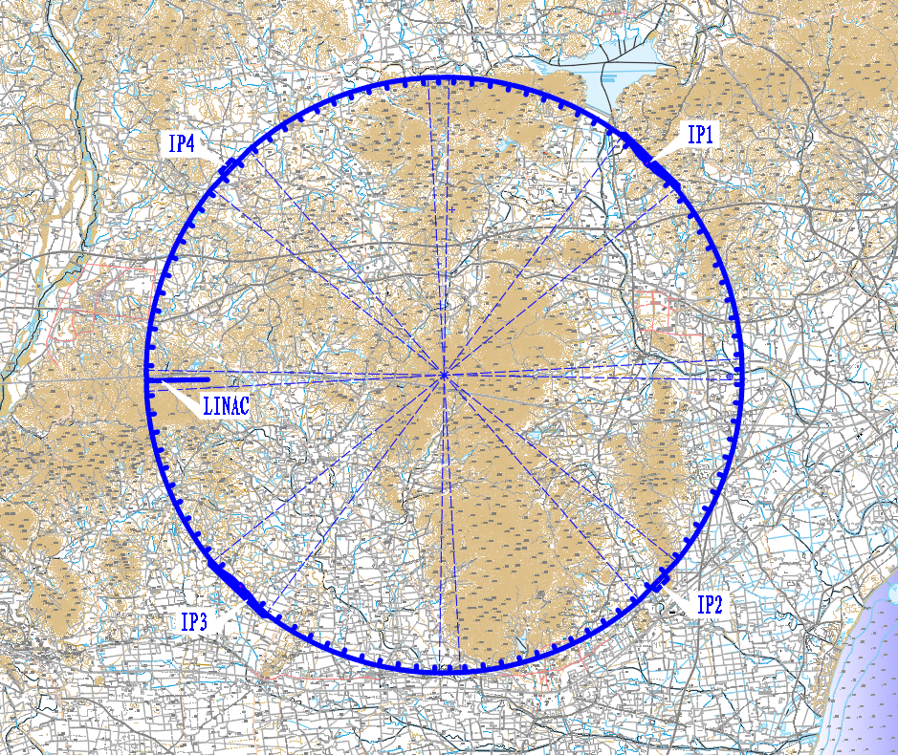
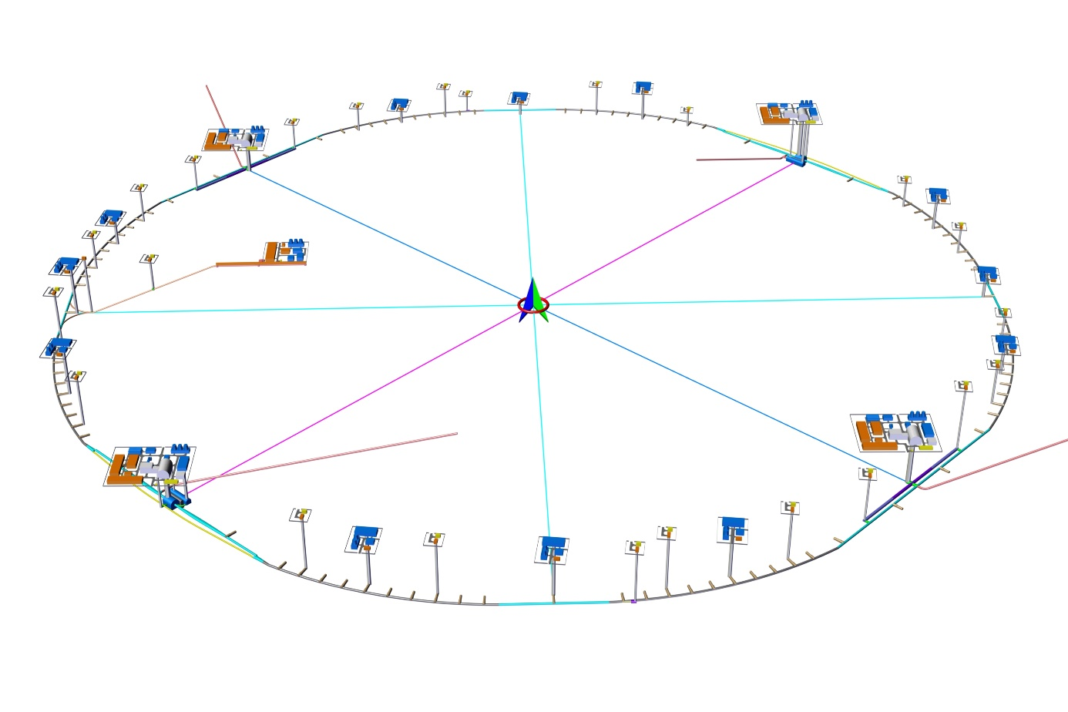
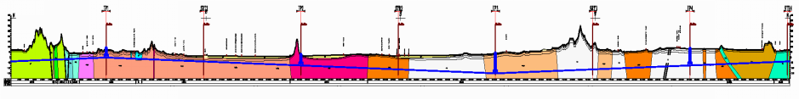
3 Project Layout and Preliminary Scheme
CEPC Civil Enginnering Design (Funing 100km, example)

Slide 18

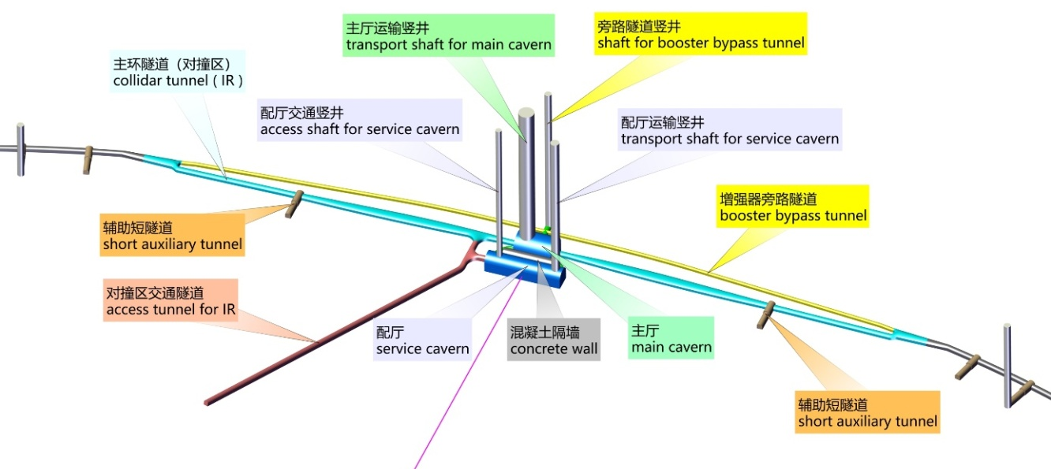
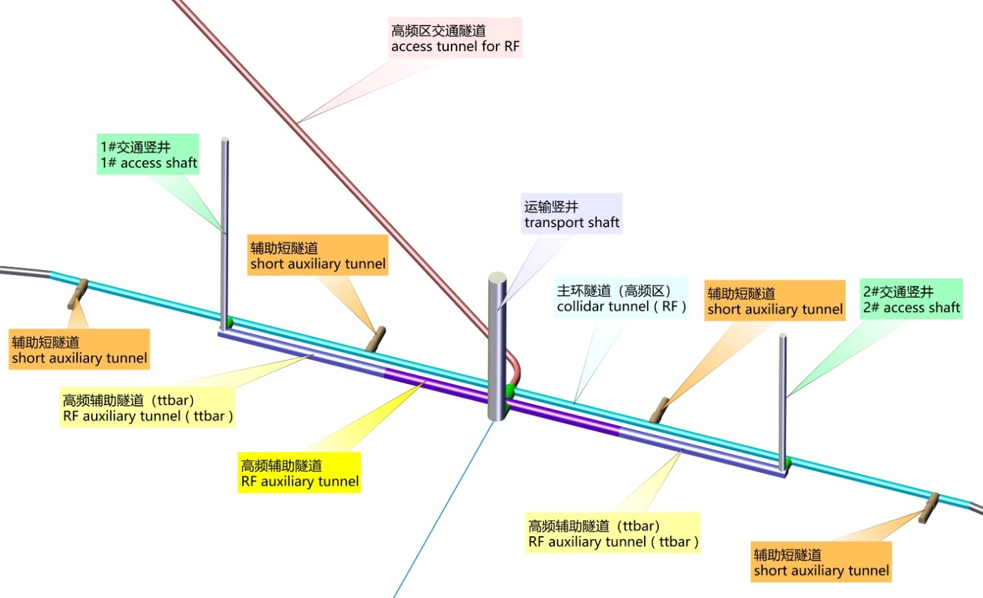
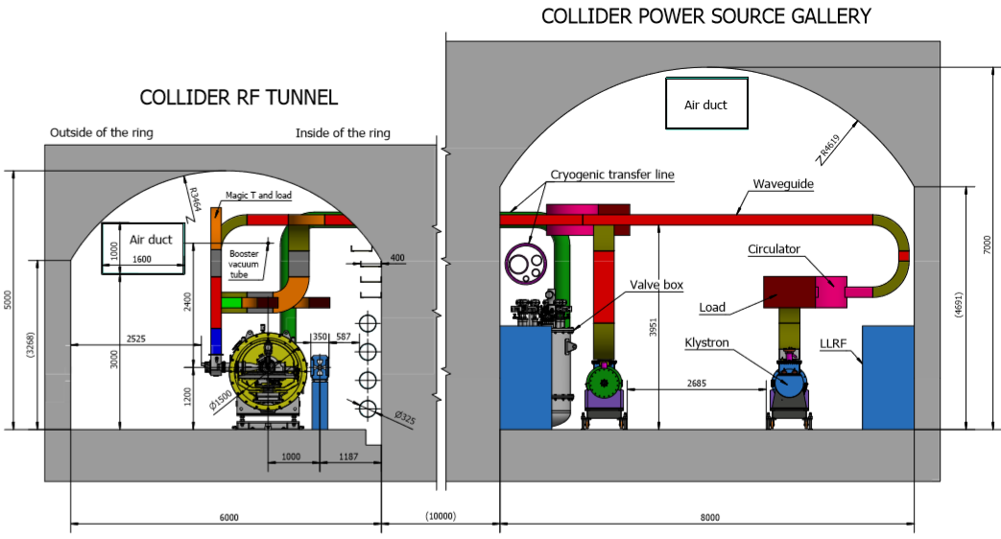
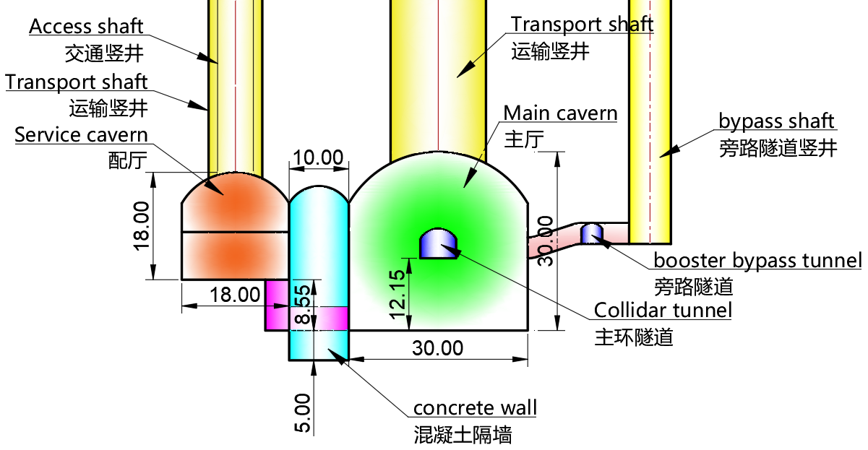
CEPC Tunnel Cross Sections, Detector and SCRF Regions
IP1 / IP3
IP2 / IP4--SCRF region
Notes:
IR is arranged at IP1/IP3, with the length of 3320.00m for each one. The sections from the intersections of tunnels in the IR and tunnels at the curve sections to the zones within 1532.00m of both sides of halls are linear sections with the width ranging from 6.00m~10.74m and the height of 5.00m. At these linear sections, the routing direction of tunnel will be adjusted according to booster line and transfer lines. The zones within 1532.00m of both sides of halls are divided into two tunnels respectively for arranging positive / negative electron beam and booster beam . The tunnel for arranging positive / negative electron beam is 6.00m~11.40m wide, 4.50m high and 1509.30m long (single side). The tunnel for arranging booster line is 3.50m wide, 3.50m high, and 3018.60m long. The dimension of tunnel section is determined with consideration given to local control, electrical, beam measurement, vacuum and cooling equipment as well as requirements of passage of personnel and maintenance .

Slide 19
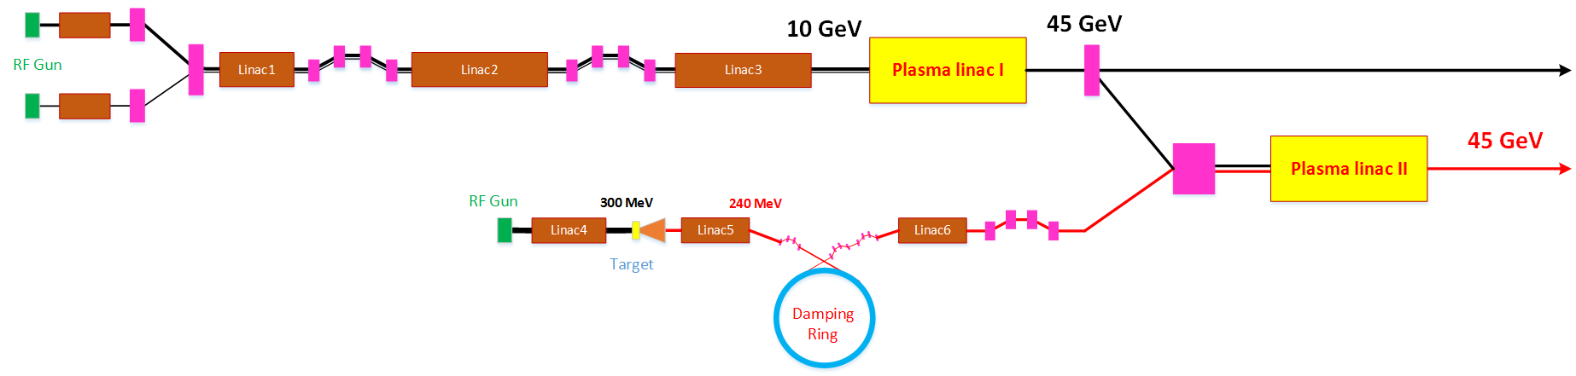
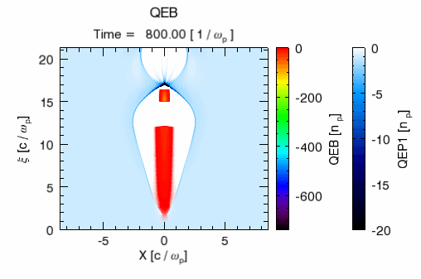
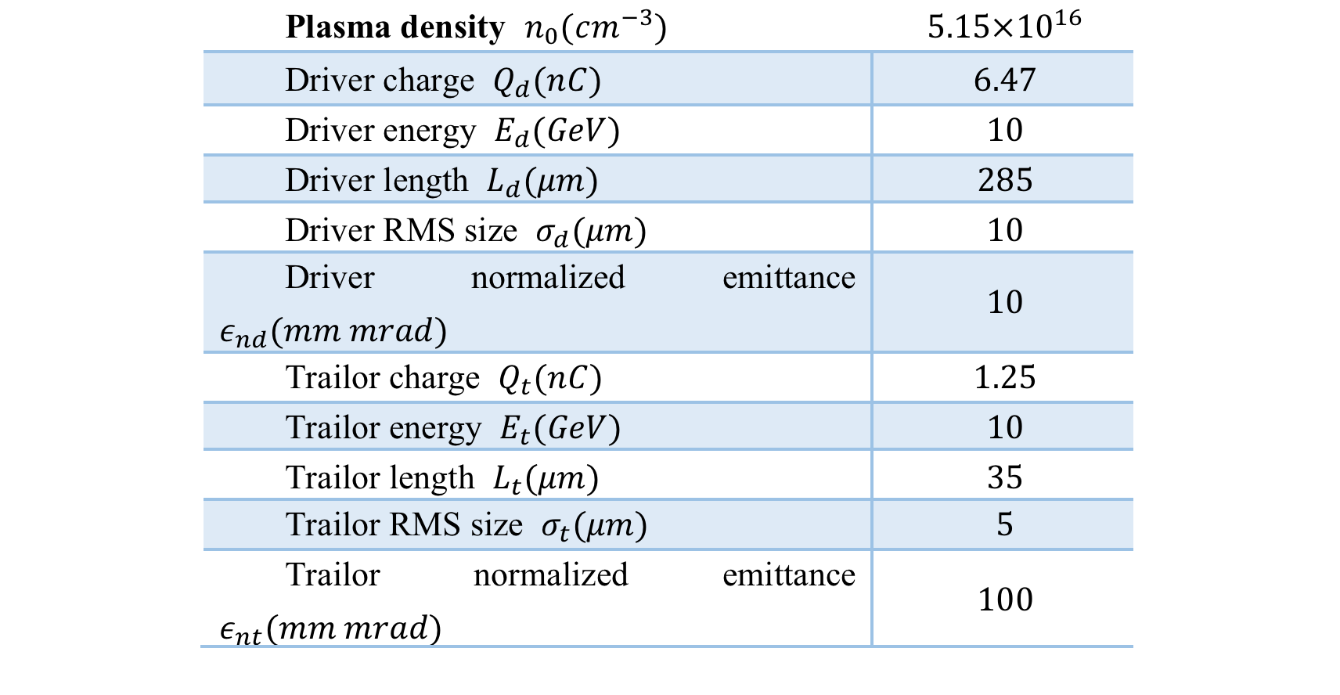
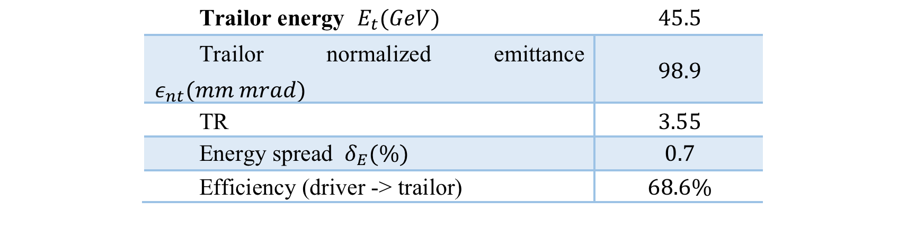
Alterniative solution (example): A High Energy CEPC Injector Based on Plasma Wakefield Accelerator
Driver/trailer beam generation through Photo-injector
HTR PWFA with good stability (single stage TR=3-4, Cascaded stage 6-12, high efficiency)
Positron generation and acceleration in an electron beam driven PWFA using hollow plasma channel (TR=1)

Slide 20
CEPC Accelerator Key Component Designs and Technologies R&D
The CEPC keycomponents hardware have been designed and R&Ds have been planed and execued on the way
Polarized electron gun
  Super-laIce GaAs photocathode DC-Gun
High current positron source
  bunch charge of ~3nC,
  6Tesla Flux Concentrator peak magnetic field
SCRF system
  High Q cavity - Max operation Q₀ = 2E10 @ 2 K
  High power coupler - 300kW（Variable）
High efficiency CW klystron
  Efficiency goal > 80%
Low field dipole magnet（booster）
  Lmag=5m, Bmin=30Gs, Errors <5E-4
Vacuum system
  6m long cooper chamber
  RF shielding bellows
Electro-static separator
  Maximum operating field strength: 20kV/cm
  Maximum deflection: 145 urad
Large scale cryogenics
  12 kW @4.5K refrigerator, Oversized,
  Custom-made, Site integration
HTS magnet
  Advanced HTS Cable R&D: > 10kA
  Advanced High Field HTS Magnet R&D: main field 12~12T

Slide 21
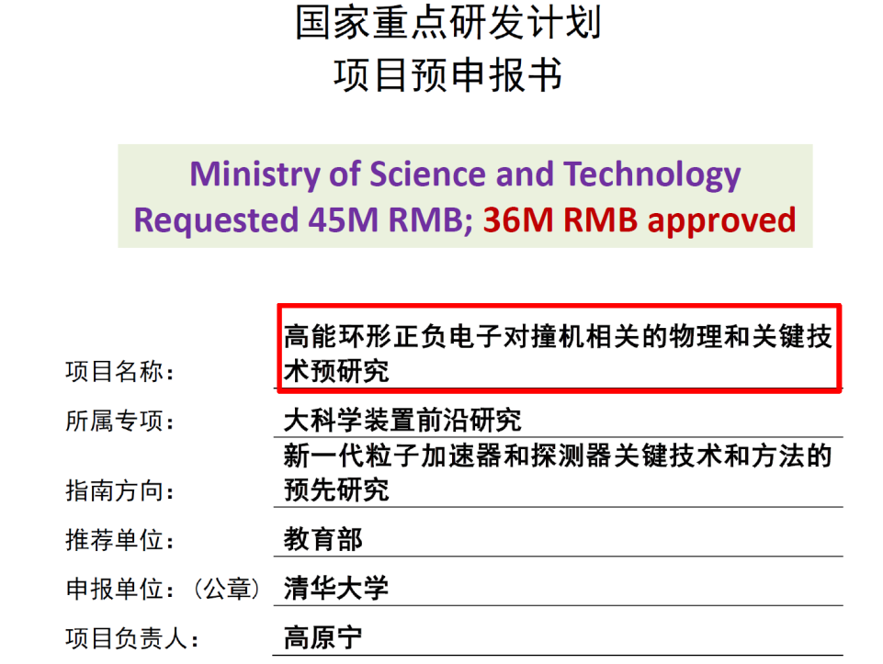
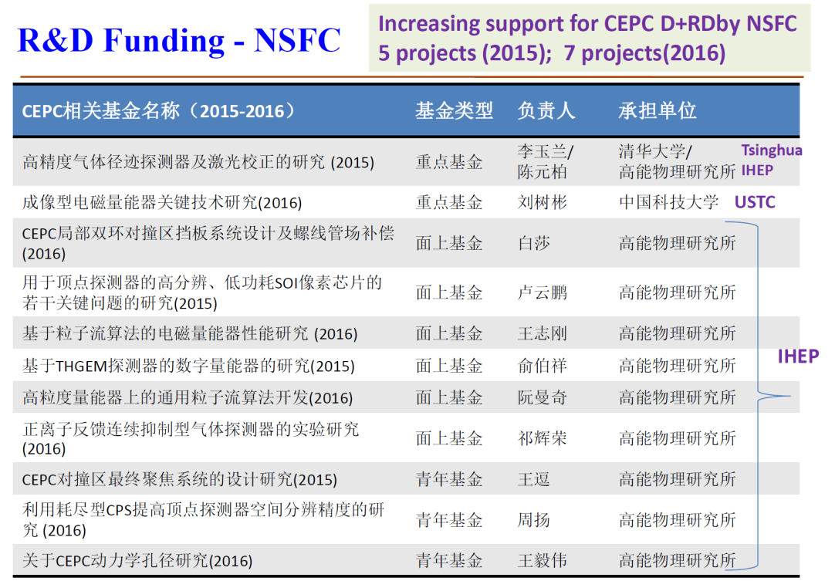
CEPC Funding
  IHEP seed money
  11 M CNY/3 years (2015-2017)
FY 2016
~60M CNY CAS-Beijing fund, talent program
~500M CNY Beijing fund (light source)
year 2017 funding request (32M) to MOST approved
Basic funding needs for carrying out the CEPC design and
the R&D should be met by end of 2018

Slide 22
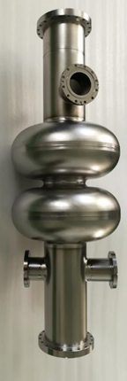
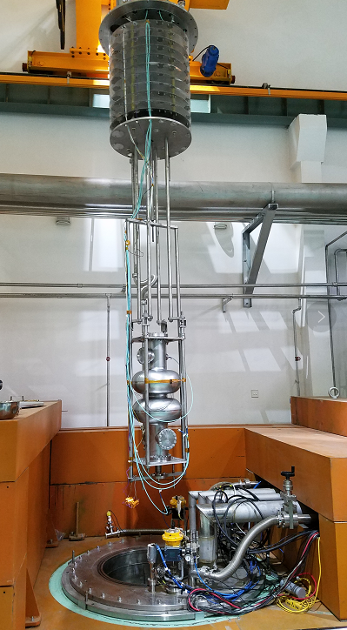
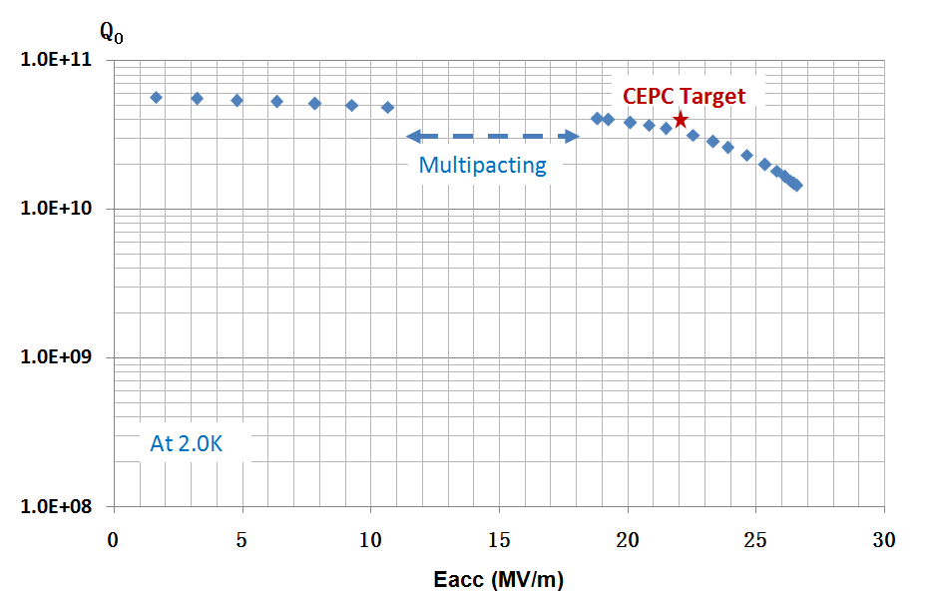
CEPC 650 MHz Cavity development
Vertical test result: Q₀=4.0E10@19.2MV/m，which is close to the CEPC target (Q₀=4.0E10@22.0MV/m).
Next, the CEPC target will be achieved by N-doping and EP, etc.
Vertical test

Slide 23
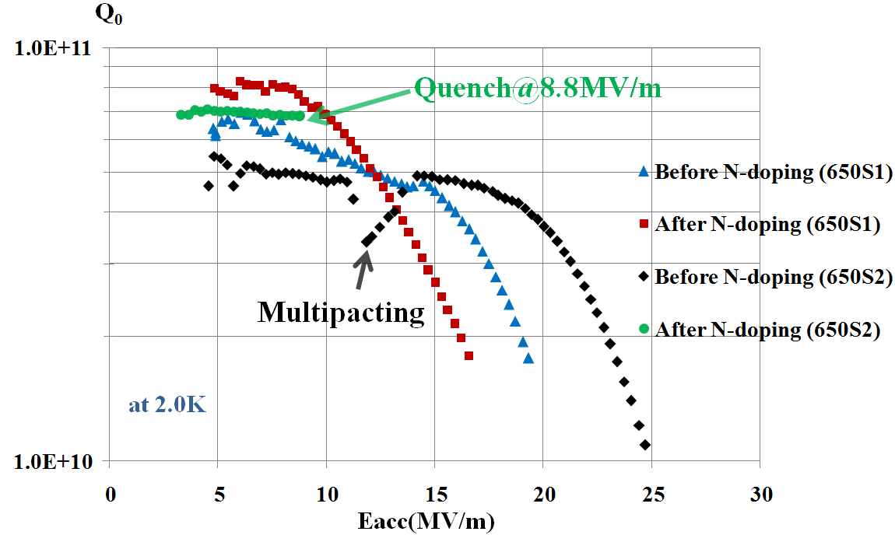
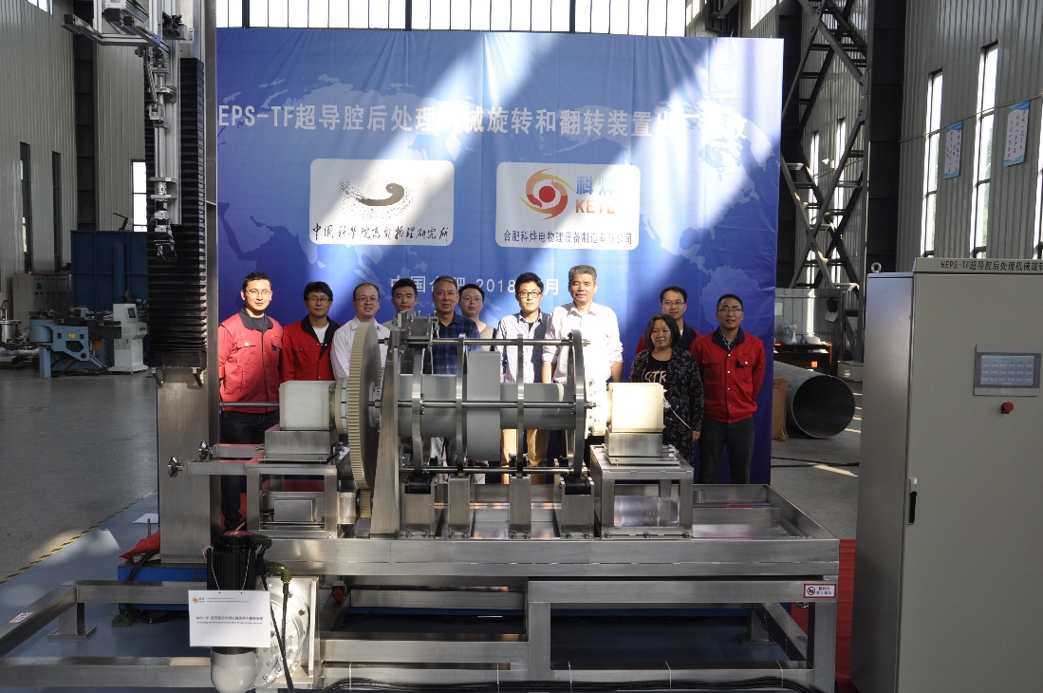
N-doping Research High Q SC Cavity
After N-doping, Q₀ increased obviously at low field for both 650MHz 1-cell cavities.
650S1: Q₀=7e10@Eacc=10MV/m. But Q₀ decreased quickly at high field (>10 MV/m) because of no BCP/EP after N-doping.
650S2: Quench at Q₀=6.9e10@Eacc=8.8MV/m.
The key components of the EP machine have passed the factory acceptance test.
The civil construction of the EP facility is on going, and the commissioning will be on Sep-Oct 2018.
Vertical test results of 650 MHz 1-cell cavities
The first EP facility in China

Slide 24
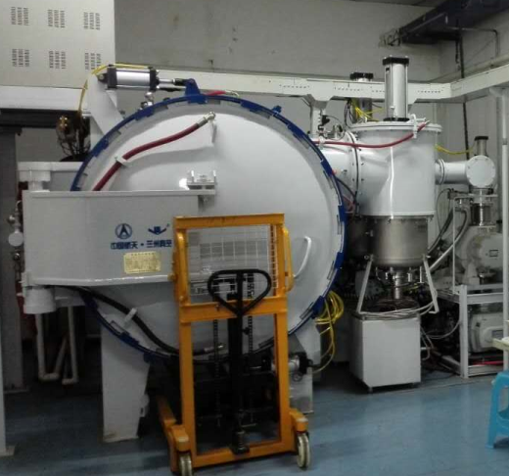
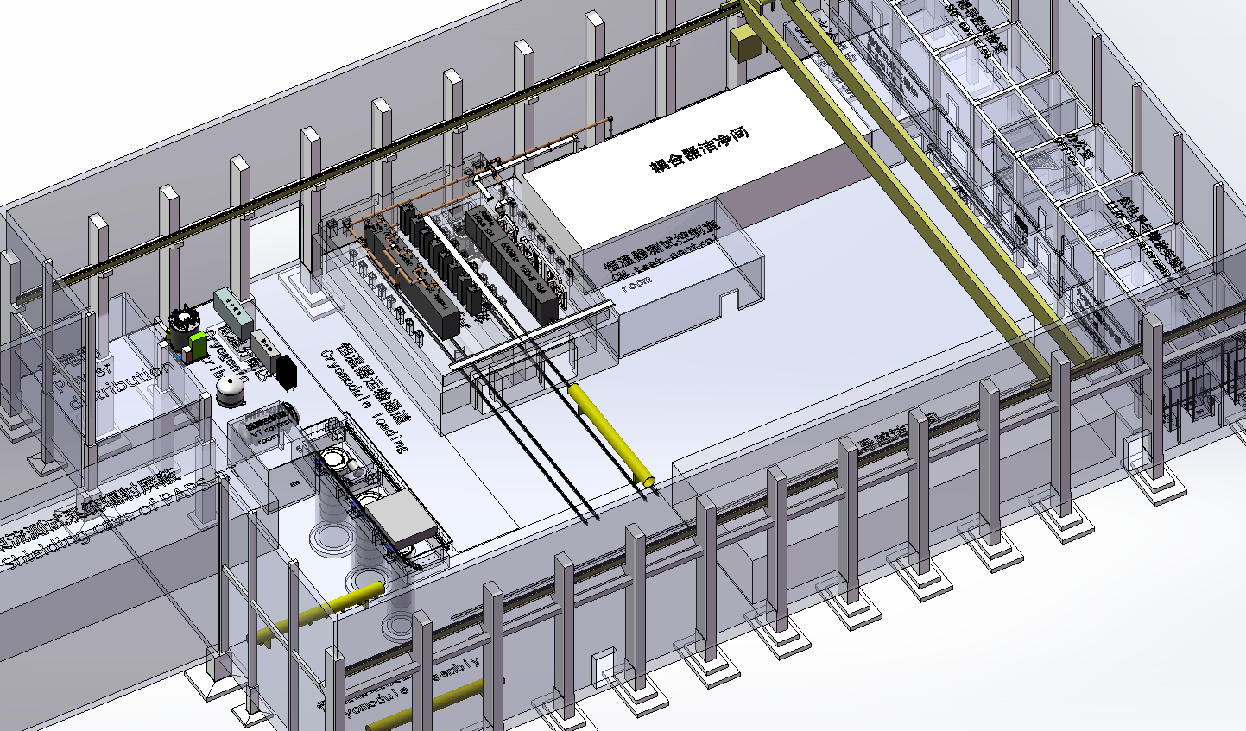
IHEP New SRF Infrastructure
4500 m² SRF lab in the Platform of Advanced Photon Source Technology R&D (PAPS), Huairou Science Park, Beijing.
Mission to be World-leading SRF Lab for Superconducting Accelerator Projects and SRF Frontier R&D.
Mass Production:
  200 ~ 400 cavities & couplers test per year
  20 cryomodules assembly and horizontal test per year.
Construction : 2017 - 2020
N-doping/N-infusion furnace
2 Horizontal test
  3 VT dewars , 2 HT caves,
  500m2 Clean Room
3 Vertical test
Coupler Test
Shanghai city government decided to built Shanghai Coherent Light Facility(SCLF).
432 1.3 GHz cavities
54 Cryomodules
IHEP plans to provide > 1/3 of cavities and cryomodules, an excellent exercise for CEPC
CM Assembly Clean room
Beam tester

Slide 25
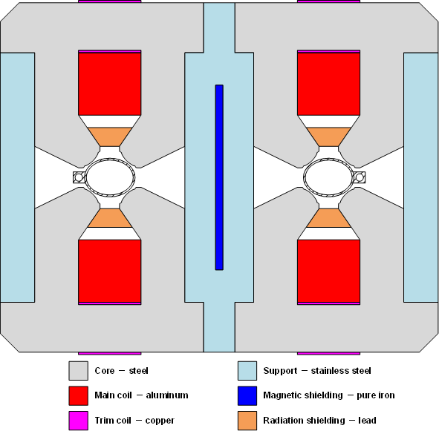
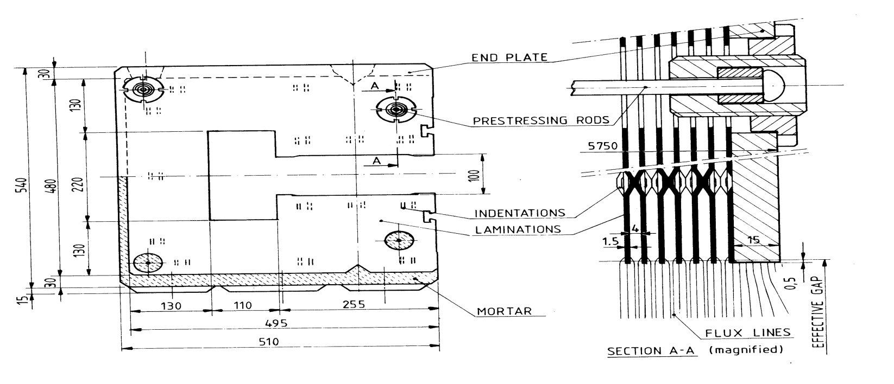
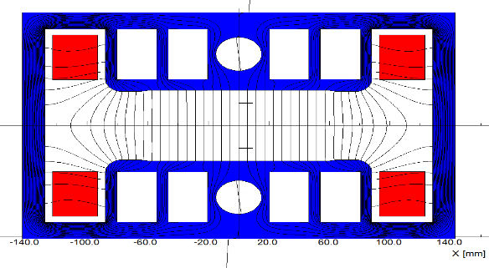
CEPC Collider and Booster Ring Conventional Magnets
CEPC collider ring magnets
 | Dipole | Quad. | Sext. | Corrector | Total
Dual aperture | 2384 | 2392 | - | - | 13742
Single aperture | 80*2+2 | 480*2+172 | 932*2 | 2904*2
Total length [km] | 71.5 | 5.9 | 1.0 | 2.5 | 80.8
Power [MW] | 7.0 | 20.2 | 4.6 | 2.2 | 34
Dipole
Quadrupole
Booster ring low field magnets
Sextupole
Dipole
Quantity | 16320
Magnetic length(m) | 4.711
Max. strength(Gs) | 338
Min. strength(Gs) | 28
Gap height(mm) | 63
GFR(mm) | 55
Field uniformity | 5E-4

Slide 26
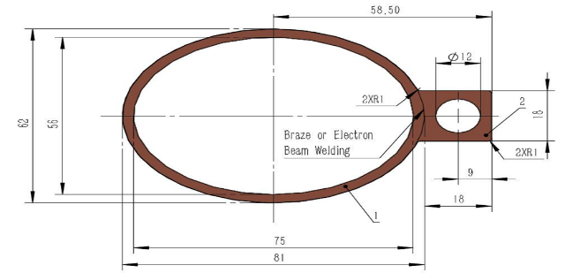
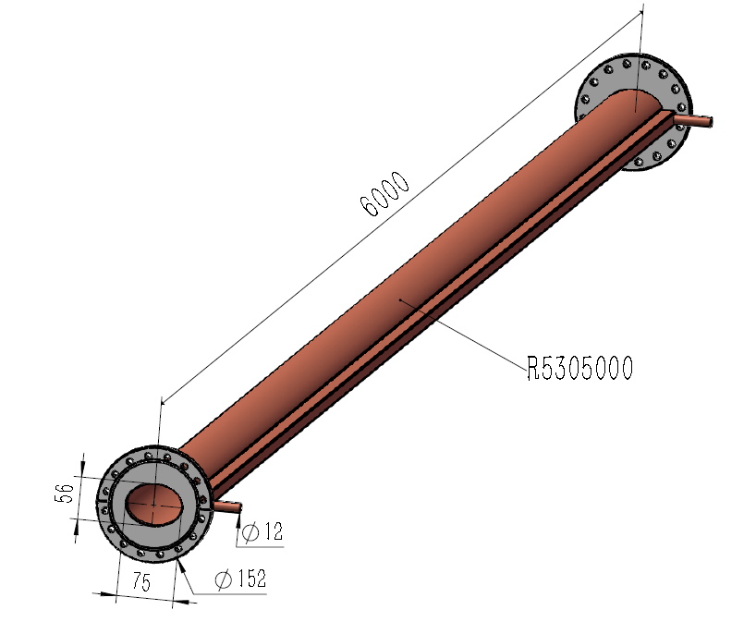
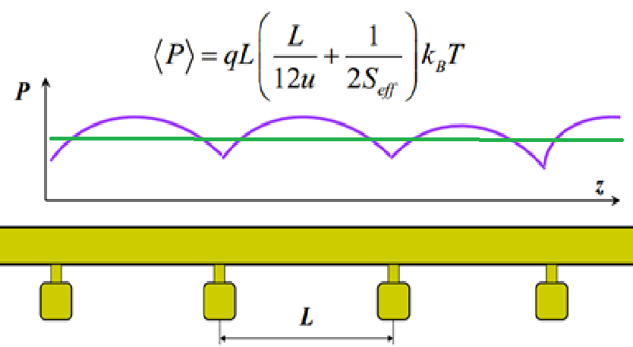
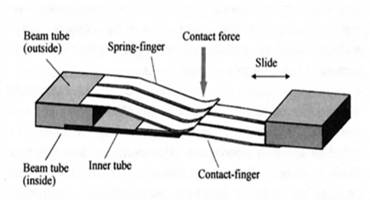
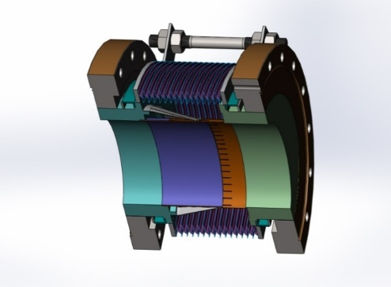
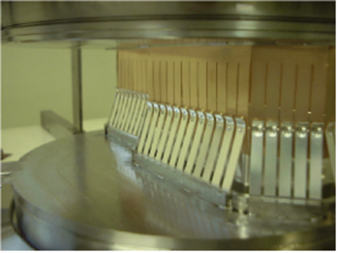
Vacuum System R&D
The vacuum pressure is better than 2 x 10-10 Torr
Total leakage rate is less than 2 x 10-10 torr.l /s.
Positron ring
NEG coating suppresses electron multipacting and beam-induced pressure rises, as well as provides extra linear pumping. Direct Current Magnetron Sputtering systems for NEG coating was chosen.
Copper vacuum chamber (Drawing)
(elliptic 75×56, thickness 3, length 6000)
NEG coating pump
Ion sputtering pump
Function of the bellows module : allow thermal expansion of the chambers and for lateral, longitudinal and angular offsets due to tolerances and alignment,
Providing a uniform chamber cross section to reduce the impedance seen by beam
The Finger contact force of RF shielded bellow is 125±25 g/Finger.

Slide 27


High Efficiency Klystron Development
Established “High efficiency klystron collaboration consortium”, including IHEP & IE(Institute of Electronic) of CAS, and Kunshan Guoli Science and Tech.
  2016 – 2018： Design conventional & high efficiency klystron
  2017 – 2018：Fabricate conventional klystron & test
  2018 - 2019 ：Fabricate 1st high efficiency klystron & test
  2019 - 2020 ：Fabricate 2nd high efficiency klystron & test
  2020 - 2021 ：Fabricate 3rd high efficiency klystron & test
Parameters | Conventional efficiency | High efficiency
Centre frequency (MHz) | 650+/-0.5 | 650+/-0.5
Output power (kW) | 800 | 800
Beam voltage (kV) | 80 | -
Beam current (A) | 16 | -
Efficiency (%) | ~ 65 | > 80
Mechanical design of conventional klystron
73%/68%/65% efficiencies for 1D/2D/3D

Slide 28

High Field Magnet Based on HTS Material
Huge impact If advanced HTS materials (IBS) can be used for 10-20T magnets
  Huge cost reduction of high field magnets
  Huge applications in other area and industry
Fe-based HTS material (IBS)
  Advantages: Metal, easy to process; Isotropic; Cheap in principle
  Good start at CAS
    World highest Tc Fe-based materials
    World first ~ 115 m Fe-based SC conductor: 12000 A/cm² @ 10 T
A collaboration on “advanced HTS materials ” established
  IOP, USTC, IEE, SC conductor companies
  Two approaches:
    IBS
    ReBCO & Bi-2212
CAS has allocated 25Million RMB on HTS
and ~200Million RMB will be allocated in 2018

Slide 29




High Field Magnet R&D for SppC
Magnet development for HL-LHC (exercise of the dipole magnet)
  CERN-IHEP collaboration on HiLumi LHC magnets
NbTi+Nb₃Sn, 2*ф10 aperture
Nb₃Sn+HTS, 2*ф30 aperture
All HTS
10.2T @ 4.2K
First dipole magnet in China (NbTi+Nb₃Sn) test successful

Slide 30
The study path from CEPC Pre-CDE to CEPC CDR baseline and alternative choice has been overviewed
CEPC Accelerator CDR has been completed with all systems reaching the CDR design goals with new ideas beyond CDR
CEPC hardware design and key technologies' R&D plan are ready for full TDR phase
Conclusions

Slide 31
Thanks go to
CEPC accelerator team and international collaborators
Thank you for your attention

