Slide 1
Beam-Beam Effect & Dynamic Aperture at CEPC
Y. Zhang, D. Wang, Y. Wang, C. Yu, H. Geng
28~30 June, 2018, Beijing
CEPC Conceptual Design Report Review Meeting
Many thanks: K. Ohmi(KEK), D. Shatilov(BINP), K. Oide(CERN), D. Zhou(KEK), J. Qiang(LBNL)

Slide 2
Outline
Introduction
Beam-Beam Effect
Dynamic Aperture & Lifetime
Summary

Slide 3
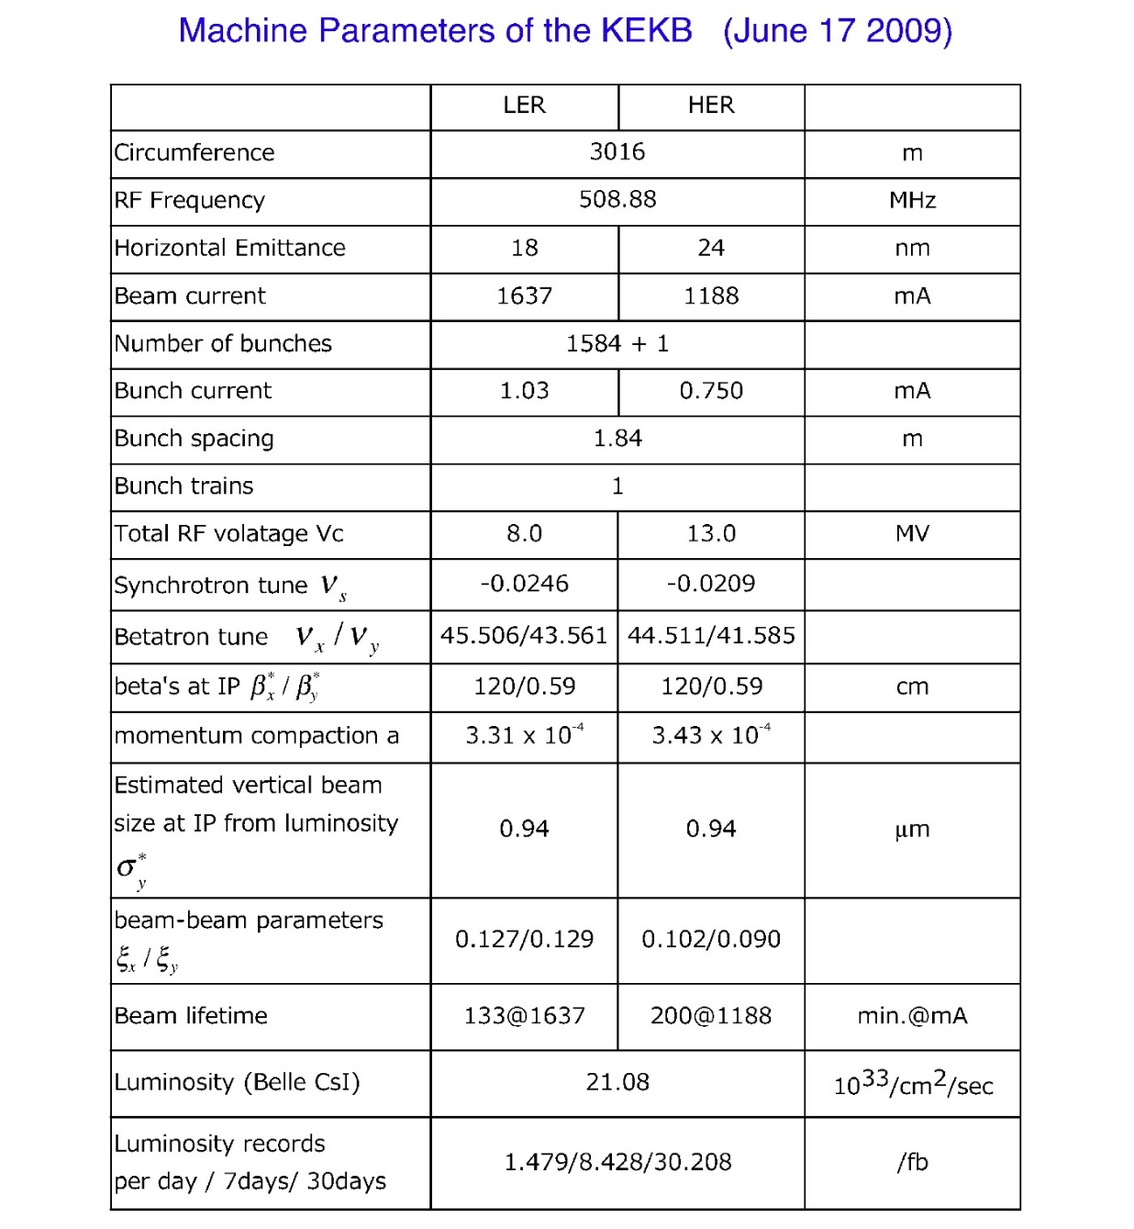
Beam-beam parameter in e+/e- colliders
J. Seeman, “Observations of the beam–beam interaction”, 1985

Slide 4
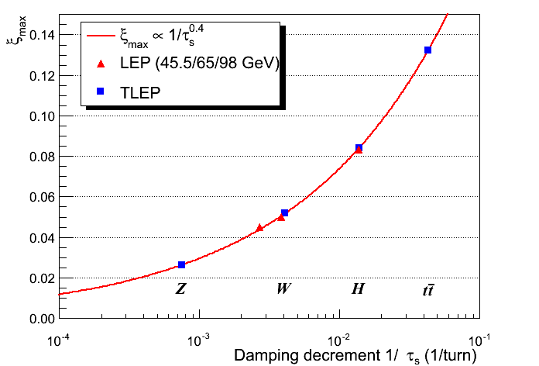
Beam-Beam Parameter at CEPC & LEP2
http://tlep.web.cern.ch/content/accelerator-challenges
CEPC-H
CEPC-W
CEPC-Z
R. Assmann
the damping rate per beam-beam interaction

Slide 5
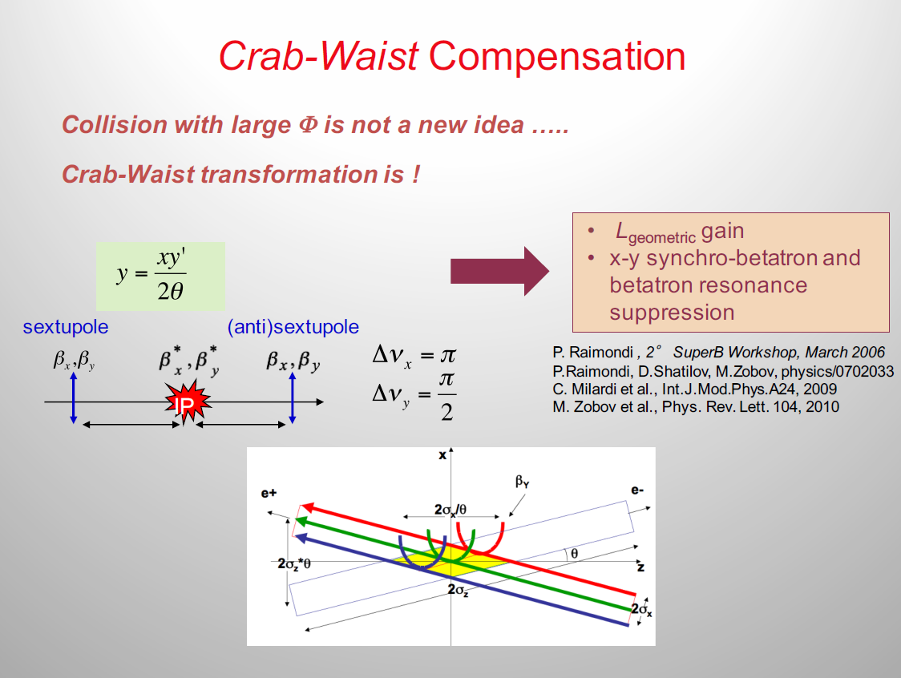
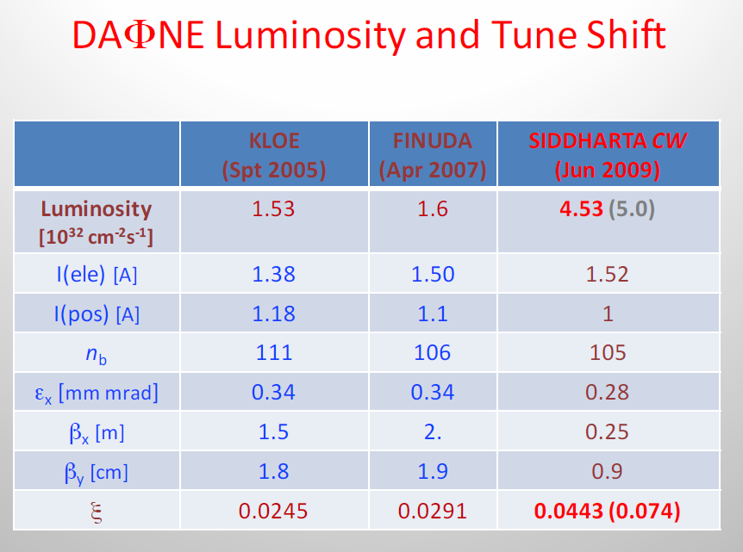

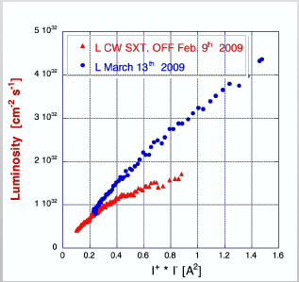
C. Milardi

Slide 6
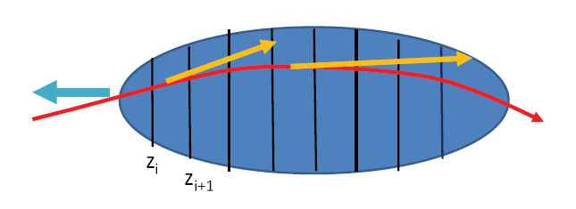
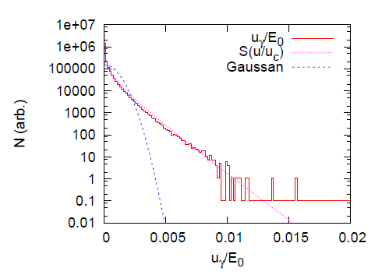
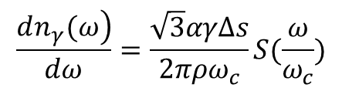

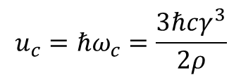
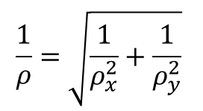
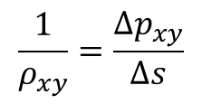
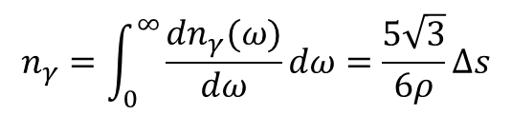
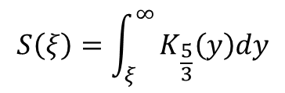
Simulation of Beamstrahlung
K. Ohmi
$$∆s=(z_{i}−z_{i+1})/2$$
$$\frac{1}{ρ_{xy}}=\frac{∆p_{xy}}{∆s}$$
$$\frac{1}{ρ}=\sqrt{\frac{1}{ρ_{x}^{2}}+\frac{1}{ρ_{y}^{2}}}$$
$$u_{c}=ℏω_{c}=\frac{3ℏcγ^{3}}{2ρ}$$
$$n_{γ}=\int_{0}^{∞}{\frac{dn_{γ}(ω)}{dω}dω}=\frac{5\sqrt{3}}{6ρ}∆s$$
$$\frac{\left.dn_{γ}(ω\right)}{dω}=\frac{\sqrt{3}αγΔs}{2πρω_{c}}S(\frac{ω}{ω_{c}})$$
$$S\left(ξ\right)=\int_{ξ}^{∞}{K_{\frac{5}{3}}\left(y\right)dy}$$

Slide 7
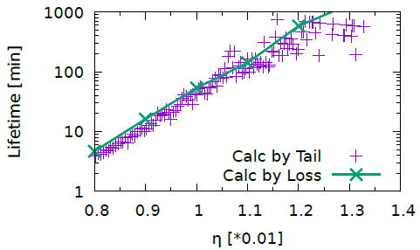
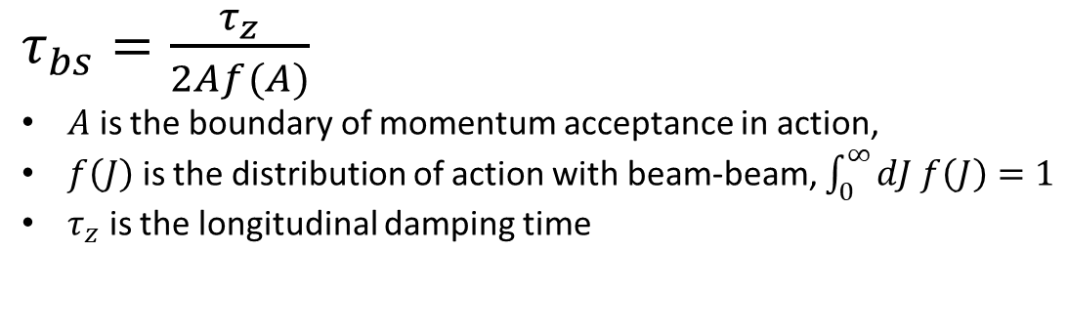
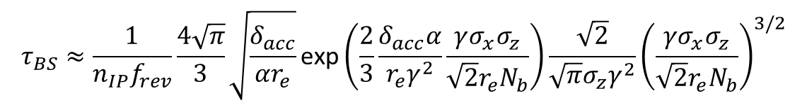
Beamstrahlung lifetime
Analysis
Calculated by beam distribution
[V. Telnov, Phys. Rev. Letters 110 (2013) 114801]
$$τ_{BS}≈\frac{1}{n_{IP}f_{rev}}\frac{4\sqrt{π}}{3}\sqrt{\frac{δ_{acc}}{αr_{e}}}\text{exp}\left(\frac{2}{3}\frac{δ_{acc}α}{r_{e}γ^{2}}\frac{γσ_{x}σ_{z}}{\sqrt{2}r_{e}N_{b}}\right)\frac{\sqrt{2}}{\sqrt{π}σ_{z}γ^{2}}{\left(\frac{γσ_{x}σ_{z}}{\sqrt{2}r_{e}N_{b}}\right)}^{3/2}$$
K. Ohmi
$τ_{bs}=\frac{τ_{z}}{2Af(A)}$
$A$ is the boundary of momentum acceptance in action,
$f\left(J\right)$ is the distribution of action with beam-beam, $\int_{0}^{∞}{dJ f\left(J\right)=1}$
$τ_{z}$ is the longitudinal damping time

Slide 8
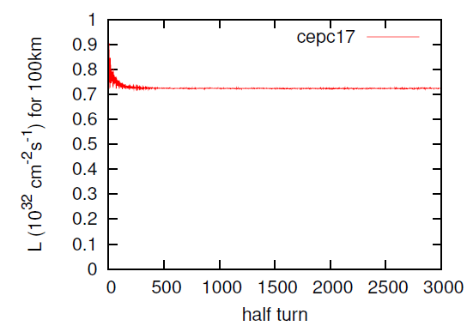
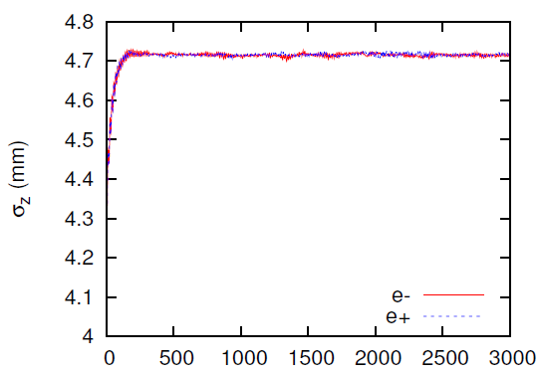
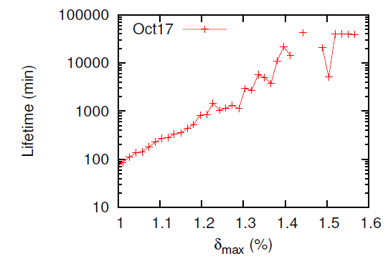
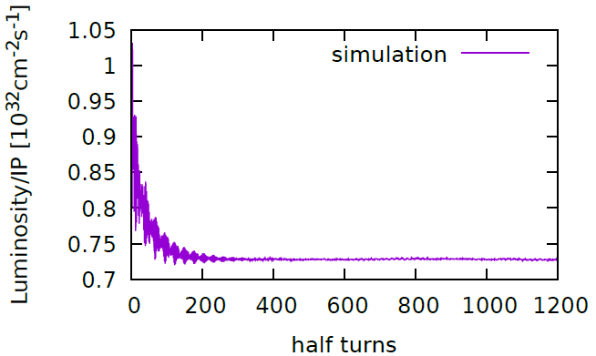
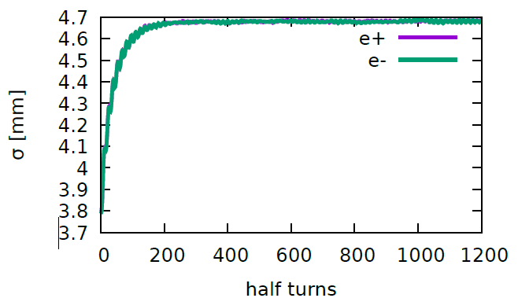
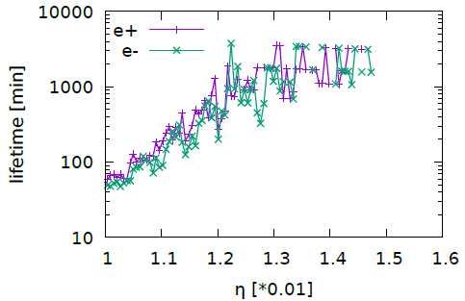
Cross check of Beam-Beam Code
Luminosity
Bunch Length
Beamstrahlung Lifetime
BBSS by
K. Ohmi
IBB by
Y. Zhang

Slide 9
If the machine parameter is reasonable
Limit of bunch population by beam-beam interaction
  Beamstrahlung lifetime
  If X-Z instability is suppressed
  If asymmetric bunch current collision is stable
  If there exist large enough stable working point space
  If beam-beam parameter is safe enough
Notes:
We do not focus on the optimization of the machine parameter

Slide 10
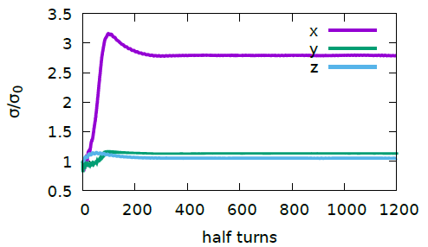
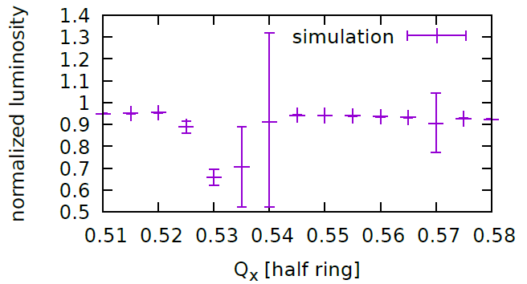
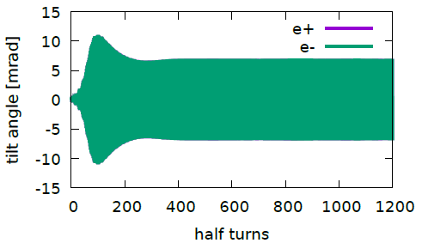

Tune Scan
Higgs
K. Ohmi and etal., DOI:10.1103/PhysRevLett.119.134801
X-Z instability @(0.535,0.61)
$Q_{y}=$0.61, $Q_{s}=0.035$
The error bar shows the turn-by-turn luminosity difference.

Slide 11
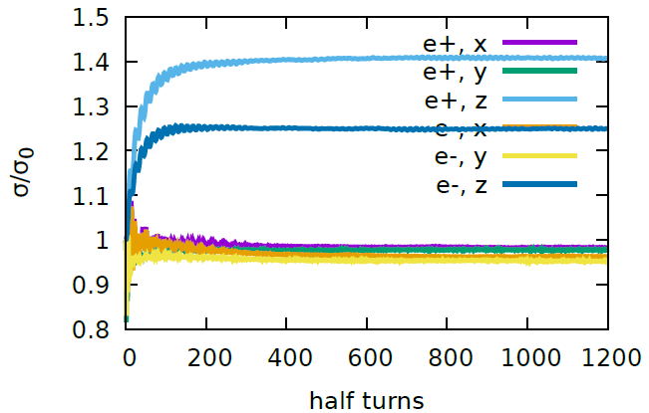
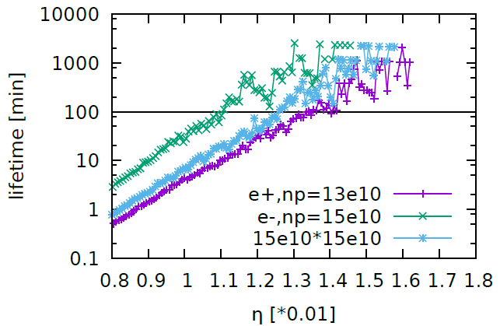
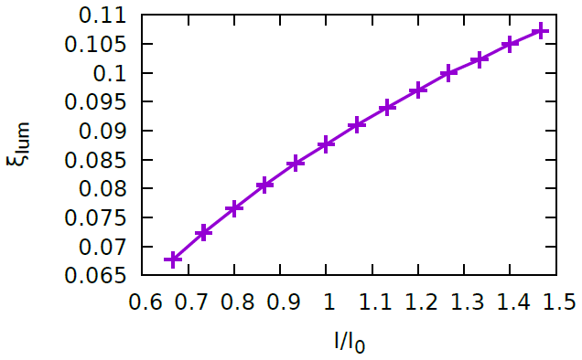
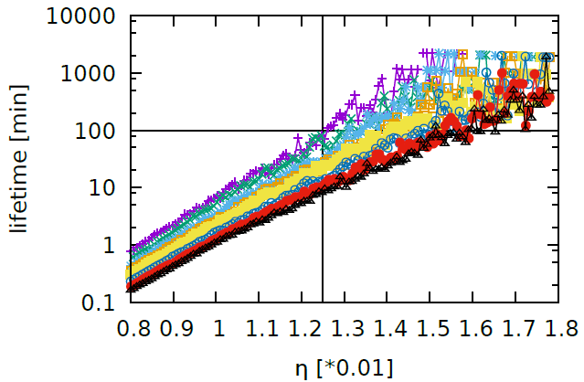
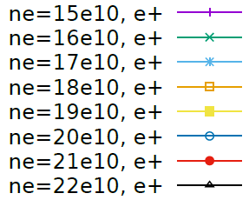
Bunch Current
Higgs
With 13e10*15e10(13%), the weak beam’s lifetime is about 50% of the symmetric collision (15e10*15e10)
With 5% difference, the weak beam’s lifetime is about 20-30% shorter
Asymmetrical
Bunch Current
Bunch Current Limit

Slide 12
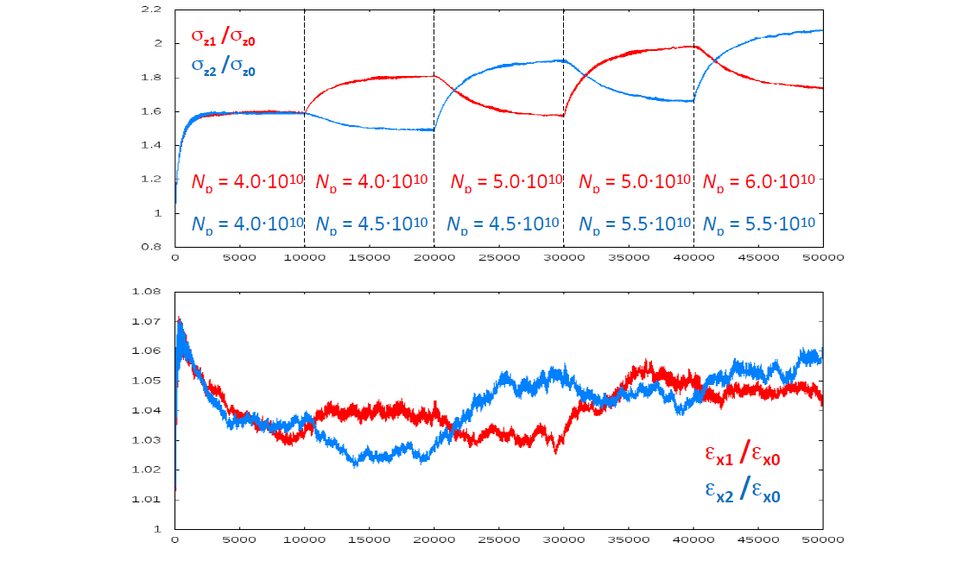

Bootstrapping Injection
D. Shatilov
Np $∝ \frac{α_{p}σ_{δ}σ_{z}}{β_{x}^{∗}}$ (K. Oide)

Slide 13
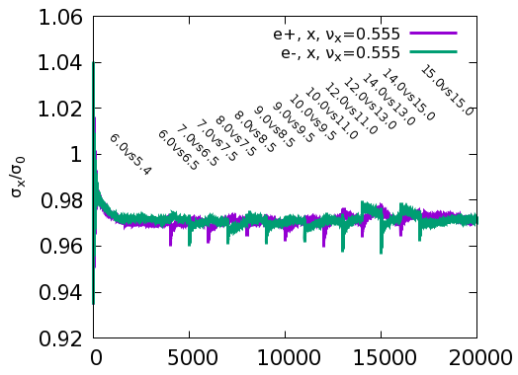
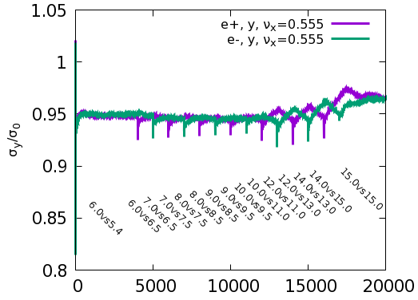
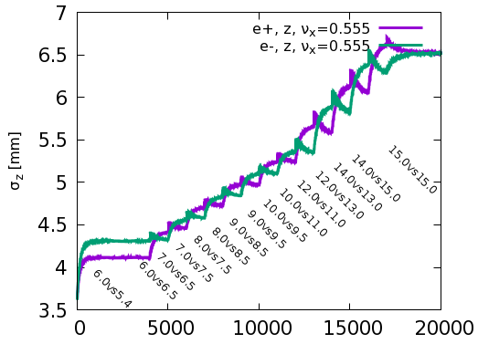
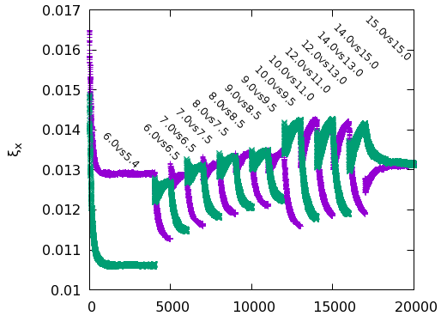
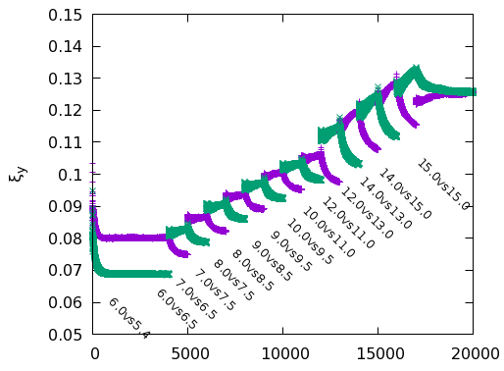
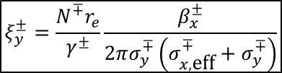
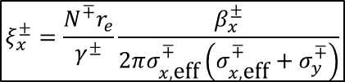

Bootstrapping Injection of W @ Qx=0.555
W
Beam Size
$$ξ_{x}^{±}=\frac{N^{∓}r_{e}}{γ^{±}}\frac{β_{x}^{±}}{2πσ_{x,\text{eff}}^{∓}\left(σ_{x,\text{eff}}^{∓}+σ_{y}^{∓}\right)}$$
Beam-Beam
Parameter
$$ξ_{y}^{±}=\frac{N^{∓}r_{e}}{γ^{±}}\frac{β_{x}^{±}}{2πσ_{y}^{∓}\left(σ_{x,\text{eff}}^{∓}+σ_{y}^{∓}\right)}$$
$$σ_{x,\text{eff}}=\sqrt{σ_{z}^{2}\tan^{2}{θ}+σ_{x}^{2}}$$

Slide 14
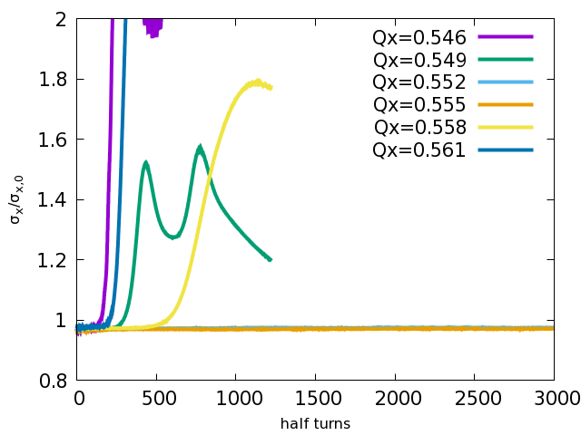
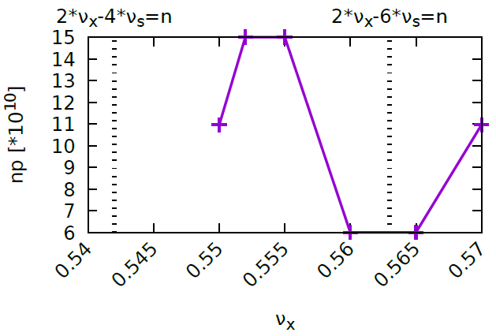

Bunch Current Limit versus Horizontal Tune
W
Collision is stable in the range of [0.552, 0.555]
Np=$12×{10}^{10}$
Notes:
@0.552 and 0.555, np > 15e10,
@0.560 and 0.565, np < 6e10

Slide 15
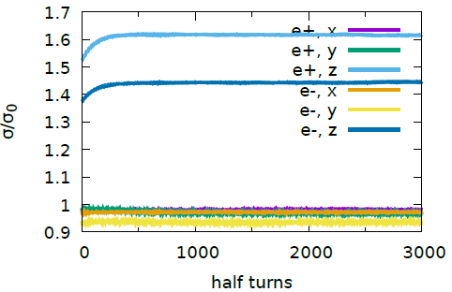
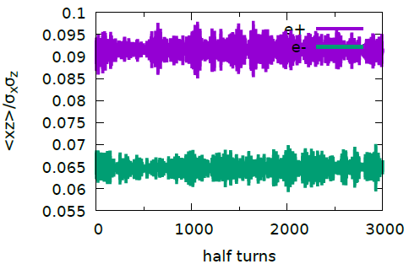
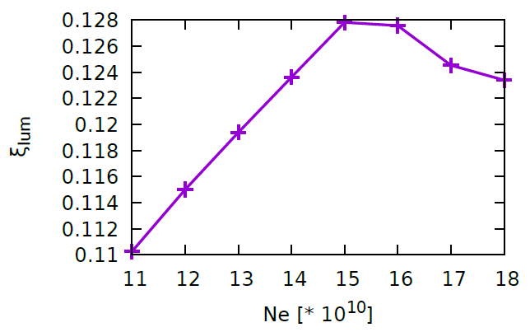
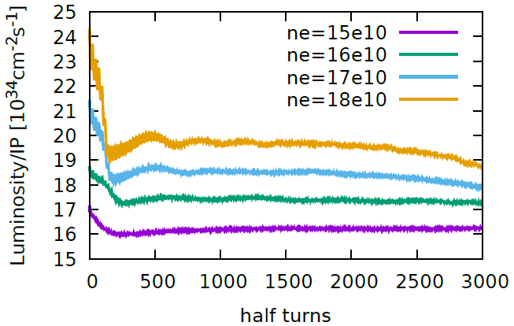
Bunch Current
W
Asymmetrical
Bunch Current
STABLE!
13.5e10 * 15e10
Bunch Current Limit

Slide 16
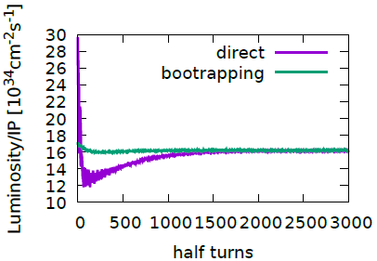
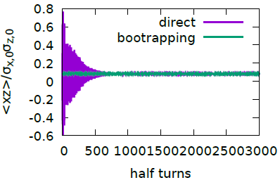
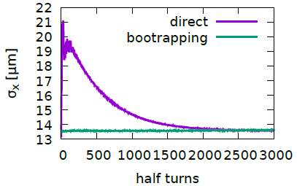
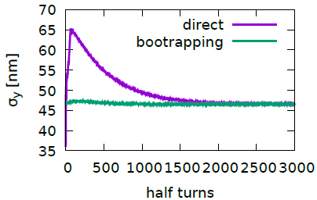
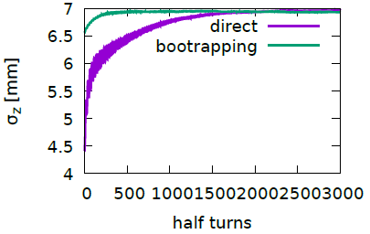
Bootstrapping is necessary? (15e10*15e10)
W

Slide 17





Bootstrapping Injection of Z @ Qx=0.568
Z-3T
Beam Size
$$ξ_{x}^{±}=\frac{N^{∓}r_{e}}{γ^{±}}\frac{β_{x}^{±}}{2πσ_{x,\text{eff}}^{∓}\left(σ_{x,\text{eff}}^{∓}+σ_{y}^{∓}\right)}$$
Beam-Beam
Parameter
$$ξ_{y}^{±}=\frac{N^{∓}r_{e}}{γ^{±}}\frac{β_{x}^{±}}{2πσ_{y}^{∓}\left(σ_{x,\text{eff}}^{∓}+σ_{y}^{∓}\right)}$$
$$σ_{x,\text{eff}}=\sqrt{σ_{z}^{2}\tan^{2}{θ}+σ_{x}^{2}}$$

Slide 18






Bunch Current Limit versus Horizontal Tune
Z-3T
Width of safe Qx ~ 0.006
Criteria: $\frac{σ_{x}}{σ_{0}}$ <1.1
Collision is stable in the range of [0.562, 0.568]
It is similar in case of Z-2T, with np=12$×{10}^{10}$
Np=$15×{10}^{10}$

Slide 19





Bunch Current
Z-3T
Asymmetrical
Bunch Current
Np=13e10 vs 15e10
$$ξ_{y}=\frac{2r_{e}β_{y}^{0}}{Nγ}\frac{L}{f_{0}}$$
Bunch Current Limit
Bunch Lengthening and Energy Spread w/o Collision

Slide 20





Bootstrapping is necessary? (12e10*12e10)
Z-3T

Slide 21




$β_{y}^{∗}$=1.5mm->1mm (Solenoid: 3T -> 2T)
Z
$$ξ_{y}=\frac{2r_{e}β_{y}^{0}}{Nγ}\frac{L}{f_{0}}$$
With same beam current,
smaller $β_{y}^{∗}$+weaker solenoid, luminosity increase by a factor of two.
bunch population increase from $8×{10}^{10}$ to $12×{10}^{10}$, luminosity increase about 20%.

Slide 22


Dynamic Aperture Tracking & Optimization
SAD (http://acc-physics.kek.jp/SAD/):
Synchrotron motion, synchrotron radiation in dipoles, quads and sextupoles, tapering, Maxwellian fringes, kinematical terms, crab waist are considered.
Two algorithms are used in the optimization
MODE: Multi-Objective optimization by Differential Evolution (Y. Zhang and D. Zhou, IPAC’16; J. Qiang, IPAC’13)
Downhill Simplex implemented in SAD
Suppress noise of DA with SR fluctuation
10 more times survey for on-momentum particle is tracked, and the minimum value is treated as the on-momentum DA
Tracked DA result will be clipped to ensure DA at large momentum deviation will be less than that at small deviation

Slide 23

IR knobs
Main Chromaticity Sextupoles (2)
Neighbor weaker sextupole to correct finite length effect
(2)
A. Bogomyagkov, ArXiv:0909.4872
Sextupole to correct higher order chromaticity in vertical direction (1)
Y. Cai, PRAB.19.111006
Different strength between Upstream and Downstream of IP.
10 knobs in IR.

Slide 24



Arc sextupole
90/90 FODO
Non-interleave sextupole scheme
4 SF + 4 SD sextupole configurations in one arc section
7 sub-period in in one arc section，
4 arc section in half ring
Total knobs: 32 (or 56*4=224)
$$φ_{x}=10π$$
$$φ_{y}=10π$$
1
1
2
3
4
5
6
7
8
1
2
3
4

Slide 25

Phase Advance Tuning
1
Phase tuning section
2
10 knobs in x/y direction
Keep tune fixed
Only 8 free knobs
3
4
Phase tuning section
5

Slide 26




DA: w/o and w/ beam-beam interaction
2*longitudinal damping time is tracked
100 samples, 90% survival
Higgs

Slide 27





DA: w/o and w/ beam-beam interaction
 | Higgs | W | Z
with on-axis injection | 8σ_{x} ×12σ_{y}×1.35% | - | -
with off-axis injection | 13σ_{x} ×12σ_{y}×1.35% | 15σ_{x} ×9σ_{y}×0.4% | 17σ_{x} ×9σ_{y}×0.23%
Higgs
Initial Phase = 0
Off - > On
Initial Phase = $\frac{π}{2}$

Slide 28


Beam Distribution in Collision
Lattice + Beamstrahlung + SR Fluctuation
Higgs
w/o error
SR quantum excitation in vertical direction is modeled with a map

Slide 29




Beam Lifetime in Collision
Lattice + Beamstrahlung + SR Fluctuation
Higgs
$τ_{bs}=\frac{τ_{z}}{2Af(A)}$
100min, DA requirement: 7.5$σ_{x}$, 12.5$σ_{y}$, 0.0135
Achieved DA: ~$15σ_{x}$, ~$20σ_{y}$, ~0.016

Slide 30








Discussion on Beam Tail & Lifetime
Higgs
Collision Off
Beamstrahlung effect is the main cause of halo particles
Weaker final focus quadrupoles would help suppress the beam halo
The photon emission would break the crab-waist transformation, and makes the vertical beam blowup
Beamstrahlung Off
Beamstrahlung On
Final Quadrupole Doublet Rad Off

Slide 31
Summary
The present beam-beam parameter is about 2-3 times higher than that of LEPII experience, which is the benefit of crab-waist.
  Higgs is mainly limited by beam lifetime
  W nearly reaches the beam-beam limit
  With further improvement, we could increase bunch population by 50% for Z
New x-z instability limit the choice of horizontal working point
Initial result shows that the beam-beam interaction does not reduce the DA seriously
The lifetime is estimated without error, which is acceptable

Slide 32
Backup Slides

Slide 33
CEPC Parameters
 | Higgs | W | Z（3T） | Z（2T）
Number of IPs | 2
Beam energy (GeV) | 120 | 80 | 45.5
Circumference (km) | 100
Synchrotron radiation loss/turn (GeV) | 1.73 | 0.34 | 0.036
Crossing angle at IP (mrad) | 16.5×2
Piwinski angle | 2.58 | 7.0 | 23.8
Number of particles/bunch N_{e} (10¹⁰) | 15.0 | 12.0 | 8.0
Bunch number (bunch spacing) | 242 (0.68μs) | 1524 (0.21μs) | 12000 (25ns+10%gap)
Beam current (mA) | 17.4 | 87.9 | 461.0
Synchrotron radiation power /beam (MW) | 30 | 30 | 16.5
Bending radius (km) | 10.7
Momentum compact (10⁻⁵) | 1.11
β function at IP β_{x}* / β_{y}* (m) | 0.36/0.0015 | 0.36/0.0015 | 0.2/0.0015 | 0.2/0.001
Emittance ε_{x}/ε_{y} (nm) | 1.21/0.0031 | 0.54/0.0016 | 0.18/0.004 | 0.18/0.0016
Beam size at IP σ_{x} /σ_{y} (μm) | 20.9/0.068 | 13.9/0.049 | 6.0/0.078 | 6.0/0.04
Beam-beam parameters ξ_{x}/ξ_{y} | 0.031/0.109 | 0.013/0.106 | 0.0041/0.056 | 0.0041/0.072
RF voltage V_{RF} (GV) | 2.17 | 0.47 | 0.10
RF frequency f _{RF} (MHz) (harmonic) | 650 (216816)
Natural bunch length σ_{z} (mm) | 2.72 | 2.98 | 2.42
Bunch length σ_{z} (mm) | 3.26 | 5.9 | 8.5
HOM power/cavity (2 cell) (kw) | 0.54 | 0.75 | 1.94
Natural energy spread (%) | 0.1 | 0.066 | 0.038
Energy acceptance requirement (%) | 1.35 | 0.4 | 0.23
Energy acceptance by RF (%) | 2.06 | 1.47 | 1.7
Photon number due to beamstrahlung | 0.107 | 0.05 | 0.023
Lifetime _simulation (min) | 100
Lifetime (hour) | 0.67 | 1.4 | 4.0 | 2.1
F (hour glass) | 0.89 | 0.94 | 0.99
Luminosity/IP L (10³⁴cm⁻²s⁻¹) | 2.93 | 10.1 | 16.6 | 32.1

Slide 34





Dynamic Aperture of Higgs (100 samples)
Phase=0
Phase=Pi/2

Slide 35




Dynamic Aperture of W
Phase=0
Phase=Pi/2

Slide 36





Dynamic Aperture of Z (2T, $β_{y}^{∗}$=1mm)
Phase=0
Phase=Pi/2

Slide 37

Beamstrahlung lifetime of W (ne=15e10)

