Slide 1
CEPC Booster Design
Dou Wang, Tianjian Bian, Chenghui Yu, Xiaohao Cui, Daheng Ji, Chuang Zhang, Jiyuan Zhai, Yudong Liu, Yuan Zhang, Cai Meng, Jie Gao
CEPC CDR international review, Jun. 28, 2018 . A415, IHEP.

Slide 2
Outline
Introduction
Design requirements
Geometry & optics
Performance with errors
Ramping curves
Summary

Slide 3
CEPC CDR Parameters
 | Higgs | W | Z（3T） | Z（2T）
Number of IPs | 2
Beam energy (GeV) | 120 | 80 | 45.5
Circumference (km) | 100
Synchrotron radiation loss/turn (GeV) | 1.73 | 0.34 | 0.036
Crossing angle at IP (mrad) | 16.5×2
Piwinski angle | 2.58 | 7.0 | 23.8
Number of particles/bunch N_{e} (10¹⁰) | 15.0 | 12.0 | 8.0
Bunch number (bunch spacing) | 242 (0.68μs) | 1524 (0.21μs) | 12000 (25ns+10%gap)
Beam current (mA) | 17.4 | 87.9 | 461.0
Synchrotron radiation power /beam (MW) | 30 | 30 | 16.5
Bending radius (km) | 10.7
Momentum compact (10⁻⁵) | 1.11
β function at IP β_{x}* / β_{y}* (m) | 0.36/0.0015 | 0.36/0.0015 | 0.2/0.0015 | 0.2/0.001
Emittance ε_{x}/ε_{y} (nm) | 1.21/0.0031 | 0.54/0.0016 | 0.18/0.004 | 0.18/0.0016
Beam size at IP σ_{x} /σ_{y} (μm) | 20.9/0.068 | 13.9/0.049 | 6.0/0.078 | 6.0/0.04
Beam-beam parameters ξ_{x}/ξ_{y} | 0.031/0.109 | 0.013/0.106 | 0.0041/0.056 | 0.0041/0.072
RF voltage V_{RF} (GV) | 2.17 | 0.47 | 0.10
RF frequency f _{RF} (MHz) (harmonic) | 650 (216816)
Natural bunch length σ_{z} (mm) | 2.72 | 2.98 | 2.42
Bunch length σ_{z} (mm) | 3.26 | 5.9 | 8.5
HOM power/cavity (2 cell) (kw) | 0.54 | 0.75 | 1.94
Natural energy spread (%) | 0.1 | 0.066 | 0.038
Energy acceptance requirement (%) | 1.35 | 0.4 | 0.23
Energy acceptance by RF (%) | 2.06 | 1.47 | 1.7
Photon number due to beamstrahlung | 0.1 | 0.05 | 0.023
Lifetime _simulation (min) | 100
Lifetime (hour) | 0.67 | 1.4 | 4.0 | 2.1
F (hour glass) | 0.89 | 0.94 | 0.99
Luminosity/IP L (10³⁴cm⁻²s⁻¹) | 2.93 | 10.1 | 16.6 | 32.1

Slide 4
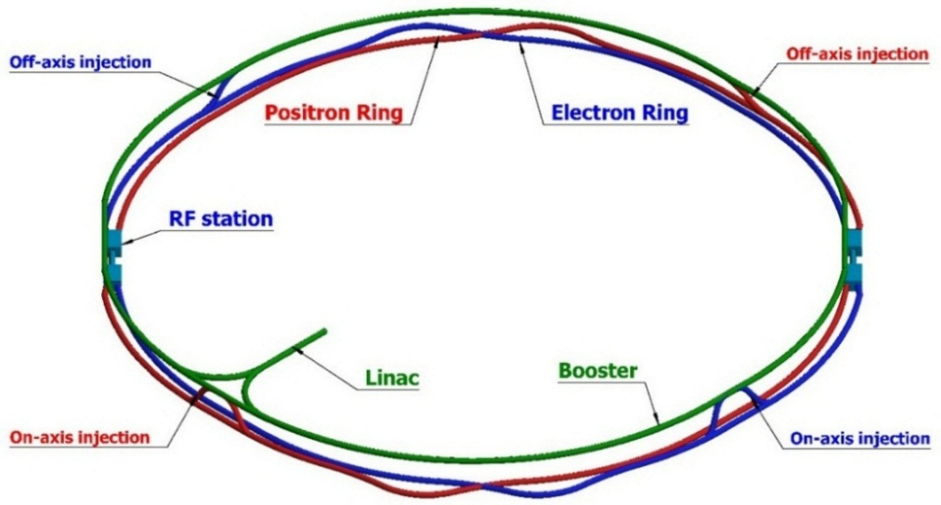
CEPC injector chain
100km
Injection energy: 10GeV
10 GeV linac provides electron and positron beams for booster.
Top up injection for collider ring ~ 3% current decay
Booster is in the same tunnel as collider ring, above the collider ring.
Booster has the same geometry as collider ring except for the two IRs.
Booster bypasses the collider ring from the outer side at two IPs.

Slide 5
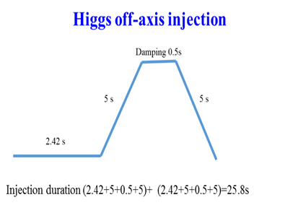
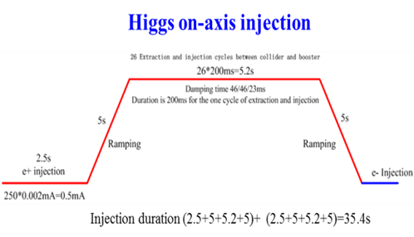
CEPC injection scheme
Linac → booster: on-axis injection
Booster → collider:
1）off-axis injection with horizontal local bump (H, W, Z)
2）on-axis injection in vertical plane (H)
100km
Injection energy: 10GeV

Slide 6

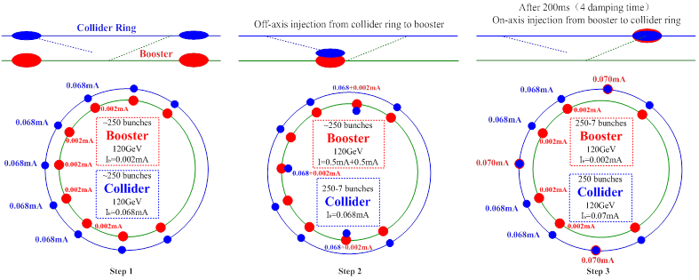
On-axis injection @ Higgs
In case DA of collider @Higgs is not large enough for the off-axis injection
26 extraction/injection cycles between collider and booster ~26*200=5.2s
Requirement for booster @120GeV
- single bunch current threshold >70uA
- coupling <0.5%
- energy acceptance >1%
Step 1: Linac→booster (242 small bunches)
Step 2: Collider→booster (7 big bunches)
off-axis injection
Step 3: Mix in booster (4 damping time)
(235 small bunches + 7 big bunches)
Step 4: Booster→collider (7 big bunches)
on-axis injection
→ Step 2
…

Slide 7
Design requirements for CEPC booster
Parameters | Design goals
Beam current (mA) | <1.0 mA(Higgs), 4.0 mA (W), 10 mA(Z)
Emittance@ 120GeV (nm rad) | <3.6
Dynamic aperture @10GeV(σ, normalized by linac beam size) | >4σ+5mm
Dynamic aperture @120GeV | >6σx+3mm, 49σy+3mm
Energy acceptance | >1%
Coupling | <0.5%
Booster transfer efficiency | >92%
Total transfer efficiency (inc. inj. & ext.) | >90% (99%*92%*99%)
Timing | Meet the top-up injection requirements
Beam current threshold in booster is limited by RF power.
The diameter of the inner aperture is selected as 55mm for high current injection.
Assumption for total efficiency 90%: 92% for booster+ 99% for transport lines.
Emittance@120GeV <3.6nm, energy acceptance >1%
Coupling <0.5%: requirement of Higgs on-axis injection scheme
DA@10GeV: BSC region, DA@120GeV:on-axis injection (V) & quan. lifetime (H)

Slide 8
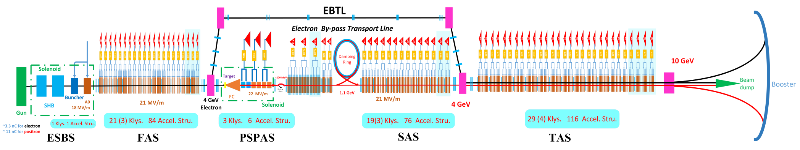
CEPC Linac
Parameter | Symbol | Unit | Baseline | Designed
e⁻ /e⁺ beam energy | E_{e-}/E_{e+} | GeV | 10 | 10
Repetition rate | f_{rep} | Hz | 100 | 100
e⁻ /e⁺ bunch population | N_{e-}/N_{e+} |  | > 9.4×10⁹ | 1.9×10¹⁰ / 1.9×10¹⁰
 |  | nC | > 1.5 | 3.0
Energy spread (e⁻ /e⁺ ) | σ_{e} |  | < 2×10⁻³ | 1.5×10⁻³ / 1.6×10⁻³
Emittance (e⁻ /e⁺ ) | ε_{r} | nm⋅ rad | < 120 | 5 / 40 ~120
Bunch length (e⁻ /e⁺ ) | σ_{l} | mm |  | 1 / 1
e⁻ beam energy on Target |  | GeV | 4 | 4
e⁻ bunch charge on Target |  | nC | 10 | 10

Slide 9
Booster parameters @ injection (10GeV)
 |  | H | W | Z
Beam energy | GeV | 10
Bunch number |  | 242 | 1524 | 6000
Threshold of single bunch current | μA | 25.7
Threshold of beam current (limited by coupled bunch instability) | mA | 100
Bunch charge | nC | 0.78 | 0.63 | 0.45
Single bunch current | μA | 2.3 | 1.8 | 1.3
Beam current | mA | 0.57 | 2.86 | 7.51
Natural Energy spread | % | 0.0078
Synchrotron radiation loss/turn | keV | 73.5
Momentum compaction factor | 10⁻⁵ | 2.44
Natural emittance | nm | 0.025
Natural chromaticity | H/V | -336/-333
RF voltage | MV | 62.7
Betatron tune ν_{x}/ν_{y}/ν_{s} |  | 263.2/261.2/0.1
RF energy acceptance | % | 1.9
Damping time | s | 90.7
Bunch length of linac beam | mm | 1.0
Energy spread of linac beam | % | 0.16
Emittance of linac beam | nm | 40~120

Slide 10
Booster parameters @ extraction
 |  | H |  |  | W | Z
 |  | Off axis injection | On axis injection |  | Off axis injection | Off axis injection
Beam energy | GeV | 120 |  |  | 80 | 45.5
Bunch number |  | 242 |  | 235+7 | 1524 | 6000
Maximum bunch charge | nC | 0.72 |  | 24.0 | 0.58 | 0.41
Maximum single bunch current | μA | 2.1 |  | 70 | 1.7 | 1.2
Threshold of single bunch current | μA | 300
Threshold of beam current (limited by RF power) | mA | 1.0 |  |  | 4.0 | 10.0
Beam current | mA | 0.52 |  | 1.0 | 2.63 | 6.91
Injection duration for top-up (Both beams) | s | 25.8 |  | 35.4 | 45.8 | 275.2
Injection interval for top-up | s | 73.1 |  |  | 153.0 | 438.0
Current decay during injection interval |  | 3%
Energy spread | % | 0.094 |  |  | 0.062 | 0.036
Synchrotron radiation loss/turn | GeV | 1.52 |  |  | 0.3 | 0.032
Momentum compaction factor | 10⁻⁵ | 2.44
Emittance | nm | 3.57 |  |  | 1.59 | 0.51
Natural chromaticity | H/V | -336/-333
Betatron tune ν_{x}/ν_{y} |  | 263.2/261.2
RF voltage | GV | 1.97 |  |  | 0.585 | 0.287
Longitudinal tune |  | 0.13 |  |  | 0.10 | 0.10
RF energy acceptance | % | 1.0 |  |  | 1.2 | 1.8
Damping time | ms | 52 |  |  | 177 | 963
Natural bunch length | mm | 2.8 |  |  | 2.4 | 1.3
Injection duration from empty ring | h | 0.17 |  |  | 0.25 | 2.2

Slide 11
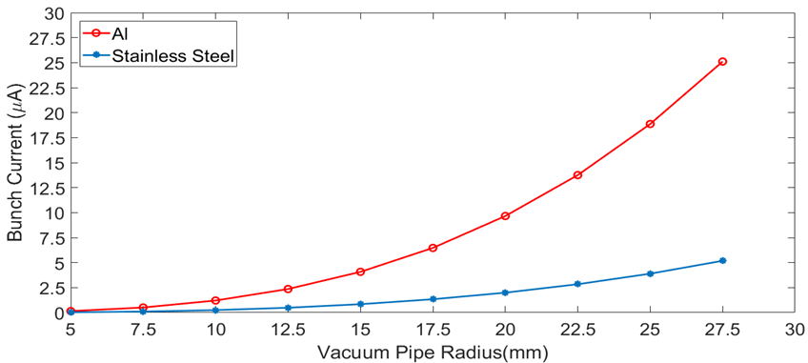
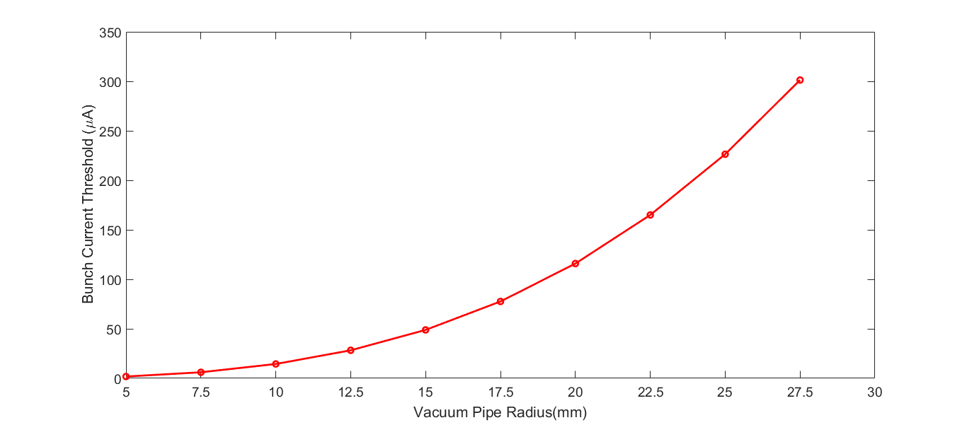
Beam instability
Aluminum pipe with radius 27.5 mm is chosen
Higher threshold of beam current for reasonable injection time during z operation
Higher single bunch current threshold@120GeV (on-axis injection)
Threshold of single bunch current (TMCI): 25.7uA (10GeV), 300 uA (120GeV)
Threshold of beam current (resistive wall) w. FB: 127.5mA (10GeV)
Damping time of transverse feedback system: 1.67ms (~5 turns)
Threshold of beam current (RF HOMs) w. FB: 100mA (10GeV)
Total beam current limited by RF power: 1mA(H), 4mA(W), 10mA(Z)
10GeV
120GeV

Slide 12
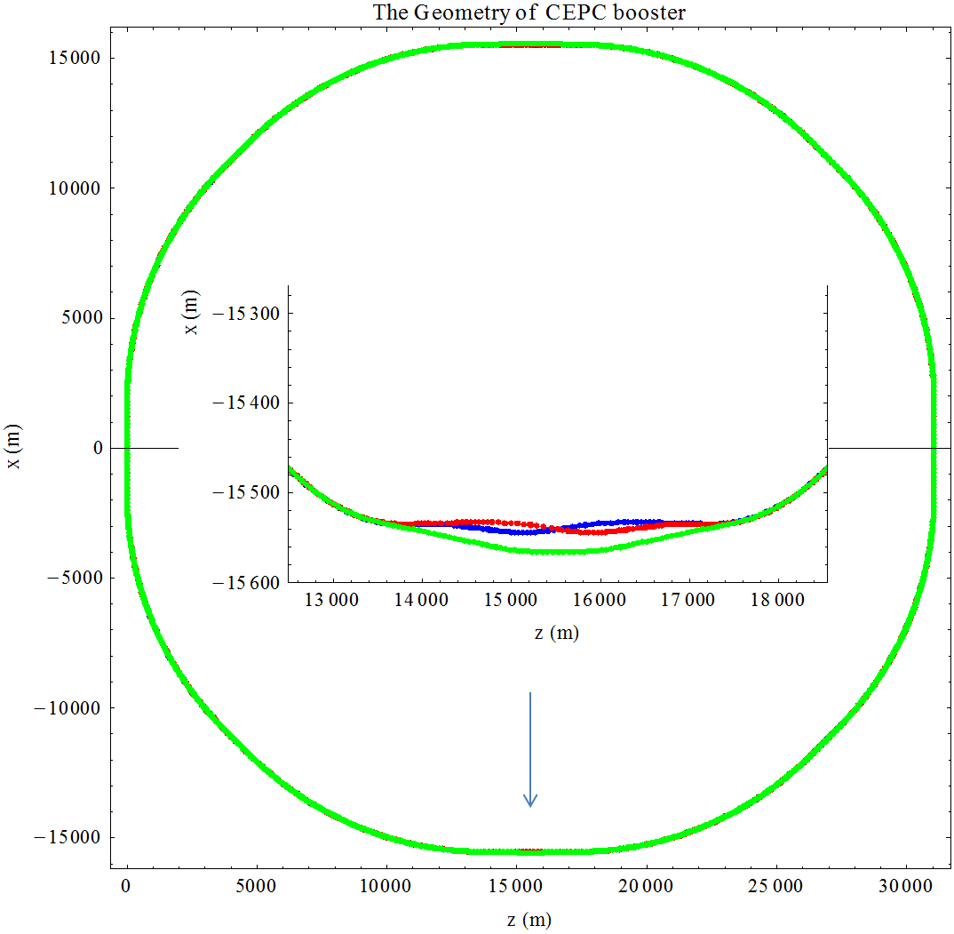
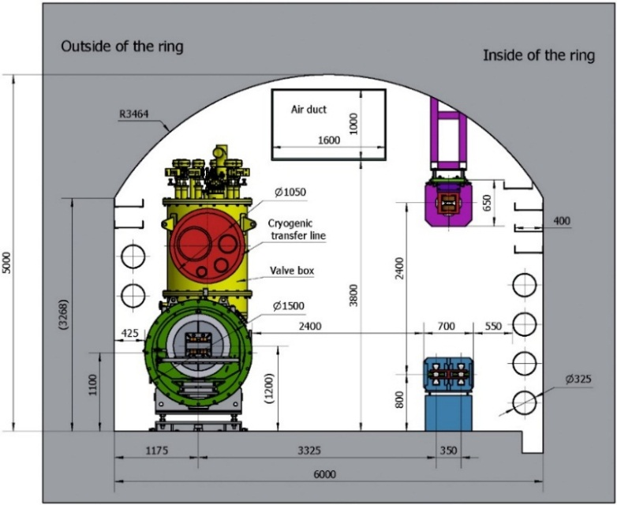
Booster geometry design
Booster has almost same geometry as collider ring except for the two IRs.
ARC: booster is in between the two beams of collider ring, error=±0.17m
-- precision of element length: ~10⁻⁵ m
-- precision of dipole angle: ~10⁻⁷ rad
IR: separation between detector center and booster: ~25 m

Slide 13
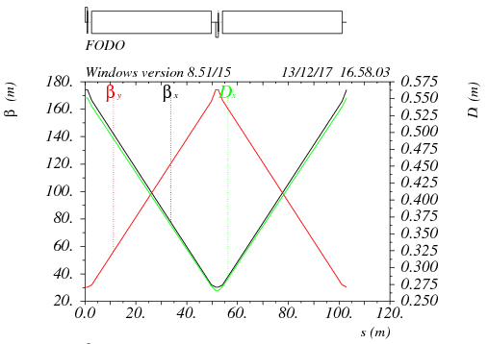
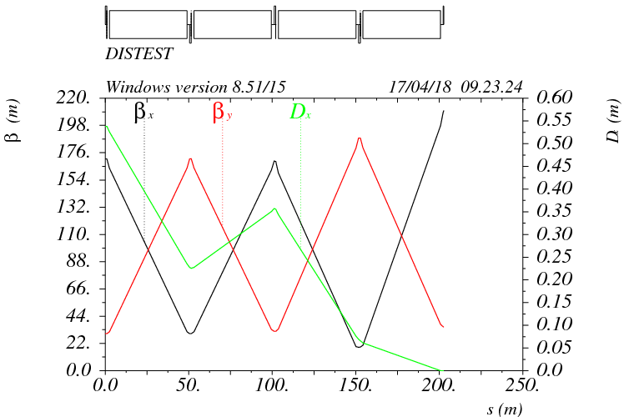
Booster optics - ARC
90°/ 90° FODO cell
2 cells @ booster = 3 cells @ collider
FODO length: 101m
Noninterleave sextupole scheme
Dispersion suppressor
- two standard FODO cell
- adjust bend strength- match the geometry of collider ring
FODO cell
Dispersion suppressor

Slide 14
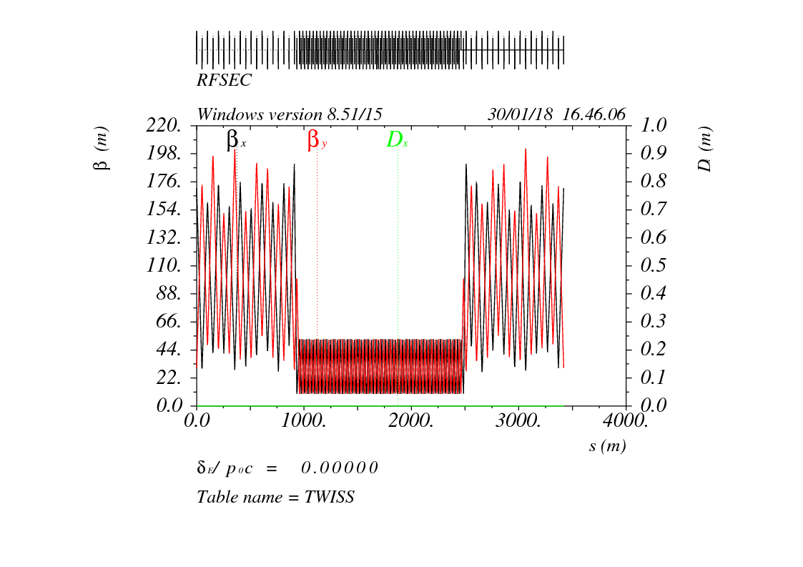
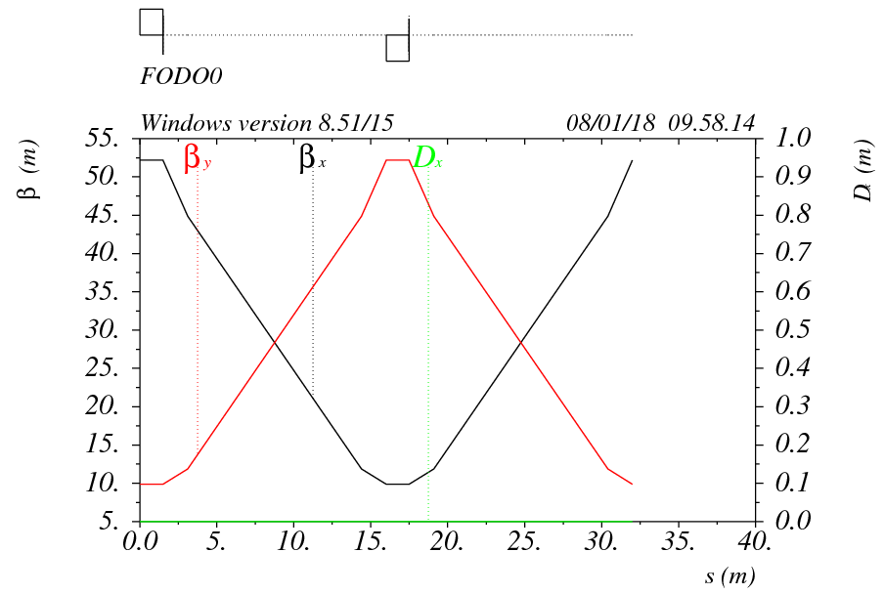
Booster optics - RF
Booster RF straight section at the same location as collider ring -3.4km
Low average beta to reduce the multi-bunch instability by RF cavities -1.6km
- 90°/ 90° FODO cell
- Average beta: 30 m
- Space between quadrupoles :12m
RF section

Slide 15
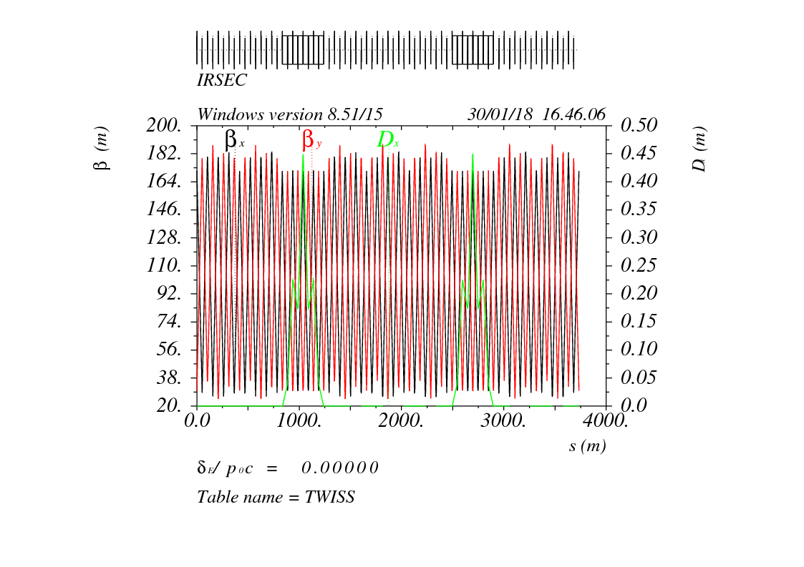
Booster optics – IR bypass
In CEPC detector region, booster bypasses the collider ring from the outer side.
25m separation: requirements of civil engineering and the radiation protection

Slide 16
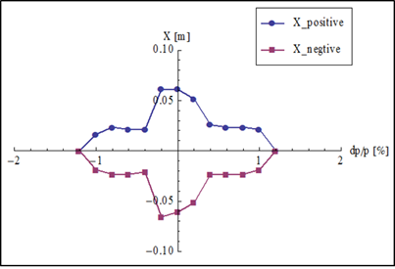
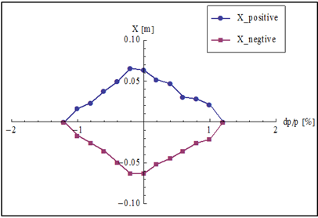
Off-momentum DA optimization
Noninterleave sextupole scheme
Two sext. families (SF, SD)
Optimize the phase of the straight section between two octants automatically by downhill method
cancel the fourth order resonance with δ¹ (h₄₀₀₀₁ and h₀₀₄₀₁) and hence enlarge the off-momentum DA

Slide 17
Booster error studies
Gaussian distribution and cut-off at 3σ
Errors Setting
Parameters | Dipole | Quadrupole | Sextupole
Transverse shift x/y (μm) | 50 | 70 | 70
Longitudinal shift z (μm) | 100 | 150 | 100
Tilt about x/y (mrad) | 0.2 | 0.2 | 0.2
Tilt about z (mrad) | 0.1 | 0.2 | 0.2
Nominal field | 3×10⁻⁴ | 2×10⁻⁴ | 3×10⁻⁴
 | Accuracy (m) | Tilt (mrad) | Gain | Offset after BBA(mm)
BPM | 1×10⁻⁷ | 10 | 5% | 30×10⁻³

Slide 18
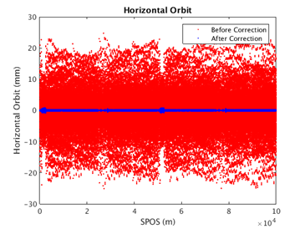
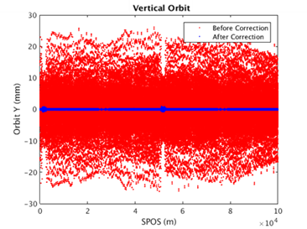
Booster orbit with errors
Beam pipe: 55mm (diameter)
Orbit within the beam pipe
“First turn trajectory” is not necessary
Horizontal Corrector: 1053
Vertical Corrector : 1054
BPM : 2108

Slide 19
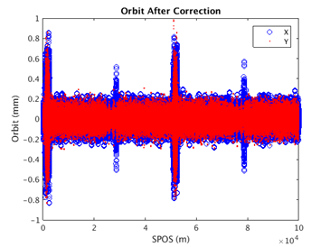
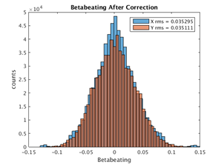
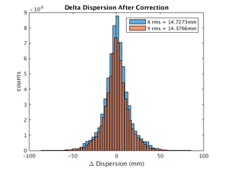
Booster orbit & optics with COD corrections
  Orbit correction: response matrix and SVD
  RMS Orbit ~ 80um, RMS betabeat ~3.5%, RMS disp. ~15mm
  Emittance growth < 10% for the simulation seeds
Coupling <10% before coupling correction
RMS coupling: 0.5% after coupling correction
Hor. 80um / Ver. 79um
Hor. 3.5% / Ver. 3.5% Hor. 0.0147m / Ver. 0.0144m

Slide 20
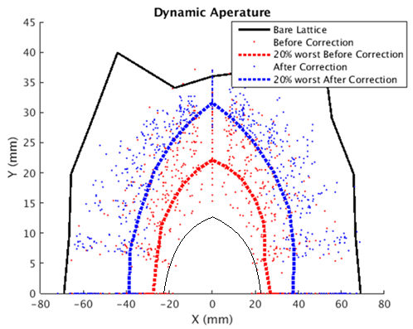
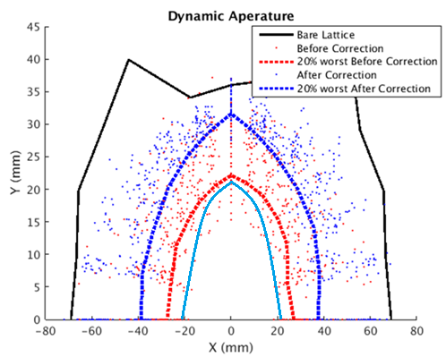
Dynamic aperture with errors
With only COD corrections, DA is nearly two thirds of bare lattice
At 120GeV, radiative damping was considered.
DA requirement @ 10GeV determined by the beam stay clear region
DA requirement @ 120GeV: 1) H- quantum lifetime, 2) V- re-injection process from the collider in the on-axis injection scheme
10GeV
120GeV
BSC
w damping
 | DA requirement |  | DA results
 | H | V | H | V
10GeV (ε_{x}= ε_{y} =120nm) | 4σ_{x} +5mm | 4σ_{y} +5mm | 7.7σ_{x} +5mm | 14.3σ_{y} +5mm
120GeV (ε_{x}=3.57nm, ε_{y}= ε_{x*}0.005) | 6σ_{x} +3mm | 49σ_{y} +3mm | 21.8σ_{x} +3mm | 779σ_{y} +3mm
Requirement for linac emittance: < 150nm, otherwise BSC > beam pipe

Slide 21
Emittance evolution
Emittance @injection = 120nm
Emittance is small enough for H &W after ramping, extra 5s damping for Z
H
Beam loss due to lifetime at low energy determined by the emittance of Linac and the DA.
W
Z

Slide 22
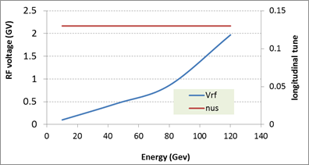
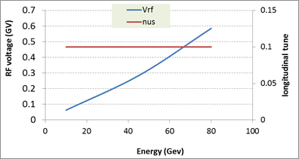
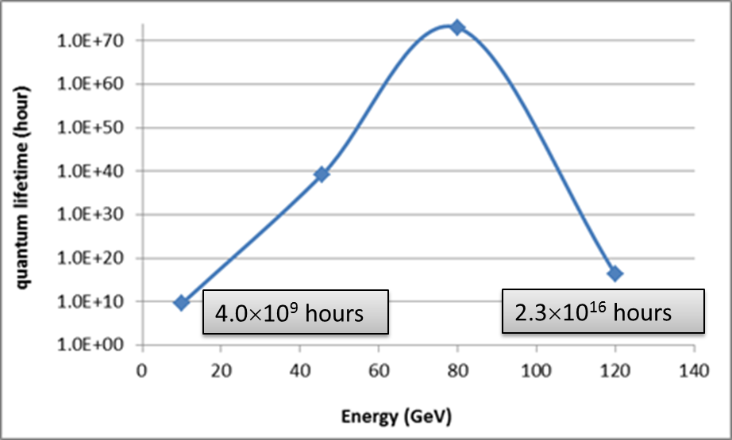
RF ramping curve
Higgs
W & Z
nus=0.13 (Higgs), nus=0.1 (W&Z)
10 GeV & 45 GeV: transverse quantum lifetime
80GeV & 120 GeV: longitunidal quantum lifetime
Beam loss during ramping due to lifetime << 1%

Slide 23
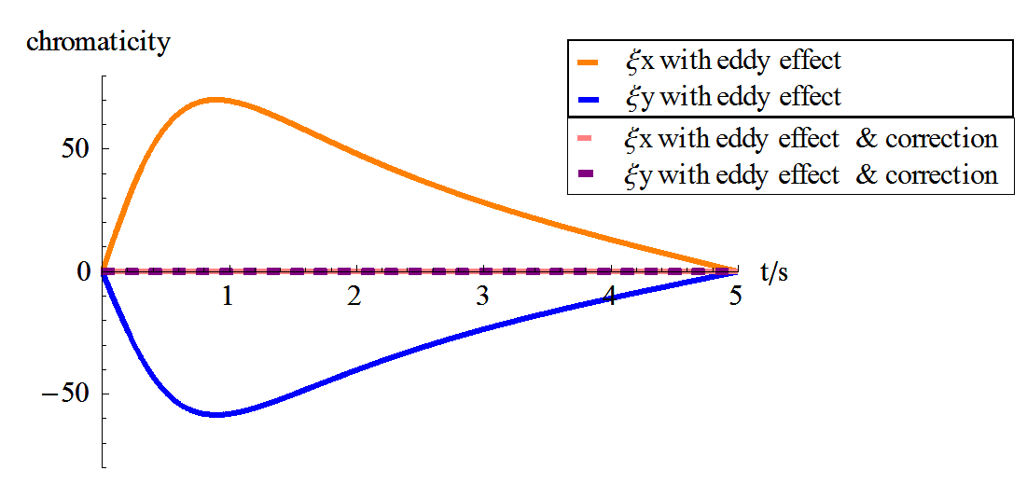
Eddy current effect
During ramping, parasitic sextupole field is induced on beam pipe inside dipoles due to eddy current.
Ramping rate is limited by eddy current effect.
Dedicated ramping curve to control the maximum K2.
Maximum K2=0.000345 (m⁻³)
Chromaticity distortion needs to be corrected during ramping.
Dynamic DA is under studying.

Slide 24
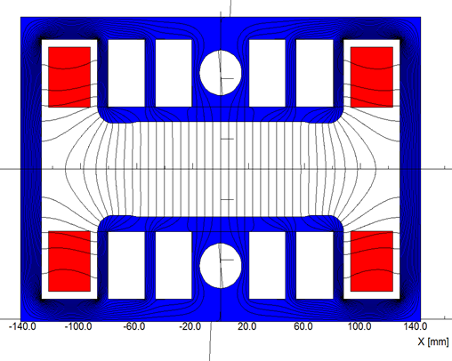
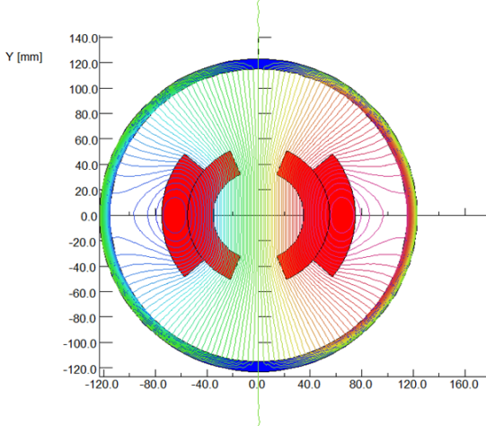
Low field dipole magnets
Challenges:
Solutions by technical way
With magnetic core - dilution (better material)
Without magnetic core
(Twice excitation current)
Field error <29Gs*0.1%=0.029Gs
Field reproducibility <29Gs*0.05%=0.015Gs
The Earth field ~0.2-0.5 Gs, the remnant field of silicon steel lamination ~ 4-6 Gs.
Thinking beyond CDR
Wiggler dipole scheme
Combine the magnets with core and without core
…

Slide 25
Summary
The booster design can meet the injection requirements at three energy modes.
Accelerator physics design satisfy the requirements of geometry, beam dynamics and key hardware.
Error effects are studied. Errors in the booster are tolerable.
The study of eddy current and dynamic DA is ongoing.
Low magnetic field in the booster is still a challenge. Both technical and physical solutions are studied continuously.

Slide 26
Thanks for your attention!

