Slide 1

Linac Injector Design of CEPC CDR
环形正负电子对撞机
Circular Electron Positron Collider
International review of CEPC CDR
28 June, 2018
Cai Meng, Guoxi Pei, Jingru Zhang, Xiaoping Li,
Dou Wang, Chenghui Yu, Jie Gao, Shilun Pei, Yunlong Chi
Institute of High Energy Physics, CAS, Beijing

Slide 2
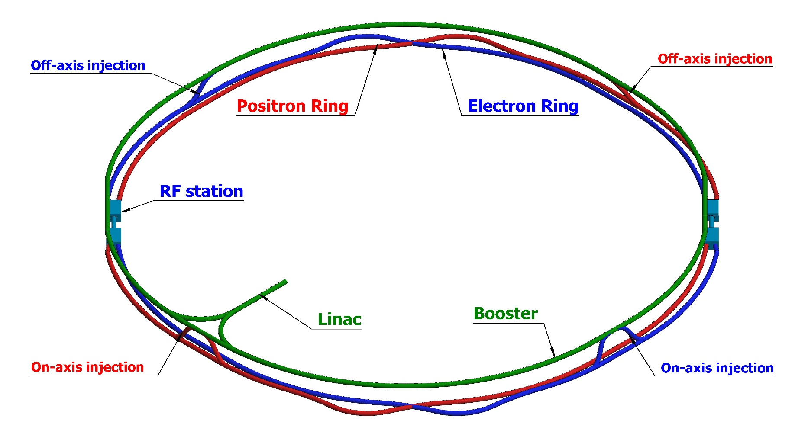
Outline
Introduction
  Main parameters
  Linac layout
Source design
  Electron source
  Positron source
Linac design
  Electron mode
  Positron mode
Summary

Slide 3
Outline
Introduction
  Main parameters
  Linac layout
Source design
  Electron source
  Positron source
Linac design
  Electron mode
  Positron mode
Summary

Slide 4

Introduction
Basic information
Luminosity is the core and key parameter of the collider
Integral Luminosity is the fundamental value of the collider
  T_{s} is the scheduled operation time
  η is the availability
As the first injector part, high availability
of the Linac is very important
  Beam commission, operation

Slide 5
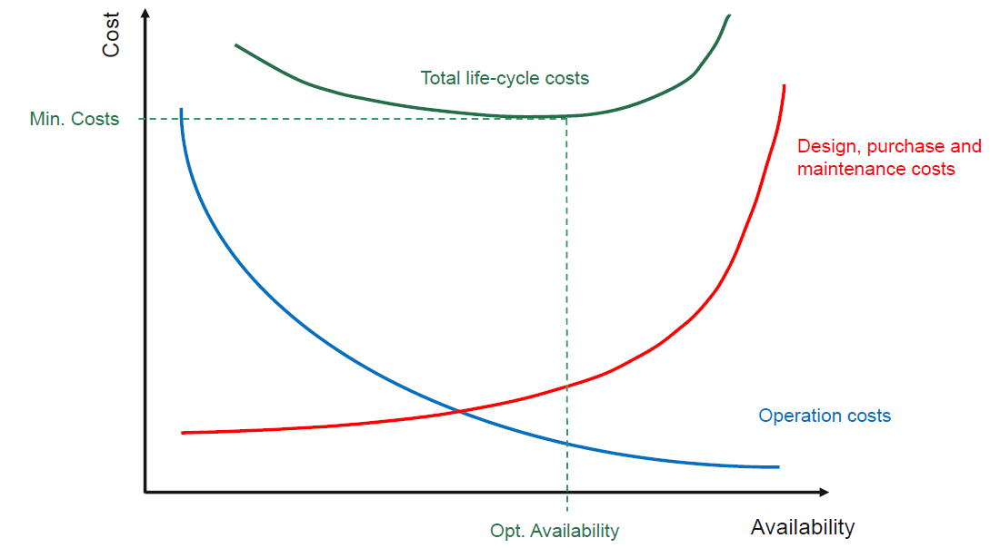
Introduction
Linac design goal
Linac design goal and principles
  High Availability and Reliability
    ~ 15% backups for Klystrons and accelerating structure, need to study in the future
    Simplicity
      Layout / S-band accelerating structure (2856.75MHz)
  Always providing beams that can meet requirements of Booster
Parameter | Symbol | Unit | Value
e⁻ /e⁺ beam energy | E_{e-}/E_{e+} | GeV | 10
Repetition rate | f_{rep} | Hz | 100
e⁻ /e⁺ bunch population | Ne-/Ne+ |  | >9.4×10⁹
 |  | nC | >1.5
Energy spread (e⁻ /e⁺ ) | σ_{E} |  | <2×10⁻³
Emittance (e⁻ /e⁺ ) | ε_{r} | nm | <120
e⁻ beam energy on Target |  | GeV | 4
e⁻ bunch charge on Target |  | nC | 10
A. Apollonio’s figure
Notes:
Common

Slide 6
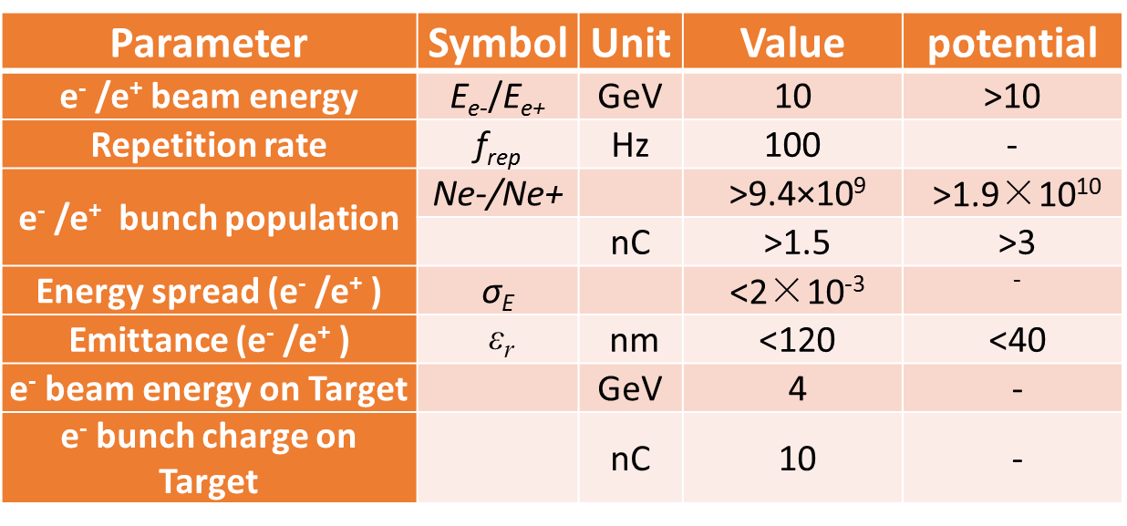
Introduction
Potential
The linac should be have potential to meet the higher requirements and updates in the future, which is very likely for mostly accelerators
  Emittance:
    Linac emittance can meet the requirement without damping ring
    Damping Ring for positron beam and layout
      Higher transmission of linac
      Larger errors tolerance
      Higher injection efficiency, easier injection design, smaller damping time in some case
  Bunch charge: larger than 3 nC
    Positron production and layout
      4 GeV electron beam
  Bunch structure
    One-bunch-per-pulse
      short-range Wakefield
    Two-bunch-per-pulse is possible for the linac design

Slide 7
Introduction
Layout of Linac
Positron Linac
ESBS
PSPAS
DR
FAS
SAS
TAS
50MeV
4GeV
200MeV
1.1GeV
4GeV
10GeV
ESBS ( Electron Source and Bunching System)
  50 MeV && 11nC for positron production
SAS (the Second Accelerating Section)
  Positron beam to 4 GeV && 3 nC
DR (Damping Ring)
  Positron beam 1.1GeV, 60m
FAS (the First Accelerating Section)
  Electron beam to 4 GeV && 10nC for positron production
TAS (the Third Accelerating Section)
  Positron beam to 10 GeV && 3 nC
PSPAS (Positron Source and Pre-Accelerating Section)
  Positron beam larger than 200 MeV && larger than 3 nC

Slide 8
Introduction
Layout of Linac
Electron Linac
EBTL
ESBS
PSPAS
DR
FAS
SAS
TAS
50MeV
4GeV
200MeV
1.1GeV
4GeV
10GeV
ESBS ( Electron Source and Bunching System)
  50 MeV && 3 nC
EBTL (Electron Bypass Transport Line)
  Electron beam @ 4 GeV && 3 nC
FAS (the First Accelerating Section)
  Electron beam to 4 GeV && 3 nC
TAS (the Third Accelerating Section)
  Electron beam to 10 GeV && 3 nC

Slide 9
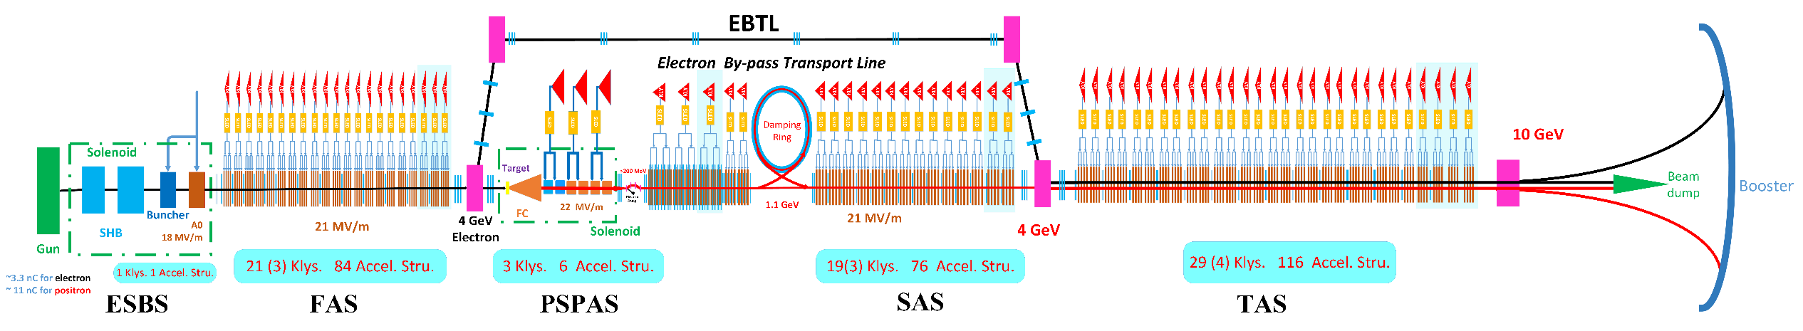
Introduction
Layout of Linac
EBTL
ESBS
DR
FAS
PSPAS
SAS
TAS
50MeV
4GeV
200MeV
1.1GeV
4GeV
10GeV

Slide 10
Outline
Introduction
  Main parameters
  Linac layout
Source design
  Electron source
  Positron source
Linac design
  Electron mode
  Positron mode
Summary

Slide 11
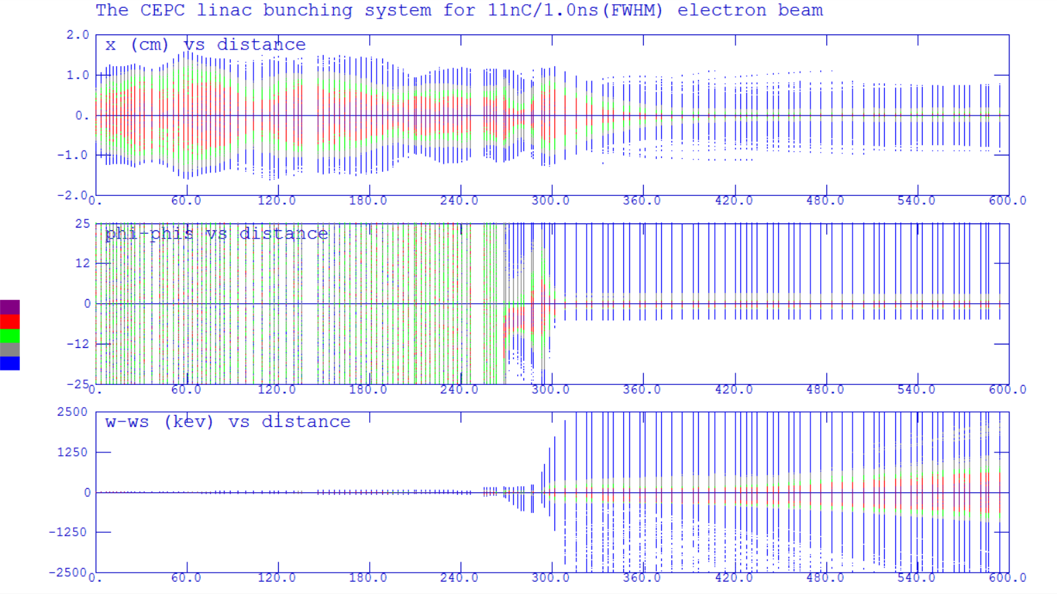
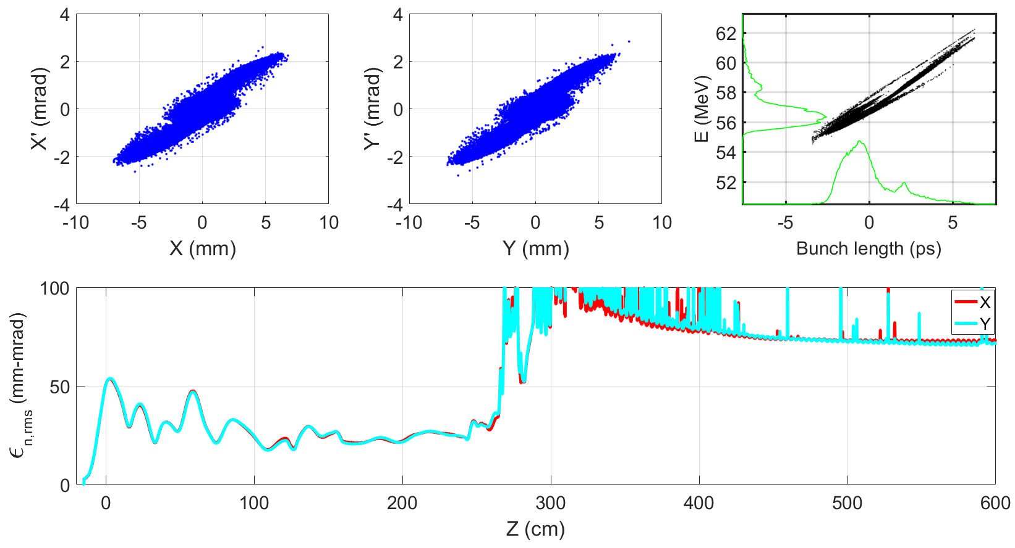
Source design
Electron source
Thermionic electron gun
Sub-harmonic pre-buncher
  142.8375 MHz
  571.35 MHz
Buncher & A0
  2856.75 MHz
Focusing structure
  Solenoid
Emittance
  <100 mm-mrad (Norm.Rms)
Transmission
  ~90%
Parmela

Slide 12
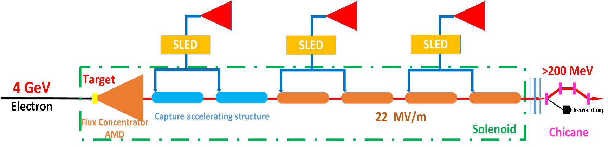
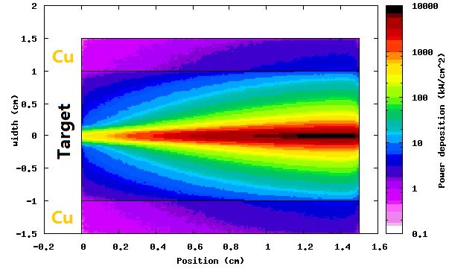
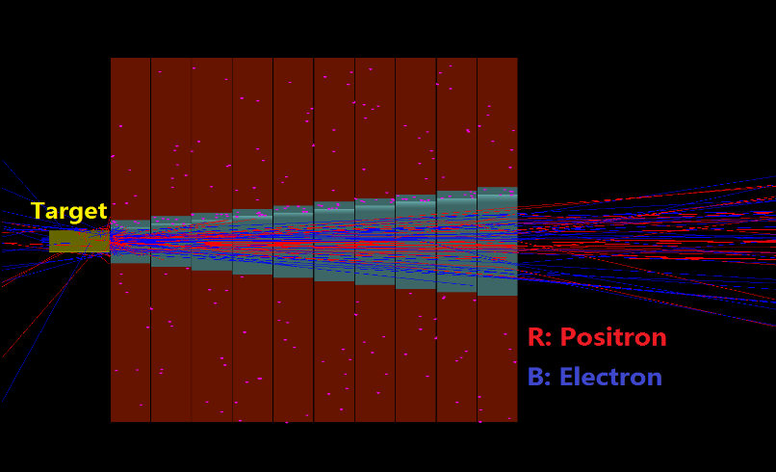
Source design
Positron source
Layout of positron source
  Target (Conventional)
    tungsten@15 mm
    Beam size: 0.5 mm
  Energy deposition
    0.784 GeV/e- @ FLUKA
    784 W → water cooling
    The cylindrical W target is embedded in a cuboid copper block for supporting and cooling
  AMD (Adiabatic Matching Device)
    Length: 100mm
    Aperture: 8mm→26mm
    Magnetic field: (5.5T→0T) + 0.5T

Slide 13
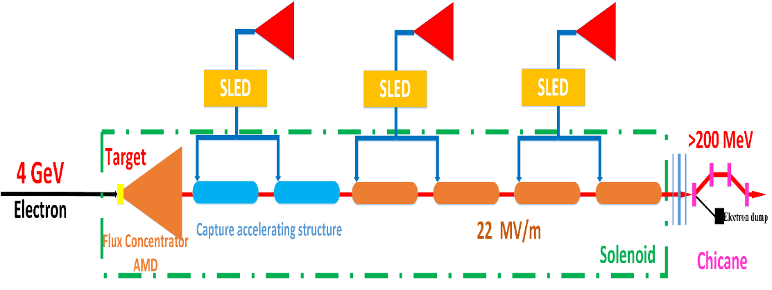
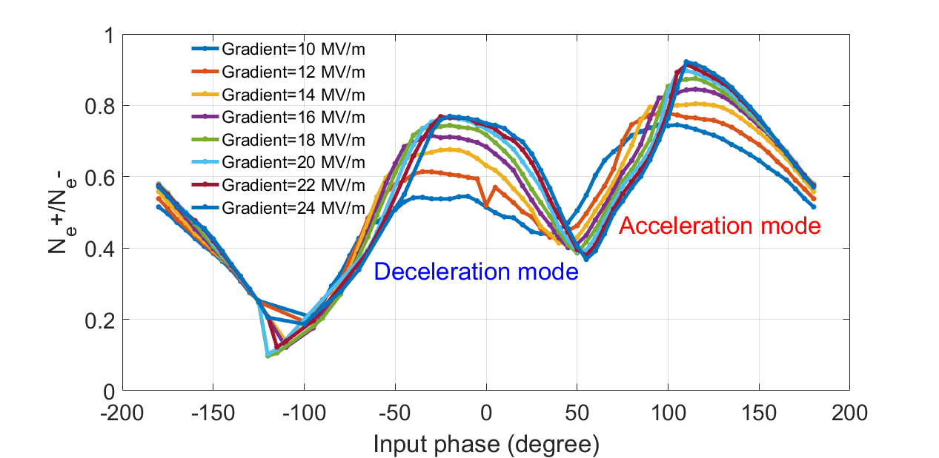
Source design
Positron source
Layout of positron source
  Capture & Pre-accelerating structure
    Length:2 m
    Aperture: 25 mm
    Gradient: 22 MV/m
  Chicane
    Wasted electron separation
  Norm. RMS. Emittance
    ~2400 mm-mrad→~120nm@10GeV
    Capture section & low energy part of positron linac
  Energy: >200 MeV
  Positron yield
    Ne+/Ne- > 0.5 @ [-8°,12°,235MeV, 265MeV]

Slide 14
Outline
Introduction
  Main parameters
  Linac layout
Source design
  Electron source
  Positron source
Linac design
  Electron mode
  Positron mode
Summary

Slide 15
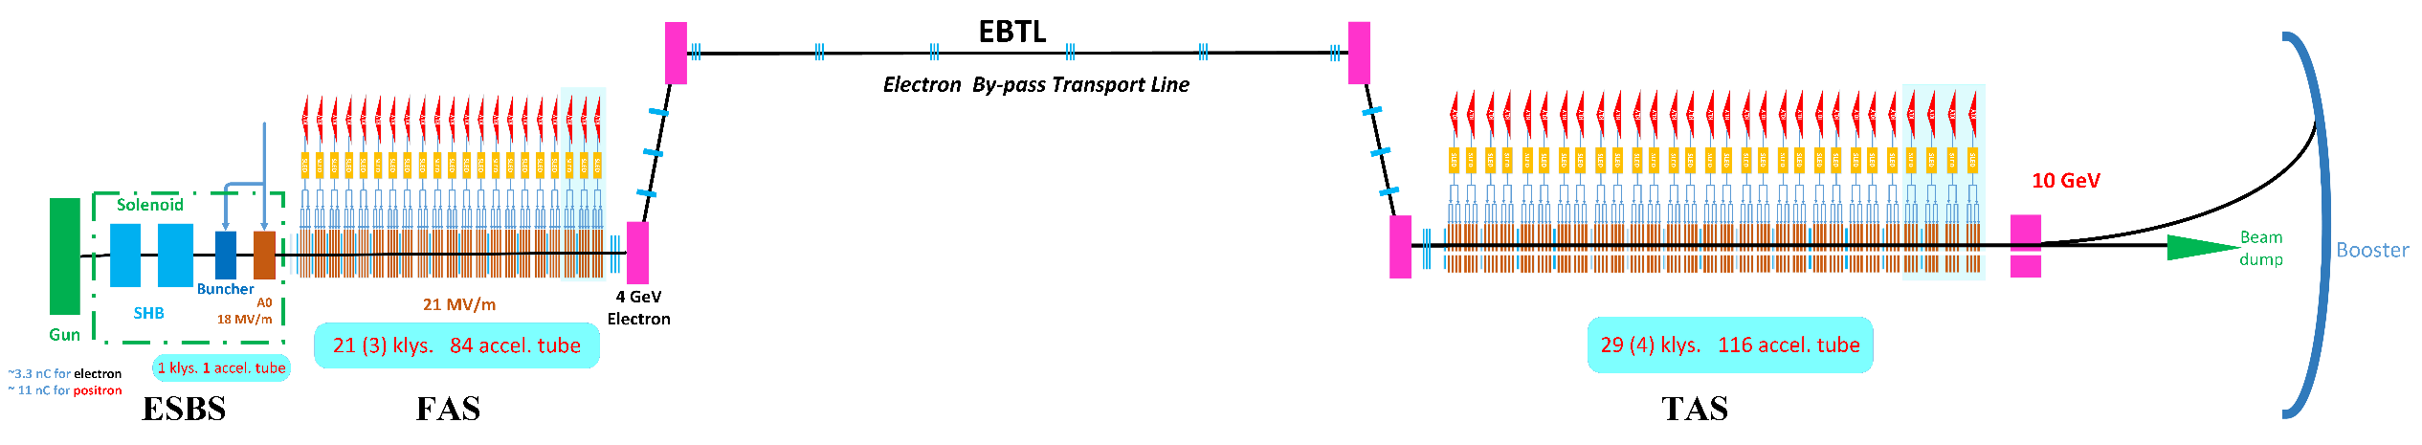
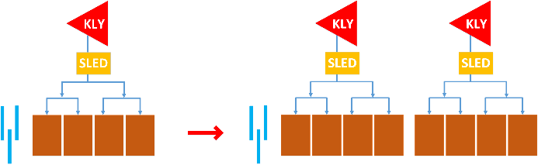
Linac design
Electron linac
Focusing structure: Triplet
  Same beam envelopes at X/Y planes
  1 triplet+4 Acc. Stru.→1 triplet+8 Acc. Stru.
Operation mode :
  High charge mode (positron production)
    4GeV & 10 nC
    ESBS+FAS
  Low charge mode (electron injection)
    10 GeV & 3 nC
    ESBS+FAS+EBTL+TAS

Slide 16
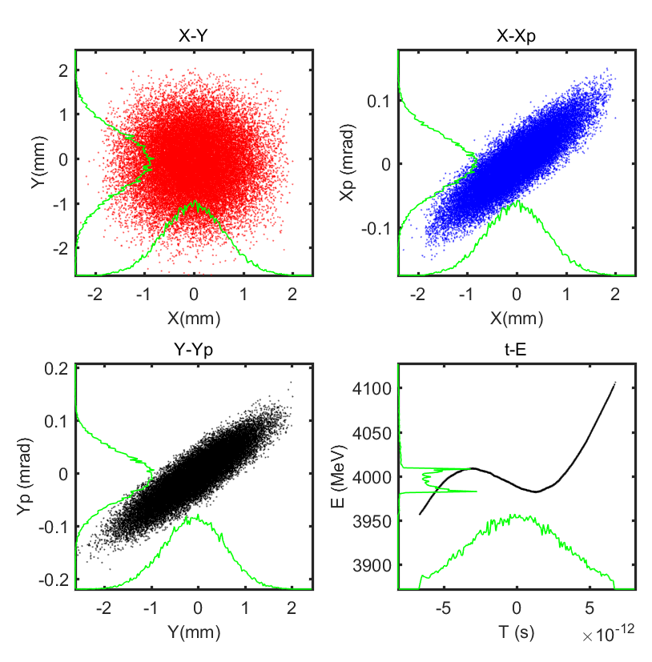
Linac design
Electron linac→ Positron production
High charge mode
  10 nC @ 4 GeV
  Energy spread (rms): 0.5%
  Emittance growth with errors

Slide 17
Linac design
Electron linac→ Electron injection
High charge mode
  10 nC @ 4 GeV
  Energy spread (rms): 0.5%
  Emittance growth with errors
Low charge mode
  EBTL
    Local achromatic
    Matching
    Collimator (momentum tail)
  Bypass distance is 2 m

Slide 18
Linac design
Electron linac→ Electron injection
High charge mode
  10 nC @ 4 GeV
  Energy spread (rms): 0.5%
  Emittance growth with errors
Low charge mode
  3 nC @ 10 GeV
  Energy spread (rms): 0.15%
  Emittance (rms): 5 nm

Slide 19
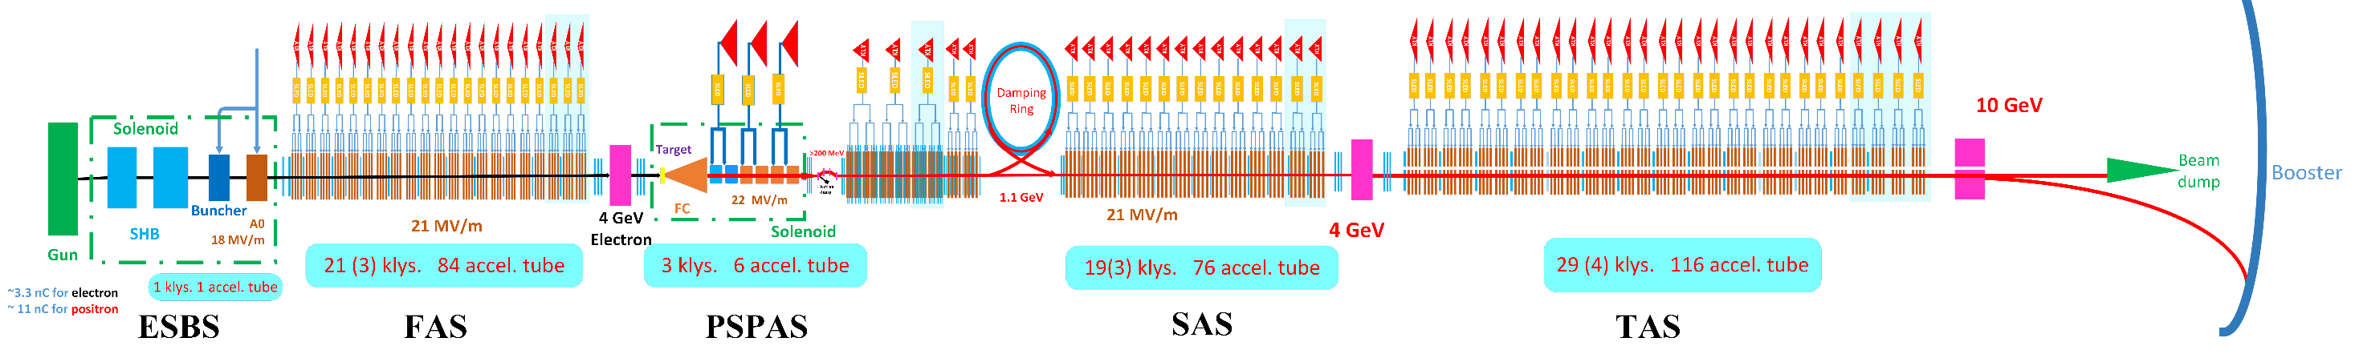
Linac design
Positron linac
PSPAS→SAS (DR) +TAS
  SAS: 200 MeV→4 GeV
  Damping Ring @ 1.1 GeV
  TAS: 4GeV→10 GeV
Transverse focusing structure
  FODO, nesting on Acc. Stru.
  Triplet

Slide 20
Linac design
Positron linac
Positron linac
  3 nC && 10 GeV
  Energy spread (rms): 0.16%
  Emittance with DR (rms): 40/24nm
  Emittance without DR (rms): ~120/120nm

Slide 21
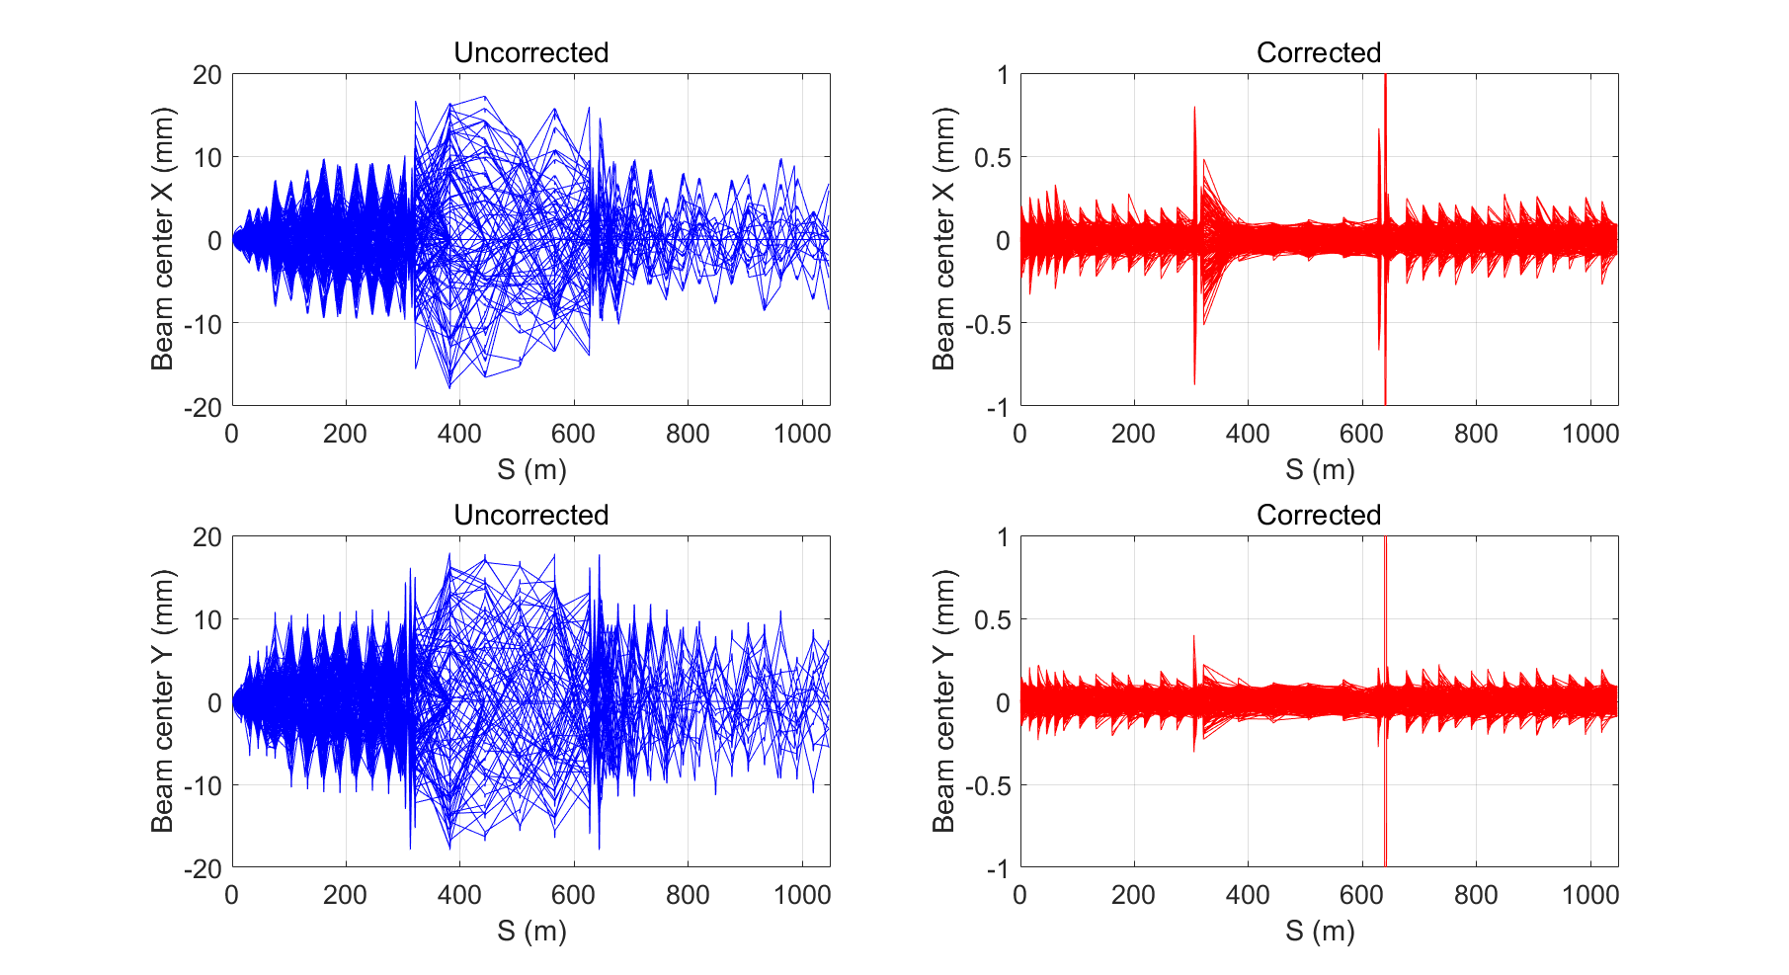
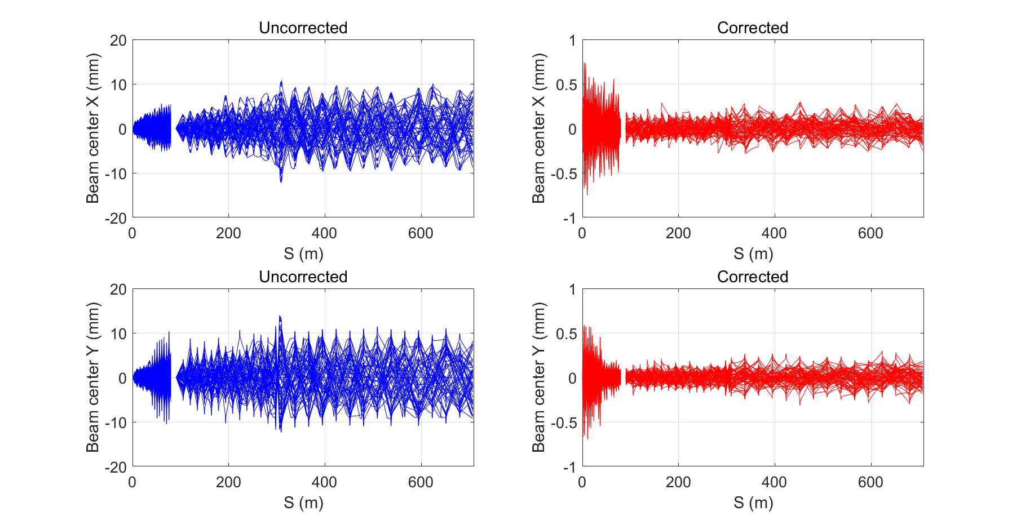
Linac design
Misalignment errors with correction
linac
  One-to-one correction scheme
  Errors: Gaussian distribution, 3σ truncated
Beam orbit
  <1mm
Error description | Unit | Value
Translational error | mm | 0.1
Rotation error | mrad | 0.2
Magnetic element field error | % | 0.1
BPM uncertainty | mm | 0.1

Slide 22
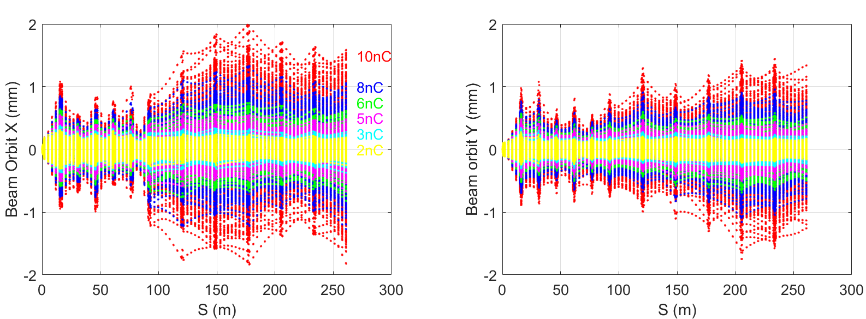
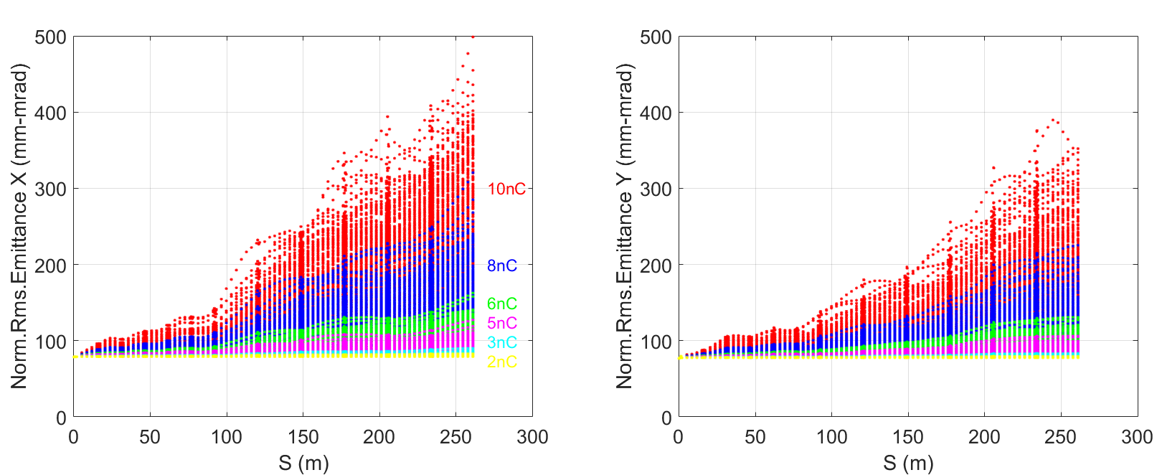
Error study
Misalignment errors with correction
Electron linac
  First orbit correction + multi-particles simulation
  Low charge
    Beam orbit can be controlled well
  High charge
    Misalignments of Acc. Tubes
    BPM noisy
    Wakefield
  In operation, the orbit and emittance growth can be controlled better. Correction is based on multi-particles orbit
  Meet the requirements for positron production

Slide 23
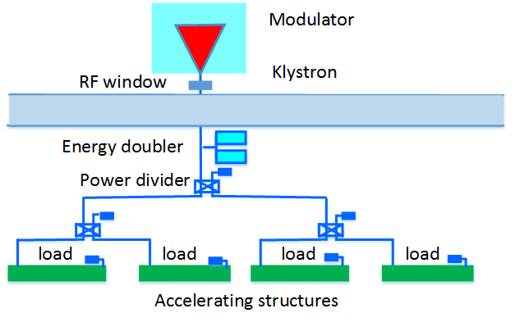
Linac design
Field errors
Simulation condition
  5000 seeds
  Accelerating tubes
    phase errors and amp errors
    4 in 1 KLY, 4 accelerating tubes in one group
    3σ--Gaussian
Energy spread < 0.2%
Energy jitter: 0.2%
  Phase errors: 0.5 degree (rms)
  Grad. errors: 0.5% (rms)

Slide 24
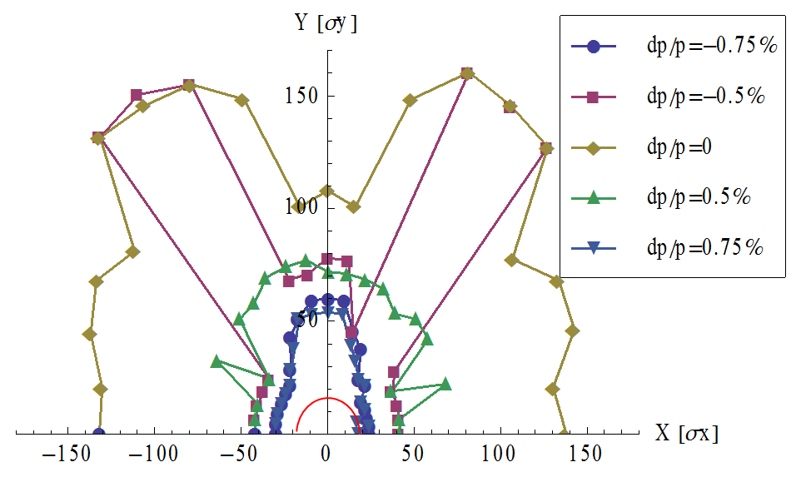
Linac design
Damping Ring
DR V1.0 | Unit | Value
Energy | GeV | 1.1
Circumference | M | 58.5
Repetition frequency | Hz | 100
Bending radius | M | 3.62
Dipole strength B₀ | T | 1.01
U₀ | keV | 35.8
Damping time x/y/z | ms | 12/12/6
δ₀ | % | 0.05
ε₀ | mm.mrad | 287.4
Nature σ_{z} | mm | 7 (23ps)
ε_{inj} | mm.mrad | 2500
ε_{ext x/y} | mm.mrad | 704/471
δ_{inj} /δ_{ext} | % | 0.3/0.06
Energy acceptance by RF | % | 1.0
f_{RF} | MHz | 650
V_{RF} | MV | 1.8
@ D. Wang
Emittance not critical
One bunch in DR(200ns)
  10 ms→20ms
  Two bunch: yes
IBS
  Emittance growth
CSR (Coherent synchrotron radiation)
  CSR Instability

Slide 25
Summary
The CEPC linac works with 100 Hz repetition, 10 GeV and one-bunch-per-pulse, which can meet the requirements of Booster;
The linac have the potential to provide positron beam and electron beam with bunch charge larger than 3nC;
One preliminary damping ring is proposed, the emittance with DR is smaller than 40 nm, and have more potential to lower emittance;
By now it’s no bottleneck in linac design and further works continues.

Slide 26
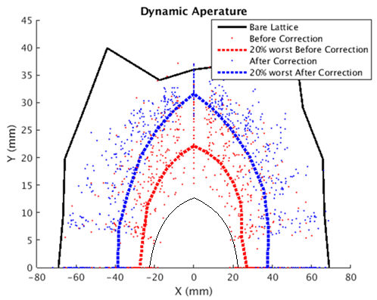
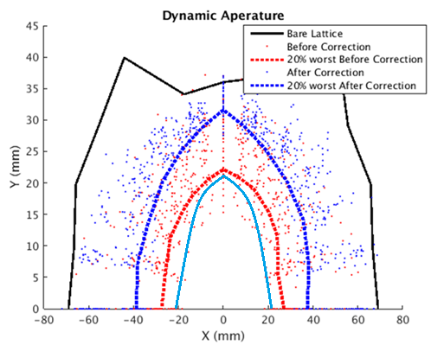
Dynamic aperture with errors
With only COD corrections, DA is nearly two thirds of bare lattice
At 120GeV, radiative damping was considered.
DA requirement @ 10GeV determined by the beam stay clear region
DA requirement @ 120GeV: 1) H- quantum lifetime, 2) V- re-injection process from the collider in the on-axis injection scheme
10GeV
120GeV
BSC
w damping
 | DA requirement |  | DA results
 | H | V | H | V
10GeV (ε_{x}= ε_{y} =120nm) | 4σ_{x} +5mm | 4σ_{y} +5mm | 7.7σ_{x} +5mm | 14.3σ_{y} +5mm
120GeV (ε_{x}=3.57nm, ε_{y}= ε_{x*}0.005) | 6σ_{x} +3mm | 49σ_{y} +3mm | 21.8σ_{x} +3mm | 779σ_{y} +3mm
Requirement for linac emittance: < 150nm, otherwise BSC > beam pipe

Slide 27
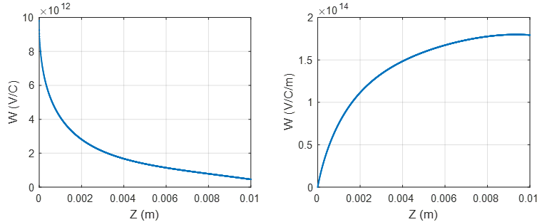
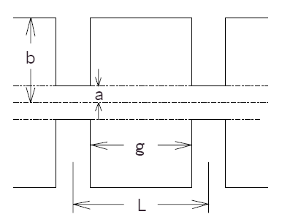
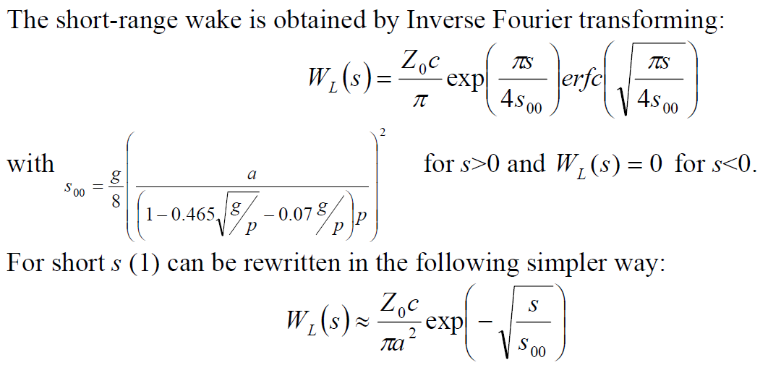
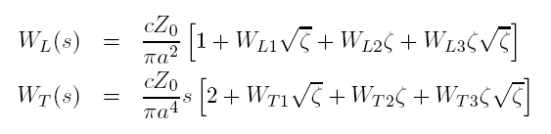
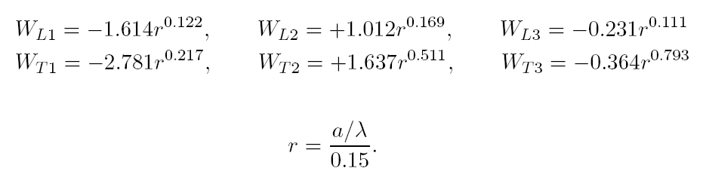

Linac design
Short-Range Wakefield
k. Yokoya and K. bane’s Wakefield model
  periodic linac structure
k. Yokoya and K. bane, “The longitudinal high-frequency impedance of a periodic accelerating structure”, Proceedings of the 1999 IEEE Particle Accelerator Conference Vol. 3 pag. 1725, New York, March 1999

