Slide 1


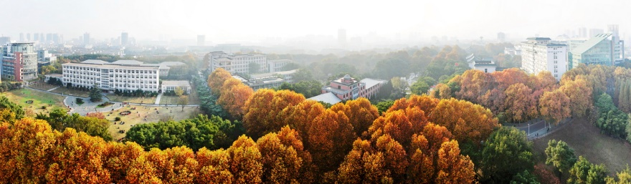
Two slit interferometer at fermi scale:
Coherent photoproduction from UPC to HHIC
Wangmei Zha
Zhen Liu
University of Science and Technology of China
arXiv:1810.10694
The 4th China LHC Physics Workshop (第4届中国LHC物理工作会议) , CCNU(华中师范大学)，19th – 22th Nov. 2018

Slide 2

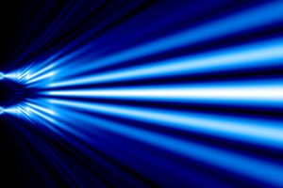


The heart of quantum mechanism
Wave-particle duality
Young’s Double-Slit Interference Experiment
Path length differences result in a phase shift, creating an interference pattern!
Which slits?
? ? ?
Interference of individual particle?
Both!
Interference of particle species: photon, electron, proton, neutron, atom, molecule, fullerene…
Demonstrate the principle of wave-particle duality!
All of quantum mechanics can be gleaned from carefully thinking through the implications of this single experiment! --- Feynman

Slide 3
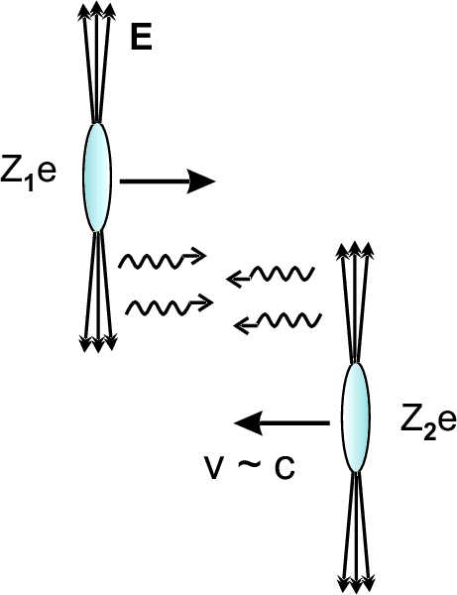
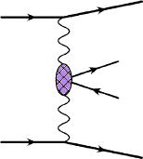
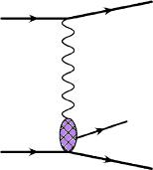
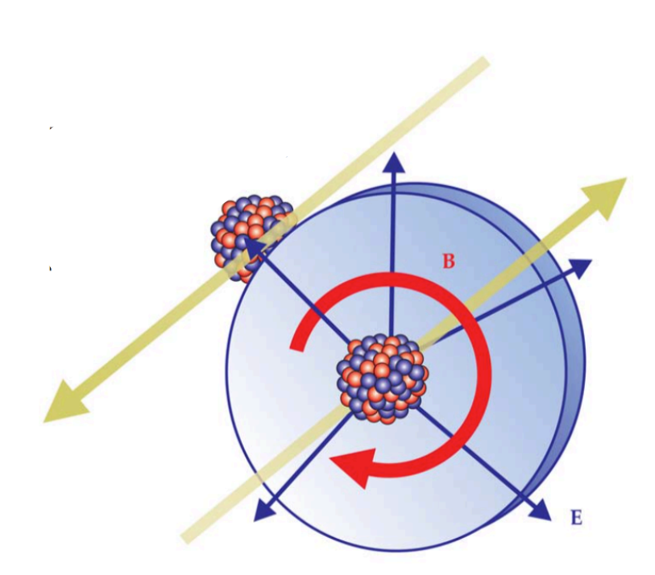
Entities for the interferometer
Coherent photon products
Ann. Rev. Nucl. Part. Sci.55:271
(2005)
=
+
V=ρ , ω , φ , J/ψ
Photon-photon
interactions
Photon-nucleus
interactions
View photons as “partons” being present with fast moving ions!
  Photon-nucleus interactions: Vector meson
  Photon-photon interactions: dileptons …
The extent of photons swarming about the ions:
  Take the photoproduction of ρ (Au+Au 200 GeV )in ultra-peripheral collisions (UPCs) as example: <R_{producton}> ∼ 40 fm R_{photons} >> R_{Nuc}
Physics Today 70, 10, 40 (2017)

Slide 4
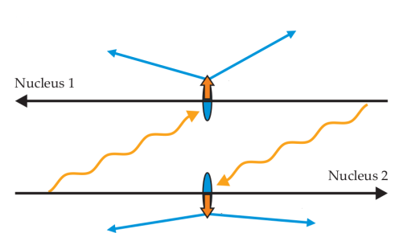
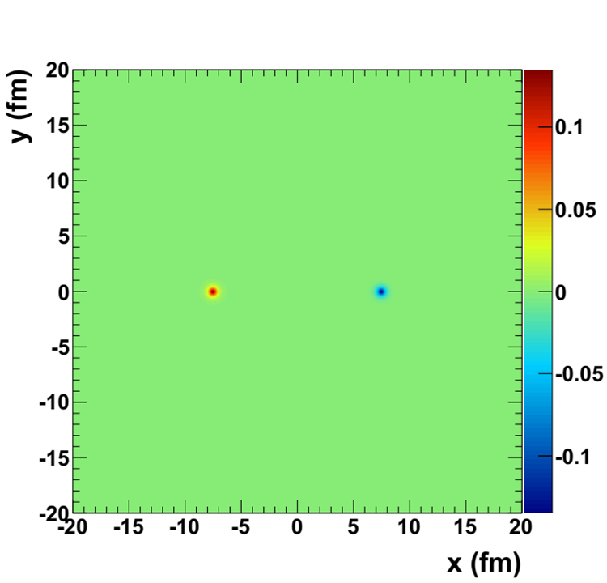
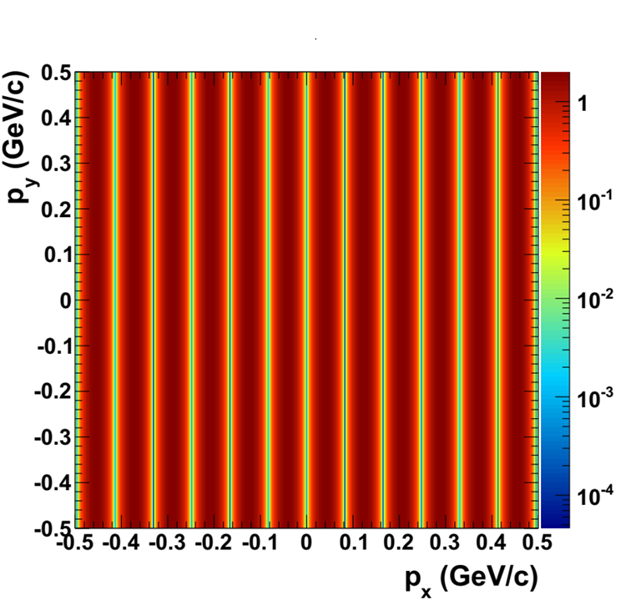
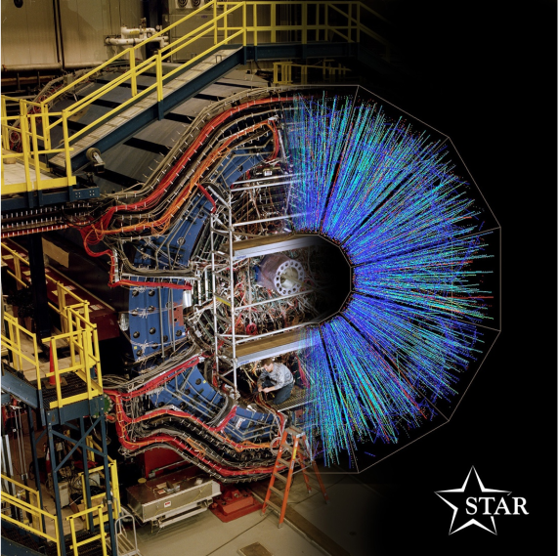
The setup of the interferometer
e⁺
The choice without information:
  Which is photon emitter?
  Which is the Pomeron provider?
e⁻
J/ψ
J/ψ
The slits: two colliding nuclei
e⁺
e⁻
Interferometer of individual J/ψ
Slit separation
b=15 fm
e⁻
J/ψ
e⁺
The parity of J/ψ is -1, the phase shift between the two slits is π

Slide 5
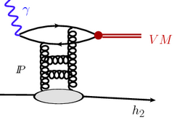
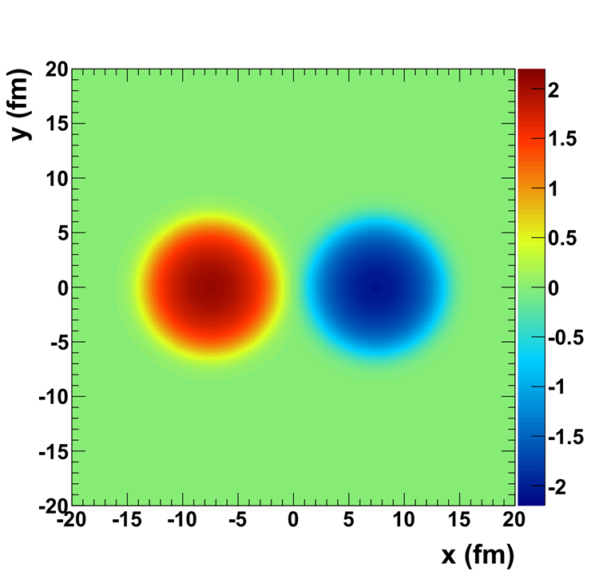
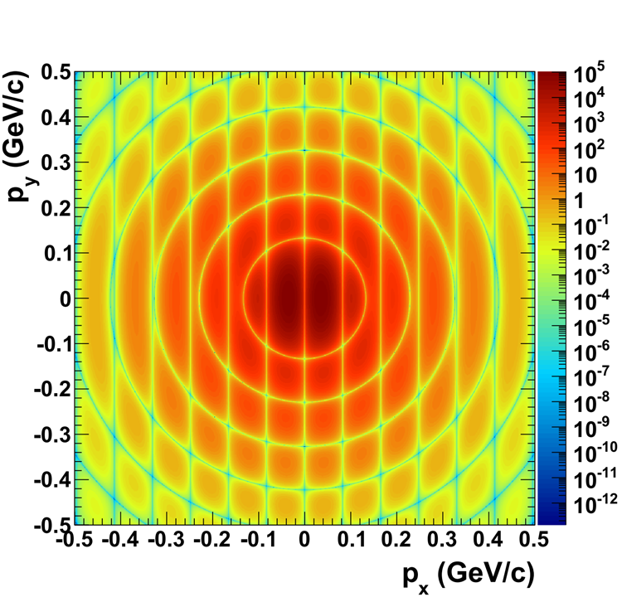
The size of slits
Production rate ∝ Pomeron density ∝ gluon density² ∝ nuclear density²
Amplitude ∝ nuclear density
Momentum distribution in transverse plane
Amplitude density
b = 15 fm
Au + Au
Wood-Saxon distribution
J/ψ y=0
Interference fringes + diffraction rings

Slide 6
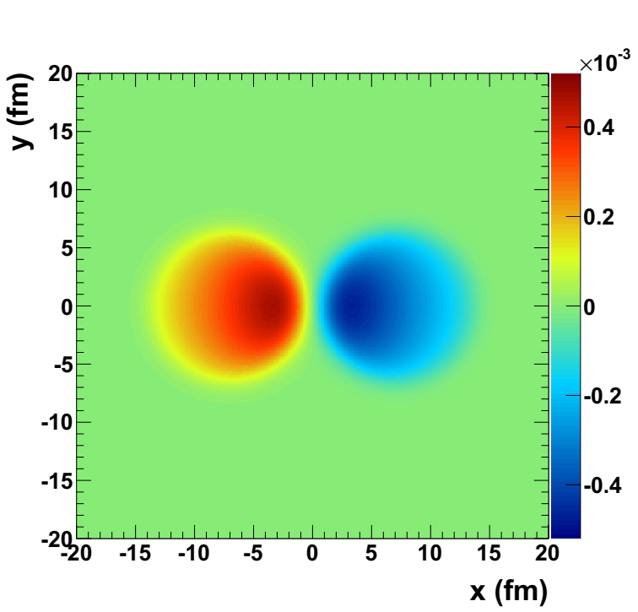
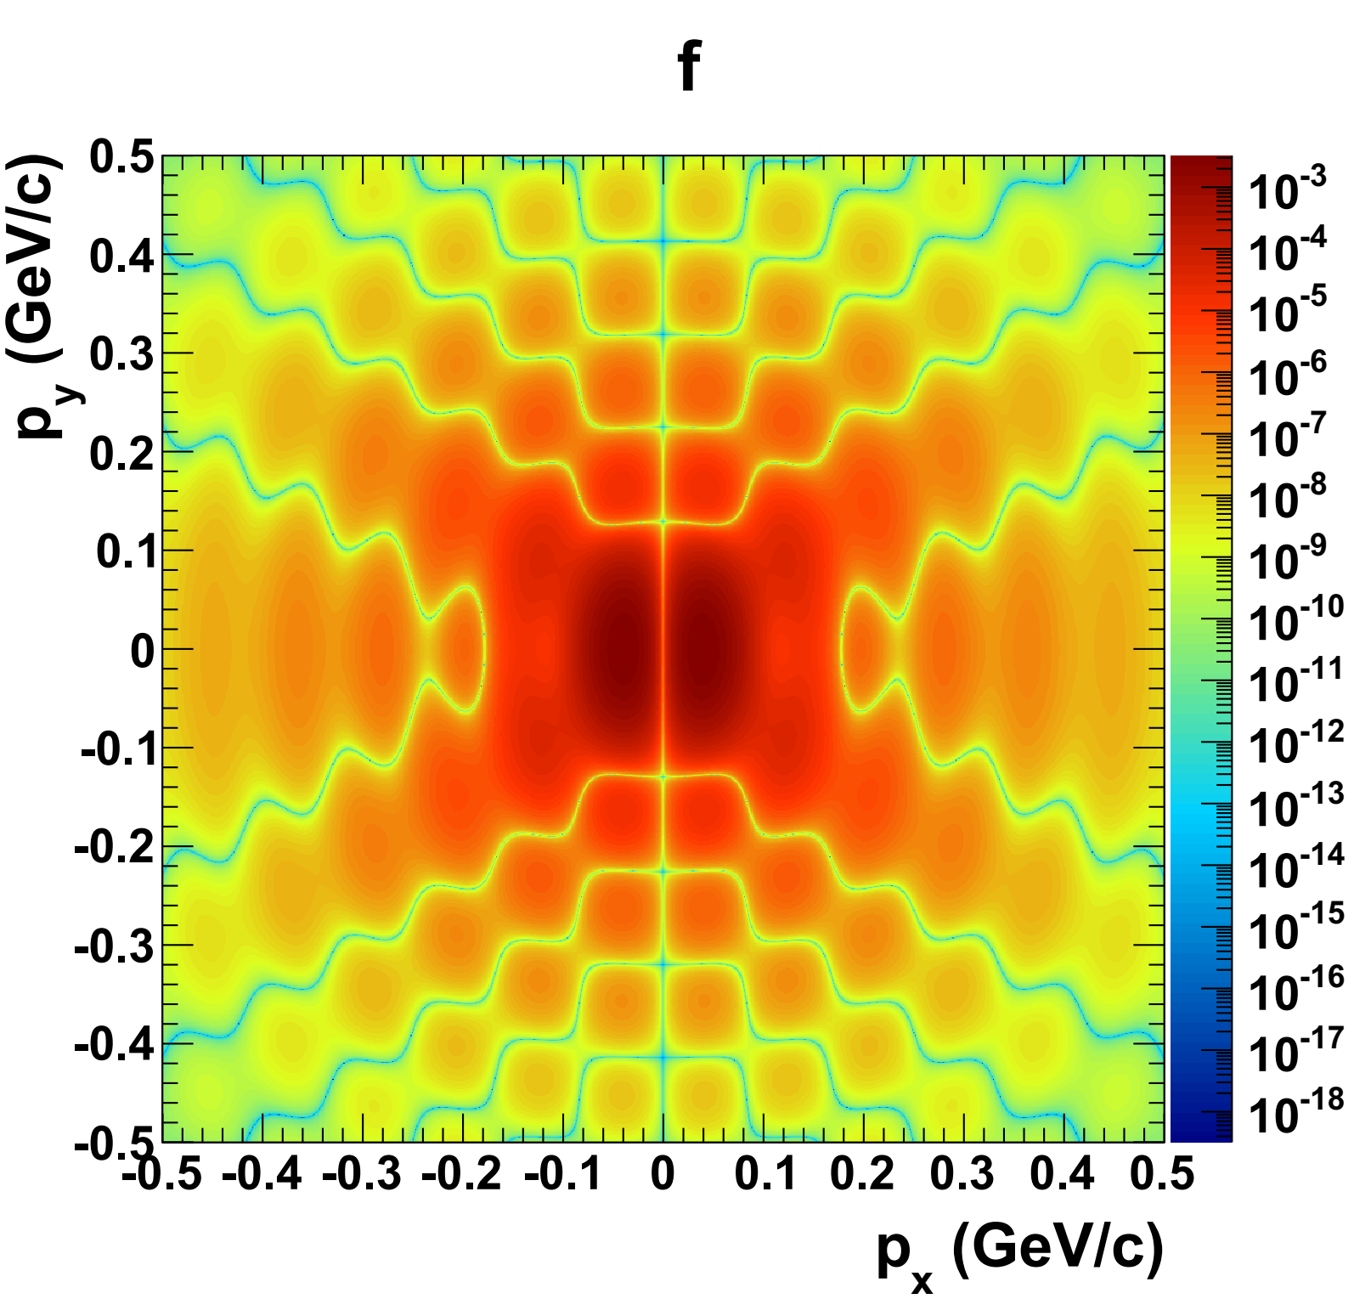
The final interference pattern
EPA flux + VMD approach
b = 15 fm
Au + Au 200 GeV
Y=0
The slits become more asymmetric!
  The interference + diffraction pattern changes.
This interference pattern can not be observed in ultra-peripheral collisions.
  No special azimuthal direction can be determined as reference.
Only possible in hadronic heavy-ion collision --- the two nuclei collide
  Reaction plane can be precisely obtained

Slide 7
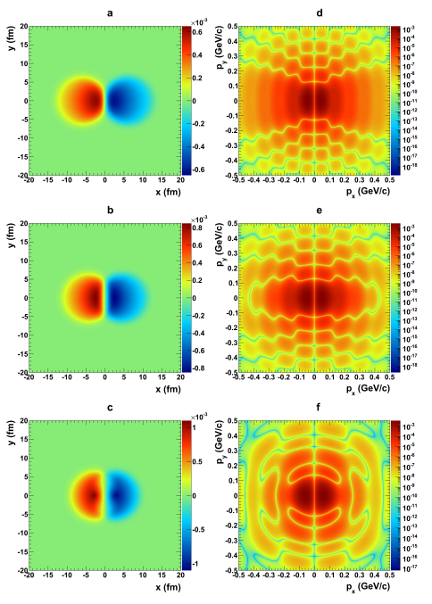
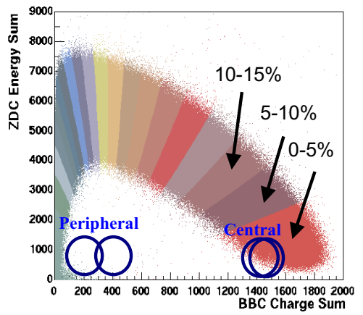
Can we change the distance between the slits?
Centrality dependence
70 - 80%
40 - 50%
The slit separation --- impact parameter can be precisely determined by the detector!
20 - 30%

Slide 8
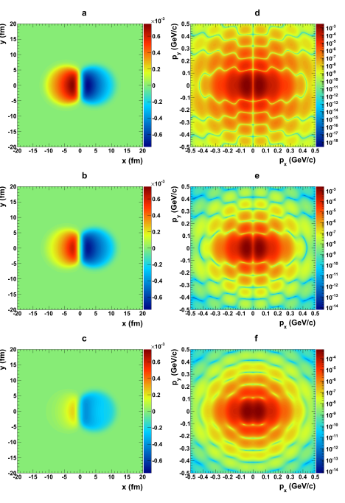
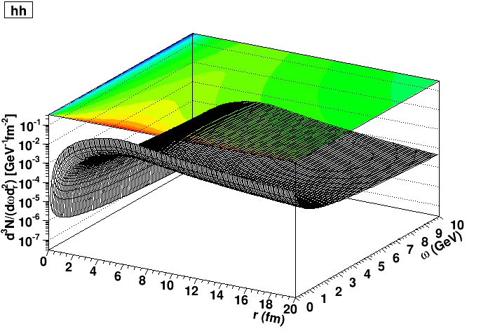
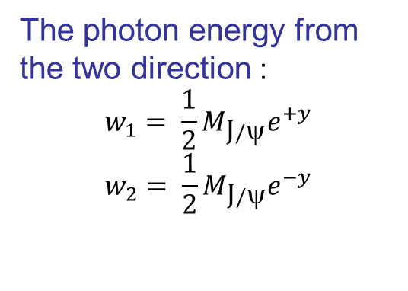
Can we dim one of the slits?
Rapidity dependence
b = 10 fm
The photon energy from the two direction :
$$w_{1}= \frac{1}{2}M_{\text{J}/\text{y}}e^{+y}$$
$$w_{2}= \frac{1}{2}M_{\text{J}/\text{y}}e^{−y}$$
Y=0
Y=0.6
The amplitude from the two direction will change with rapidity!
Y=1.4

Slide 9
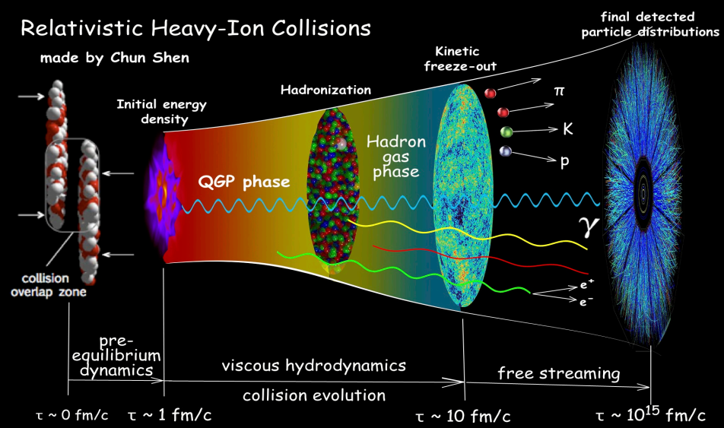
Observation Affects Reality!
Take the Young’s Double-Slit Interference Experiment as example:
  If we place detectors at the slits, knows which slit the photon goes (“which-way” or “path” solved), the interference pattern disappear! --- Observation collapse the wave function!
The hot medium (QGP) detect the J/ψ, and prohibit the coherent photoproduction?

Slide 10
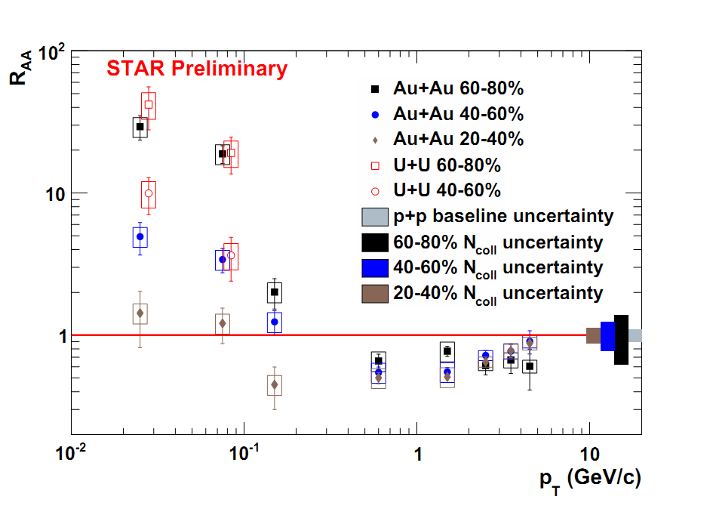
The coherent photoproduction in HHIC!
PRL 116, 222301 (2016)
This large flux of quasi-real photons makes a hadron collider also a photon collider!
  Photon-nucleus interactions: Vector meson
  Photon-photon interactions: dileptons …
Coherent produced J/ψ are observed in HHIC!

Slide 11
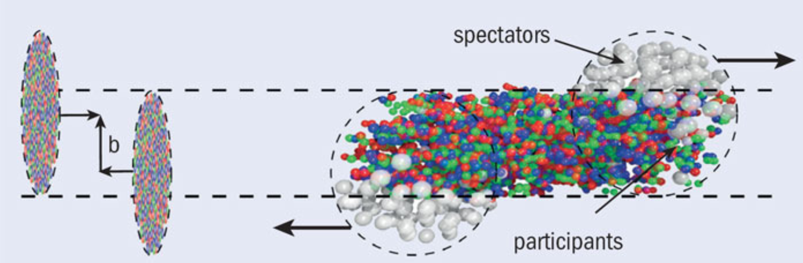
Why?
J. Phys.: Conf. Ser. 856 (2017) 012002
The strong interactions in the overlap region observe the created J/ψs in this region, solve the “which-way” or “path” problem for the J/ψs in the overlap region!
  The interference in this area disappear!
The slits are only sectional blocked!

Slide 12
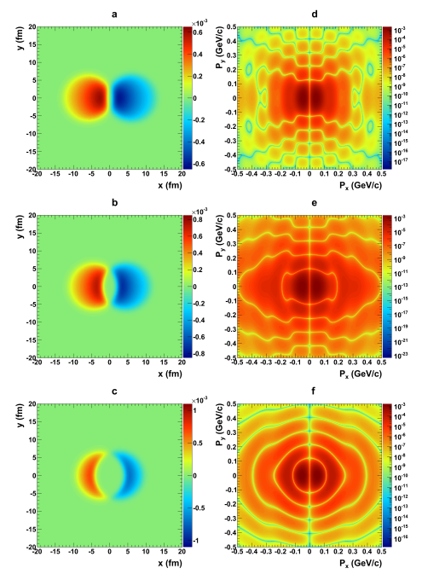
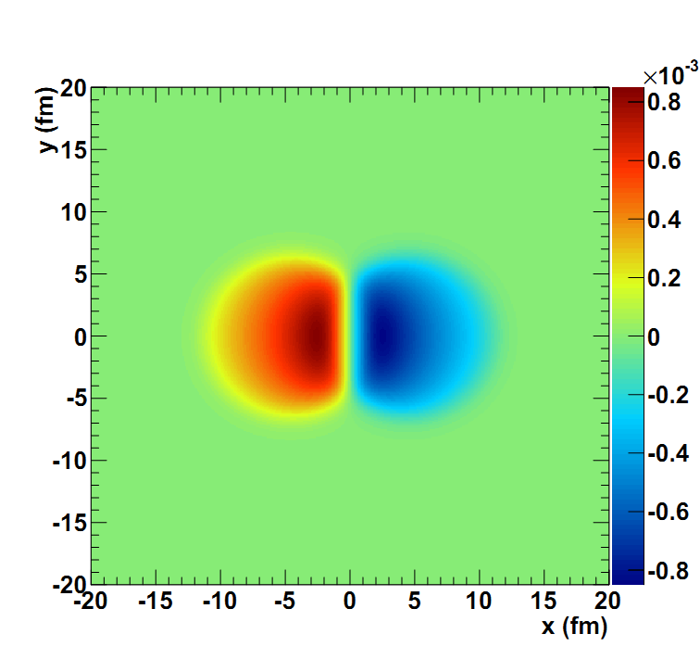
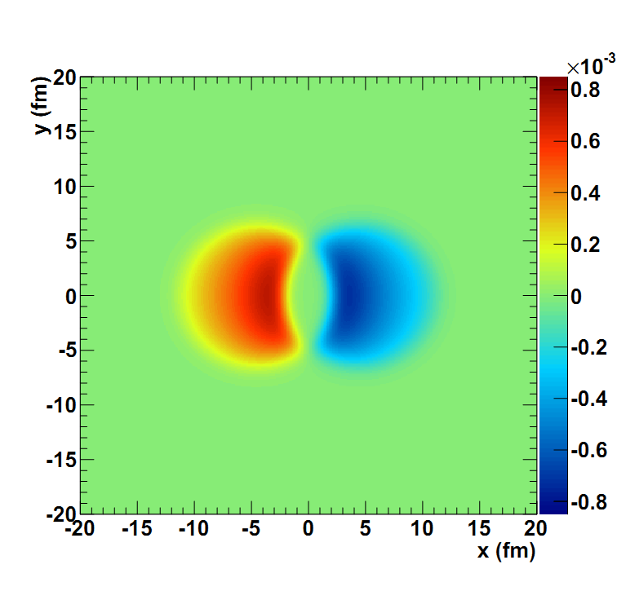
The interference with observation effect
Exclude the amplitude in the overlap region!
70 - 80%
y = 0 b = 10 fm
40 - 50%
The interference and diffraction pattern change significantly with the observation effect!
20 - 30%

Slide 13
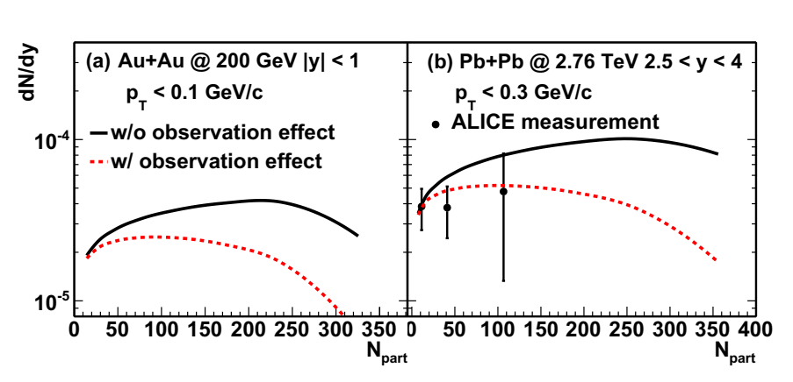
The observation effect on cross section
The observation effect significantly reduce the cross section!
The calculations with observation effect describe the data better!

Slide 14
Summary
The two-slit interferometer at fermi scale --- coherent photoproduction in heavy-ion collisions
  Interference entities --- J/ψ
  The radius of the slit --- at the level of fm (Au: 6.3 fm)
  The distance between the slits --- at the level of fm ( 0 – 13 fm for Au+Au 200 GeV)
Vary the distance between the slits --- centrality
Adjust the relative brightness between the slits --- rapidity
Check the observation effect --- complementary principle
Looking forward to the experimental measurements

