Slide 1

Pentaquark study at LHCb
张黎明
（清华大学）
The 4th China LHC Physics Workshop (Dec. 19-22, 2018)

Slide 2
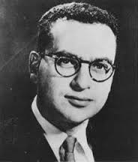
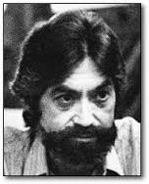
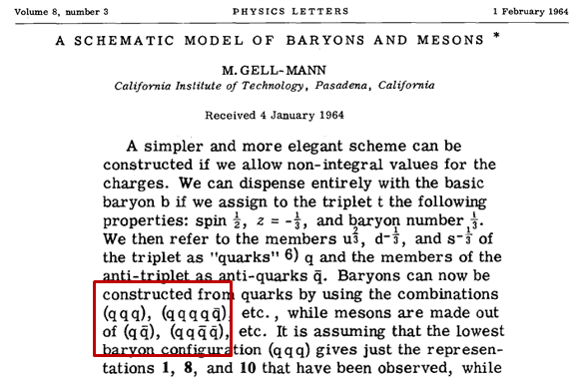



Quark model
In the beginning of quark model, multiquark objects were predicted - now called exotic
…
…
_
qqqqq baryons later called “pentaquarks”;
qqqq meson called “tetraquarks”
_ _

Slide 3
Why pentaquarks?
Interest in pentaquarks arises from the fact that they would be new type of particles beyond the simple quark-model picture. Could teach us a lot about QCD.
There is no reason they should not exist
  Predicted by Gell-Mann (64), Zweig (64), others later in context of specific QCD models: Jaffe (76), Högaasen & Sorba (78), Strottman (79), Lipkin (87)
These would be short-lived ~10⁻²³ s “resonances” whose presence is detected by mass peaks & angular distributions showing the presence of unique J^{P} quantum numbers

Slide 4
LHCb detector and performance
The LHCb detector described in JINST 3 (2008) S08005
Int. J. Mod. Phys. A 30 (2015) 1530022
Notes:
我们精确的顶点探测器可以有效地选出长寿命的B强子

Slide 5
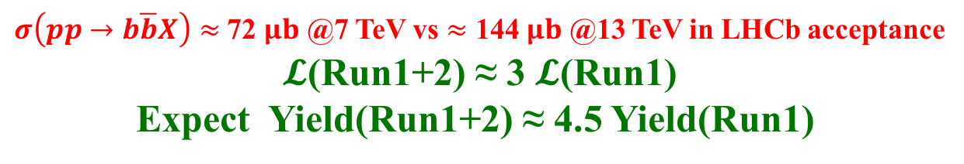
LHCb collected luminosity
2.19/fb
1.7/fb
1.7/fb
8TeV
2.1/fb
0.3/fb
Results at this talk
only based on run-1
data
7TeV
1.1/fb
13TeV
$σ\left(pp→b\overline{b}X\right)≈$ 72 $μb$ @7 TeV vs $≈$ 144 $μb$ @13 TeV in LHCb acceptance
$𝓛$(Run1+2) ≈ 3 $𝓛$(Run1)
Expect Yield(Run1+2) ≈ 4.5 Yield(Run1)
PHYS. REV. LETT. 118, 052002 (2017)

Slide 6
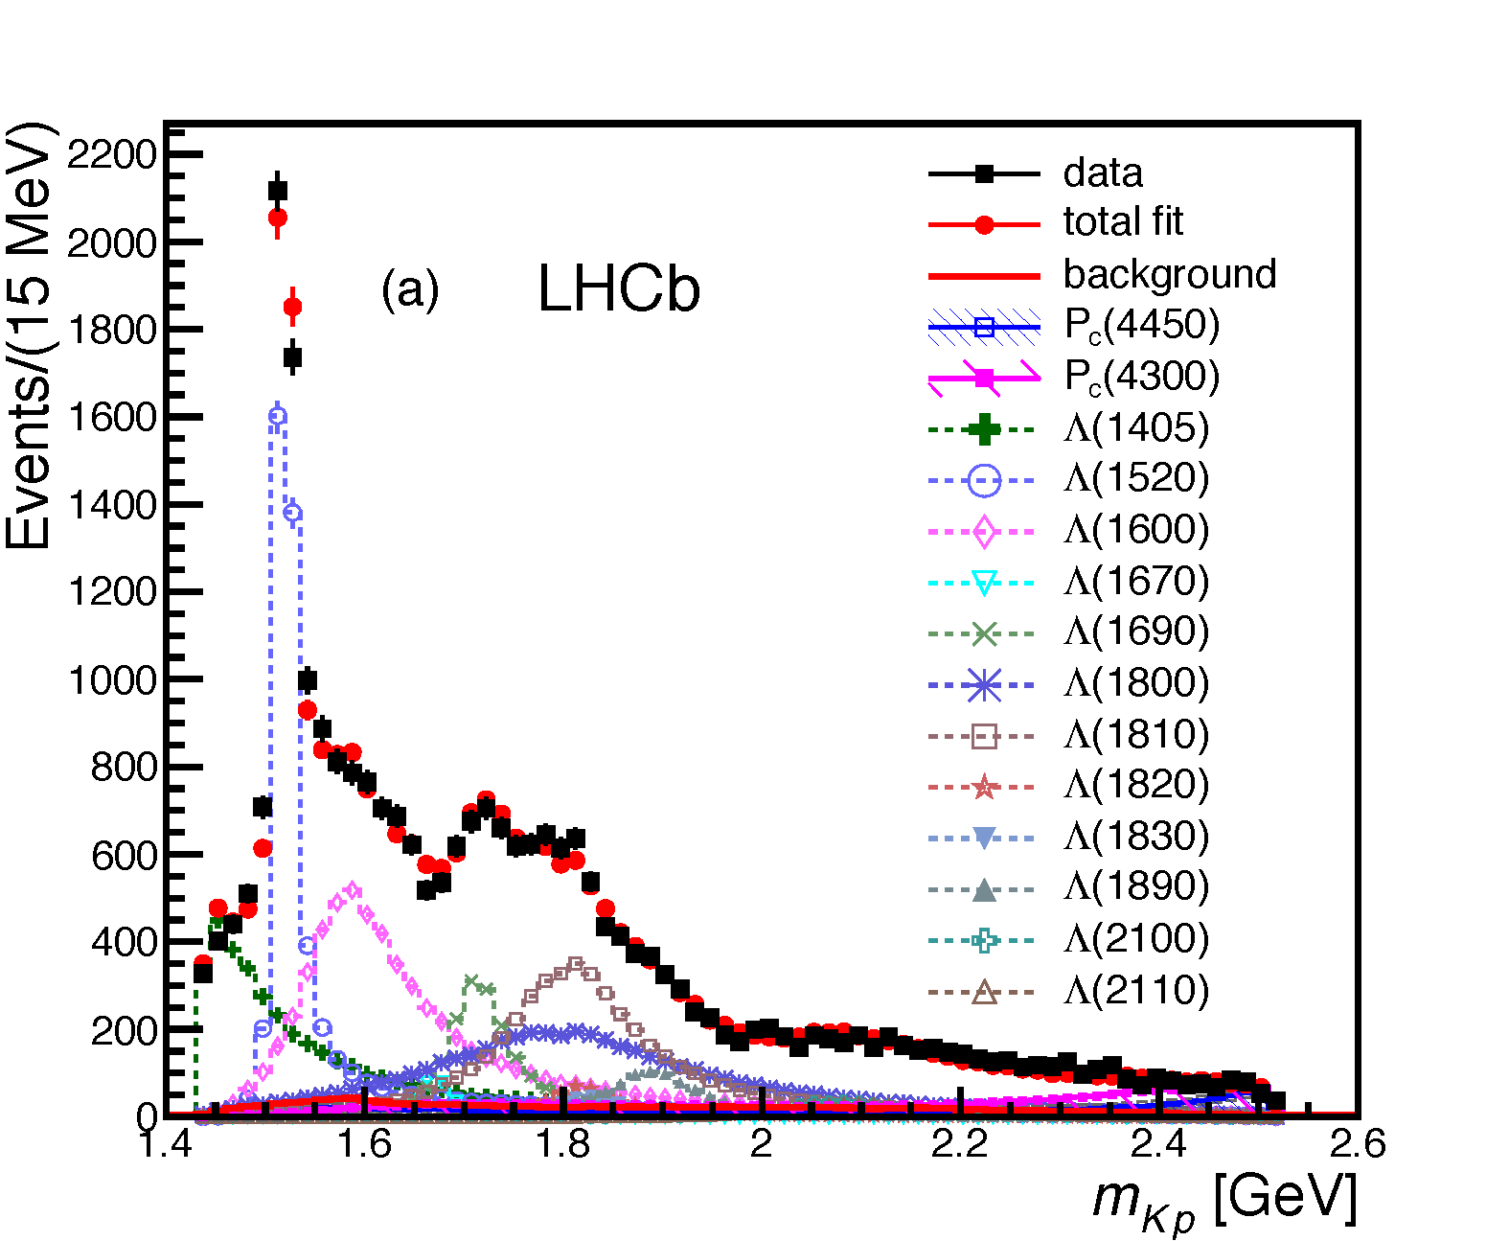
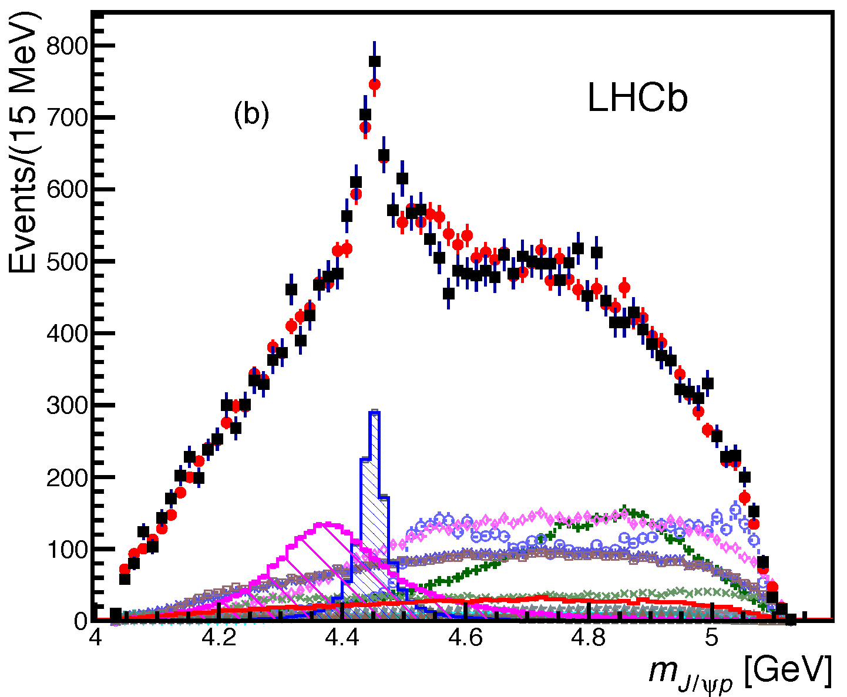





Discovery of pentaquark states
PRL 115, 072001 (2015)
Two pentaquark states observed in 26,000 $Λ_{b}^{0}→J/ψpK^{−}$ decays
Data
Fit
7+8 TeV
$$P_{c}{\left(4450\right)}^{+}$$
$$P_{c}{\left(4380\right)}^{+}$$
$$m_{pK^{−}} [GeV]$$
$$m_{J/ψp} [GeV]$$

Slide 7
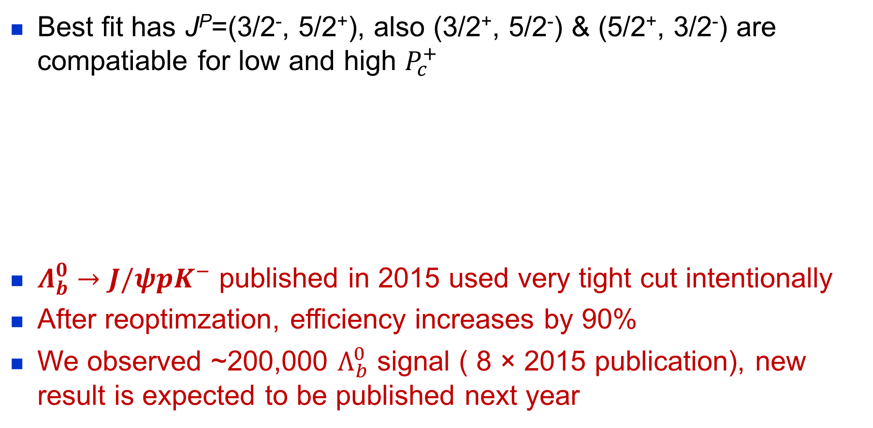
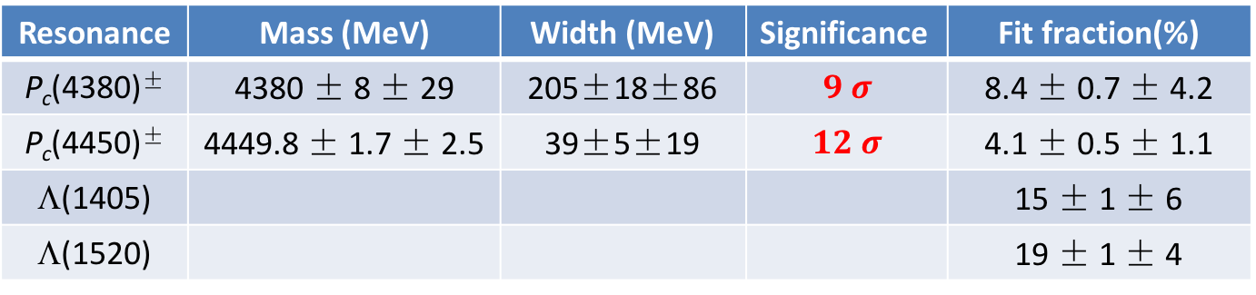
Fit results
Best fit has J^{P}=(3/2⁻, 5/2⁺), also (3/2⁺, 5/2⁻) & (5/2⁺, 3/2⁻) are compatiable for low and high $P_{c}^{+}$
$Λ_{b}^{0}→J/ψpK^{−}$ published in 2015 used very tight cut intentionally
After reoptimzation, efficiency increases by 90%
We observed ~200,000 $Λ_{b}^{0}$ signal ( 8 × 2015 publication), new result is expected to be published next year
PRL 115, 072001 (2015)
Resonance | Mass (MeV) | Width (MeV) | Significance | Fit fraction(%)
P_{c}(4380)± | 4380 ± 8 ± 29 | 205±18±86 | $$9 σ$$ | 8.4 ± 0.7 ± 4.2
P_{c}(4450)± | 4449.8 ± 1.7 ± 2.5 | 39±5±19 | $$12 σ$$ | 4.1 ± 0.5 ± 1.1
Λ(1405) |  |  |  | 15 ± 1 ± 6
Λ(1520) |  |  |  | 19 ± 1 ± 4

Slide 8
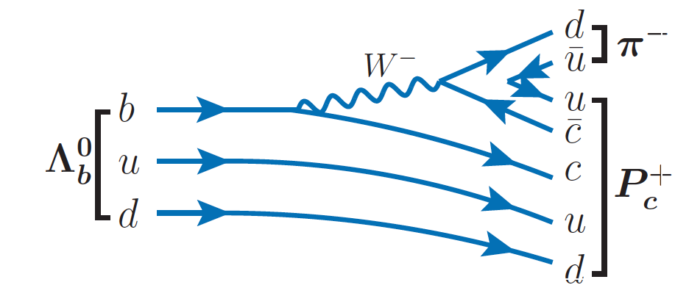
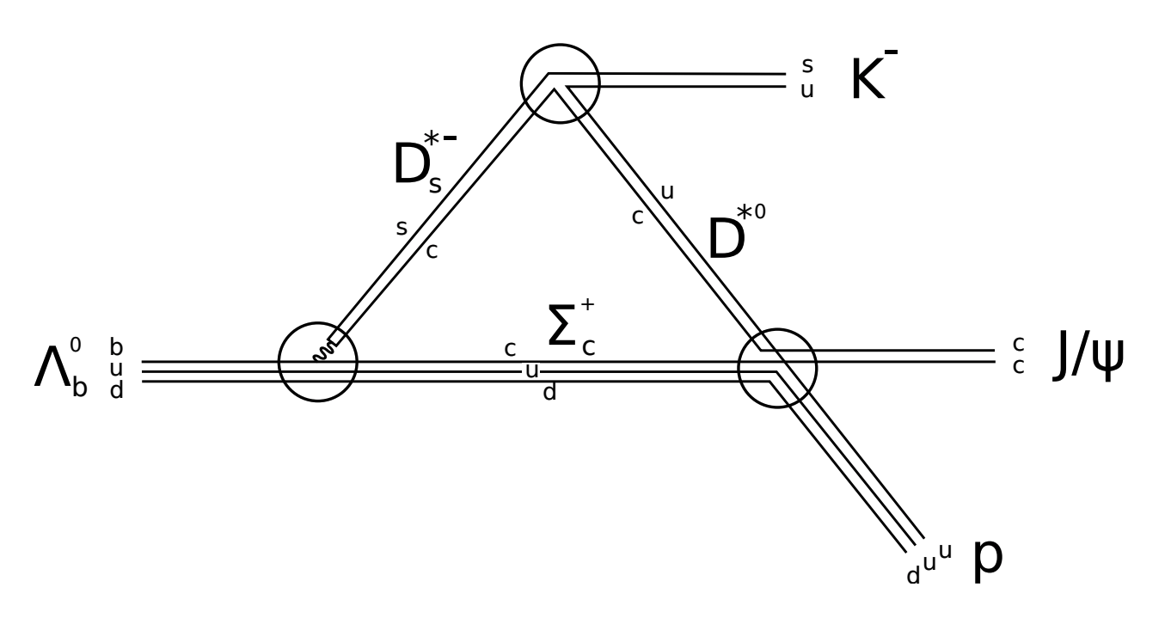
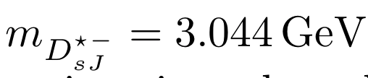


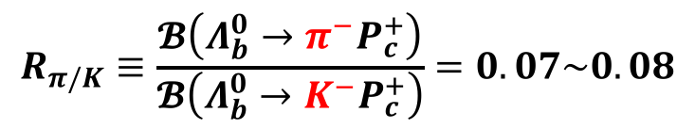
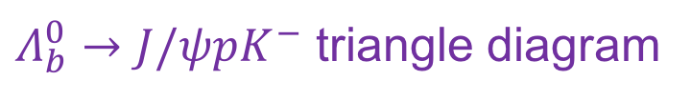


Cabibbo-suppressed decays
Find the same $P_{c}^{+}$ in other channels is helpful to understand the production mechanism and internal structure
$Λ_{b}^{0}→J/ψpπ^{−}$ is Cabibbo-suppressed w.r.t. $J/ψpK^{−}$
Arxiv:1507.06552
$$b→c$$
$Λ_{b}^{0}→J/ψpK^{−}$ triangle diagram
q
$$K^{−}(π^{−})$$
$$R_{π/K}≡\frac{𝓑\left(Λ_{b}^{0}→π^{−}P_{c}^{+}\right)}{𝓑\left(Λ_{b}^{0}→K^{−}P_{c}^{+}\right)}=0.07\sim 0.08$$
  [Cheng, Phys. Rev. D 92, 096009 (2015)]
Triangle in $Λ_{b}^{0}→J/ψpπ^{−}$ shouldn’t generate peak at the same position

Slide 9
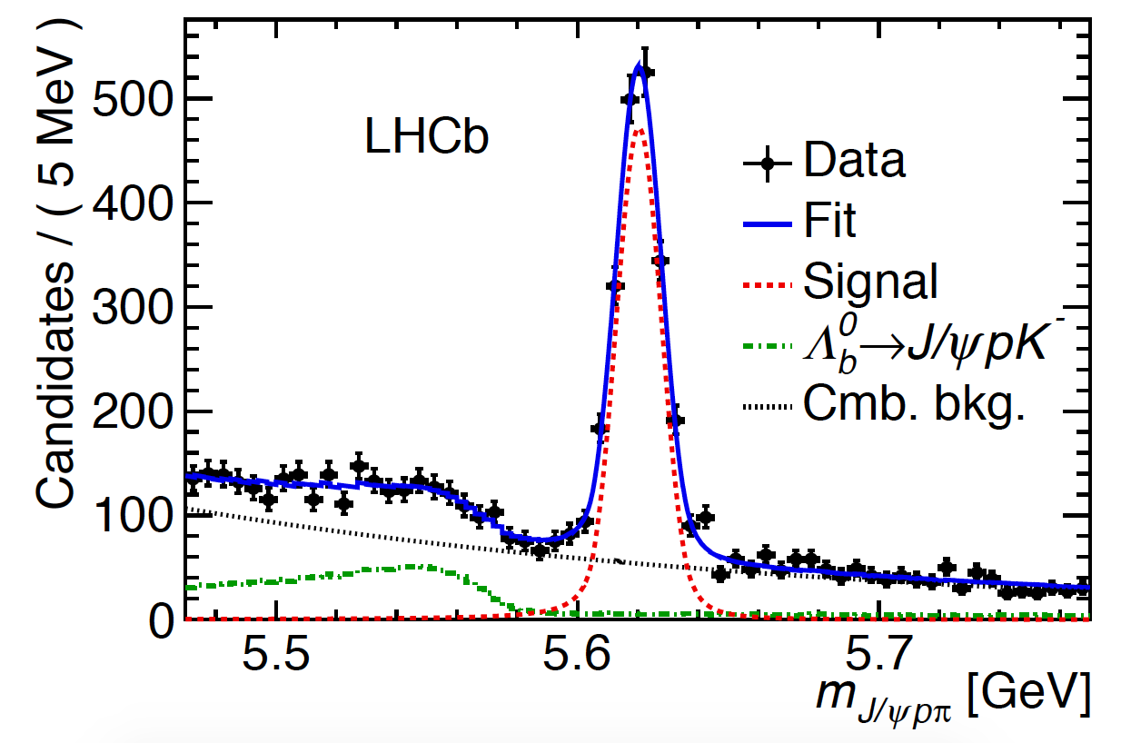
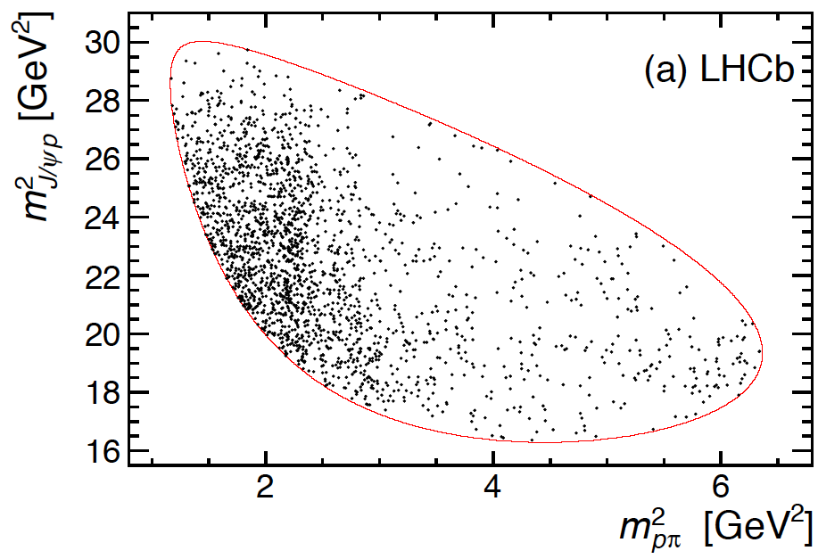
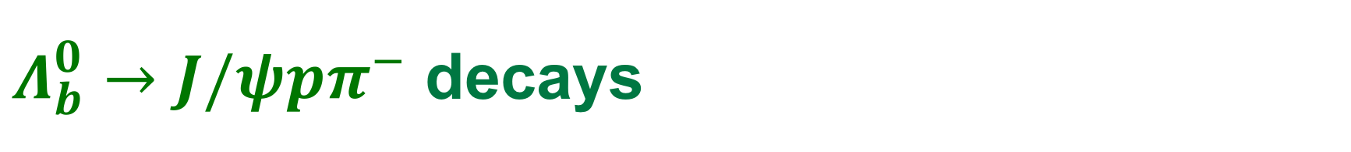


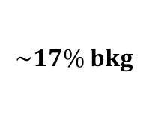

$Λ_{b}^{0}→J/ψpπ^{−}$ decays
PRL 117, 082003 (2016)
$$N_{sig}=1885±50$$
$$\sim 17\% bkg$$
$$P_{c}^{+}$$
Nucleon excitations
>10 less signal in $Λ_{b}^{0}→J/ψpπ^{−}$ than in $Λ_{b}^{0}→J/ψpK^{−}$
But more complex because of possible $Z_{c}^{−}→J/ψπ^{−}$

Slide 10
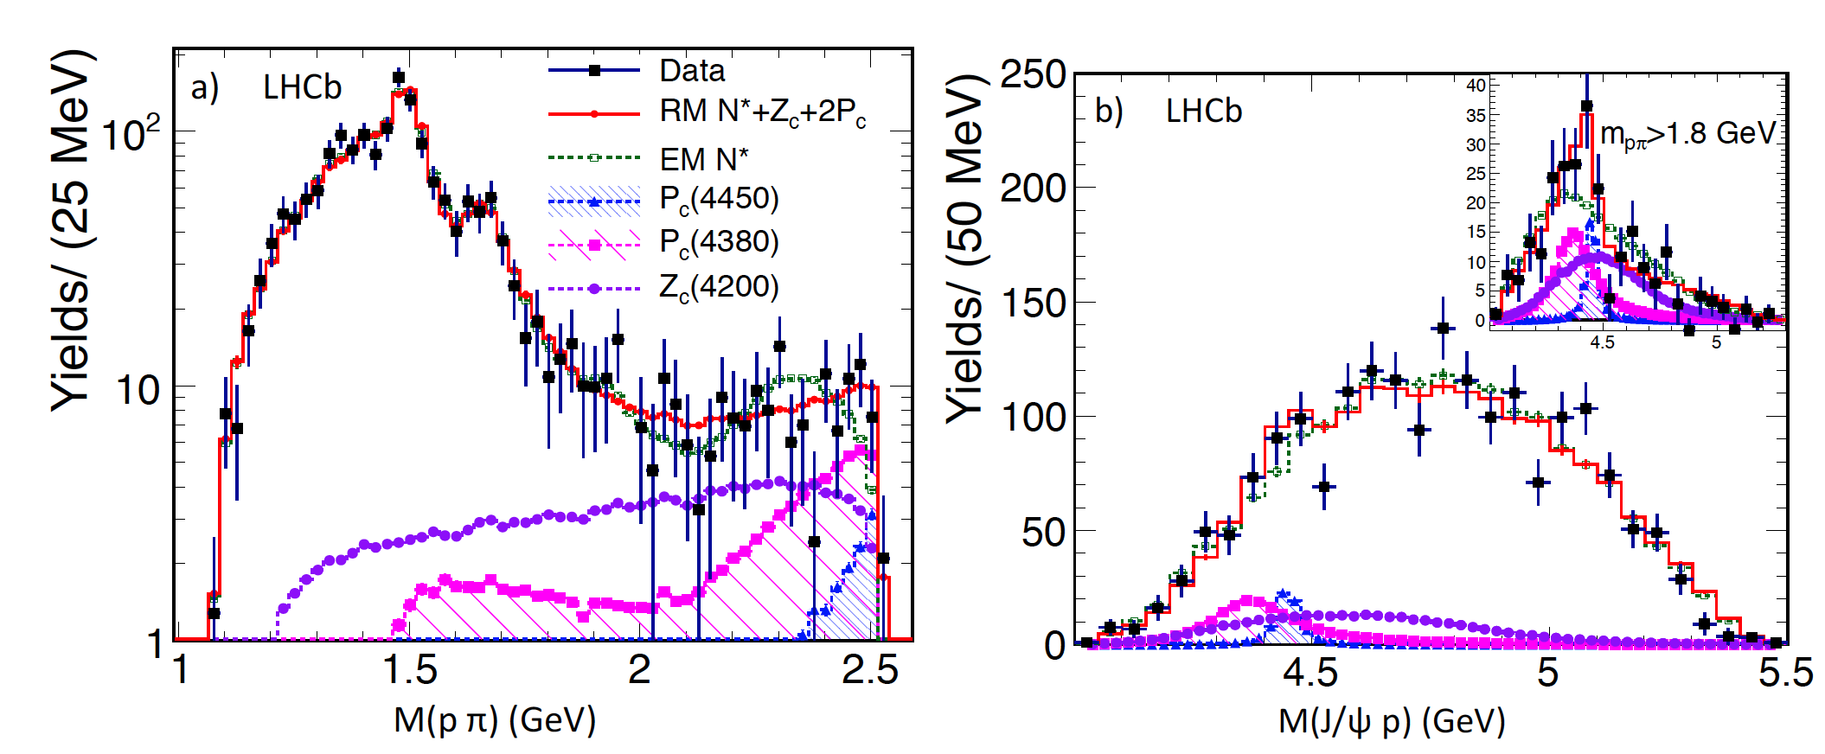
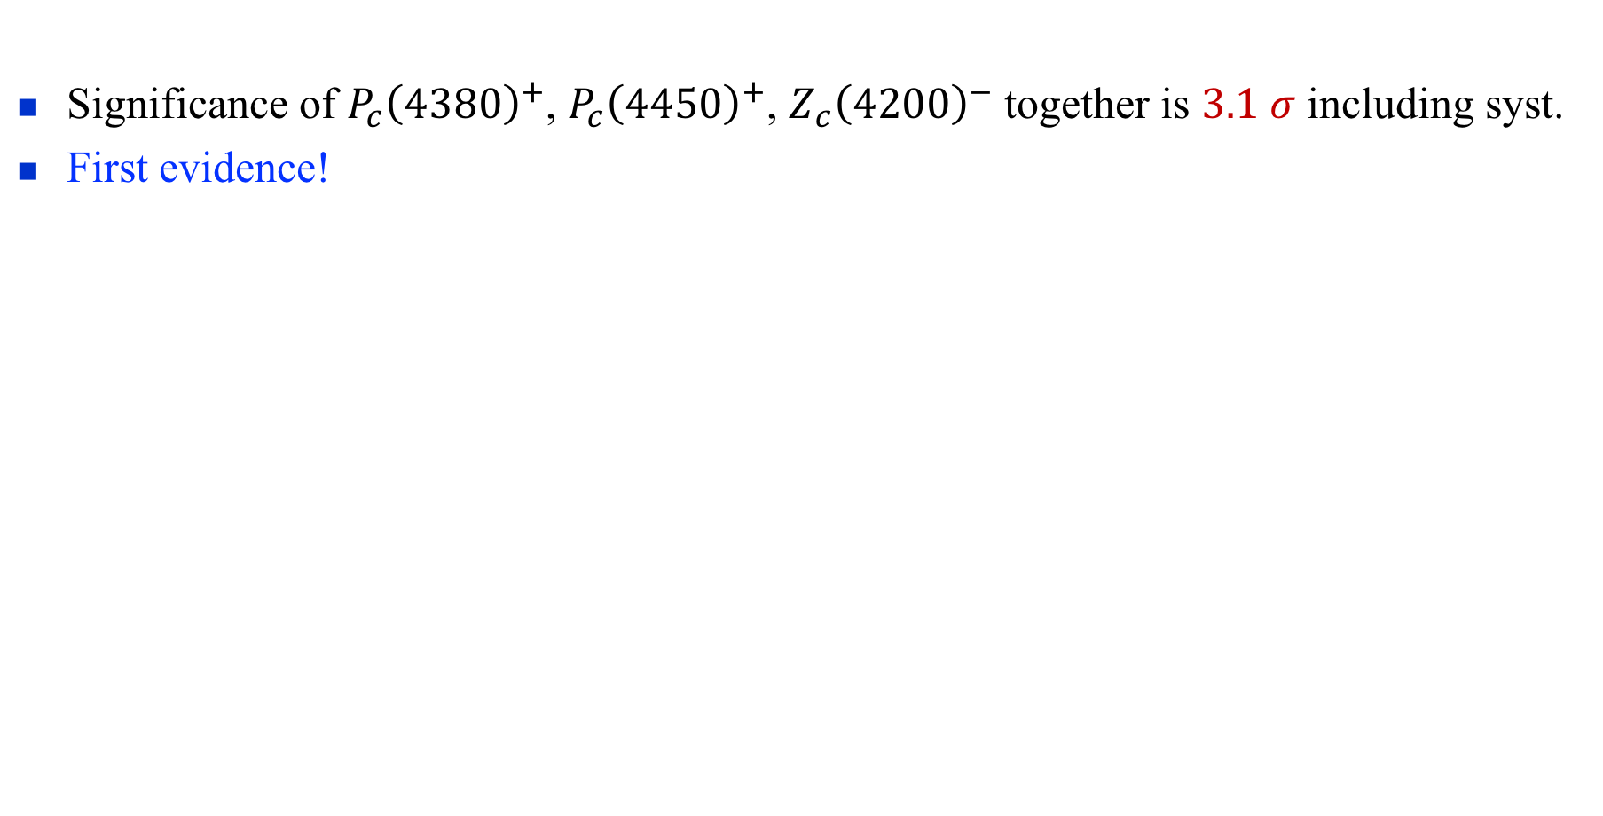


Full amplitude fits to $Λ_{b}^{0}→J/ψpπ^{−}$
Significance of $P_{c}{\left(4380\right)}^{+}$, $P_{c}{\left(4450\right)}^{+}$, $Z_{c}{\left(4200\right)}^{−}$ together is $3.1 σ$ including syst.
First evidence!
PRL 117, 082003 (2016)
2 $P_{c}^{+}$?
Expect ~10,000 signals with full data

Slide 11
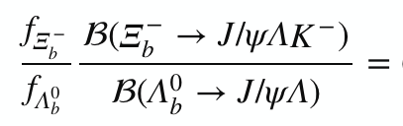

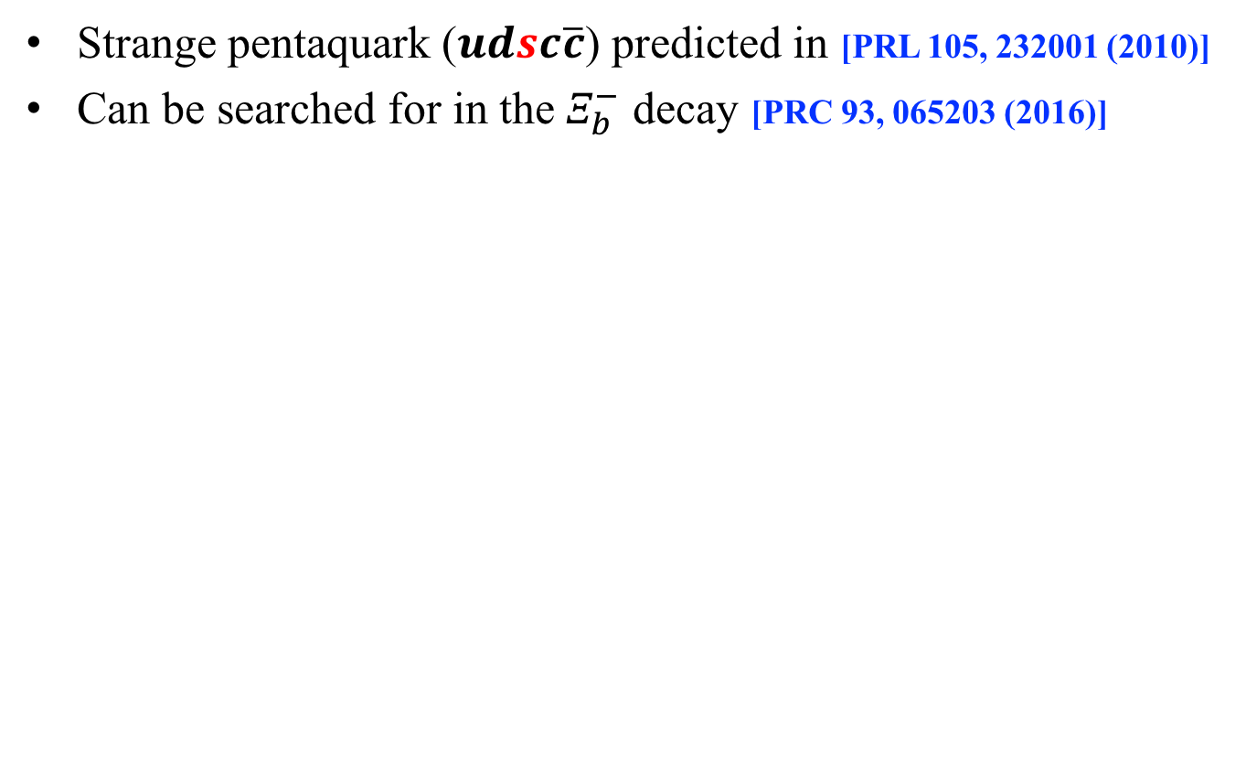


Observation of ${ Ξ}_{b}^{−}→J/ψΛK^{−}$
Strange pentaquark ($udsc\overline{c}$) predicted in [PRL 105, 232001 (2010)]
Can be searched for in the $Ξ_{b}^{−}$ decay [PRC 93, 065203 (2016)]
N_{sig} = $308±21$ (21σ)
PLB 772 (2017) 265-273
(4.19 ± 0.29 ± 0.15)×10⁻²
Expect ~1700${ Ξ}_{b}^{−}$signals, amplitude analysis
is in good progress

Slide 12
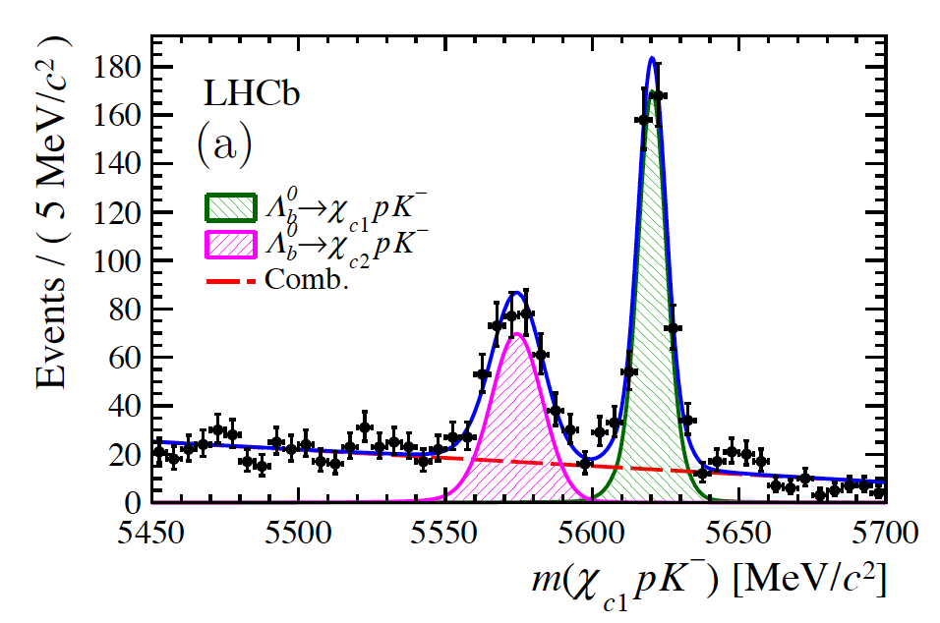

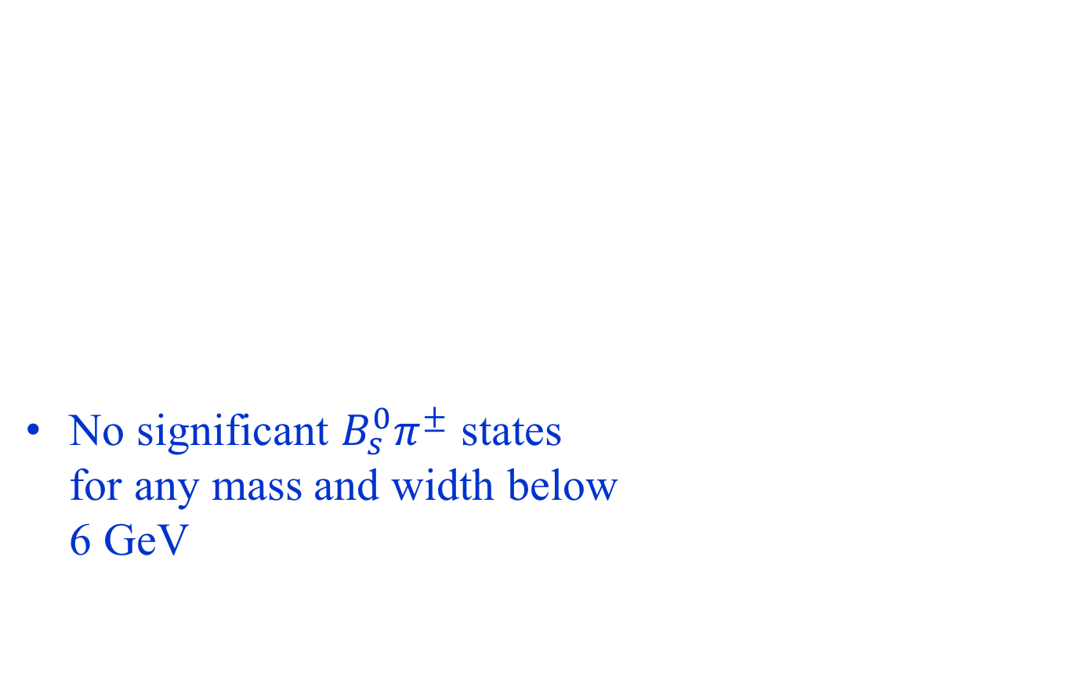

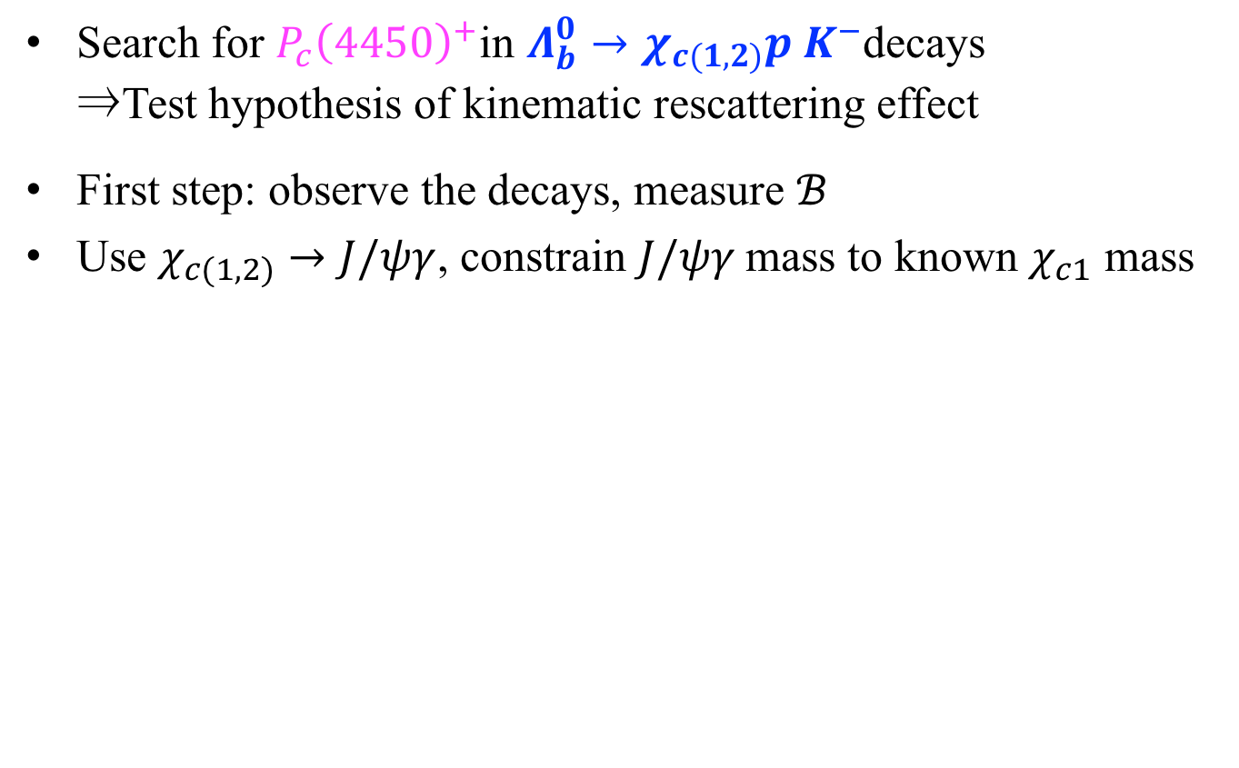


Observation of $Λ_{b}^{0}→χ_{c(1,2)}pK^{−}$
Search for $P_{c}{\left(4450\right)}^{+}$in $Λ_{b}^{0}→χ_{c(1,2)}p K^{−}$decays
⇒Test hypothesis of kinematic rescattering effect
First step: observe the decays, measure $ℬ$
Use $χ_{c(1,2)}→J/ψγ$, constrain $J/ψγ$mass to known $χ_{c1}$ mass
PRD 92 (2015) 071502
$$\frac{𝓑(Λ_{b}^{0}→χ_{c1}pK^{−})}{𝓑(Λ_{b}^{0}→J/ψpK^{−})}=$$
$0.242±0.014±0.013±0.009$
$$\frac{𝓑(Λ_{b}^{0}→χ_{c2}pK^{−})}{𝓑(Λ_{b}^{0}→J/ψpK^{−})}=$$
$0.248±0.020±0.014±0.009$
PRL 119 (2017) 062001
$χ_{c2}$
$$285±23$$
$χ_{c1}$
$$453±25$$
$$𝓑(χ_{cJ})$$
Next step: full amplitude analysis with more data

Slide 13
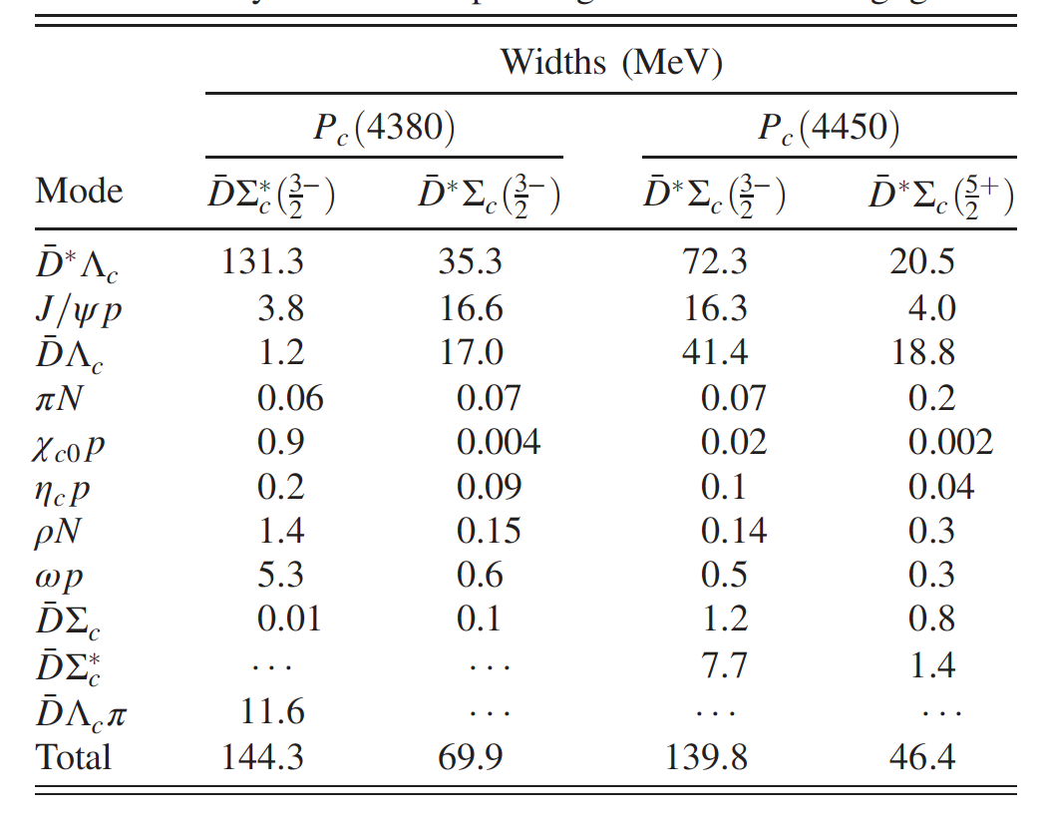

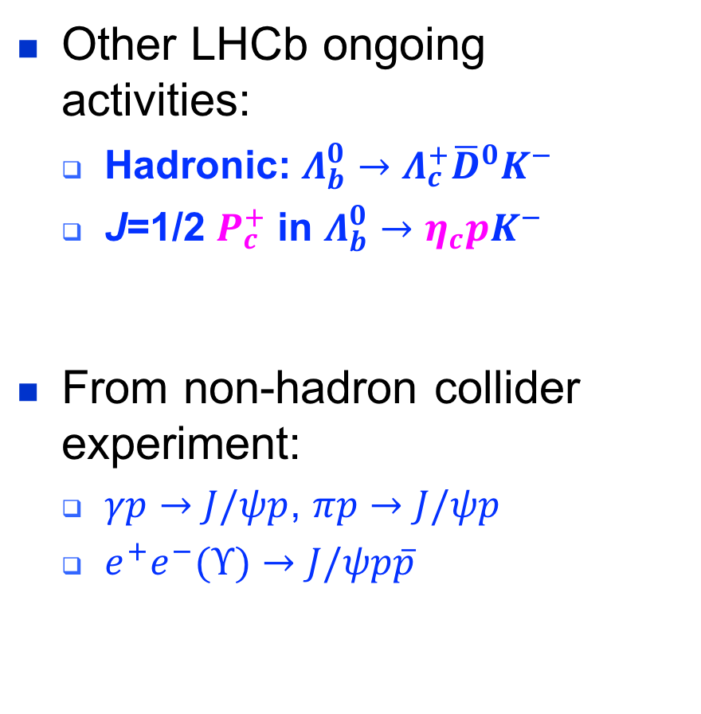
Other $P_{c}$ channels
Other LHCb ongoing activities:
  Hadronic: $Λ_{b}^{0}→Λ_{c}^{+}{\overline{D}}^{0}K^{−}$
  J=1/2 $P_{c}^{+}$ in $Λ_{b}^{0}→η_{c}pK^{−}$
From non-hadron collider experiment:
  $γp→J/ψp$, $πp→J/ψp$
  $e^{+}e^{−}(Υ)→J/ψp\overline{p}$
YH Lin, CW Shen, FK Guo, BS Zou, PRD 95, 114017 (2017)
☞
✓
☞
Preferred interpretations

Slide 14
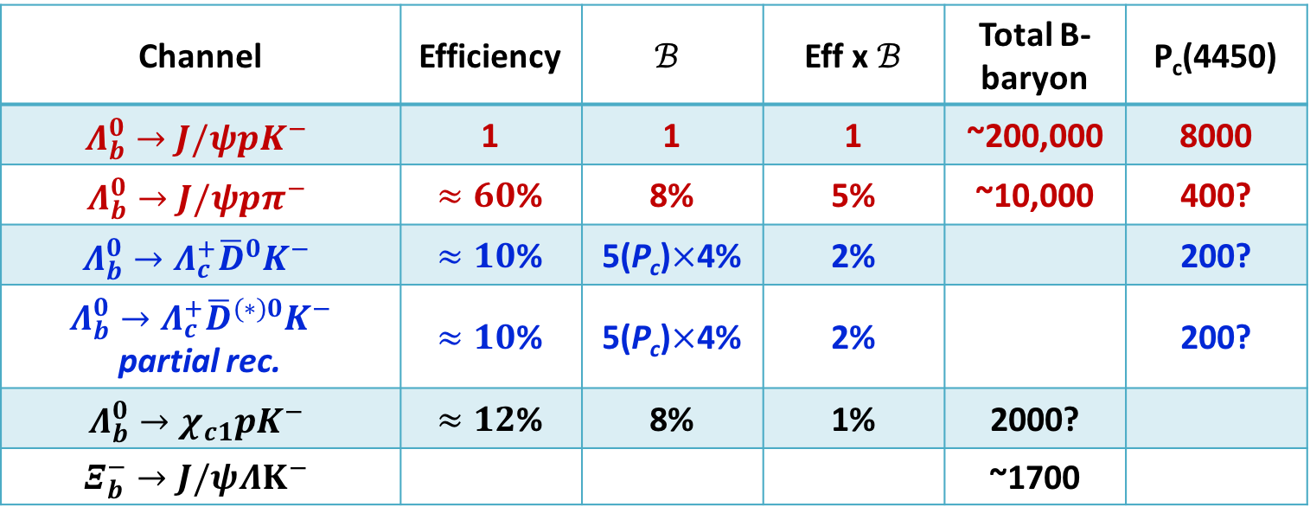
Expected yields with full Run1+2 data
Efficiency in other channels published are reasonable:
Hadronic mode is difficult, since less efficiency (due to more tracks) and less production branching fraction (two charm decays)
Channel | Efficiency | $$ℬ$$ | Eff x $ℬ$ | Total B-baryon | P_{c}(4450)
$$Λ_{b}^{0}→J/ψpK^{−}$$ | 1 | 1 | 1 | ~200,000 | 8000
$$Λ_{b}^{0}→J/ψpπ^{−}$$ | $≈60$% | 8% | 5% | ~10,000 | 400?
$$Λ_{b}^{0}→Λ_{c}^{+}{\overline{D}}^{0}K^{−}$$ | $≈10$% | 5(P_{c})$×$4% | 2% |  | 200?
$Λ_{b}^{0}→Λ_{c}^{+}{\overline{D}}^{(∗)0}K^{−}$ partial rec. | $≈10$% | 5(P_{c})$×$4% | 2% |  | 200?
$$Λ_{b}^{0}→χ_{c1}pK^{−}$$ | $≈12$% | 8% | 1% | 2000?
$$Ξ_{b}^{−}→J/ψΛK^{−}$$ |  |  |  | ~1700

Slide 15
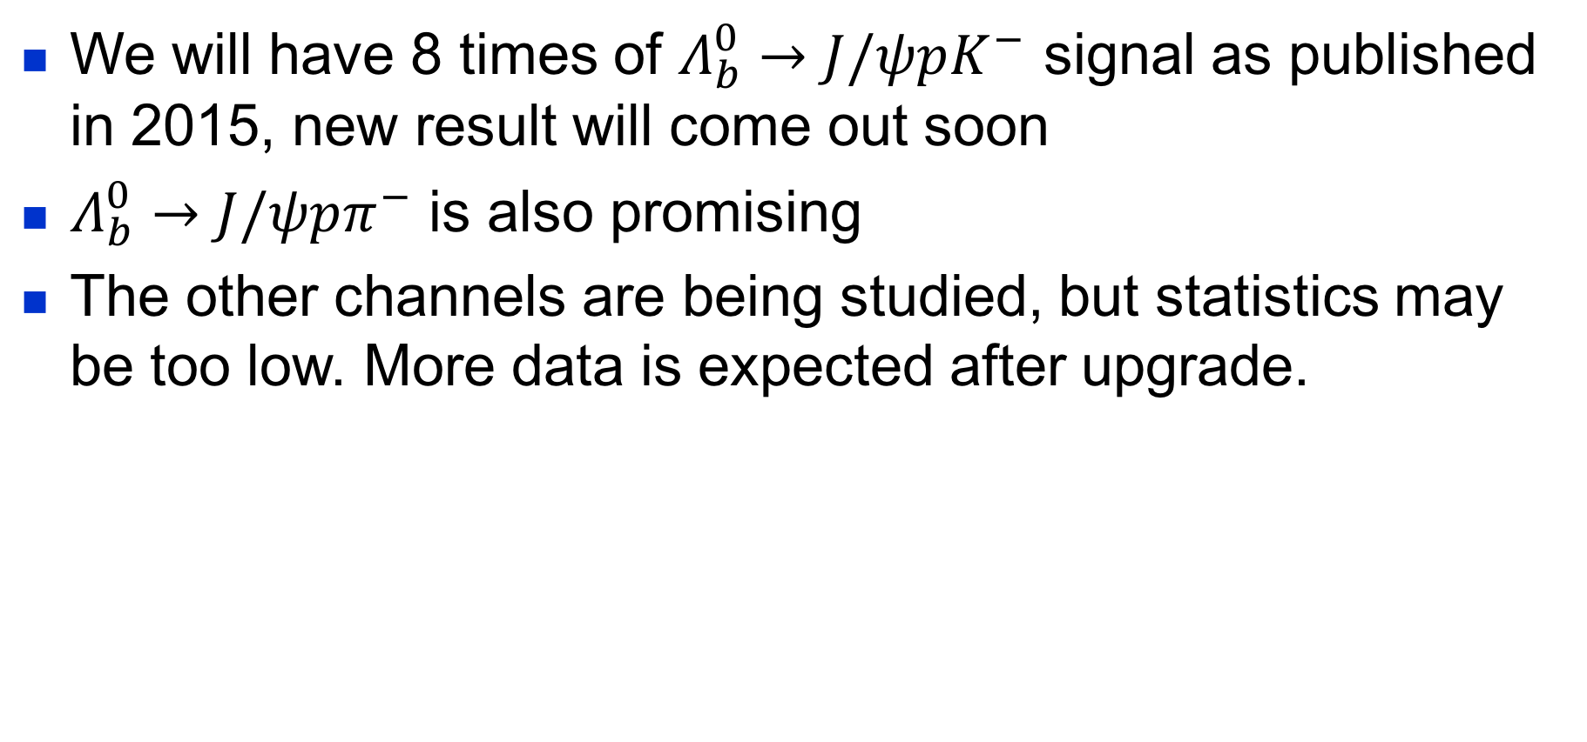
Summary
We will have 8 times of $Λ_{b}^{0}→J/ψpK^{−}$ signal as published in 2015, new result will come out soon
$Λ_{b}^{0}→J/ψpπ^{−}$ is also promising
The other channels are being studied, but statistics may be too low. More data is expected after upgrade.
LHC |  |  | HL-LHC
Run-1 (2010-12) | Run-2 (2015-18) | Run-3 (2021-24) | Run-4 (2027-30) | Run-5 (2031+)
3 fb⁻¹ | 9 fb⁻¹ | 23 fb⁻¹ | 50 fb⁻¹ | >300 fb⁻¹

Slide 16
Thank you!

Slide 17
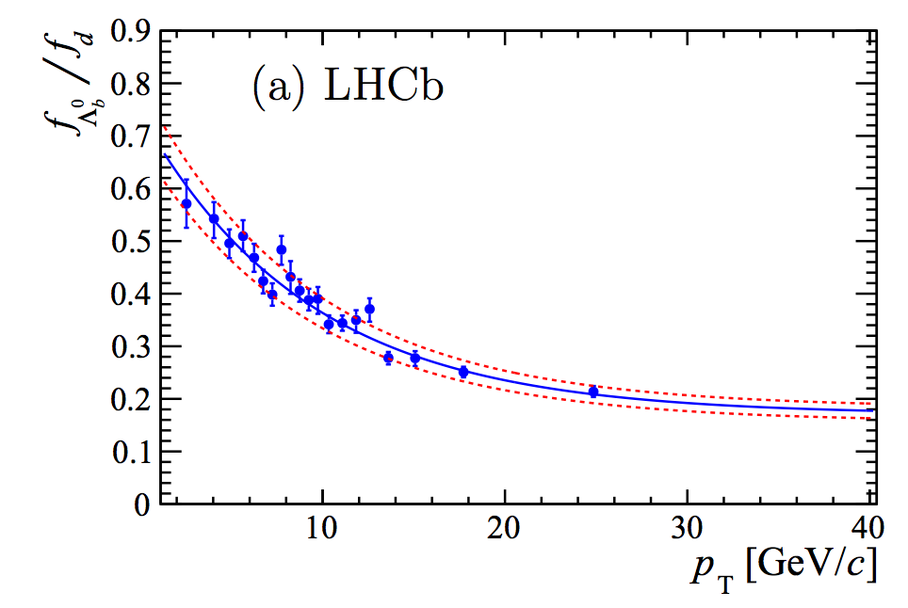
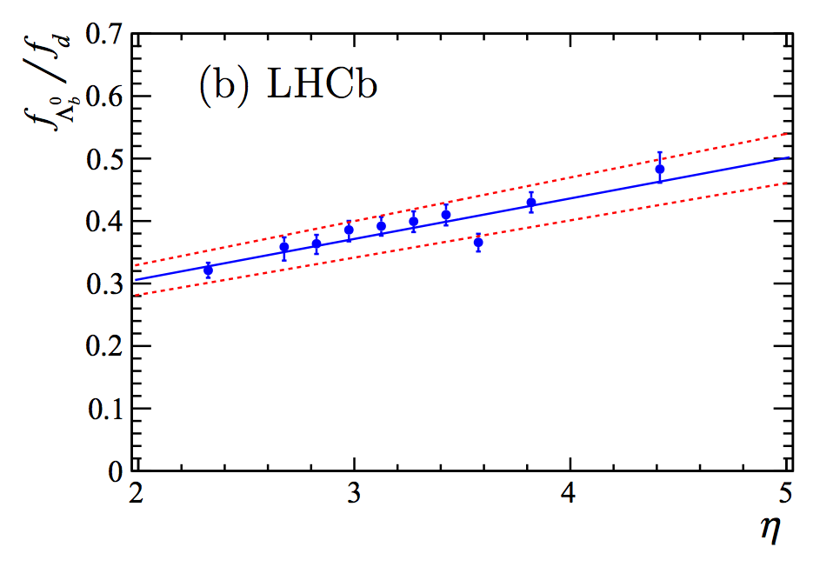
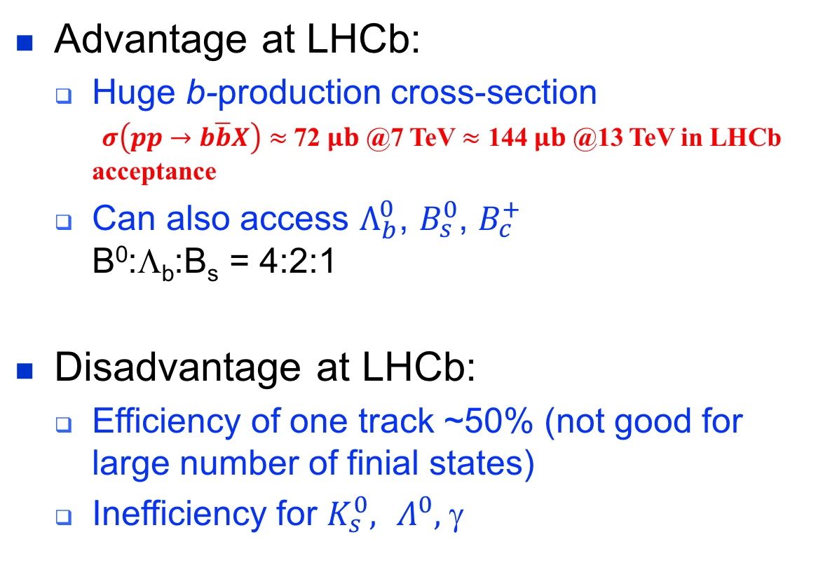
LHCb advantage and disadvantage
Advantage at LHCb:
  Huge b-production cross-section
  $σ\left(pp→b\overline{b}X\right)≈$ 72 $μb$ @7 TeV $≈$ 144 $μb$ @13 TeV in LHCb acceptance
  Can also access $Λ_{b}^{0}$, $B_{s}^{0}$, $B_{c}^{+}$
  B⁰:Λ_{b}:B_{s} = 4:2:1
Disadvantage at LHCb:
  Efficiency of one track ~50% (not good for large number of finial states)
  Inefficiency for $K_{s}^{0},$ $Λ^{0},$ γ
f_{Λb}/f_{d}
PHYS. REV. LETT. 118, 052002 (2017)
f_{Λb}/f_{d}
[LHCb, JHEP 08(2014) 143]

Slide 18
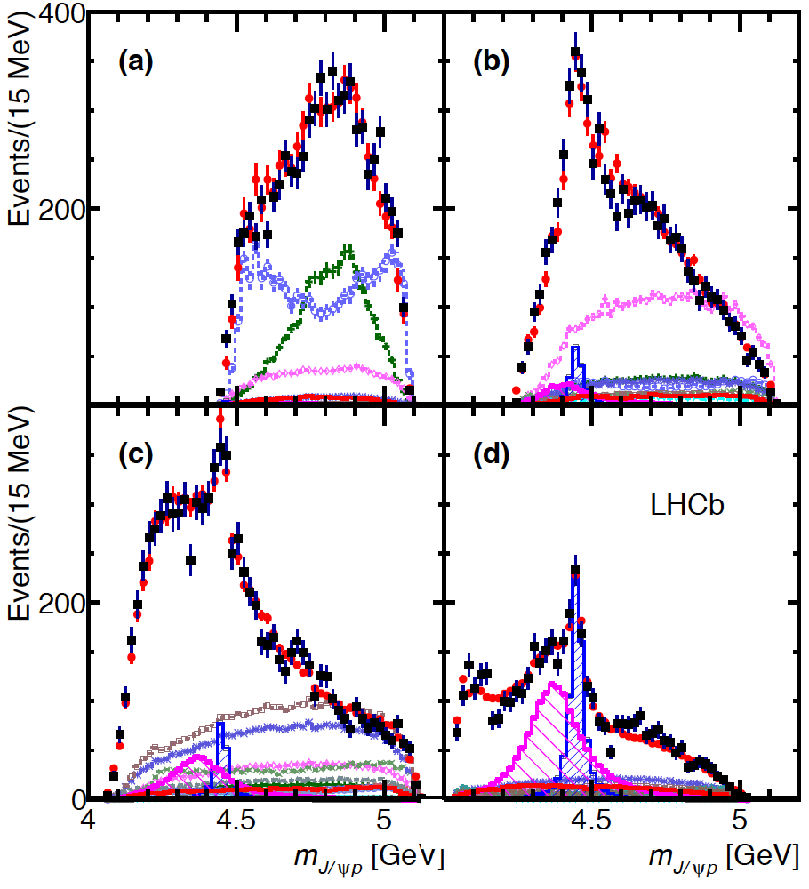
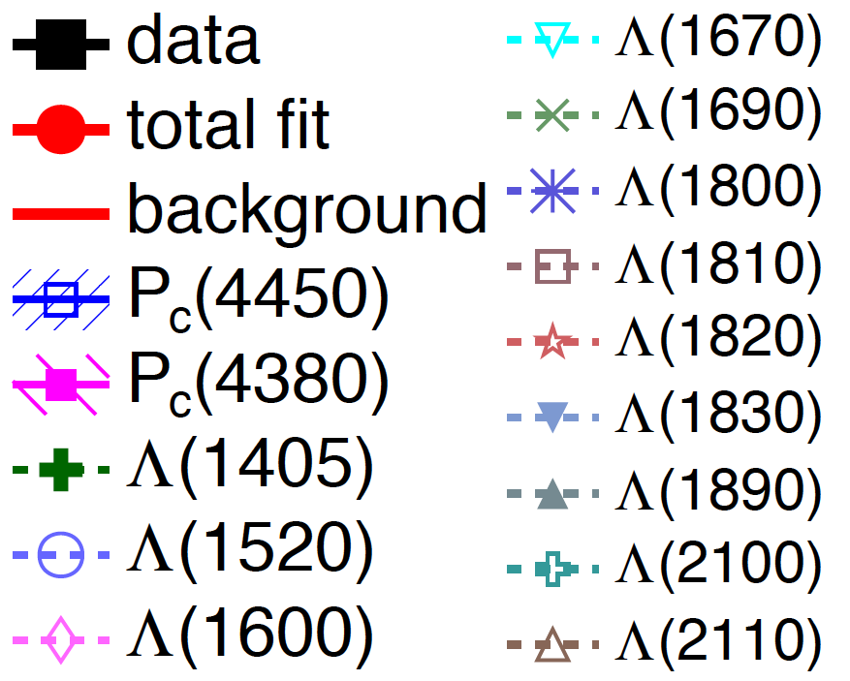
In m(Kp) slices
P_{c}’s not appear in first interval as they outside of the Dalitz plot boundary
M(Kp)<1.55 GeV
1.55<M(Kp)
<1.70 GeV
Events/(20 MeV)
[PRL 115, 072001 (2015)]
1.70<M(Kp)
<2.00 GeV
2.00 GeV<M(Kp)
Events/(20 MeV)

Slide 19
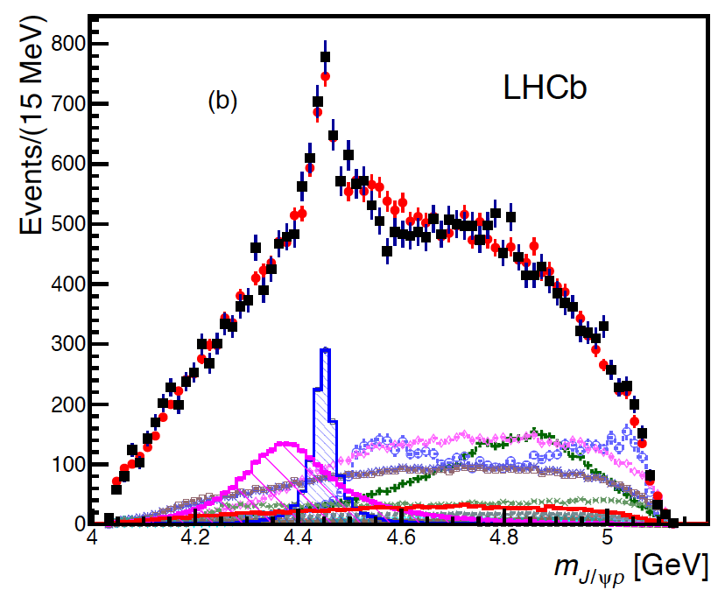
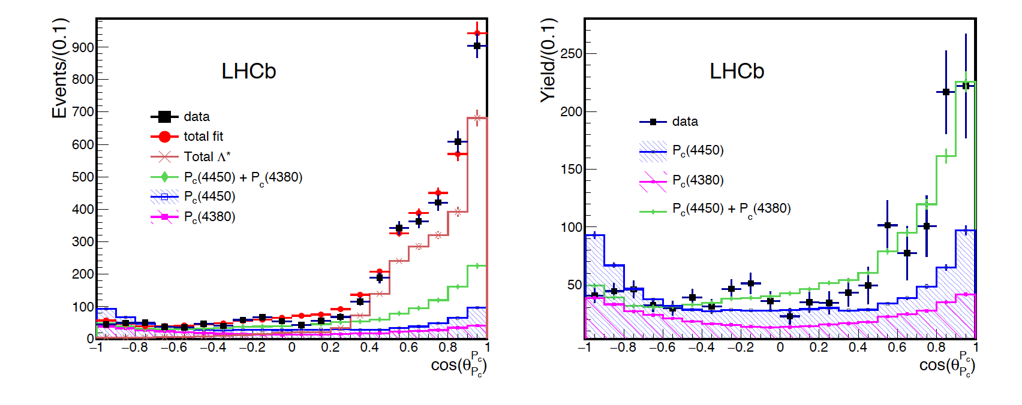
P_{c}± decay angle distribution
Events in $m_{0}±Γ$ of P_{c}(4450)
Asymmetric distribution from 2P_{c} is evident
2 P_{c} overlap and interfere
CERN-THESIS-2016-086
Λ* subtracted
2P_{c}
Λ*+2P_{c}

Slide 20

Weakly decaying b-flavoured pentaquarks
PRD 97 (2018) 032010
Skyrme model: heavy quarks give
tightly bound pentaquark
Search for mass peaks below strong
decay threshold
Upper limit on production ratio $σ⋅ℬ$ wrt $Λ_{b}^{0}→J/ψK^{−}p$
PLB 590(2004) 185; PLB 586(2004)337; PLB 331(1994)362

Slide 21
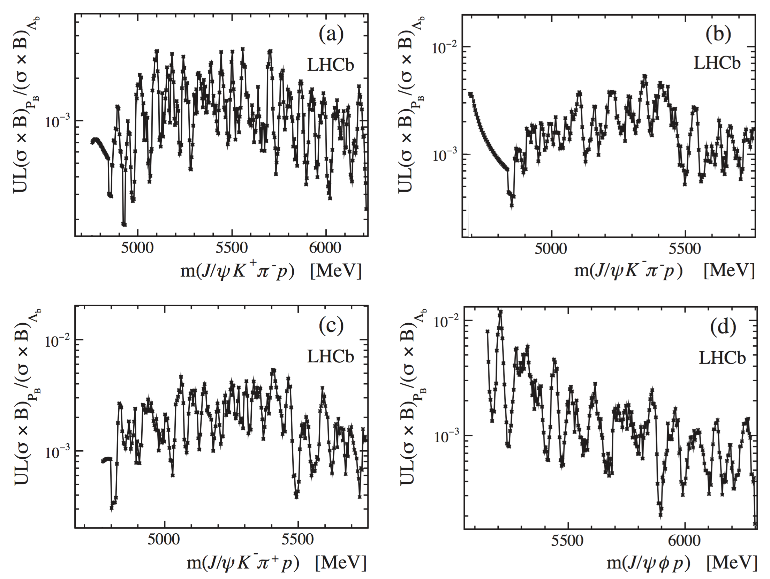
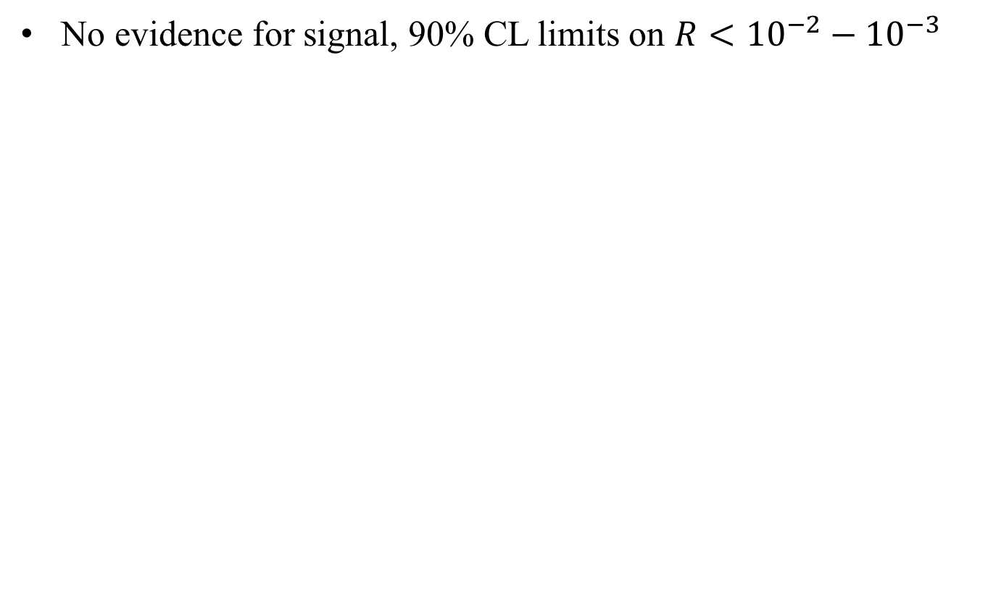
Weakly decaying b-flavoured pentaquarks
PRD 97 (2018) 032010
No evidence for signal, 90% CL limits on $R<{10}^{−2}−{10}^{−3}$
7+8 TeV

Slide 22

Search for dibaryon state
Phys. Lett. B784 (2018) 101
A dibaryon state $\left[cd\right]\left[ud\right][ud]$
could be produced in $Λ_{b}^{0}$ decays
to final state $Λ_{c}^{+}π^{−}p\overline{p}$
Can also be used to search for
$\overline{u}\left[cd\right]\left[ud\right]→Λ^{+}π^{−}$ pentaquark
LHCb has discovered the decay
${Λ_{b}^{0}→Λ}_{c}^{+}π^{−}p\overline{p}$
L. Maiani, et al. PLB 750 (2015) 37
Resonance contributions
7+8 TeV
926±43 signal

Slide 23
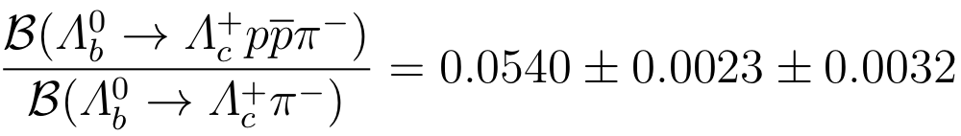


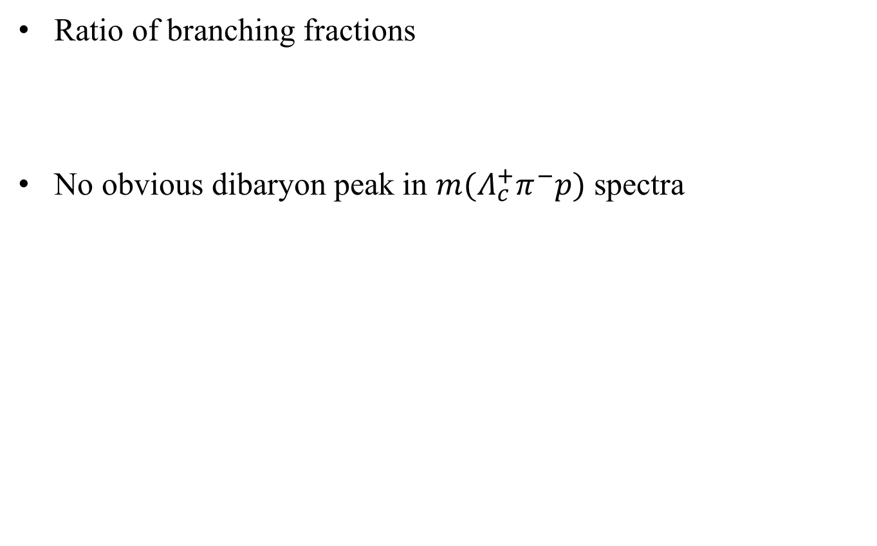
Search for dibaryon state
Phys. Lett. B784 (2018) 101
Ratio of branching fractions
No obvious dibaryon peak in $m(Λ_{c}^{+}π^{−}p)$ spectra
All signals
$Σ_{c}^{0}$ region signals
$Σ_{c}^{∗0}$ region signals

Slide 24
LHCb detector and performance
Int. J. Mod. Phys. A 30 (2015) 1530022
Notes:
我们精确的顶点探测器可以有效地选出长寿命的B强子

