Slide 1
BEIJING-LCG2 & NGI_CHINA Report
Yan Xiaofei
IHEP-CC

Slide 2
OutLine
IHEP Computing Center
Grid Computing BEIJING-LCG2
Tier2 & Tier3
Internet connections & Security
Contact

Slide 3
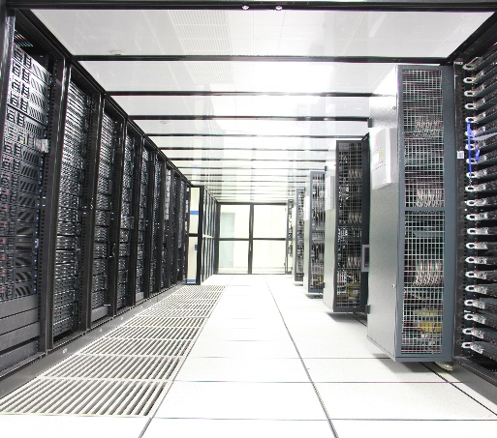
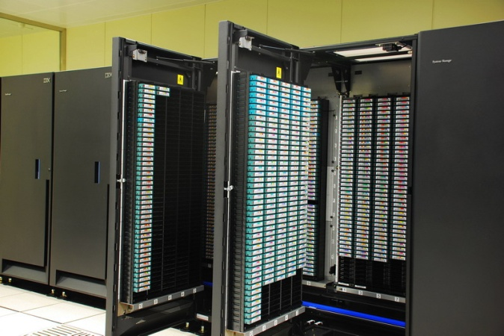
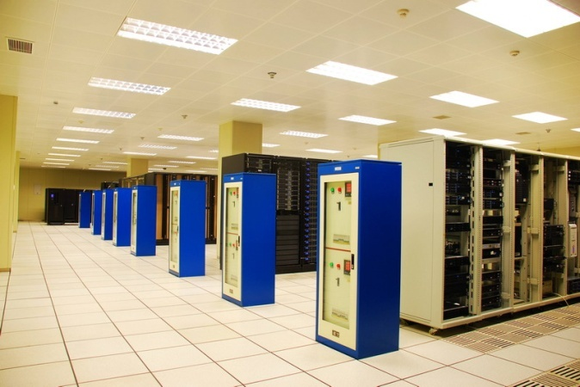
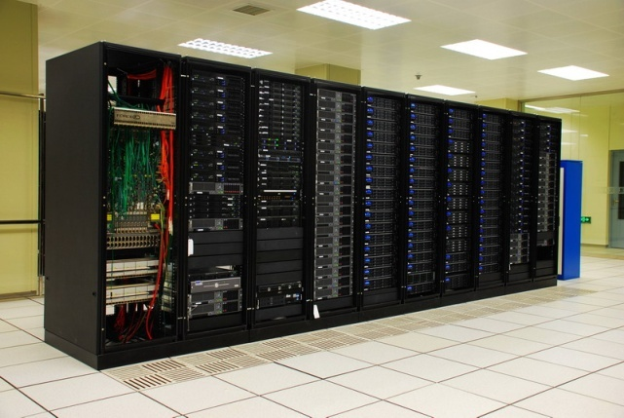
IHEP computing center Infrastructure
~19000 CPU cores
Water cooling
6PB tape library
10PB disk space
Power supply system
ATLAS, CMS, LHCb, BESIII, JUNO, DYB, CEPC, HEPS, LHAASO, ARGO, HXMT, …

Slide 4
Cluster & Storage Service Topology
Local User
Grid User
Login Nodes
Dirac
UMD
Local Cluster
15000 Cores
Cloud Cluster
2000 Cores
Grid PBS Cluster
1896 Cores
Gluster
350TB
Lustre
9PB
EOS
1240TB
dCahce
540TB
DPM
735TB
Castor 6PB
Part of the luster and gluster data have backup in Castor, usually user data, some experiment data

Slide 5
Computing Resource Usage
Resource Usage：95.8%

Slide 6
Grid computing for LHC
WLCG is consists of 1 Tier0, 11 Tier1s, over 100 Tier2s
Raw data generated at Tier0, distributed to Tier1s
Reconstructed data generated at Tier1s, transfer back to Tier0, and distributed to Tier2
Analyzed data generated at Tier1/Tier2s, transfer back to Tier1s and Tier0

Slide 7
BEIJING-LCG2 GRID Site Services
VM
CNIC
APEL
MyProxy
Vobox
LFC
BDII
Frontire-Squid
UI
Beijing_ERA_Mcore
Cream CE
Torque
ArcCEs
dCache
DPM
1Gb Eth
BEIJING-TIANJIN-TH-1A_MCORE
WN
WN
WN
WN
Poolnode
Poolnode
Poolnode
Poolnode
WN
WN
WN
WN
Poolnode
Poolnode
WN
WN
WN
WN
Poolnode
Poolnode
Poolnode
Poolnode
WN
WN
WN
WN
Worknodes
Disk nodes
10Gb Eth

Slide 8
BEIJING-LCG2 Tier2 Resources
Grid Site(WLCG)
CPU: 1896 Cores
Intel Golden 6140: 1008 Cores (New for LHCb)
Intel E2680V3: 696 Cores (2015)
Intel X5650: 192 Cores(2011) Very Old
ATLAS: BEIJING-LCG2
Total 400TB (2014)
4TB X 24slots With Raid 6
CMS: T2_CN_BEIJING
Total: 540TB(2014)
4TB X 24slots With Raid 6. 8 Array box.
3TB X 24slots With Raid 6. 1 Array box.
LHCb: LCG.BEIJING.CN
Total 375TB (2018)
8TBX60 slots DELL MD3860

Slide 9
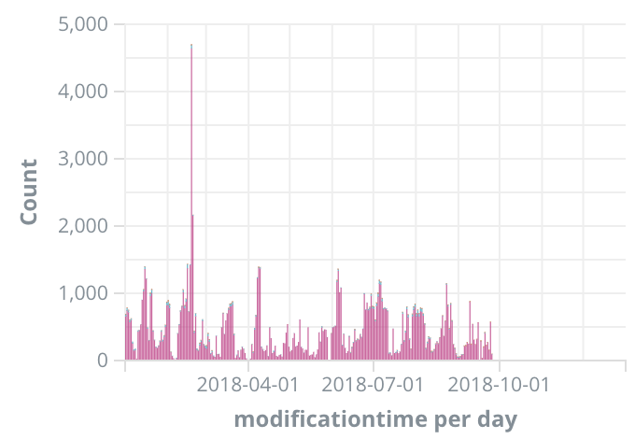
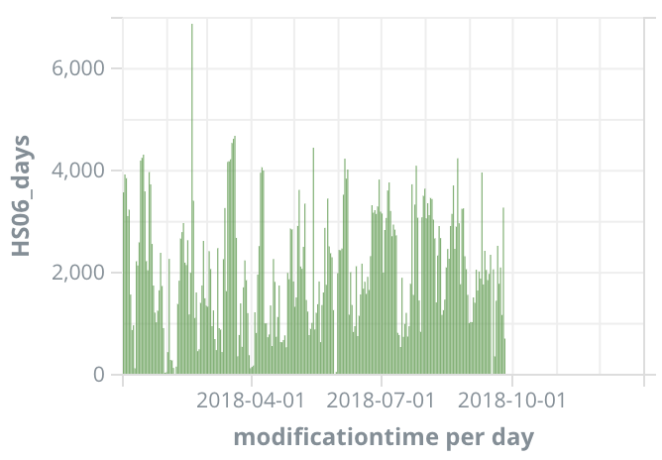
BEIJING-LCG2 Volunteer Computing
Number of Jobs
ATLAS@home on Beijing Site
Number of jobs : 122,383 (2018.1.1 ~ now)
HS06 Days : 550,760 (2018.1.1 ~ now)
CEPC@home project in progress
Experience from ATLAS@home applied
VM wrapper is adopted
BOINC validator & assimilator in development
HS06 resources

Slide 10
BEIJING-LCG2 Tier2 Operations
Adding support for LHCb.
Upgrade service to Centos7
Develop auto configuration modules for C7.
Upgrade DPM storage element to new version.
Testing new computing element and Batch system.
ARCCE
HT-Condor-CE
Tier2 site auto deployment(puppet modules)
https://github.com/yyxfei/emiconfig

Slide 11
Tier3 Resource
IHEP-CC
ATLAS
CPU: E5430(2008, 128), E5-2660(2012, 192),E5-2650v2(2014,256):
576 cores
Storage: 277TB +630TB(2018)
4TB X 24 slots With Raid 6;
3TB X 24 slots With Raid 6;
10TBX84 slots DELL ME4084
CMS
CPU: E5430(2008,128), E5-2650v2(2014,256)
384 cores
Storage: 493TB
4TB X 24 slots With Raid 6;
LHCb
CPU: GOLD 6140(2018, 72): 72 cores
Total 375TB (2018)
8TBX60 slots DELL MD3860(2018)
USTC-T3 (ATLAS)
CPU: 1088 cores (2176 HT on)
Storage: 2.0PB
/lustre 621 TB
Shared with USTC-T3 (Storage Element)
DELL R720 + MD1200.
/ustcfs 1300TB
DELL R630 + SC2080

Slide 12
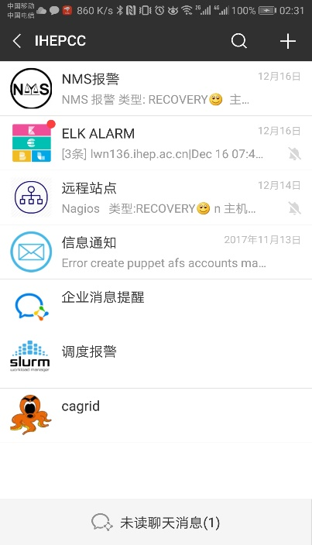
Tier3 remote management
Remote Distribute Deployment
OS and software auto installation
Software auto configuration
Some operations need hardware support
Remote Distribute Monitoring
Auto notification with SMS
Auto notification with WeChat
Auto notification with email
CentXman
Foreman
USTC
PKU
Puppet
LHAASO
BUAA

Slide 13
Tier2 & Tier3
Monitored
Tier2 For Production users. Tier3 For local users.
Tier2
Other Sites
DataSet
OR Files
For Production User
CPU
Data Disk
User Disk
Grid User
Transfer Data With RUCIO or PhEDEx
RUCIO,
SRM,GFAL
Tier3
CPU
Disk

Slide 14
NGI_CHINA
National Grid Initiatives or Infrastructures
Set up by individual countries to manage the computing resources.
Reginal operation center of EGI
Central of the China LHC computing.
Contributes a number of sites to the grid infrastructure.
BEIJING-LCG2
Only one running tier2 in china mainland
Good Reliability for many years.
Main gate to share data from CERN and other laboratory.
HK-LCG2
USTC-T3
Others were deprecated
Support For Tier2 operations

Slide 15
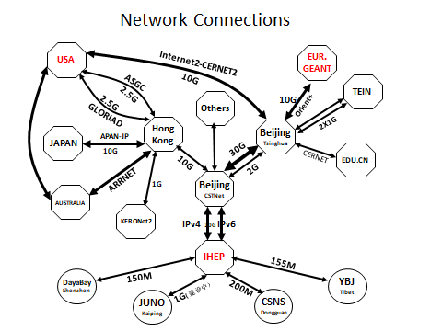
Internet Connections
IHEP-USA(Internet2)
IHEP-CSTNet-CERNET-USA
Bandwidth: 10Gbps
IHEP-EUR(GEANT)
IHEP-CSTNet-CERNET-LONDON-Euro
Bandwidth: 10Gbps
IHEP-Asia(HK & TOKYO)
IHEP-CSTNet-HONGKONG-Asia
Bandwidth: 10Gbps
IHEP-*.edu.cn
IHEP-CSTNet-CERNET-University
Bandwidth：10Gbps
Notes:
国际国内链路；
1、（加入lhc1 qfz），进展情况；
2、中欧链路问题；

Slide 16
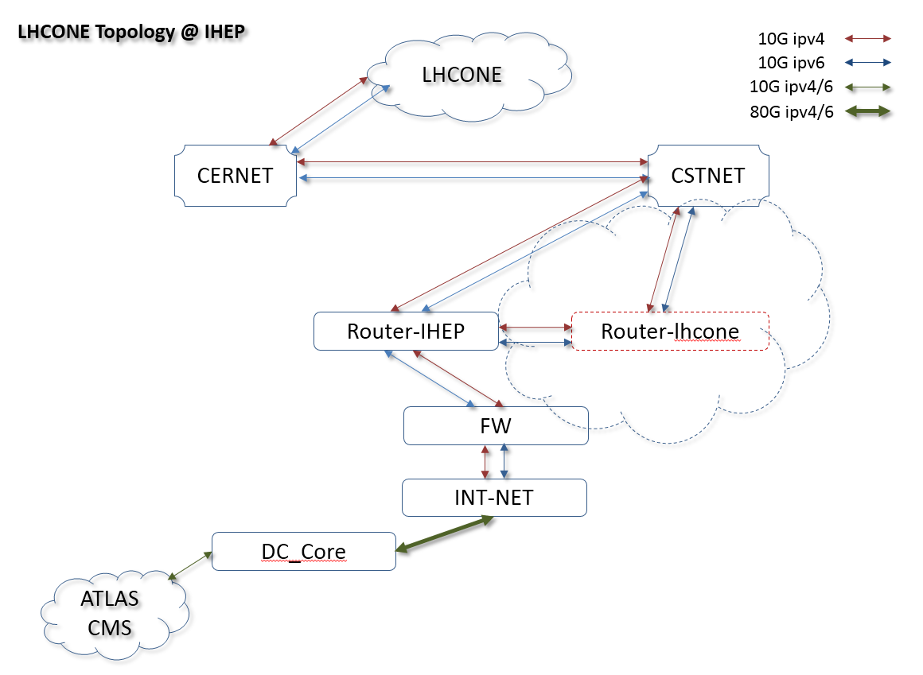
LHCONE
Introduction
Provide a collection of access locations that are effectively entry points into a network that is private to the LHC T1/2/3 sites.
The Progess
CERNET and CSTNET joined LHCONE at Feb 2018
IHEP joined LHCONE at Mar 2018
Individual router equipment
New physical link for Ipv4 and ipv6 2*10G
Problems
Ipv6 asymmetric routing between CERN and IHEP
More routing info ought to be learned

Slide 17
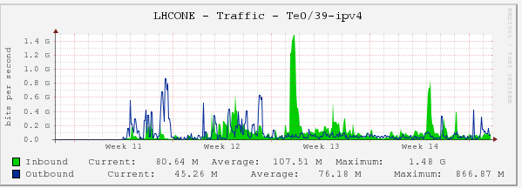
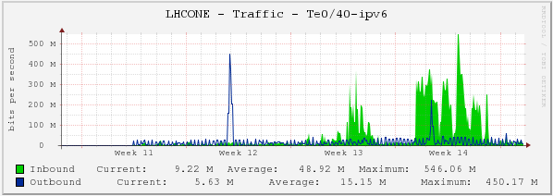
LHCONE
LHCONE IPv4 traffic
LHCONE IPv6 traffic

Slide 18
Security
China Cyber Security Federation For HEP(CSFHEP)
cooperated to deal with security incident
share threat information, technology and expertise
help site system administrators with workshops/trainings
communicate/cooperate with HEP security teams outside China, and security teams outside HEP community

Slide 19
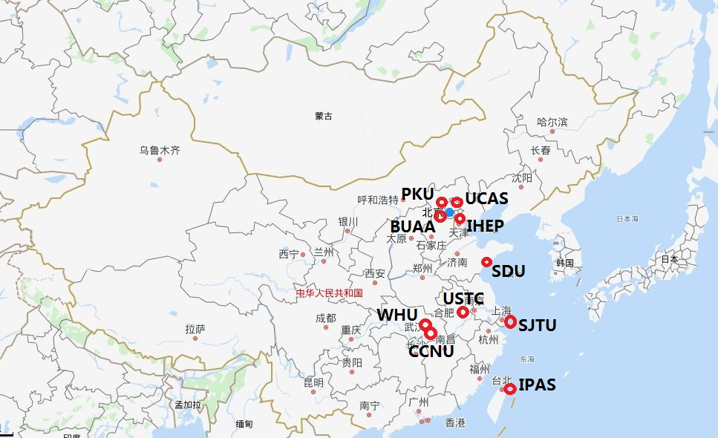
Locations of Members

Slide 20
BEIJING-LCG2 Tier2 Issues
Lack of funding support.
All hardware are very old except for LHCb.
Lack of man power.
1 for Tier2 site operations, one for each experiments.
Need support from experiment.
Network
Not very stabile. Lots of Internet interrupt and maintenance.
Timeout when transfer large files.
Pressures from Experiment
Need more resource, for atlas: 0.5% Atlas total storage. Ie 400TB today, 600TB in 2020(+15%)

Slide 21
Contact information
Tier2 Site operations and grid service deployment
Xiaofei Yan: yanxf@ihep.ac.cn
ATLAS
Xiaofei Yan: yanxf@ihep.ac.cn
CMS
Xiaomei Zhang: zhangxm@ihep.ac.cn
LHCb
Xiaowei Jiang: jiangxw@ihep.ac.cn
Xiaofei Yan: yanxf@ihep.ac.cn

Slide 22
Summary
Only one running well Tier2 WLCG grid site in China mainland.
Reginal operation center of WLCG grid computing.
Atlas@home contribute more cpus to Atlas computing.
Network: Good connections to Internet, but not very stable.
Security: China Cyber Security Federation For HEP(CSFHEP).
Lake of funding support on infrastructure and manpower.

Slide 23
Thanks

