Slide 1
Heavy Ion Collisions at LHC: Theory
Pengfei Zhuang Physics Department, Tsinghua University
● Phases of QCD
Lattice QCD, Critical Point, CME and CVE
● Probes of QGP
Jet Quenching and Charmed Hadrons
Pengfei Zhuang, CLHCP2018, CCNU, Wuhan, 20181222 1

Slide 2
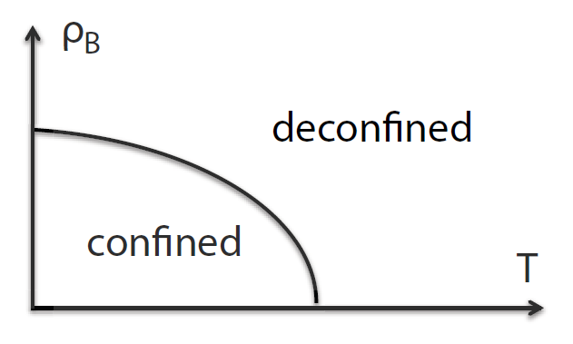
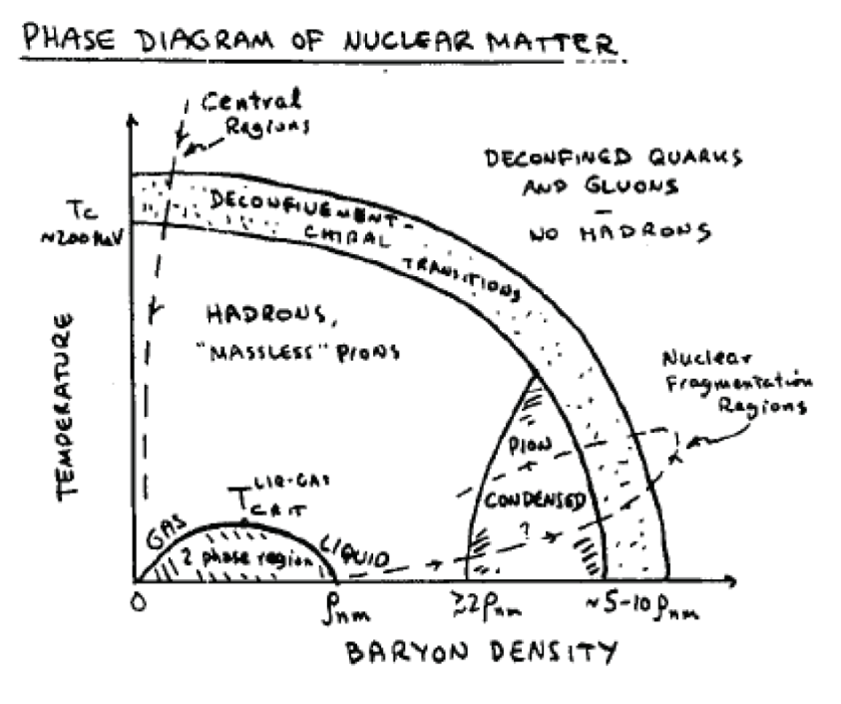
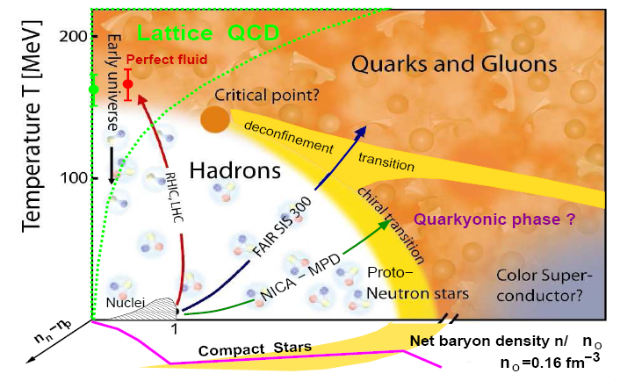
QCD Phase Diagrams
Deconfinement N.Cabbibo and G.Parisi, PLB59, 67(1975)
+ Chiral restoration G.Baym, NSAC Long Rang Plan, 1983
+ CSC, Quarkonic phase, Critical point, ……
Theoretical Methods: Lattice QCD Functional RG Resumed pQCD Dyson-Schwinger equation AdS/CFT Effective models
Pengfei Zhuang, CLHCP2018, CCNU, Wuhan, 20181222 2

Slide 3
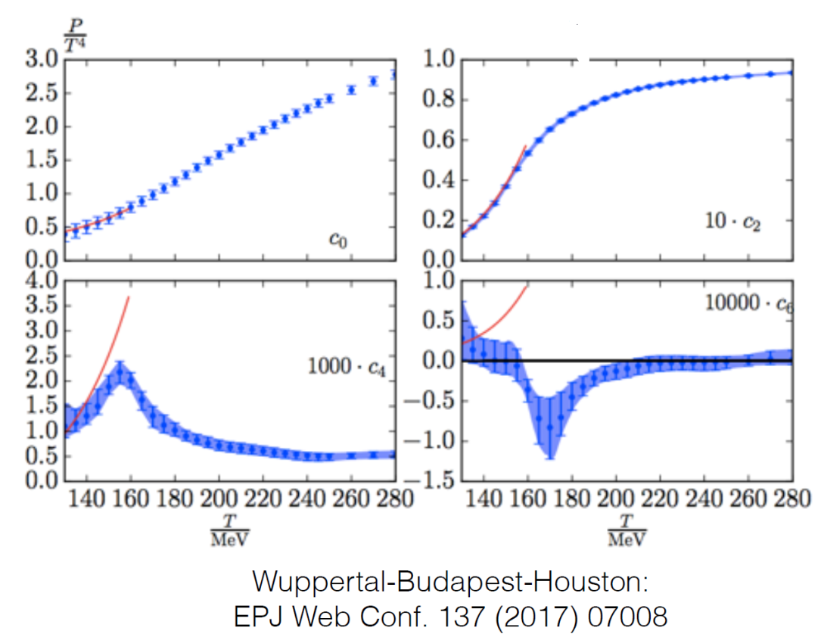
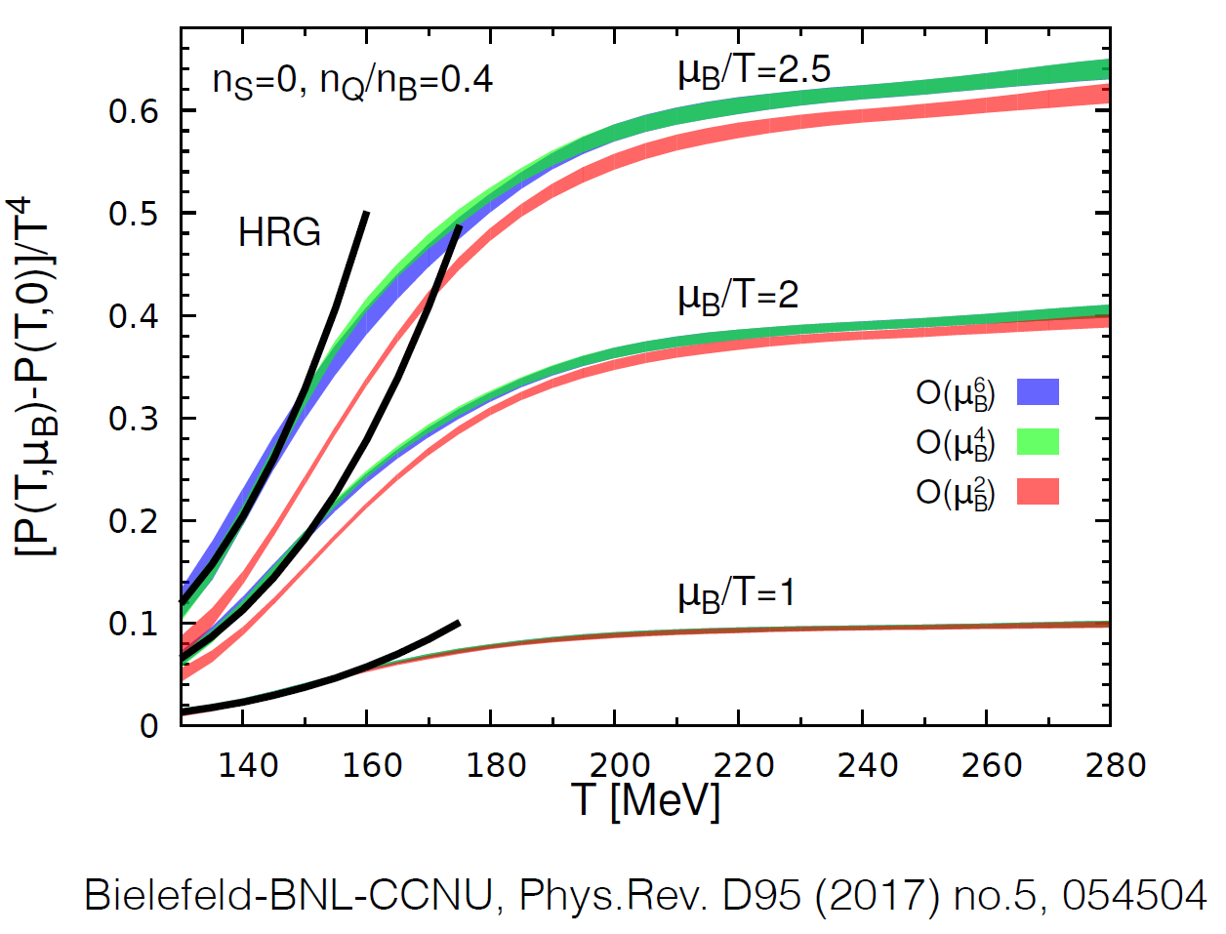
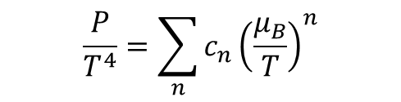

Lattice QCD: Equation of State at Nonzero $μ_{B}$
$$\frac{P}{T^{4}}=\sum_{n}{c_{n}{\left(\frac{μ_{B}}{T}\right)}^{n}}$$
Taylor expansion
Imginary $μ_{B}$.+ Taylor expansion
The EoS is well under control at $μ_{B}/T$≲ 2 or $\sqrt{s_{NN}}$≳12 GeV
Pengfei Zhuang, CLHCP2018, CCNU, Wuhan, 20181222 3

Slide 4
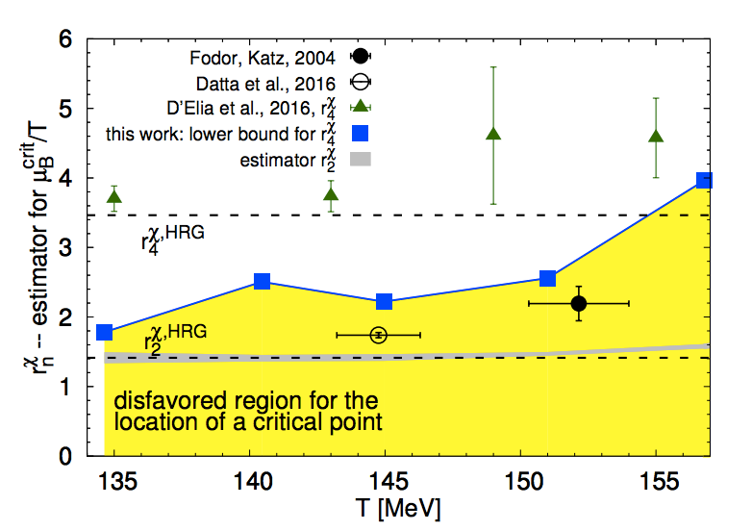
Lattice QCD: Critical Point is Disfavored at $μ_{B}/T$≲ 2
Critical point is a singularity of EoS,
Calculating the radius of convergence of EoS to 6th order at high T
Bielefeld-BNL-CCNU, PRD 95 (2017) no.5, 054504
D’Elia et al., PRD 95 (2017) 094503
Datta et al., PRD 95 (2017) 054512
Fodor and Katz, JHEP 0404 (2004) 050
Critical point is not excluded in this region ！
Pengfei Zhuang, CLHCP2018, CCNU, Wuhan, 20181222 4

Slide 5
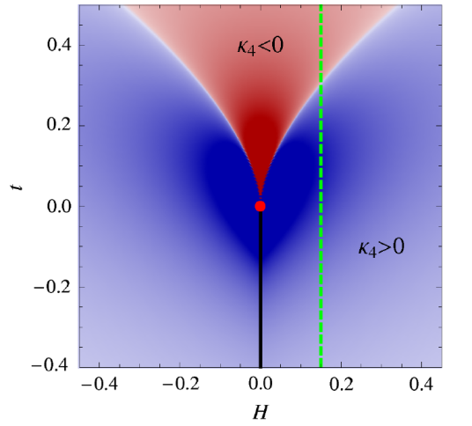
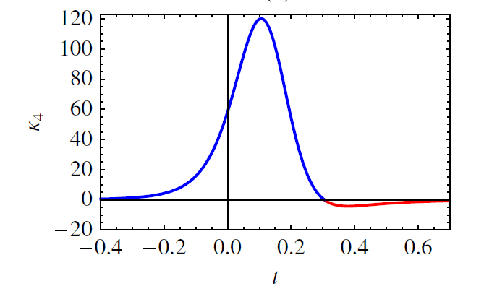
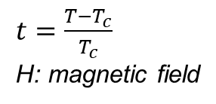

Dynamical Fluctuations around Critical Point
●Correlation length $ξ→∞$ at a critical point
●Order parameter field $σ(x)$
fluctuation distribution $P\left[σ\right] \sim e^{−Ω\left(σ\right)/T}$
Cumulants:
High order cumulants are more sensitive to $ξ$ and cab be used to
sensitively probe the critical point.
● The sign of $C_{4} \left(C_{4}/C_{2}\right)$ depends on which side of the critical point we are.
Far from CP: $C_{4}=0$
Crossover side: $C_{4}<0$
First order side: $C_{4}>0$
M.Stephanov, PRL102, 032301(2009) M.Asakava, S.Ejiri, M.Kitazawa, PRL103, 262301(2009)
M.Stephanov, PRL107, 052301(2011)
$t=\frac{T−T_{c}}{T_{c}}$
H: magnetic field
Pengfei Zhuang, CLHCP2018, CCNU, Wuhan, 20181222 5

Slide 6
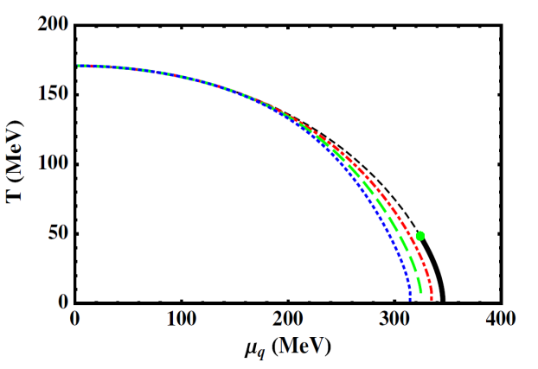
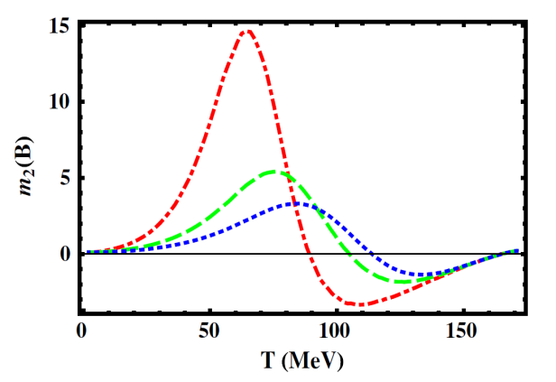
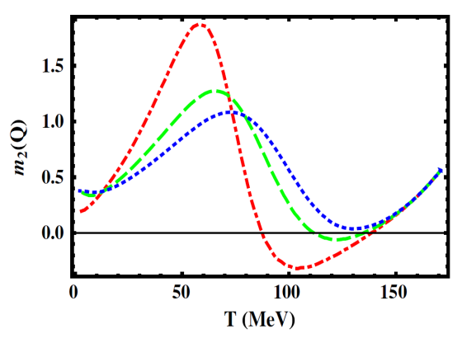
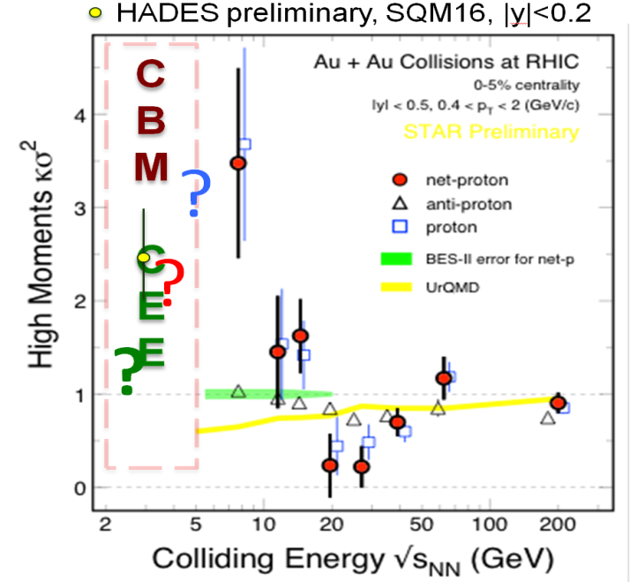
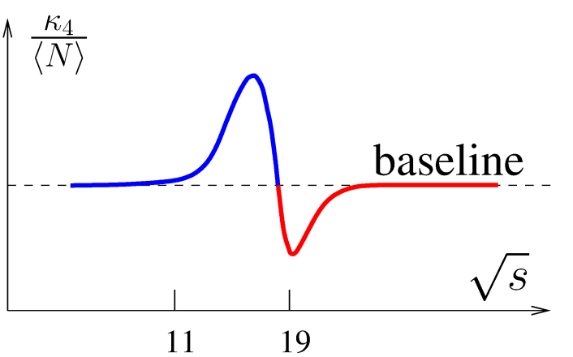

Baryon Number Moments in HIC
● NJL model
Chen, Deng, Kohyama, Labum, PRD93, 034037 (2016)
$$m_{2}\sim χ^{4}$$
Chemical
freeze-out lines
1) The shape depends on the location of the freeze-out with respect to the location of CP. 2) Baryon number moments are more sensitive to the correlation length than electronic charge moments.
Similar results in PQM (Schaefer, Wanger, PRD85,034027(2012), V.Skokov, QM12), VDW (Vovchenko et al., PRC92, 054901(2015)), and considering Memory and Non-equilibrium effects (Swagato et al., PRC92, 034912(2015)).
● Experimental data
Challenges: ♣ finite size ♣ non-equilibrium (Yin, Song,……) ♣ background ♣ data at lower energies
Pengfei Zhuang, CLHCP2018, CCNU, Wuhan, 20181222 6

Slide 7
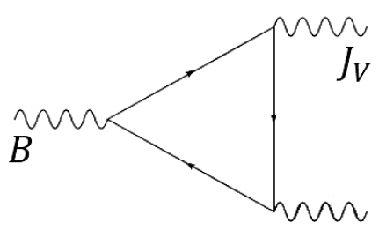

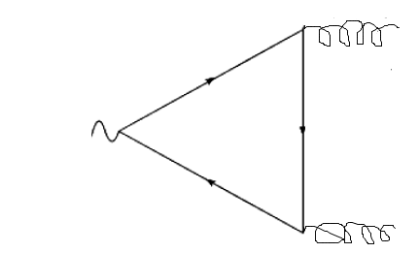



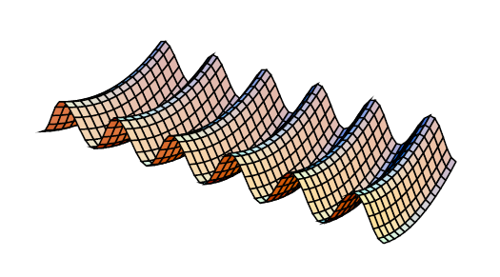
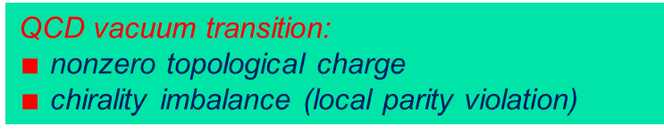
Chiral Magnetic Effect
A chirality imbalance induced electric current in external magnetic field, a probe of nontrivial topology of QCD.
QED VVA triangle anomaly
CME:
sphalerons
Topological transitions have never been observed directly. An observation of the local strong parity violation could be a clear proof for the existence of such physics.
QCD VVA triangle anomaly
instantons
QCD vacuum transition:
$∎$ nonzero topological charge
$∎$ chirality imbalance (local parity violation)
Kharzeev, 2004 Kharzeev, Warringa, McLarren, Fukushima, 2008 Kharzeev, Liao, Voloshin, Wang, Prog. Part. Nucl. Phys., 2016, 88: 1 Huang, Rep. Prog. Phys., 2016, 79: 076302,……
Pengfei Zhuang, CLHCP2018, CCNU, Wuhan, 20181222 7

Slide 8
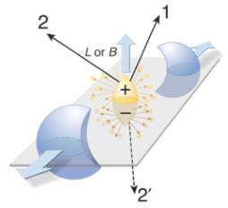
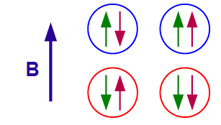
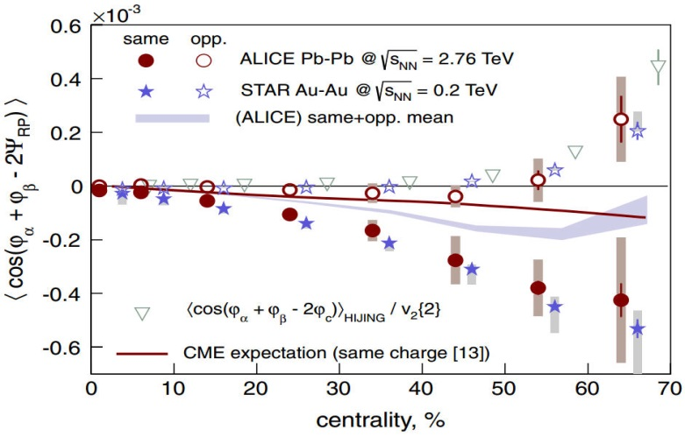
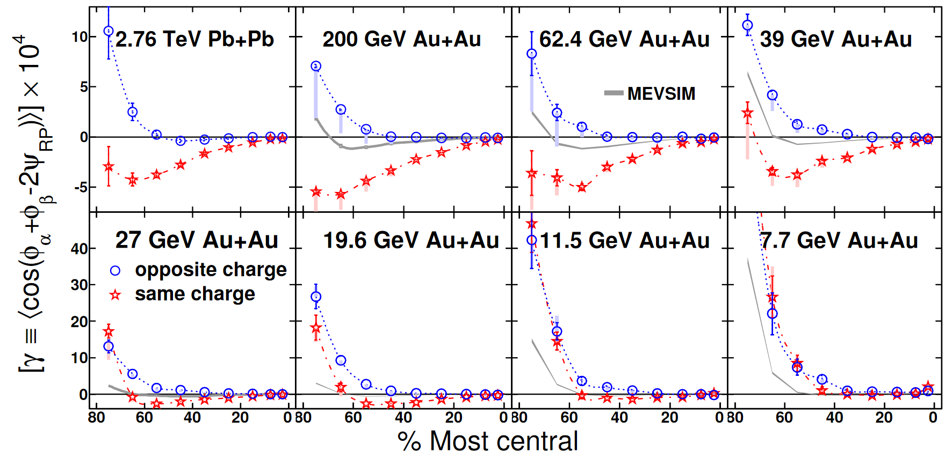
Charge Separation in HIC
chirality
left right
p
+
s
s
p
charge
s
s
p
-
Strongest magnetic field (Rotation) in nature !
p
negative goes up
positive goes down
positive goes up
negative goes down
The observable: The gamma correlator (Voloshin 2004)
An excess of right or left handed quarks should lead to a current flow along the magnetic field ！
ALICE 2013
STAR 2014
Main challenge: how to separate the background effects?
Pengfei Zhuang, CLHCP2018, CCNU, Wuhan, 20181222 8

Slide 9
Chiral Magnetic Effect in Isobaric Collisions from Anomalous-Viscous Fluid Dynamics (AVFD)
Shuzhe Shi , Hui Zhang, Defu Hou , Jinfeng Liao , QM2018 @ Venice May. 13~19, 2018
The absolute difference between isobars, after identical multiplicity+elliptic flow cuts,
will provide the most sensitive and clean probe of CME signal.
Pengfei Zhuang, CLHCP2018, CCNU, Wuhan, 20181222 9

Slide 10
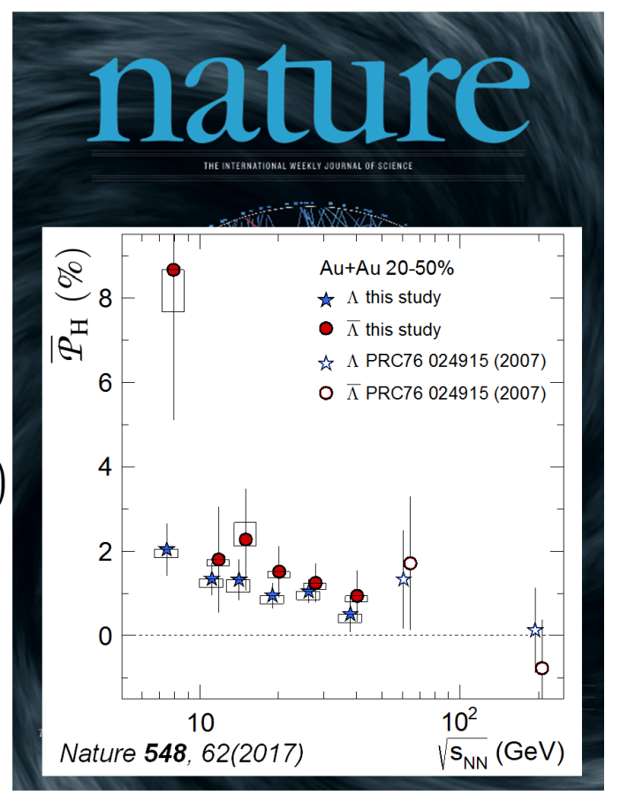
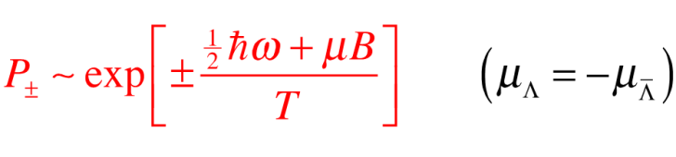
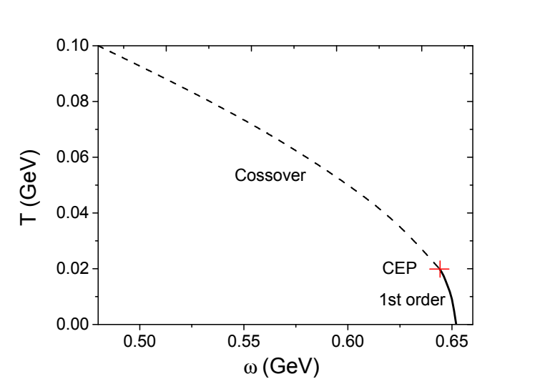
Chiral Vortical Effect in HIC
The signal is consistent with vorticity ω = (9 ± 1)x10²¹/s, greater than previously observed in any system.
Liang & Wang, PRL (2005)
Betz, Gyulassy, Torrieri, PRC (2007)
Becattini, Piccinini, Rizzo, PRC (2008) Becattini, Karpenko, Lisa, Upsal, Voloshin, PRC (2017)
The Chiral phase diagram on T-ω plane
Y. Jiang, J. Liao, PRL117, 192302 (2016)
Pengfei Zhuang, CLHCP2018, CCNU, Wuhan, 20181222 10

Slide 11
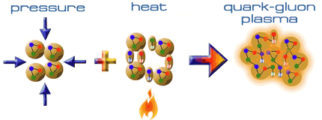

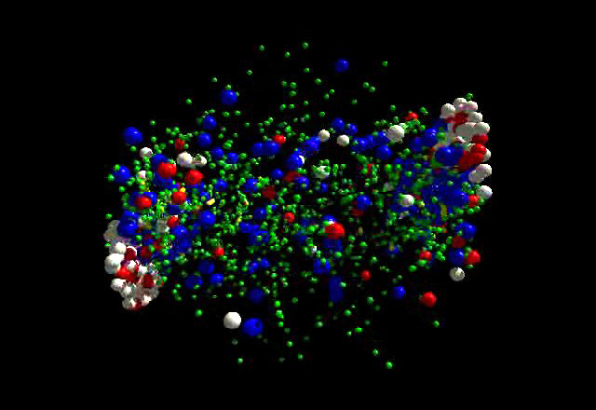
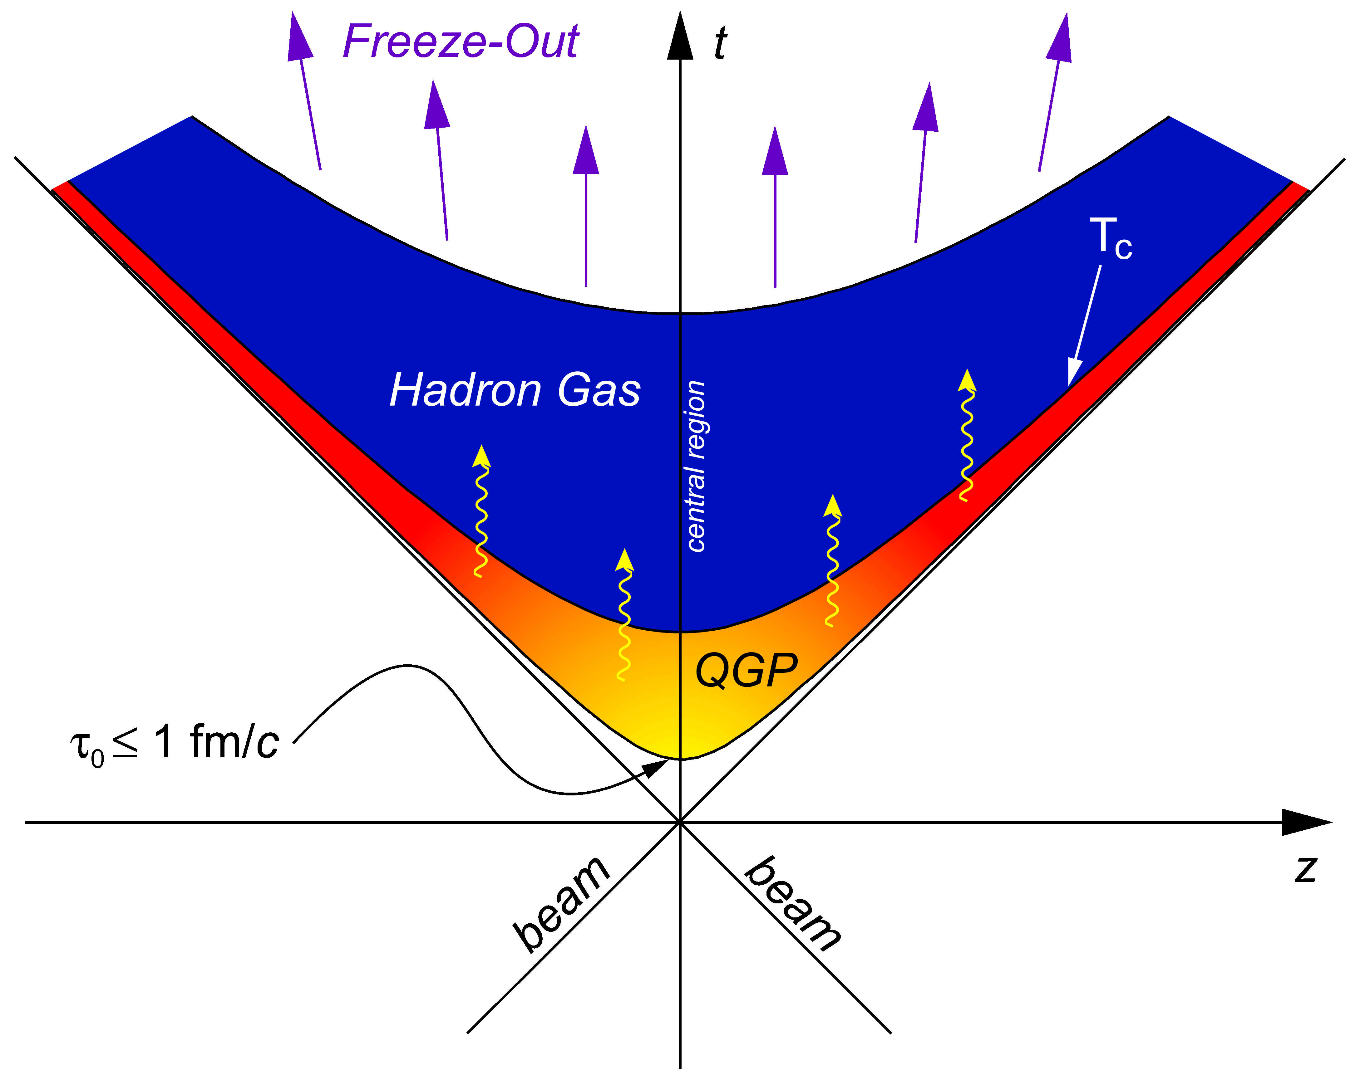
Probing QGP in HIC
Signatures of QGP: Collective flow Strangeness enhancement Jet quenching Quarkonium supression/enhancement Global polarization ……
Pengfei Zhuang, CLHCP2018, CCNU, Wuhan, 20181222 11

Slide 12
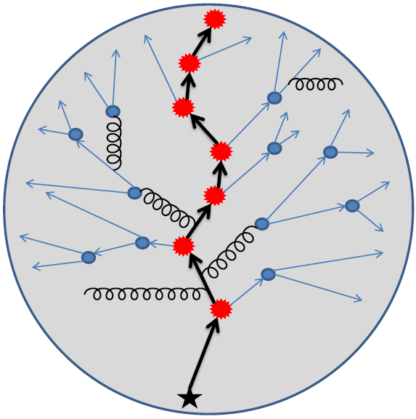
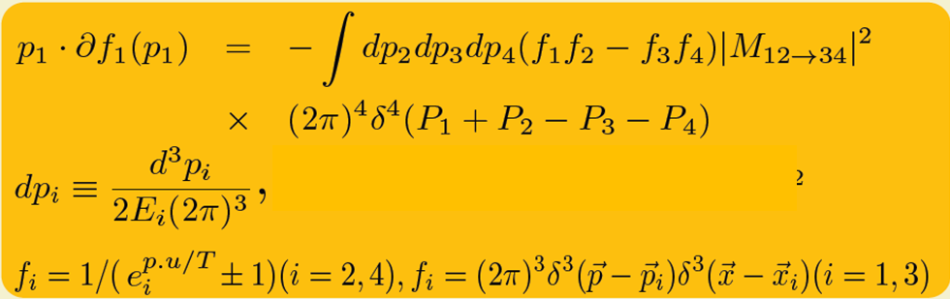
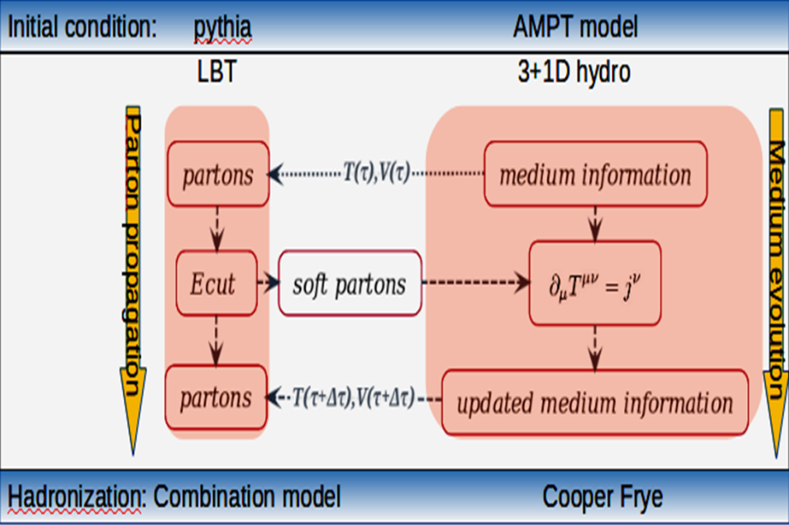
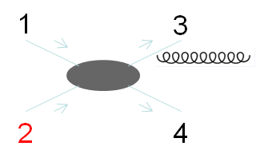
Coupled Linear Boltzmann Jet Transport and Hydrodynamics
A comprehensive treatment of soft physics (medium) and hard physics (jet)
S S Cao, W Chen, Y He, T Luo, L Pang, E Wang, X Wang, 2017
+ radiation
Complete set of 2-2 processes
Jet energy loss and medium excitation
complete set of 2-2 processes
+ radiation:
Pengfei Zhuang, CLHCP2018, CCNU, Wuhan, 20181222 12
Notes:
高能重离子碰撞中的喷注淬火效应是高能核物理中的一个重要研究课题。通过研究喷注穿过夸克胶子等离子体过程中喷注的能量和结构的改变，我们可以获得关于热密物质性质的信息。在喷注能量损失的同时，高能部分子与介质的相互作用也会改变介质本身。为了研究喷注的传播过程， 在王新年领导下的武汉-伯克利小组发展出了线性玻尔兹曼输运模型（LBT Model），在模型中我们引入了完备的2到2弹性散射过程和辐射过程（High twist） 我们同时考虑了领头粒子,辐射胶子和被激发的热部分子的传播，从而可以同时研究喷注能量损失以及由此引起的介质激发。在重建喷注的过程中我们同样考虑了介质中被激发的热部分子的影响。
我们首先研究了RHIC和LHC能区重离子碰撞中光子标记喷注的能量损失和结构的变化。
在对高能粒子与热密介质的相互作用的进一步研究中，我们引入了完备的2到2弹性散射过程，讨论了夸克喷注和胶子喷注的区别。在真实的高能重离子碰撞中，喷注和其所穿过的介质是同时演化的。
The model we use is the linearized boltzmann transport model. Which is based on this equation,
the two terms in the bracket are the loss and gain term of particle 1.
M^2 is the scattering amplitude.
We include both the elastic scattering and inelastic radiation process in the model.
And we follow the propagation of the jet shower parton and radiated gluons and the recoiled parton from the scattering process and allow they to scatter further in our simulation.
(which we called Jet-induced medium partons.)
those recoiled partons are also included in the final jet reconstruction along with the shower partons and radiated gluons
////////////////////////////////////////////////////////////////////////////////////////////////////////////////////////////////////////
In particularly we also follow the initial thermal parton who are denoted by negative particle to include the back reaction of the boltzmann transport. It is essentially the depletion of different phase space which is a part of Jet-induced medium excitation, and we need to subtract their contribution in the final results.
>>>>>>>>>>>>>>>>>>>>>>>>>>>>>>>>>>>>>>>>>>>>>>>>>>>>>>>>>>>>>>>>>>>>>>>>>>>>>>>>>>>>>>>>>>>>
mu^2 in the denominator is there to regulate the IR divergent.
>>>>>>>>>>>>>>>>>>>>>>>>>>>>>>>>>>>>>>>>>>>>>>>>>>>>>>>>>>>>>>>>>>>>>>>>>>>>>>>
When a jet parton traveling through the medium, the thermal partons will be excited by the jet parton from the medium
those recoiled partons will further scatter with other thermal partons in the medium.
In our simulation, both the leading parton – thermal scattering and the recoiled parton – thermal parton scattering are taken in to account
But we neglect the scattering between the recoiled partons, that is the reason we call it a linearized (Boltzmann transport) model
?????????
it is a good approximation when the medium excitation is relatively small.
>>>>>>>>>>>>>>>>>>>>>>>>>>>>>>>>>>>>>>>>>>>>>>>>>>>>>>>>>>>>>>>>>>>>>>>>>>>>>>>
And in our simulation,
whenever there is a thermal parton excited from the medium, there is a original thermal parton missing in the original phase space,
therefore every scattering will leave a particle hole in the background, those particle hole are denoted as negative particles,
And we have to subtract their 4-momentum in the final results.
????????????
Actually those negative particles are account for the ???????? back reaction in the Boltzmann transport
So they are also transported according to the Boltzmann equation.
We have to subtract their 4-momentum in the final results. C…To conserve the energy and momentum.
>>>>>>>>>>>>>>>>>>>>>>>>>>>>>>>>>>>>>>>>>>>>>>>>>>>>>>>>>>>>>>>>
In this way we can conserve the energy and momentum.

Slide 13
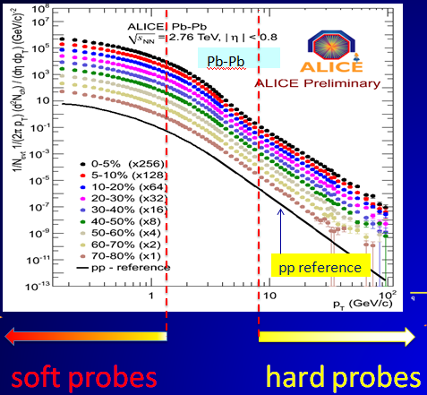
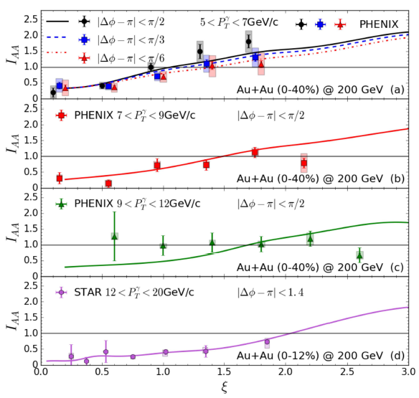





Results with CoLBT-Hydro Model
W Chen, S Cao, T Luo, L G Pang, X Wang, arXiv:1704.03648
Charged hadron $p_{t}$ distribution
Photon+ hadron with CoLBT-hydro
Strong suppression of high $p_{t}$ leading hadrons due to jet energy loss and significant enhancement of low $p_{t}$ hadrons due to jet-induced medium excitation.
Pengfei Zhuang, CLHCP2018, CCNU, Wuhan, 20181222 13
Notes:
发展CoLBT-hydro模型（Coupled Linear Boltzmann Jet Transport and Hydrodynamics）。我们已发展了LBT模型以及（3+1）D流体力学模型，我们已把线性Boltzmann方程（LBT）方法和（3+1）D流体力学结合起来，发展一个既考虑热密QCD介质对喷注的影响，又包含喷注（及能量损失）对介质的影响的统一模型：CoLBT-Hydro模型。得到一个普适的模型：从soft Physcis到high pT physics. (如图）。我们已经得到一些初步结果。

Slide 14

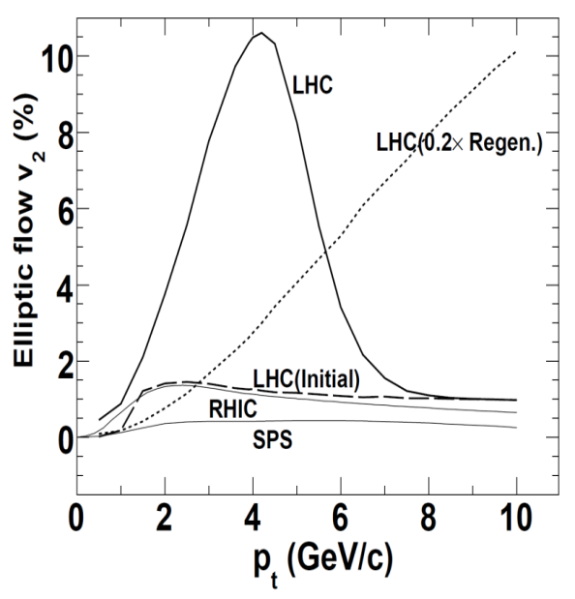
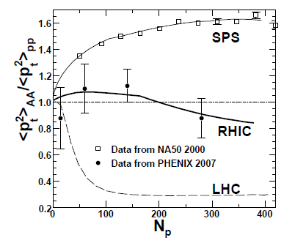
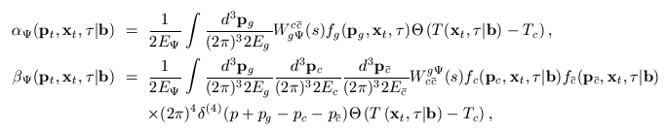
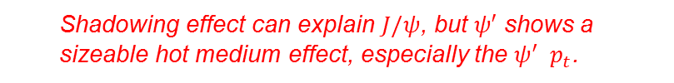
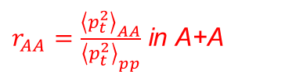
Quarkonia in p+A and A+A
Chen, Guo, Liu, Zhuang, PLB765, 323(2017)
Transport equations for quarkonia and hydrodynamic equation for QGP:
+ QCD equation of state
$r_{AA}=\frac{{\left\langle p_{t}^{2}\right\rangle }_{AA}}{{\left\langle p_{t}^{2}\right\rangle }_{pp}}$ in A+A
Charmonia in p+A
$V_{2}$ in A+A
Shadowing effect can explain $J/ψ$, but $ψ′$ shows a sizeable hot medium effect, especially the $ψ^{′} p_{t}$.
Pengfei Zhuang, CLHCP2018, CCNU, Wuhan, 20181222 14

Slide 15
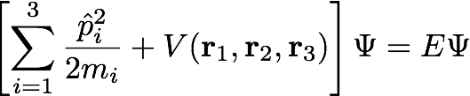
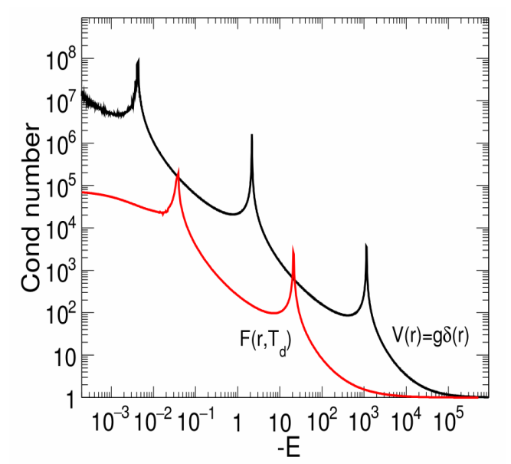
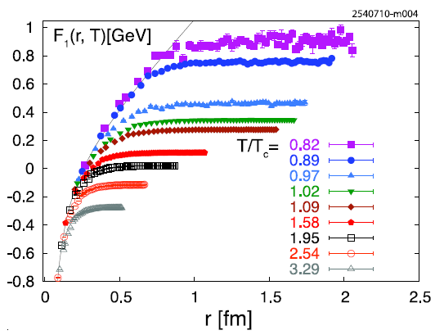

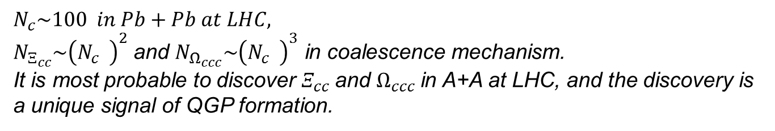

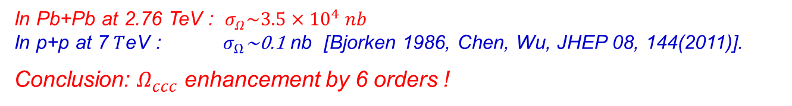

$Ξ_{cc}$ and $Ω_{ccc}$ in HIC
He, Zhuang, PLB746, 59(2015), Zhao, Zhuang, PLB771, 349(2017) Zhao Zhuang, PLB
$$N_{c}\sim 100 in Pb+Pb at LHC,$$
$N_{Ξ_{cc}}\sim {\left(N_{c}^{}\right)}^{2}$ and $N_{Ω_{ccc}}\sim {\left(N_{c}^{}\right)}^{3}$ in coalescence mechanism.
It is most probable to discover $Ξ_{cc}^{ }$and $Ω_{ccc}$in A+A at LHC, and the discovery is a unique signal of QGP formation.
Lattice QCD potential at finite T
In Pb+Pb at 2.76 TeV : $σ_{Ω}\sim 3.5×{10}^{4} nb$
$\text{In} \text{p}\text{+}\text{p} \text{at} \text{7 }T\text{eV}\text{ : }σ_{Ω}\text{\sim }\text{0.1} \text{nb}\text{ [}$Bjorken 1986, Chen, Wu, JHEP 08, 144(2011)].
Conclusion: $Ω_{ccc}$ enhancement by 6 orders !
short range potential at high T !
$\frac{E_{n}}{E_{n+1}}=e^{2π/s_{0}}=515$, Efimov states !
Pengfei Zhuang, CLHCP2018, CCNU, Wuhan, 20181222 15

Slide 16
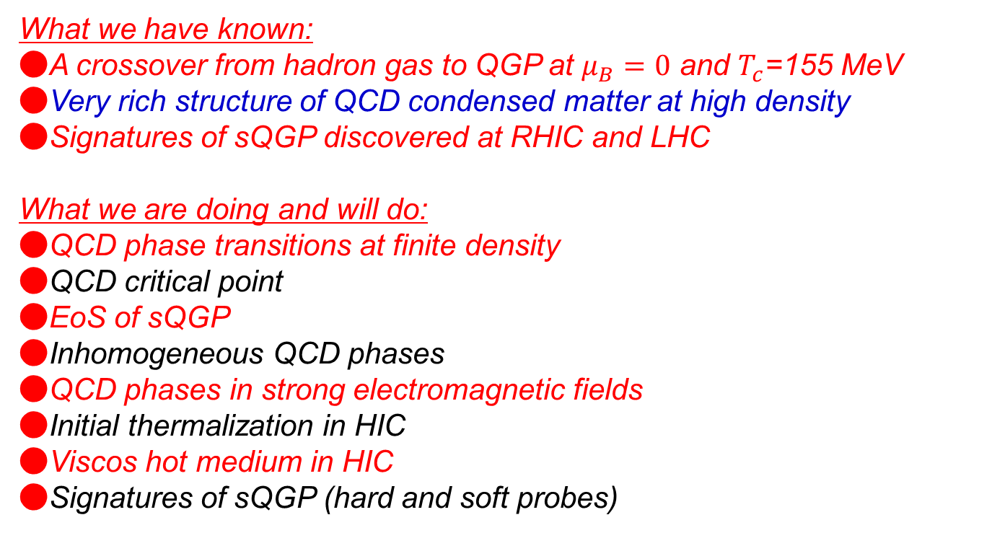
Summary & Outlook
What we have known:
●A crossover from hadron gas to QGP at $μ_{B}=0$ and $T_{c}$=155 MeV
●Very rich structure of QCD condensed matter at high density ●Signatures of sQGP discovered at RHIC and LHC
What we are doing and will do:
●QCD phase transitions at finite density ●QCD critical point ●EoS of sQGP ●Inhomogeneous QCD phases ●QCD phases in strong electromagnetic fields ●Initial thermalization in HIC ●Viscos hot medium in HIC ●Signatures of sQGP (hard and soft probes)
Pengfei Zhuang, CLHCP2018, CCNU, Wuhan, 20181222 16

Slide 17
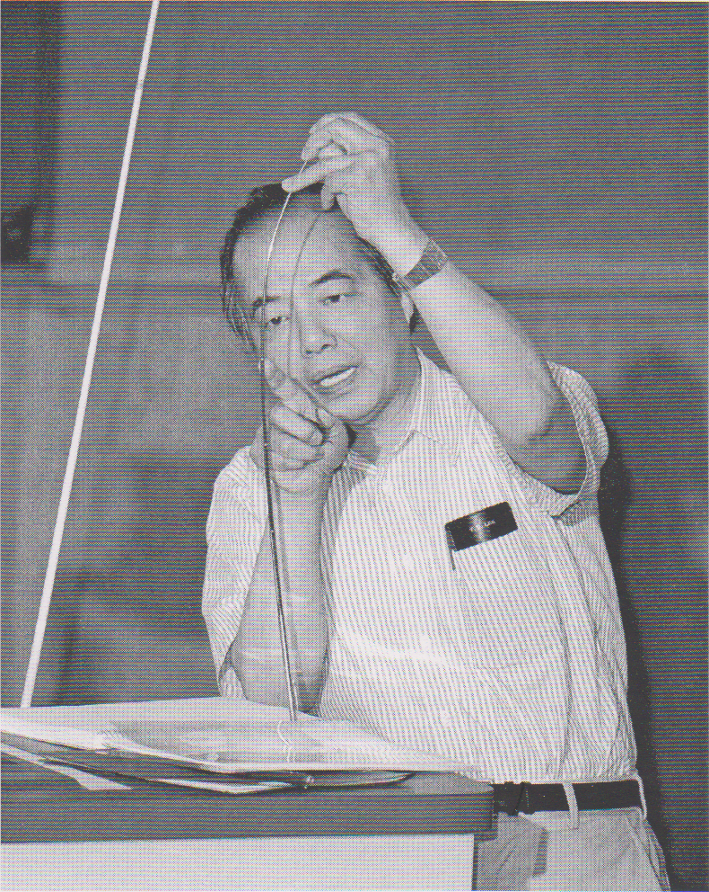
To Know the Smallest, We Need the Largest
T.D.Lee
Theory Workshop on Relativistic Heavy Ion Collisions, July 8-19, 1996, BNL
Large things are made of small And even smaller. To know the smallest We need also the largest.
All lie in vacuum Everywhen and everywhere. How can the micro Be separate from the macro?
Let vacuum be a condensate Violating harmony. We can then penetrate Through asymmetry into symmetry.
大事物由小事物组成
甚至是更小的。
要想认识最小的
我们也需要知道最大的。
一切都取决于真空
无论何时何地。
微观的事物怎能
与宏观相分离？
真空其实是一种凝聚
破坏了和谐。
如此我们方可洞穿
不对称中的对称。
Pengfei Zhuang, CLHCP2018, CCNU, Wuhan, 20181222 17

Slide 18
I thank the following colleagues during the preparation of the talk: Hengtong Ding, Xuguang Huang, Zuotang Liang, Jinfeng Liao, Xiaofeng Luo, Ralf Rapp, M. Stephanov, Nu Xu, Benwei Zhuang, ……
Pengfei Zhuang, CLHCP2018, CCNU, Wuhan, 20181222 18

