Slide 1






CMS 探测器升级中国组进展
班勇-（北京大学）- 2018年12月22日/武汉

Slide 2
内容：
Tasks shared by Chinese group in CMS Phase II upgrade project
Endcap inner ring station 1、2 GEM detector upgrade（Peking Univ.）
Endcap inner ring station 3、4 MRPC detector R&D（Tsinghua Univ.）
Endcap High Granularity Calorimeter（HGCal）upgrade（IHEP）
iRPC/RPC system backend electronics upgrade（IHEP）
Summary

Slide 3
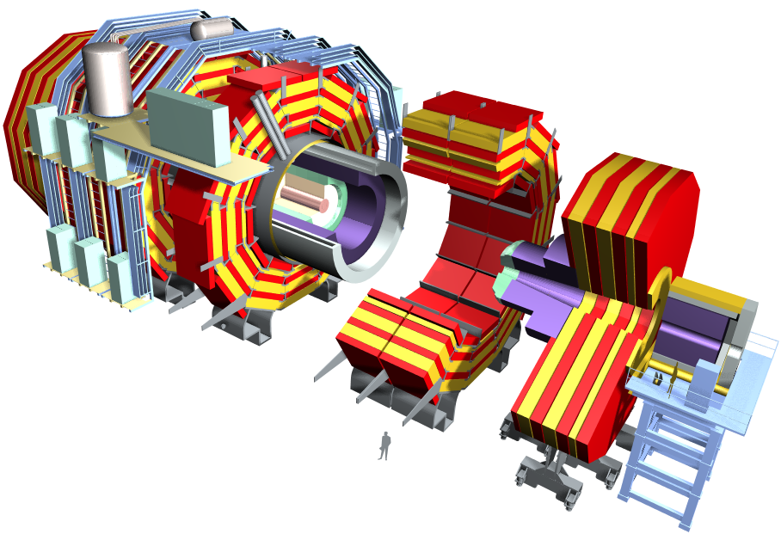
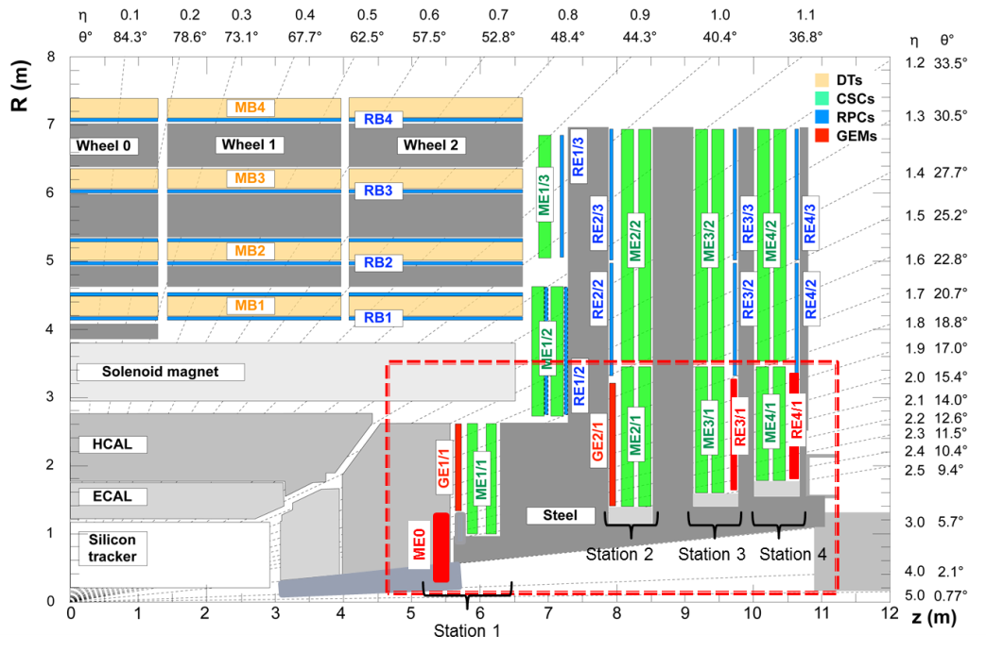
中国组承担的CMS升级任务
iRPC/RPC系统backend电子学
（高能所）
GE1/1
GE2/1
ME0
ME01
端部高粒度量能器
HGCal升级(高能所)
端盖μ探测器GEM升级
GE1/1,GE2/1,ME0(北京大学)
端盖μ探测器mRPC研制（清华大学）

Slide 4
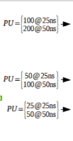
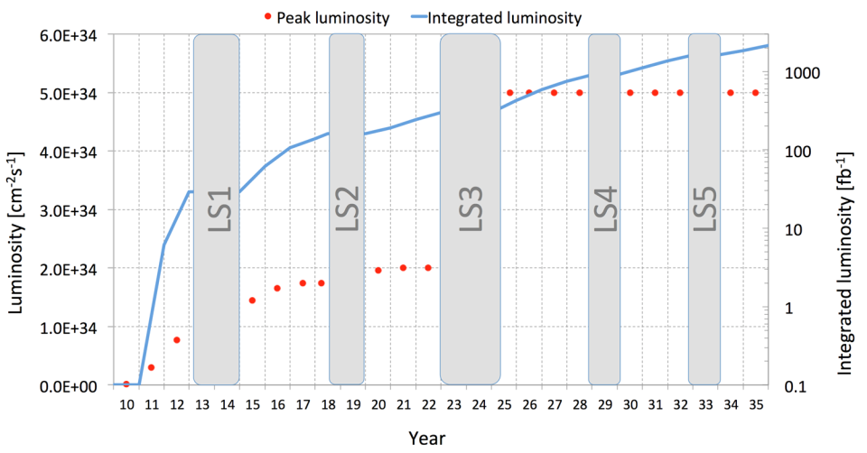
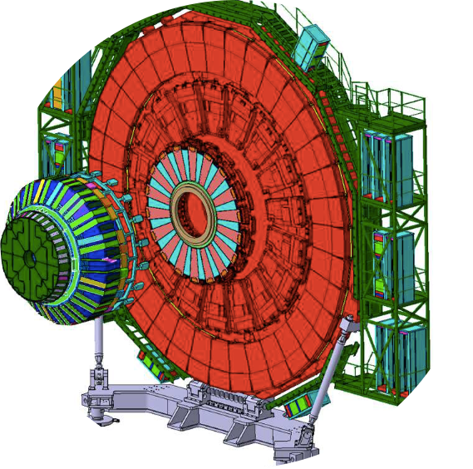
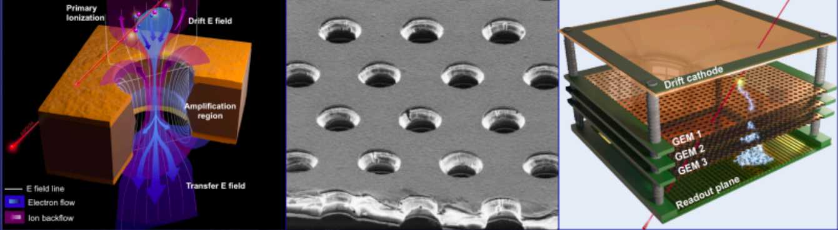
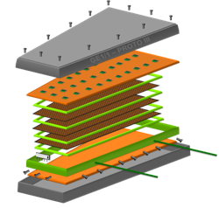

CMS 端盖$μ$子探测器升级-GEM GE1/1
>3000 fb⁻¹
PU ∼140-200
300 fb⁻¹
PU ∼50
CMS Upgrade
Phase I Upgrade
Phase II Upgrade
GEM （Gas Electron Multipliers）
144 chambers have been assembled by Dec. 2018, in six assembly sites.
GE1/1:
PhaseII project, installed in PhaseI period.
CMS-GEM Chamber structure

Slide 5
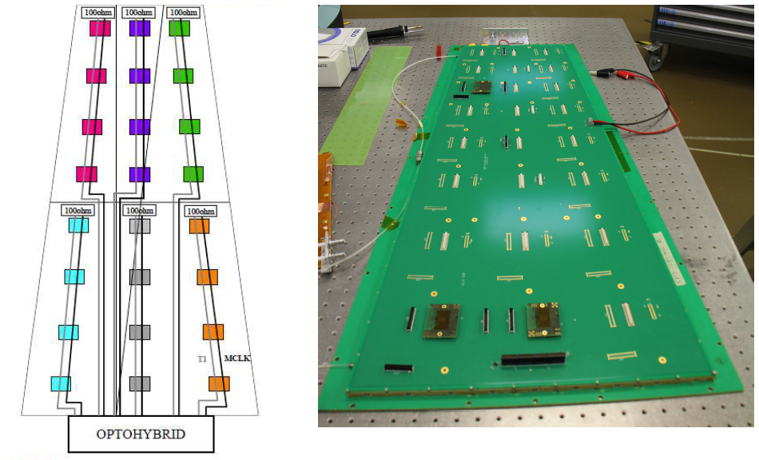
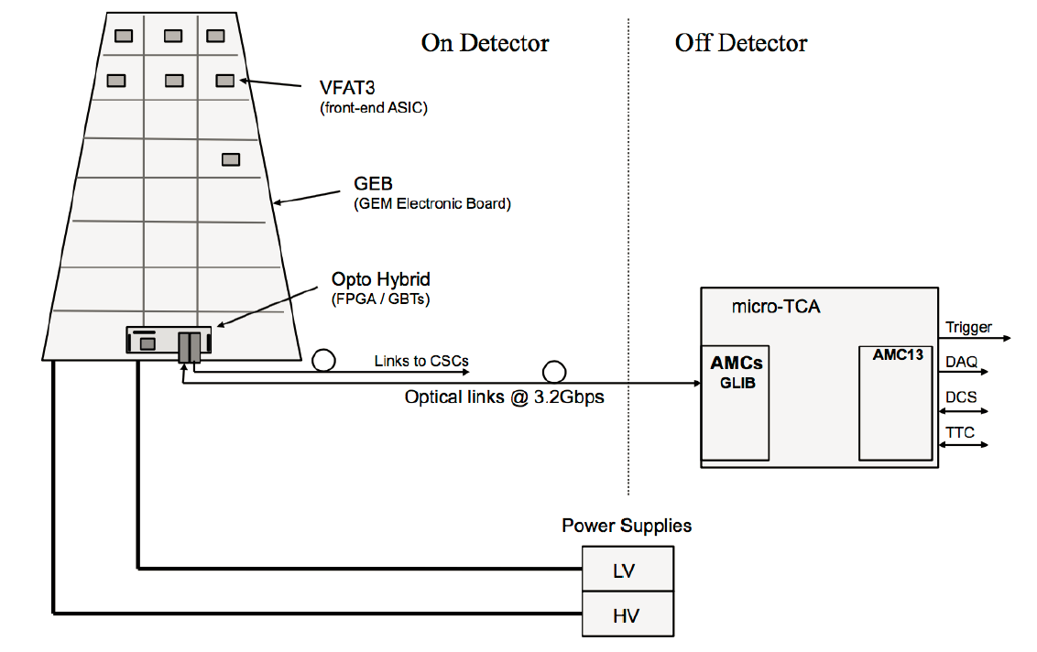
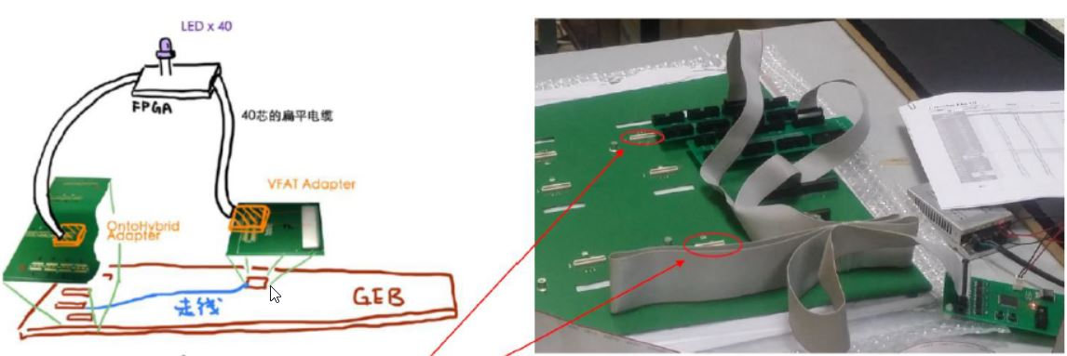
CMS 端盖$μ$子探测器升级-GEM GE1/1
Production & test of GE1/1 GEB in China:
The production and installation of GE1/1 detector will be completed by 2019, while the front end electronics boards (GEB) will be produced in Sinofast company in China. PKU group is in charge of production and test.
A conductivity test facility based on FPGA and LED was developed by PKU group. Up to Dec. 2018, 82 sets of GE1/1 GEB were produced and tested successfully, were shipped to CERN for installation.

Slide 6
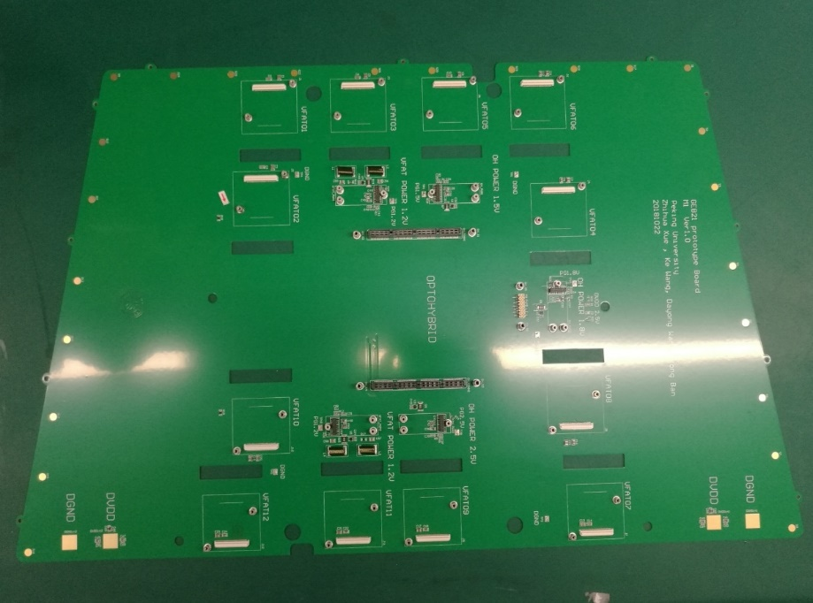
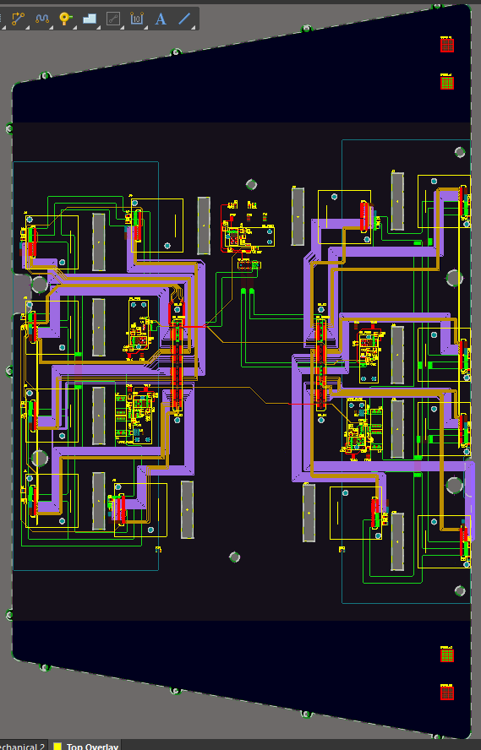
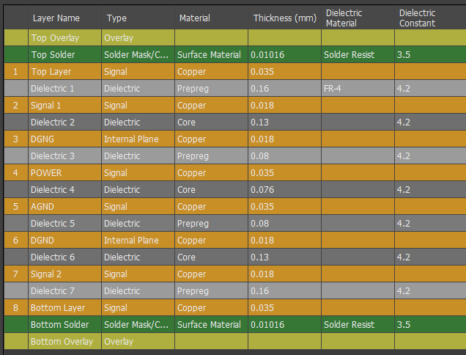
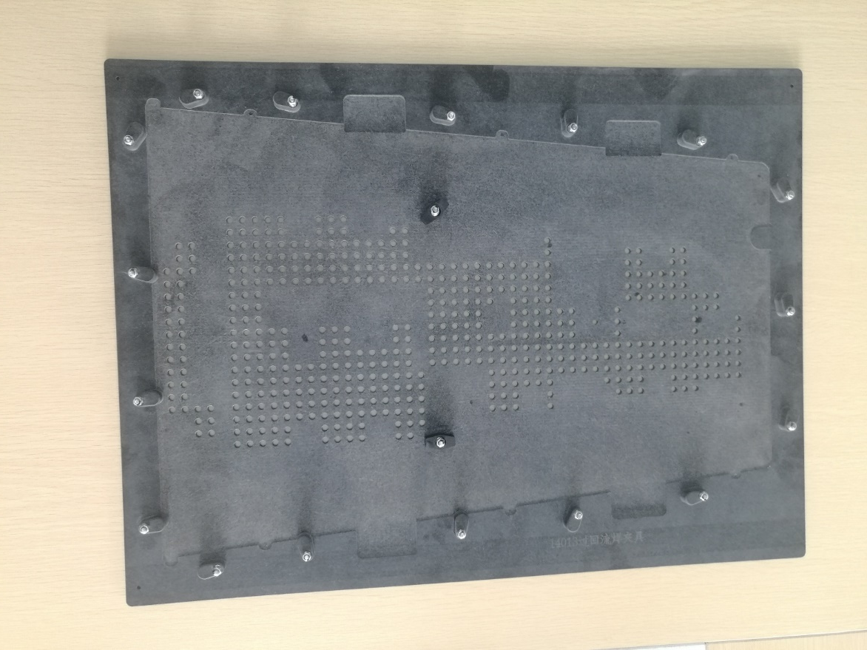
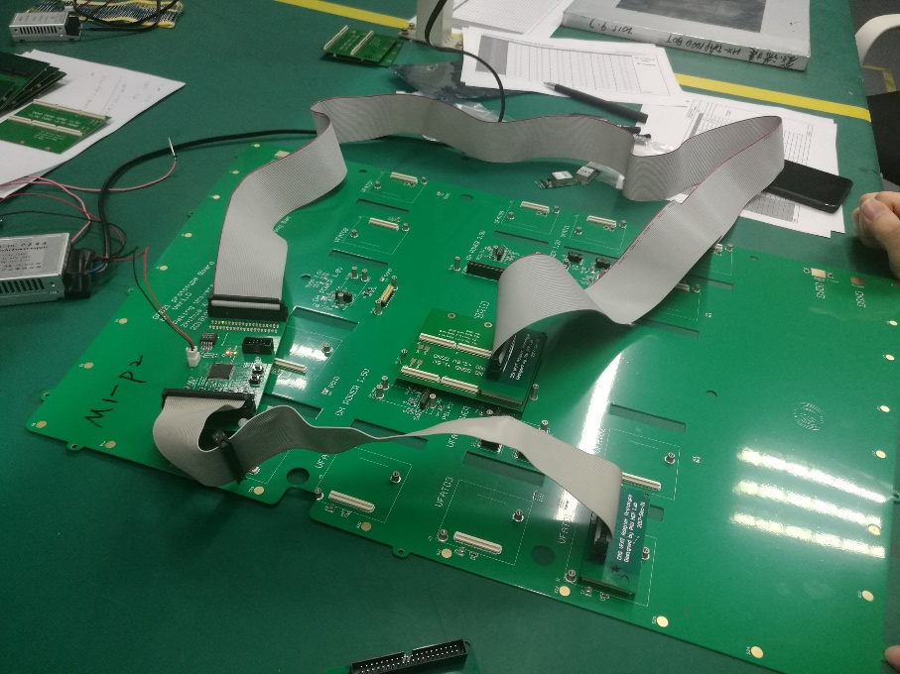
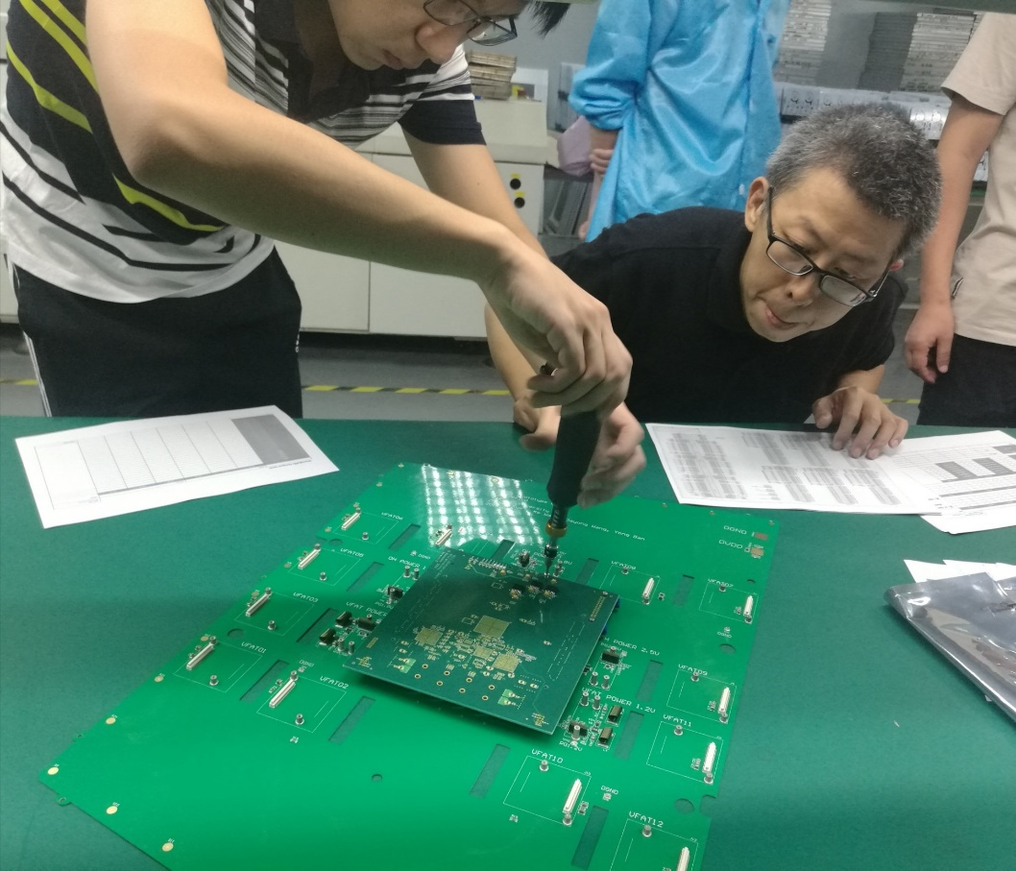
CMS GE2/1 GEB 设计和研制
Design, prototyping and production of GE2/1 GEB（2019-2022年）: full responsibility of PKU group
Stack structure of 8 layer GEB
Design of GE2/1 M1 GEB
GE2/1 M1 GEB prototype produced in Nov. 2018
Fixture tooling during soldering in the oven
5 M1 GEB prototypes produced and tested;
5 M2 GEB prototypes production will be completed next week;
M3 GEB design completed, production starts soom.
M4-M8 under design.
Test of GE2/1 M1 prototype in Sinofast

Slide 7
CMS-GEM 1/2、ME0 探测器生产
GE2/1 8 different modules.
Total modules: (36 modules + 1 spare + 1 test bench chambers) x 8 = 304 modules.
ME0 216 chambers + 3 spares + 3 test bench chambers = 222 chambers
GE2/1 Production sites proposal:
38 China
76 INFN
76 Belgium
38 Pakistan
76 India
ME0 Production sites proposal:
~46 per each site.
 | Number of modules (China） | Total Number of modules | cost per module (kCHF) | Total cost (kCHF) | Start Production | End Production
GE2/1 | 38 | 304 | 6,3 | 239,4 | July 2019 | Jan 2022
ME0 | 46 | 222 | 7,7 | 354,2 | Jan 2022 | Jan 2024
total | 84 | 526 |  | 593,6

Slide 8
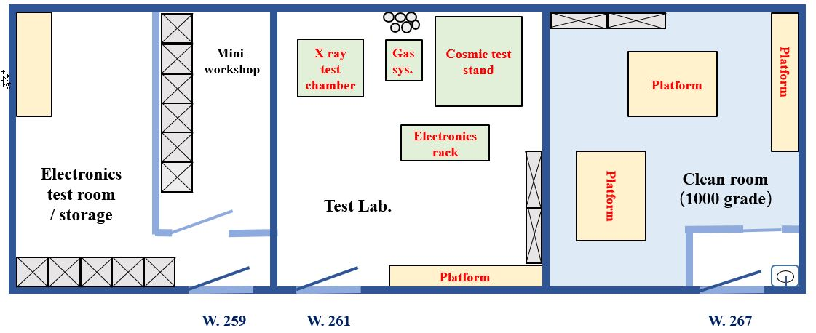
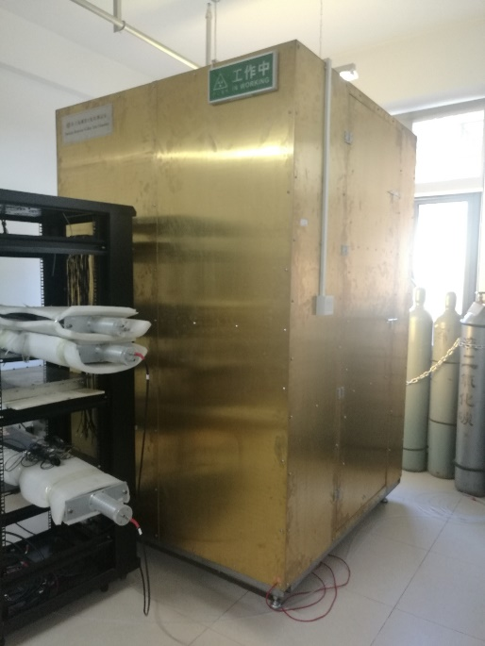
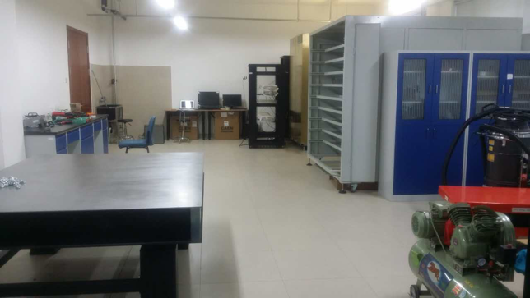
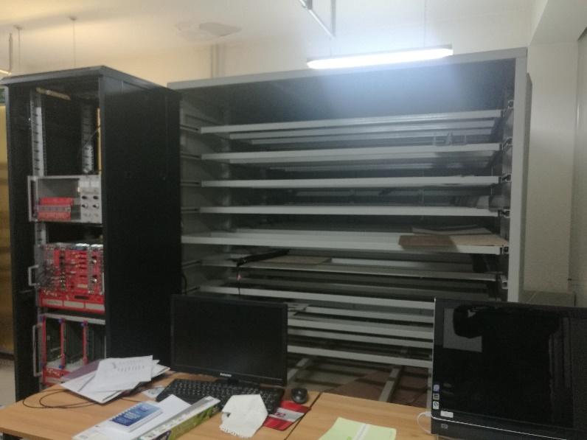
CMS-GEM 1/2、ME0 生产基地建设
Upgrade of PKU laboratory for GEM production site
Gas system
X-ray test chamber
Cosmic test system
Cosmic test system
X-ray test chamber

Slide 9
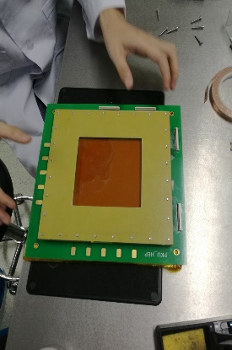
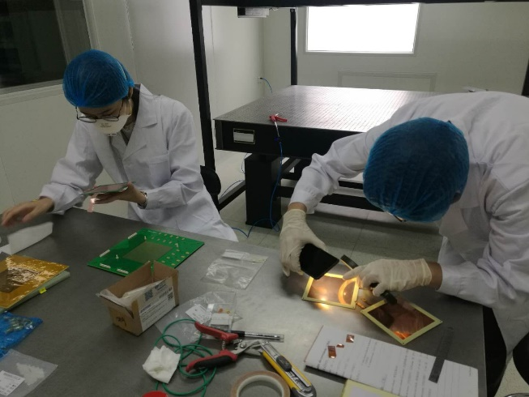
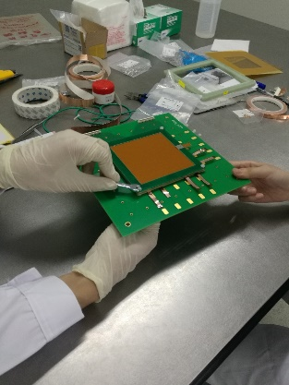
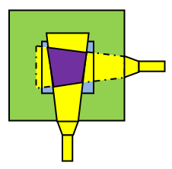
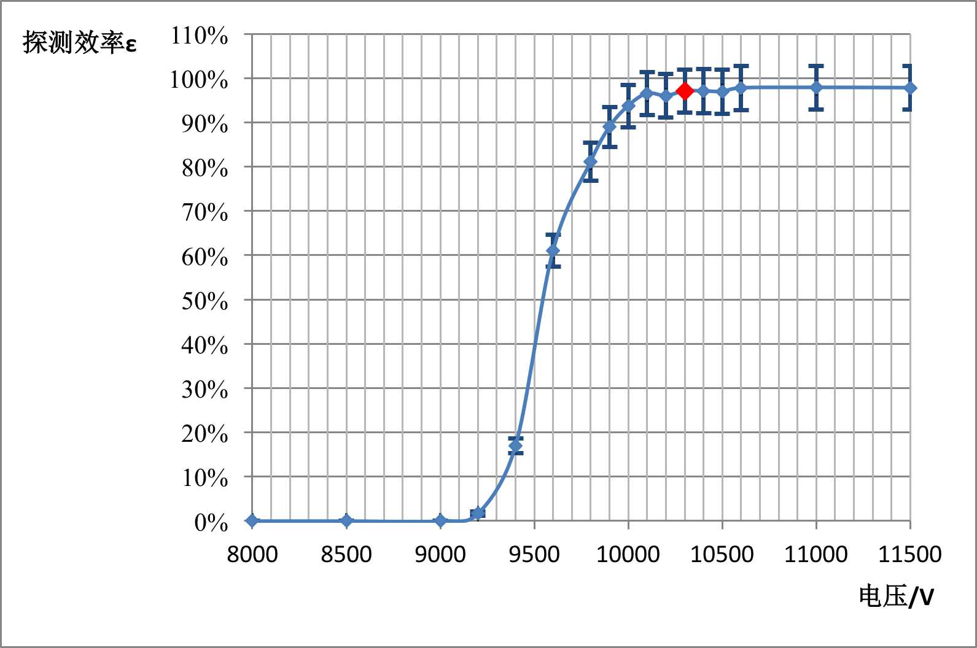
CMS-GEM 1/2、ME0 生产基地建设
Activities:
Assembly of a small 10×10 cm2 CMS-GEM prototype
Set up a cosmic-test system
Set up GEM mass production QC procedures:
GEM foil HV QC, chamber gas-tightness QC, GEM HV QC, X-ray test…
Plan:
QC Jambo. Stage 1: ~15 Jan. 2019;
(Prepare SRS system…)
QC Jambo. Stage 2: ~May 2019;
Site Checkout Visit from CERN: July 2019
QC Jambo. Stage 3: ~Aug. 2019;
Assembly of 10×10 GEM in cleanroom
Cosmic ray test system

Slide 10

CMS 端盖$μ$子探测器-MRPC研制进展
Endcap μ system MRPC R&D（Tsinghua Univ.）

Slide 11
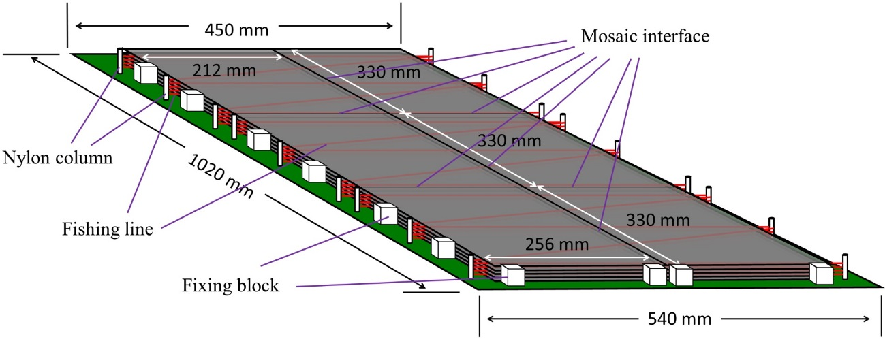
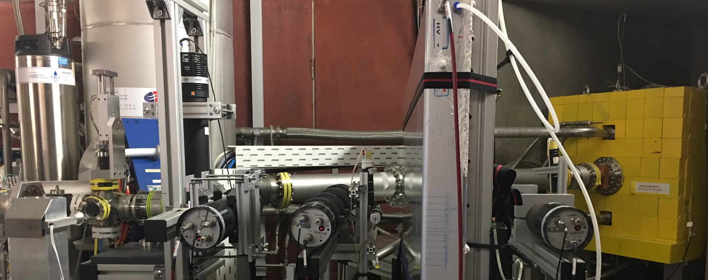

CMS 端盖$μ$子探测器-MRPC研制进展
Two technologies were investigated for RE3/1, RE4/1：
iRPC：double gap bakelite RPC
MRPC：Multi-gaps Glass RPC（Tsinghua Univ.）
iRPC was adopted in 2018
MRPC structure:
Dimension: 100cmx (54cm-45cm) x 6cm
Number of strip: 44
Strip width: trapezoidal (6mm/8mm)
Gas gap number: 5
Gas gap width: 250 μm
Glass thickness: 0.7 mm
Glass bulk resistivity: ~ 10¹⁰ Ωcm
Mosaic interface: glass directly mosaic together
Beam Test at HZDR
(Helmholtz - Zentrum Dresden-Rossendorf)

Slide 12
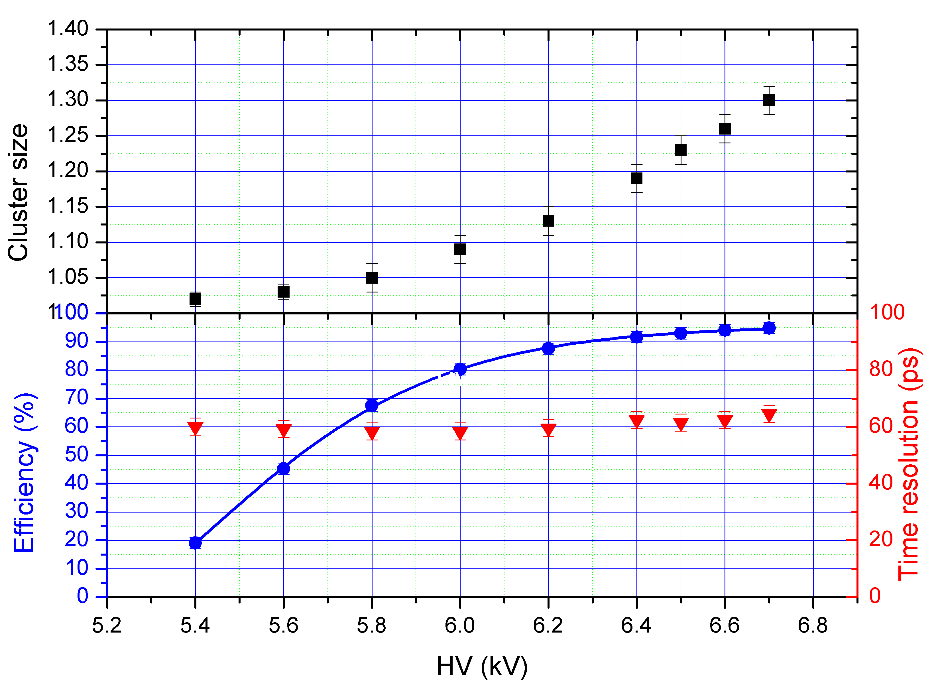
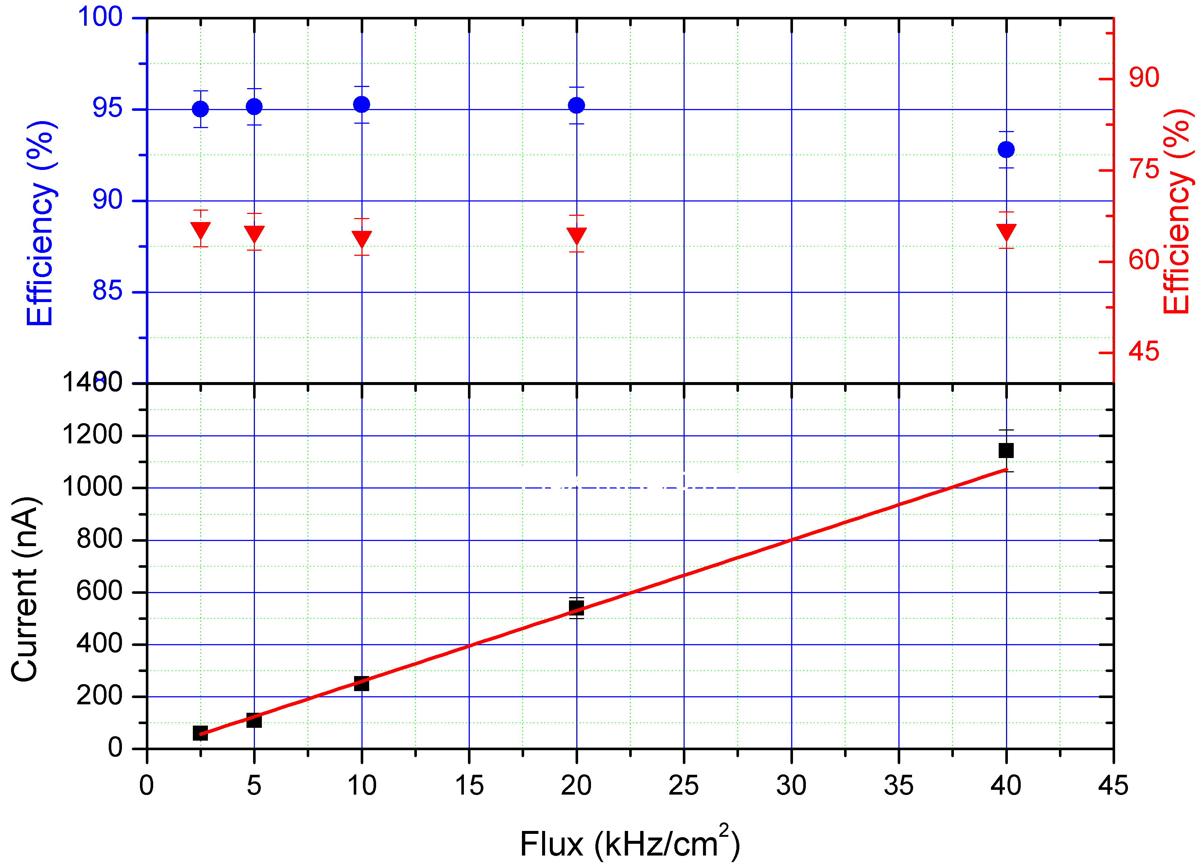
CMS 端盖$μ$子探测器-MRPC研制进展
Found a good technology to develop high rate, high time resolution and large area MRPC
30 MeV electron beam at HZDR at rate of 10kHz/cm²
Efficiency reaches 95% at ±6800V
Time resolution around 55ps.
Efficiency loss at mosaic interface is about 2%.
The real size mosaic MRPC can keep good performance with CMS dry gas.
Efficiency can reaches about 94% at ± 6000V at rate of 10kHz/cm².

Slide 13
CMS-HGCal升级
Endcap HGCal (IHEP)

Slide 14
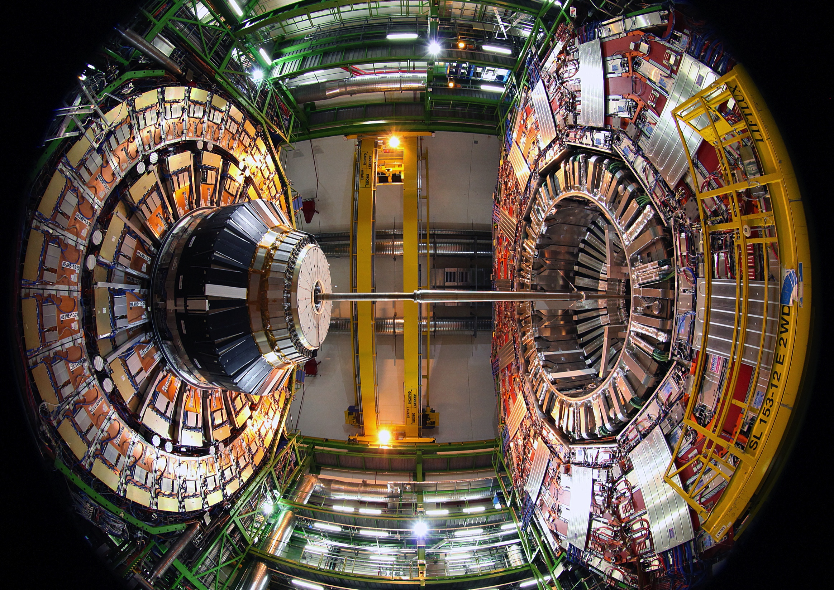
CMS-HGCal升级
IHEP Activities:
• Testbeam campaigns of HGC silicon modules
• Module Assembly Center (MAC) at IHEP
Probably responsible to assemble ~20% of HGCal silicon modules
Silicon sensors

Slide 15
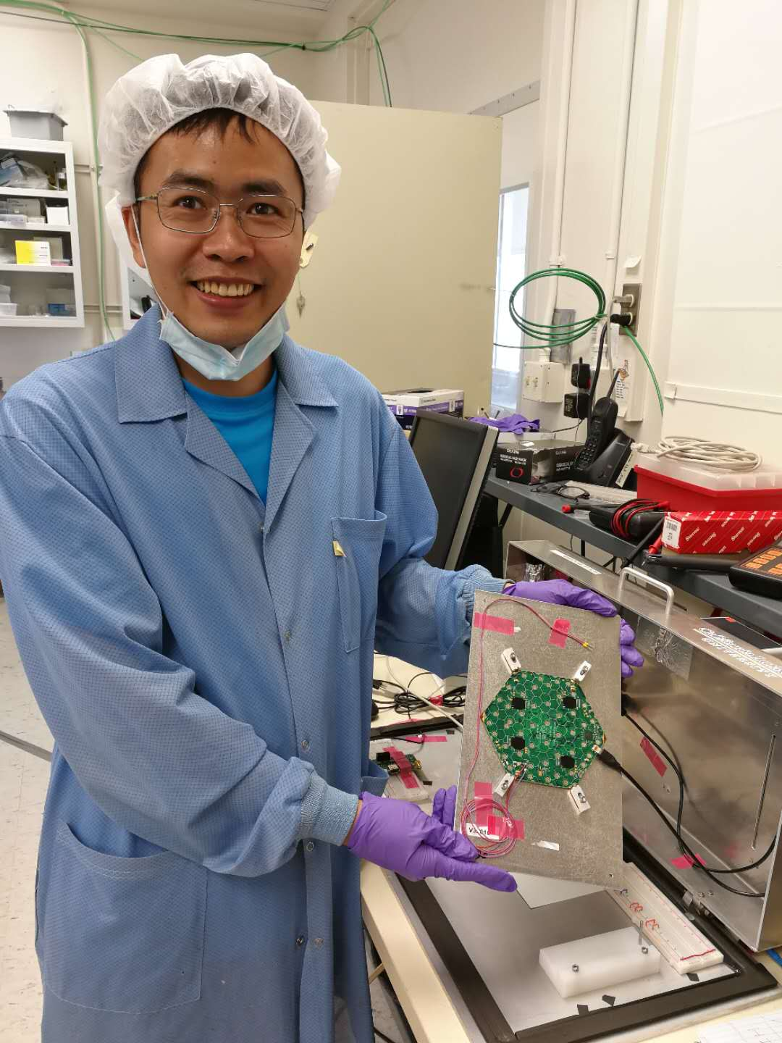
CMS-HGCal升级：参加PCB测试和束流测试
High Gain
PCB-V3 test at UCSB
DESY TB21 (2018 March)
CERN SPS H2 (2018 October)
MIP signal pulse
MIP signals with e- at different energies

Slide 16
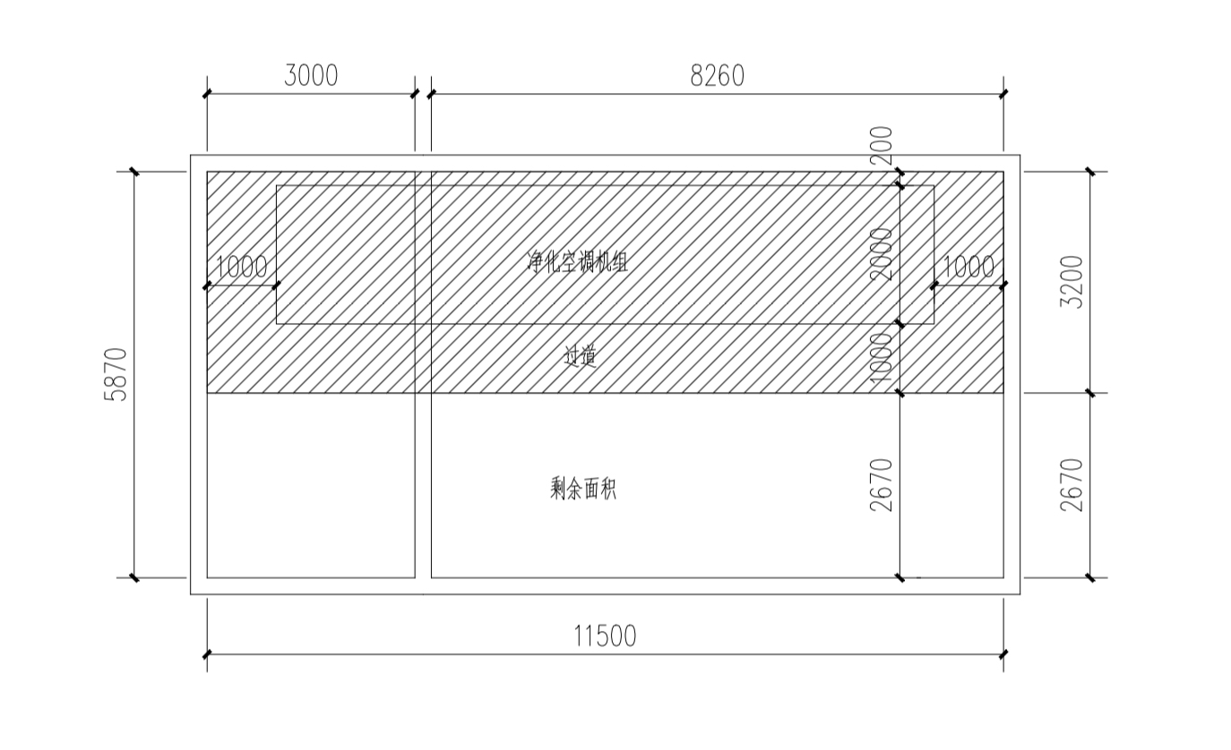
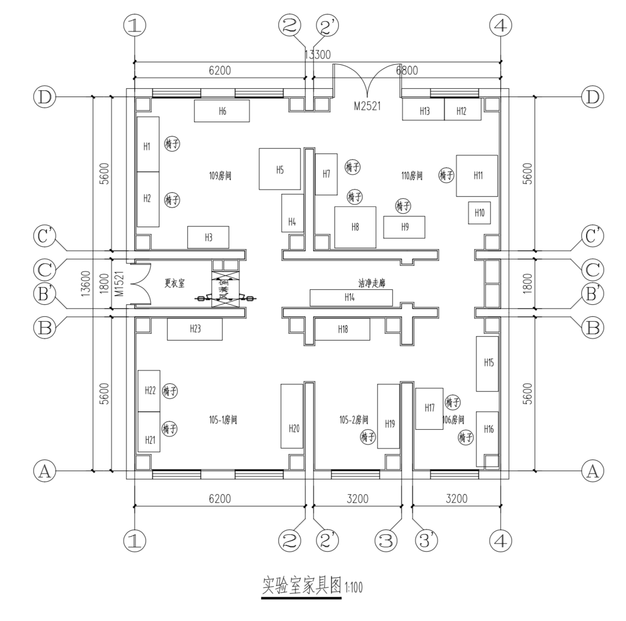
CMS-HGCal升级：高能所MAC基地建设
HGC Module Assembly Centers
• UCSB: the pilot MAC
• 5 MACs: Beijing-IHEP, India (BARC), Taiwan(NCU-NTU), US (CMU, TTU)
IHEP MAC site in construction:
  IHEP Hall 4, ground floor (160 m² clean room, 20 m² reception room, 60 m² air condition room)
  Bids completed, start construction next month
Instrumentation: being investigated/ordered
• Bonder, gantry, optical gauging
• Custom-designed tooling
• Probe stations, glue dispenser, …
HGC lab: test stand development
Air condition room
10m
Clean room
109
110
103
105
106
4m
Shipping/receiving room
Load on the floor
Vibration

Slide 17
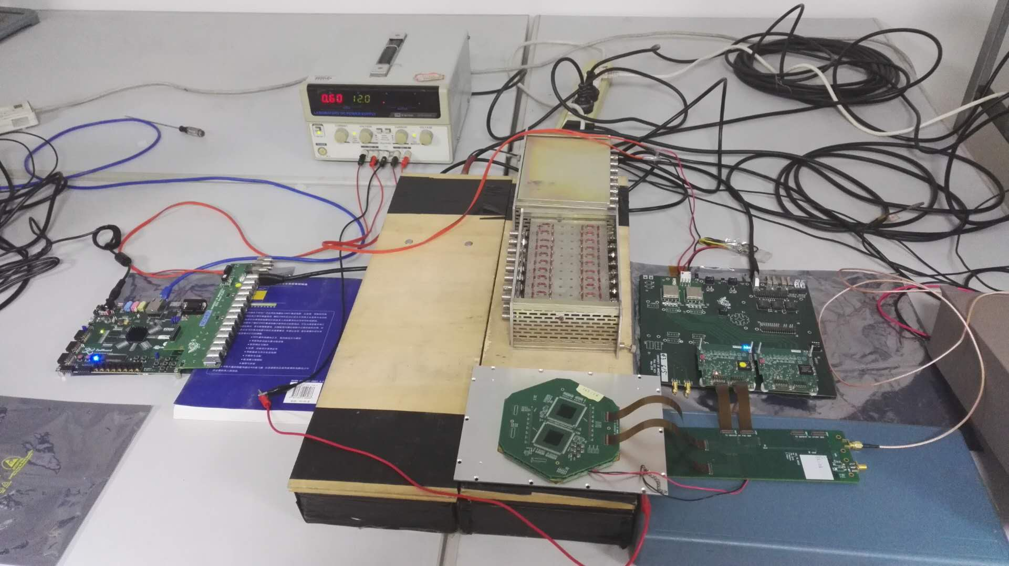
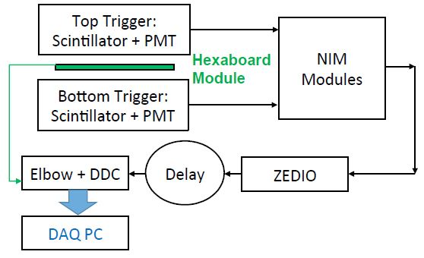
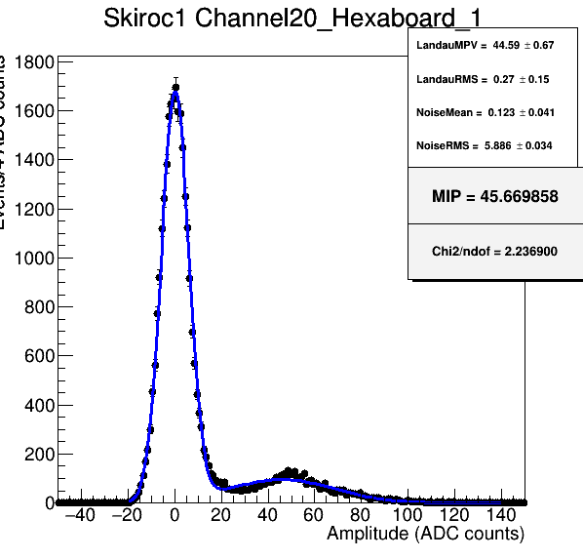
CMS-HGCal升级：高能所搭建的宇宙线测试系统
A cosmic ray test system was set up at IHEP.
Cosmic ray events were observed with HGCal module with the system.
Next step: use this system on beam test with BEPC.
cosmics

Slide 18
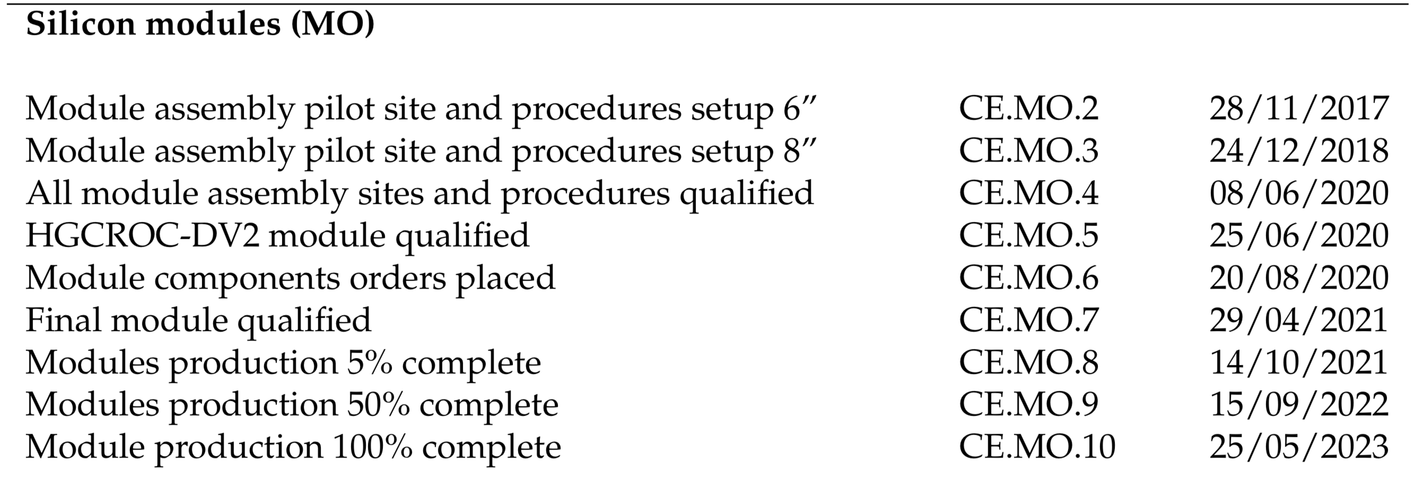
CMS-HGCal升级：计划
Clean room in construction
Equipment: Investigating, biding started
Manpower and expertise: ramping up
  Physicist: H. Liao, H. Zhang, Yong Liu, F. Wang （post-doc), B. Li (Ph.D) + more
  Engineers: X. Cao, Y. Gu, X. Li, X. Liu, B. Meng, L. Sun, C. Zhang, W. Zhang
2018: Clean room
2019: main MAC equipment
2020: training & site qualification
2021:start production
Plan:

Slide 19
CMS Phase I/II 触发工作
Existing RPC system
iRPC/RPC system backend electronics（IHEP）
iRPC

Slide 20
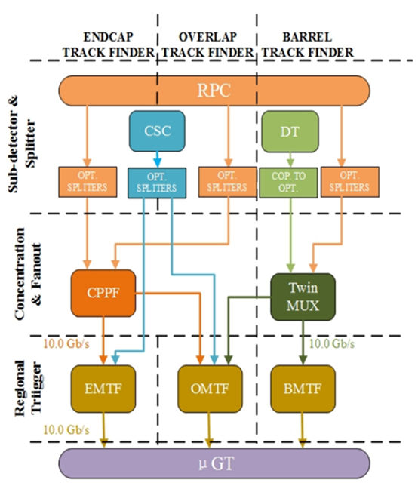
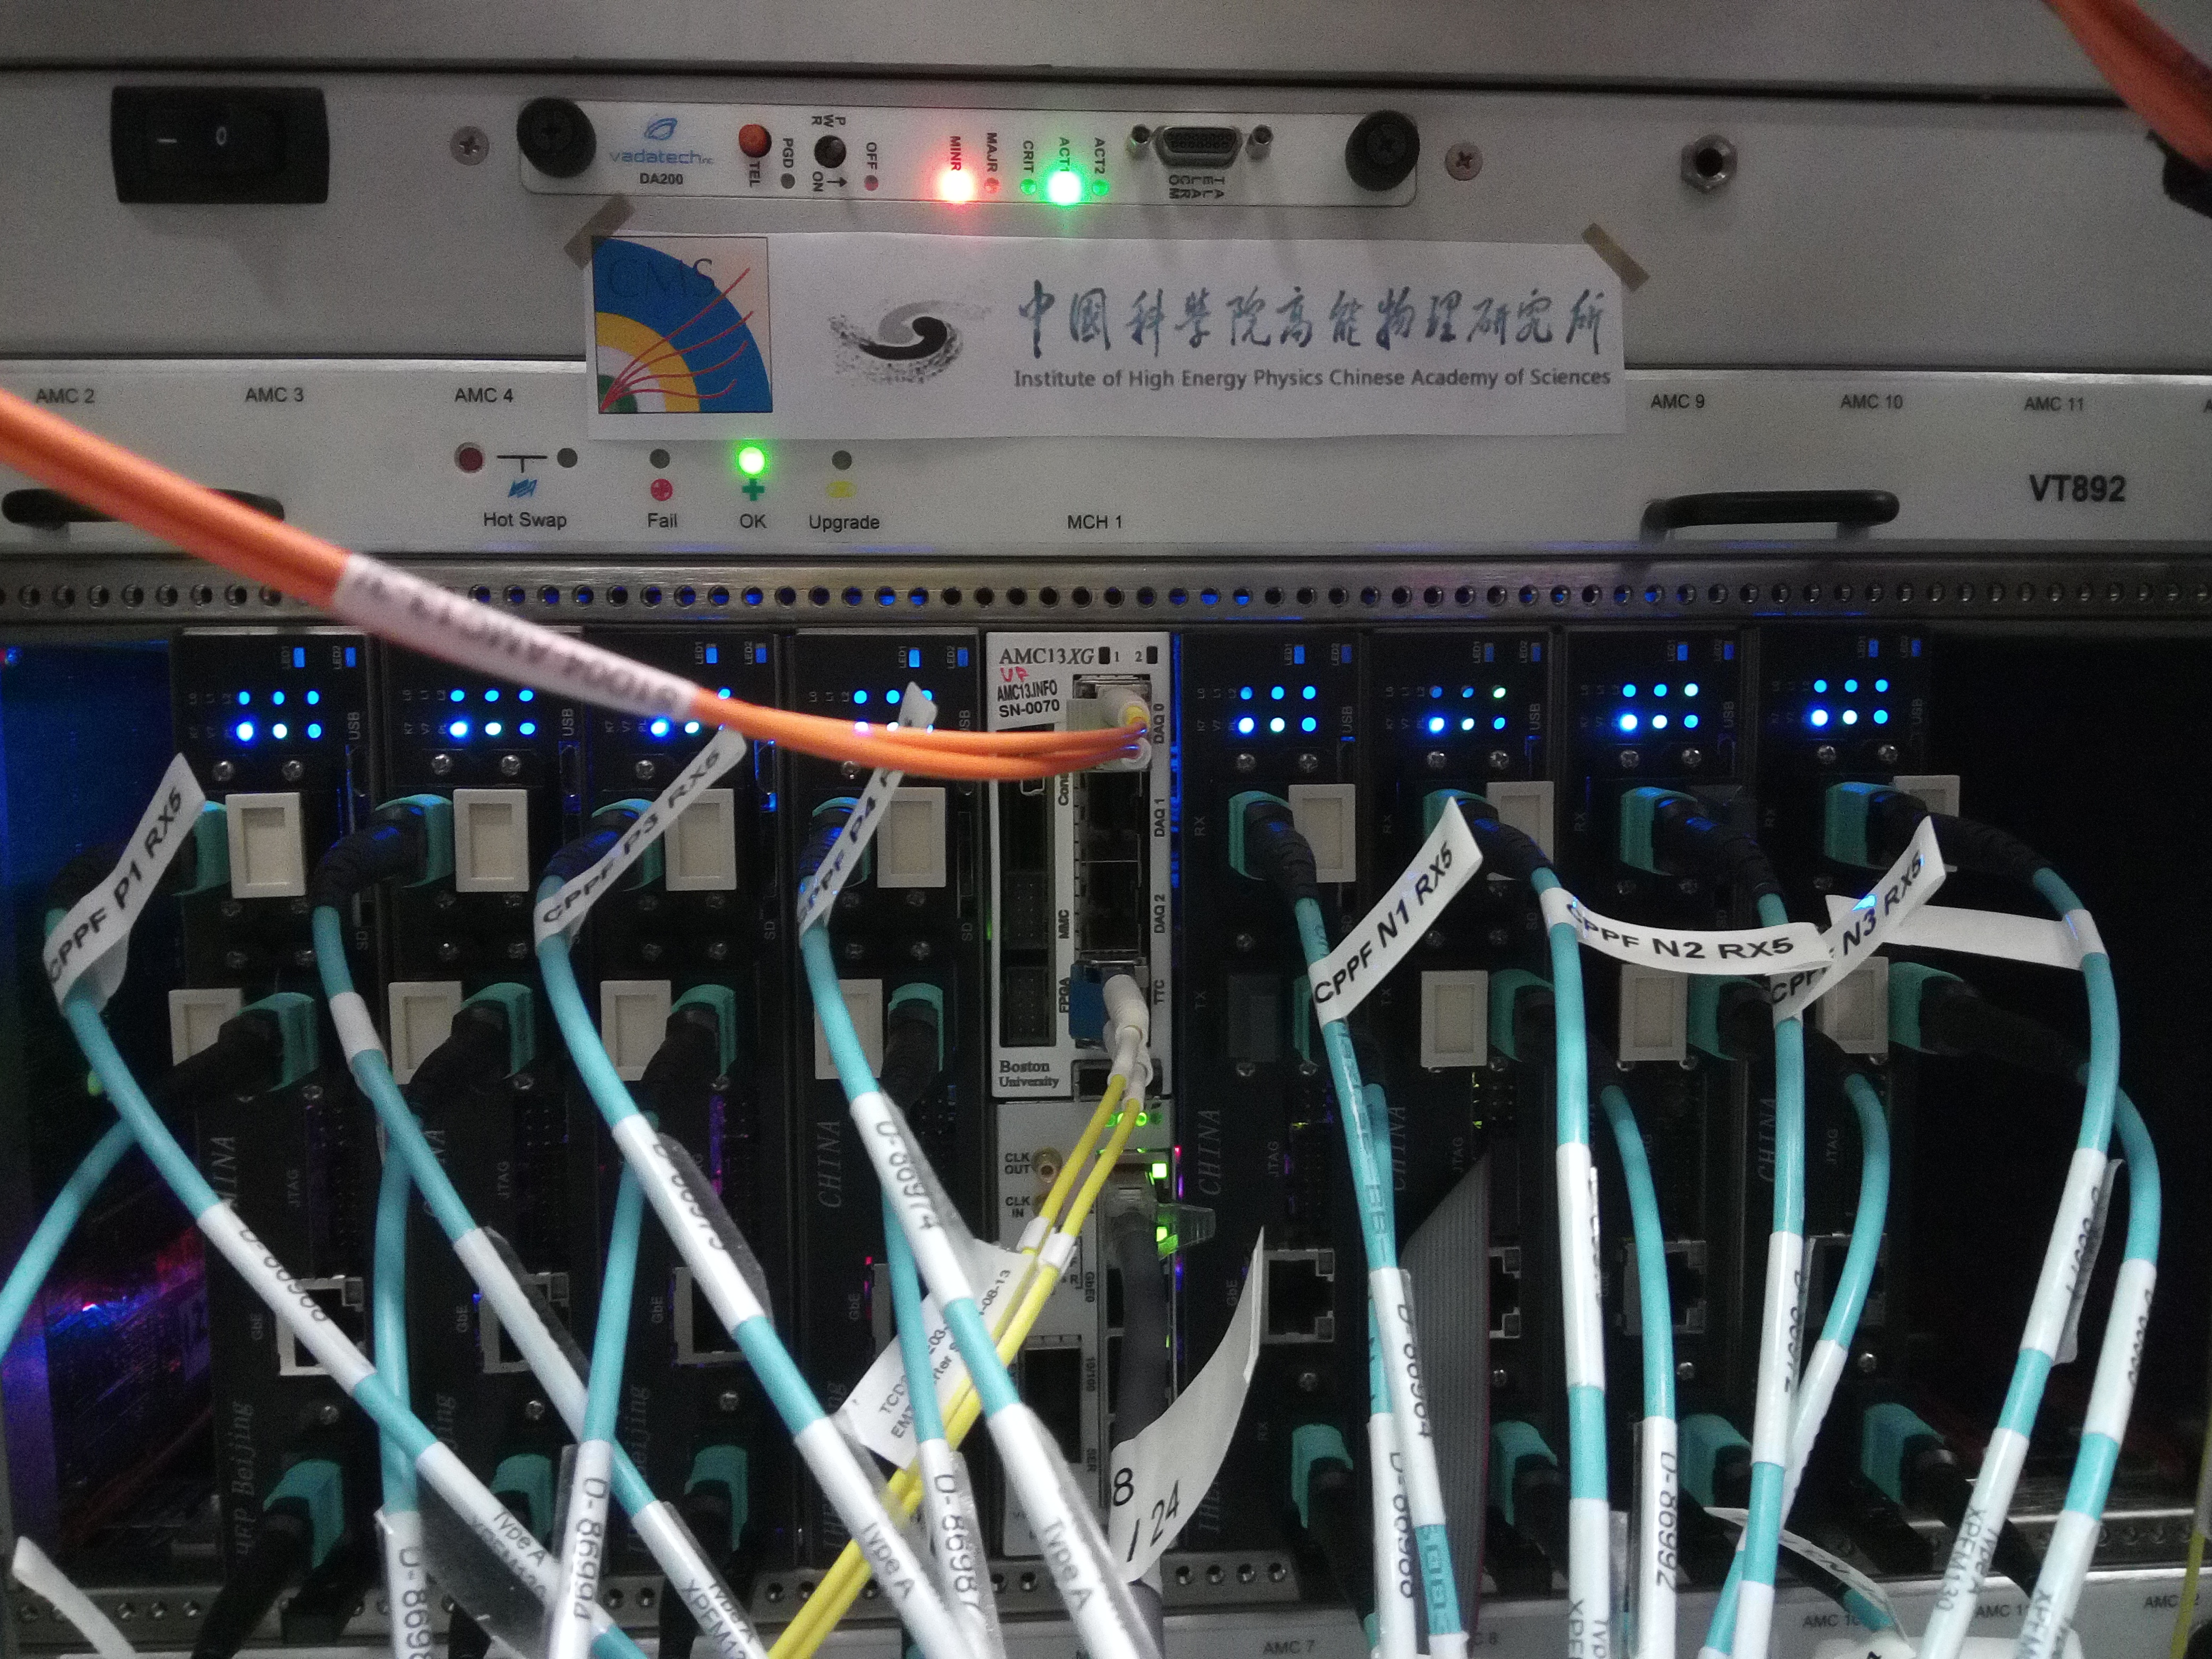
CMS L1 触发工作
CMS China-Group had designed and Constructed the CPPF system in CMS L1 Trigger Phase I upgrade which started running since May 2017. In 2018 more works done on CPPF System
On-call Service by China Group: Libo, Ahmad/Siying-Pengcheng/Jingzhou/Zhen-An close collabration home/broad
CPPF Emulator + Unpacker SoSware Devlopment by Libo
CPPF data validation by Libo
CPPF board firmware IPBUS Builder by Pengcheng
CPPF Test Manager Security software by Hanjun/Pengcheng
CPPF DQM by Guangyi/Mingshui/Zhen-An
Layer 1
Layer 2
Layer 3
中国设计制造的CPPF 系统

Slide 21
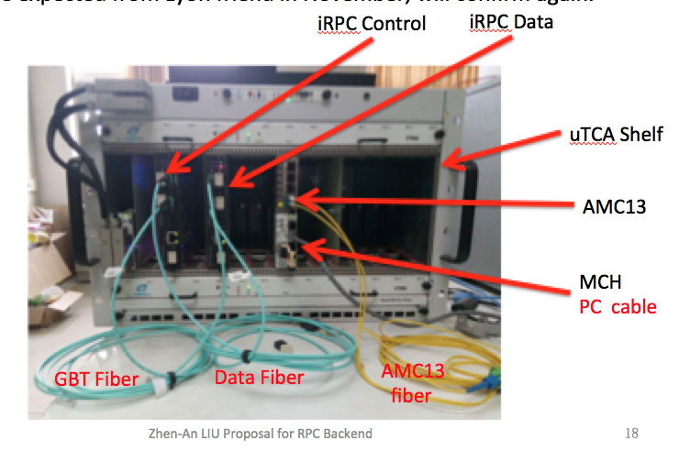
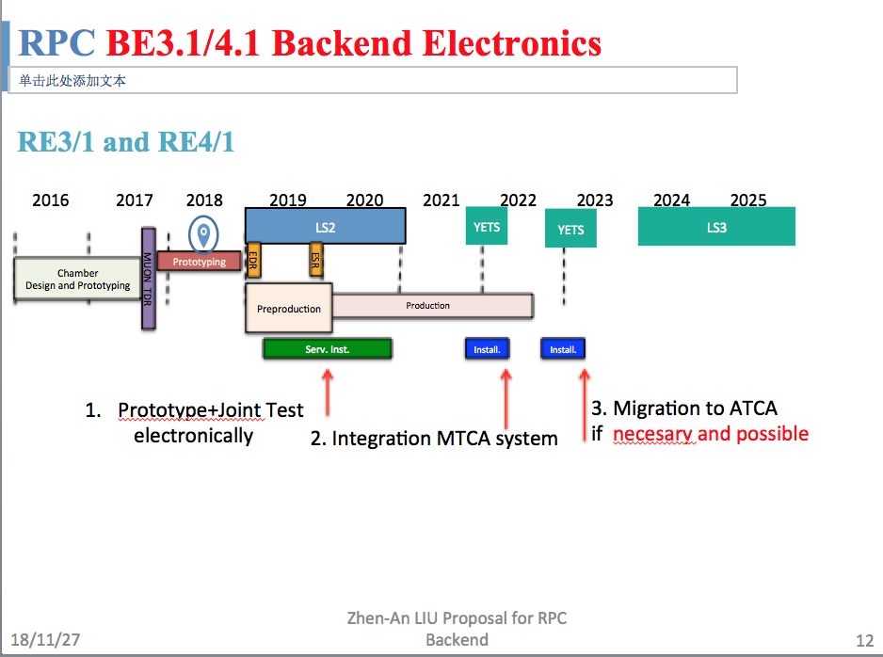
CMS Phase II 触发升级进展（端部内圈第3、4站iRPC）
Progress:
The develop and test system were set up at IHEP, the design of principle prototype was completed
Developed the software frame for iRPC frontend – backend GBT transmission and receiving
Finalized responsibilities：IHEP is responsible for the design and construction of :
  Layer1 trigger
  Fast control（DTCS)
  DAQ
Schedule:
  Joint test in 2019
  Small batch production in 2020
  Two installation in 2020-2011coordinated with detector construction

Slide 22
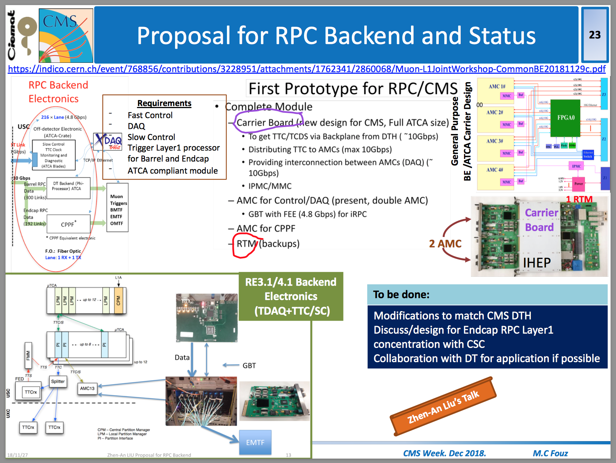
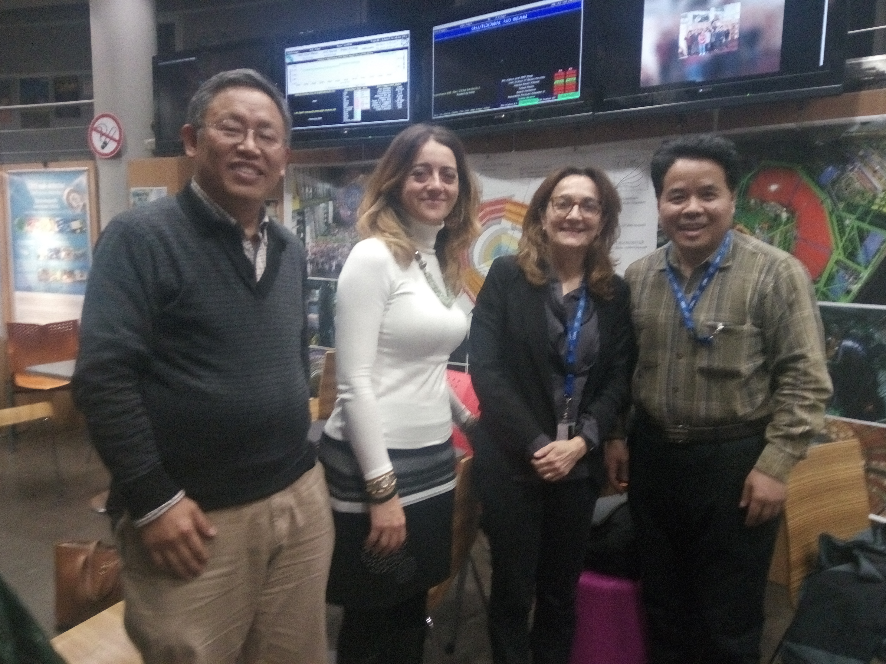
Phase II 触发升级进展（现有RPC系统）
The design and construction of the backend electronics for the existing RPC system
  All design should be based on ATCA standard required by CMS
  The design and test of the first version of ATCA board by IHEP were completed, and reported to CMS community
Pogress
  IHEP Proposal was discussed and accepted by CMS
  Responsibilities is agreed in principle by intensive communication between CMS and Chinese side, costs and contributions are being finalized
  It’s promising that China will take full responsibility for the full system.

Slide 23
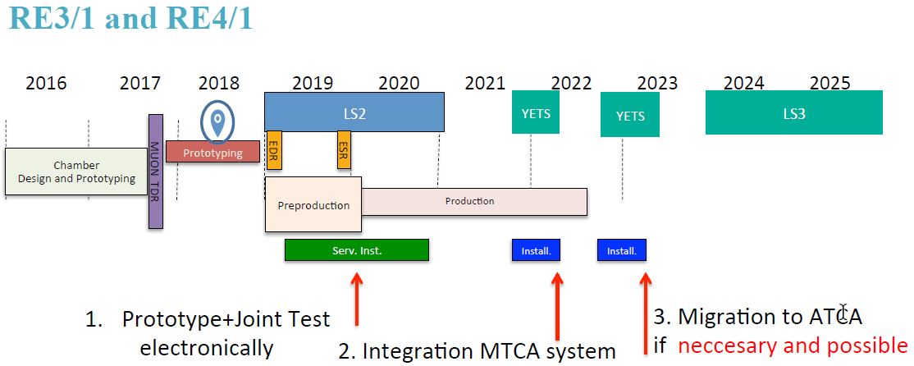
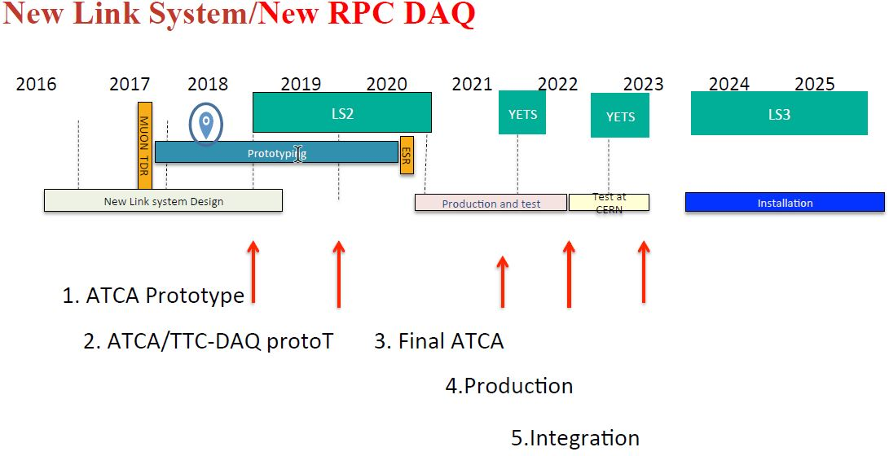
CMS RPC/iRPC Phase II触发升级计划
iRPC

Slide 24
总结：论文与专利
Lyu Pengfei, Wang Yi. Development and performance of self-sealed MRPC. JINST，12，C03055
Pengfei Lyu,Dong Han, Yi Wang, et al. Performance study of a real-size mosaic high-rate MRPC. 2018 JInst. 13 P06016
Fuyue Wang, Ultimate position resolution of pixel clusters with binary readout for particle tracking, NIMA 899(2018) 10-15
Fuyue Wang, Dong Han, Yi Wang, et al. The study of a new time reconstruction method for MRPC read out by waveform digitizer, NIMA 2018 (已接收)
Simulation Study of the Performance of New Micro Pattern Gaseous Detectors, S. He, Q. Huang, H. Qiao, D. Wang, Y. Ban, Radiation Detection Technology and Methods (2018) 2: 21
The Phase-2 Upgrade of the CMS Endcap Calorimeter – Technical Design Report, CMS-TDR-019，Apr. 2018
First beam tests of prototype silicon moudules for the CMS-HGCal, 2018 JInst 13 P10023
一种用于气体组性板探测器的流气盒，申请日：2017.11.20，授权日：2018.7.3，专利号：ZL201721553050.8
一种高计数率多气隙阻性板探测器，申请日：2017.11.20，授权日：2018.7.3，专利号：ZL201721598761.7
多气隙电阻板室探测器。申请日：2015.7.8，授权日：2018.8.28，发明专利号：ZL201510399044.0

Slide 25
总结：
CMS-GEM upgrade:
GE1/1 GEB: Production & test in China by PKU group. up to Dec. 2018, 82 sets of GE1/1 GEB were produced and tested successfully, were shipped to CERN for installation.
GE2/1 GEB: Design, prototyping and production was the full responsibility of PKU group. Different sections of GEB is being developed according to plan.
GE2/1+ME0 chamber production: Laboratory upgrade is moving forward to become one of the production site, it is expected to produce 84 sets of GE2/1+ME0 chambers in future.
CMS-HGCal upgrade:
Activities: take part in module assembly, PCB test and beam test campaigns; module assembly center at IHEP under development, man power ramping up
Plans: module assembly: training and exercise; module beam test at IHEP-TBF; Silicon sensors R&D (low leakage current, radiation tolerance, …)

Slide 26
总结：
CMS RPC/iRPC upgrade:
Activities: Stronger responsibility in CPPF system operation; a RPC Backend Electronics Solution is accepted, a prototype for CMS is presented
Plan: Joint test in 2019; small batch production in 2020, two installation in 2020-2011coordinated with detector construction.
Thanks！

