Slide 1



Design and Characterization of MIC4, the Monolithic Active Pixel Sensor for the CEPC Vertex Detector
Ping Yang
On behalf of the CCNU VTX study group
The 4th China LHC Physics Workshop
Dec, 21th 2018

Slide 2
Outline
Design specifications
Design
  MIC4 overall introduction
    Pixel front-end
    Matrix data-driven readout circuit
  Test
    Front-end and in-pixel logic
    Digital readout
  Summary
The 4th China LHC Physics Workshop

Slide 3
Design specification
Vertex detector:
  Single point resolution near the IP: ≤ 3 µm→ high granularity
  material budget: ≤ 0.15%X₀/layer → Low power dissipation,
  thinned, monolithic pixel sensor
  pixel occupancy: ≤ 1% → High granularity and/or short readout time
  Radiation tolerance: ～1Mrad/y (TID) and ～10¹² N_{eq}/cm²/y (NIEL)
Generally require：
    High granularity, thin pixel sensors with fast readout and low power dissipation
Stage objectives：
    σ = 3-5 μm;
    integration time = 10 -100 μs ;
    Power < 100 mW/cm²
* Numbers may be updated as both of our understanding of the physics requirements and detector/accelerator designs evolve
The 4th China LHC Physics Workshop

Slide 4
CMOS pixel sensor & technology
NMOS
PMOS
Reset diode P+/Nwell
Integration diode N+/epi
^{N+}
p well
^{N+}
^{N+}
^{P+}
N well
^{P+}
STI
^{N+}
N well
^{P+}
STI
+
_
Deep P well
Deep P well
Depletion Region
_
+
_
+
Epi
Sub
Minus voltage 0~ -6V
Integrated sensor and readout electronics on the same silicon bulk with “standard” CMOS process : low material budget, low power consumption, low cost …
Standard TowerJazz 0.18 µm CIS technology for CEPC R&D, featuring:
  Quadruple well process: deep PWELL shields NWELL of PMOS
  Thick (18 μm) and high resistivity (≥1 kΩ•cm) epitaxial layer: larger depletion
  Thin gate oxide (< 4 nm): robust to total ionizing dose
  6 metal layers
The 4th China LHC Physics Workshop

Slide 5
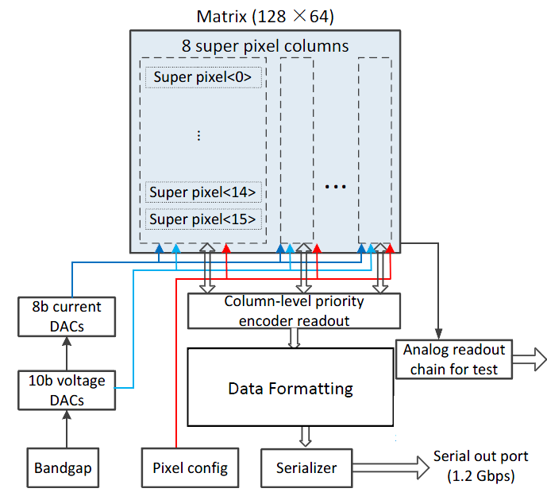
MIC4 overall introduction
MIC4 (MAPS IN CCNU4) is to explore a new data-driven readout architecture which can be implemented into a small pixel size. Based on ALPIDE.
TowerJazz 180nm CIS process
Pixel size: 25 um x 25 um
Matrix: 128 rows x 64 columns
Two different front-ends in the matrix
  Zero suppression readout
  DACs, bias
  No memory in the periphery, real time readout, serial readout rate 1.2Gbps
  Analog test for the last row pixels
The 4th China LHC Physics Workshop

Slide 6
Pixel digital front-end design version 1
Ying Zhang@IHEP
CSA based analog front-end by Ying ZHANG @ IHEP
The front-end includes an amplifier and one bit comparator
OUT_A can be tested
The 4th China LHC Physics Workshop

Slide 7
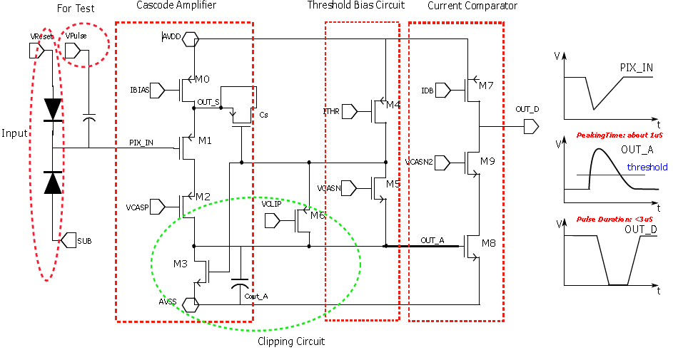
Pixel digital front-end design version 2
The ALPIDE front-end structure, Power: 61 nA/pixel
Peaking time< 1 μs, duration < 3 μs
Thermal noise < 8 e- (including amp noise ~4 e- and mismatch ~2 e-)
Coupling capacitor is used to inject charge, OUT_A can be tested
The 4th China LHC Physics Workshop

Slide 8
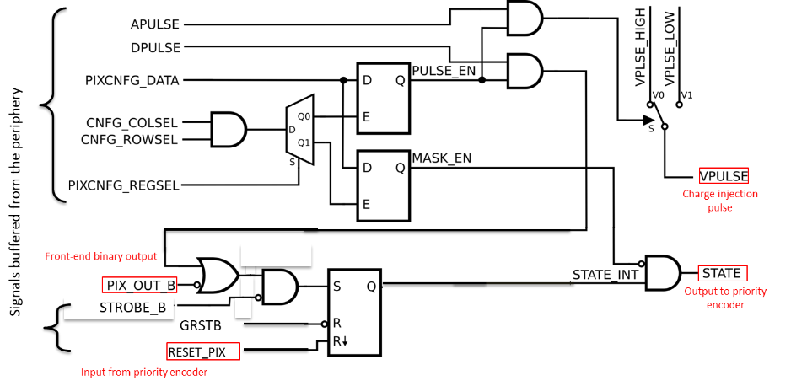
In-pixel digital logic
3 bit latches inside each pixel: 1 bit for analog test, 1bit for mask noisy pixel,
1 bit to save the state of the pixel, custom layout
STROBE as an option for test, is used to control when to write to the state latch
The 4th China LHC Physics Workshop

Slide 9
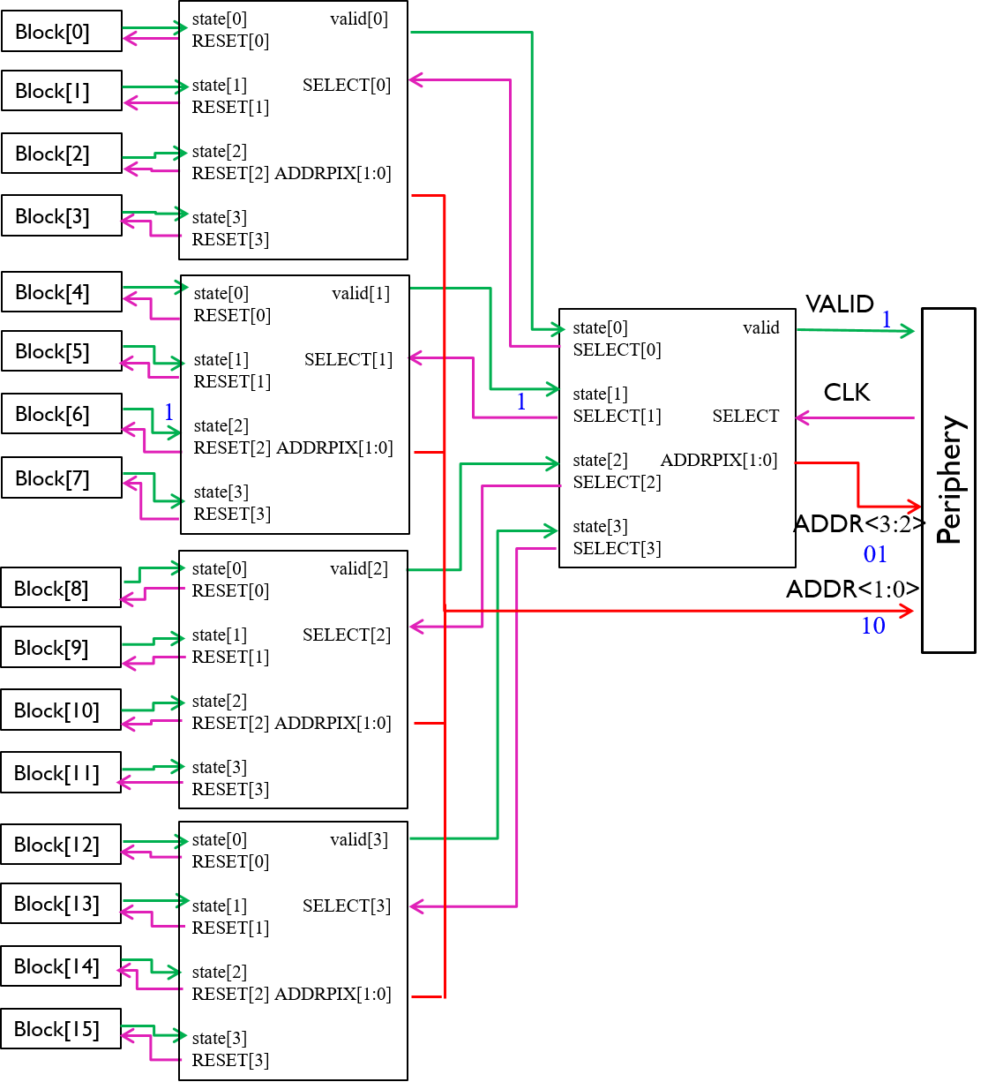
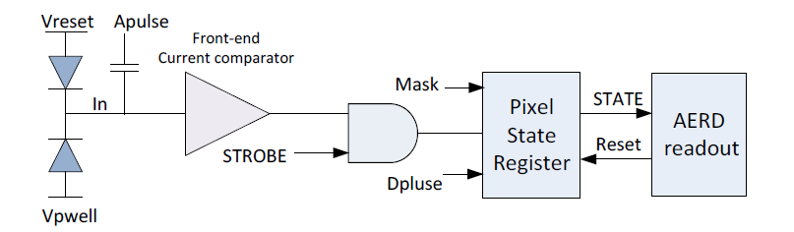
ALPIDE data-driven readout scheme
ALPIDE in-pixel readout chain
Hierarchical readout: 1 encoder/double col.
4 inputs basic block repeated to create a larger encoder
5 hierarchy to encode 1024 pixels
ALPIDE readout scheme: AERD (Address Encoder Reset Decoder )
The 4th China LHC Physics Workshop

Slide 10
MIC4 data-driven readout scheme
Active low
8*8 pixels
ADDRX<0:7>
ADDRY<0:7>
ADDR<0:3>
Pix_OR_logic
20 address lines to the Periphery
ALPIDE matrix readout circuit AERD has many connection lines occupy larger area than the logic circuit itself;
OR gate chain: speed is limited with the number of the chain pixels;
Combine these two solutions: 64 pixels as a group using OR gate chain, groups using AERD structure to readout
The 4th China LHC Physics Workshop

Slide 11
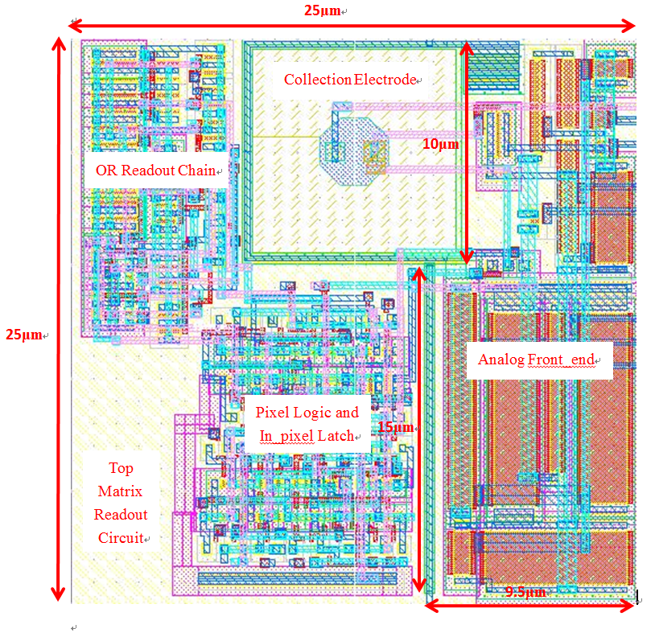
MIC4 data-driven readout scheme
Inside each pixel
Share
The ADDRX ADDRY should be reset;
Need half of the clock cycle to enable the ADDRX ADDRY and propagate the value, and
another half cycle to reset them;
RESET_PIX signal used to enable the address line inside the pixel;
Digital periphery provide a CLK signal of 60% duty cycle to enhance the readout circuit
to work at 40 MHz to decode 1024 pixels; -> a few μs readout time
The 4th China LHC Physics Workshop

Slide 12
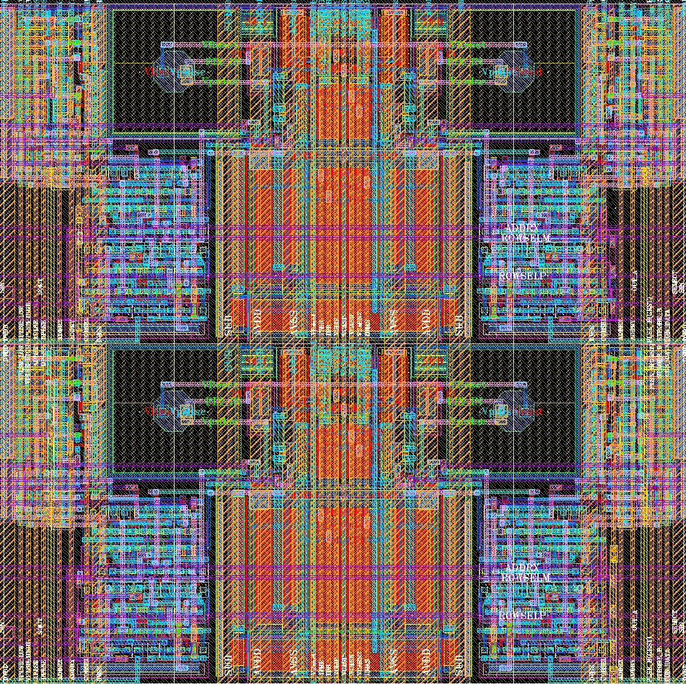
Layout of 4 pixels
Diode
Diode
M1-M3 used for in-pixel blocks;
M4-M6 used for signal connections including power supply;
Pixels are aside to separate the analog part and the digital part;
Readout
Front-ends
Readout
Diode
Diode
Address lines
Front-end bias supply
Address lines
The 4th China LHC Physics Workshop

Slide 13
Digital periphery
Matrix config
SPI interface;
Pixel address random configuration;
Matrix data readout
Use priority readout scheme in the periphery;
Real-time readout, No Memory in the periphery;
8B/10B encoder, serial output at 1.2Gbps;
Data frame structure: 10 bit K28.5 + 23 bit data *16 + 10 bit information
The 4th China LHC Physics Workshop

Slide 14
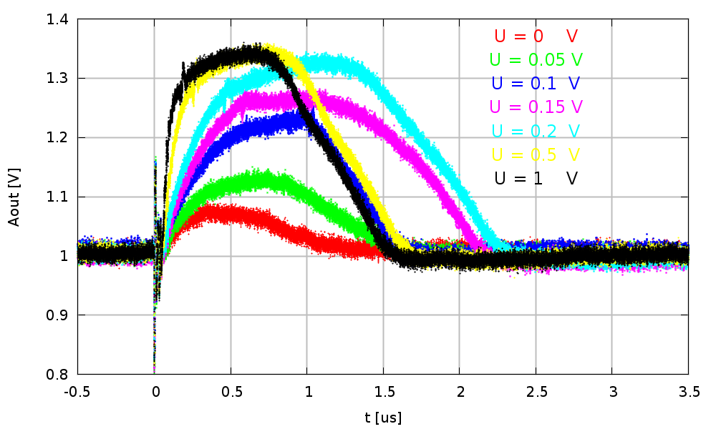
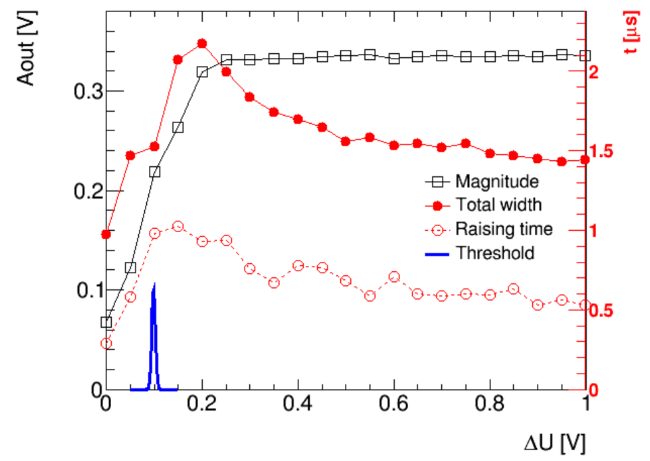
Pixel front-end design version 2 test results
The front-end response is non-linear which is as expected.
Peaking time < 1 μs, duration < 3 μs, consistent to the simulation results.
The 4th China LHC Physics Workshop

Slide 15
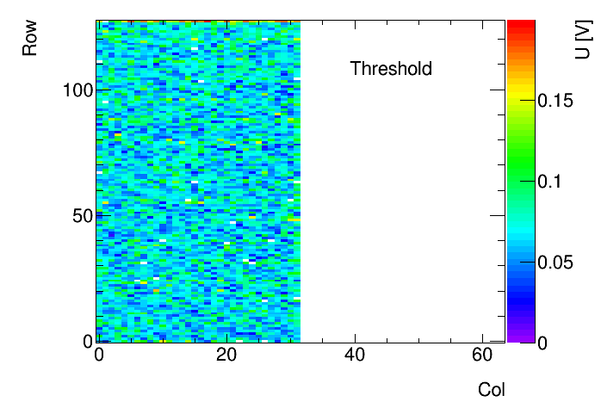
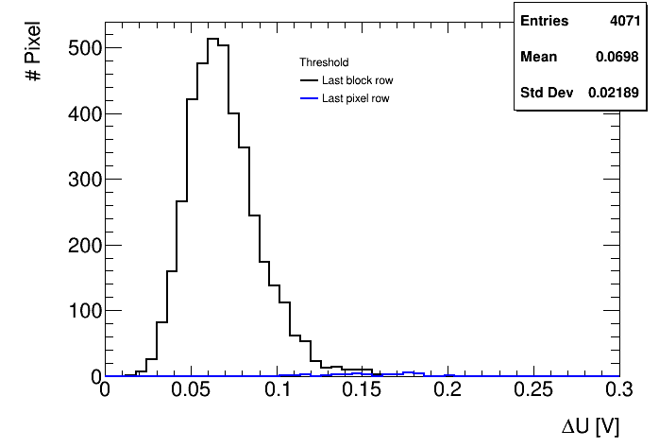
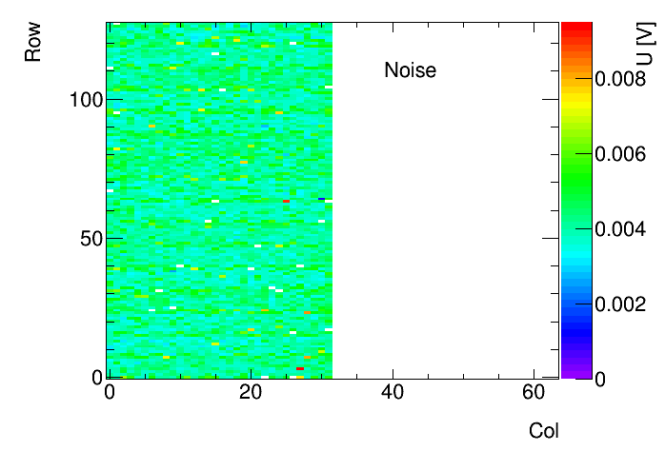
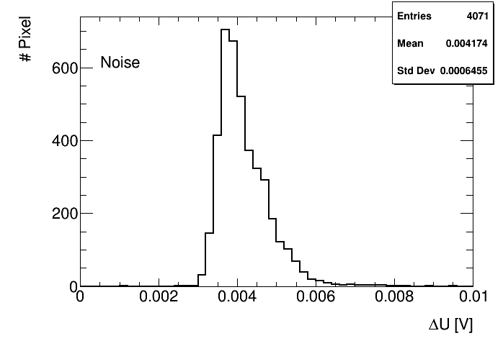
Digital readout test：threshold and noise
Use 1e- equal 0.7 mV
Mean threshold around 99 e-
Mean FPN ~ 31 e-, TN around 6 e-
The 4th China LHC Physics Workshop

Slide 16
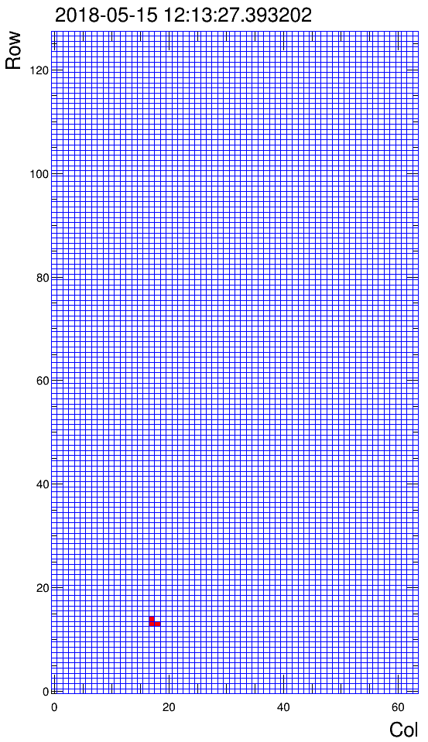
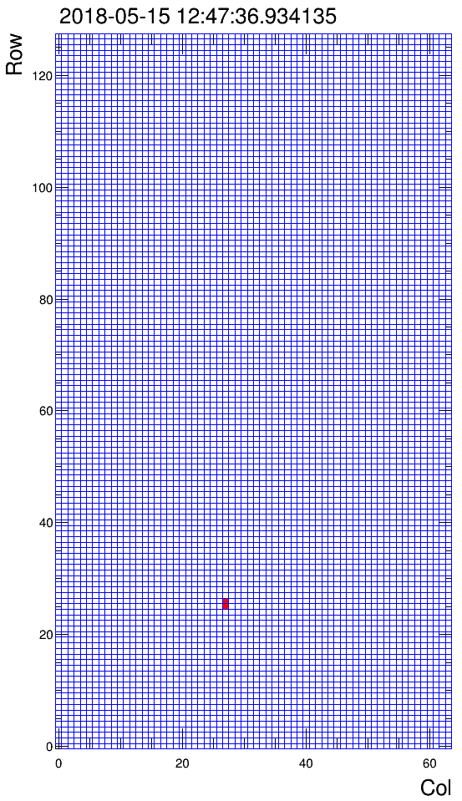
Cosmic data
Threshold set to 220 e-, observed 2.5 hours
9 events were recorded, like physics data
Expect number of muons p > 1GeV :10.5
The 4th China LHC Physics Workshop

Slide 17
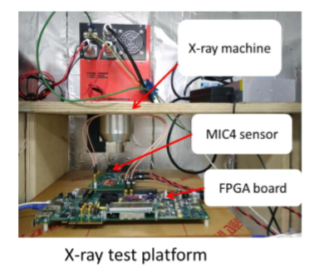
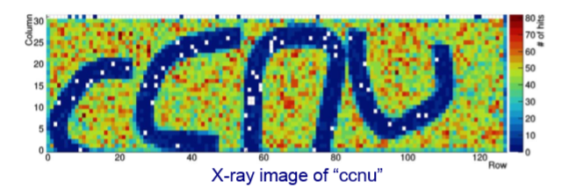
Xray test results
X-ray source imaging test: using 6 KV, get picture of “ccnu” (ccnu are copper wires)
The 4th China LHC Physics Workshop

Slide 18
Summary
As the 1st prototype, all the modules of MIC4 are functional which is very encouraging. The threshold are consistent to the design.
Chip periphery modules should be optimized on the power consumption.
More test is still ongoing like the spatial resolution, SEU etc.
Thank you very much for your attention!
The 4th China LHC Physics Workshop

Slide 19
ACKNOWLEGMENTS
CCNU team: Chaosong. Gao, Xing, Huang,
Yashu. Li, Jun. Liu, Weiping. Ren, Xiangming. Sun, Bihui. You, Le. Xiao, Ping. Yang,
Dongliang. Zhang, Wei. Zhou

