Slide 1



R&D on thin gap RPC for ATLAS Phase-II upgrade
Yongjie Sun
State Key Laboratory of Particle detection and electronics
Department of Modern Physics,
University of Science and Technology of China (USTC)

Slide 2
Outline
Introduction
RPC Simulation – gas amplification & signal induction
Prototype test – readout board & two-end readout method
Summary and outlook

Slide 3
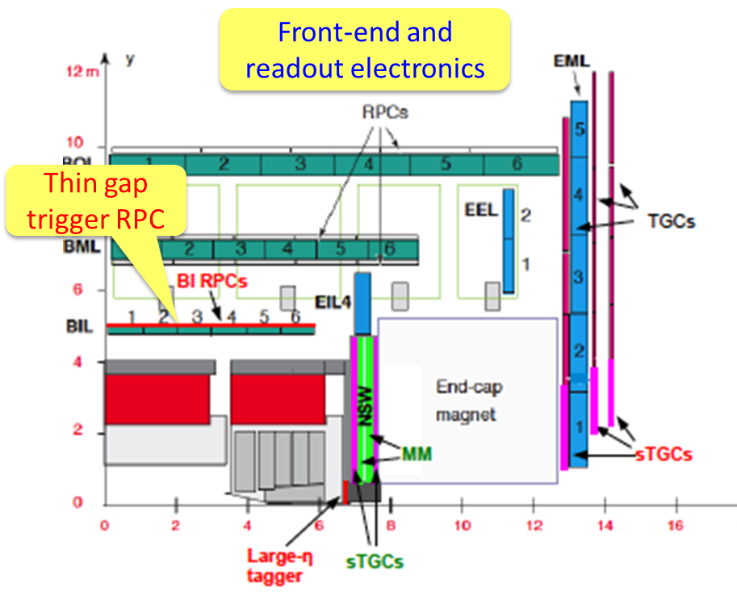
Introduction
Trigger RPC @ High Luminosity LHC
Exceed their service time (10 years @ LHC)
Rate capability limited: 20 Hz/cm²
Work under lower voltage ➔ 15-35% eff. Lost
The solution
Add BI RPC layers (3 RPCs)
  Additional overall redundancy
  Additional overall lever arm
  Additional acceptance
Improved performance:
  rate, longevity, time & spatial resolution.
L=7×10³⁴cm⁻²s⁻¹@14TeV
9 layers instead of 6
4 chambers instead of 3

Slide 4
Requirements on RPC detector
strips
Forex-board
Higher rate capability: ~ kHz/cm²
Longer longevity: 10 years of HL-LHC
Higher spatial resolution: ~ cm
Higher time resolution: ~0.5ns
Reduced gap size:
  Less charge produced per event → improve longevity, rate capability
  Less high voltage applied but higher field → better time resolution
Reduced bakelite thickness:
  Less voltage loss in bakelite → improve the rate capability
New generation FE electronic:
  Higher amplification factor and high S/N ratio to compensate the less gas amplification.
Improved readout panel and method
  Better mechanics structure, better signal transmission and better spatial resolution.
RPC gas gap
GND
Front-End board
Gap size: 2mm→1mm
Bakelite: 1.8mm→1.2mm

Slide 5
Main challenges
More sensitive, high signal-to-noise ratio, fast, low power consumption Front End Electronics.
Increasing the signal-to-noise ratio by optimizing the gas gap and readout panel structure. ➔ impedance, cross talk, shielding, …
New materials for a thinner and more rigid chamber structure
Optimizing the detector design to maximize spatial and time resolution, for example, the two-end readout method.

Slide 6
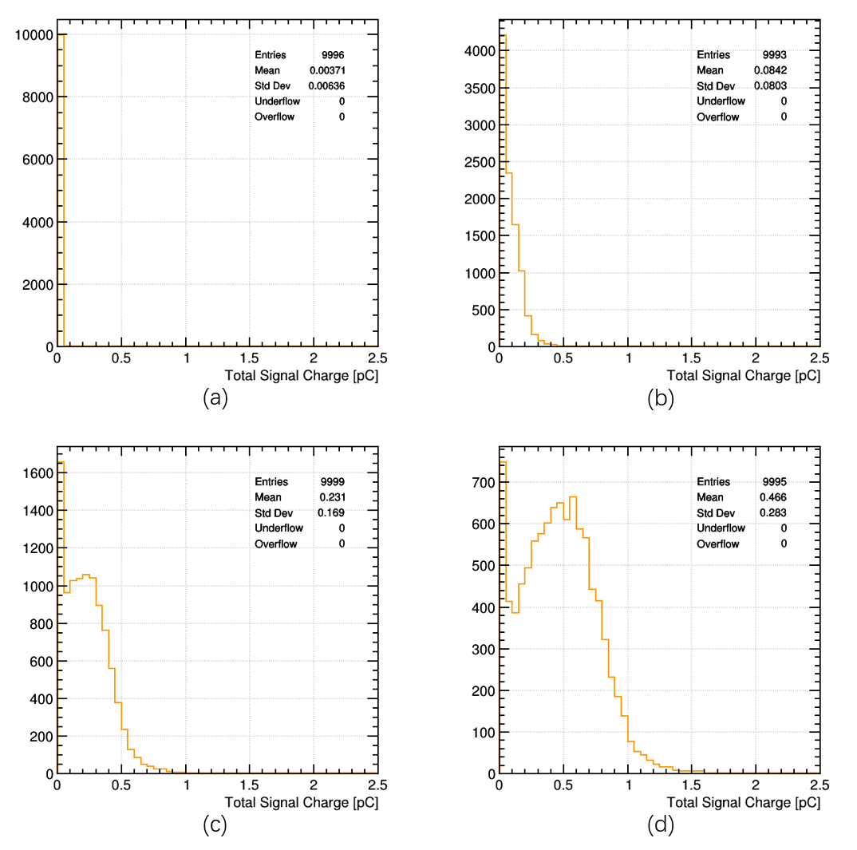
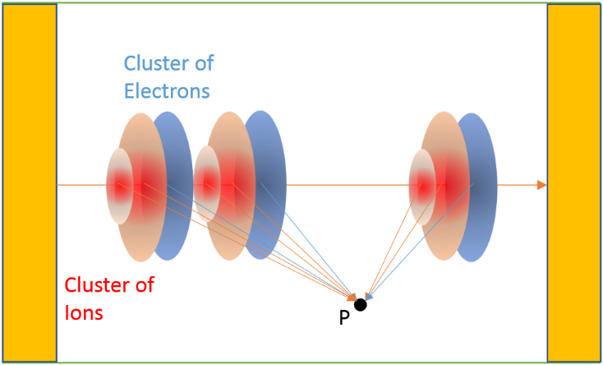
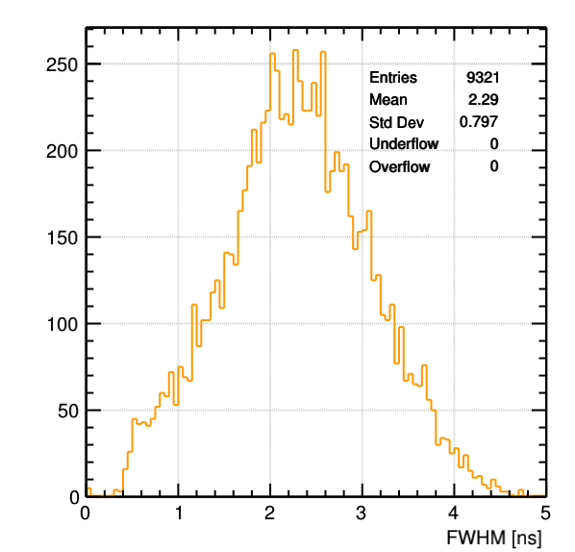
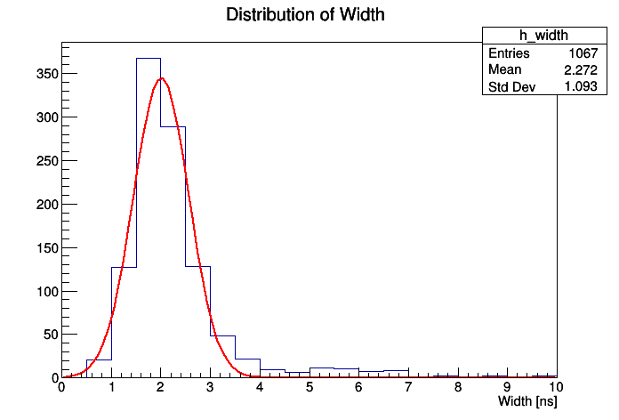
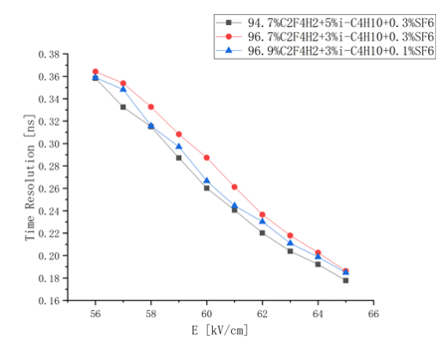
RPC detector simulation
Gas amplification simulation by Garfield++
Better understanding the working mechanism
Guide the detector design and optimization
Comparable results achieved to the experimental test.
5000V
5400V
simulated
5600V
5800V
Time resolution
experimental
Signal charge distribution
Signal width

Slide 7
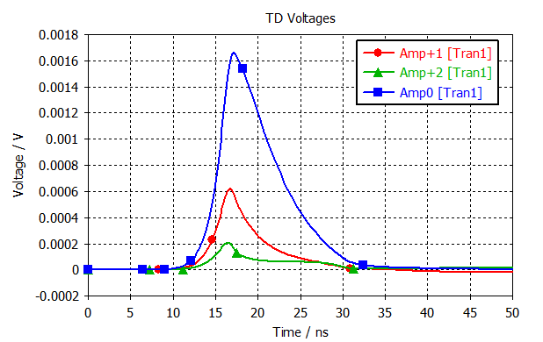
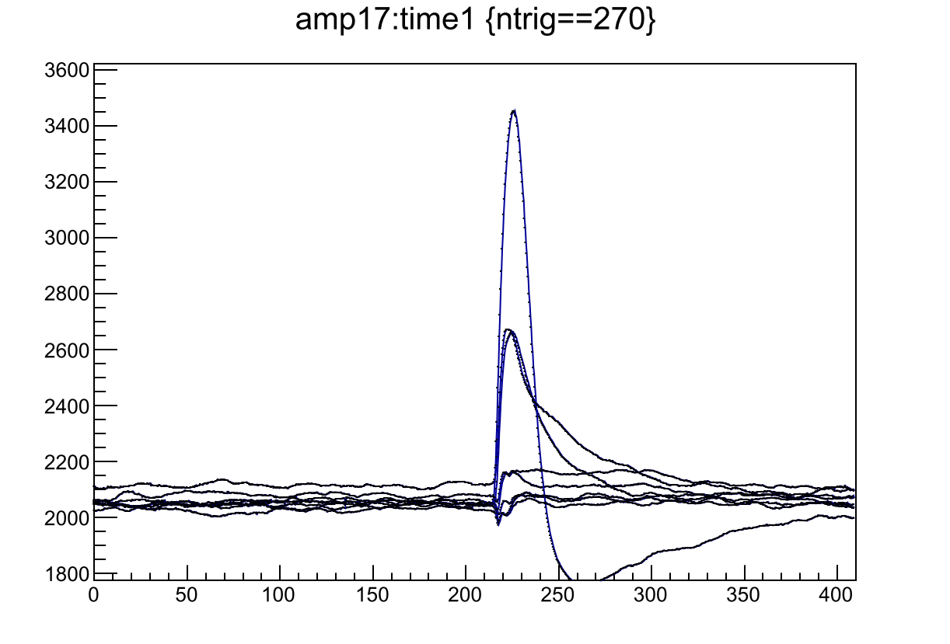
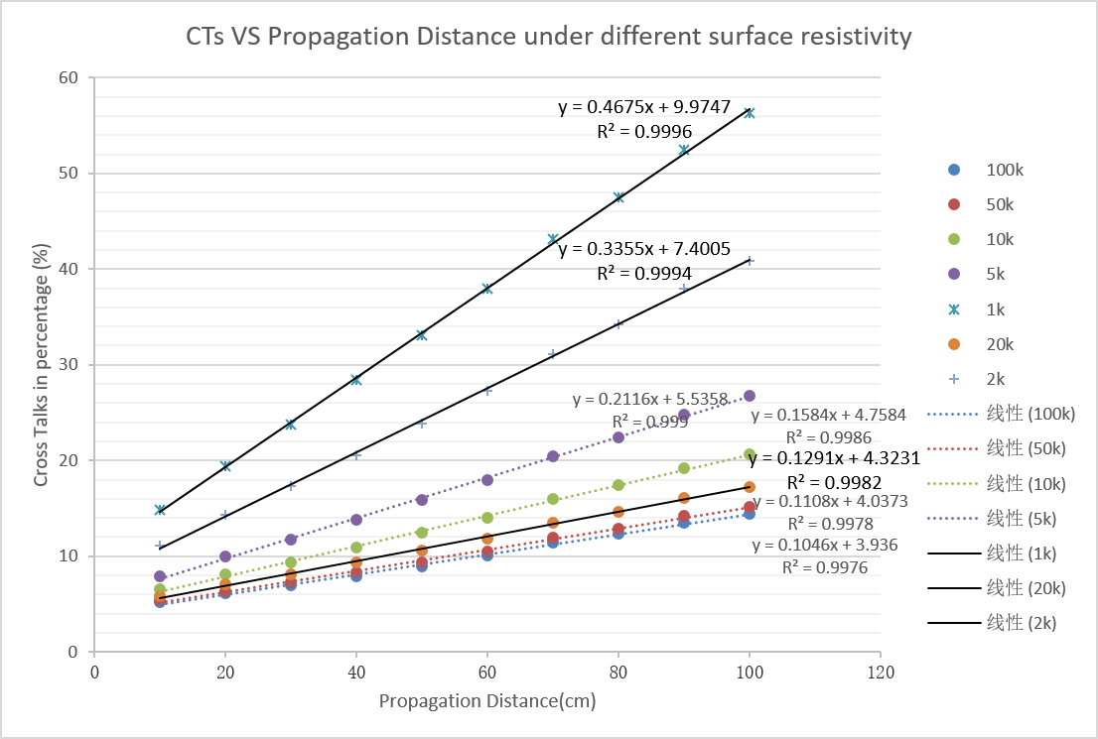
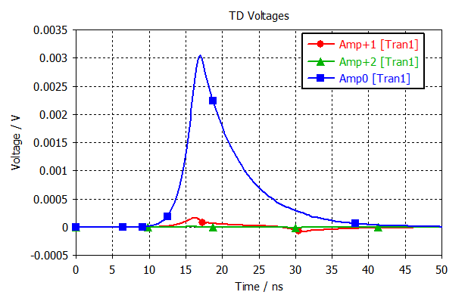
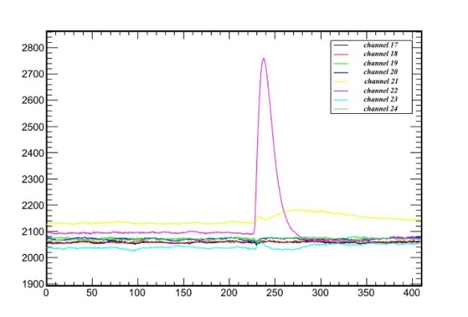
RPC detector simulation
Signal induction and transmission by CST PCB studio
Simulated causes relate to the “cross-talk”
Predict the high cluster size caused by the low surface resistivity of HV layer
Results have been used to optimize the BIS7/8 RPC production
1 kΩ/□
120 kΩ/□
100 kΩ/□
620 kΩ/□
simulation
Test results

Slide 8
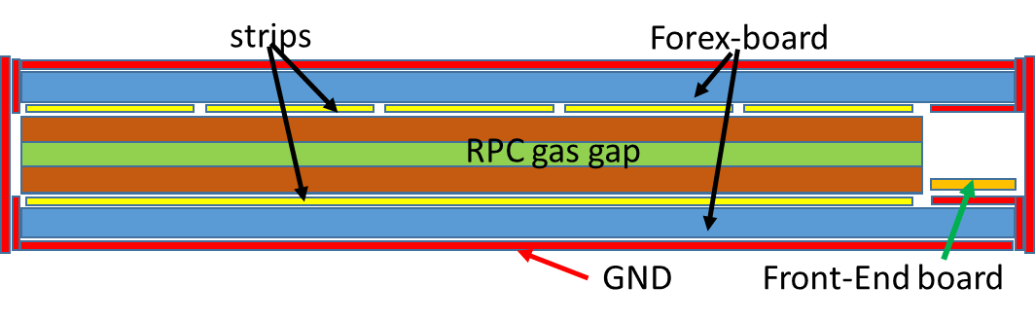

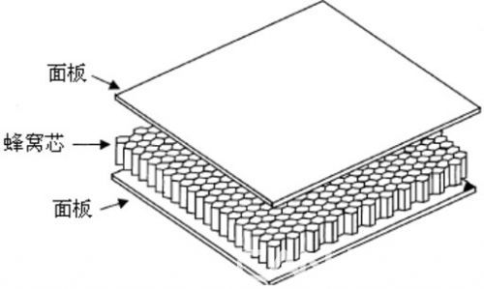
Readout panel design
Main considerations:
  Impedance matching: dielectric constant (ε_{r}) ↓, S ↓, d ↑, → smaller capacitor
  Light and good mechanic properties
Foam-like material: mainly air inside, ε_{r} close to 1.
But, foam board is very fragile and not stiff.
Honeycomb board
  “empty” structure inside: low ε_{r} and light
  Hard and stiff, very good mechanic performance.

Slide 9
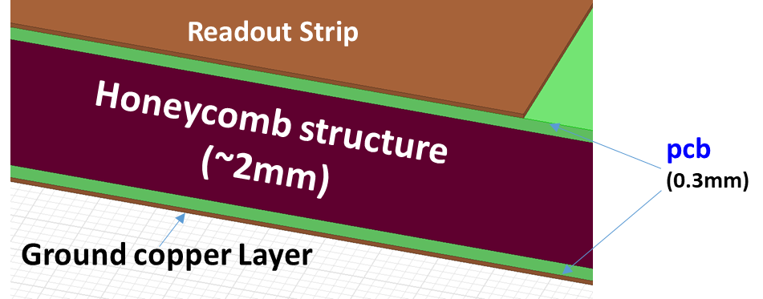
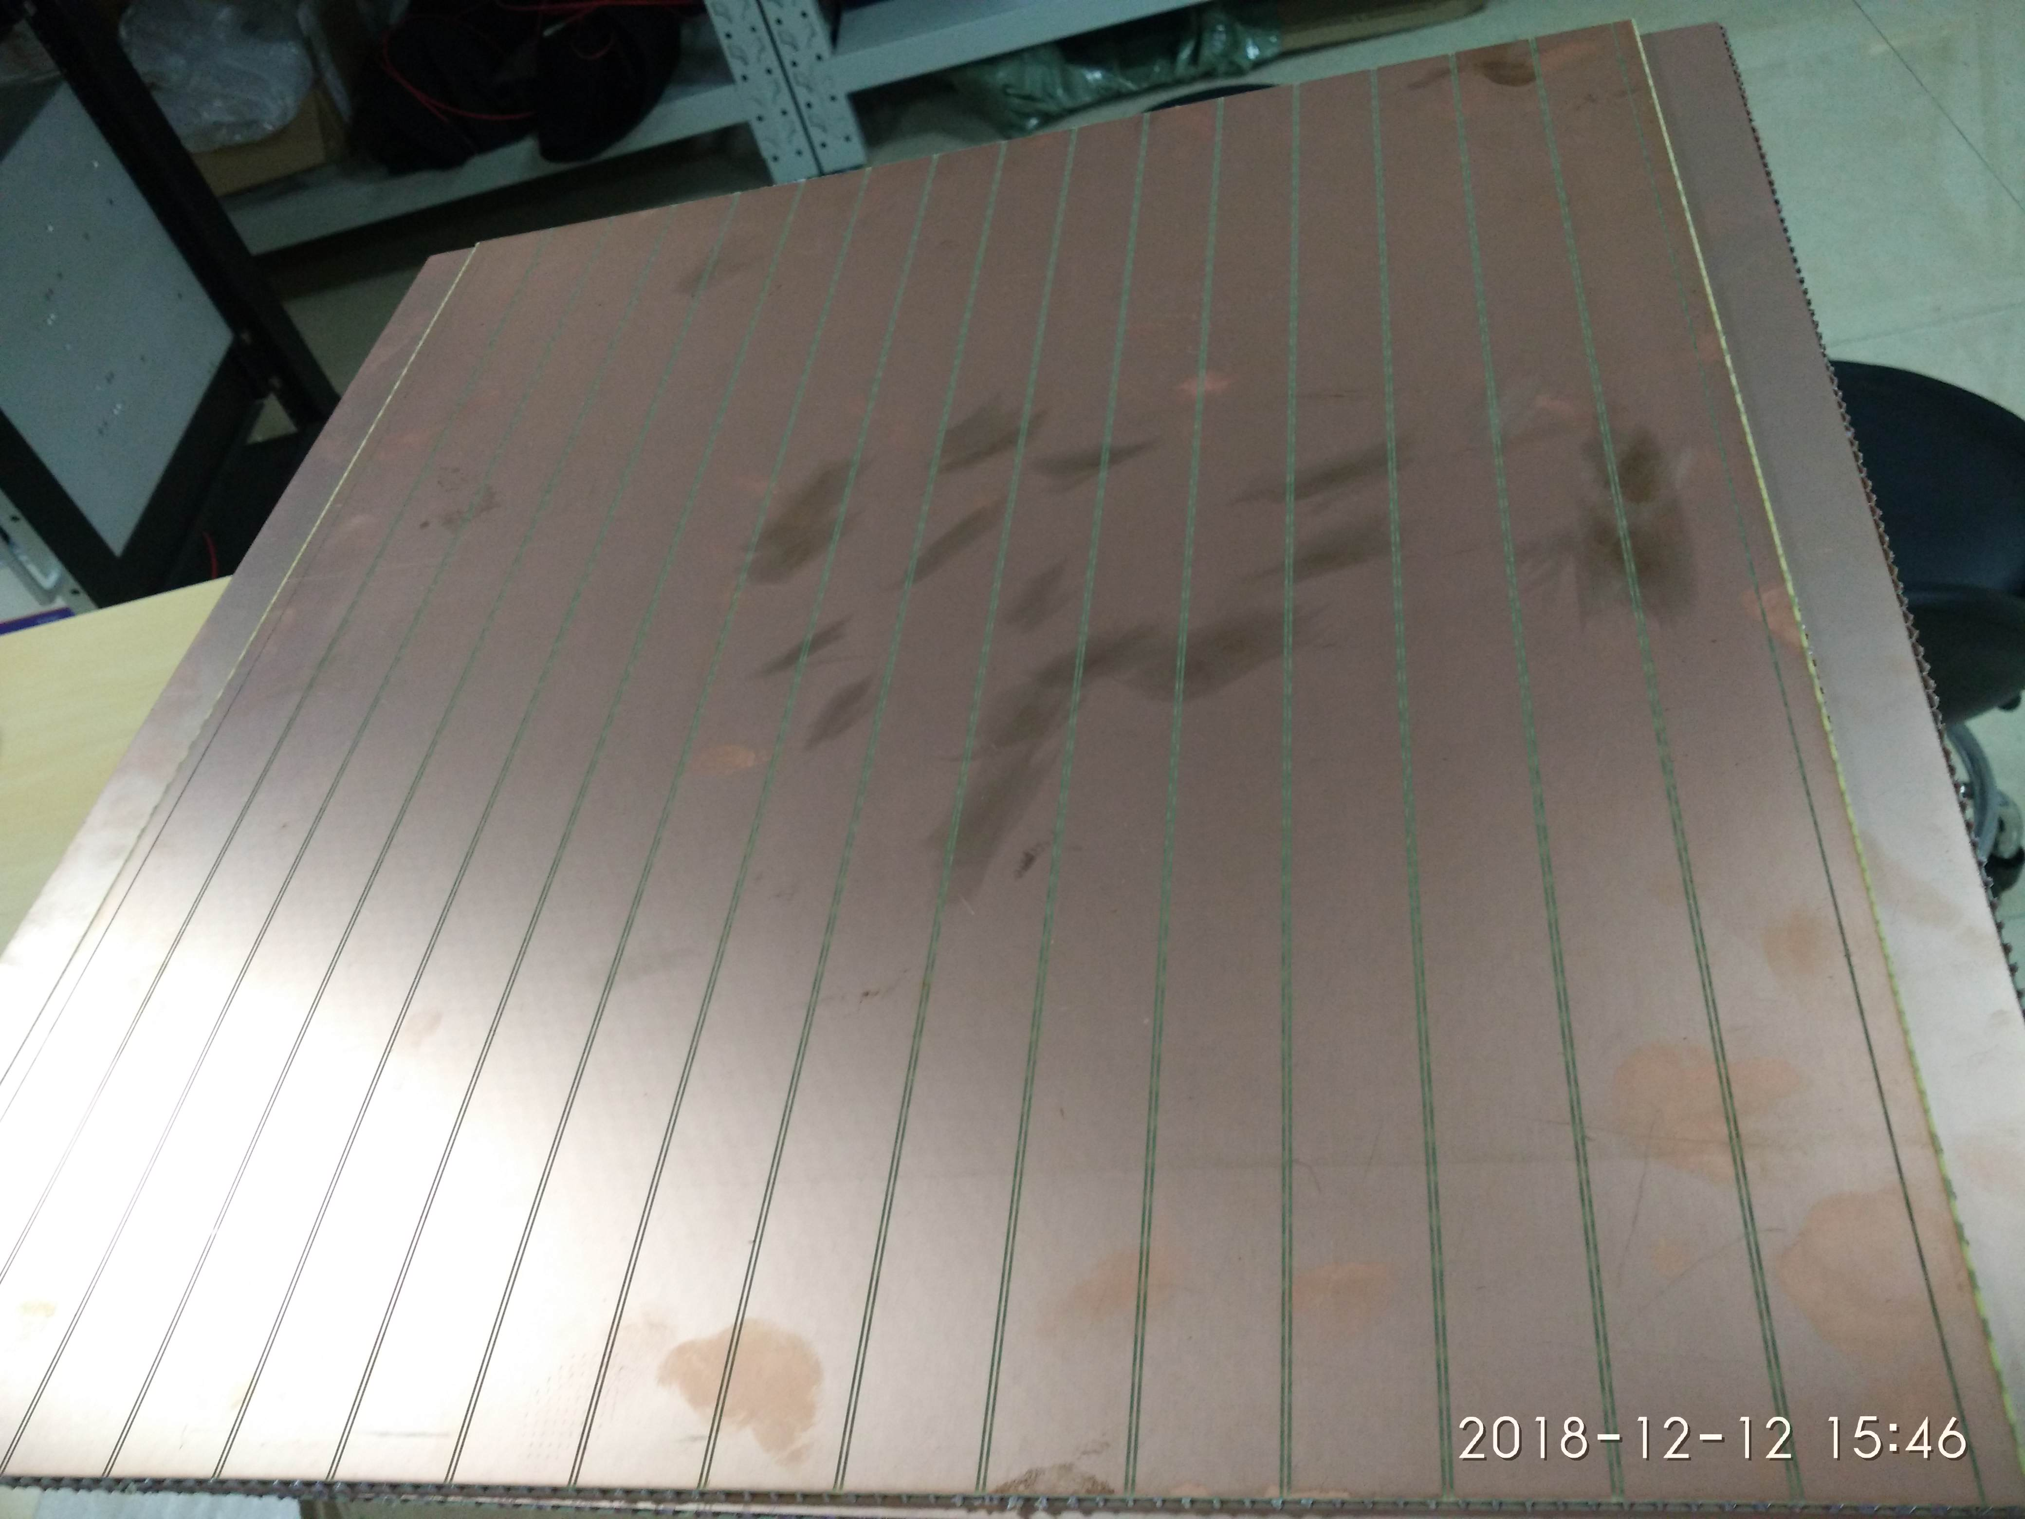
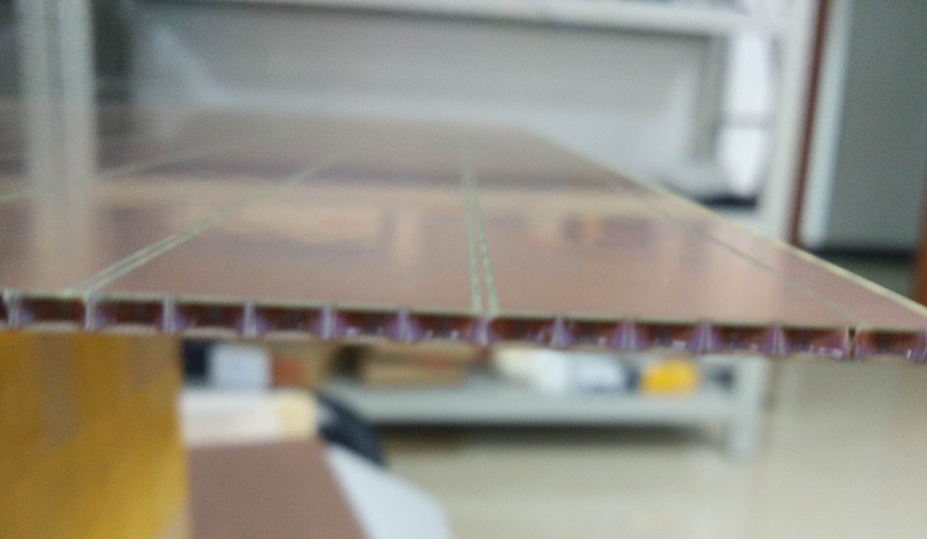
Honeycomb readout board
2 layers of PCB as readout strip and ground
~2 mm honeycomb plate as medium
Characteristic impedance: 18.5 ohm
Used in the two-end readout test

Slide 10
Two-end readout method
Current structure
Two readout layers in two directions, η & φ
Single-end readout on each layer.
Spatial resolution: strip pitch
Two-end readout:
One readout layer in one direction, φ
Φ position: time difference from two ends
Save electronics channels and space.
strips
honeycomb-board
RPC gas gap

Slide 11
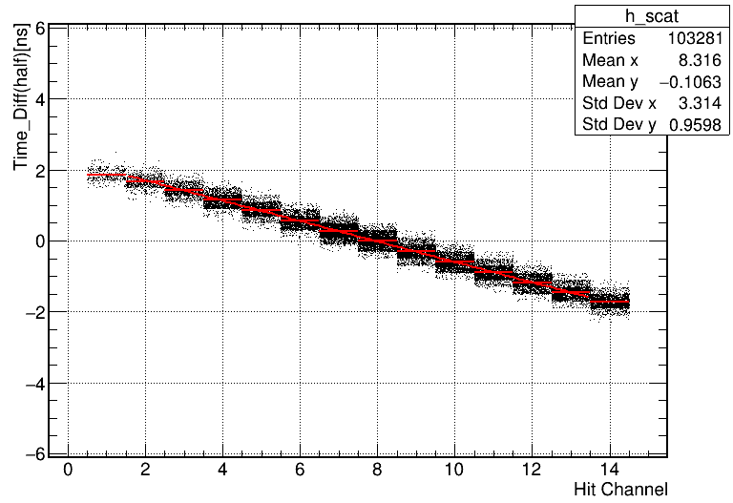
Signal speed along strip
Gas gap2 and readout panel2
Gap 2 and panel 2 is used to reconstruct the hit position with the fired strip.
Gap1 and panel 1, readout from two ends, the time difference (T_diff) is related to the hit position.
Very linear correlation observed between T_diff and hit channel.
The signal transmission speed achieved with the fitted slope.
Gas gap1 and readout panel1
8 channels
8 channels
16 channels readout
1/v = [slope=2.87ns]/(2.7cm*2)
= 53 ps/cm
Scintillator1
RPC1
RPC2
Trigger area:
40cm*20cm
Correlation between the reconstructed position
Scintillator2

Slide 12
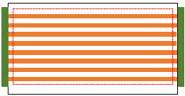
Spatial resolution measurement
Two honeycomb panels on two gas gaps
with two-end readout
Series4
Back End
Series2
V1742 digitizer
Muon
Scintillator1
Series 1 and 2
RPC1
Readout panel made by honeycomb
RPC2
Scintillator2
Gas gap
Series 3 and 4
Front End
Series3
Series1

Slide 13
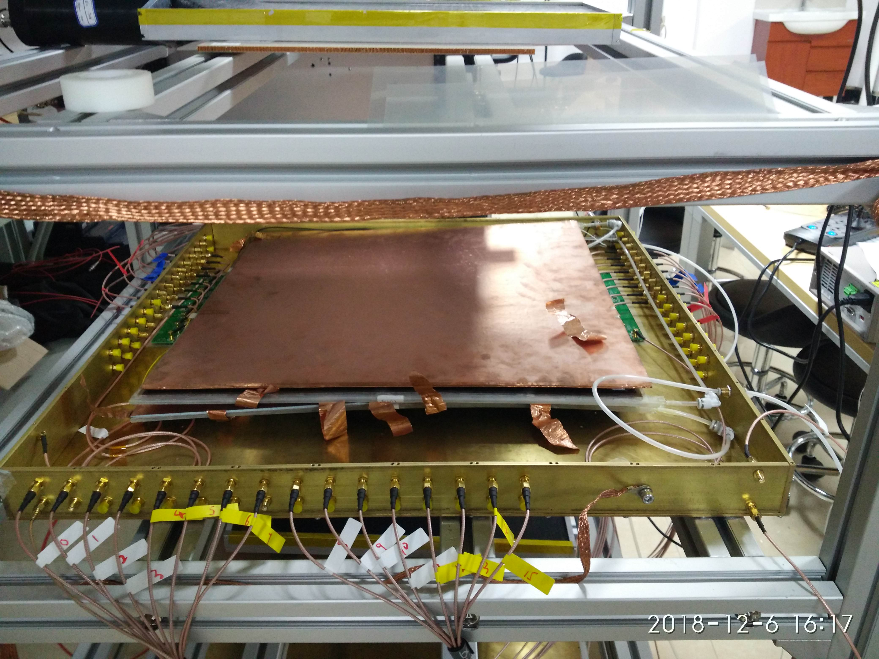
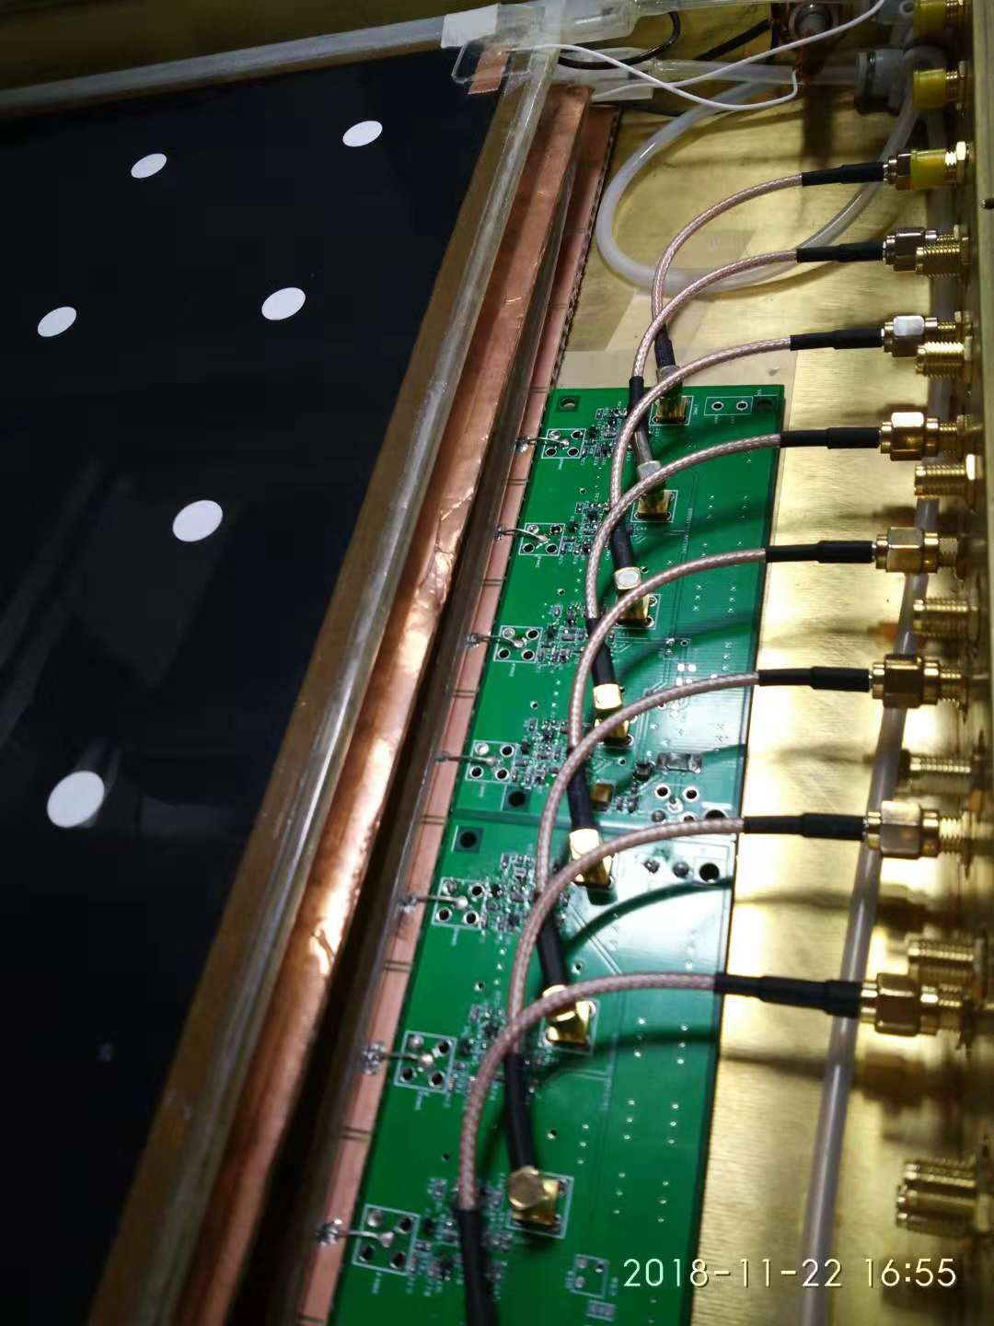
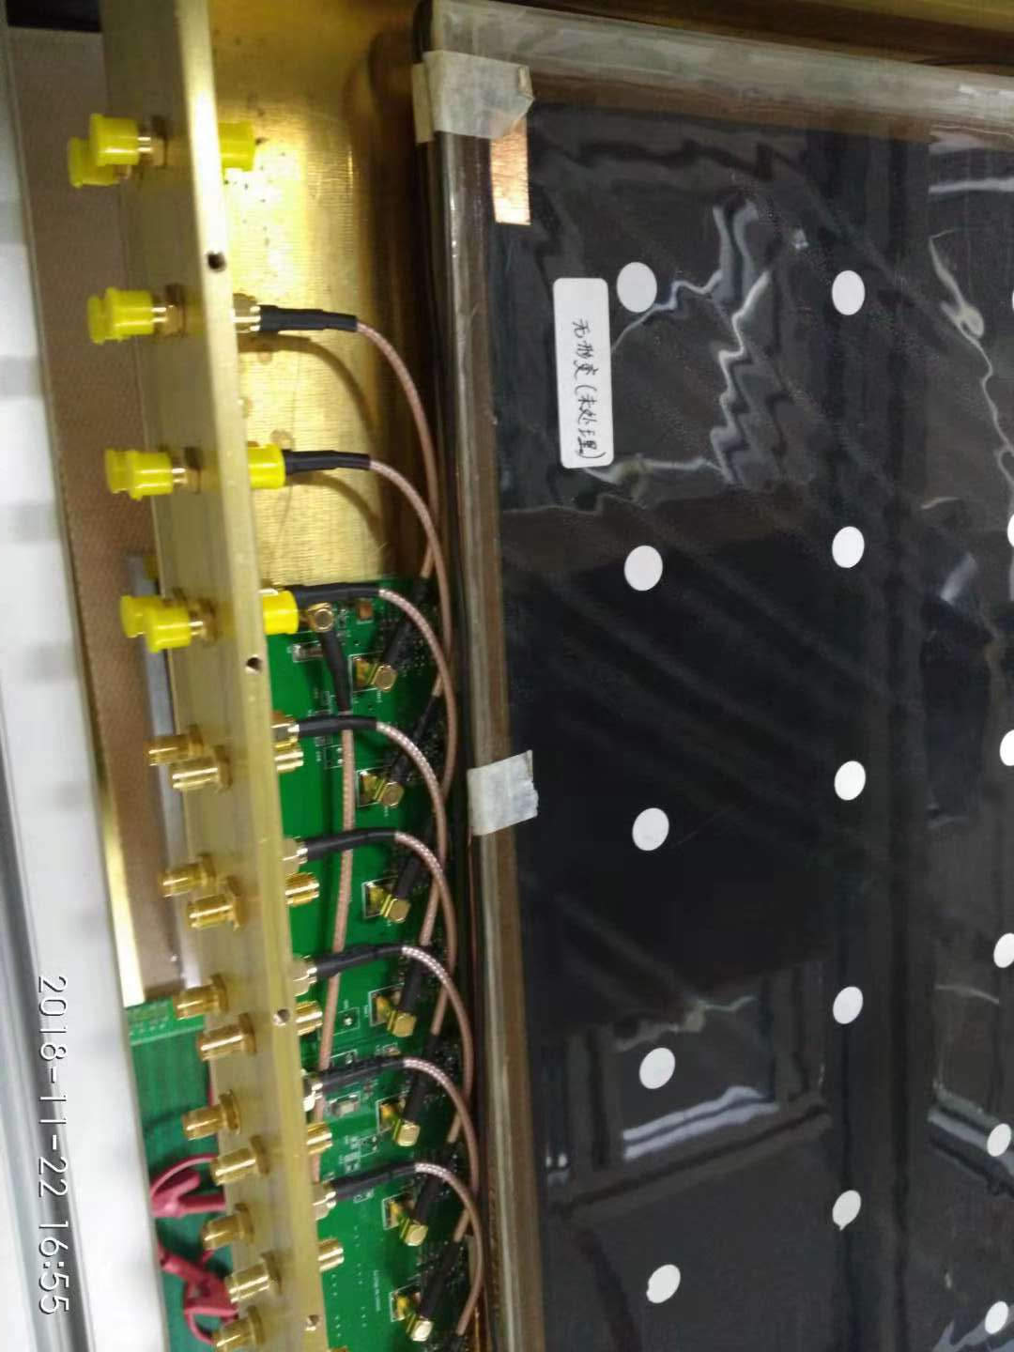
System setup
Back End
Front End

Slide 14
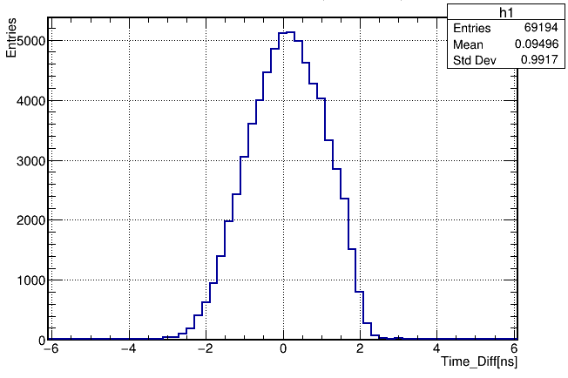
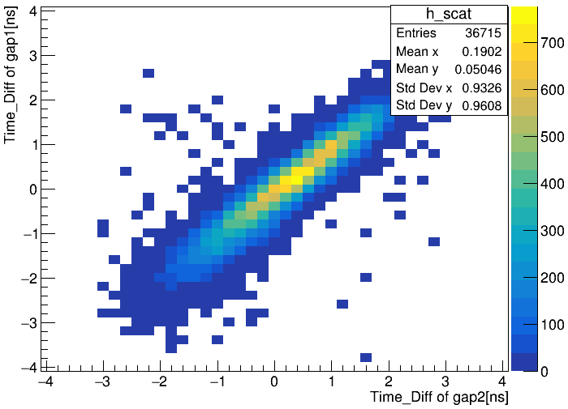
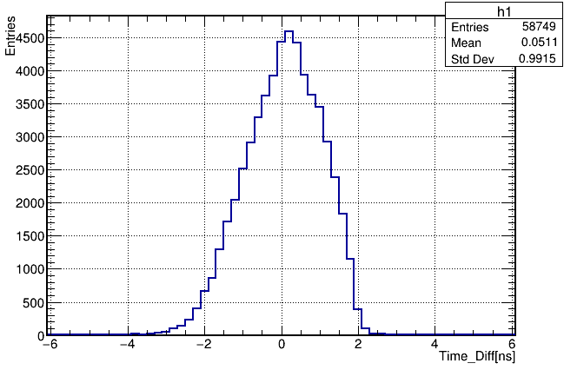
Reconstructed position
Gas gap1
Gas gap2
Red line:
40 cm trigger area.
Position correlation between 2 gas gaps

Slide 15
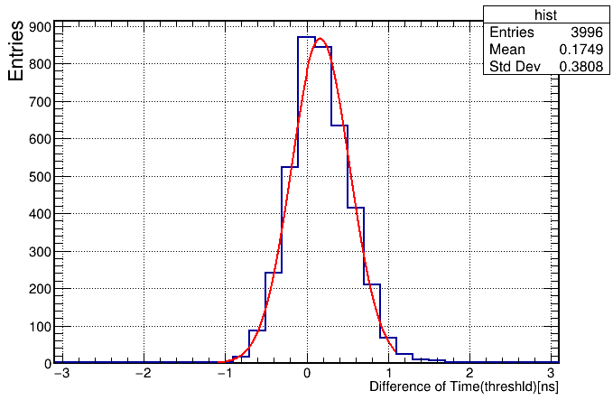
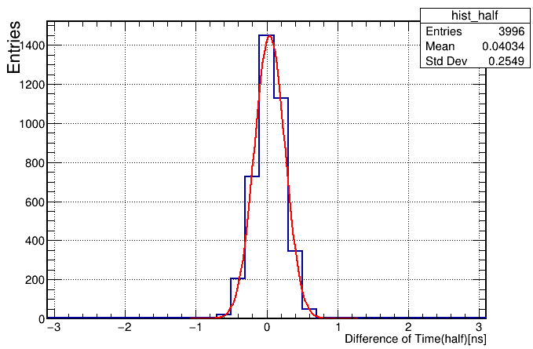

Spatial resolution
$$σ=\frac{σ_{DT_D}∙v}{2×\sqrt{2}}$$
v = 18.78 cm/ns
Difference of Time_Diff (cross threshold)[ns]
Difference of Time_Diff (half_peak)[ns]
NO. NAME VALUE ERROR
Constant 8.67033e+02 1.74151e+01
Mean 1.67119e-01 6.05049e-03
Sigma 3.58737e-01 4.55105e-03
NO. NAME VALUE ERROR
1 Constant 1.44985e+03 2.88736e+01
Mean 3.96725e-02 3.46177e-03
Sigma 2.15601e-01 2.56307e-03
Spatial resolution = 2.39 cm
Spatial resolution = 1.43 cm
Peak time: Spatial resolution: 1.74 cm

Slide 16
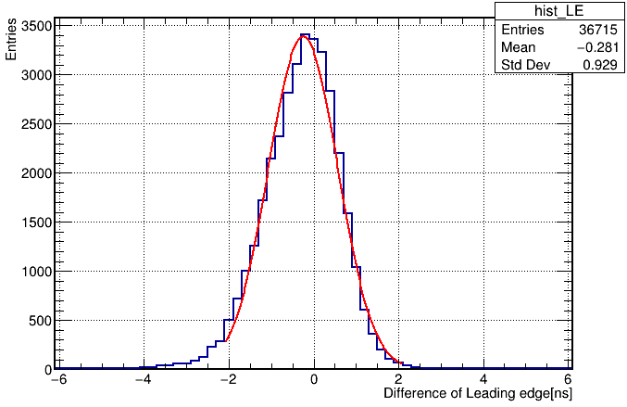
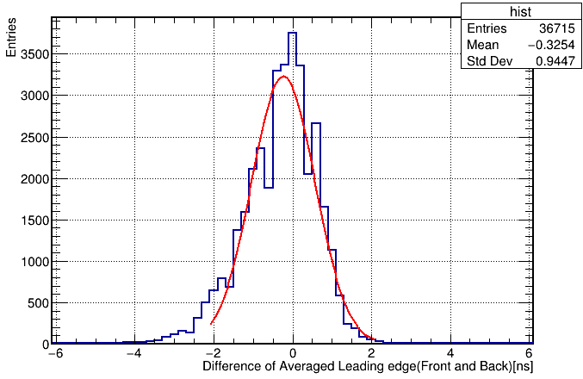
Time resolution
Distribution of difference of leading edge between the 2 gas gaps
Distribution of difference of averaged leading edge between front end and back end
Time of single end
Mean Time of two ends
NO. NAME VALUE ERROR
1 Constant 3.38852e+03 2.31866e+01
2 Mean -2.53700e-01 4.94975e-03
3 Sigma 8.18264e-01 3.82034e-03
NO. NAME VALUE ERROR
1 Constant 3.22816e+03 2.29162e+01
2 Mean -2.38151e-01 5.23308e-03
3 Sigma 8.05174e-01 3.90446e-03
Time resolution: 0.818ns/sqrt(2)=0.578ns
Time resolution: 0.805ns/sqrt(2)=0.569ns

Slide 17
Summary and outlook
The requirements of Phase-II RPC upgrade are clearly identified.
Simulation environment has been set up.
Honeycomb readout panel has been successfully built and it works properly.
Two-end readout method has been tested.
  Spatial resolution: 1-2 cm
  Time resolution: ~550 ps
Further optimization, test, analysis method will be performed continuously.
Thank you!

Slide 18
Backup

Slide 19
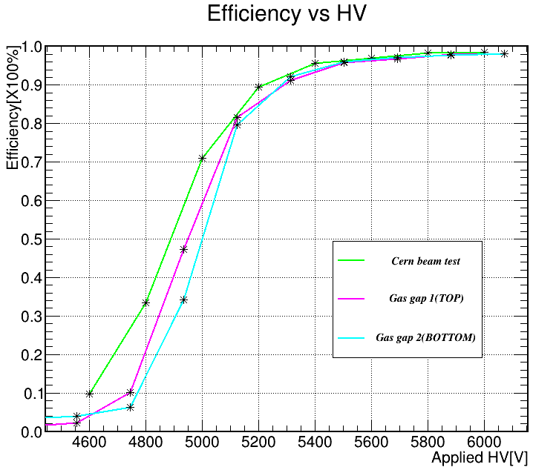
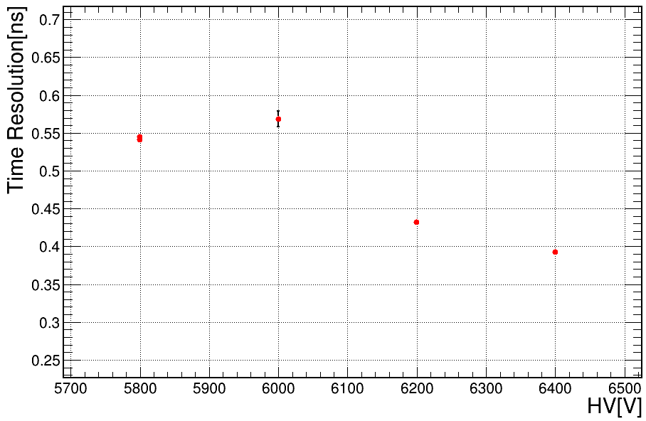
Compared with PCB readout panel
1
2
Time resolution of PCB readout panel.
Time resolution of honeycomb panel @6000V: ~570 ps
Efficiency plateau of PCB readout panel after applying the correction of air pressure
3
The characteristic impedance of PCB panel: ~14.4 ohm
The characteristic impedance of honeycomb: ~18.5 ohm
Efficiency of honeycomb panel @6000V: 97.68%

Slide 20
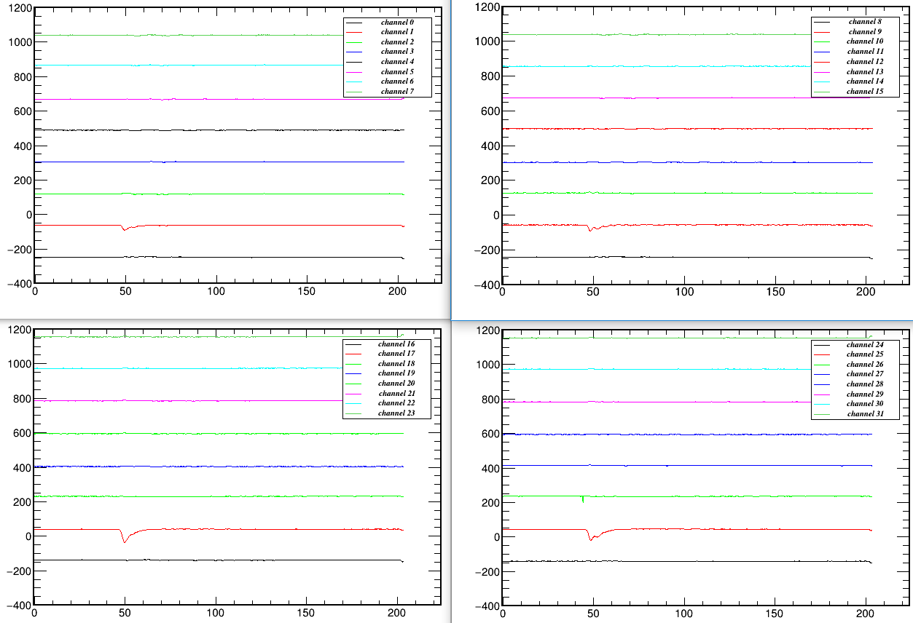
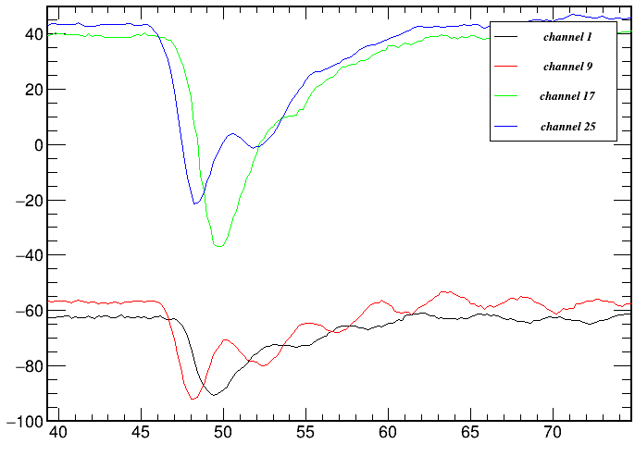
Typical signal waveform
Front end of gap 1
Back end of gap 1
Front end of gap 2
Back end of gap 2

Slide 21
Optimize timing in the waveform
Y axis:
Amplitude
Point 2 in waveform
The LSB of the digitizer is 200 ps
Fit the 2 nearby points linearly: Y = a*X + b
When Y=threshold, X is the optimized time.
Threshold
Point 1 in waveform
X axis:
Time
Optimized leading edge
200 ps

Slide 22
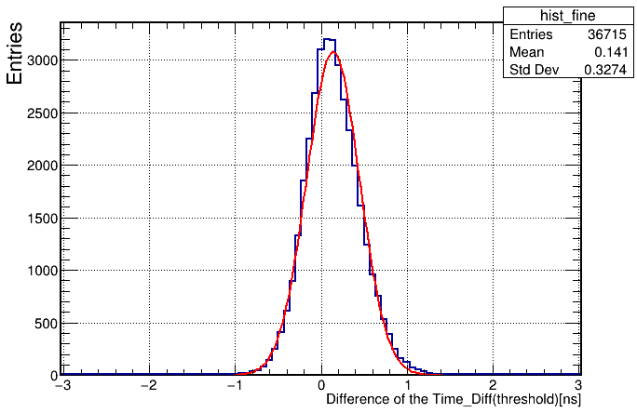
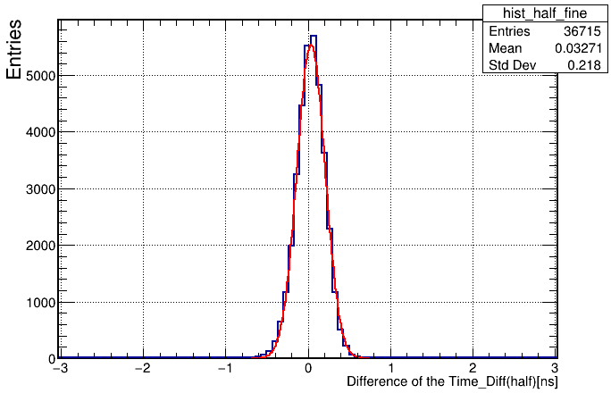
Spatial resolution (optimized timing)
NO. NAME VALUE ERROR
1 Constant 3.07766e+03 2.07736e+01
2 Mean 1.37971e-01 1.69424e-03
3 Sigma 3.09449e-01 1.30087e-03
NO. NAME VALUE ERROR
1 Constant 5.53964e+03 3.71053e+01
2 Mean 3.54555e-02 9.21285e-04
3 Sigma 1.71935e-01 7.07849e-04
Spatial resolution = 2.05 cm
Spatial resolution = 1.14 cm

