Slide 1
MUC will not change the angular distribution
Longzhou Liao, Changzheng Yuan

Slide 2
Introduction
From our analysis, We found that the MUC efficiency is not correctness with the MC simulation. And the MUC will lose parts of events information, which because of the MUC time window is too narrow (study by Guangyi Tang). For this reason, we can’t do correction to the MUC efficiency.
Deeply study, we found the MUC time window problem will lead to events lose randomly and not change the angular distribution. So we can still use the MUC information in some analysis.

Slide 3
Dimu chosen cut critrion
${|V}_{z}|$<10.0cm
$V_{r}$<1.0cm
Two charged tracks
Total charges = 0
EMC<0.4GeV
TOF |∆t|<3ns
$M_{μ^{+}μ^{−}}>4.0GeV/c^{2}$
We should make sure our chosen dimu events purity enough.

Slide 4
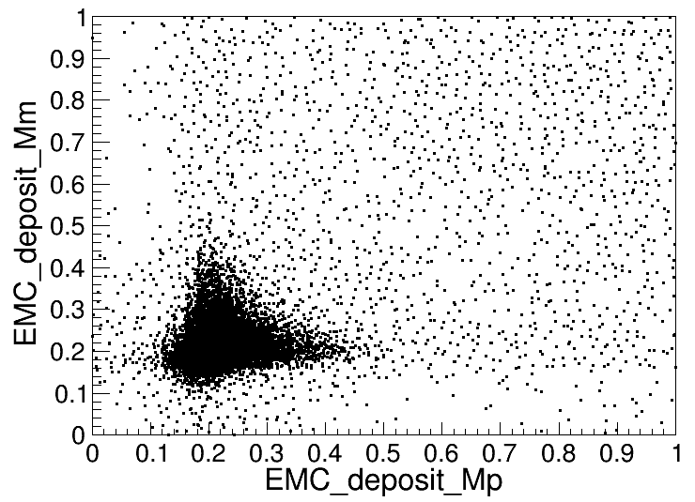
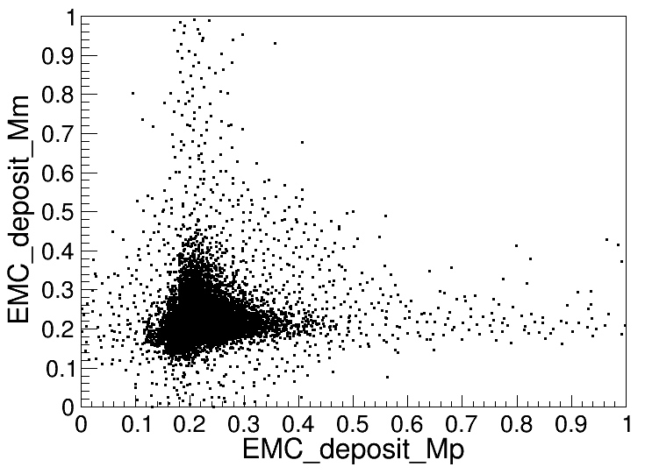
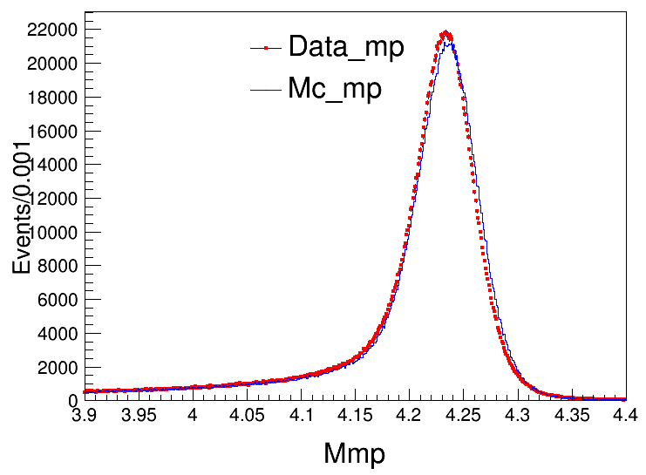
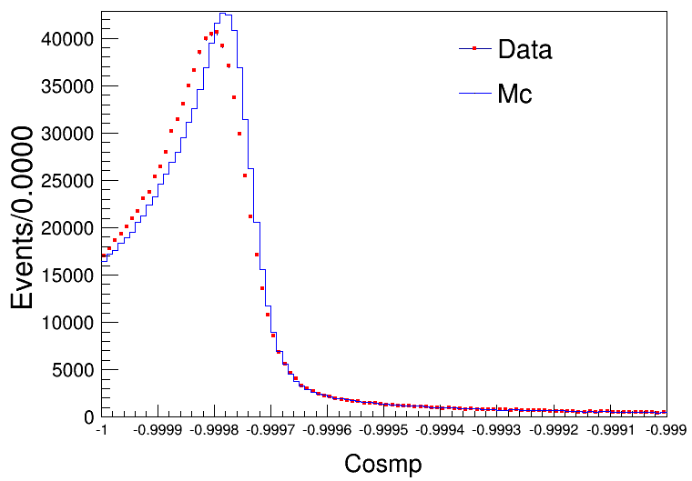
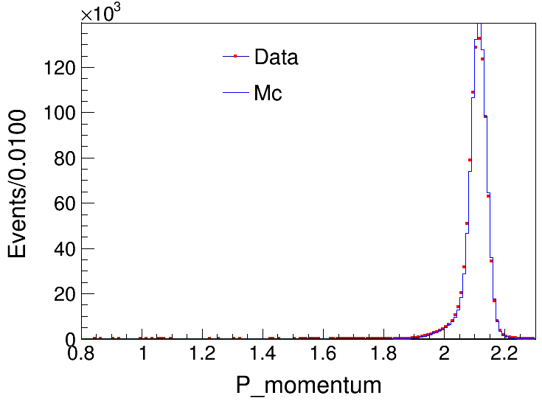
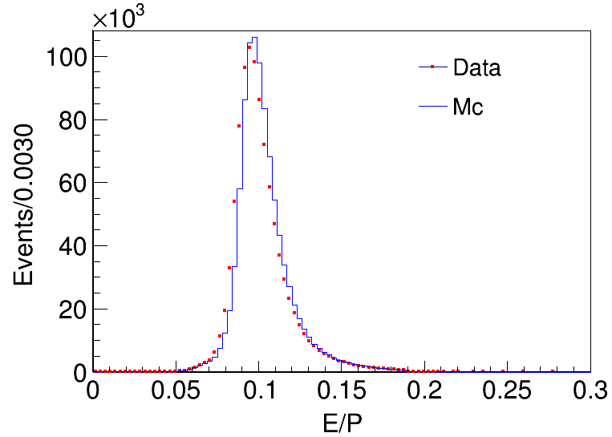
Dimu Events
(1)Data: Deposited energy in EMC
(2)MC: The muon deposited in EMC with MC simulation
(3)Invarant mass of Dimu $M_{μ^{+}μ^{−}}$
(4)The angle between $μ^{+}μ^{−}$
(5)The momentum of $μ^{+}μ^{−}$
(6)The deposited energy in EMC over momentum

Slide 5
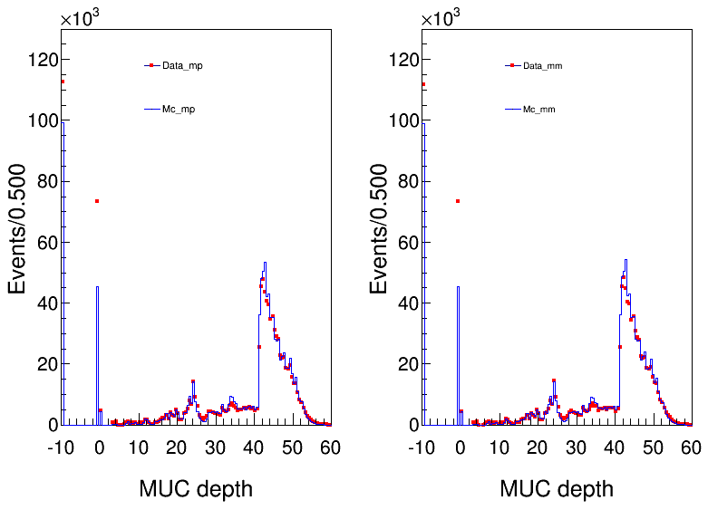
Depth information of MUC
Depth = -1 corresponding to those events with no MUC information.

Slide 6
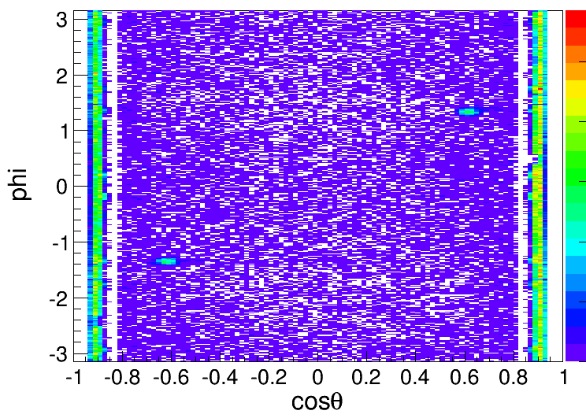
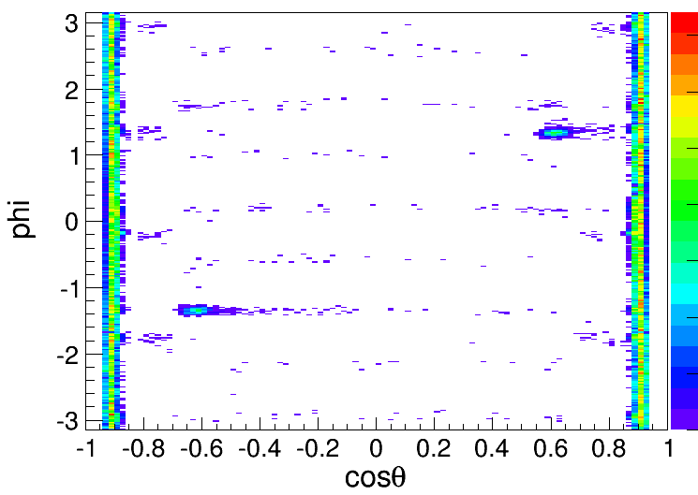
Angular distribution of Depth = -1 events
Because of the correlation of Dimu events, when one muon track’s position at the MUC hole, another track will be in the joint of two RPC.
MUC hole
RPC joint
Data: depth= -1:(cost , phi)
MC: depth =-1: (cost, phi)
From the plot, we can see clearly correlation of Dimu events with (cost, phi) distribution and that’s reasonable with two tracks have no information, but the background of data is not.

Slide 7
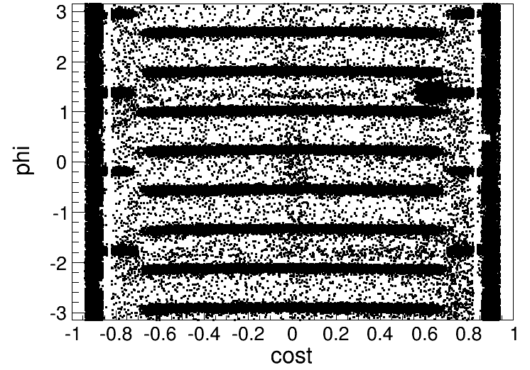
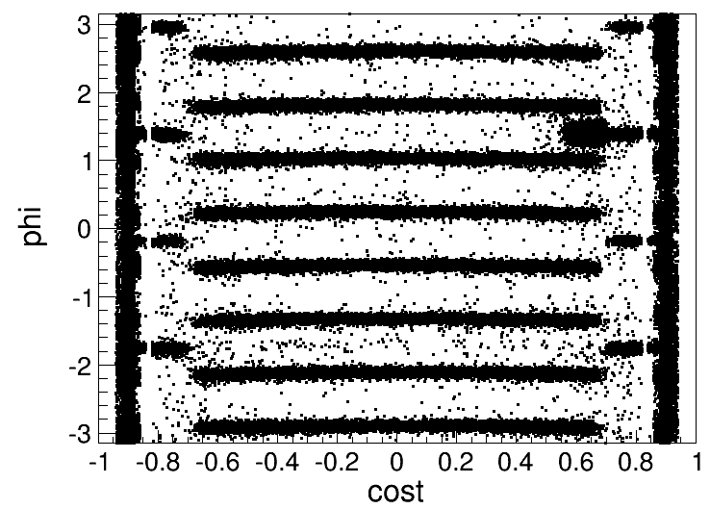
MUC RPC joints
Mc:
Data:
Depth_mp==-9.9
Depth_mp==-9.9
(pcost,PhiMp)
(pcost,PhiMp)

Slide 8
Reason for MUC losing events
From Guangyi Tang’s analysis, the time window of MUC is too narrow and lead to lose events randomly.
For this reason, different processes and different energy points may have the different lose ratio. And we can’t find a control sample to correct the efficiency of MC.
But from our analysis, the lost events will not change the angular distribution and it only has a constant factor with the total, and different processes and energy points the factor are different.

Slide 9
Losing ratio of Dimu events
 | 4180 | 4190 | 4200 | 4210 | 4220 | 4237 | 4246 | 4270 | 4280
N_losing | 213485 | 39145 | 39366 | 47019 | 64195 | 36902 | 37939 | 30660 | 19287
N_tot | 10198530 | 1668197 | 1673681 | 1558494 | 1642808 | 1689567 | 1710211 | 1679803 | 556254
Ratio | 2.09% | 2.35% | 2.35% | 3.02% | 3.91% | 2.18% | 2.22% | 1.83% | 3.47%
For calculate the losing ratio of Dimu events, we not subtract the MUC hole events and this part the MC has simulated. And require -0.8<Costheta<0.8, because out of this region the events with depth = -1.0 MC also has simulated and it has a big proportion.

Slide 10
The processes of dimu and pipijpsi
Depth | none | (20||20) | (20||15) | (15||20) | (15||15)
3686dimu_data | 4379313 | 3410800 | 3459273 | 3459826 | 3488793
3686dimu_mc | 705673 | 585668 | 595125 | 595290 | 600297
3686pipijpsi_data | 3345636 | 2651819 | 2690813 | 2690429 | 2717455
3686pipijpsi_mc | 392349 | 334477 | 339144 | 339021 | 342239
Ratio_dimu_data | 1.0 | 77.88% | 7899 | 7900 | 7966
Ratio_dimu_mc | 1.0 | 82.99% | 8433 | 8436 | 8436
Ratio_dimu | 1.0 | 1.0656 | 1.0676 | 1.0678 | 1.0589
Ratio_pipijpsi_data | 1.0 | 79.26% | 8043 | 8042 | 8122
Ratio_pipijpsi_mc | 1.0 | 85.25% | 8644 | 8641 | 8723
Ratio_pipijpsi | 1.0 | 1.0755 | 1.0747 | 1.0745 | 1.0739

Slide 11
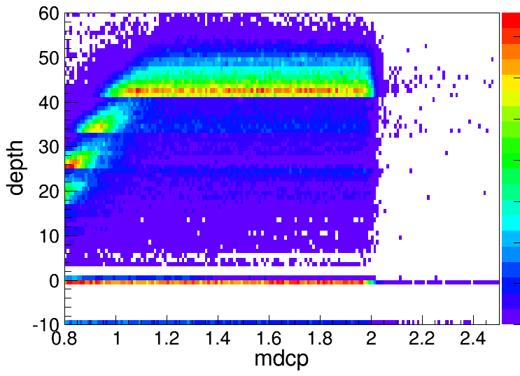
MUC depth distribution of momentum of muon
We use the momentum of singular muon from 0.8 GeV to 2.0 GeV to do simulation and get the distribution of MUC depth. We can see , when the momentum of muon is bigger than 1.0GeV, the depth distribution have no dependence on it.

Slide 12
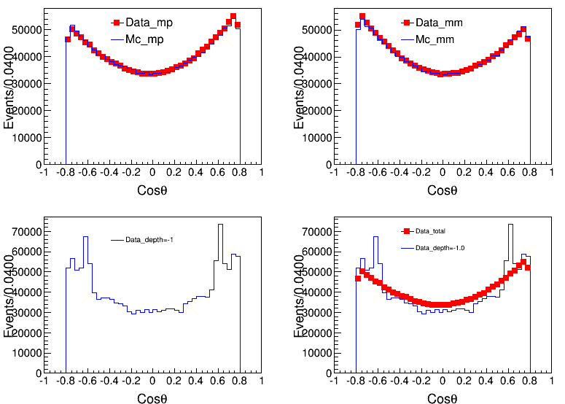
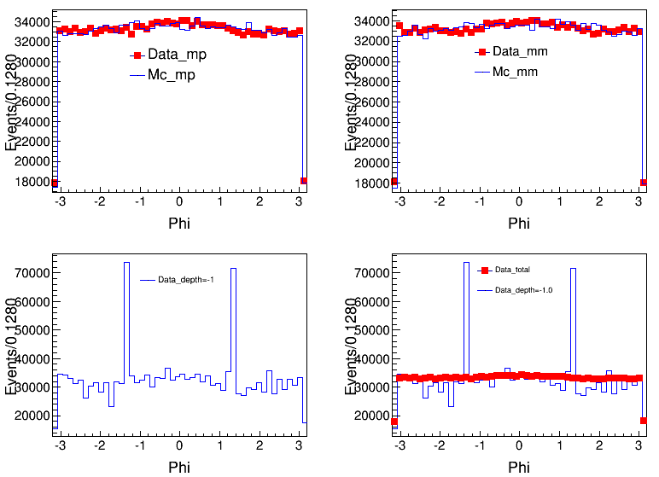
Angular distribution of Lost events
Total data and MC
Total data and MC
Depth=-1.0
Depth=-1.0
Dimu: cos(theta) of muon
Dimu:phi of muon
Losted vs Total

Slide 13
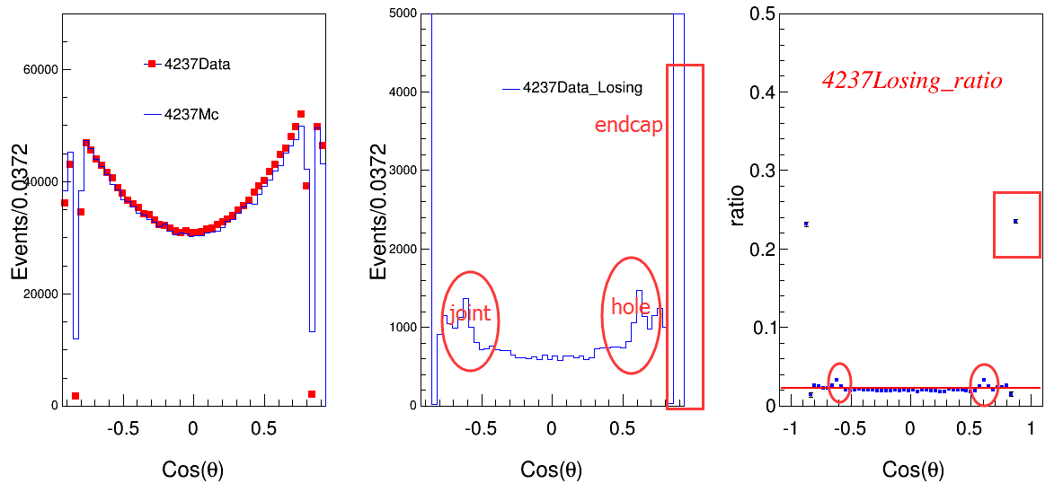
Angular distribution of Lost events
Depth=-1
Data
Mc

Slide 14
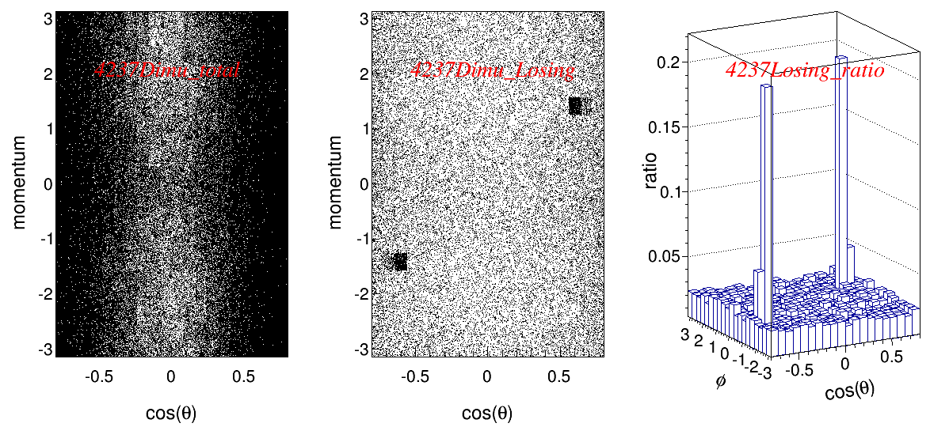
Ratio distribution of lost events

Slide 15
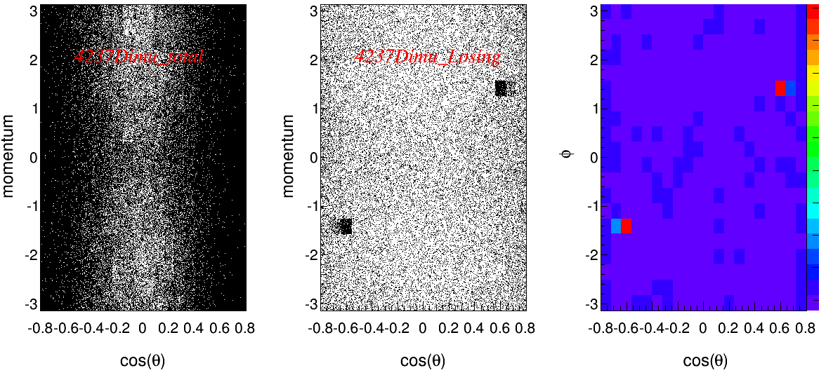
Ratio distribution of lost events

Slide 16
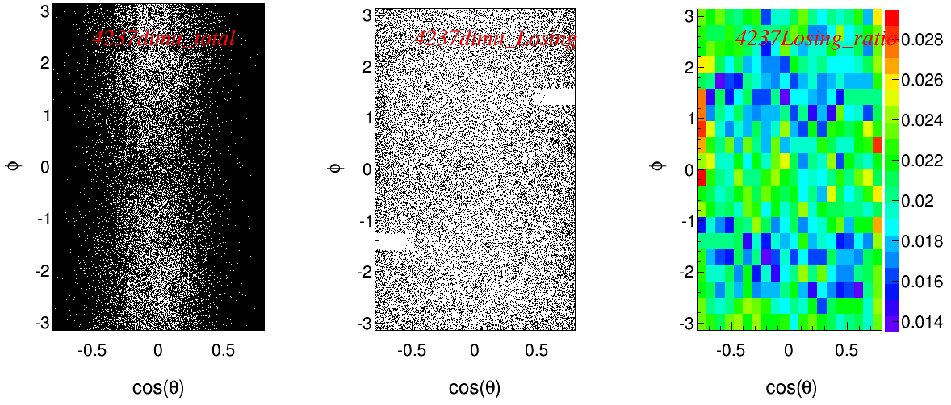
Ratio distribution of lost events
To eliminate the MUC hole’s influence, we take out these parts events.

Slide 17
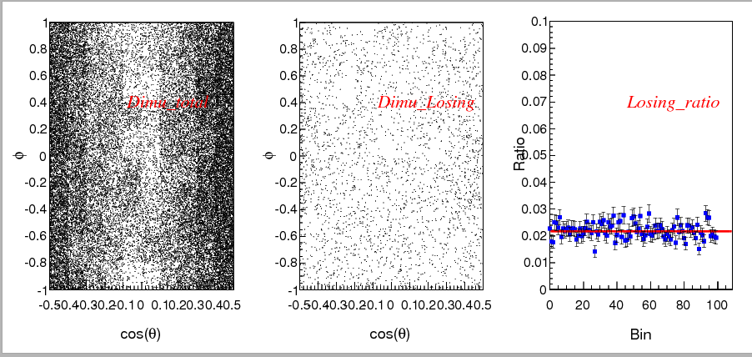
Ratio distribution of lost events
To eliminate the MUC hole’s influence, we chose the a region Costheta (-0.5, 0.5),Phi(-1.0, 1.0) and give the distribution of ratio from bin to bin.

Slide 18
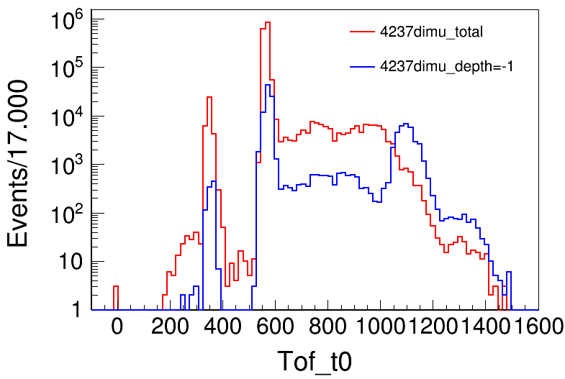
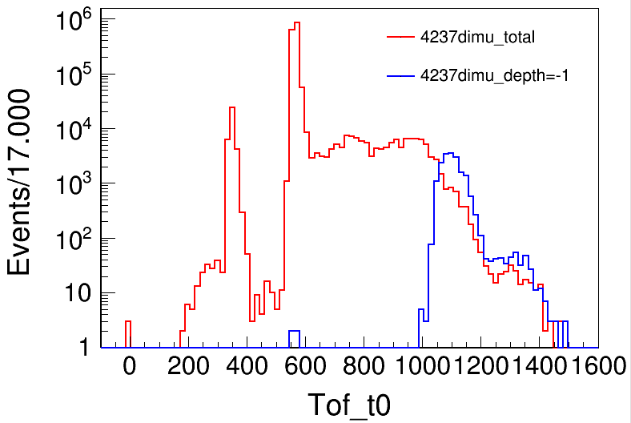
T0 distribution
4237dimu events
Depth=-1.0
Depth=-1.0
-0.5<costheta<0.5
T0>1000 response to the lost events

Slide 19
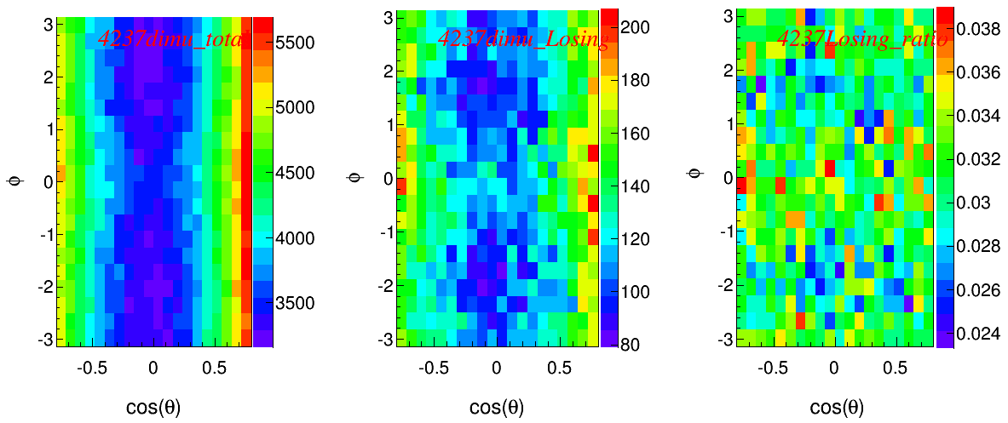
Ratio distribution of lost events
4237 dimu
By asking the T0>1000, we can also get the ratio distribution. But there are obviously structure on the plot.
We consider the influence of cosmic ray and we have using the pipijpsi process of 3686 data sample (12) to do the check.

Slide 20
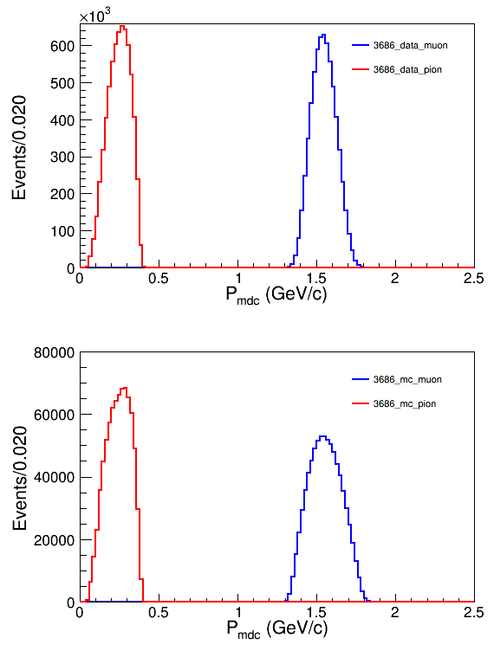
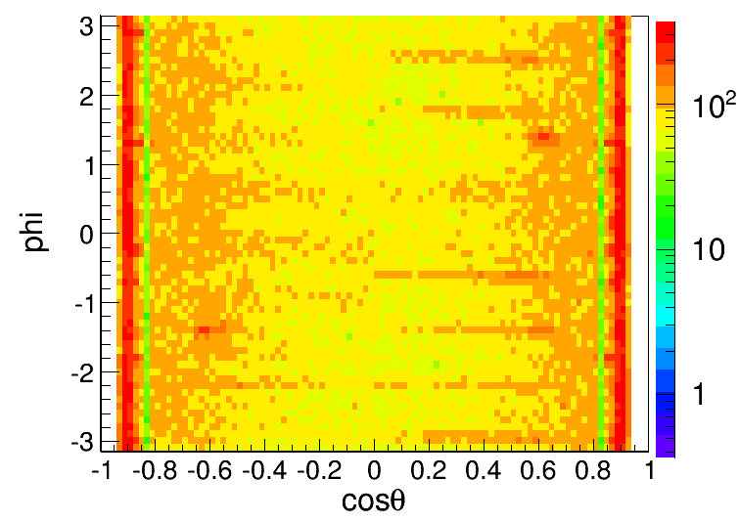
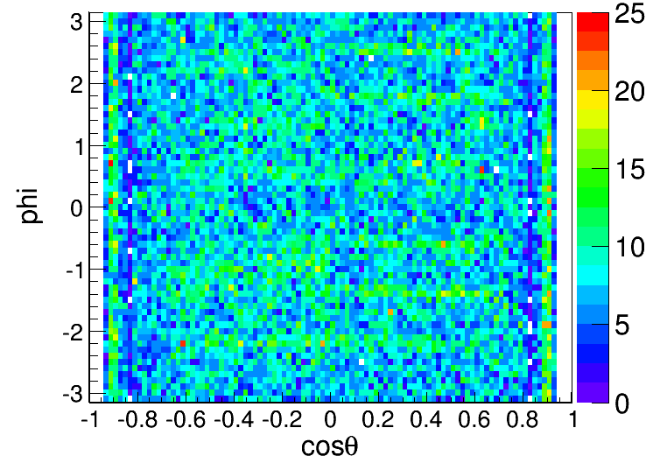
3686pipijpsi
MUC Depth =-1.0
Data
Mc

Slide 21
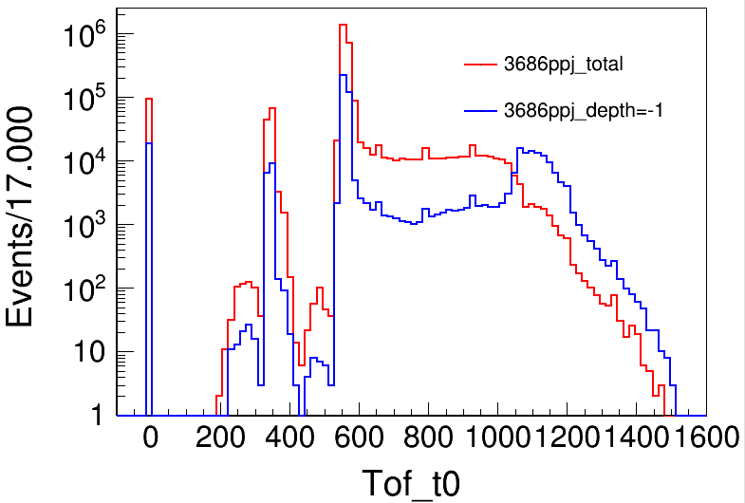
T0 distribution
3686 pipijpsi events
MC: MUC Depth =-1.0

Slide 22
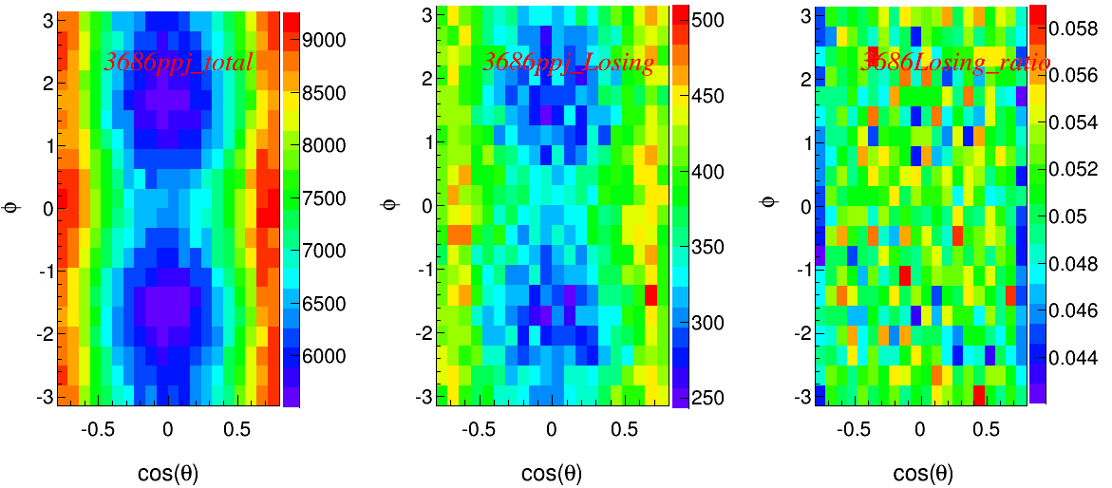
Ratio distribution of lost events
3686 pipijpsi T0>1000
There are still a structure on the plot, but not obviously. And this may have other hidden problem we not find.

Slide 23
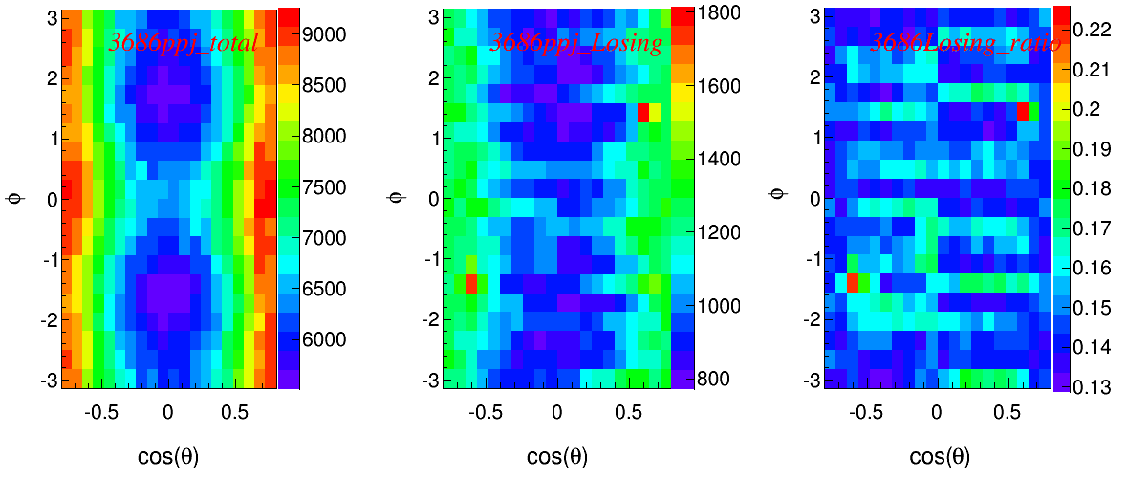
Ratio distribution of lost events
3686 pipijpsi with depth=-1.0 cut

Slide 24
Conclusion
From our analysis, in spite of the MUC lost part events angular distribution has fluctuation, but consider the ratio of lost events and the error of angular distribution, the influence can be ignored. And the MUC will not change the angular distribution.

Slide 25
Puzzle
4237dimu
3686pipijpsi(12)

Slide 26
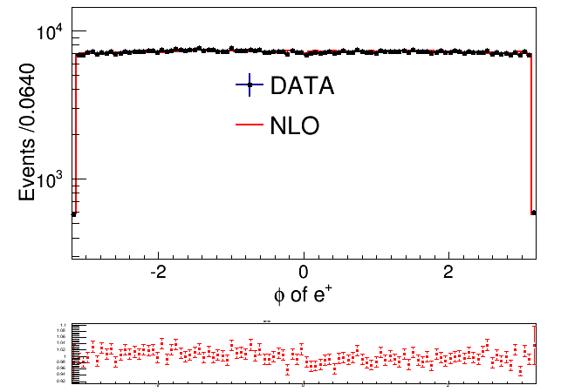
4237 Bhabha
Offered by Guangyi Tang

Slide 27
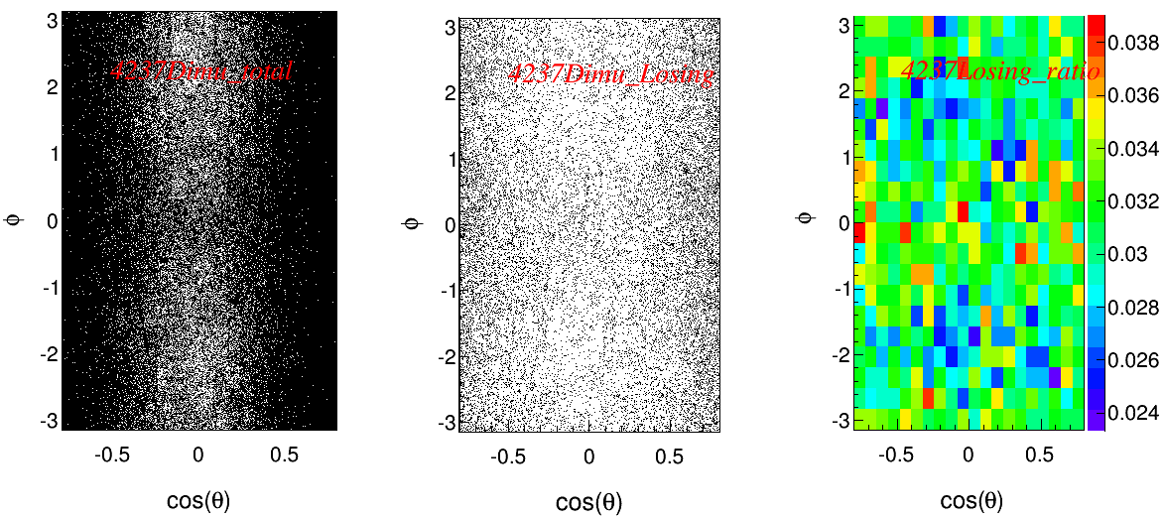

Slide 28
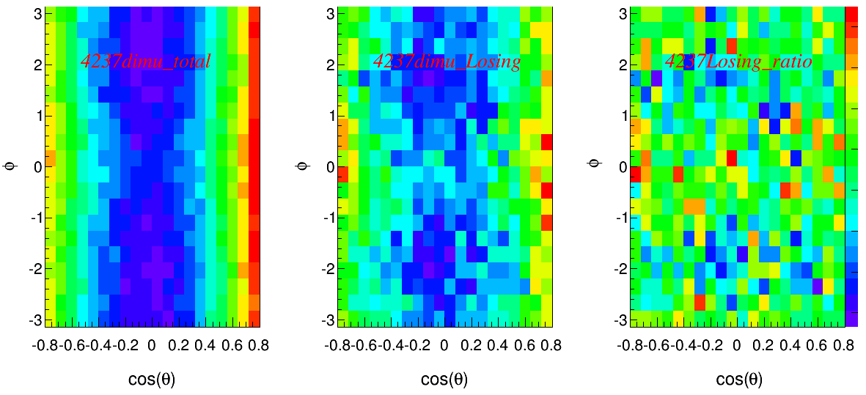
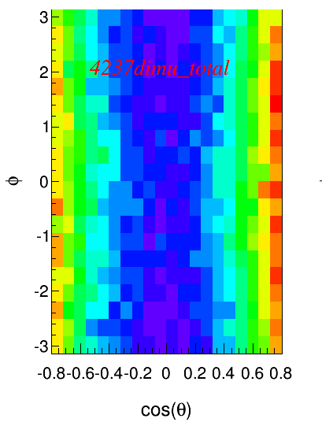
Data:4237dimu
Mc:4237dimu

Slide 29
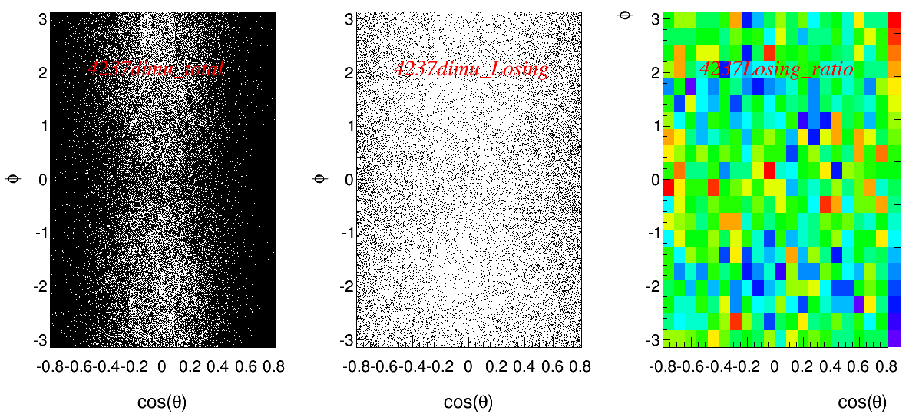
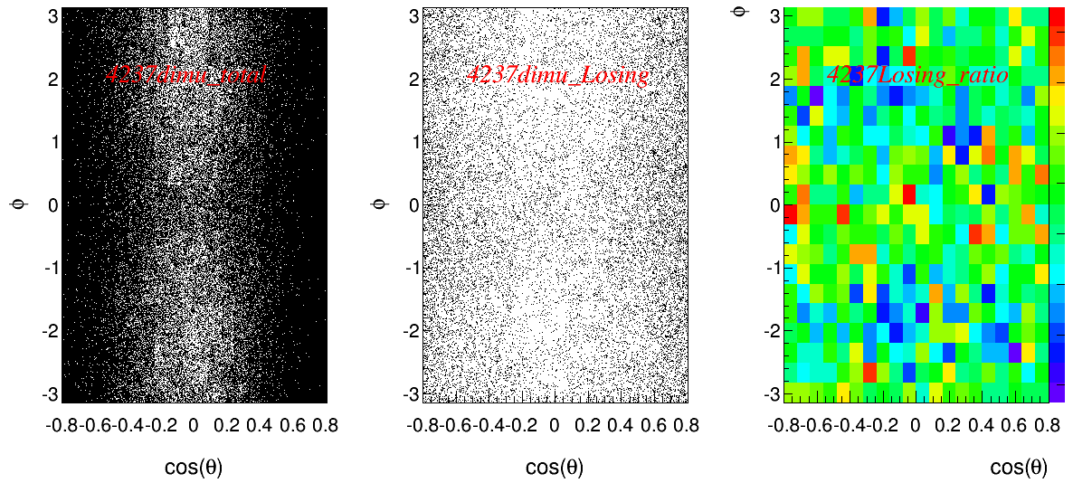
Delta t = 2
Delta t = 4

Slide 30
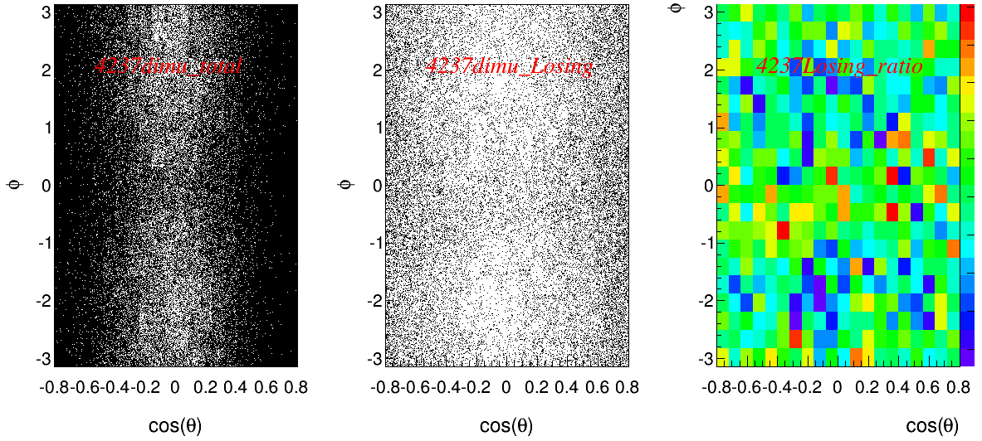
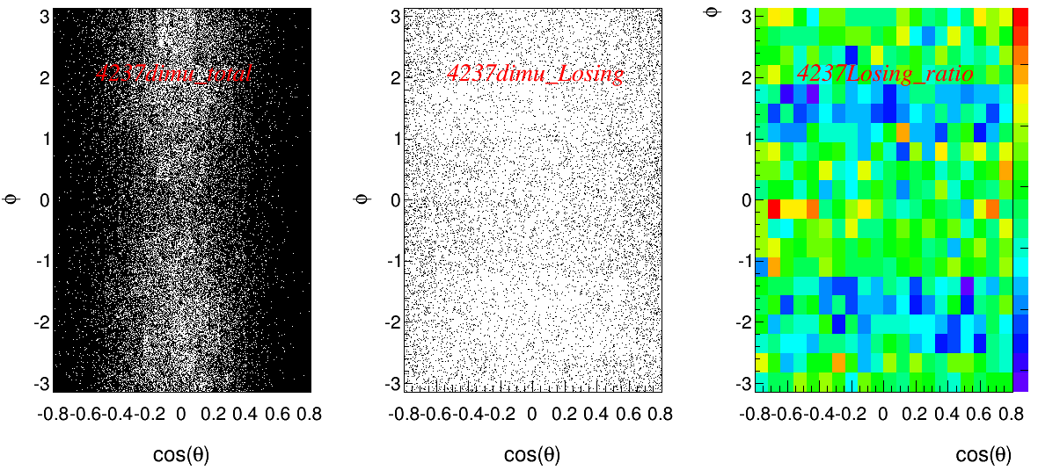
T0 =900
T0 =1000
T0 =1100

