Slide 1
Weekly Meeting Report
Maoqiang Jing
27/07/2018

Slide 2
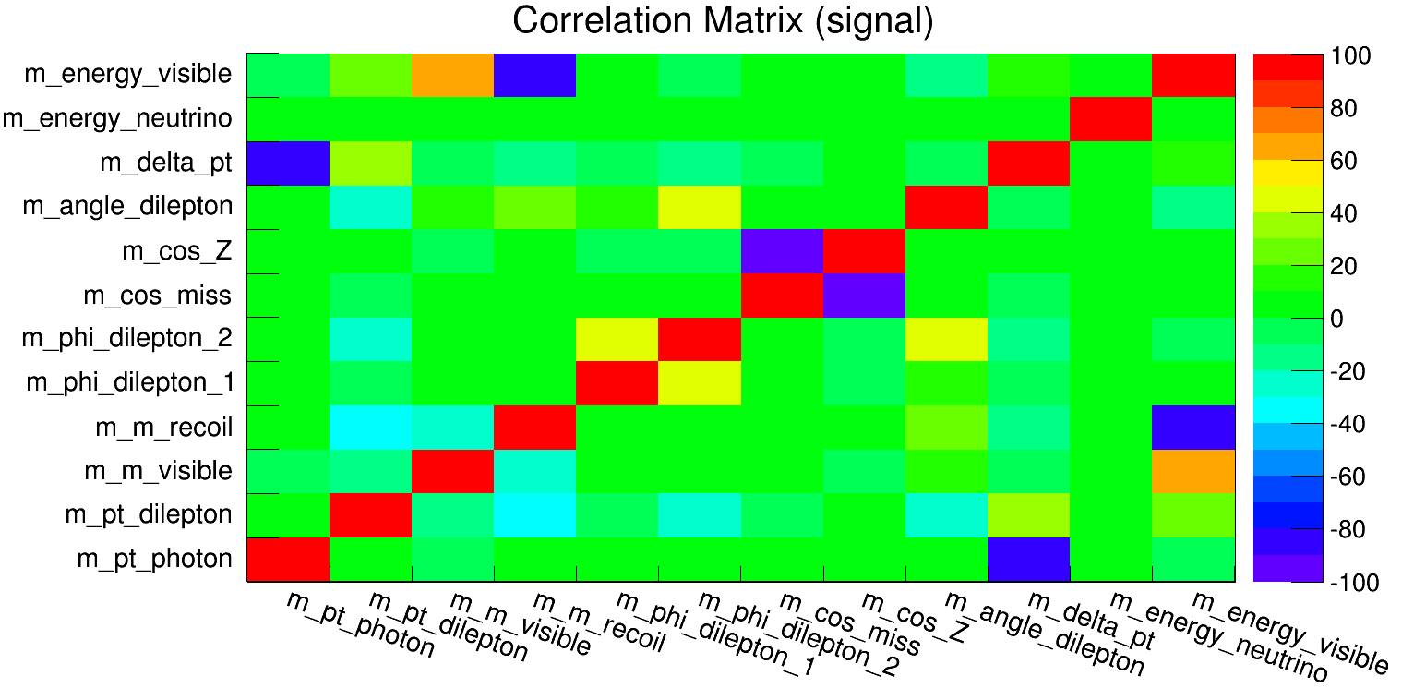
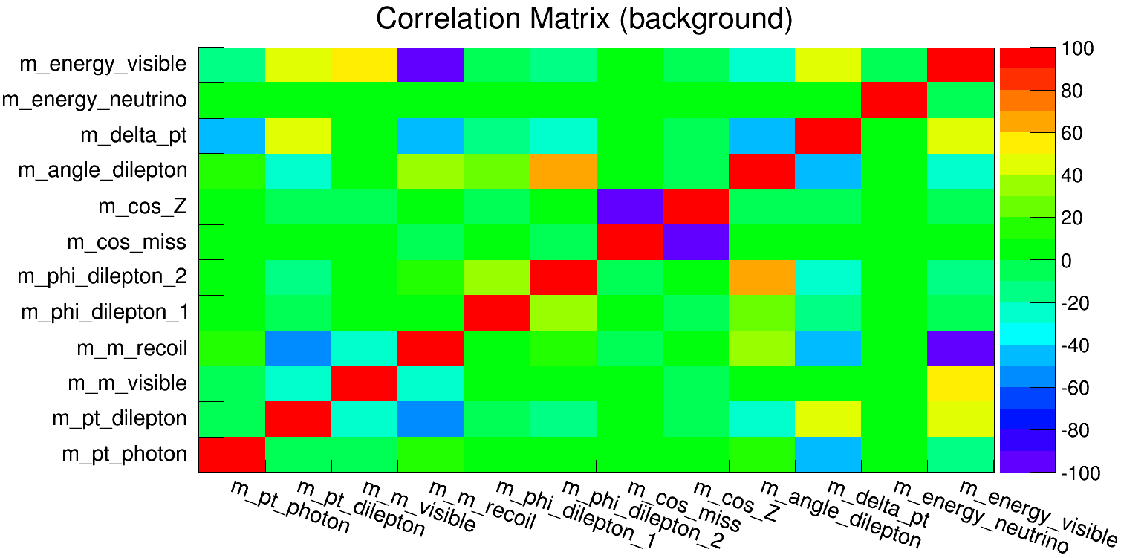
Run on 3T samples
Give a report in the Thursday Meeting
Get some feedback from Kaili:
The BDT correlation matrix has some variables that are too correlated(I have removed them and get a reasonable correlation matrix, but I didn’t see much improvement)
The calculation of signal weight might be wrong —> since the branch ratio of Higgs —> Invisible in SM is 0.106% rather than 0.106(but I don’t know why when he performed the calculation for me, he used 0.106 instead of 0.106%)

Slide 3
Run on 3T samples
Give a report in the Thursday Meeting
Get some feedback from Kaili:
3. Kaili thought that our calculation of branch ratio had some problems right now(I’ll ask him how to do that correctly this afternoon)
4. Because we don’t have all of the background samples, how can we estimate the contribution of the missing ones(ask him this afternoon)
Plans on qq channel
With the help of Ryuta, I have known how to deal with qq channel, but due to the hot weather holiday, I might start this work after that

