Slide 1
Select detector geometry by using DetVerSvc package
Long Peixun
2018.7.5

Slide 2
Outline
Using Run Number Directly
About DetVerSvc
Using DetVerSvc
Discuss next step of BesVis

Slide 3
Using Run Number Directly
Build a list to record geometry files and run number.
When load an event file, BesVis gets Run Number and look up the list to find a suitable geometry file.
Disadvantages:
It is not in accord with other software package in BOSS.

Slide 4
About DetVerSvc
Utilities/DetVerSvc is a software package for identifying the detector geometry phase by run number.
0 – old detector
1 – remove 4 scintillators and add 2 MRPC modules
2 – TOF is replaced by MRPC
……
DetVerSvc/share/config.txt
DetVerSvc converts run number to phrase by looking up this file.
This package existed in 7.0.0 firstly, so CgemBOSS 6.6.5.b doesn’t contain this package. In CgemBOSS 6.6.5.b, BesVis uses Run Number directly to choose geometry.

Slide 5
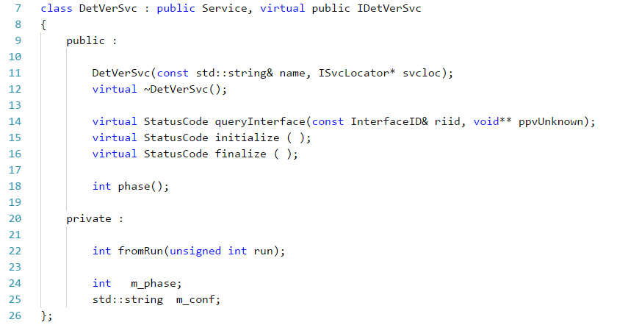
About DetVerSvc
class DetVerSvc
This function can be used for getting phrase from run number

Slide 6
Using DetVerSvc
DetVerSvc is designed for BOSS jobs, but the software structure is not suitable for BesVis.
DetVerSvc uses jobOption to input information, but BesVis calls DetVerSvc directly.
DetVerSvc/share/joboptions_DetVerSvc.txt
Function fromRun() is private, but BesVis needs to call it.
So we need to modify DetVerSvc to adapt to BesVis as well as other software packages which use it.

Slide 7
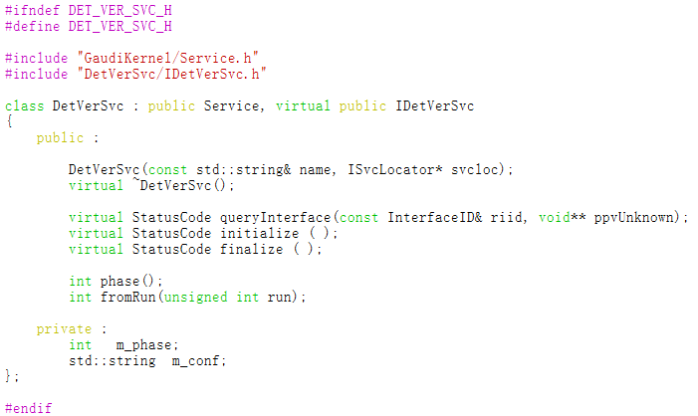
Using DetVerSvc
1. Change fromRun() function to be public.

Slide 8
Using DetVerSvc
2. Initialize variable of config file without jobOption.

Slide 9
Using DetVerSvc
3. In order to use DetVerSvc, the list in BesVis should be modified – the second column need to be changed from Run Number to Phase.

