Slide 1
Progress of Full Silicon Tracker Option for CDR
Weiming Yao (LBNL) and Chengdong Fu (IHEP)
2018-7-17

Slide 2
General Issues to fix
update once the rules and the names are ready
baseline tracker name in both text and figures
if no, use Si&TPC option? same as other sections
full silicon tracker name
FS1 option, FS2 option (SiF1, SiF2), (FST1,FST2)
Remove ILD
Remove introduction to the beginning of Chapter 4
How?
Change “design” to “layout option”
Change “optimization” to “validation”
Correct the citation
At the same time, the tracker layout can be optimized to further based a better software.

Slide 3
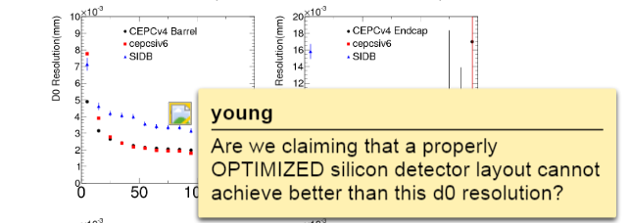
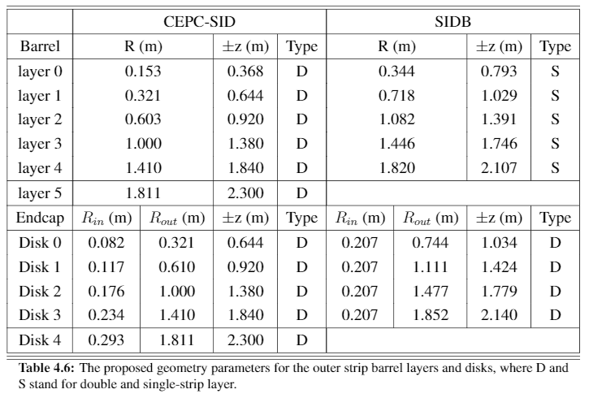
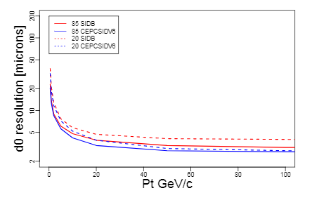
Two layout options
replacing TPC with extra silicon strip barrel and disks (Weiming)
CEPCSID→FS1
expanding the SID design to full tracking volume (Sergei+Argonne)
SIDB→FS2
cite SID?
Keep two layout options?

Slide 4
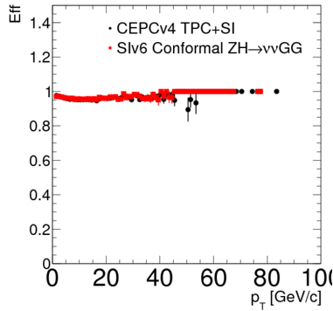
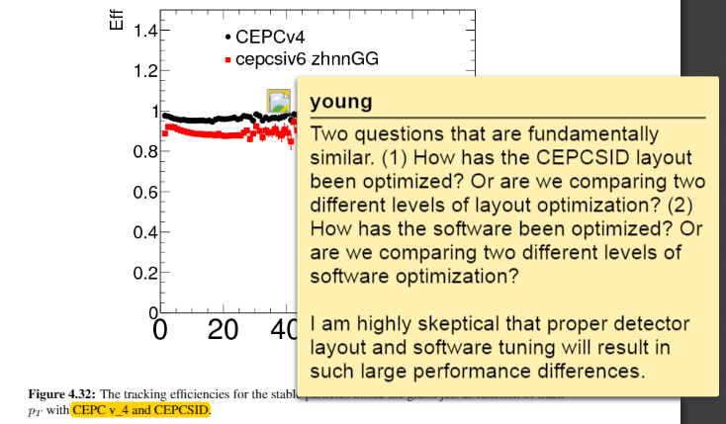
Software update for FS1
Tracking algorithm
ConformalTracking improve the efficiency.
Add description for ConformalTracking
Corresponding update

Slide 5
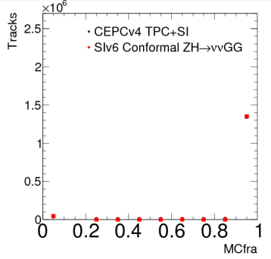
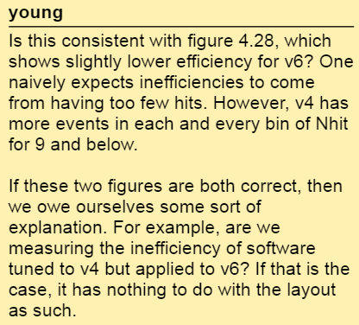
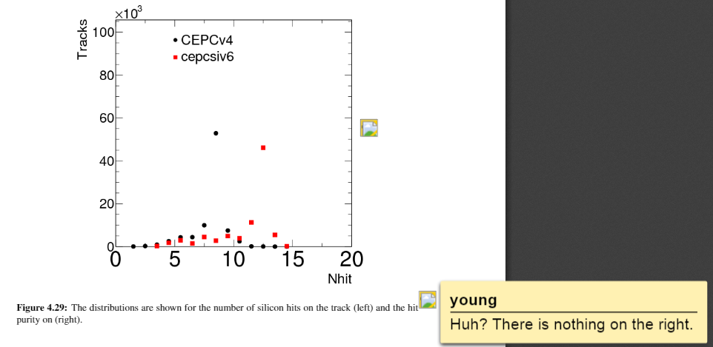
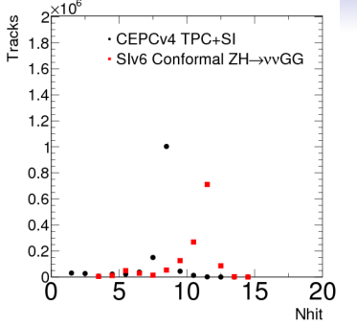
Hits number in silicon layers
Different layer number
Consider to remove

Slide 6
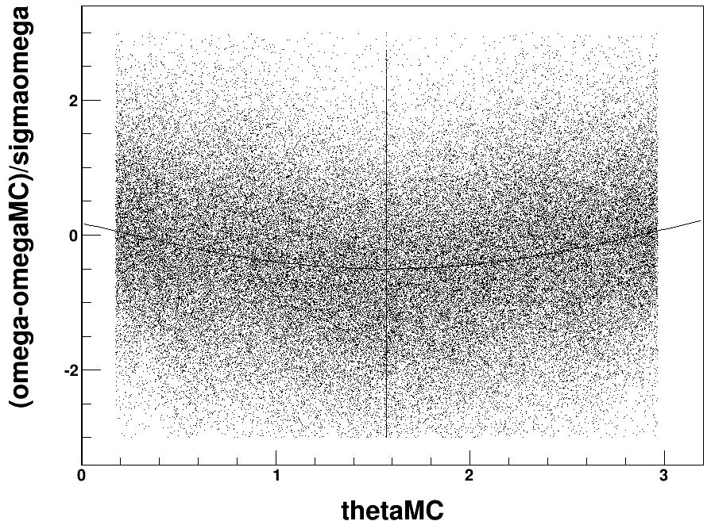
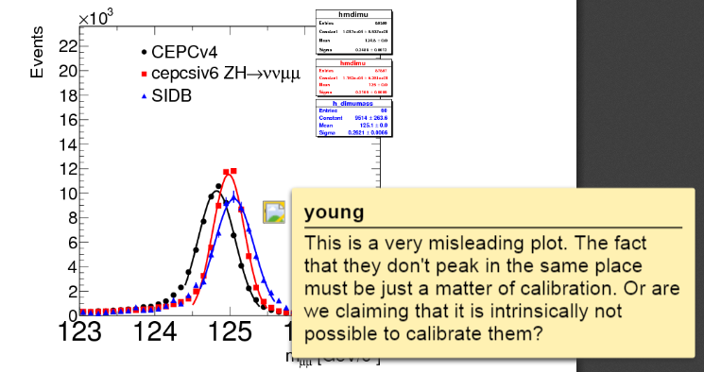
Correction for momentum
The mass shift is caused by the software between simulation and reconstruction, not hardware. A correction is quick choice while the software can not be updated in time.
Correction on omega
The figure will be redrawed by Weiming. If the correction does not work, consider to remove the comparison and keep full silicon tracker options only.

