Slide 1
Dominant Decay Channel of Higgs Particle Observed at ATLAS
Zhijun Liang （梁志均）
Institute of High Energy Physics ,
Chinese Academy of Science

Slide 2
Outline
Introduction to Higgs physics
Introduction to ATLAS experiment
Search for H→bb mode (Dominant Decay Channel)
VBF H→bb analysis
VH(→bb)
H→bb Comination

Slide 3
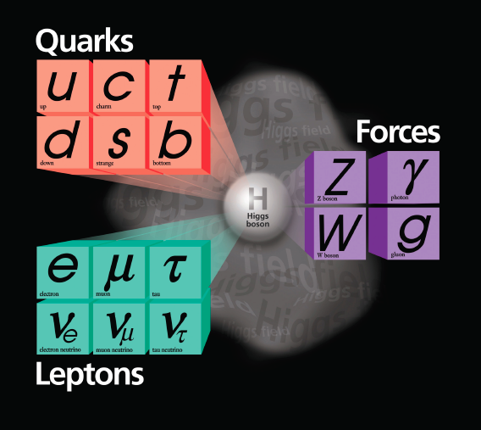
Introduction
Previously known: quarks, leptons, and vector bosons
SM Higgs Mechanism solves two separate problems.
Electroweak symmetry breaking
Fermion masses

Slide 4
History of Higgs discovery
July 15: Text in Git ready for editing
July 30: Text editing finalized by team
Aug 1-30: Internal review and iteration on draft
Sept 1: International review

Slide 5
History of Higgs discovery (2)

Slide 6
Standard Model Lagrangian

Slide 7
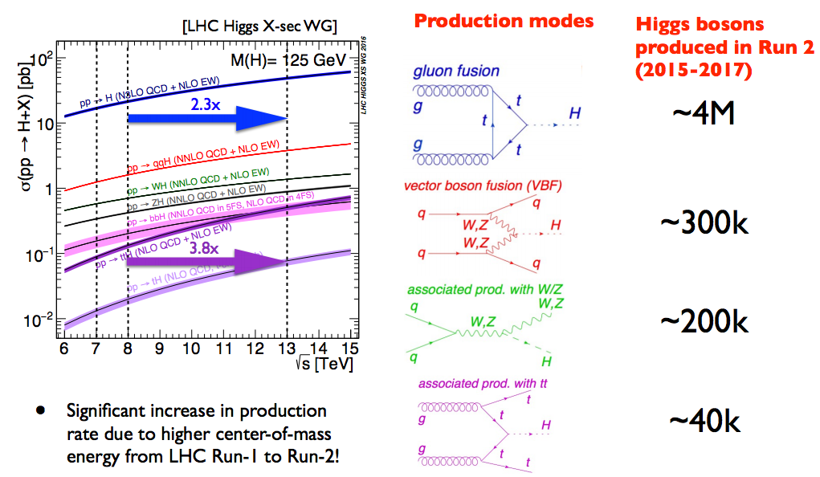
Higgs Production
df

Slide 8
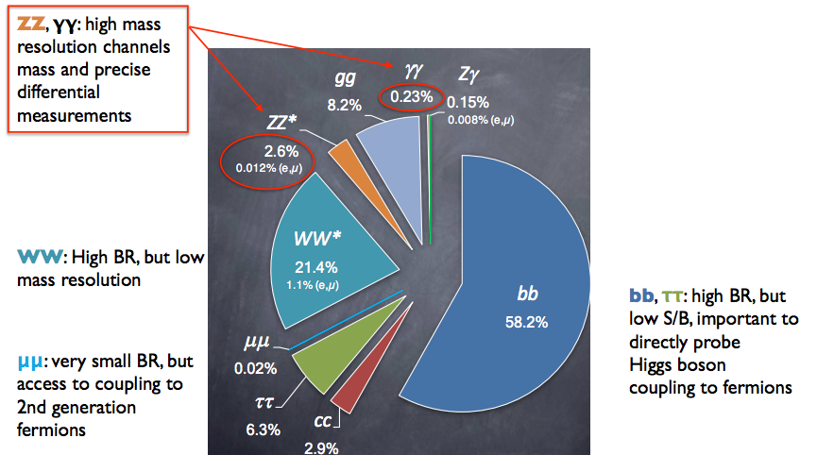
Higgs Decay
H→bb is the Dominant Decay mode of Higgs Boson(58%)

Slide 9
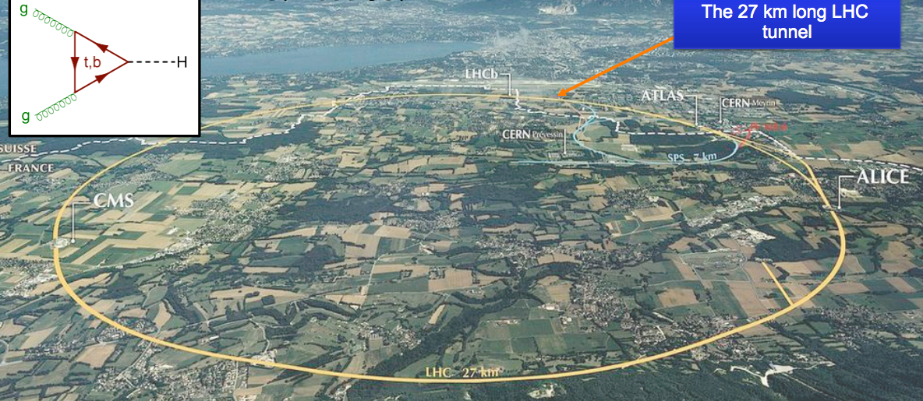
Large Hadron Collider

Slide 10
ATLAS experiment
df

Slide 11
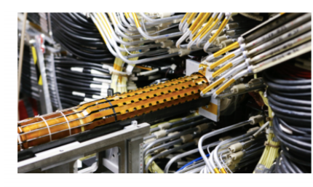
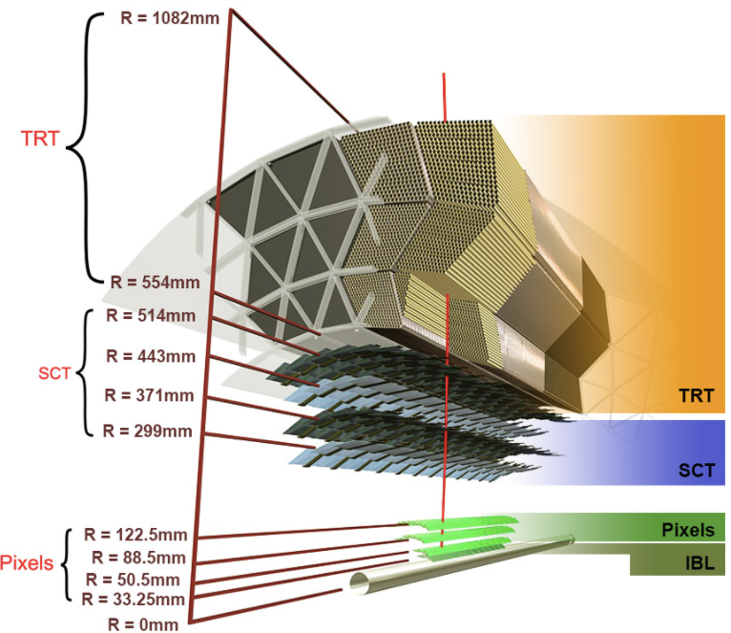
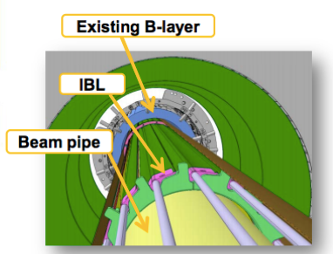
ATLAS Detector phase 0 upgrade from run 1 to run 2
IBL = New Insertable pixel B-Layer at R=33 mm

Slide 12
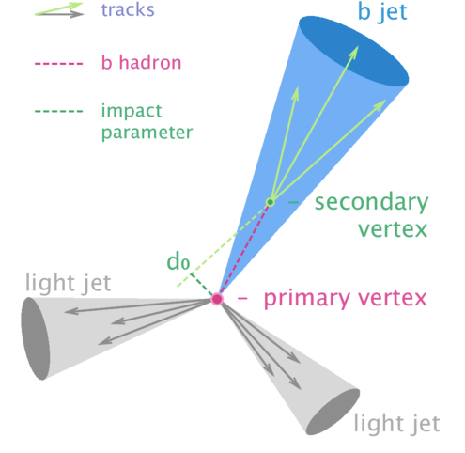
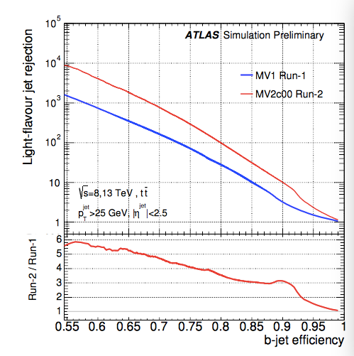
b quark jets in ATLAS
Light jet rejection power increases by a factor of 10 in run 2
Two ways to Identify b jets
impact parameters
secondary vertex from B decay

Slide 13
Outline
Introduction to Higgs physics
Introduction to ATLAS experiment
Search for H→bb mode (Dominant Decay Channel)
VBF H→bb analysis
VH(→bb)
H→bb Comination

Slide 14
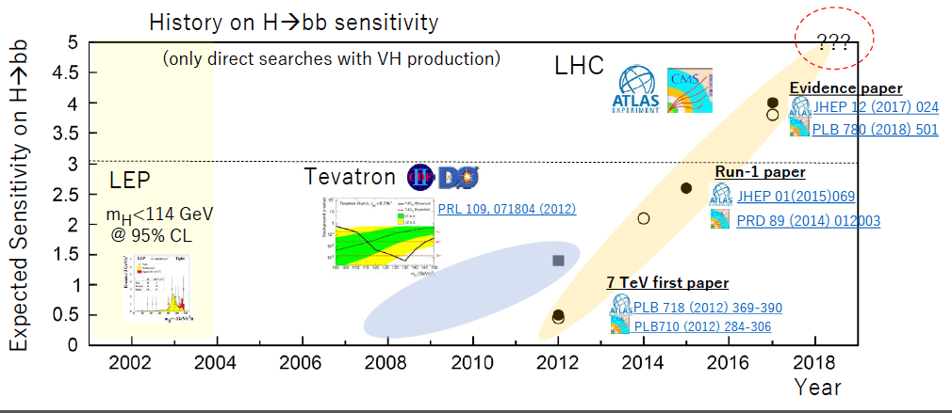
The history of H→bb search
Started in LEP, developed in Tevatron, then LHC.

Slide 15
Search for SM VBF H(bb)+𝛾
Motivation: Search H→bb decay mode
largest branching ratio (~58%), not confirmed yet
VHbb ATLAS (3.5σ), CMS (3.8σ).
VBF H(bb)+𝛾
VBF

Slide 16
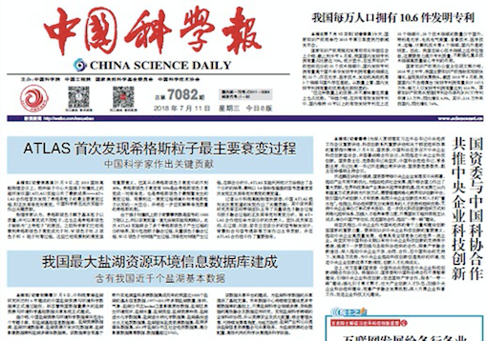
H→bb observation in ICHEP2018
ATLAS collaboration presented H→bb observation result in ICHEP2018 at July 9th
China Science Daily reported this in its front page

Slide 17
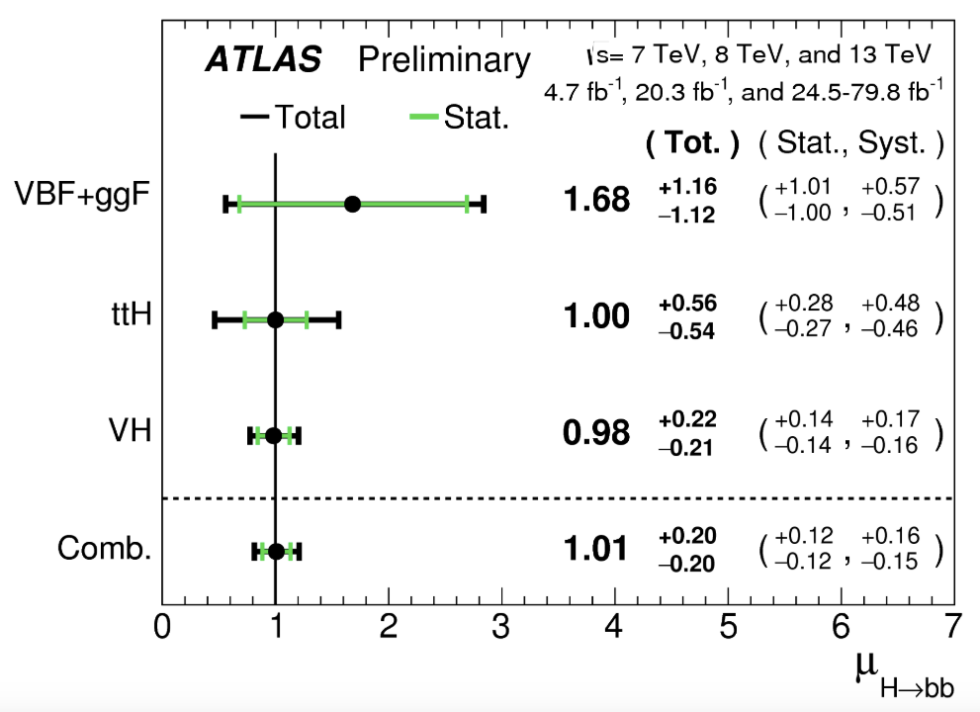
IHEP contribution to H->bb observation
Three channel contributed to H->bb observation
VBF+ggF， VH，ttH，
IHEP ATLAS team led the VBF+ggF analysis

Slide 18
Introduction to Higgs physics
Introduction to ATLAS experiment
Search for H→bb mode (Dominant Decay Channel)
VBF H→bb analysis
VH(→bb)
H→bb Comination

Slide 19
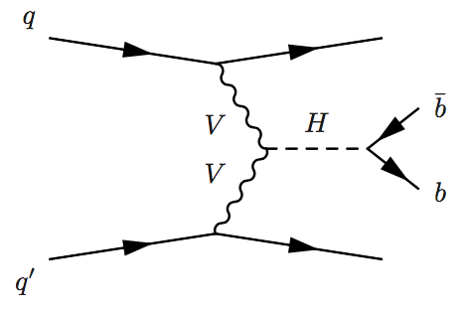
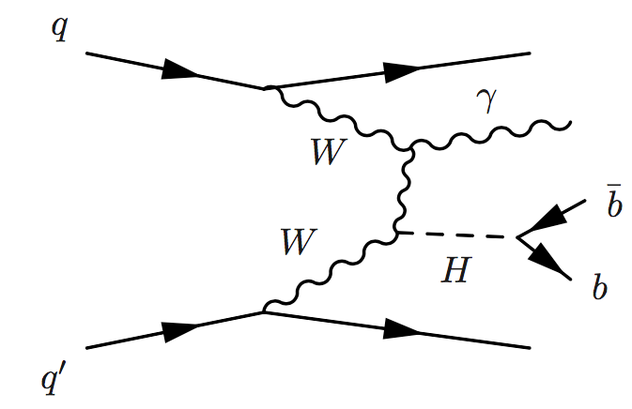
VBF H(bb) analysis
IHEP team propose Search for H->bb in VBF events containing a central photon
Advantages of requiring a photon
extra handle for trigger
suppresses QCD background
Sensitive to WWH VBF production
not sensitive to ZZH VBF
VBF H(bb) +𝛾
VBF H(bb)

Slide 20
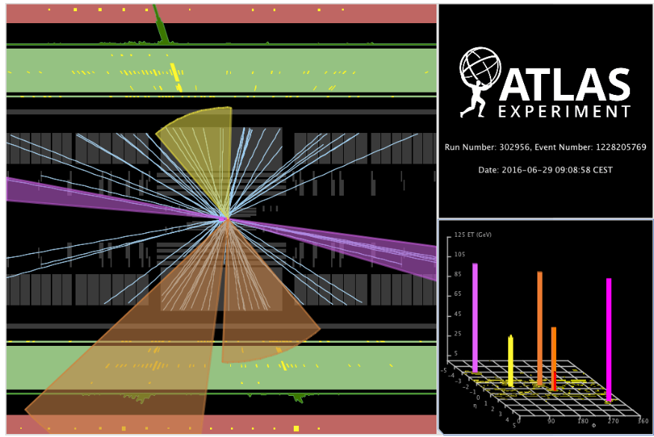
Event display for VBF H(bb)
Photon
VBF jets
b-jets
Notes:
H(bb

Slide 21
Analysis strategy
Trigger
Event pre-selection
Boosted decision tree
Divide into different categories based on BDT weight
Simultaneous M(bb) Fit on all categories

Slide 22
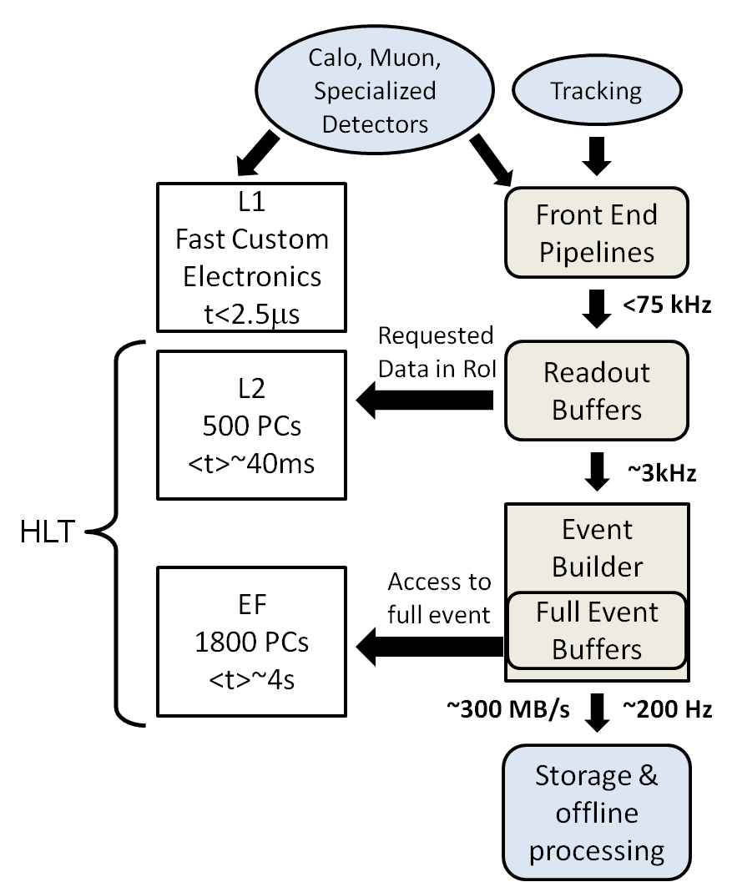
ATLAS trigger system
Three level trigger system
L1 trigger: Calo / Muon ( 75kHz)
L3/Event filter: PC based (~200Hz)
Difficulty
Hard to lower threshold for jets
Typical 4jet trigger (pT>80GeV)
Higgs need lower thresholds
Eg: pT>35GeV

Slide 23
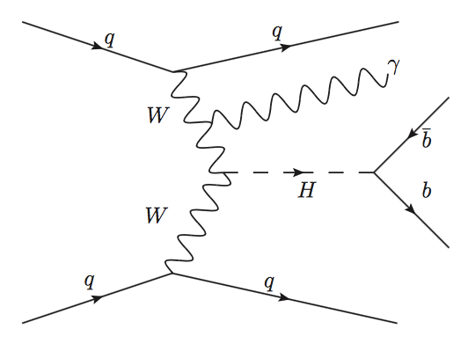
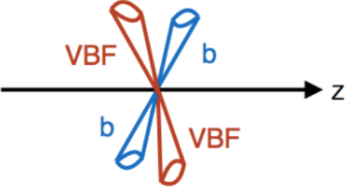
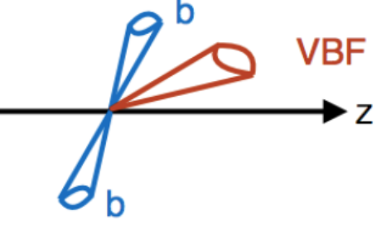
Trigger
divided into 3 channels based on triggers:
VBF inclusive
Two central : 4 central jets with 2 bjet(2b+2j)
Four central: 2 central + 1 forward trigger jet (1fj+2b)
VBF+photon
Photon: photon + 2bjet+2 forward jets (γ+2b+2fj)
L1: 1 forward jet
+2 central jets
L1: 1 EM object
L1 trigger: 4 central Jet
Four central
Channel (2b+2j)
Two central
Channel (1fj+2b)
Photon channel
γ+2b+2fj

Slide 24
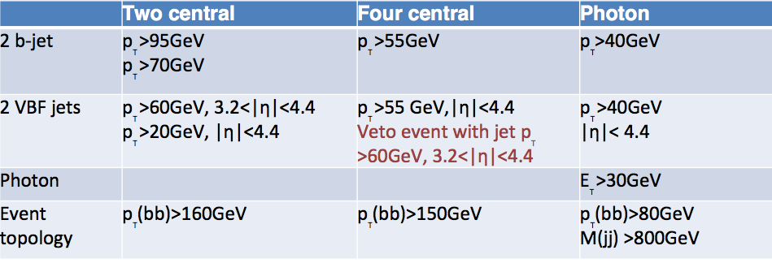
Event Selection
Two central
Channel (1fj+2b)
Four central
Channel (2b+2j)
Photon channel
γ+2b+2fj
Inclusive analysis veto data events in photon channel
orthogonality between different channels

Slide 25
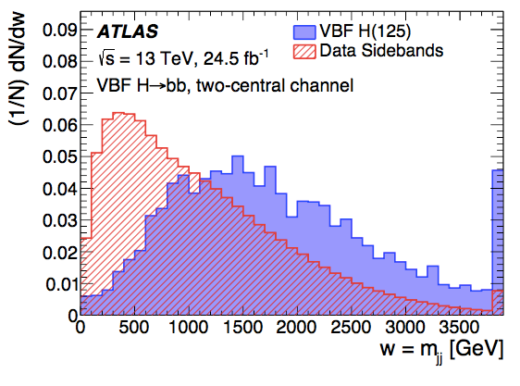
Boost decision tree analysis
More than 10 variable used in BDT analysis

Slide 26
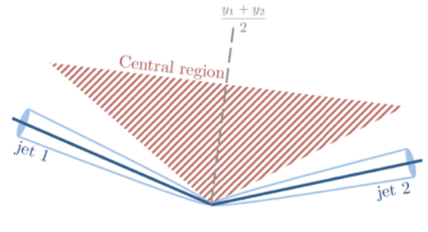
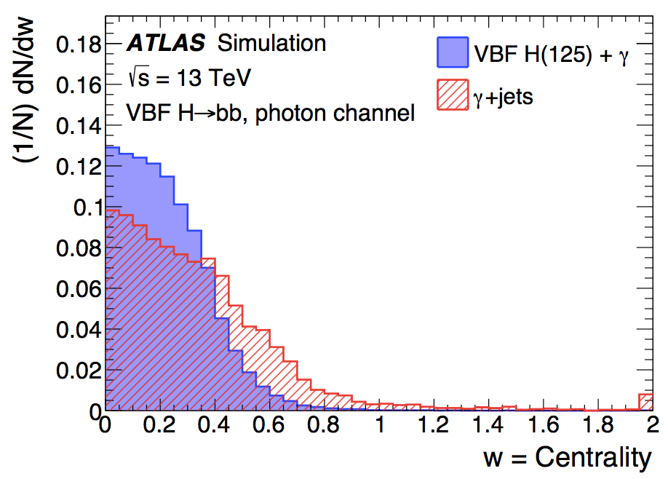
MVA Input variable: photon centrality
No color connection between VBF jets and b jets in signal

Slide 27
Analysis strategy
Trigger
Event pre-selection
Boosted decision tree
Divide into different categories based on BDT weight
Simultaneous M(bb) Fit on all categories

Slide 28
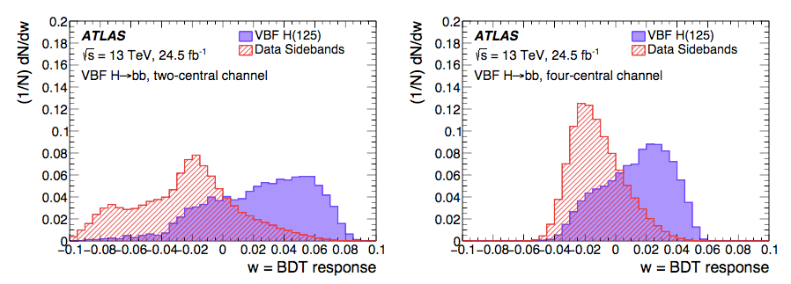
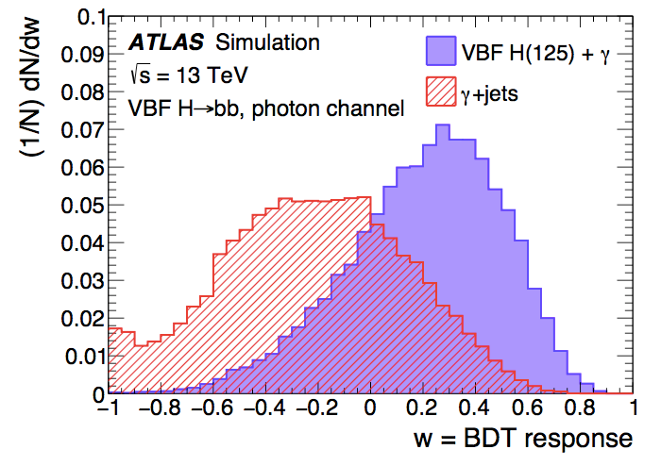
BDT response
Divide into 9 categories based on BDT weight
Expected Higgs and Z events in 100GeV<m(bb)<140GeV
SRIII
SRII
SRIII
SRII
SRI
SRII
SRI
SRIV
SRI
Two central
Four central
Photon channel

Slide 29
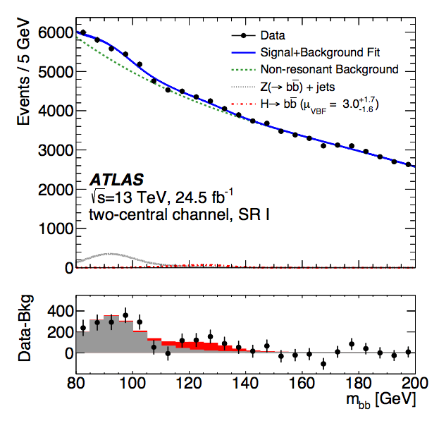
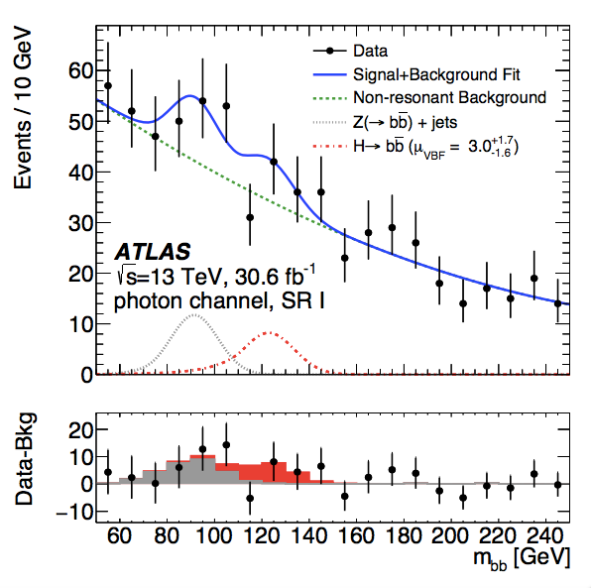
Simultaneous m(bb) Fit
Simultaneous m(bb) Fit to all 9 regions

Slide 30
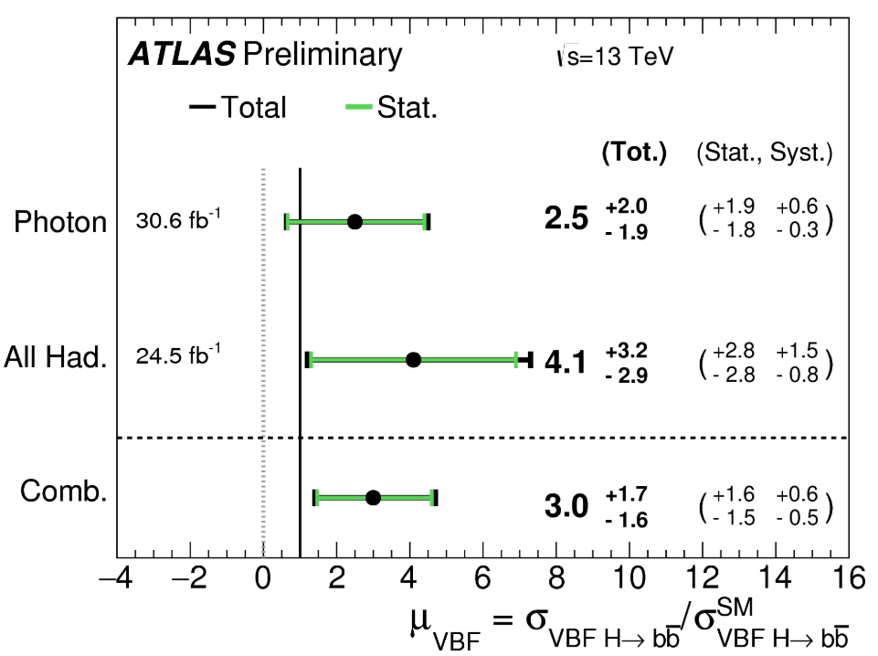
Results of VBF H(bb)
Observed significance: 1.9σ (μ= 3.0+-1.7)
Analysis sensitivity dominated by the photon channel.
Dominant uncertainty from data statistics
Expect significant improvement with full run-2 data.
CERN-EP-2018-140

Slide 31
Introduction to Higgs physics
Introduction to ATLAS experiment
Search for H→bb mode (Dominant Decay Channel)
VBF H→bb analysis
VH(→bb)
H→bb Comination

Slide 32
ATLAS-CONF-2018-036
df

Slide 33
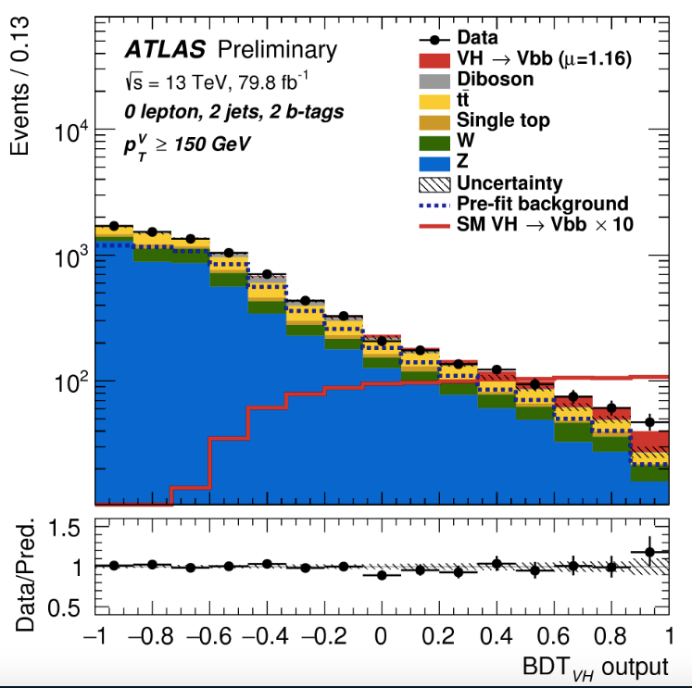
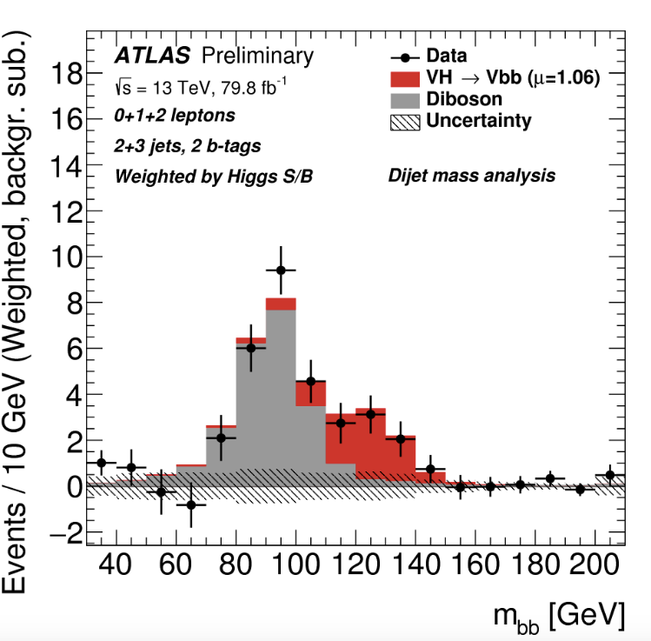
VH(→bb)
Two methods: Boost decision base (nominal) and cut based

Slide 34
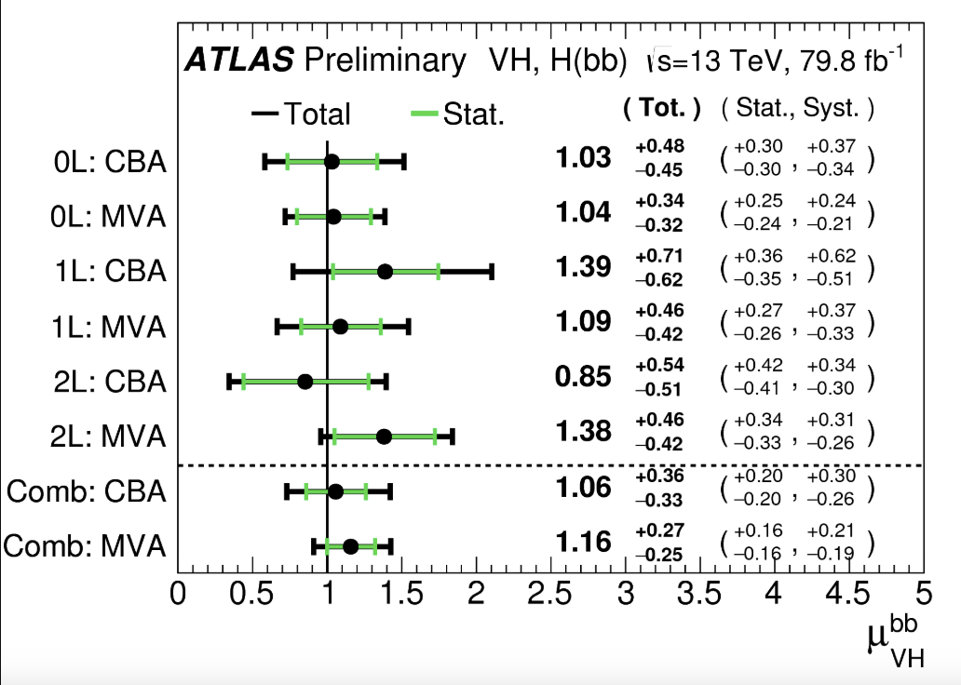
VH(→bb) sensitivity
Each channel contributes 2σ ~3σ significance
Multi-variable (MVA) analysis is better than Cut based (CBA)

Slide 35
H→bb combination
First observation of H->bb decay mode
First observation
ATLAS-CONF-2018-036

Slide 36
H->bb observation
IHEP ATLAS team contributed to VBF+ggF analysis

Slide 37
Higgs result summary in ICHEP
df

Slide 38
Summary
First observation of H->bb decay mode
IHEP ATLAS group made major contribution
lead ggF+VBF channel
First observation of VH production mode
Main Higgs production mode in CEPC
Current precision of H->bb coupling about 20%
CEPC can reach precision with 1%

Slide 39
IHEP contribution to H->bb observation
IHEP ATLAS team led the VBF+ggF analysis

Slide 40
H->bb observation
IHEP ATLAS team contributed to VBF+ggF analysis

Slide 41
H→bb observation in ICHEP2018
ATLAS collaboration presented H→bb observation result in ICHEP2018 at July 9th

