Slide 1
Muon PID in b-Jet
Jifeng Hu, Liang Li

Slide 2
MC Samples
$e^{+}e^{−}→ZH→νν, b\overline{b}$ 9950 events
$e^{+}e^{−}→ZH→[μ] νν, b\overline{b}$ 10000 events,
Plugin muon by hand
vertex set to (0,0,0,0)
Momentum set to rand(0,45) GeV*direction(max(MCP)),
Probability of following jet direction is about 86.8% by counting events.
charge +/- is half-to-half
generator status set to 1
PDG value set to 13.

Slide 3
Software Packages
Mokka-08-04
Reference mokk steer file: /besfs/groups/higgs/users/hujf/ref/mokka.steer
Arbor_KD_3.3
Reference reconstruction file: /besfs/groups/higgs/users/hujf/ref/lich00.xml

Slide 4
How to do ?
Step 1: muon selection, loop each MC particle in truth collection,
If generator status is not 0, that’s to say, the particle is produced at generator level not created in simulation,
If particle type is muon (PDG code is 13 or -13), and decay from Higgs (by tracing back mother particles’ PDG code), or our plugin muon (the first particle).
Step 2: muon match,
loop each reconstructed particle in two jets (force two jets to be reconstructed in this channel), select only one particle with the minimum momentum difference from selected MC muon.
Step 3: save information,
truth vertex, 4-momentum,
return value of isCreatedinSimulation(),
reconstructed pid-type, 4-momentum,
calculate the min(dR₁, dR₂) with two jets.
No requirement within detector acceptance

Slide 5
What to do ?
For tagged muons,
Reconstructed momentum difference from truth momentum.
Efficiency versus min(dR₁, dR₂), dR_{1,2} defined as $∆R=\sqrt{{∆η}^{2}+{Δφ}^{2}}$.
Efficiency versus truth momentum.
Efficiency versus reconstructed momentum.
Efficiency versus cosine of polar angle (Ref. truth momentum).
Efficiency versus cosine of polar angle (Ref. reconstructed momentum).

Slide 6
Summarized results
Selections:
Denominator: TMath::Abs(type)==13&&isCreatedinSim==0&&isFromH==1 (Before PID)
Numerator: TMath::Abs(type)==13&&isCreatedinSim==0&&isFromH==1&&type==rtyp (After PID)
 | Muon from Higgs Sample 1 | Muon from Higgs Sample 2 | Muon plugin Sample 2
Before PID (N1) | 4483 | 4503 | 10000
After PID (N2) | 2967 | 2721 | 7178
Efficiency (N2/N1) | 66.1% | 60.4% | 71.7% (reduced eff. ~67.6%)
$$ε=f_{h}ε_{h}+\left(1−f_{h}\right)ε_{iso}$$
$${f_{h}\sim 86.8\%, ε}_{iso}\sim 98.5\%$$

Slide 7
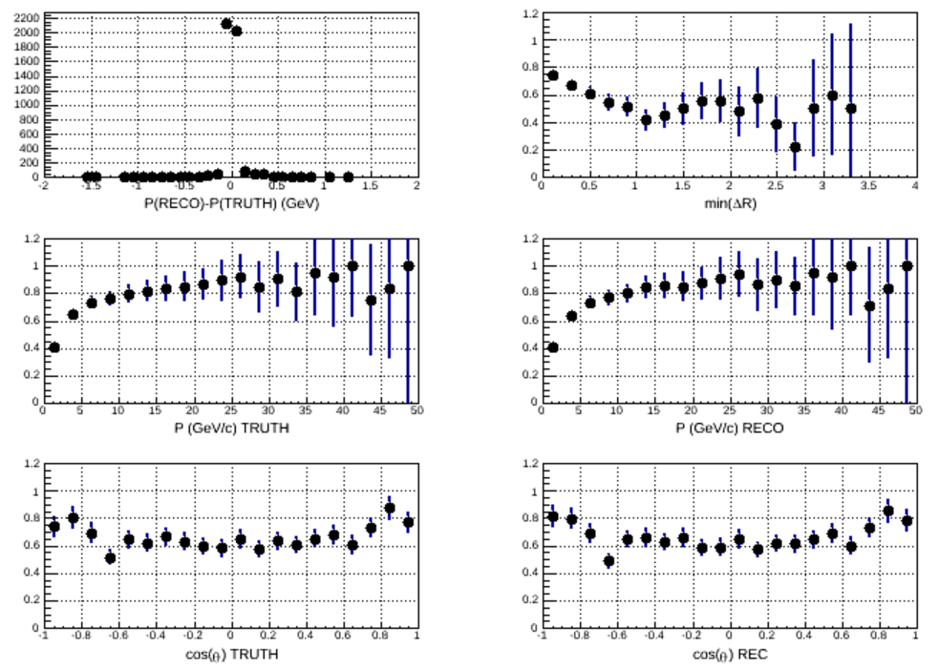
Plots (Sample 1, muon from Higgs )

Slide 8
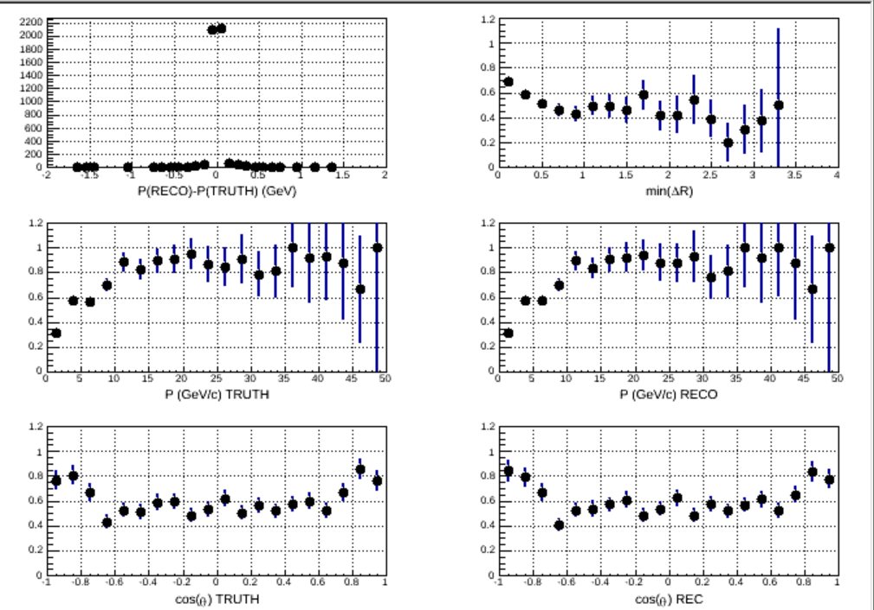
Plots (Sample 2, muon from Higgs)

Slide 9
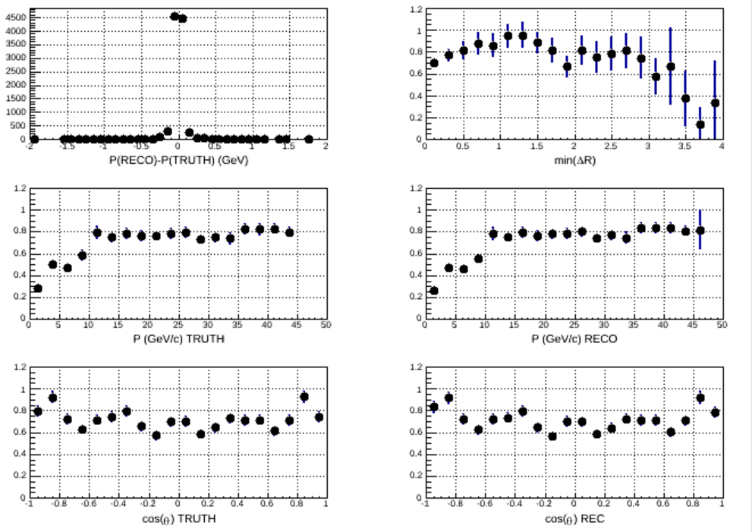
Plots (Sample 2, plugin muon)

Slide 10
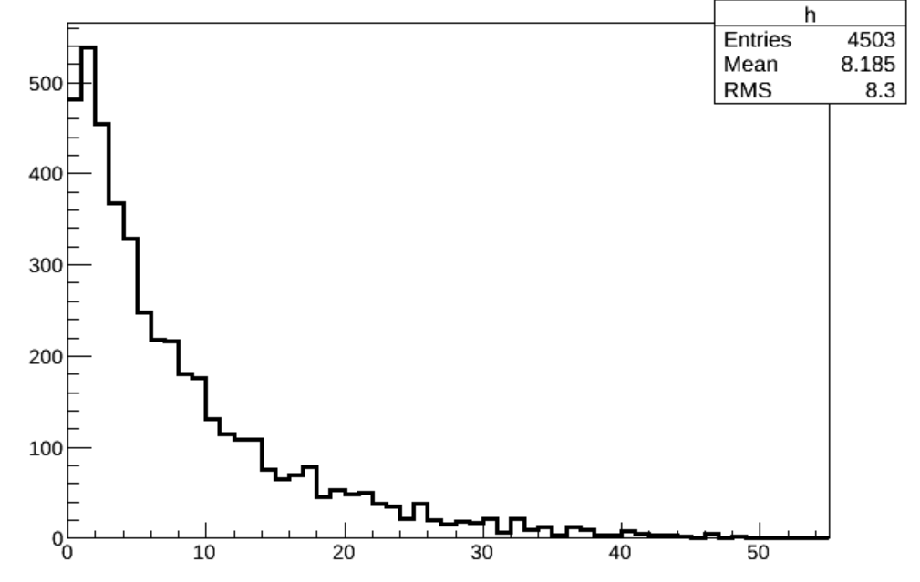
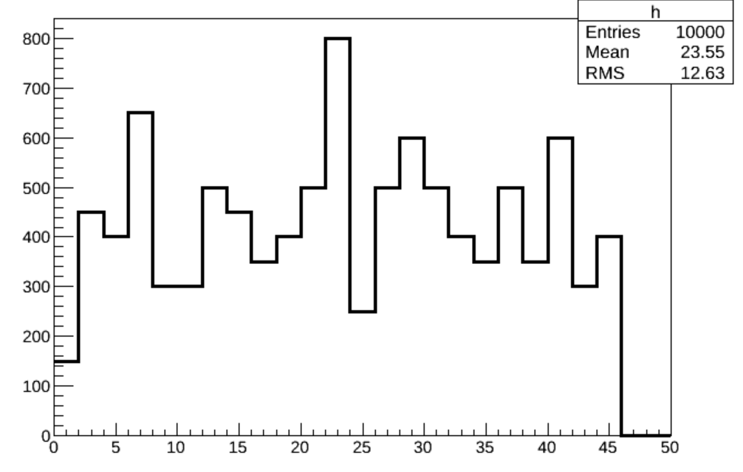
Momentum Distribution
$$e^{+}e^{−}→ZH→[μ] νν, b\overline{b}$$
$$e^{+}e^{−}→ZH→[μ] νν, b\overline{b}$$
Muon momentum (GeV)
Plugin muon momentum (GeV)

Slide 11
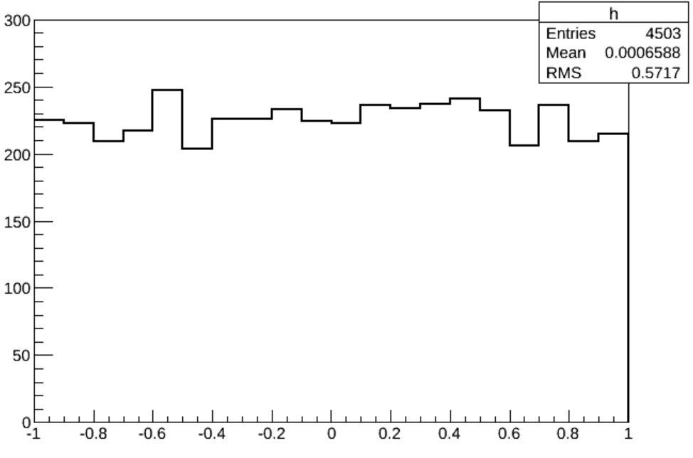
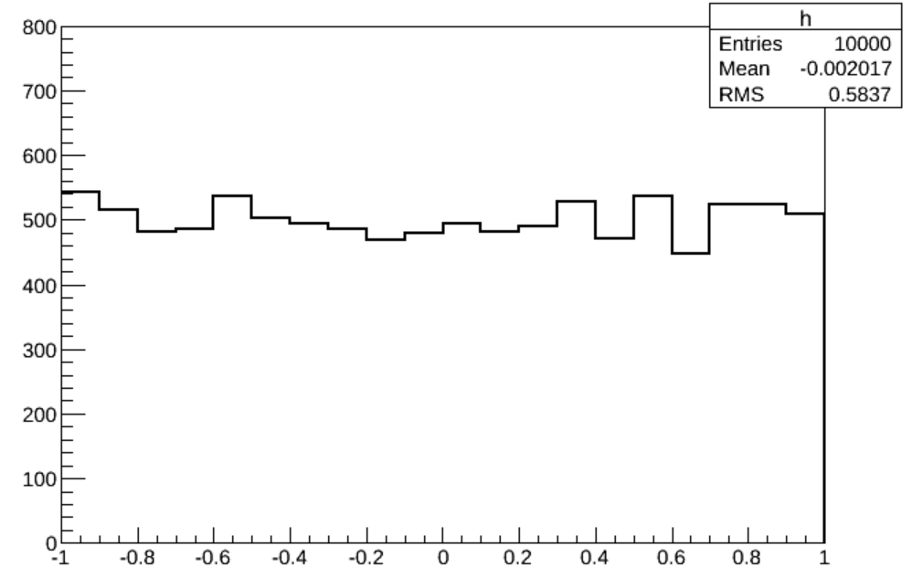
cos(θ) Distribution
Muon momentum cos(θ)
Plugin muon cos(θ)

Slide 12
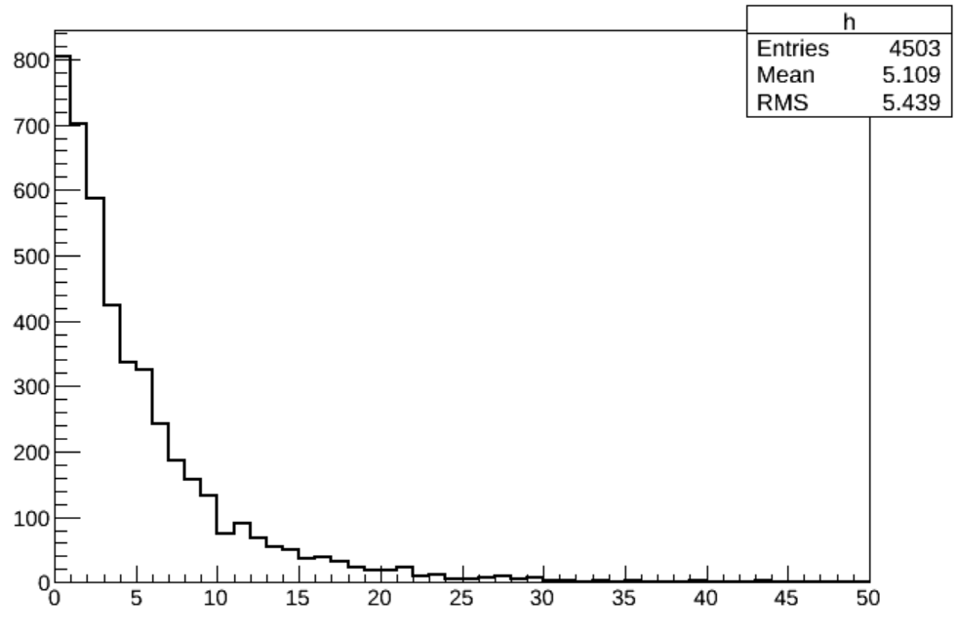
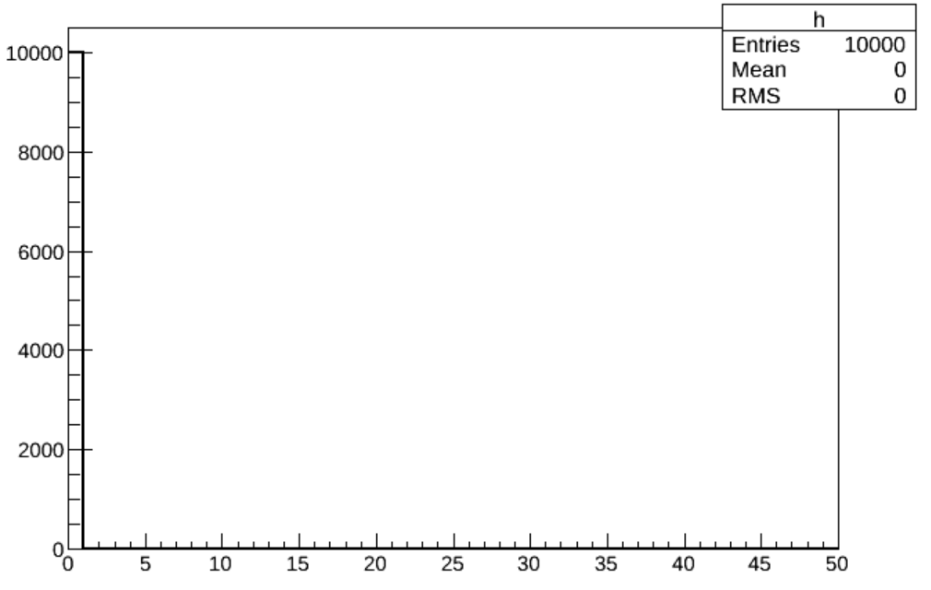
Vertex Distribution
$$r= \sqrt{x^{2}+y^{2}+z^{2}}$$
Muon vertex (mm)
Plugin muon vertex (mm)

Slide 13
Summary
Two samples are investigated to study muon identification in jets.
5 performance index are evaluated.
Identification efficiency of muon in jets is lower than isolated muons.
new training needed? (no new training applied to this sample)
Extra detector information needed ?

