Slide 1
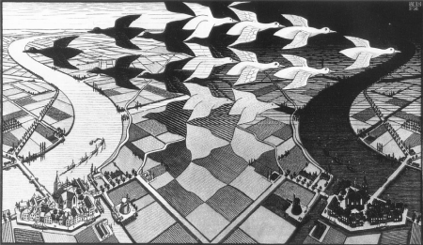

CP Violation
-- Lecture 4 --
M.C. Escher
Stephen Lars Olsen
July-August, 2018

Slide 2

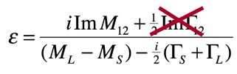
Summary of Lecture 3
K⁰ and K⁰ mesons are not mass eigenstates; K_{S} and K_{L} are mass eigenstates
K_{L} mesons discovered at Brookhaven Laboratory
a K⁰ will oscillate into a K⁰ and vice versa
neutral K mesons produced in φ decay are ~100% “quantum correlated”
K_{S} mesons are “regenerated” when a K_{L} passes through matter
_
_
Discovery of K_{L}→π⁺π⁻ decays proved that CP symmetry is violated
Measurements consistent with K_{L}=K₂ + ε K₁; ε= 2.2x10⁻³
Phase of ε consistent with CPV originating
from short-distance Mass-Matrix terms
Many beautiful, high-statistics measurements of CPV interference effects reported

Slide 3
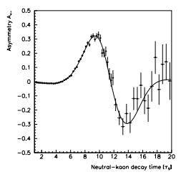
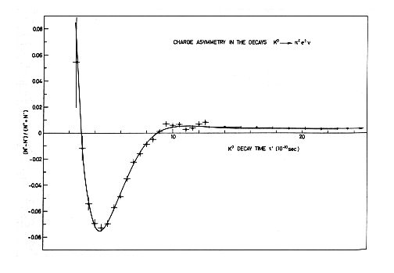



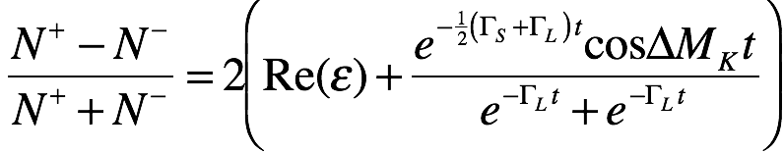

Question from lecture 3
how do we measure time?
CPLEAR
NA31

Slide 4
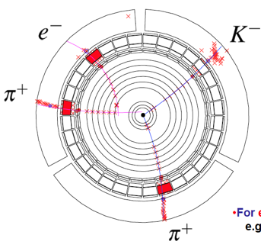
infer time from distance
d=vt=βct,→ t=d/βc
CPLEAR
this is the time in the lab frame
time in K⁰ rest frame is τ=t/γ
“proper time”
τ=d/γβc=m_{K}d/p_{K}
d
(γβc=p_{K}/m_{K})
proper time
interval
distance
interval
Δd
Δτ=(m_{K}/p_{K})Δd
decay probabilty in Δd = Δτ/τ_{K}
pr

Slide 5
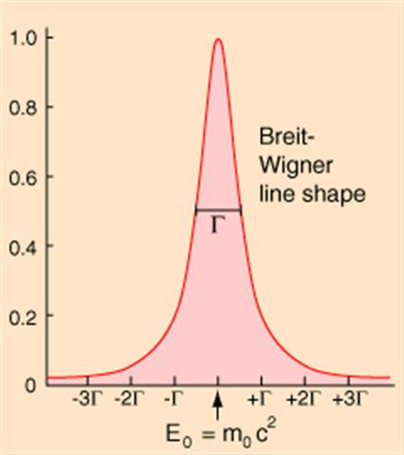
comment on widths, lifetimes, branching factions, partial widths
branching fraction
Γ=total
width
partial width
τ=lifetime
these are what theories calculate

Slide 6
example:
total widths
partial widths
although Bf(K_{S}→πeν)<<Bf(K_{L}→πeν), the partial widths are equal

Slide 7
units when h=c=1
_
mass, energy & momentum units are MeV (sometimes GeV)
length and time units are MeV⁻¹
in “normal” units:
a 1 MeV⁻¹ length unit =
& a 1 MeV⁻¹ time unit =

Slide 8
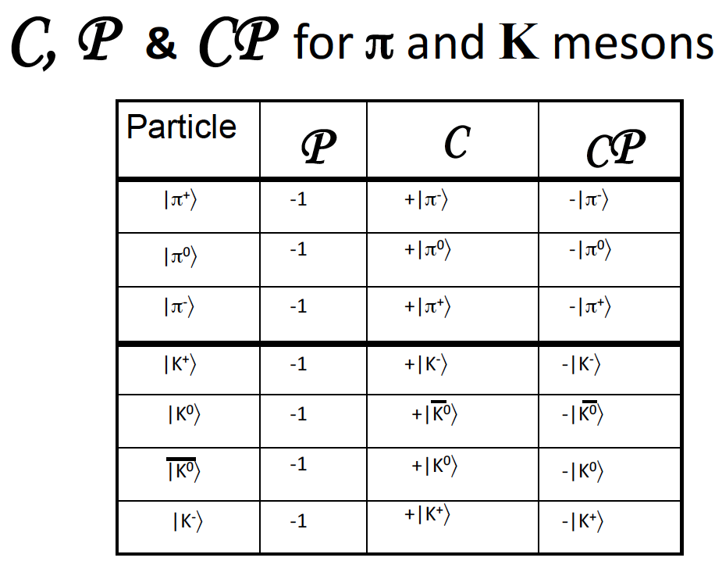
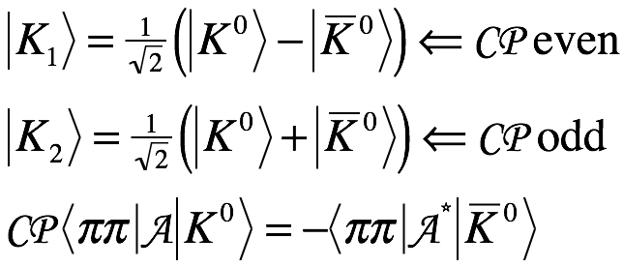
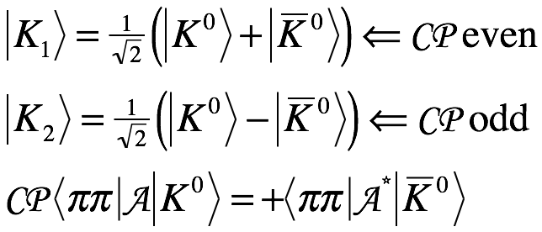
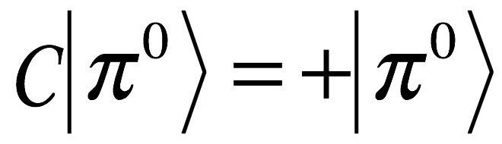
Comments on choice of C
Input: C²=1 and
-- my choice for C values --
-- others (mostly theorist’s) choices --
-
+
-
+
Physics stays the same (of course)

Slide 9
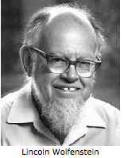
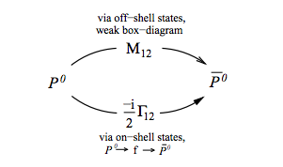
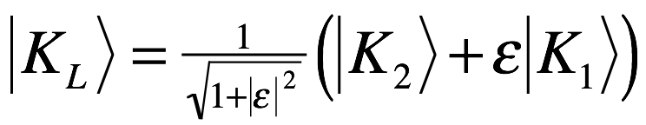
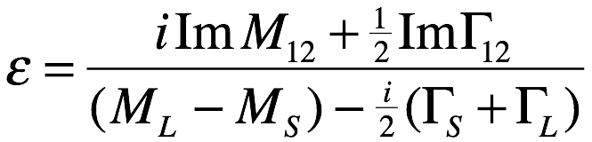
Superweak model for CPV?
CPV is very small, ~10⁻³G_{F}²: is there a new “superweak,” very
short-ranged ΔS=2 interaction that directly couples K⁰ to K⁰?
_
K⁰
|ΔS|=2
K⁰
This interaction has a coupling strength ~10⁻¹⁰ G_{F} and is only strong enough to produce ImM₁₂, i.e. ε, and nothing else. It
is seen in K_{L} decay because ΔM_{K} (<10⁻¹² MeV) is so small.

Slide 10

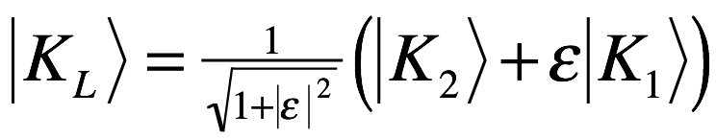
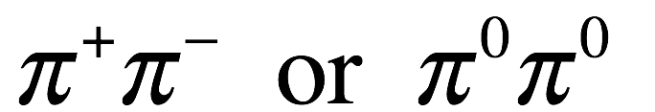
Decay of the K_{L}
CP odd
CP even
OK
direct CPV?
indirect CPV
OK
CP odd
CP even
Is there a direct decay K_{CP-odd} to π⁺π⁻ or π⁰π⁰?
The Superweak model says no!

Slide 11


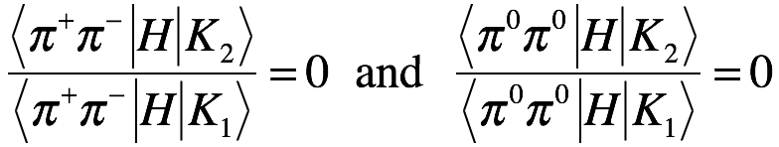
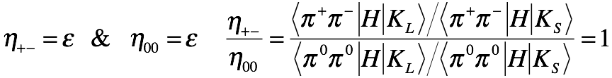
η₊₋ and η₀₀ with direct decays
If Superweak is correct, and
there are no direct CPV terms:
Then

Slide 12
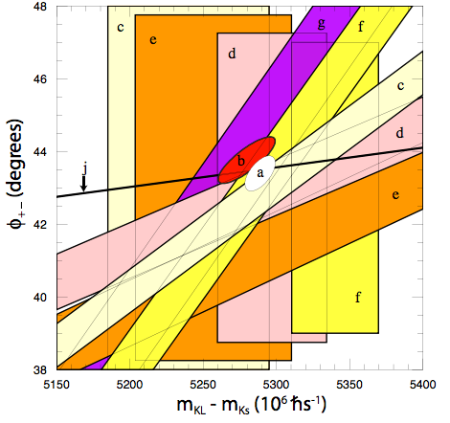
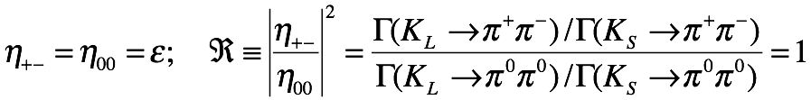
Predictions of Superweak model
All CPV is due to influence of ε, no other measureable results
different φ₊₋ measurements
SW phase

Slide 13
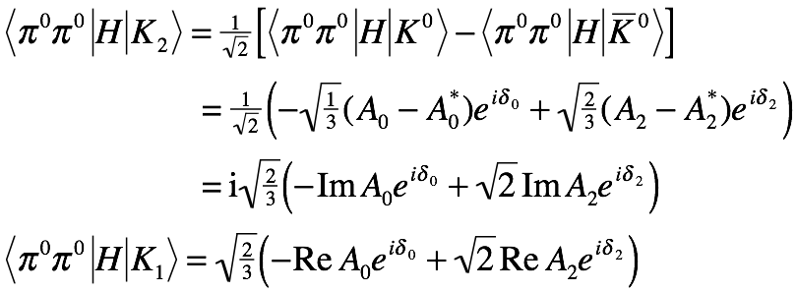
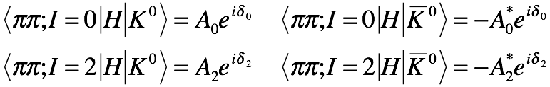

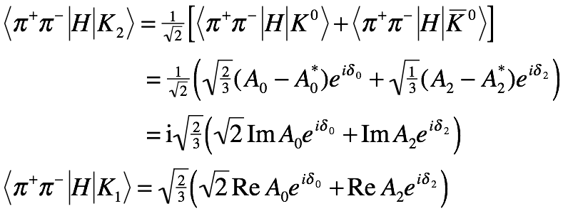

direct K₂ →ππ effects π⁺π⁻ & π⁰π⁰ differently
since we use CP(K⁰)=-K⁰
_
Clebsch-Gordon coefficients
Physics is in the difference between A₀ & A₂ phases. It is customary* to chose A₀ to be real
*

Slide 14
from previous
slide
define:
ΔI=1/2 rule →
different

Slide 15
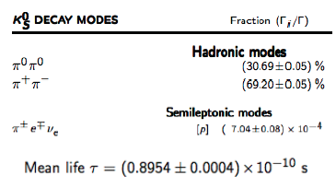


ΔI=1/2 rule
phase space is same for both modes
Ispin=0
π⁺π⁻
Ispin=2
π⁺π⁻
Ispin=2
π⁺π⁻

Slide 16
direct CP violation double asymmetry
If there are direct CP violations:
precision measurements of K_{L} →π⁰π⁰ are very important

Slide 17
Quest for K_{L}→π⁰π⁰
π⁺
“Easy”
K⁰→π⁺π⁺
distinguishable tracks
clean vertex
δp~0.2%p
π⁺
Hard!
γ
matching ambiguities
no well defined vertex
δE~5%/√E
K⁰→π⁰π⁰
π⁰
γ
π⁰
γ
unmeasurable
decay paths
γ
gets better at
high energy

Slide 18
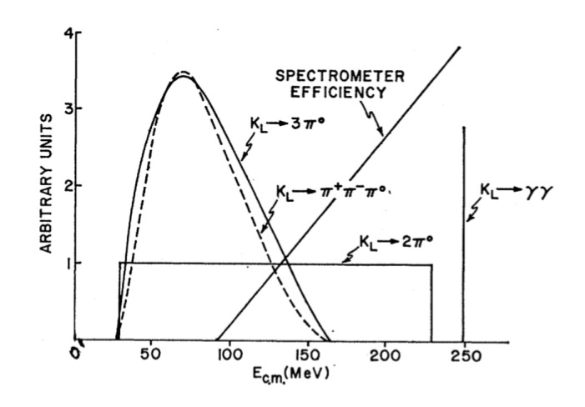
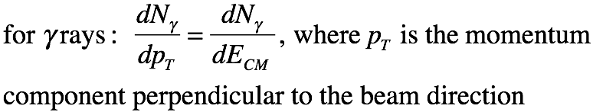
1st attempt by Cronin
p_{KL}
Exploit kinematics
p_{T}
p_{γ}
Pb converter
spark
chambers
K_{L}
beam
γ
γ
γ
K_{L}
signal
magnet
p_{T} of the γ rays (MeV)

Slide 19
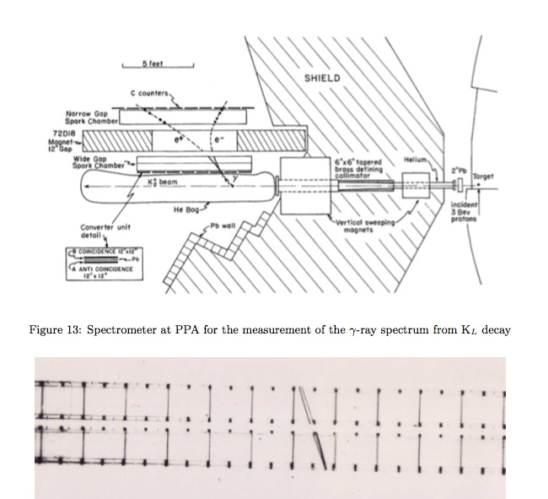
Trigger on one γ-ray with P_{T}>160 MeV
Measure angle and energy of one
γ-ray well; directions of other 3 γ’s
E<1 GeV beam

Slide 20
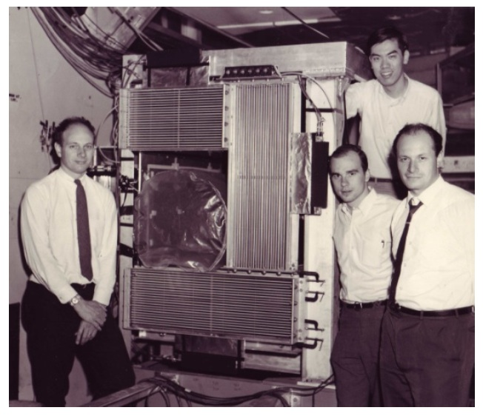
J.K. Liu
J. Cronin
J. Pilcher
M. Banner

Slide 21
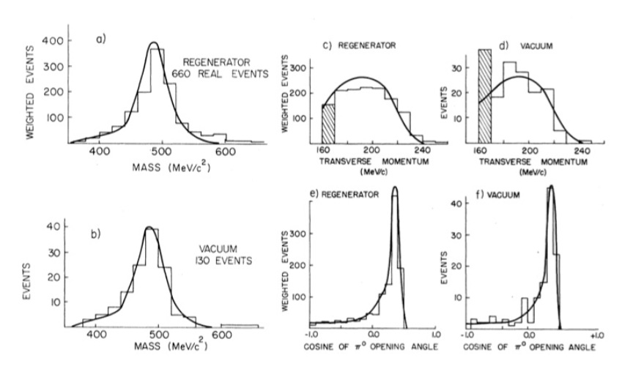
results
K_{S}→π⁰π⁰
signal
K_{L}→π⁰π⁰
signal
130
events
|η₊₋/η₀₀|²
7% precision

Slide 22
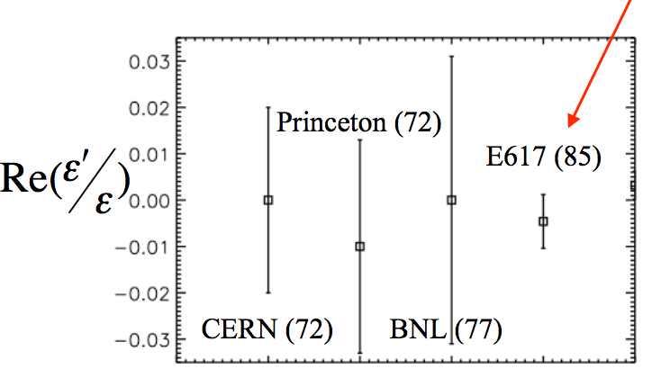
The early measurements
3100 π⁰π⁰ events
all results are consistent with ε’=0
Superweak is looking good!!
1% precision

Slide 23
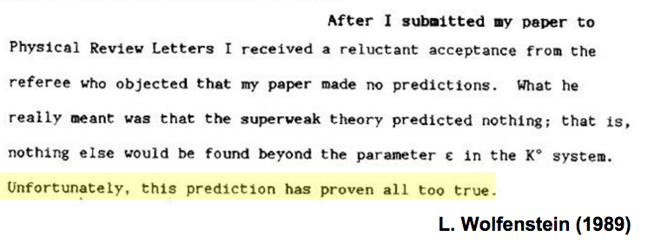
1989 on non-zero measurement of ε’

Slide 24
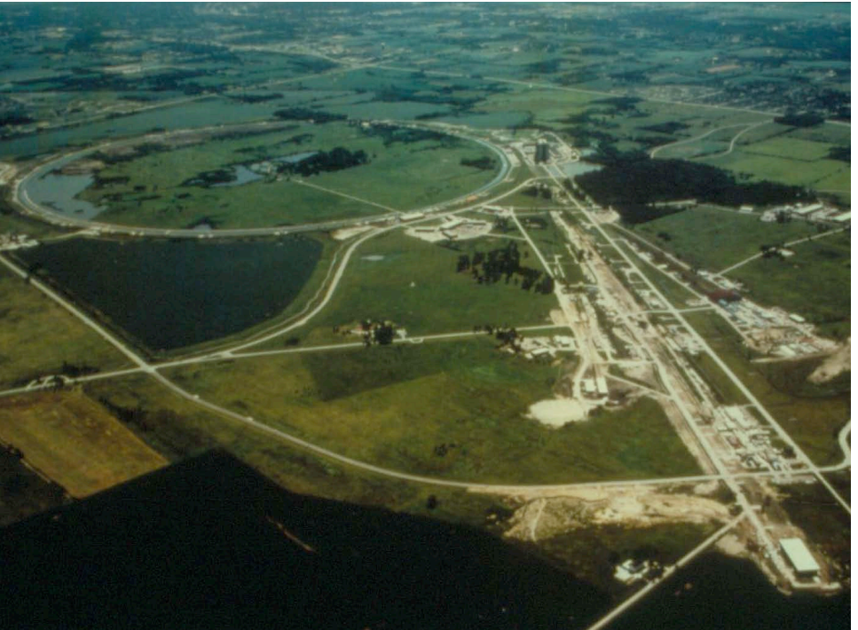
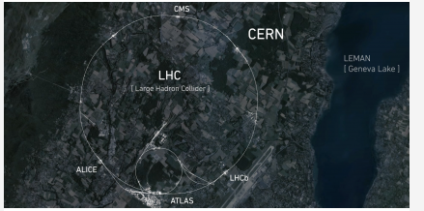
Go to higher energy
US: E731 at Fermilab
Europe: NA-31 at CERN
North Area

Slide 25
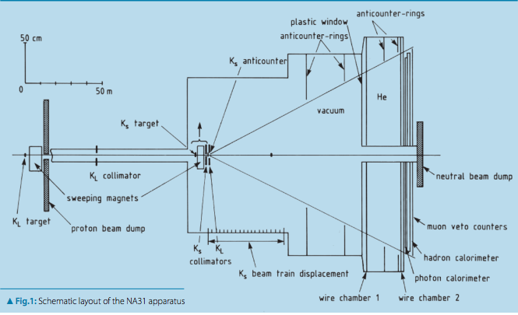
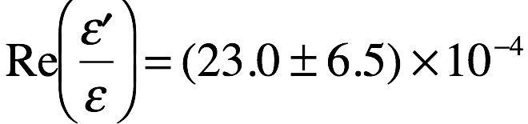
NA31 (CERN) 1st “evidence” for ε’≠0
calorimeter
No magnet!
moveable
proton bean

Slide 26
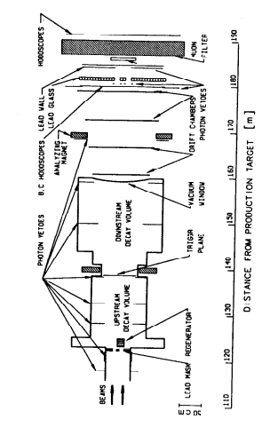
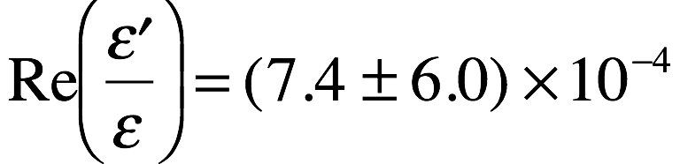
E731 (Fermilab) finds ε’=consistent with 0
magnet
2 beams with
a regenerator
that moves

Slide 27
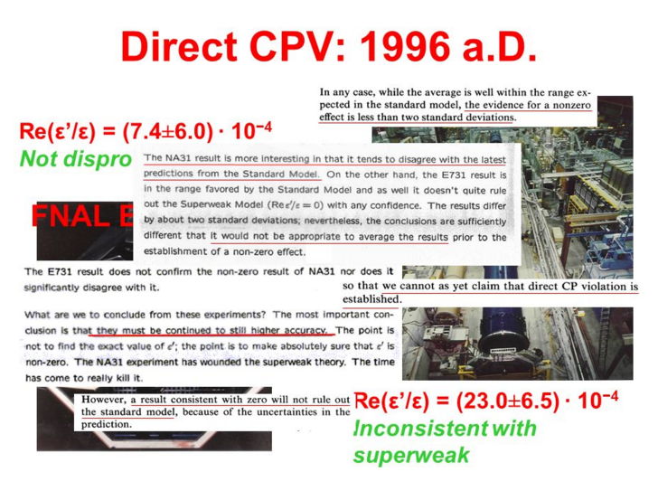
Big Controversy
E731:
NA31

Slide 28
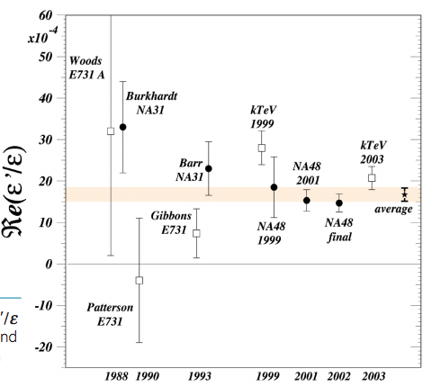
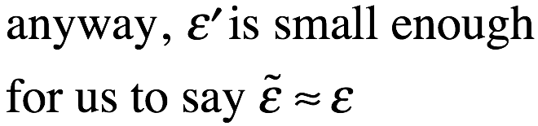
ε’=0? or ε’≠ 0?, that is the question

Slide 29
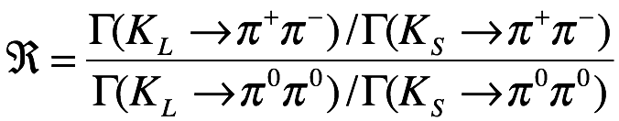
Experimental goal
Measure:
with ≈± 0.1% precision

Slide 30
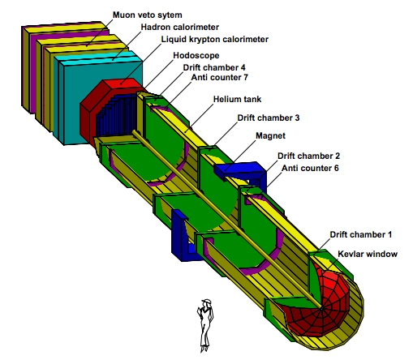
The NA-48 experiment at CERN

Slide 31
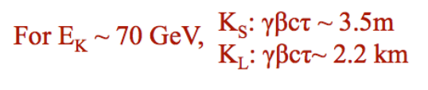
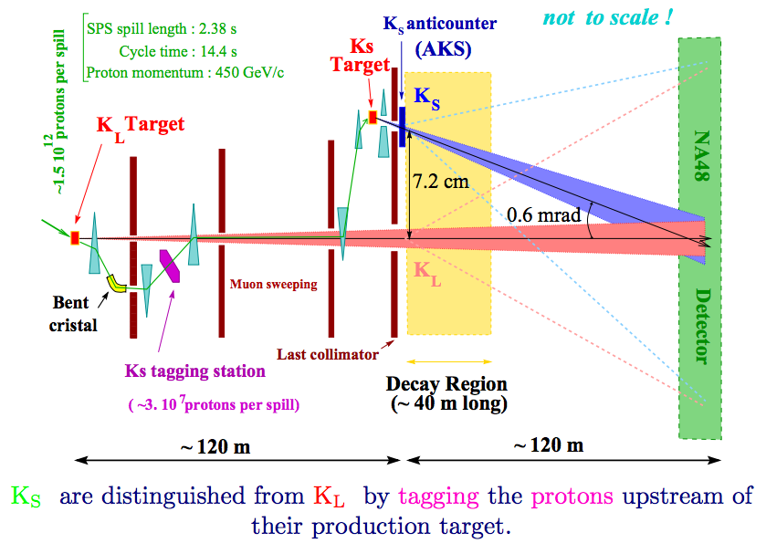
NA48: K_{S} and K_{L} beams simultaneously

Slide 32
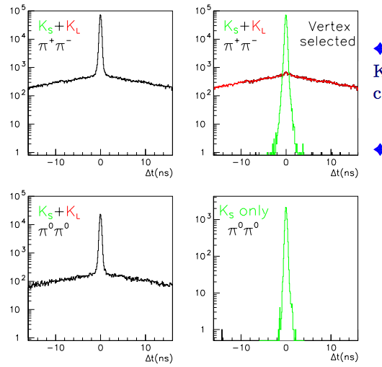
K_{S} and K_{L} signatures
K_{S}
K_{L}
Event time – proton beam counter time

Slide 33
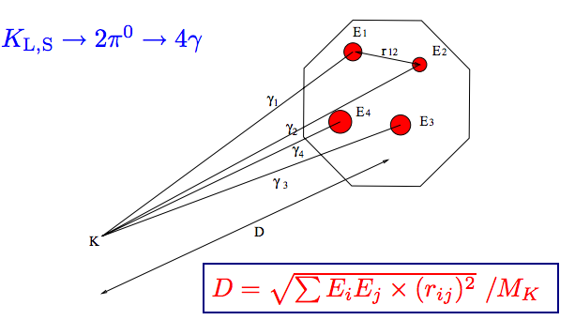
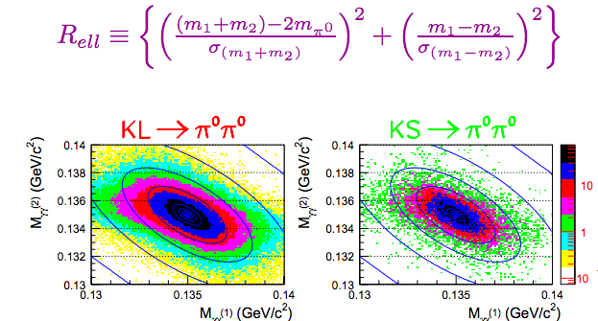
K→π⁰π⁰ events
Find the value of D that
gives the correct M_{K} value

Slide 34
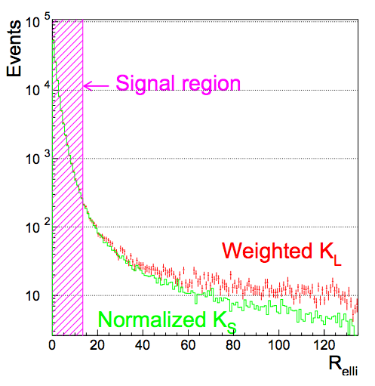
K→π⁰π⁰ event selection

Slide 35
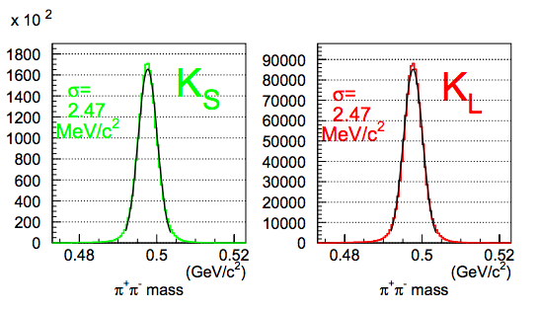
K→π⁺π⁻ detection

Slide 36

K→π⁺π⁻ selection

Slide 37

Problem: different decay-time distributions
from KTeV
Ideally, efficiency corrections
cancel out in the ratios:
However, because of the
differences in the decay vertex distributions, these cancellations are not so effective.

Slide 38


Determining the R (double ratio)
z_{i}
|
Δz_{i}
Consider a slice of decay volume, Δz_{i} at z_{i}. and a range of K momentum Δp_{j} at p_{j} :
numbers of K_{L(S)} in
(Δz_{i} ,Δp_{j}) during
the experiment
this is Δτ/τ_{L(S)}
probability for
decay in Δz_{i}
decay branching fraction
to this channel
numbers of
detected events
efficiencies
this is 00(+-) specific;
same for K_{L} & K_{S}
this is K_{L} & K_{S} specific
same for 00(+-)

Slide 39

Low statistics experiments
Compute ε⁰⁰⁽⁺⁻⁾(z,p) with Montecarlo;
Determine F_{L}(z,p) from K_{L}→π⁺π⁻π⁰ decays + Monte Carlo, etc
Weight events
Determine:
Make ratios
Systematic errors are dominated by MC, but are smaller than statistical errors

Slide 40




High statistics experiments (+-)
z_{i}
|
Δz_{i}
efficiencies cancel

Slide 41






Efficiency weighting (00)
z_{i}
|
Δz_{i}
efficiencies cancel

Slide 42



High statistics experiments
make a double ratio:
-- beam flux factors cancel --
no dependence on efficiency
or beam intensity
just count events
This results in many (N=Z_{tot}/Δz×P_{tot}/Δp?)
independent measurements with no MC
dependence & small systematic errors
combine these to
get the final result:
The final statistical error is larger, but the systematic error is smaller

Slide 43

Use “life-time weighting”
Important to correct
for different decay
vertex distributions

Slide 44


Slide 45




Double-beam with active regenerator
Beam collimators
active regenerator:
reject incoherent events
2 K_{L} beams
use K_{L}→ππ – K_{S}→ππ interference
to measure ρ

Slide 46

pure CsI crystals

Slide 47


Slide 48


Slide 49


Slide 50

Huge numbers of events
KTeV
NA-48
4.8 million π⁰π⁰ events total
~1000x increase over the best pre-1990 experiments

Slide 51


Final ε’ results
64M π⁺π⁻ evts & 16M π⁰π⁰ evts
17M π⁺π⁻ evts & 3.6M π⁰π⁰ evts

Slide 52

Final ε’ results
Superweak is dead!!

Slide 53

What do the theorists say?

Slide 54

ε, η₊₋ and η₀₀ today
Not to scale!!
ε’ ≈0.002ε

Slide 55
CP violating asymmetries in QM

Slide 56
CPV in K_{L}→π⁺π⁻
δ_{CP} ≈45^{ο}
δ_{CP}
ε
δ_{com} ≈45^{ο}
−δ_{CP}
Not to scale!!
p² ≈q² ≈1
ε ≈0.002
K⁰→π⁺π⁻
δ_{com} = θ_{ππ} ≈45^{ο}

Slide 57
S-wave ππ phase shifts
δ_{ππ}
ππ S-wave
δ_{ππ}≃45º
m_{Κ}
m_{ππ}

Slide 58

K⁰→ K⁰→ K⁰ in pp→K⁰K⁻π⁺ (K⁰K⁺π⁻ ) (CPLEAR)
_
_
_
common phase
π⁺
K⁰
δ_{com} =Δmτ
π⁻
π⁺
_
K⁰
K⁰
π⁻

Slide 59
direct CP parameter ε’
common phase
Not to scale!!
ε’≃0.02ε
2δ_{CP}
δ_{com =} δ_{ππ}(I=2)-δ_{ππ}(I=0)≃-40º
K_{L}→ππ (I=2)
ε’
K_{L}→ππ (I=0)≃ε
φ_{SW}

Slide 60
If it’s not superweak, what is it?

Slide 61
Can CPV fit into the Standard model?
Clue: CPV is seen in strangeness-changing
weak decays.
maybe CPV has something to do with
flavor-changing Weak Interactions

Slide 62
Flavor mixing
&
CP Violation

Slide 63



Three Quarks for Müster Mark
1963: all known strongly interacting particles are comprised of three basic constituents: fractionally charged quarks (and their three anti-quark partners).
Murray Gell-Mann
q=+2/3
proton
q=−1/3
π⁺-meson

Slide 64

The elementary particles before 1974

Slide 65





Weak Interactions in the 3-quark era
1964--1974
3 quarks:
q=+2/3
K⁻
n
|ΔS|=0
|ΔS|=1
s
q=−1/3
_
4 leptons:
μ⁻→e⁻ν_{μ}ν_{e}
ν_{e}n→e⁻p
μ⁻
G

Slide 66
Problems with the Weak Interactions & the 3-quark model

Slide 67

1) anomalous quark W.I.“charges”
Strength of the weak interaction, characterized by the
Fermi constant, G_{F}, is well measured in muon decays
Fermi Constant
G_{F}
μ⁻
ν_{μ}
same quantity measured for
d- and s-quarks gives different results
d→u
G_{d}≈ 0.98G_{F}
s→u
G_{s}≈ 0.21G_{F}
d
G_{d}
G_{s}
s
n
u
K⁻
u
p
π⁰

Slide 68

Cabbibo’s solution: flavor mixing
mass
eigenstates
Weak Int
flavor state
d′ = α d + β s
Nicola Cabbibo
u
α=0.98
u
β=0.21
u
G_{F}
α G_{F}
s
βG_{F}
d’
=
d
+
W⁻
W⁻
W⁻
α²+β²≃1

Slide 69


Missing neutral currents
2: no flavor-changing “neutral currents” seen.
s
G_{N}
K⁻
d
d,u
d,u
π⁻
flavor-preserving neutral currents (e.g. νN→νX) are seen
flavor-changing neutral currents (e.g. K→π l⁺l⁻) are strongly supressed
discovered at CERN

Slide 70



GIM sol’n: Introduce a 4th quark
2 quark doublets:
charmed quark
mass eigenstates
weak eigenstates
GIM: Glashow, Iliopoulis and Maiani

Slide 71

d’ & s’ are mixed d & s
4-quark
flavor-mixing
matrix
mass eigenstates
weak eigenstates

Slide 72

Mixing matrix must be Unitary
UU† = 1
|α|² + |β|² = 1 & α∗β − αβ∗ =0

Slide 73
W.I. quark spinors

Slide 74
Charged currents (u-quark)
|ΔS|=1
αG_{F}
u(c)
u(c)
βG_{F}
d(s)
s(d)
W⁻
W⁻
G_{F} modified by α
G_{F} modified by β

Slide 75
Charged currents (c-quark)
|ΔC|=1
|ΔS|=1
|ΔC|=1
|ΔS|=0
−βG_{F}
c
c
αG_{F}
d
s
W⁻
W⁻
G_{F} modified by β
G_{F} modified by α

Slide 76

Flavor preserving Neutral Current
=1
d,(S)
|α|²+|β| ²G_{N}
d,(s)
Z⁰
=1
=0
=0
=1
=1
From Unitarity
OK

Slide 77


Flavor changing Neutral Current
=0
(α∗β+βα∗)G_{N}
d(s)
s(d)
Z⁰
=0
=1
=1
=0
=0
From Unitarity
GIM-
Mechanism
FCNC forbidden by Unitarity

Slide 78

Flavor mixing with 4 quarks
-- 2-dimensional rotation --
s
mass
eigenstates
s’
d’
Weak Int
flavor state
θ_{c}
d

Slide 79
Cabibbo’s flavor mixing revisitd
Weak Int
flavor state
flavor mass
eigenstates
d′ = α d + β s
Nicola Cabibbo
1935-2010
u
u
β=sinθ_{c}=0.21
u
α=cosθ_{c}=0.98
G_{F}
αG_{F}
s
βG_{F}
d’
=
d
+
W⁻
W⁻
W⁻
Unitarity: |α|² + |β|² = 1
α=cos θ_{c}; β = sin θ_{c}
θ_{c}=“Cabibbo angle”≈12⁰

Slide 80






short-distance K⁰ K⁰ mixing
_
s
u,c
d
K⁰
W±
W±
K⁰
ΔS=2 process
_
d
u,c
_
_
_
s
_
4-quark world:
θ_{C}=Cabibbo angle
W.I. eigenstates
mass eigenstates
+
s
s
s→d FCNC
u
d
c
d
W±
W±
W±
W±
cosθ_{c}sinθ_{c}
-cosθ_{c}sinθ_{c}

Slide 81

|Δm_{s}|=|m_{KS}-m_{KL}| constrained original prediction of c-quark mass
Original GIM paper:
…
m_{c}

Slide 82




Japan physicists knew about the c quark
1971 paper by Nagoya particle physicist
Kiyoshi Niu and colleagues
2mm
Shuzo Ogawa (Nagoya) interpreted this event as production of one particle
with a c-quark (X→π⁰p) and one with an anti-c-quark (X→π⁰π±).

Slide 83
Introducing a CP-violating, complex amplitude into the Standard Model

Slide 84
The elementary particles in 1973
In Nagoya
In the rest of the world

Slide 85




1973 Kobayashi & Maskawa
Nagoya Theory Group 1973
Makoto
Kobayashi
Toshihide
Maskawa
PAGE 1
“quartet scheme”
=4-quark model

Slide 86


Quark-flavor-mixing for 4 flavors
Can we add a complex CPV phase
to one of these matrix elements?
Number of parameters: 8
Unitarity conditions: 4
4 flavors; # of arb. phases: 3
# of free parameters: 1
Weak int
eigenstates
Mass
eigenstates
Only 1 free parameter:
the Cabibbo angle, θ_{C}
V†V= 1

Slide 87



KM paper, page 12
“6 quark model”
‘
‘
etc., etc.
‘
3 Euler angles: θ₁ θ₂ & θ₃, plus 1 CP-violating phase: δ
i.e., theory can accommodate CP violation, but only with 6 (or more) quarks

Slide 88


What about 6 quark flavors
Can we add a complex CPV phase
to one of these matrix elements?
Number of parameters: 18
Unitarity conditions: 9
6 flavors; # of arb. phases: 5
# of free parameters: 4
Weak int
eigenstates
b
s’
Mass
eigenstates
b’
Yes!
θ₂
4 parameters, 3 or rotations
(Euler angles: θ₁ θ₂ & θ₃) with
one left over for a CPV phase
s
d’
θ₁
θ₃
d

Slide 89
Quark field “re-phasing”
multiply each quark by an arbitrary phase factor:
6 (2N) arbitrary phase factors: φ_{i}
simultaneously “rephase” the CKM matrix:
or
is unchanged:
1 overall phase can be factored out:
for example φ_{u}
5 (2N-1) arbitrary phases in CKM matrix + 1 overall (trivial) phase

Slide 90
KM paper was in 1973, the 3-quark age
1964-1974
3x3 matrix ⇒3 generations, i.e. 6 quarks
predicted by GIM
discovered in Nagoya 1971
rest of the world: Nov 1974
6 quarks:
In 1973, these were
not in our dreams.
3 quarks:
4 quarks:
q=+2/3
s^{−1/3}
q=−1/3

Slide 91





History
November 1974:
Charmed (4th) quark “discovered”
@ Brookhaven & SLAC
J/ψ =
c
c
1976 Nobel prize
M(e⁺e⁻)
E_{cm}(e⁺e⁻)
pp→J/ψ + X; J/ψ→e⁺e⁻
e⁺e⁻→ hadrons
Phys.Rev.Lett.33:1404-1406,1974.
Phys.Rev.Lett.33:1406-1408,1974
Sam Ting
Burt Richter
Kiyoshi Niu

Slide 92


More History
November 1977:
Bottom (5th) quark discovered
@ Fermilab
February 1995:
Top (6th) quark discovered
@ Fermilab
Ύ=
b
b
ℓ⁺ν
_
_
pp→ t t X
_
bc
CDF: Phys.Rev.Lett.74:2626-2631,1995
Phys.Rev.Lett.39:252-255,1977.
D0: Phys.Rev.Lett.74:2632-2637,1995

Slide 93
A little history
1963 CP violation seen in K⁰ system
1973 KM 6-quark model proposed
1974 charm (4th ) quark discovered
1978 beauty/bottom (5th) quark discovered
1995 truth/top (6th) quark discovered

Slide 94
CKM matrix today
*
V_{ub}
u
CPV phases are
in the corners
φ₃ (γ)
b
W⁺
V_{td}
d
t
W⁺
φ₁ (β)

Slide 95
The challenge
*
V_{ub}
u
V_{td}
d
b
t
W⁺
W⁺
Measure a complex
phase for b→u
or in t→d
or, even better, both

Slide 96
Summary of Lecture 4
The Superweak model was a plausible explanation for the K_{L}→π⁺π⁻ observation
  It predicted the phase of ε = φ_{SW} =arctan(2ΔM_{K}/ΔΓ_{Κ})≃45º, in agreement with experiment,
  no other observable CPV processes, & a dull future for specialists in the field.
Precise comparisons of the rates for K_{L}→π⁺π⁻ and K_{L}→π⁰π⁰ in high-statistics
experiments exposed a direct CPV amplitude in K_{L}→ππ decays, killing the
Superweak model
The measured Weak Interaction charge of the d-quark is 0.98 G_{F}, that for the
s-quark is 0.21 G_{F}. These differences from G_{F} are due to quark-flavor mixing
The non-existence of Flavor-Changing Neutral Currents was explained by the
discovery of the charmed quark & Unitarity of the 4-quark flavor mixing matrix
Kobayashi & Maskawa: a CP violating phase can be accommodated in the quark-
flavor mixing matrix but only if there are 6 quark flavors (not 3, known in 1973)
Three more quark-flavors are discovered: charm, bottom and top.

