Slide 1
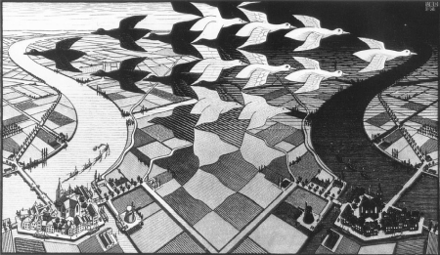

CP Violation
-- Lecture 3 --
M.C. Escher
Stephen Lars Olsen
July-August, 2018

Slide 2
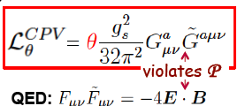
Question from Lecture 1
why does this term appear
in the QCD Lagrangian,
while the corresponding term
does not appear in QED?

Slide 3




QED and QCD, similarities and differences
QED Lagrangian:
QCD Lagrangian:
+
gluon “self-coupling”

Slide 4
Vacuum polarization QED vs QCD

Slide 5
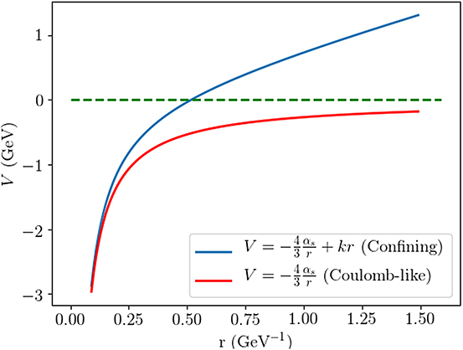
QED & QCD long-distance behavior is very different

Slide 6
Technical details
gluon self-couplings produce different behavior as r → infinity:
QED:
no effect on dynamics, absent from the Lagrangian
QCD:
X
effects the dynamics, must be included in the Lagrangian

Slide 7
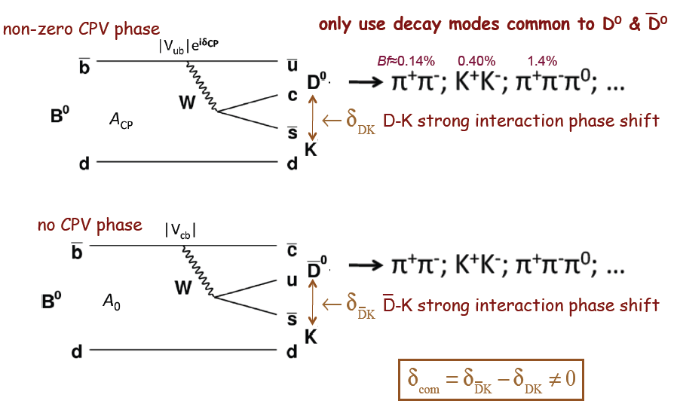
Question from lecture 2
Why is ?
resonances
no resonances

Slide 8
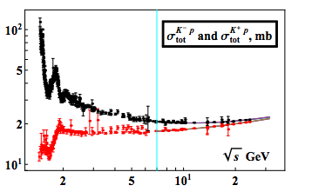
Kp and Kp interactions are different
_
resonances
no resonances
So, we can expect that DK can differ from D K.
_
In fact, LHCb measures

Slide 9
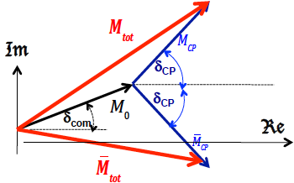
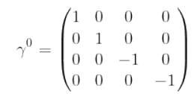
Lecture 2 Summary I
δ_{CP} measurements require an interfering
process with a non-zero δ_{com}
The P operator for Dirac spinors is
the γ⁰ matrix; P ² =1
Fermions and anti-fermions (i.e. spin ½ particles) have opposite P
c operating on a fermion → an antifermion;
for ψ=fermion-antifermion eigenstate:
Pions have P=-1

Slide 10


Lecture 2 Summary II
C eigenstates with:
K mesons discovered in a cosmic ray cloud chamber experiment with a magnetic field
The θ−τ puzzle was resolved by the discovery of P violations
in the Weak Interactions
C and P violations in μ± decays were found such that CP seemed
to be conserved
The C-parity of the π⁰ has to be +1:
By (our) choice:

Slide 11
The K mesons

Slide 12
K mesons: K⁺, K⁻, K⁰ , K ⁰
_
u s
S(s-quark)=+1
_
_
u^{+2/3}
K⁺:
Charge (Q) = 2/3 + 1/3 = 1
Strangeness (S) = 0 + 1 =1
s^{+1/3}
d s
d^{-1/3}
_
K⁰:
s^{1/3}
Q = -1/3 + 1/3 = 0
S = 0 + 1 = 1
antiparticles
antiparticles
_
K⁰:
d^{1/3}
s^{-1/3}
s d
S(s-quark)=-1
Q = -1/3 + 1/3 = 0
S= -1 + 0 = -1
s^{-1/3}
s u
K⁻
_
u^{-2/3}
Q = -1/3 - 2/3 = -1
S = -1 + 0 = -1

Slide 13
P of the K mesons
fermion-antifermion “atom”
from Dirac Eqn
quarks are Dirac particles
S=0
u^{+2/3}
Κ⁺:
P =-1
s^{+1/3}
f
P =-1
_
L =0
f
C =+1
same for Κ⁻
L =0
“Para-positronium”
d^{-1/3}
K⁰:
s^{+1/3}
P =-1
L =0
_
same for K⁰

Slide 14
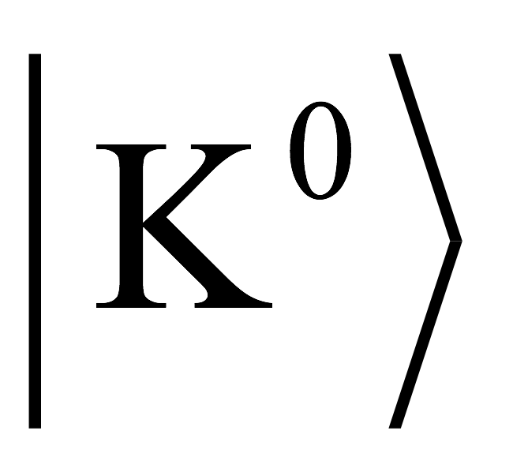
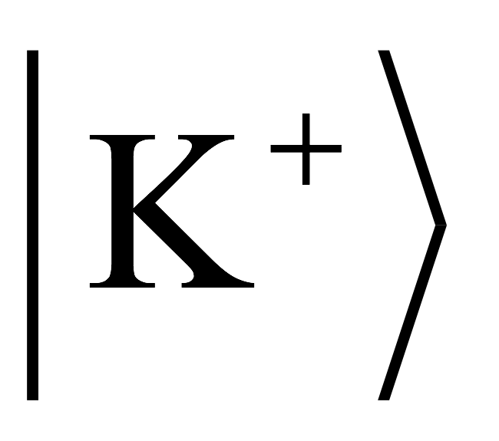
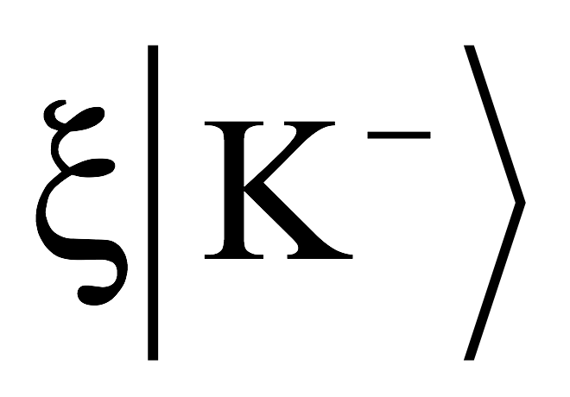
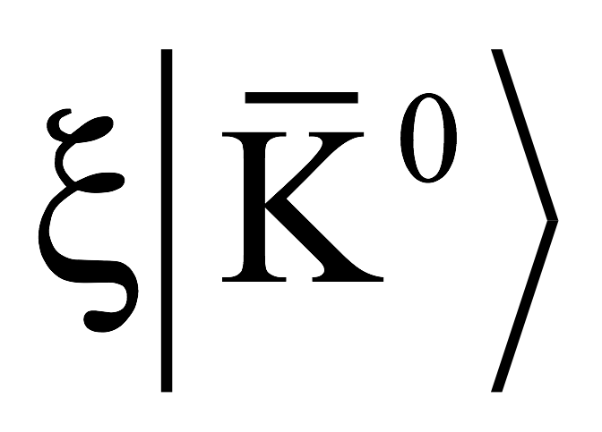

C-operator on K⁺ and K⁰?
u^{+2/3}
C
K⁺→ξ₊K⁻
s^{-1/3}
s^{+1/3}
u^{-2/3}
d^{-1/3}
C
_
K⁰→ξ₀K⁰
d^{1/3}
s^{-1/3}
s^{1/3}
ξ₊ and ξ₀ can be either +1 or -1
the choice is arbitrary
I chose both ξ₊=+1 and ξ₀=1, same as the C-parity of the π⁰

Slide 15
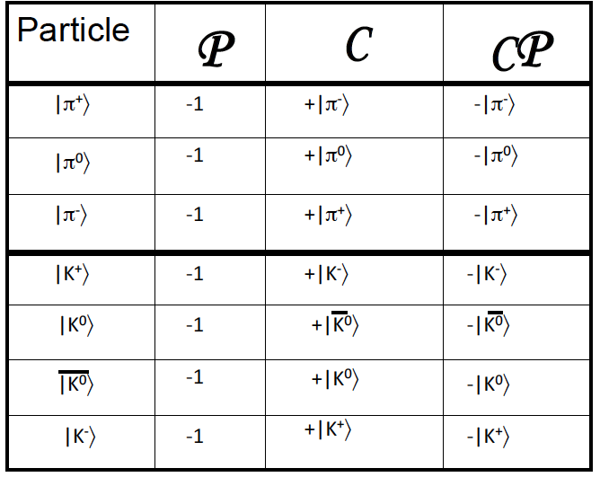


C, P & CP for π and K mesons
beware:
some literature uses
γ −1 −1 +1

Slide 16
But this is not the whole story

Slide 17
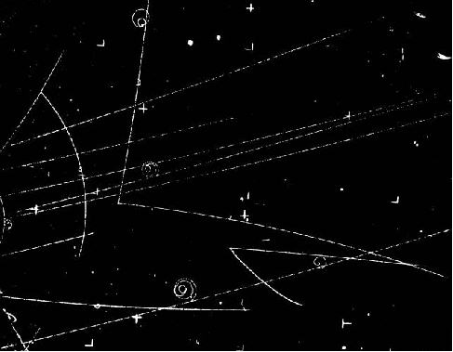
π⁻p→ K⁰(→π⁺π⁻ ) + Λ⁰(→pπ⁻ )
must be
S=+1➔ K⁰
π⁻
S=0
S=-1
π⁻p
K⁰?
Λ⁰
K⁰?
_
K⁰
π⁺
π⁻
Λ⁰
p
π⁻
hydrogen bubble chamber

Slide 18
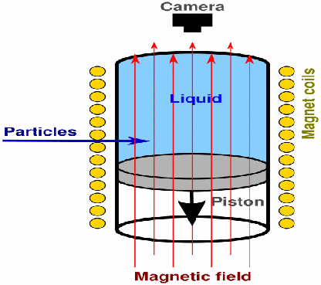
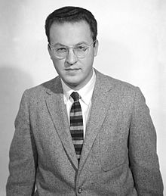
Bubble chambers
Pressurize the liquid to ~10 Atm
to keep it from boiling
Pass particle beam through liquid
Rapidly depressurize the liquid
--it starts to boil around the
track-induced ions.
Allow bubbles to grow for ~3 msec
Flash lamps; take photographs
Recompress before general boiling
occurs.
Repeat
Cryogenic liquid
above its normal
boiling point
1959 Nobel physics prize
Donald Glaser
1926-2013

Slide 19
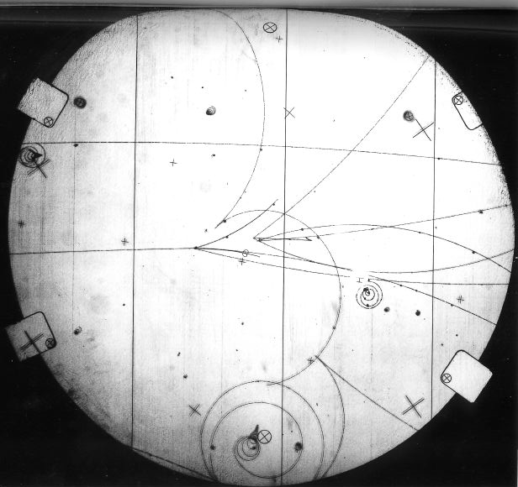
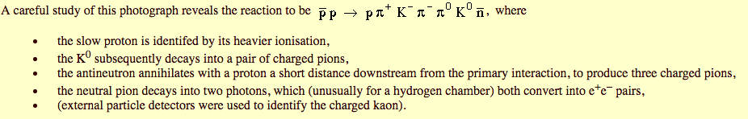
Bubble chamber event
K⁻ S=-1
K⁻
K⁰
K⁰ S=+1

Slide 20
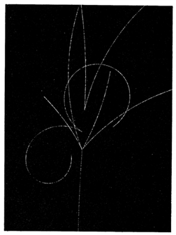
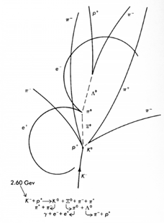
K⁻p→ K⁰ Ξ⁰ π⁺ π⁻ event
Ξ⁰ S=-2
K⁻ S=-1
K⁰ S=+1
Λ⁰
K⁰

Slide 21
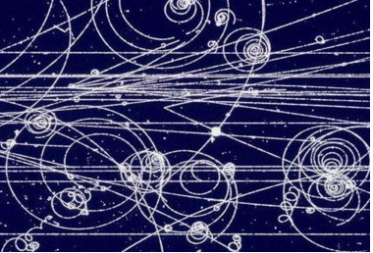
K⁰ →π⁺π⁻ or K ⁰→π⁺π⁻ ?
_
K⁰? K⁰?
_
cannot tell
C\
π⁺
both decays are allowed
π⁺
K⁰
K⁰
_
ΔS=-1
ΔS=+1
G_{F}
π⁻
G_{F}
π⁻

Slide 22
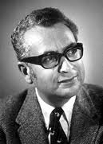
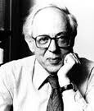
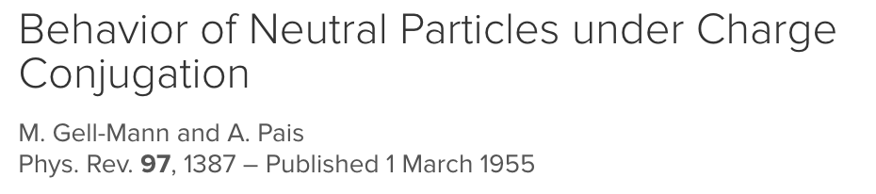
The K⁰ and K⁰ mesons are coupled
_
Gell-Mann
A.Pais
K⁰ and K⁰ can both decay to π⁺π⁻ via a |ΔS|=1 weak interaction
_
π⁺
K⁰
π⁺
K⁰
ΔS=-1
_
ΔS=+1
G_{F}
π⁻
G_{F}
π⁻
Thus, the K⁰ and K⁰ are coupled by a |ΔS|=2, 2nd-order weak interaction
_
π⁺
K⁰
K⁰
|ΔS|=2
_
G_{F}
G_{F}
π⁻
The coupling is very small (G_{F})²,
but the K⁰ & K⁰ are coupled!!
2nd-order Weak Interaction
_

Slide 23
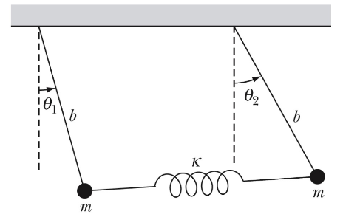
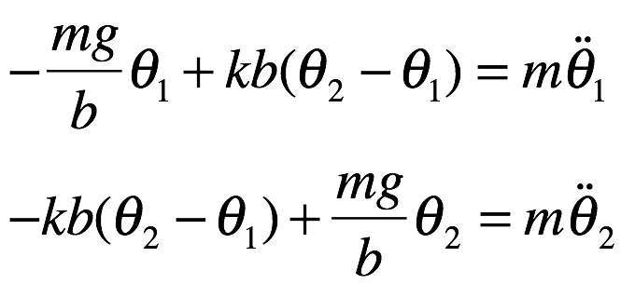
Coupled systems in classical physics
kb(θ₂-θ₁)
m
kb(θ₂-θ₁)
m
mgθ₂
mgθ₁
mg
mg
equations of motion:

Slide 24
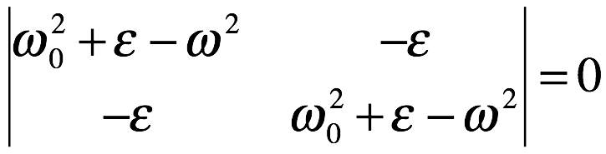
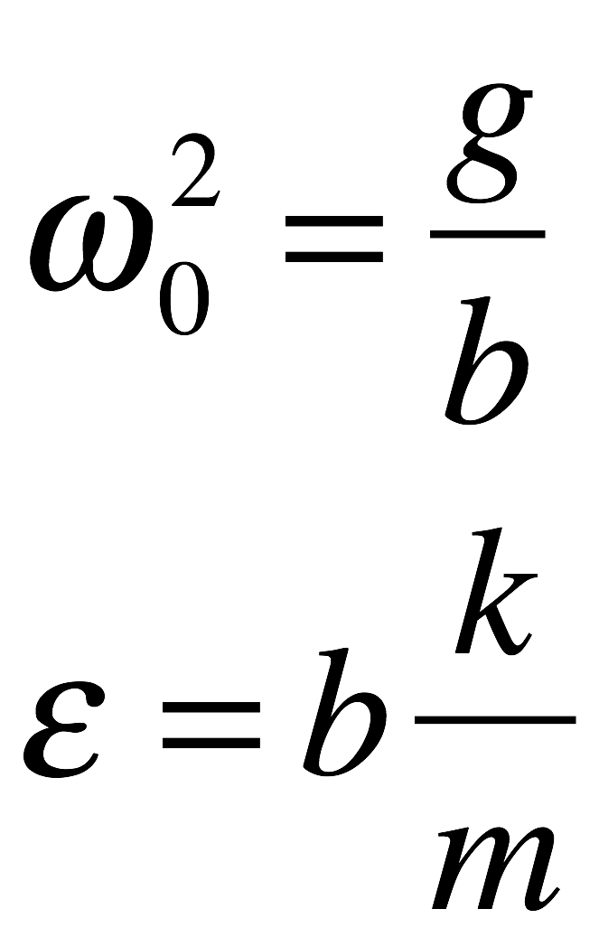
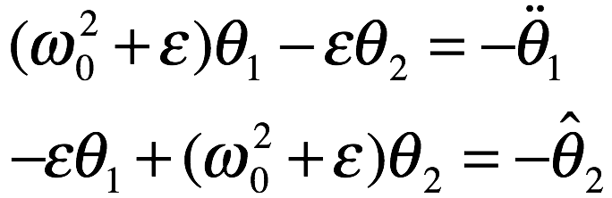
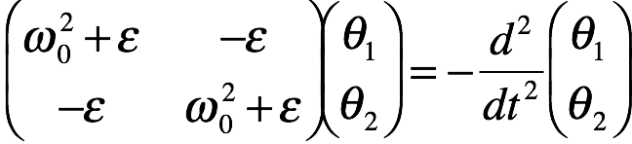
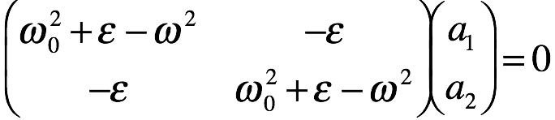
Coupled oscillator problem
use:
Equations of motion
matrix form
Solve determinant eqn. for eigen-frequencies
pick positive solutions

Slide 25
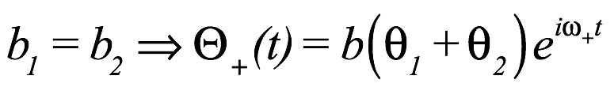
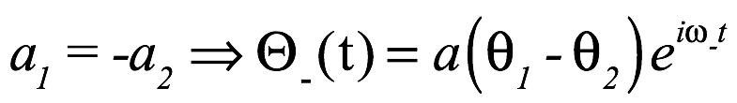
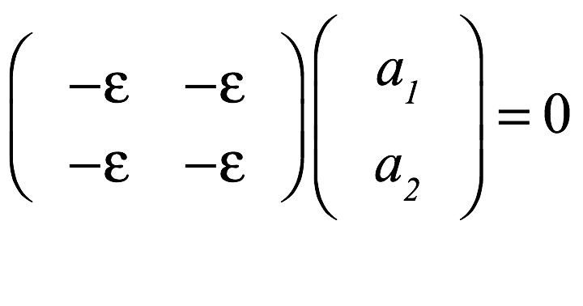
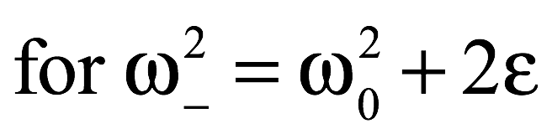
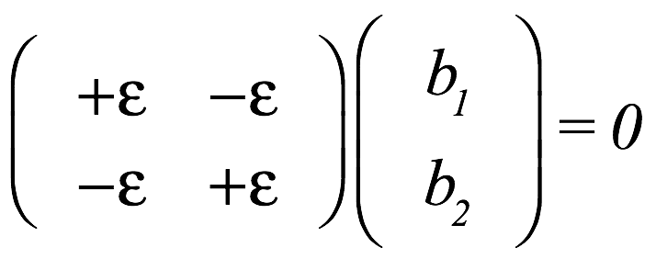
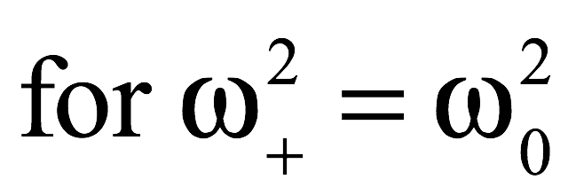
Solve for the normal modes

Slide 26
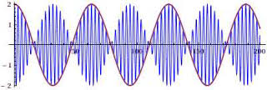
θ₁ – θ₂ mixing
Start with θ₁=θ₀; θ₂=0
θ₀ -
θ₁(t)
θ₀ -
θ₂(t)

Slide 27
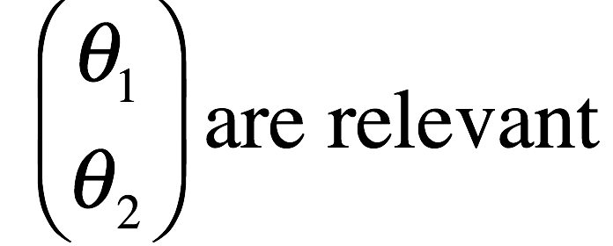
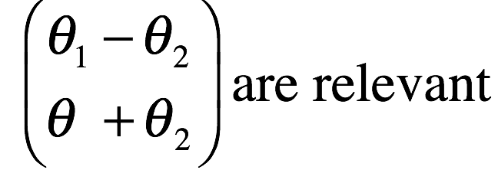
Common feature of coupled systems
a coupling drastically changes the system properties
even for very weak couplings

Slide 28
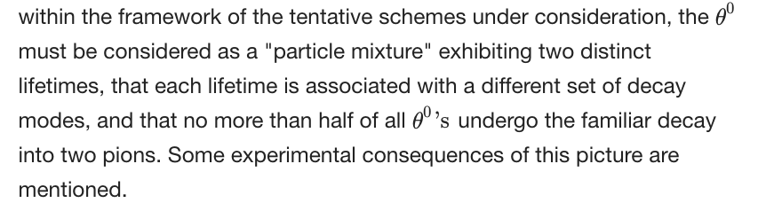
Prediction of a long-lived K⁰ meson
…
two neutral K mesons
they have different lifetimes
only one of them decays to π⁺π⁻

Slide 29
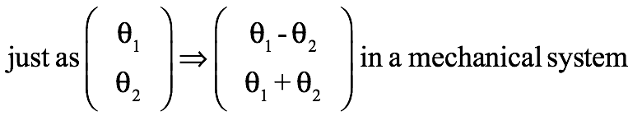
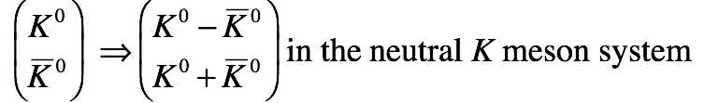
Pais Gell-Mann prediction

Slide 30
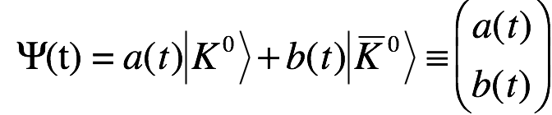
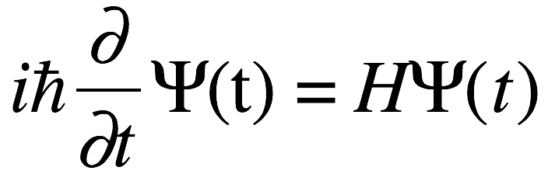
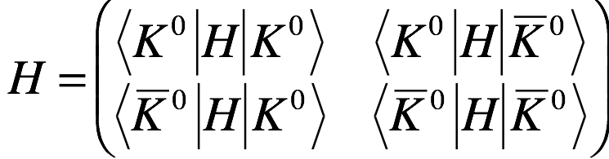
The K⁰ – K⁰ system
_
In a neutral K meson system, the K⁰ K⁰ coupling
makes it a time-dependent mixture of K⁰ and K⁰.
_
_
Schrodinger’s eqn gives the time dependence:
H = Hamiltonian operator, in the
K restframe, H= “mass matrix:”

Slide 31
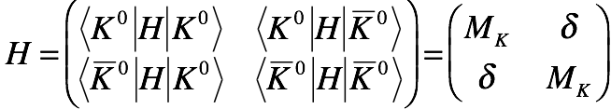
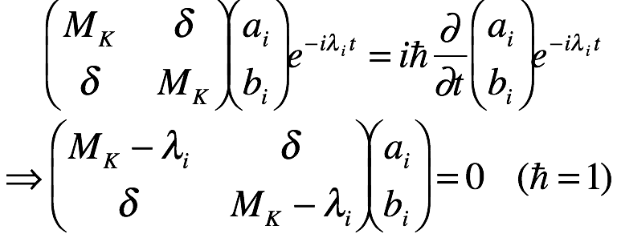
Properties of the Mass Matrix
-- assuming CP symmetry --
I ignore K⁰ life-time
terms (for now)
CPT symmetry requires:
CP symmetry says:
Schrodinger’s equation
for energy eigenstates;

Slide 32
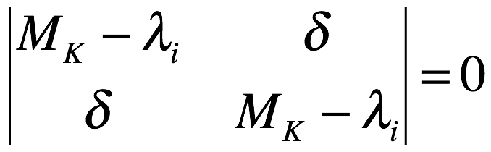
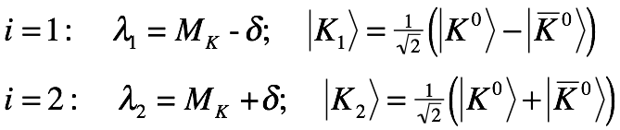
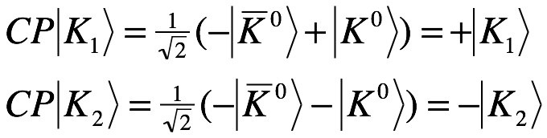

Solutions for ψ(t)
world’s simplest
eigenvalue
equation:
eigenvalues
eigenstates
using:
CP even
CP odd

Slide 33





Decay modes of the K₁ and K₂ states
CP even
CP odd
Gell-Mann & Pais:
“…no more than half
of all θ⁰’s…decay into
two pions.”
OK
CP even
X
X
CP odd
OK

Slide 34
K₁ & K₂ lifetimes
相空间
Κ₂ → π⁺ π⁻ π⁰ has little phase space
Q_{K2} = m_{K} – 3m_{π} ≈ 80 MeV
Κ₁ → π⁺ π⁻ has more phase space
Q_{K1} = m_{K} – 2m_{π} ≈ 215 MeV
Easier for K₁ to decay
➔τ_{K1}<<τ_{K2}

Slide 35

1956: Search for long-lived K⁰
Brookhaven-Columbia Expt

Slide 36

First observation of a long-lived neutral K meson
Can you see it?

Slide 37
K_{S} & K_{L} mesons
Two neutral K mesons were identified:
K₁ ➔ π⁺π⁻ τ_{KS} ≈ 0.1 nanosecs (≈10⁻¹⁰s)
500x bigger
K₂ ➔ π⁺π⁻π⁰ τ_{KL} ≈ 50 nanosecs (≈5x10⁻⁸s)
K₁ K_{S} “K-Short”
K₂ K_{L} “K-long”
“capital S”
“capital L”

Slide 38




K_{S} & K_{L} mesons

Slide 39
C, P & CP for π and K mesons
γ −1 −1 +1

Slide 40
K_{S} & K_{L} mesons

Slide 41
Production of K_{S} and K_{L} mesons

Slide 42



K_{L} & K_{S} mesons in e⁺e⁻ annihilation
need K⁰ and K⁰ with J^{PC}=1⁻⁻
E_{cm}=m_{φ}=1.02 GeV
_
_
e⁻
K⁰
J=1 : K and K in a P-wave
P=-1: (-1)_{K} (-1)_{K} (-1)_{P-wave}
C=-1: (+1)_{KS} (-1)_{KL}
_
C=-1
φ
e⁺
P=-1
K⁰
only K_{S}K_{L}has C=-1
φ-factory:
e⁺e⁻ → φ →K_{S}K_{L}
@ E_{CM}=1.02 GeV
E_{CM}

Slide 43



e⁺e⁻ φ-factory at Frascati, Italy
Daφne collider
KLOE detector
Daphnis
Chloe

Slide 44


e⁺e⁻ φ-factory in Novosibirsk, Russia
VEPP collider
CMD detector

Slide 45
K_{L} & K_{S} mesons from an e⁺e⁻ φ-factory
K_{S} = K-short
p_{S} = 110 MeV
<γβcτ> = 6mm
π⁺
π⁻
φ
e⁺
510MeV
e⁻
510MeV
π⁺
p_{L} = 110 MeV
<γβcτ> = 3.4m
φ= ss
M(φ) = 1020 MeV
π⁰
K_{L} = K-long
π⁻
Same quantum numbers
As ortho-positronium

Slide 46







φ → K_{L} + K_{S}
“quantum-correlated” decays
99.9%: ππ←K_{s}← φ →K_{L}
of all events
“flavor-tagged” decays
0.1%: ← ← φ →
of all events
CHARM-FACTORIES
B-FACTORIES

Slide 47

KLOE
Experiment
in Italy
K_{L}
2m
K_{S}
In this event the K_{L}
only travels ~1m
before it decays

Slide 48

Usually, the K_{L} traverses to entire 2m radius of the drift chamber
K_{L} “crash”
β= 0.22 (TOF)
K_{L} “crash”
2m
K_{S} → π⁻e⁺ν
K_{S}

Slide 49
Neutral K mesons “Basis” sets
These have a
well defined
quark structure
strong interactions select these
K⁰-K⁰
Flavor States
These are the
particles with
well defined
lifetimes that
exist in Nature
K₁-K₂
CP eigenstates
K_{S}-K_{L}
Mass eigenstsate
are these
the same?
weak interactions select these

Slide 50






K⁰ K⁰ oscillations (mixing)
_
Now let us consider
decay times
+
eigenstates
+
start at t=0 with a K⁰:
then, at a later time t:
+
+
+
+
These are the
K⁰ and K⁰ rates
we measure
_
I₀ = beam intensity
(# of particles/s)

Slide 51


K⁰ survival; K⁰ appearance
_
--strangeness oscillations--
about 10 K_{S} lifetimes,
all the K_{S} have decayed

Slide 52


Comparison with classical system

Slide 53
Producing K mesons with π beams
Threshold for producing a K⁰ (or K⁺)
π⁻
K⁰
p
Λ⁰
π⁻ p → K⁰ Λ⁰: E_{cm} >1.61 GeV; E_{π}>0.9 GeV
Threshold for producing a K⁰ (or K⁻)
_
π⁻
K⁰
_
N
N
K
π⁻ p → K⁰KN : E_{cm} >1.93 GeV; E_{π}>1.41 GeV
_
_
Easier to produce K mesons than K mesons at fixed target hadron machines

Slide 54
The ΔS=ΔQ rule
_
Distinguishing K⁰ from K⁰ decays

Slide 55
K⁰→π⁻e⁺ν and not π⁺e⁻ν
_
d
π⁻
u
K⁰
d
ΔS=+1
s
W.I.
ΔQ=+1
W⁺
ν
e⁺
ΔS=ΔQ rule

Slide 56

K⁰→π⁺e⁻ν and not π⁻e⁺ν
_
_
ΔS=ΔQ rule
π⁺
d
u
K⁰
d
_
ΔS=-1
s
W.I.
ΔQ=-1
W⁻
ν
e⁻

Slide 57








Detecting K⁰ & K⁰ in a neutral kaon beam
_
_
start with ≈75% K⁰ and ≈25% K⁰

Slide 58




Let’s put in some numbers
e^{-t/τs}: 1 0.05 0.0025 10⁻⁴ 6x10⁻⁶
|
0
|
≃πτ_{S}
|
≃ 2πτ_{S}
|
≃ 3πτ_{S}
|
≃ 4πτ_{S}

Slide 59
revisit the φ-factory
CP=-1
φ→K_{S}K_{L}
CP=-1
OK
π⁺
CP=+1
π⁻
φ
e⁺
510MeV
e⁻
φ→K_{S}K_{s}
φ→K_{L}K_{L}
K_{L}→ππ
510MeV
violate CP
π⁺
π⁰
π⁻
π⁺
NG
π⁻
φ
e⁺
510MeV
e⁻
510MeV
π⁺
π⁻

Slide 60

KLOE sees many ππ←φ→ππ events
K_{L}→ππ?
p (K_{S} )= 110 MeV
<γχτ> = 6mm
Is this CP violation?

Slide 61

The ππ←φ→ππ events have strange pattern
π⁺
π⁻
φ
π⁺
π⁻
ρ

Slide 62
K⁰ N & K⁰ N cross-section differences
_
-- N= proton or neutron --
K⁰:
d^{1/3}
s^{-1/3}
K⁻:
s^{-1/3}
← contain an s-quark
u^{-2/3}
K⁰:
d^{-1/3}
s^{1/3}
K⁺:
u^{+2/3}
_
s^{+1/3}
← contain an s-quark
_
The Λ⁰ and Σ⁺, Σ⁰, Σ⁻ all contain an s-quark:
Λ⁰:
Σ⁺:
Σ⁰:
d^{-1/3}
Σ⁻:
d^{+-1/3}
d^{-1/3}
u^{+2/3}
d^{-1/3}
u^{+2/3}
u^{+2/3}
u^{+2/3}
s^{-1/3}
s^{-1/3}
s^{-1/3}
s^{-1/3}
K + N→Λ (Σ) + π allowed
K + N→Λ (Σ) + π forbidden
_
conserves Strangeness
violates Strangeness
_
K + N has only a few channels
K + N has many possible channels

Slide 63
K N cross-sections larger than KN
_
σ_{tot}(mb)
σ_{tot}(KN)
σKN)
_
_
When penetrating material K is more strongly affected than K
_

Slide 64





K_{L}→K_{S} regeneration
π⁻
π⁺
“regenerator”

Slide 65

K_{L}→K_{S} regeneration in KLOE
The peaks correspond to the location of material

Slide 66

K_{L}→K_{S} regeneration in KLOE

Slide 67

Angular dist for K_{L}→K_{S} regeneration
coherent
incoherent

Slide 68



Coherent regeneration
f = f(θ=0)
remains coherent with initial beam
f = f(θ≠0)
Scatters out of initial beam
scintillating material
dangerous background
very useful experimental tool

Slide 69

Some K-meson properties

Slide 70
the search for CP violation

Slide 71
Properties of the Mass Matrix
-- slide 26 --
I ignore K⁰ life-time
terms (for now)
CPT symmetry requires:
CP symmetry says:
Let’s not use
this condition
& assume CP
is violated
Schrodinger’s equation
for energy eigenstates;

Slide 72




Hamiltonian operator with decays
i
2
-
H=M - -- Γ
-- now we will include decays --
Hermitian
Mass matrix
Decay matrix
CPT symmetry:
no assumptions about CP
Hermiticity:

Slide 73


Schrodinger’s Equation
-- allowing for CP violation and including decays --
to conform to the standard notation:
Schrodinger’s equation
for energy eigenstates;

Slide 74




Solutions for Ψ(t)
eigenvalue
equation:
eigenvalues
eigenstates
HW
in terms of the
CP eigenstates:
HW

Slide 75



Decay of the K_{L}
CP odd
CP even
OK
OK
CP odd
CP even
If CP is violated: K_{L} contains a CP -even K₁ component

Slide 76
Discovery of K_{L} decays to π⁺π⁻

Slide 77


“Hint” for K_{L}→π⁺π⁻ ??
a Bubble chamber
in a neutral beam
at Brookhaven saw
some π⁺π⁻ events
neutrons & K_{L}’s
K_{L}→π⁺π⁻events or K_{L}→K_{S} via regeneration

Slide 78


proposal

Slide 79


AGS Brookhaven’s 2nd HE accelerator
-- world’s first strong focusing accelerator, still running, more than 50 years later --
“Inner Mongolia”

Slide 80

BEPC—AGS see the differences?

Slide 81

AGS combined function magnets

Slide 82


Quadrupoles & dipoles
dipole
Quadrupole

Slide 83

the “inner Mongolia” beam line
“Inner Mongolia”
shielding blocks
sweeping magnet
AGS accelerator magnets
Internal target

Slide 84

The Fitch-Cronin experiment
Helium gas
all K_{S} have
decayed

Slide 85

Spark chamber

Slide 86


Slide 87


Slide 88


Slide 89
Data-taking and analysis

Slide 90

➔
➔
➔
➔

Slide 91

_______
____________________________

Slide 92





Slide 93


5211 K_{L} ➔ π⁺ + π⁻ candidates remeasured on a commercial bubble chamber measuring machine
π⁺π⁻ “invariant mass”
M(π⁺π⁻)<M(K_{L})
M(π⁺π⁻)=M(K_{L})
π⁺
|
θ=1º
π⁺π⁻)>M(K_{L})
cosθ

Slide 94



Slide 95

Results

Slide 96
CP is violated!!
James Cronin
Val Fitch
1980 Nobel Prize for Physics
No prizes for Christenson or Turlay

Slide 97

25 year anniversary reunion

Slide 98







Let’s look at ε:
what we know about p & q
definition of ε:
rewrite ε in terms
that we know:

Slide 99


Some comments
CP is only violated if the off-
diagonal terms are different
*
Hermiticity: M₂₁=M₁₂ & Γ₁₂=Γ₂₁
CPV only driven by imaginary terms
*
Latest numbers:
CPV is very small, ~10⁻³G_{F}², far from
the maximum that is possible
(unlike P and C violations)

Slide 100



virtual & on-shell K⁰--K⁰ couplings
_
2nd-order quark-level
virtual |ΔS|=2 process
“short-distance processes”
due to Mass Matrix CPV
On-shell pion-induced
|ΔS|=2 process
“long-distance processes”
due to Decay Matrix CPV

Slide 101


Phase of ε (η₊₋)
&
φ_{SW}=“Superweak phase”

Slide 102


K⁰ -- K⁰ basis states with CPV
_
Solve for K⁰ and K⁰
_
Please check
this for HW

Slide 103

The CPLEAR experiment

Slide 104
Strangeness-tagging at CPLEAR

Slide 105





Time-dependence of K⁰(K⁰)→π⁺π⁻
_
K_{S}
K_{L}(xη₊₋)

Slide 106




Phase of (η₊₋) from CPLEAR
CPLEAR Phys. Lett. B458, 545 (1999)

Slide 107


Neutral Kaon spectrometer @ CERN
expanded view of target region

Slide 108


Exploit K_{L}→K_{S} coherent regeneration
Need to know regeneration phase
π⁻
π⁺
π⁻
π⁺

Slide 109


ΔM and φ(η₊₋) measured via regeneration
K_{S}
K_{L}(xη₊₋)
NA31 Phys. Lett. B237, 303 (1990)
beam

Slide 110

K⁰ K⁰ oscillations (mixing);no CPV→CPV
_
eigenstates
start at t=0 with a K⁰:
then, at a later time t:
These are the
K⁰ and K⁰ rates
we measure
I₀ = beam
intensity
(particles/s)
_

Slide 111

K⁰ K⁰ in a neutral K beam with CPV
_
_
ε=2.23
start with ≈75% K⁰ and ≈25% K⁰
(φ_{ε}=40⁰±4⁰)
3.4/2
2Reε=
3.4±0.2x10⁻³

Slide 112

Measurements of 2Reε (circa 1974)

Slide 113

Recent values of K-meson CPV parameters
consistent with ImΓ₁₂=0,
& ImM₁₂ responsible for all of the CPV

Slide 114
Summary of Lecture 3
K⁰ and K⁰ mesons are not mass eigenstates; K_{S} and K_{L} are mass eigenstates
K_{L} mesons discovered at Brookhaven Laboratory
a K⁰ will oscillate into a K⁰ and vice versa
neutral K mesons produced in φ decay are ~100% “quantum correlated”
K_{S} mesons are “regenerated” when a K_{L} passes through matter
_
_
Discovery of K_{L}→π⁺π⁻ decays proved that CP symmetry is violated
Measurements consistent with K_{L}=K₂+εK₁; ε= 2.2x10⁻³
Phase of ε consistent with CPV originating from short-distance Mass-Matrix terms
Many beautiful, high-statistics measurements of CPV interference effects reported

