Slide 1
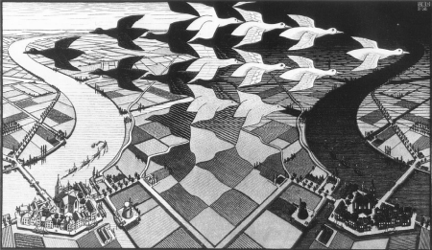

CP Violation
-- Lecture 5 --
M.C. Escher
Stephen Lars Olsen
July-August, 2018

Slide 2
Summary of Lecture 4
The Superweak model was a plausible explanation for the K_{L}→π⁺π⁻ observation
  It predicted the phase of ε = φ_{SW} =arctan(2ΔM_{K}/ΔΓ_{Κ})≃45º, in agreement with experiment,
  no other observable CPV processes, & a dull future for specialists in the field.
Precise comparisons of the rates for K_{L}→π⁺π⁻ and K_{L}→π⁰π⁰ in high-statistics
experiments exposed a direct CPV amplitude in K_{L}→ππ decays, killing the
Superweak model
The measured Weak Interaction charge of the d-quark is 0.98 G_{F}, that for the
s-quark is 0.21 G_{F}. These differences from G_{F} are due to quark-flavor mixing
The non-existence of Flavor-Changing Neutral Currents was explained by the
discovery of the charmed quark & Unitarity of the 4-quark flavor mixing matrix
Kobayashi & Maskawa: a CP violating phase can be accommodated in the quark-
flavor mixing matrix but only if there are 6 quark flavors (not 3, known in 1973)
Three more quark-flavors are discovered: charm, bottom and top.

Slide 3
Today’s topics
Necessary conditions for observable KM-type CP
violating asymmetries in B meson decays
Experimental tests of the KM model for CP violation

Slide 4
CKM matrix today
Cabbibo-Kobayashi-Maskawa
*
V_{ub}
u
CPV phases are
in the corners
φ₃ (γ)
b
W⁺
V_{td}
d
t
W⁺
φ₁ (β)

Slide 5
The challenge
*
V_{ub}
u
V_{td}
d
b
t
W⁺
W⁺
Measure a complex
phase for b→u
or in t→d
or, even better, both

Slide 6

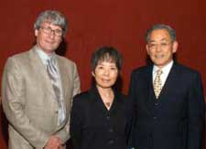

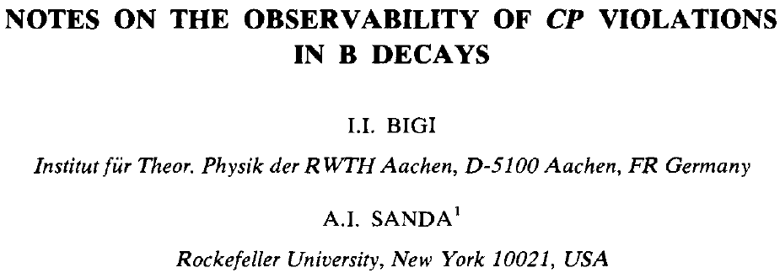
KM model predicts large differences between B⁰ and B⁰ decays
_
Ikaros Bigi
Ichiro Sanda
Ashton Carter

Slide 7
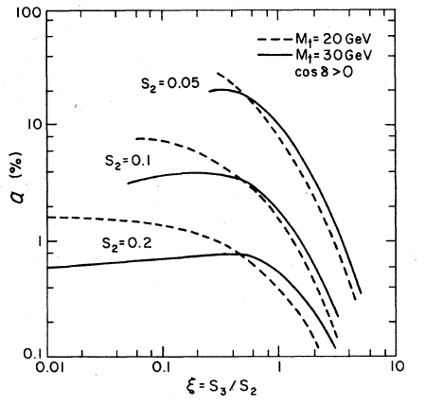
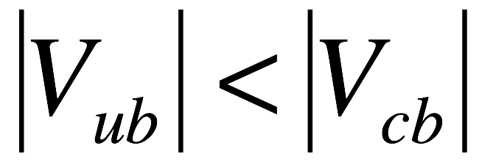
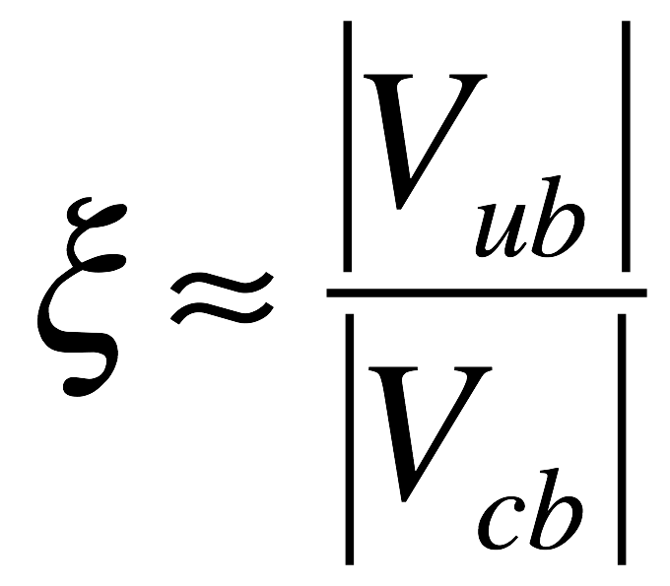

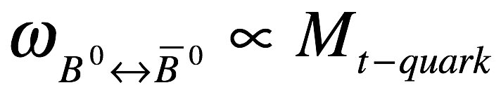
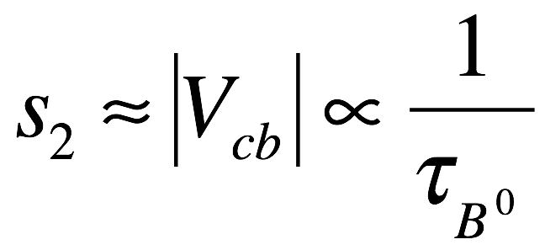

Sanda-Carter conditions
Mixing freq:
size of CPV
B⁰(B⁰) decay
asymmetry
_
Carter-Sanda Conditions
(for α≥10%):
1)
2)
3)
Phys. Rev. D23, 1567 (1981)

Slide 8
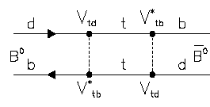
B⁰ B⁰ mixing
_
Essential element of the CPV measurement
V*
b
u,c,t
_{td}
d
tb
d
u,c,t
b
V*
_{td}
tb
These have a CPV phase: φ₁
(for B mesons, only short-distance terms are important)

Slide 9
b→d:
*
*
*
V_{ub}
V_{ud}
V_{cb}
V_{cd}
V_{tb}
V_{td}
+
+
b
u
d
b
c
d
b
t
d
*
*
*
A =V_{ub}V_{ud} f(m_{u}) + V_{cb}V_{cd} f(m_{c}) + V_{tb}V_{td} f(m_{t})
amplitude for b→u,c,t→d mixing
*
*
*
GIM: V_{ub}V_{ud} + V_{cb}V_{cd} + V_{tb}V_{td} = 0
Unitarity relation
non-zero only if: m_{u} ≠ m_{c} ≠ m_{t}

Slide 10
Large m_{t} would overide GIM
if m_{t} >> m_{c} & m_{u}:
t-quark
dominates
GIM cancellation
is ineffective
V*
_{td}
V*
_{td}
B⁰↔B⁰ mixing would be fast
(and this would allows us to access V_{td}’s CPV phase)

Slide 11
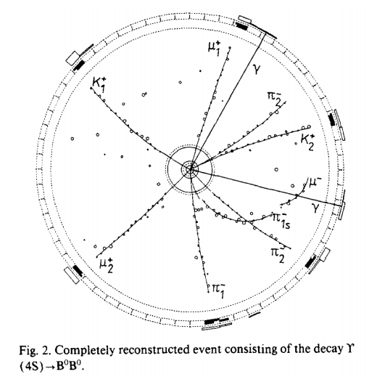
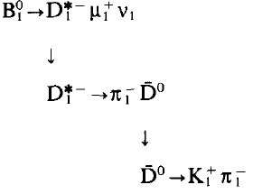
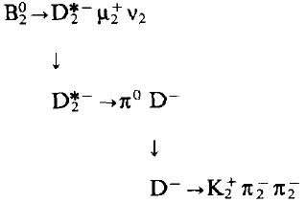
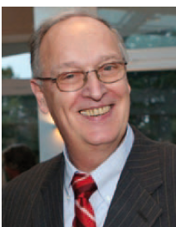
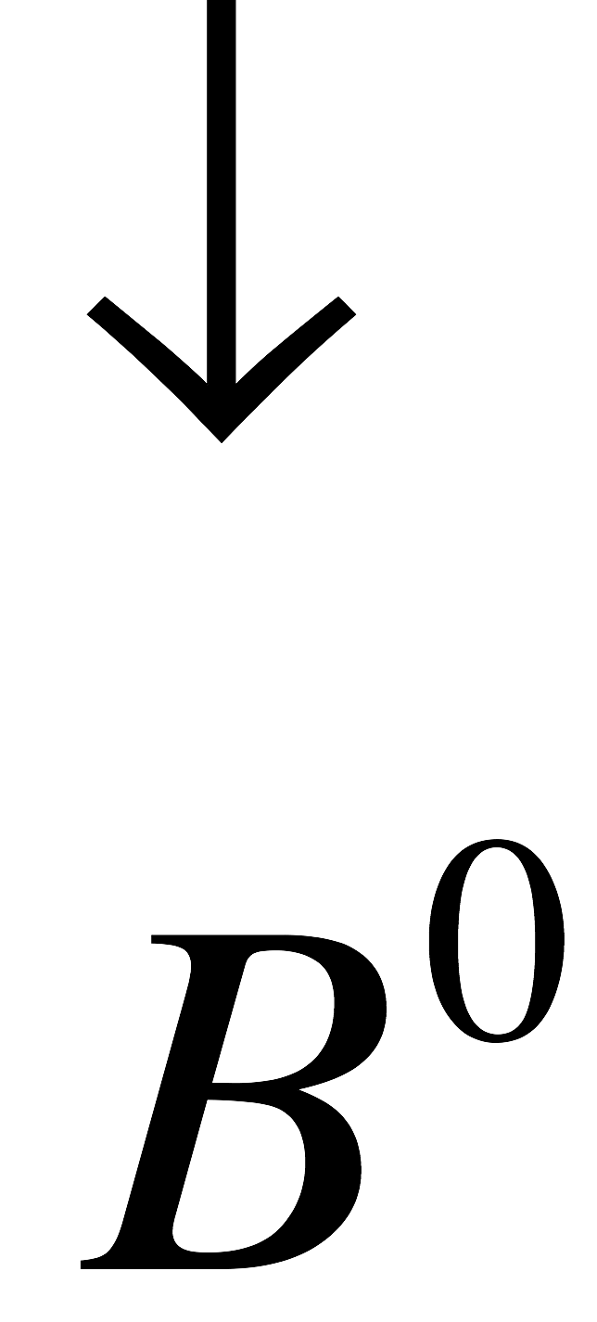
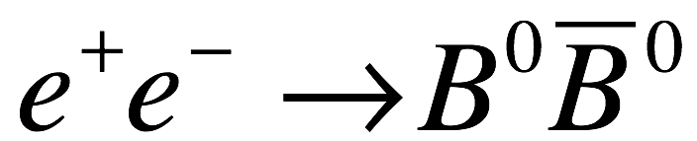
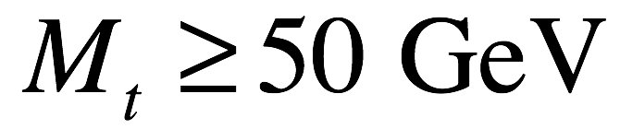
B⁰—B⁰ mixing discovered in Germany
_
ARGUS Experiment
PLB 192, 245 (1987)
Henning Schroeder
1945-2012

Slide 12
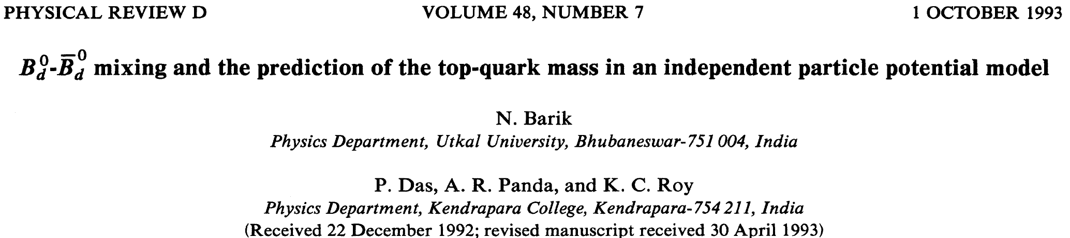
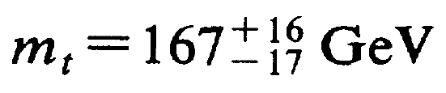
m_{t} prediction from B_{d} B_{d} mixing
_
pg 3271
PDG 2012: m_{t} = 173.5 ± 0.6 ± 0.6 GeV

Slide 13
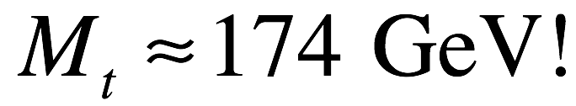
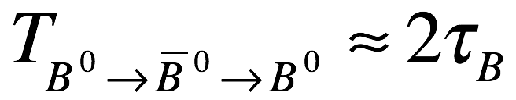
Y.H. Zheng, PhD Thesis
N(B) – N(B)
N(B) + N(B)
Y.H. Zheng et al., Phys Rev. D 67 092004 (2003)

Slide 14
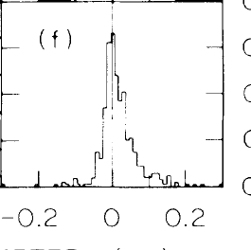
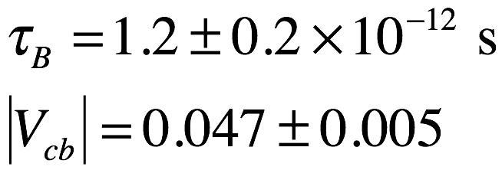
Long B-meson lifetime discovered at SLAC
more B-decays with
positive decay lengths
B⁰ meson
SLAC result in 1987:
δ (cm)
W. Ash et al., Phys. Rev. Lett. 58, 640 (1987)
B-meson
δ
<γβct>~0.5mm~resolution

Slide 15
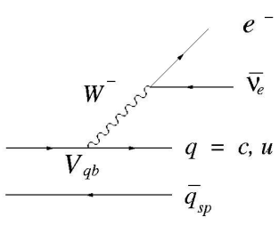
measure |V_{ub}|/|V_{cb}| from B→Xe±ν endpoint
b
c
b
u
B
B
π
_
V_{cb}
D
_
V_{ub}
q
M_{D}≈1.87 GeV
q
M_{π}≈0.14 GeV
b→ceν
endpoint
b→ueν
endpoint
2.31 GeV
2.64 GeV

Slide 16
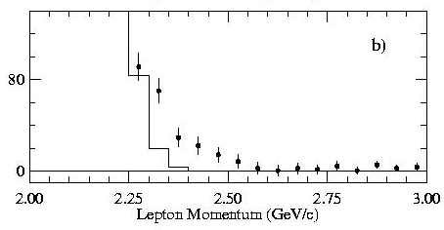
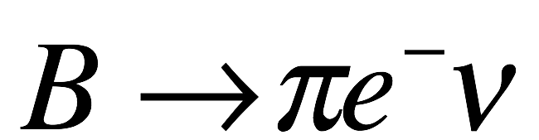
|V_{ub}|= 0.0041±0.0009 (≈0.1|V_{cb}|)
CLEO experiment
2000
B→X_{c}eν
decays
V_{cb}
B→X_{u}eν decays
V_{ub}
S.A. Anderson, PhD thesis U. Minn (2002)

Slide 17
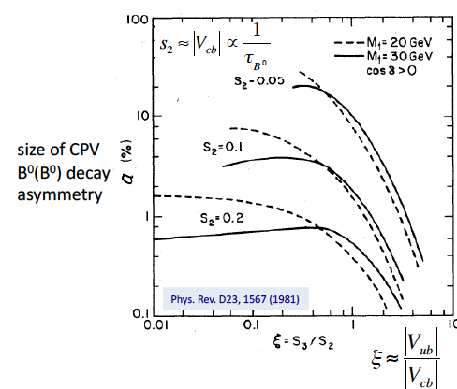
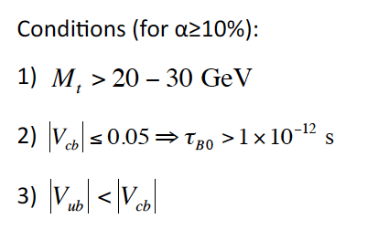
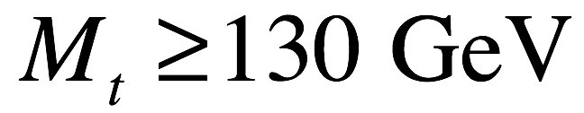
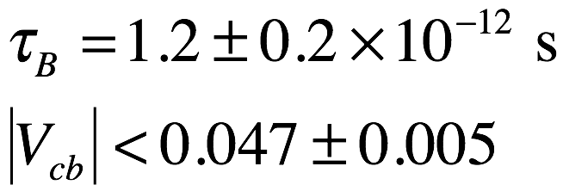
Carter-Sanda conditions are met!
Measurements (~1990)
ARGUS (DESY):
SLAC:

Slide 18
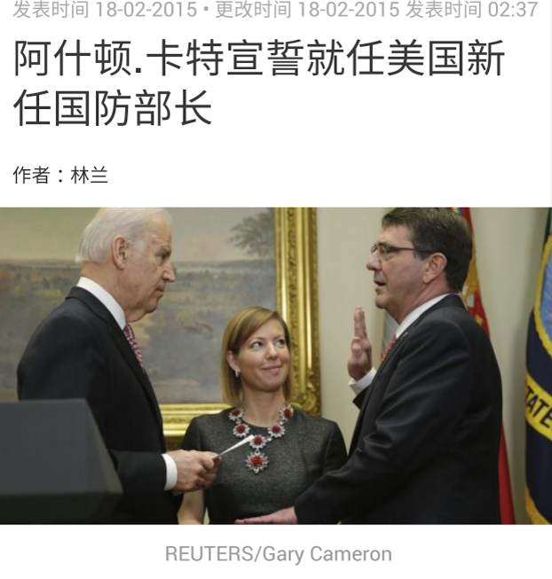
Ashton Carter in 2015

Slide 19
The Key
Use B⁰ mesons
B⁰ =
d
B⁰ =
b
b
d
B⁰/B⁰ similar to K⁰/K⁰

Slide 20
小学课本
Primer on B mesons

Slide 21
Lesson 1: Basic properties
What are B mesons?
  B⁰ = d b B⁰ = b d
  B⁺ = u b B⁻ = b u
  J^{PC} = 0⁻ ⁺
  τ= 1.5 x 10⁻¹² s (cτ ≈ 450 μm)
How do they decay?
  usually to charm: |b→c|² / |b→u|² ≈ 100
How are they produced?
  e⁺e⁻ →ϒ (4S) → B B is the cleanest process
b^{-1/3}
d^{+1/3}
d^{-1/3}
b^{+1/3}
b^{-1/3}
u^{-2/3}
u^{+2/3}
b^{+1/3}

Slide 22
Lesson 2: “flavor-specific” B decays
In >95% of B⁰ decays:
B⁰ and B⁰ are distinguishable by their decay products
semileptonic decays:
X l⁺ ν
X l⁻ ν
B⁰
B⁰
D
hadronic decays:
D X
D X
q
B⁰
C^{+2/3}
B⁰
D
C^{+2/3}
q

Slide 23
Lesson 3: B → CP eigenstate decays
In 1~2% of B⁰ decays:
final state is equally accessible from B⁰ and B⁰
charmonium decays:
J/ψK_{S}
J/ψK_{L}
…
B⁰
B⁰
J/ψ
c^{+2/3}
c^{-2/3}
J^{PC}=1⁻⁻
charmless decays:
π⁺π⁻
K⁺K⁻
…
CP=+
B⁰
B⁰

Slide 24
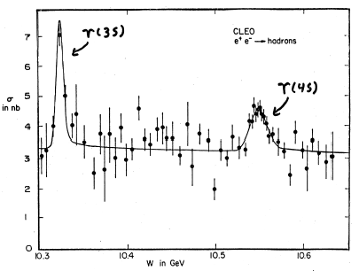
Lesson 4: The ϒ(4S) resonance
³S bb bound states
σ(e⁺e⁻→ BB) ≈ 1nb
B⁰B⁰/B⁺B⁻ ≈ 50/50
good S/N: (~1/3)
BB and nothing else
coherent 1⁻⁻ P-wave
BB
threshold
σ(e⁺e⁻)→ hadrons
CLEO PRL 54, 381 (1985)
~95% flavor-specific decays; only
a few % are CP-eigenstate decays
10.58GeV
e⁺e⁻→qq continuum (u, d, s &c)

Slide 25
Lesson 5: B⁰ ←→B⁰ mixing
_
A B⁰ can become a B⁰ (and vice versa)
_
V*
b
u,c,t
_{td}
d
tb
d
u,c,t
b
V*
_{td}
tb
These have a weak phase: φ₁
_
(in the BB system only short-distance terms are important)

Slide 26

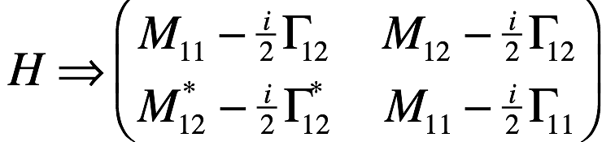
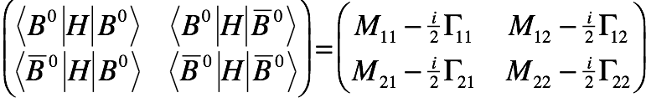
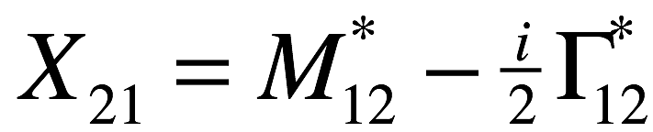
The neutral B meson system
i
2
H=M - -- Γ
Mass matrix
Decay matrix
CPT symmetry:
no assumptions about CP
Hermeticity:

Slide 27
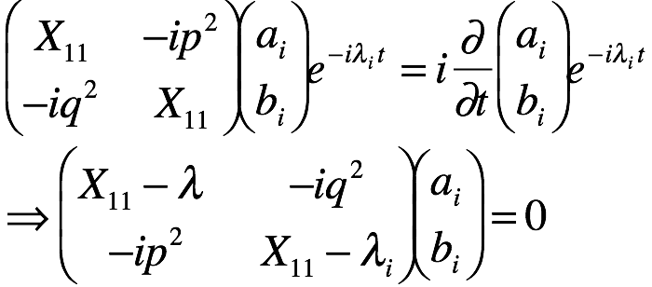
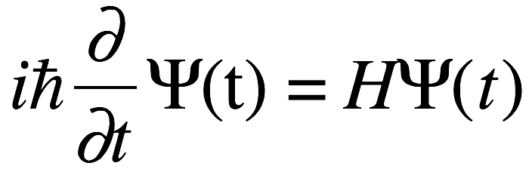
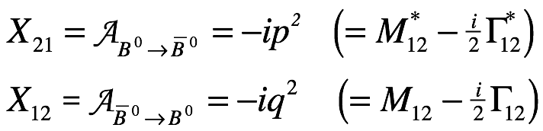
Schrodinger’s Equation
-- allowing for CP violation and including decays --
to conform to the standard notation:
Schrodinger’s equation
for energy eigenstates;

Slide 28
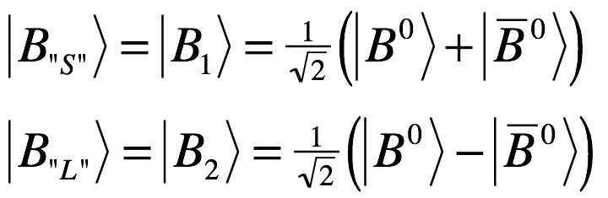
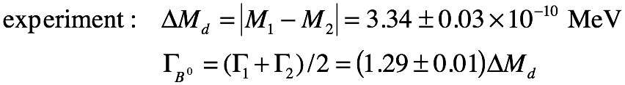
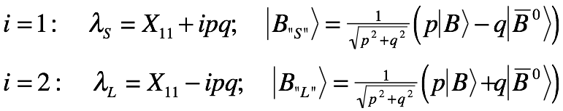
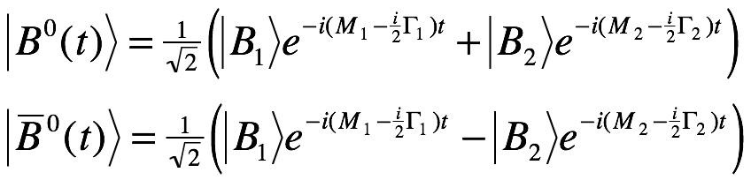
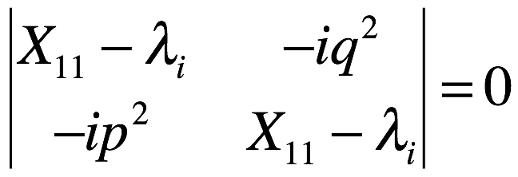
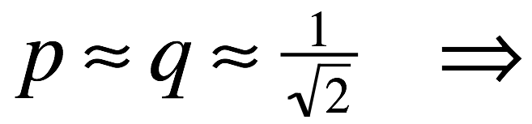
Solutions for Ψ(t)
eigenvalue
equation:
eigenvalues
eigenstates
So far, experiment says

Slide 29
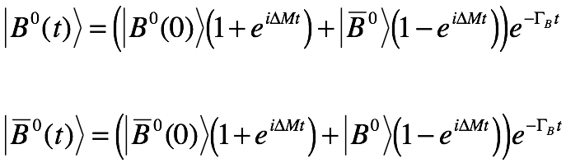
B⁰(t) and B⁰(t) time dependence
common phase
-

Slide 30
Can we measure φ₁?
two processes: B⁰→f_{cp} & B⁰ → B⁰ →f_{cp}
weak phase: 2φ₁
common phase: Δmt
Yes!!

Slide 31
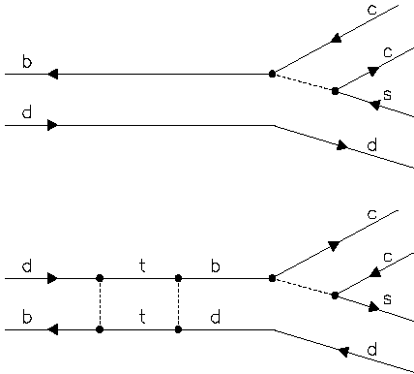
Interfere B→f_{CP} with B↔B→f_{CP}
Sanda, Bigi & Carter:
J/ψ
V_{cb}
B⁰
K_{S}
+
+
∝V*²
_{td}
J/ψ
sin2φ₁
V*
_{td}
V_{tb}
V_{cb}
B⁰
e^{iΔmt}
B⁰
B⁰
V*
K_{S}
V_{tb}
_{td}
_{td}

Slide 32
What do we measure?
Flavor-tag decay
(B⁰ or B⁰ ?)
Asymmetric energies
J/ψ
e⁺
f_{CP}
e⁻
t=0
K_{S}
Δz
B - B
B + B
sin2φ₁
more B tags
t ≈ Δz/cβγ
(tags)
more B tags
This is for CP=-1; for CP=+1,
the asymmetry is opposite

Slide 33
Requirements for CPV
Many B mesons
  “B-factory” & the ϒ(4S) resonance
Reconstruct+isolate CP eigenstate decays
  Kinematic variables for signal +(cont. bkg suppr+PID).
“Tag” flavor of the other B
Measure decay-time difference
  Asymmetric beam energies, high precision vertexing(Δz)
  Likelihood fit to the Δt distributions

Slide 34
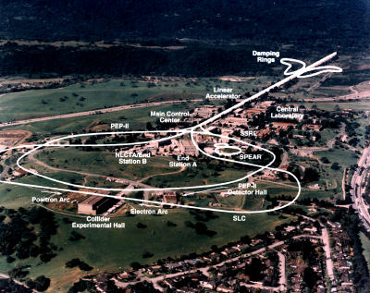
PEPII B factory in California
Stanford Linear
Accelerator Ctr
BaBar Detector

Slide 35
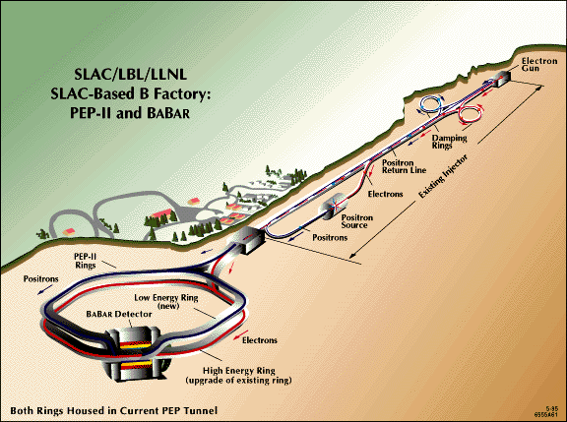
The PEPII Collider (magnetic separation)
Int(L dt)=131 fb⁻¹
On resonance:113 fb⁻¹
9 x 3.0 GeV; L=(6.5 x 10³³)/cm²/sec

Slide 36
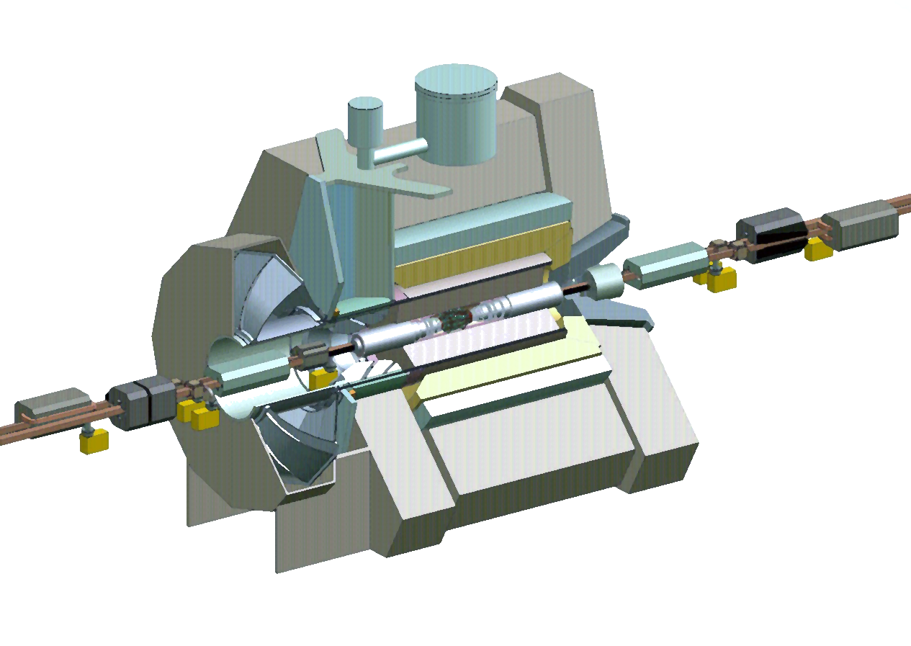
The BaBar Detector
Superconducting Coil (1.5T)
Silicon Vertex
Tracker (SVT)[5 layers]
e⁺ (3 GeV)
e⁻ (9 GeV)
Drift Chamber
[40 stereo lyrs](DCH)
CsI(Tl) Calorimeter (EMC)
[6580 crystals].
Instrumented Flux Return (IFR)
[Iron interleaved with RPCs].
Cherenkov Detector (DIRC)
[144 quartz bars, 11000 PMTs]

Slide 37
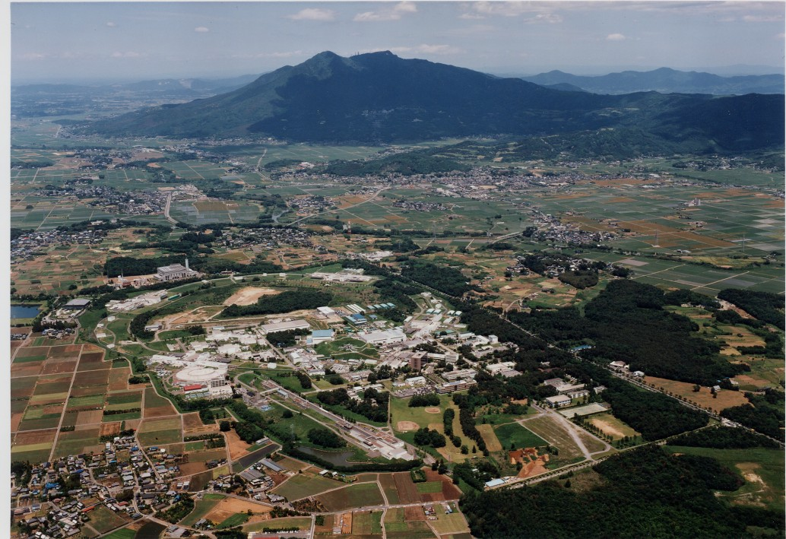
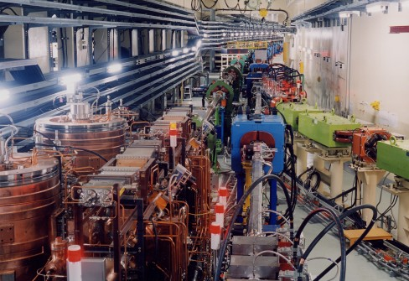
KEK laboratory in Japan
Tsukuba Mountain
KEKB Collider
KEK laboratory

Slide 38

KEKB
  Two rings
    e⁺ : 3.5 GeV 1.5A
    e⁻ : 8.0 GeV 1.1A
  E_{CM} : 10.58 GeV
  Luminosity:
    target: 10³⁴ cm⁻² s⁻¹
    actual: 2x10³⁴cm⁻² s⁻¹
        (~20 B’s/s)

Slide 39

e⁺e⁻ luminosity ~ 2^{(t/2.5yr)}

Slide 40



Slide 41


elle
A magnetic spectrometer based on a huge superconducting solenoid

Slide 42

Step 2: Select events
π⁺π⁻
B⁰ → J/ψ K_{s} event
μ⁺μ⁻
Tracking chamber only

Slide 43

Drift chamber for tracking & momentum measurement
Georges Charpak
1924-2010
1992 Physics Nobel Prize

Slide 44

Belle drift chamber under construction

Slide 45
Drift chamber cell
Charged particle track
-
E-field
-
-
-
~50 ionization electrons/cm
-
-
16mm
-
-
-
+
-
Drift speed ≈ 50μm/nsec
Position resolution ≈ 150 μm
-
-
-
-
17mm

Slide 46
Event-time structure
e⁻
Δz=1.2m; Δt=4ns
e⁺
e⁺
e⁻
δz≈0.7cm;
δt≈0.05ns
e⁺
e⁻
Events occur during 0.05ns time intervals
separated by 4ns
It is not difficult to determine the time an
event occurred (t₀) with <±0.5ns precision

Slide 47


Gas multiplication in a drift chamber
V₀
a
b
V=0
For V₀=2000V, b=2 cm a=20μm:
E-field at the wire≈150×10³ V/cm
Gas gain ~ 10⁵

Slide 48




Time vs drift distance
charged particle track
t_{drift}
t_{drift}
t₁=L/v
X
t₂=t₁+t_{drift}
t₁
t_{drift}
t₂
measure this
L
calculate this
L/v
X
t=0
t=0

Slide 49


Same event in the entire Detector
J/ψ→μ⁺μ⁻
K_{S}→π⁺π⁻
B⁰ → J/ψ K_{s} event

Slide 50

Kinematic variables for the ϒ(4S)
in CM:
E=E_{cm}/2
J/ψ
K_{S}
B⁰
e+
e+
e-
e-
B⁰
E=E_{cm}/2
invariant mass:
Beam-constrained
mass:

Slide 51

Kinematic variables for the Υ(4S)
σ≈10MeV
Energy difference:
σ ≈ 2.5 MeV
Beam-constrained mass:
Signal purity≈98%

Slide 52


B⁰ →ψ K_{L} signal event
Event display
1399±67 signal
J/ψ K_{L}
K_{L} “crash”
p_{B}* (cms)
[2332 events with a purity of 0.60]

Slide 53
Step 3: Check the other tracks to see if the other meson is a B⁰ or a B⁰
?
?
?
?
?
?

Slide 54
Flavor-tagging the other B
Figure of merit(Q)=ε(1-2 w)²: the ‘effective” tagging efficiency
Inclusive Leptons:
  high-p l⁻ b→ c l⁻ ν
  intermediate-p l⁺ s l⁺ ν
Inclusive Hadrons:
  high-p π ⁻ B⁰→D^{(*)+} π ⁻, D^{(*)+} ρ ⁻, etc.,
  low-p π⁺ D⁰ π⁺
  intermediate-p K⁻ K⁻X
w=wrong-sign tags
π⁻π⁰
Belle: effective efficiency = 30 %

Slide 55
Distinguishing different particle types dE/dx
Ionization density
in the drift
chamber (dE/dx)

Slide 56
K meson identification from dE/dx, Cherenkov & TOF

Slide 57
Distinguishing different particle types (time-of-flight)
Scintillation
Counter barrel
Time = L/v
x
x

Slide 58

Time of flight measurement
t_{TOF}
t_{Tprop}
t_{PMT}
t=0
t_{TOF}
t_{prop}
measure this
L
t_{PMT}
L/v
calculate this
t₀
here you use a much faster clock

Slide 59
TOF measurements of particle mass
Time = L/v ➔ β = v/c = p/√(p²+m²) ➔ m
Mass from TOF measurements

Slide 60
A K⁻ tag event means the other meson is (probably) a B⁰ (not a B⁰)
Identify the other tracks in the event
π⁻
π⁺
D→K⁻ not K⁺
D→K⁺ not K⁻
π⁺
B→D >> B→D
K⁻
π⁻
π⁻

Slide 61

Step 4. Find decay time difference
Beam spot: 110 μm x 5 μm x 0.35 cm
Silicon detectors measure Δz
(typically ~200 μm)

Slide 62

Silicon vertex detector
50μm

Slide 63
Silicon detector
Charged particle track
position resolution ≈ 20 μm
E-field
-
+
-
+
300μm
-
+

Slide 64

Magnified vertex
K_{s}→π⁺π⁻
~7cm

Slide 65

y-z vertices

Slide 66


A Fully-reconstructed Event
Human
hair
~200μ

Slide 67

Event-by-event Likelihood
resolution function
B-lifetime studies
background frac
Sidebands
& MC
b-flavor tag
PDG
ξ_{f}= ±1 for CP= ±1
lone free
parameter
wrong-tag frac.

Slide 68


P_{bk}, sidebands, etc
signal
1-P_{bk}
P_{bk}
sidebands

Slide 69



Resolution function
δt_{meas} – δt_{true}

Slide 70

sin2φ₁ measurement by Belle (2003)
5417 evts
Poor tags
“Raw” asymmetry
Good tags
BELLE-CONF-0353

Slide 71

Belle results at LP-2001 Rome
more B⁰s
more B⁰s
_

Slide 72

Belle Results LP-2001 Rome

Slide 73

Belle Results LP-2001 Rome
J/ψK_{S}
J/ψK_{L}

Slide 74
BaBar/Belle comparison (LP2001)
 | BaBar | Belle
Integrated Luminosity | 23fb⁻¹ | 33fb⁻¹
K_{S}(π+π−) J/ψ events (purity) | 316(96%) | 457 (97%)
K_{L} J/ψ events (purity) | 273(51%) | 569 (61%)
Other CP modes | 214 | 366
Effective tagging effic (w) | 26% | 27%
sin2φ₁ | 0.59±0.14±0.05 | 0.99±0.14±0.06
Weighted average: sin2ϕ₁=0.79±0.11; ϕ₁=26º ±5º

Slide 75



More recent results
Belle
2012
BaBar
2009
CP=-1
CP=+1
CP=-1
CP=+1
LHCb
2015
CP=-1
sin2φ₁ = 0.699 ± 0.017
sin2φ₁ = 0.699 ± 0.017
φ₁ = 22.2⁰ ± 0.7⁰

Slide 76

CP Violations seen in B meson decays
near their maximum possible values:
Consistent with KM-model-based prediction

Slide 77
Are these CPV asymmetries really due to a phase in the CKM matrix?

Slide 78
Summary of Lecture 5
Carter and Sanda establishes conditions on M_{t} , |V_{cb}| and |V_{ub}| for producing
measureable CP violating asymmetries in B meson decays.
Experiments at DESY, SLAC and Cornell show that the Carter-Sanda conditions are met
Experiments at KEK (Belle) and SLAC (BaBar) were designed to test the KM predictions
for large, mixing-induced CP violation asymmetries in B⁰→K_{S}J/ψ and K_{L}J/ψ decays
Both experiments found CP violating asymmetries similar
to the Carter-Sanda-Bigi KM-model-based predictions
Unlike the K meson system, where the observed CP
violating effects are small, the CP violating effects
in B meson decay are large, near their maximum
possible values (sin2ϕ₁≈0.68 vs a maximum possible
value of 1).

