Slide 1
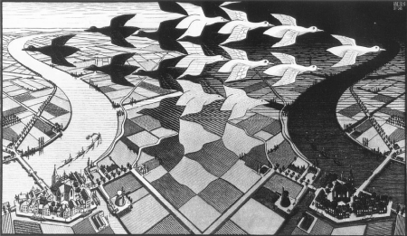

CP Violation
-- Lecture 7 --
10.200.53.248
M.C. Escher
Stephen Lars Olsen
July-August, 2018

Slide 2
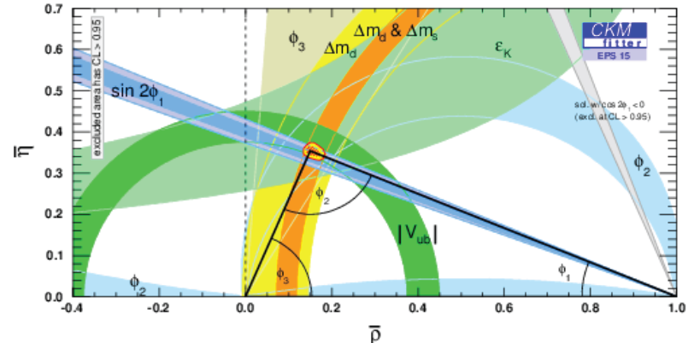
Summary of Lecture 6
Measurements of ϕ₁, the phase of V_{td} agree with constraint set by measurements of
|V_{td}| (from B⁰-B⁰ mixing); |V_{ub}| (from B→πe⁻ν); and ε (from CPV in K-mesons) .
Kobayashi & Maskawa shared the 2008 Nobel prize for their 6-quark model for CPV.
Subsequent measurements produced a precision measurement of ϕ₁= 21.9º±0.6º
and first measurements of ϕ₂=86.7º±3.5º and ϕ₃=76.2º±5.0º.
At current precision, ϕ₁+ϕ₂+ϕ₃= 185.9º±6.1^{o,}, consistent with a closed triangle.
Large direct CP violations are observed, such as a ~30% difference between B⁰ & B⁰→π⁺π⁻
All observed CP violation measurements can be
attributed to the KM phase in the 6-quark
flavor mixing matrix. The CP violations in the
3rd generation b-quark, t-quark are near their
maximum possible values (e.g, sin2ϕ₁≈0.68
vs a maximum possible value of 1).
All measured constraints on the ρ & η Wolfenstein
parameters are consistent with each other.
_
_

Slide 3
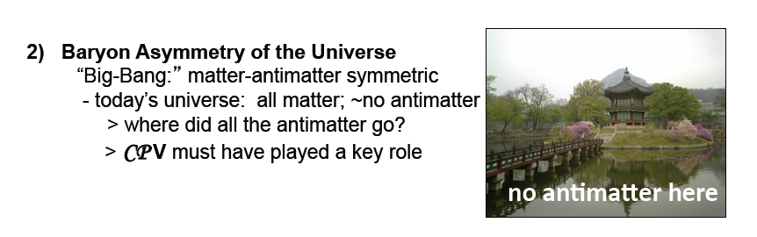
CPV and Big Bang Cosmology

Slide 4
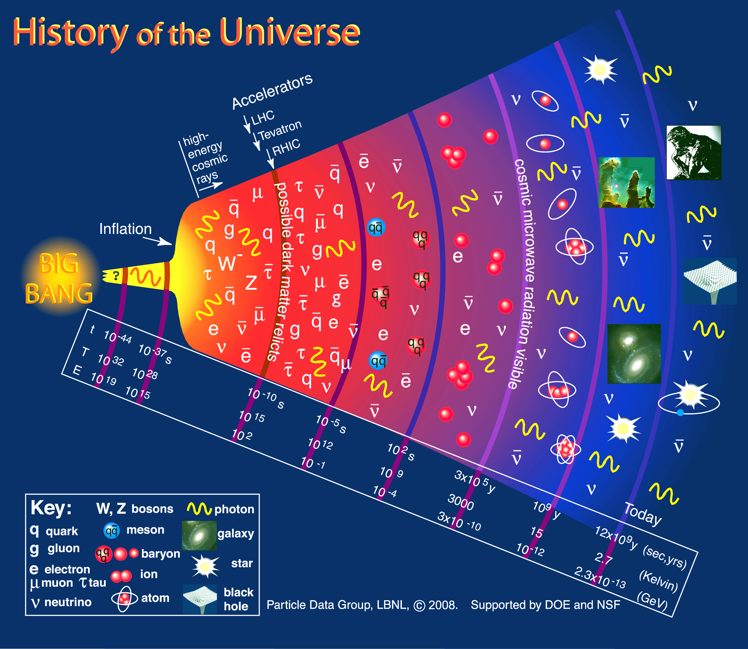
all matter &
no antimatter
equal amounts of
matter & antimatter
nuclei form here

Slide 5
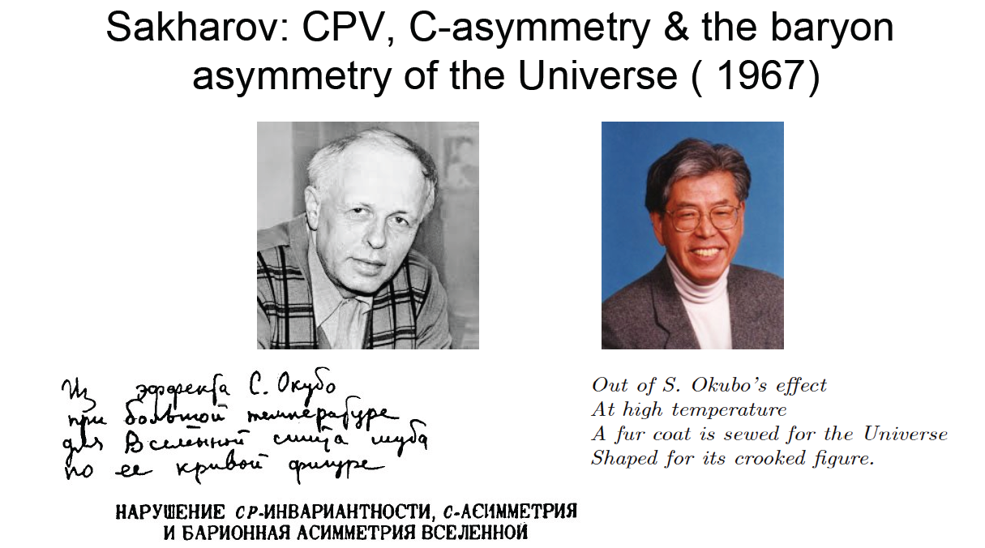
Sakharov: CP violation is necessary to explain the Baryon Asymmetry of the Universe (BAU).
-- slide from Lecture 1 --
CP violation (“S. Okubo’s effect”) is a necessary condition
for explaining why the current Universe is all matter, & not
equal amounts of matter and antimatter.

Slide 6
BAU: Baryon asymmetry of the Universe
The Universe is matter, and not antimatter.

Slide 7
How do we know that?
∼65 MeV
0.511 MeV
∼65 MeV
π⁰
p
p
_
0.511 MeV
protons and antiprotons
annihilate to pions, including π⁰s,
which decay to two ≈65 MeV γ’s
positrons and electrons
annihilate to two ≈0.511 MeV γ’s
The non-observation of these gammas indicate that there are no
large quantities of antimatter within a distance of ≲10¹¹ light yrs
Steigman, Ann.Rev.Astron.Astrophys. 14 (1976) 339-372

Slide 8
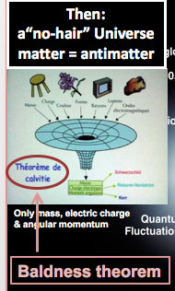
Could the baryon excess be an initial condition?
Any initial baryon (or antibaryon) excess would have been
destroyed during inflation.
Stephen Hawking’s “no hair” theorem says that the initial,
exploding Black Hole only had mass, charge and angular
momentum

Slide 9
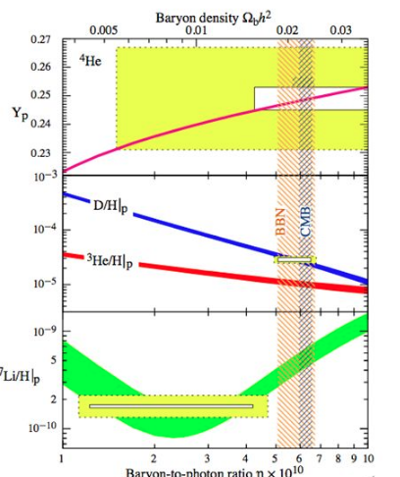
When was the baryon excess formed
nucleosynthesis models
require the matter excess
to occur for Temp > 4.7 MeV
Phys.Rev. D92 (2015) no.12, 123534
If the baryon excess didn’t
form before Temp≳40 MeV,
all of the of the protons &
antiprotons would have
annihilated each other.

Slide 10
Sakharov’s three conditions
1) Baryon number violation
2) C violation and CP violation
3) Deviation from thermal equilibrium

Slide 11
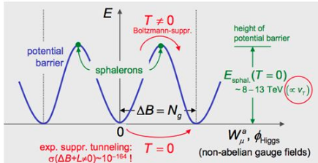
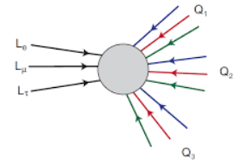
1) Baryon number violation
If we start with N_{B} = N_{B} & end with N_{B}>0 & N_{B}=0
we obviously need a ΔB ≠ 0 process
the SM theory has a ΔB ≠ 0 process called a Sphaleron
_
_
for energies E>E_{spaleron} , transitions
between adjacent vacua that
violate Lepton & Baryon number,
but conserve B-L can occur.
For example L L L → qqq qqq qqq
EW theory has different vacuum states
separated by potential barriers E_{sphaleron}∼10TeV
_
_
_
_
_
_
L=-3
B=+3
for energies E<E_{spaleron} , transitions between
different vacua are unmeasurably small
a quark has B=1/3rd
only ΔL=3 or ΔB=3 transitions occur

Slide 12
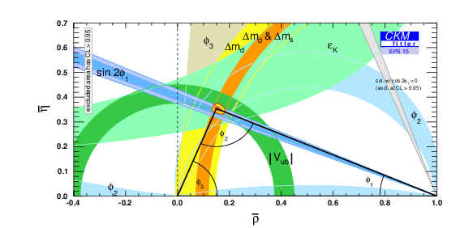
2) C violation and CP violation
as discussed at length in this class, the SM
has a well documented CPV mechanism
φ₃ (γ)
φ₁ (β)

Slide 13
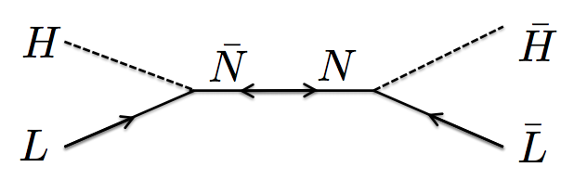
3) Deviation from thermal equilibrium
For high temperatures, ΔB ≠ 0 and CPV processes can
proceed in both directions with the net effect of
“washing out” any asymmetry that might exist.
-- need to be able to distinguish “the arrow of time” --
For the early universe, a process is in
thermal equilibrium has a rate (i.e., Γ)
that is faster than the Hubble expansion:

Slide 14
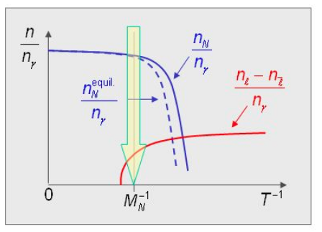
What can cause non-equilibrium?
Long lifetime (Γ≲Γ_{H}) or a mass threshold

Slide 15
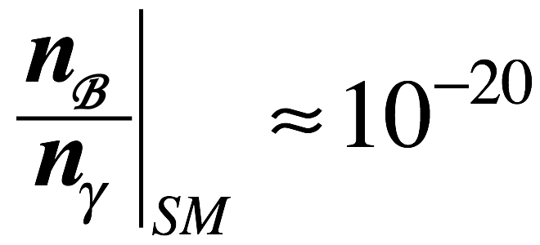
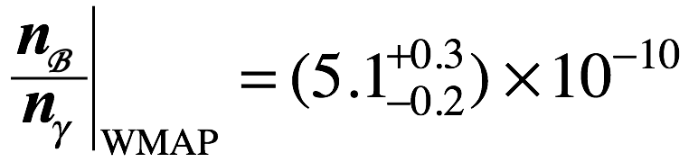
Does the KM 6-quark model do this?
Baryon asymmetry of the Universe:
WMAP
Expectation from KM 6-quark model:
too small by
10 orders-of-mag!!
Additional source of CPV is required:
-neutrinos?
-new physics?

Slide 16
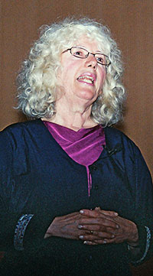
Why doesn’t the SM CPV work?
Unitarity relations give different shaped triangles
All the triangles have the same area
Cecilia
Jarlskog
J_{CKM} characterizes the size of all
CPV asymmetries in the CKM model

Slide 17
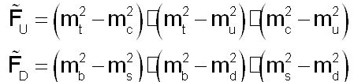
SM CPV is too small
x
x
~1.5x10⁹ GeV⁶
x
x
~6 GeV⁶
need something else

Slide 18
What about neutrinos?

Slide 19


What do we know about neutrinos?
neutrinos are left-handed antineutrinos are right-handed
ν: only
left-handed
left-handed ν: not seen
_
Left
L
ν
x
ν
_
y
ν: only
right-handed
_
right -handed ν: not seen
z
Right
R
ν
ν
_

Slide 20
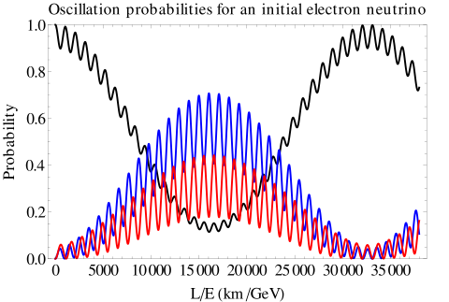
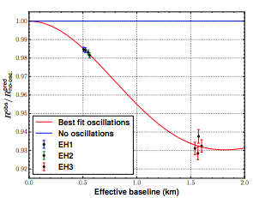
Neutrinos oscillate → they have mass
Daya Bay measured
this region
Δm_{sol} ≈7.6 x 10⁻⁵ eV²
²
Δm_{atm}≈
2.3 x 10⁻³ eV²
ν_{e}
²
ν_{μ}
ν_{τ}
Juno will measure
this region
So far we only know Δm² values, no absolute mass values.
~10⁻⁶ m_{e}
Cosmological measurements: m_{ν} < 0.7 eV (95% confidence level)

Slide 21
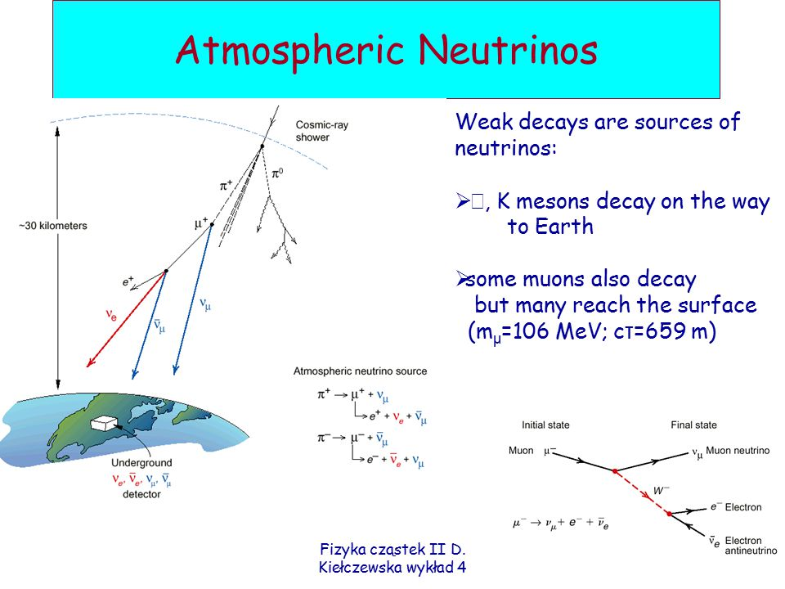

Slide 22
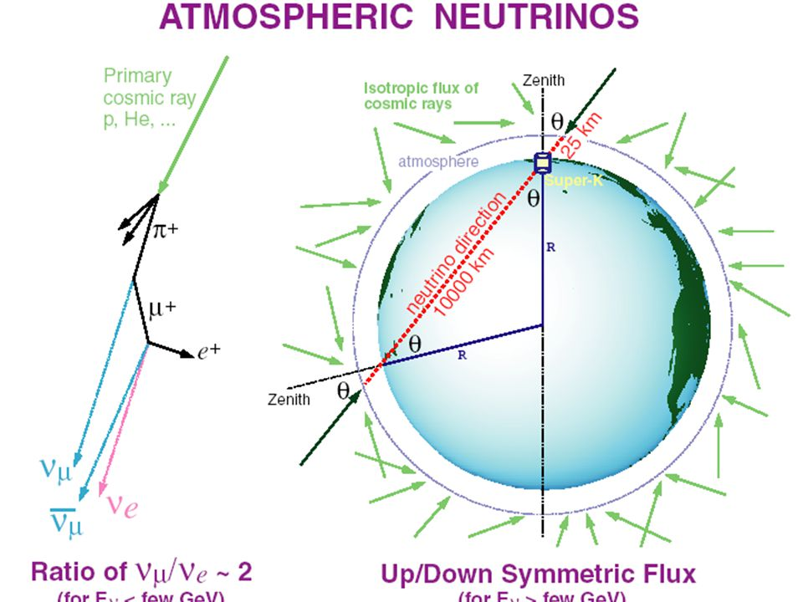
They come from all directions

Slide 23
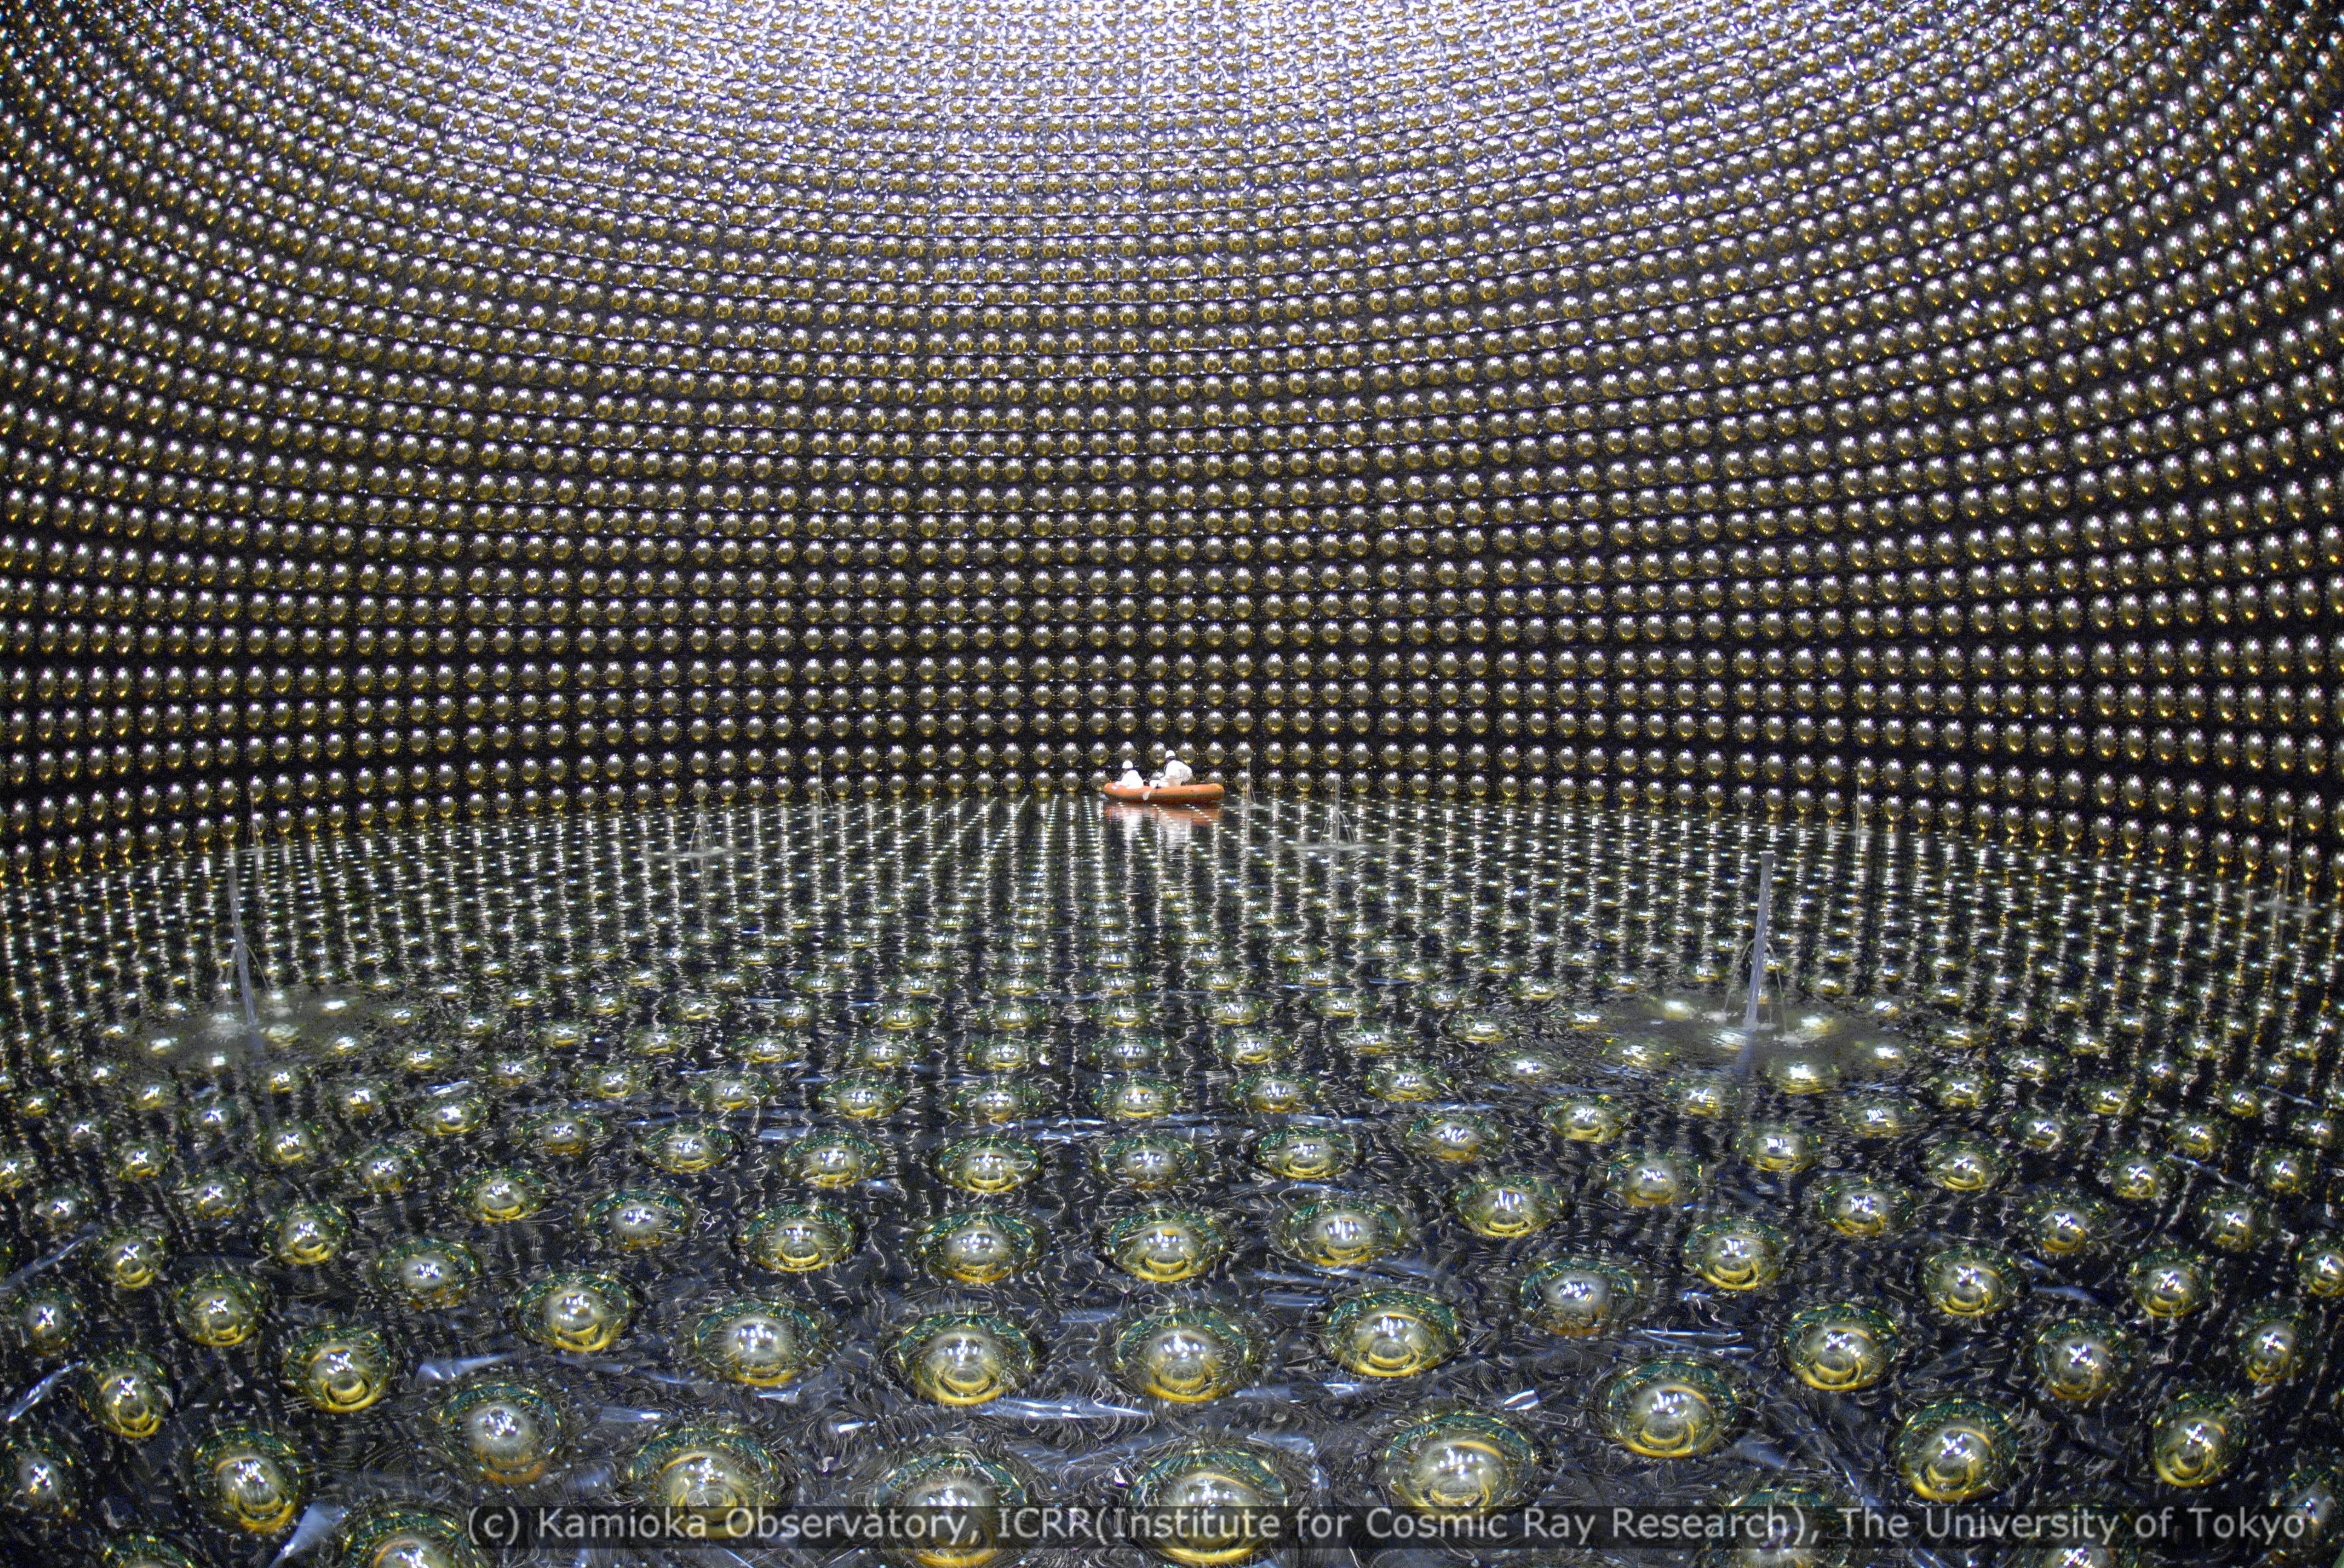
The Super Kamiokande H₂O detector

Slide 24
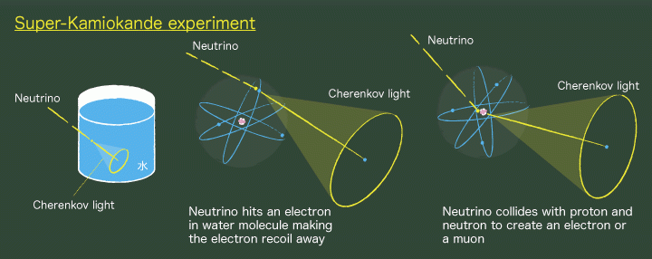
principle of detection

Slide 25

atmospheric neutrino event in Super-K

Slide 26
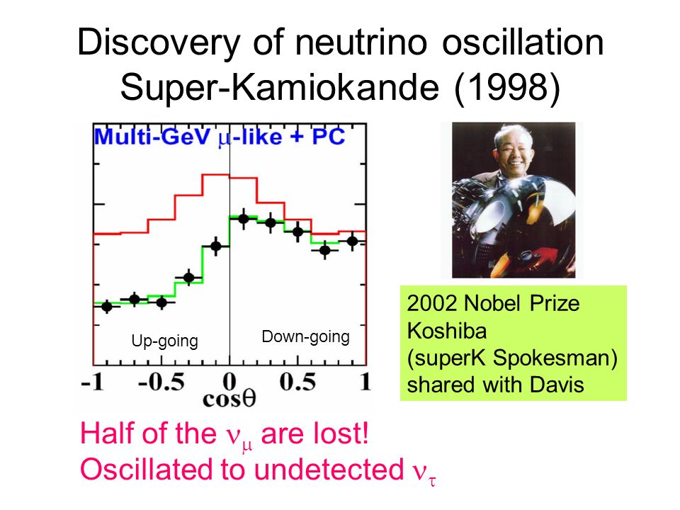
up-going muon neutrinos
oscillation frequency: Δm_{atm} ≈2.3x10⁻³ eV²
²

Slide 27
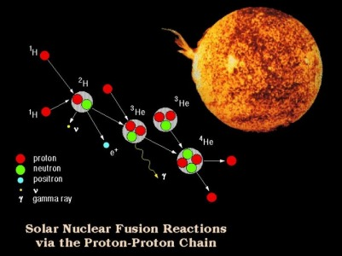
Solar neutrinos

Slide 28
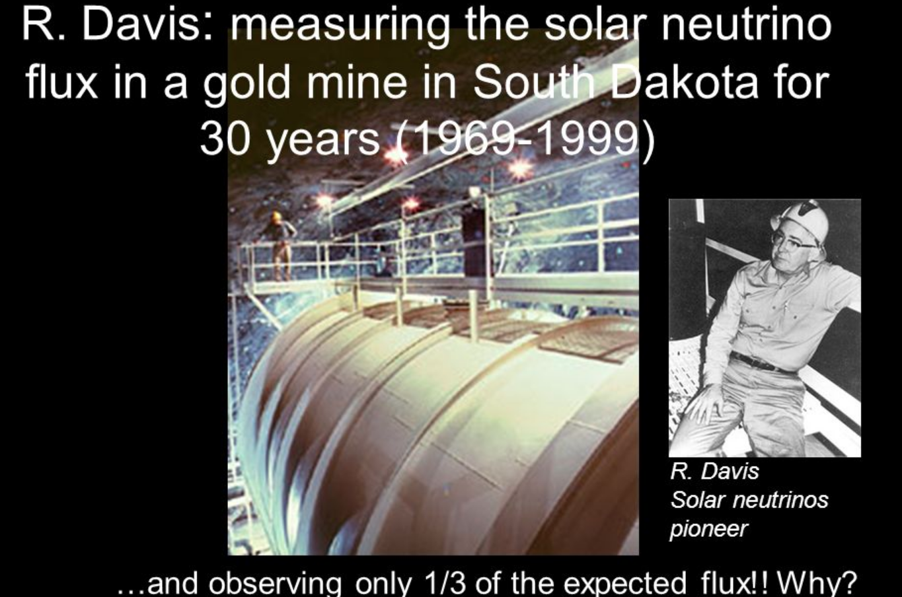
ν_{e}+³⁷Cl→³⁷Ar + e⁻
³⁷Ar: T_{1/2}=35 days

Slide 29
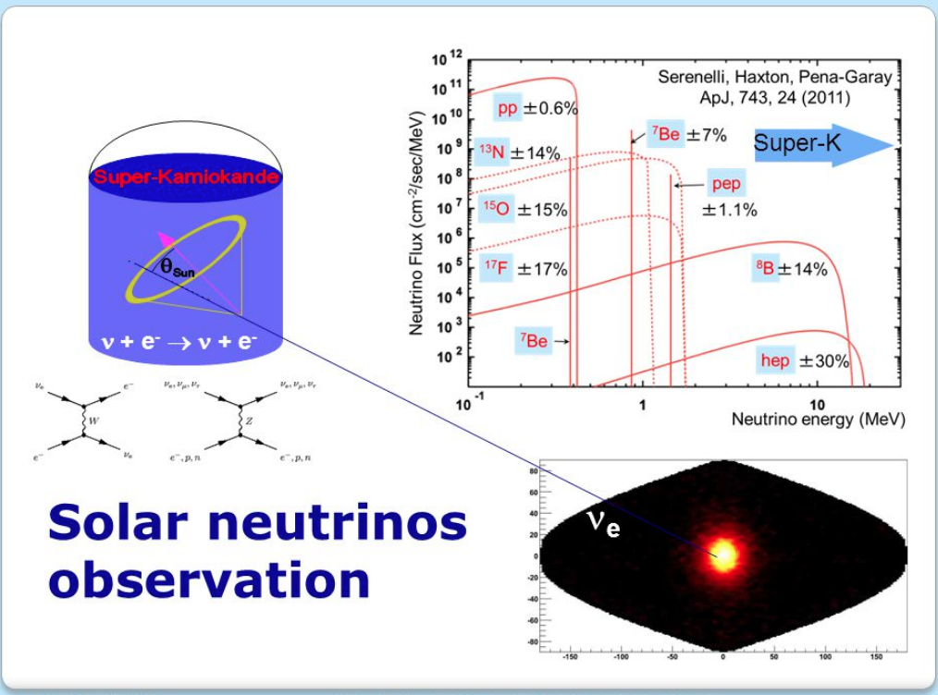
in Super-K

Slide 30
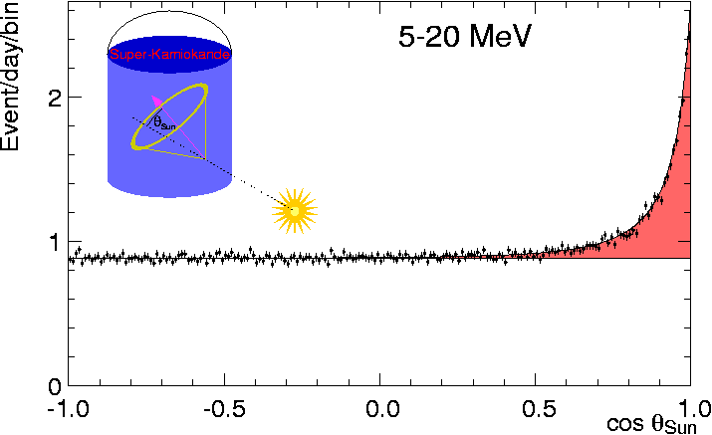
Super-K solar neutrino signal
flux is about 1/3rd expectations for no oscillations
solar neutrino oscillation frequency Δm_{sol} ≈7.6x10⁻⁵ eV²
²

Slide 31
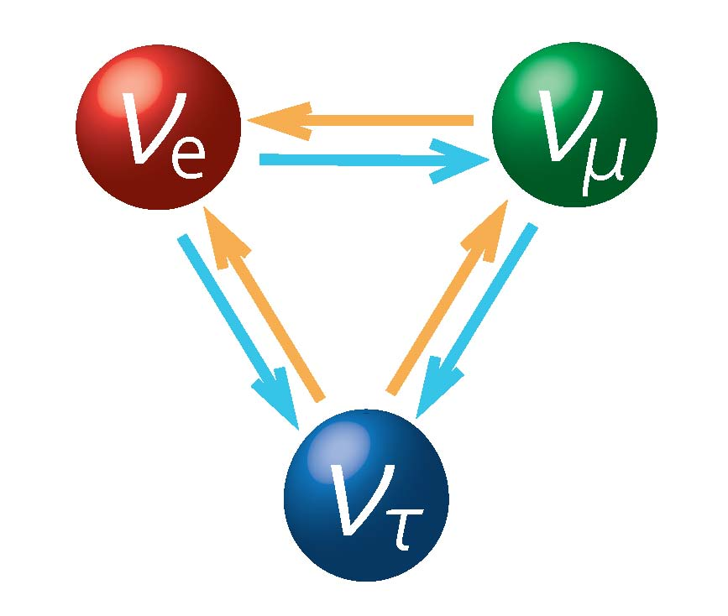
neutrinos oscillate
ν_{e}
ν_{μ}
ν_{τ}

Slide 32
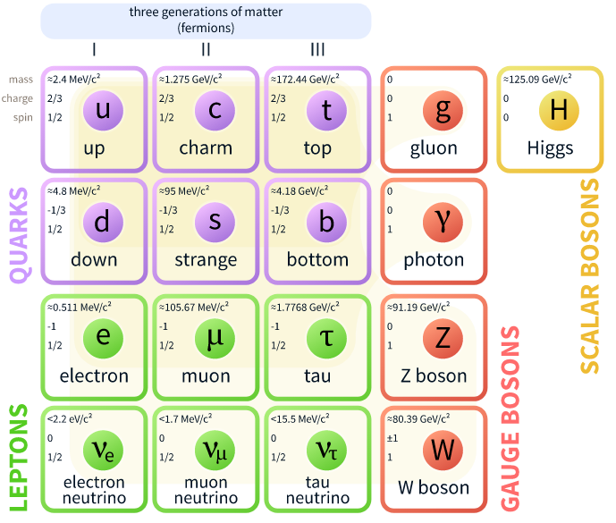
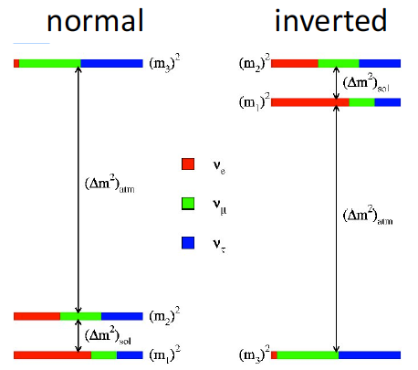

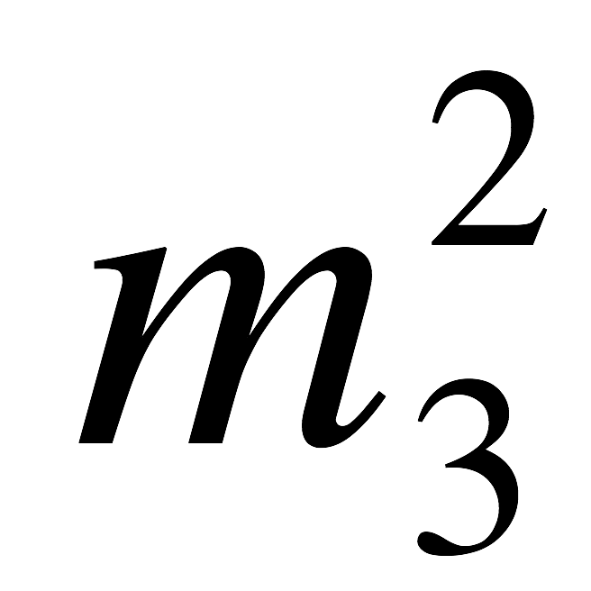
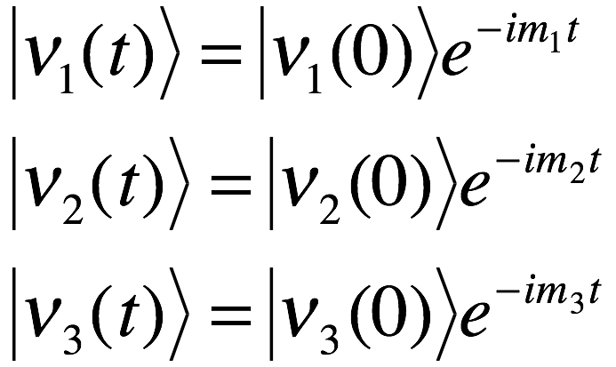
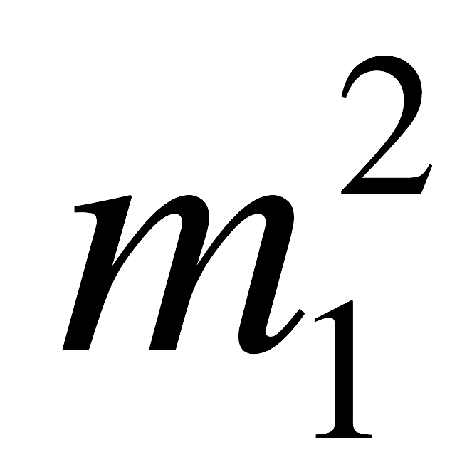
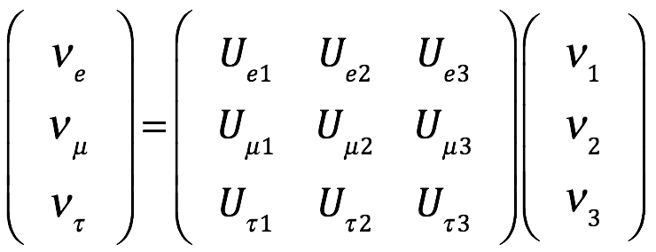
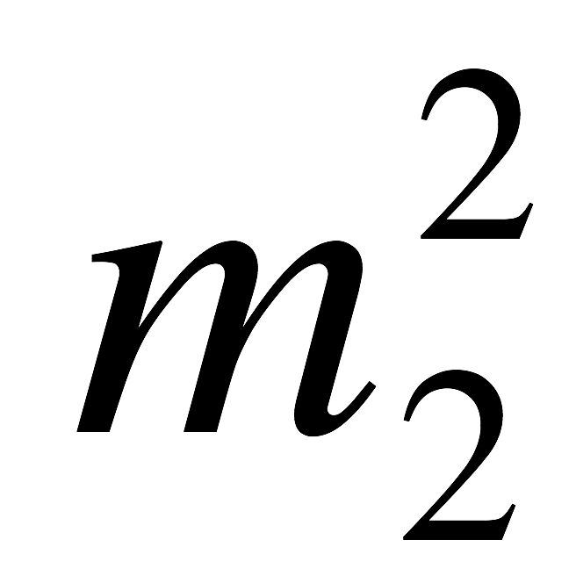
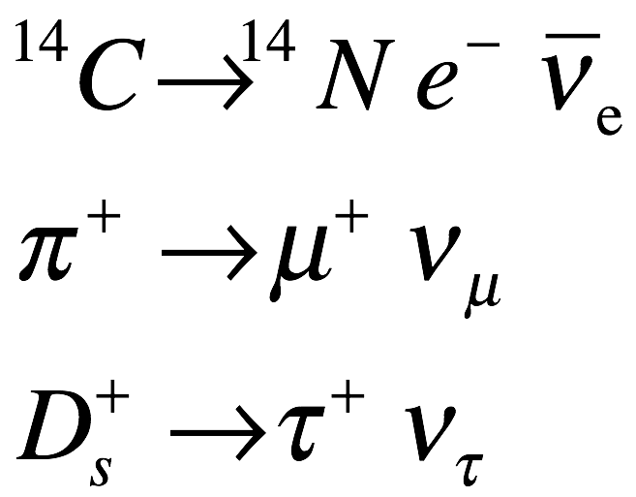
ν flavor-eigenstates and mass-eigenstates
flavor eigenstates
mass eigenstates
These are the ν’s that
we are familiar with
These ν’s have well defined
masses and frequencies
ν_{e} heaviest
flavor eigenstates
mass eigenstates
ν_{e} lightest

Slide 33
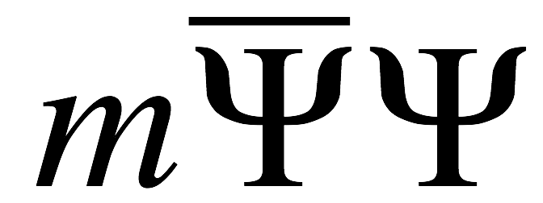
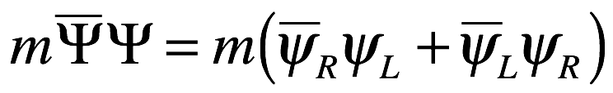


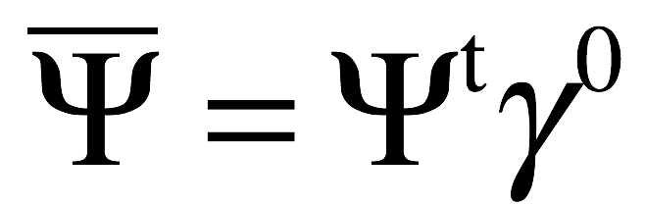
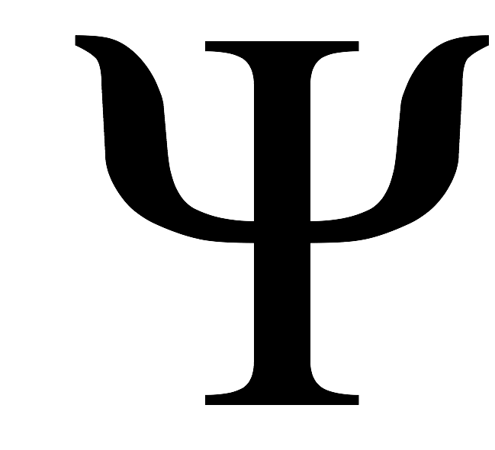
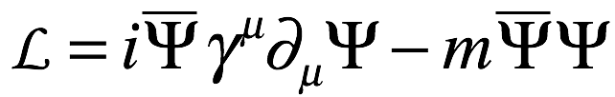
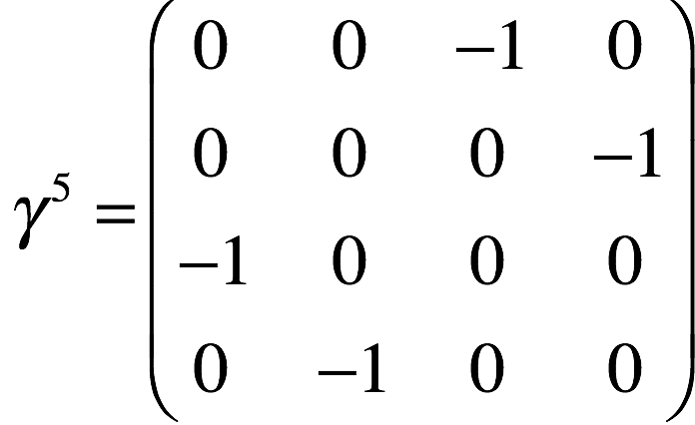
Neutrino masses are special
Hermitian conjugate
The free field-Dirac Lagrangian:
, where .
Here,
is the term that gives Dirac particles their masses.
Left-handed
proj. oper.
Right-handed
proj. oper.
Rewrite in left- and
right-handed components:
Since , it is easy to show that:
a Dirac fermion must have
both right- & left-handed
components to have mass
Since neutrinos have non-zero mass, there must be right-handed neutrinos.
-- so far, experiments only see left-handed neutrinos --

Slide 34

if m_{ν}≠0, right-handed neutrinos must exist
Left-handed
ν
ν
v₀
Right-handed
v=0
_{ν}
v’
ν
ν
v>v₀
What is this right-handed particle?

Slide 35
Neutrino masses are special
hermitian conjugate
The free field-Dirac Lagrangian:
, where .
Here,
is the term that gives Dirac particles their masses.
Left-handed
proj. oper.
Right-handed
proj. oper.
Rewrite in left- and
right-handed components:
Since , it is easy to show that:
a Dirac fermion must have
both right- & left-handed
components to have mass
Since neutrinos have non-zero mass, there must be right-handed neutrinos.
-- so far, experiments only see left-handed neutrinos --

Slide 36
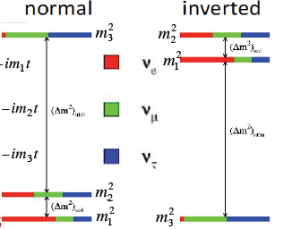
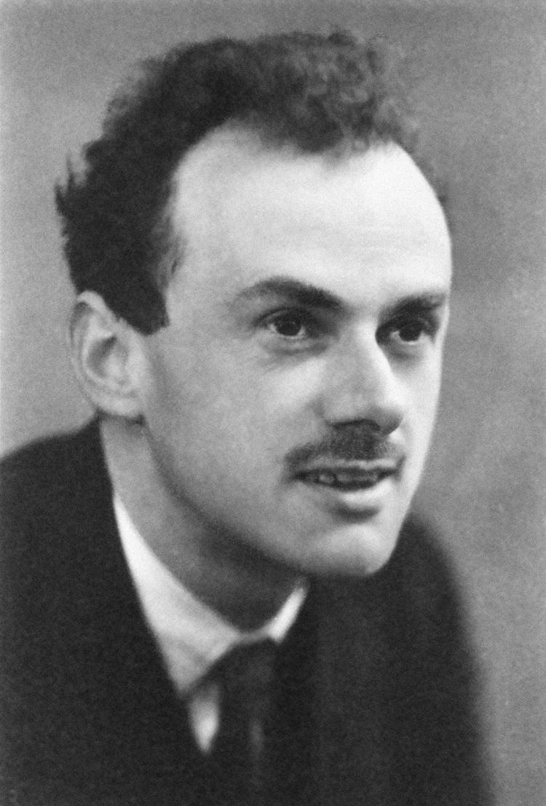
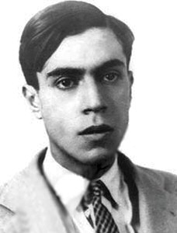
What we don’t know about neutrinos
-- What is the mass hierarchy
and absolute scale?
-- Are ν’s “Dirac” or “Majorana” particles?
-- Do neutrinos violate CP symmetry?

Slide 37
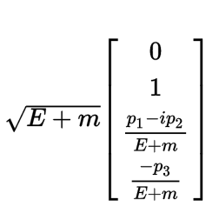
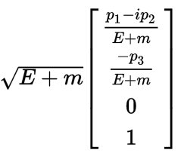
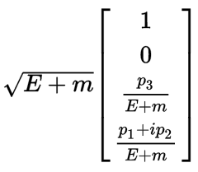
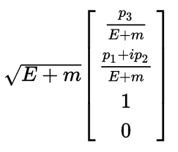
4-component Dirac neutrinos
left-handed neutrino
left-handed antineutrino
P.A.M. Dirac
1902-1984
right-handed neutrino
right-handed antineutrino

Slide 38
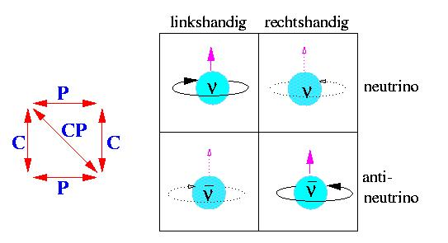
a Dirac neutrino?
no SM role
SM particles

Slide 39

Majorana neutrinos?
a neutrino is it’s
own antiparticle:
In terms of 4-comp, Dirac spinors, a Majorana neutrino is:
Ettore Majorana
1906-????
(disappeared
In 1938)
Majorana neutrinos are 2-dimensional spinors

Slide 40

Majorana neutrino?
neutrino
antineutrino

Slide 41






R- & L-handed Majorana neutrinos
ν
v’
ν
v
ν
ν
left-handed
neutrino
right-handed
“anti”-neutrino

Slide 42

What happened to Ettore Majorana?
-- 80 year old, unsolved mystery --
Has anyone seen?
Ettore Majorana, U. of
Naples physicist, mysteriously
disappeared on the last day of
March (1938). 31yrs old,
1.70m tall, slender, black hair,
dark eyes, long scar on the
back of one of his hands.
If you know something,
please write to R.P.E.
Marianecci, 66 Regina
Margherita St, Rome.
-- Fermi’s most brilliant student --

Slide 43

July 25-26 1938: What boat Majorana take?
Ferry to Palermo
suicide?
SS Oceania
to Argentina?
If he planned to commit suicide,
why did he take all his money?

Slide 44


lots of speculation
Scientist Majorana not kidnapped

Slide 45
CP V and neutrinos

Slide 46

Dirac neutrino mixing
Number of parameters: 18
Unitarity conditions: 9
6 leptons; (6-1) arb. phases: 5
# of free parameters: 4
3 Euler angles &
1 Dirac phase
Pontecorvo–Maki–Nakagawa–Sakata matrix (PMNS matrix
Daya Bay, RENO & CHOOZ
This is no more effective at generating
a BAU than the CKM phase

Slide 47

hierarchy of the PMNS mixing matrix
very different than that of the CKM matrix; the smallest element is U_{e3}≈0.15
for comparison:
V_{CKM}=

Slide 48


Dirac neutrino mixing
ν_{μ}
ν_{(τ)}
ν_{e}
beam
L

Slide 49
T2K (Tokai to Kamiokande) Experiment
-- in Japan --
ν_{e}?
ν_{μ}

Slide 50
T2K (Tokai to Kamiokande) Experiment
-- in Japan --
_
ν_{e}?
_
ν_{μ}

Slide 51









T2K experiment
anti-neutrinos!
32 evts
5 bkg)
ν_{μ}
ν_{τ}
ν_{e}
0.6 GeV
no oscillations
L/E_{ν}≈500 km/GeV
E_{ν}

Slide 52
2017 T2K results
74 evts
7 evts
ν_{e}
ν_{e}
_
ν_{e}
ν_{e}
_

Slide 53


T2K results
δ_{CP}
Central value ( NH) δ_{CP}≈-π/2 ; equivalent to Nova’s preferred (NH) value δ_{CP}≈3π/2
(Nova & T2K) errors ≈ ±0.4π (≈±80º)

Slide 54


“Hints” of non-zero δ_{D}
NOνA Preliminary
sin²θ₂₃
T2K Preliminary

Slide 55

neutrino hype

Slide 56
does non-zero δ_{D} explain the baryon asymmetry?

Slide 57
Jarlskog invariant of the PMNS v mixing matrix
if |δ_{D}|≈π/2, as the data suggest, |J_{PMNS}|≈ 0.03, 10³x|J_{CKM}|
and be more efficient at creating CPV asymmetries.

Slide 58
does non-zero δ_{D} explain the baryon asymmetry?
No!
Since there are no relevant light neutrino thresholds, light neutinos
stay in thermal equilibrium (contrary to Sakharov condition 3)
→ light neutrino CPV does not create a matter-antimatter
asymmetry. instead it tends to “wash out” existing ones

Slide 59

What if neutrinos are Majorana particles?

Slide 60

Majorana neutrino mixing
lepton number isn’t conserved &, so, the
number of arbitrary phases is smaller:
& the number of free parameters larger:
Number of parameters: 18
Unitarity conditions: 9
arbitrary phases: 4
free parameters: 6
3 Euler angles,
1 Dirac phase and
2 Majorana phases
“Majorana phases”

Slide 61

Majorana neutrino mixing
lepton number isn’t conserved &, so, the
number of arbitrary phases is smaller:
& the number of free parameters larger:
Number of parameters: 18
Unitarity conditions: 9
arbitrary phases: 3
free parameters: 6
3 Euler angles,
1 Dirac phase and
2 Majorana phases
“Majorana phases”

Slide 62
Majorana neutrino mixing
ν_{μ}
ν_{(τ)}
ν_{e}
beam
L
identical to Dirac
neutrino results

Slide 63
Majorana neutrino mixing
ν_{μ}
ν_{(τ)}
ν_{e}
beam
L
Majorana phases cannot be measured
in any ν oscillation experiment
identical to Dirac
neutrino results

Slide 64
add a right-handed, but heavy neutrino

Slide 65





Heavy Majorana neutrinos (in 2 slides)
Majorana Neutrinos:
In L-R symmetric models: is in a Weak-Isospin doublet with a charged lepton
is a Weak-Isospin singlet
The mass matrix in space is: ,
where:
-- m_{D} is the “Dirac mass” and is generated by the same Higgs mechanism that
gives the charged leptons their masses – and has a similar value;
-- (input);
-- M_{R} is the very high mass scale where L-R symmetry holds
The physical neutrinos are the eigenstates of this matrix

Slide 66



Physical Majorana neutrino states
M_{R} is very large (∼10¹² GeV?)
m_{D} is a “typical” lepton mass
Eigenvalue equation:
heavy: ~10¹² GeV
right-handed
solutions:
this is the famous “See-Saw
Mechanism” used to explain
the very low, but non-zero,
ν mass values (i.e. m_{ν}~10⁻³ eV)
light: <1eV
left-handed
If CP is violated:
for m_{D}∼1 GeV, the observed m_{ν} ≲ 0.1 eV requires M_{R} ≳ 10¹¹ GeV

Slide 67

Leptogenesis: CPV provided by decaying heavy neutrinos
e^{iαmaj}
e^{iαmaj}
C and CPV violation, Sakharov condition #2 is satisfied

Slide 68
near threshold, (T∼M_{N}) equilibrium is broken
Sakharov’s condition 3 is satisfied

Slide 69

near E_{spaleron} (∼10 TeV) antileptons→quarks
Sakharov’s condition 1 is satisfied →
Baryon number conservation is violated

Slide 70
Matter-antimatter asymmetry timeline
Big Bang
T≈M_{N}∼10¹¹ GeV
T≈M_{Sphaleron}∼10⁴ GeV

Slide 71
Comments
Leptogenesis provides a plausible explanation for BAU.
However, the main features of the model, i.e., the heavy
right-handed neutrinos, and their CPV Majorana phases
are inaccessible to experiment and, thus, the essential
features of this model cannot be confirmed.
The one neutrino-sector CPV parameter that is accessible
to experiment, the light neutrino Dirac phase, δ_{D}, has
little to do with the Leptogenesis scheme for BAU.
ν oscillation experiments (Noνa, T2K, T2HK, DUNE, …) do
not directly address the baryon asymmetry.

Slide 72









What we don’t know about neutrinos
-- that is addressed by ν-oscillation expts --
yes-no question; very likely
will be answered by JUNO
of major interest only
to some specialists
ν_{μ} →ν_{e} evts
- -
ν_{μ} →ν_{e} evts
K & M taught us that
(almost certainly) δ_{CP} ≠ 0

Slide 73




What we don’t know about neutrinos
-- that is not addressed by ν oscillation expts --
only possible with 0νββ
decay experiments
Katrin-like experiments and/or
precision CMB measurements
absolute mass msmnt +

Slide 74

0
only for
Majorana
neutrinos
Q_{ββ}
|
Q_{ββ}(¹⁰⁰Mo)=3.034 MeV

Slide 75
0ν ββ half-life
effective
ν_{e} mass
phase space
factor
impossibly difficult
nuclear Matrix Element
coherent sum

Slide 76


Slide 77


Slide 78


Slide 79


Slide 80
comments
0νββ decay experiments are impossibly difficult
big payoff ➔ if you detect it, you will have established
neutrinos as Majorana particles
extracting <m_{ββ}> will require a precision calculation
of an impossibly difficult nuclear M.E.
CPV Majorana phase information will require independent
measurements of <m_{ν}> and even then you only get
one constraint for two different phases
establishing neutrinos as Dirac-like fermions is hopeless
if the ν mass hierarchy is “normal”

Slide 81
Course Summary
CP violations are interesting because they provide a unique view of what is
going on in the inner workings of the Standard Model
Mechanisms for CP violation are critical to the understanding of how the
universe evolved from the matter-antimatter symmetric condition that
existed shortly after the Big Bang to the decidedly matter-antimatter
asymmetric condition that prevails today.
Experiments at the start of the 21st century verified the Kobayashi-Maskawa
6-quark model for CP violation.
All measured CP violations can be explained by the KM 6-quark model.
CP violations are mainly confined to the b- & t-quark sector, where they occur at near-maximum levels. The small CP violating effects in the K-meson
system are due to leakage via higher-order terms from the b-/t-quark sector.
The KM-mechanism for CP violation is not sufficient to account for the Baryon
Asymmetry of the Universe. Other sources of CPV, perhaps in the ν-sector
or from still undiscovered New Physics phenomena, must be at play.

Slide 82
謝謝

