Slide 1
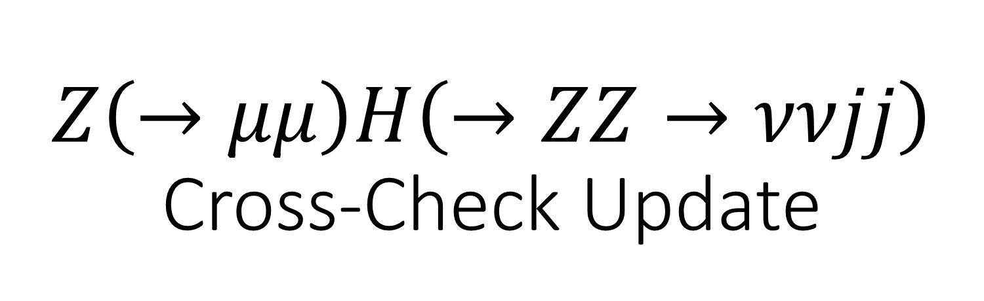
$Z\left(→μμ\right)H\left(→ZZ→ννjj\right)$ Cross-Check Update
Alex Schuy, Shih-Chieh Hsu
University of Washington

Slide 2
Cross-Check Setup
Only the signal sample (llh_zz) is considered.
Identical pre-selections and selections.
Different steering files
  Lepton Isolation
    See next slide
  Jet Clustering
    FastJet vs VertexFinder & JetClusteringAndFlavorTag
  Final State Selection
    Higgs2zz vs FSClasser

Slide 3
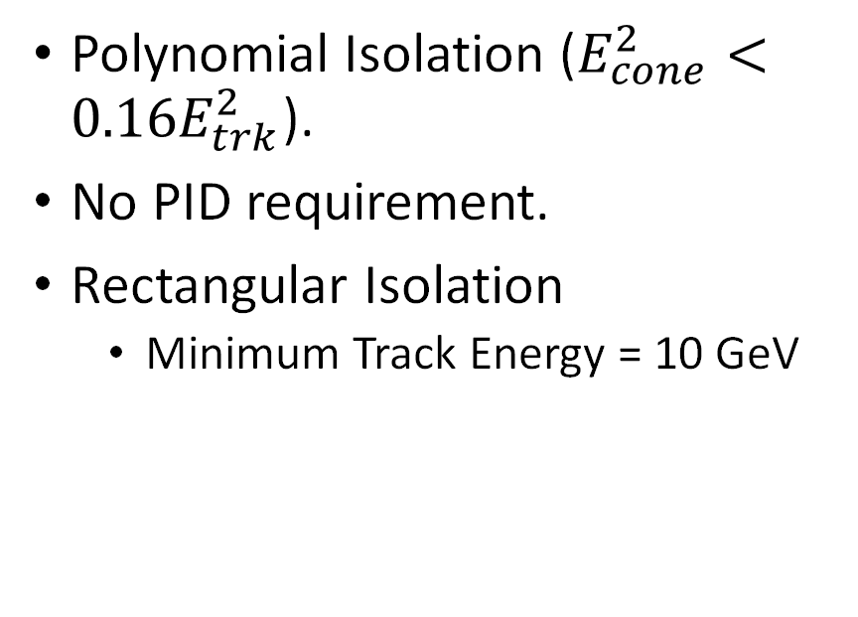
Lepton Isolation
Ryuta
Cross-Check
Polynomial Isolation ($E_{cone}^{2}<0.16E_{trk}^{2}$).
No PID requirement.
Rectangular Isolation
  Minimum Track Energy = 10 GeV
No Polynomial Isolation.
PID requirement (must be electron or muon).
Rectangular Isolation
  Minimum Track Energy = 15 GeV

Slide 4
Cut-flow Table
 | llh_zz (Ryuta) | llh_zz (Cross-Check)
Missing mass > M(di-jets) | 172 | 247
80 < M(dimuon) < 100 | 144 | 208
120 < RecM(dimuon < 160 | 142 | 204
N(pfo) > 15 | 114 | 147
Pt(total visible > 15 | 107 | 103
Min angle > 0.3 | 99 | 96
Missing Mass & M(dijets) | 82 | 76

Slide 5
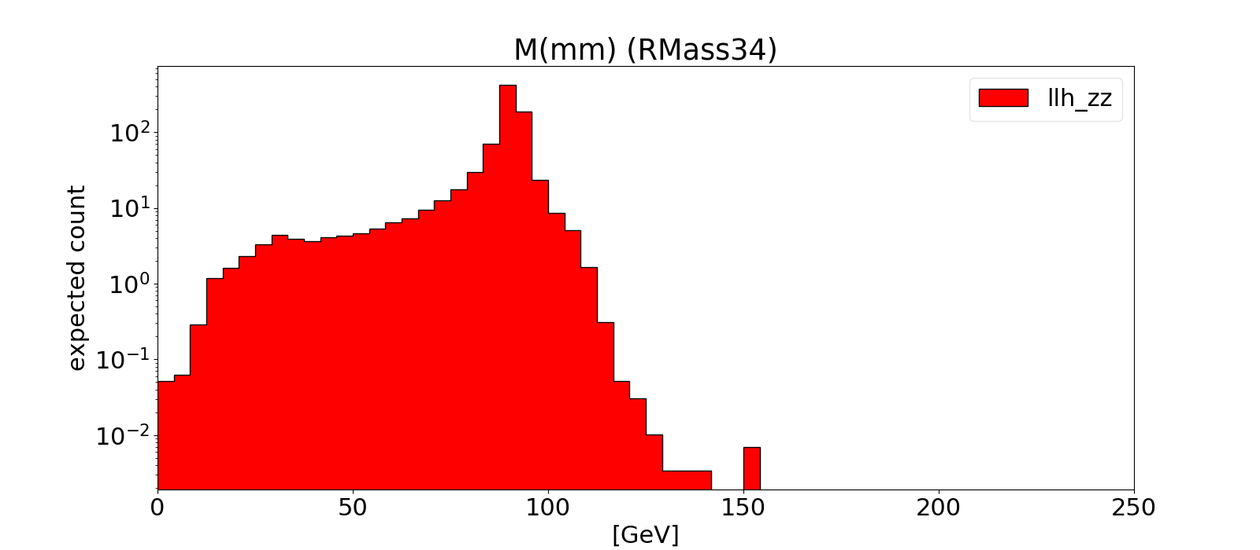
Di-muon Mass
Ryuta
Cross-Check

Slide 6
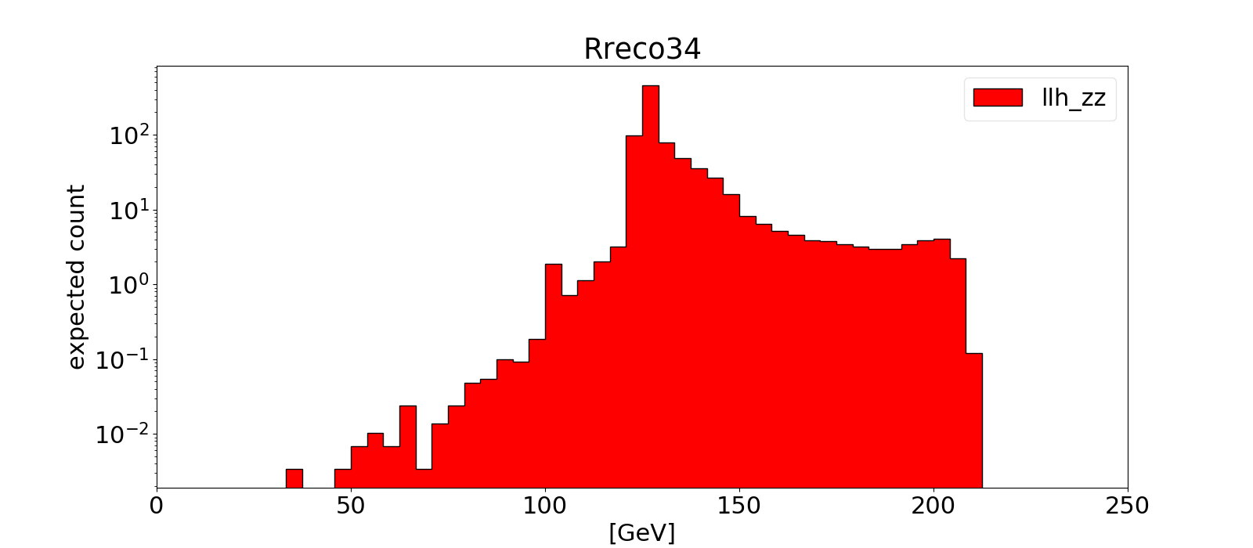
Di-muon Recoil Mass
Ryuta
Cross-Check

Slide 7
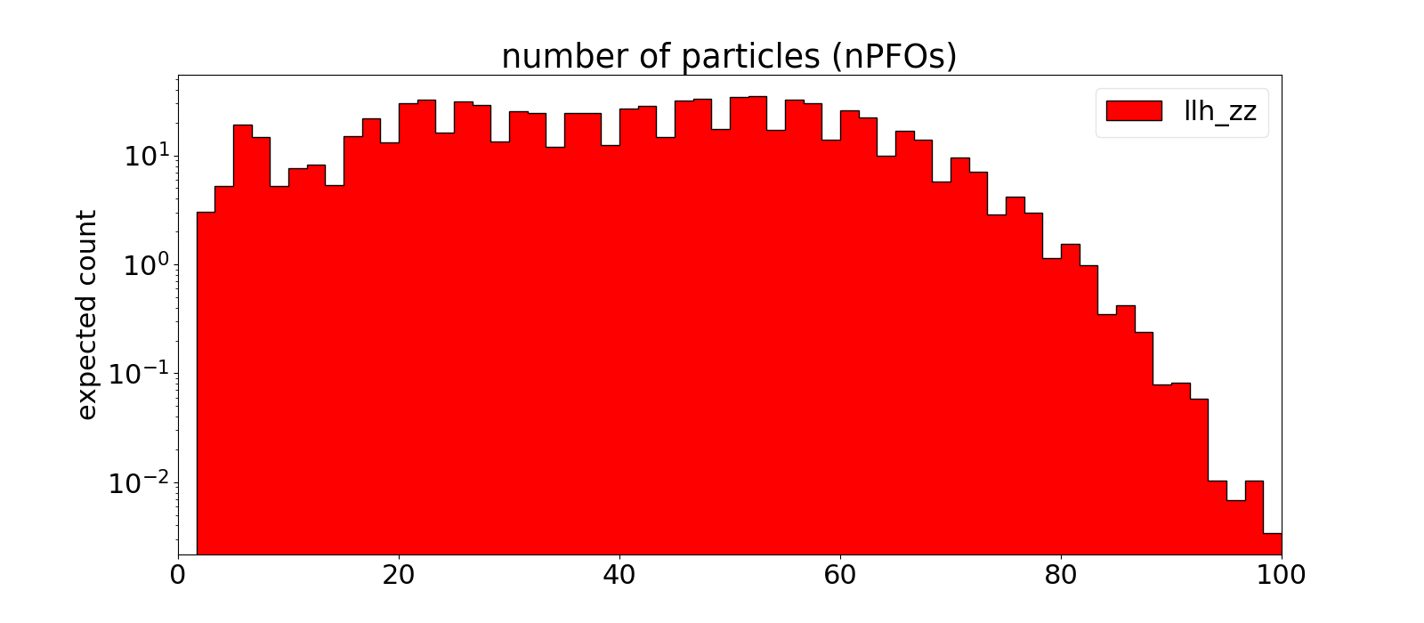
Number of Particle Flow Objects
Ryuta
Cross-Check

Slide 8
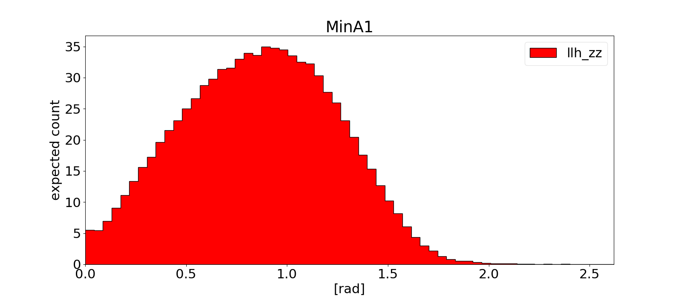
Min lepton-jet Angle
Ryuta
Cross-Check

Slide 9
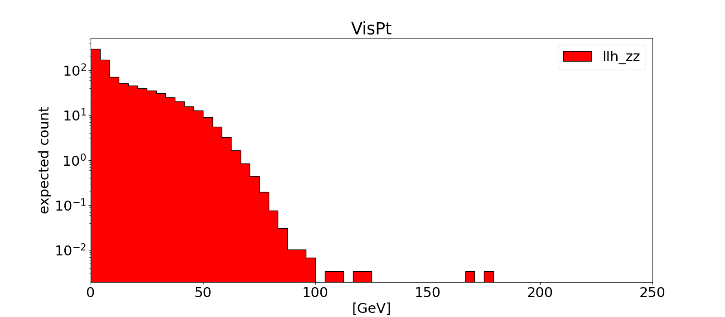
Visible pT

Slide 10
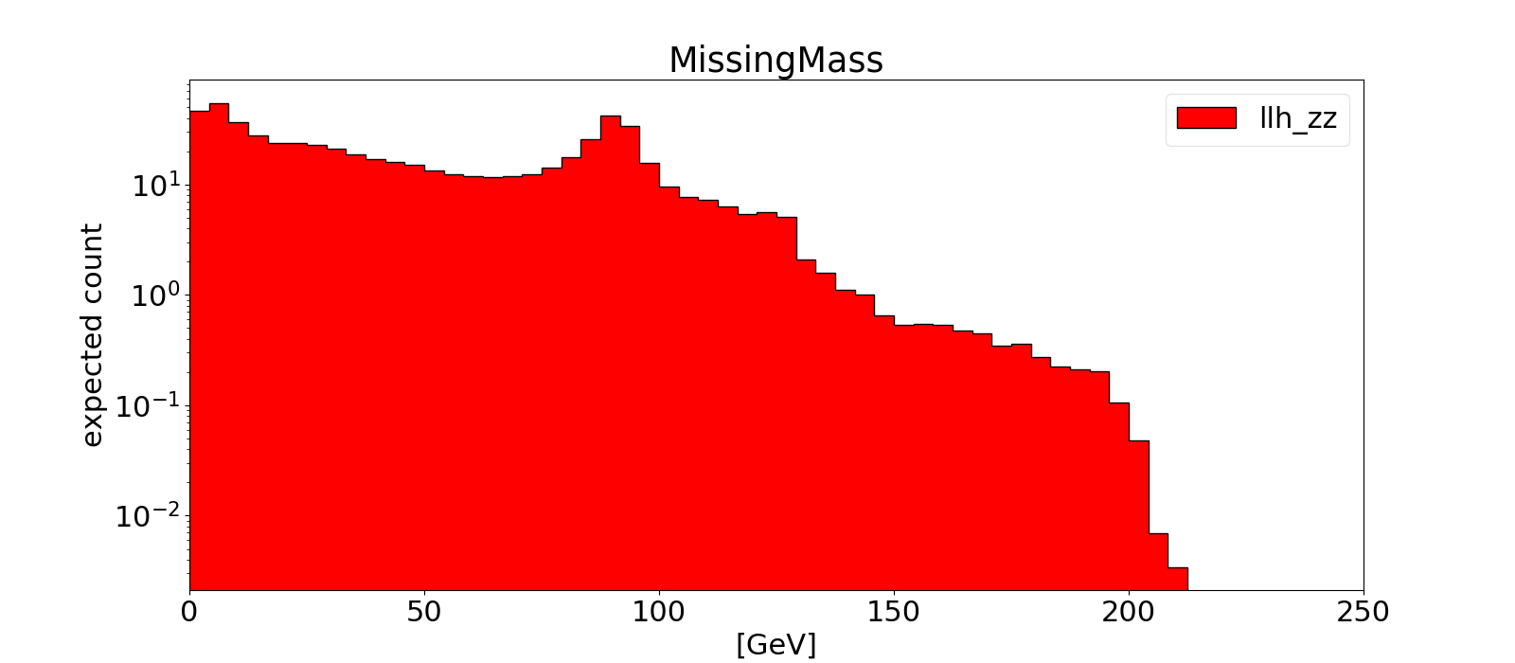
Missing Mass

Slide 11
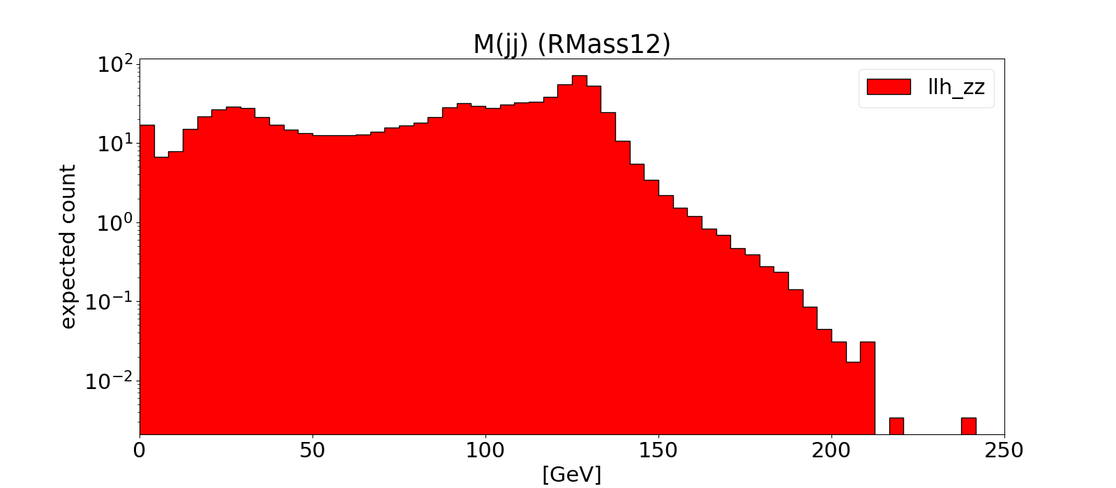
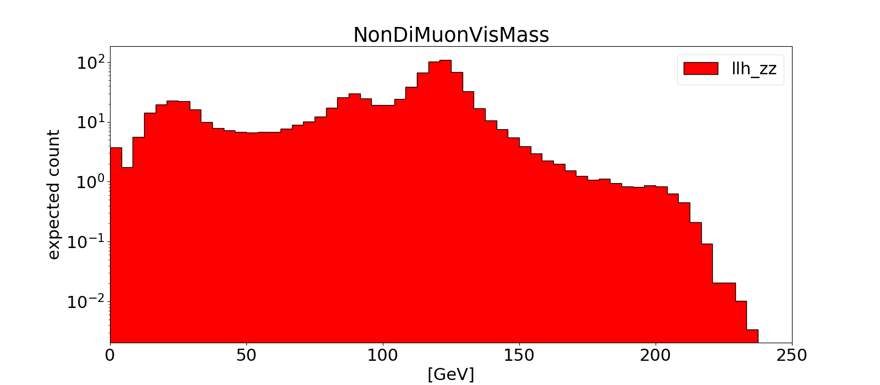
Impact of Isolated Leptons on Jet Mass
Di-jet Mass
Non-di-muon Visible Mass

